Slide 2
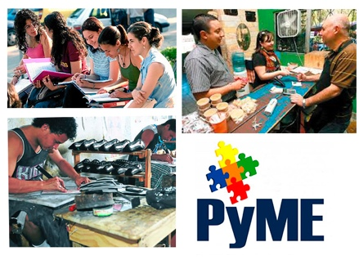
WOMEN AND INDUSTRIAL PROPERTY IN THE DOMINICAN REPUBLIC
1. College and University System, the raw material for inventors.
2. Business, the source for trademarks and commercial names (90% are Small and Medium-sized enterprises)
3. Women participating in IP.
Notes:
90% empresas RD son MIPYMES

Slide 3
WOMEN AND INDUSTRIAL PROPERTY IN THE DOMINICAN REPUBLIC
Number of Enrolled students in Higher Education
By type of institution and sex.
Notes:
Como puede verse, la matricula tiene un predominio a favor de las mujeres. Pero, cuales carreras estudiantes las mujeres, son carreras proclives a la innovacion patentable?

Slide 4
WOMEN AND INDUSTRIAL PROPERTY IN THE DOMINICAN REPUBLIC
Graduates in 2011
Less than .19% in basic sciences.
Less than 0.11% in applied sciences such as biotechnology, renewable energy, and geotechnics.
0.29% agricultural and veterinary sciences
6.43% in health sciences (predominantly women)
7% In engineering and architecture.
3.20% in information technologies.
The Dominican Republic, just like the rest of Latin America, lacks graduate students in basic sciences and needs still more graduates in engineering, (other than construction), all of which are prone to innovation and invention.
Medicine remains the exception.
Notes:
Ciencias aplicadas: una cifra decreciente comparada con 0.25% en 2010
42% de egresados lo hace en educación, lo que les garantiza un empleo como maestros de escuela

Slide 5
MUJER Y PROPIEDAD INDUSTRIAL EN
REPÚBLICA DOMINICANA
Medicine is the only major where innovation occurs frequently that is also predominated by women.
Of all 643 students enrolled in basic sciences in 2011, 413 were men and 230 women.
Other careers and fields of study where innovation is common show a more balanced picture. Chemical engineering, for example, enrolled 1,270 students of which 626 are women.
Statistics provided by the MESCYT.
Notes:
. Reorientar la educacion en carrera medicina,hacia un mayor énfasis en la investigacion aplicada, es un reto para el pais.

Slide 6
MUJER Y PROPIEDAD INDUSTRIAL EN
WOMEN AND INDUSTRIAL PROPERTY IN THE DOMINICAN REPUBLIC
 | Gender statistics for participants in Bussiness Plan Competiton for University students 2009-2014
Year | 2009 | 2010 | 2011 | 2012 | 2013 | 2014 | TOTAL | %
Female | 17 | 12 | 10 | 6 | 17 | 15 | 77 | 38.50%
Male | 19 | 21 | 22 | 13 | 30 | 18 | 123 | 61.50%
 |  |  |  |  |  |  | 200
2009-2014 gender statistics MESCYT/EMPLANED.

Slide 7
WOMEN AND INDUSTRIAL PROPERTY IN THE DOMINICAN REPUBLIC
1) U2008-0015: ROFANCY DE JESUS NUÑEZ GARCIA (DO).ODOR AND ENVIRONMENT PURIFIER.
2) U2003-0630: JUAN MARIA ARIAS (DO). SANITARY EQUIPMENT FOR DOUBLE RESERVOIR WITH SYSTEM FOR COMPLETE DISCHARGE.
3) U2003-000557: LIYBNAN SCHEKER HASBUN (DO).MODULAR SUPERBLOCK.
}4) U2011-0359: CARLOS RAFAEL NUÑEZ SANCHEZ (DO). DEVICE WITH PRE-PRINTED PUBLICITY MESSAGE.
5) U2012-0145: JOSE JULIO HERNANDEZ MOREL (DO).STEEL PROFILE FOR BUIDINGS, FLOORS AND METALLIC STRUCTURES.
6) P2005000239: DONATO PADILLA RIVAS (DO). VAPOR BATH AND EMPLOYED RESISTANCE SYSTEM.
U2009-0122: EMILIO FELIPE SANTANA (DO). WATERPROOF BOOTS
8)U2009-0108: JULIO CESAR SUERO VENTURA (DO). HYDRAULIC CLUTCH FOR MECHANICAL TRANSMISSION.
9) P2010-0313: DANIEL MATOS CUEVAS (DO). SYSTEM FOR ADAPTING AN INTERNAL COMBUSTION ENGINE FOR AIR OR COMPRESSED GAS FUELS.
10) P2012-0311: HOYMA JOEL MAZARA DIAS [DO], MANUEL ARTURO JUAN SORI [DO], MIGUEL ALEJANDRO ORTIZ LARA [DO], JOSE ROBERTO ORTIZ LARA [DO], ELECTRONIC AUTOMATIC DEVICE FOR PAINTING AND DRYING NAILS.
11) P2007-0141: FABIO PUELLO [DO]. PUBLICITY AND EXPOSURE DEVICES AND THE STRUCTURES THAT MAKE IT UP.
12) P2009-0008: GUSTAVO O. SANCHEZ DIAZ (DO)/ JOSE VELA ALBERTI (DO).SHIRT BURNER FOR NON-PRESSURIZED ALCOHOL OVEN
13) P2001-000225: HECTOR MANUEL RODRIGUEZ (DO)/JORGE PABLO GIROUD (US). ARTIFICIAL LARKSPUR FOR FIGHTING COCK WITH A CLOVER BASE.
14) P2007-0006: CARLOS JULIO REYES SOSA (DO). WATER JUG CARRYING DEVICE.
Sadly, there are no Dominican Female Patent Holders in national registry
Notes:
Sin embargo durante el periodo 2000-2015 ΩΩΩ(actualmente) entrado por PCT en hemos recibido 824 y 75 de estas solicitudes provienen de la clase femenina.

Slide 8
WOMEN AND INDUSTRIAL PROPERTY IN THE DOMINICAN REPUBLIC
ONAPI is currently undergoing an intensive innovation promotion program. Not gender oriented.
The office is currently seeking sponshorship for an investigation prize, for teams headed by women in the health sector. (2017)

Slide 9
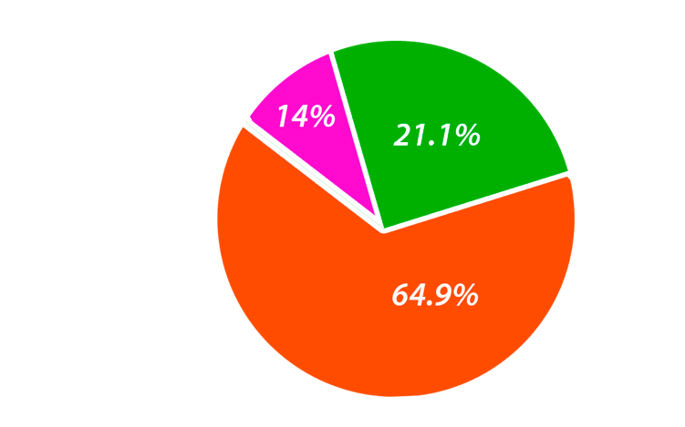
WOMEN AND INDUSTRIAL PROPERTY IN THE DOMINICAN REPUBLIC
What the Small and Medium Business Statistics Say
According to Fondo Micro 2013 survey, men own 64.9% Small and Medium enterprises, whereas women own only 14% of these; finally, the rest, 21%, are owned by association of the two genders.
Notes:
Estos resultados revelan un incremento signifi cativo de la mujer como propietaria de una pequeña o mediana empresa, pues en estudios previos35 del año 2000 las mujeres eran dueñas de apenas el 4.2% de estos negocios. Asimismo, se pone de manifi esto una de las diferencias más notorias entre una microempresa y una PYME, pues en el caso de la microempresa la mujer es propietaria de más de la mitad de los negocios (51.3%). Varios factores explican las diferencias de participación de la mujer en empresas de diversas magnitudes. Por un lado, la microempresa aporta la flexibilidad necesaria para que la mujer se inserte en labores productivas que le permiten generar ingresos a la vez que comparte su tiempo con sus compromisos familiares y domésticos, pues la mayoría de estos negocios operan en el mismo hogar de la propietaria. Por otro lado,en la medida en que la microempresa va creciendo se incorporan otros miembros de la familia al negocio y cuando se convierte en una PYME ya es una empresa de propiedad conjunta. En la mayoría de los casos la mujer inicia microempresas unipersonales, que luego incorporan trabajadores familiares no pagados, más tarde contratan empleados remunerados y así sucesivamente se establece un proceso de crecimiento y expansión. En esa etapa se incorporan al negocio la pareja, un hijo u otro socio, regularmente a la parte administrativa, y entonces la propiedad de la empresa pasa a ser compartida

Slide 10
WOMEN AND INDUSTRIAL PROPERTY IN THE DOMINICAN REPUBLIC
The trademarks and brand names database at ONAPI doesn’t segregate by sex; however, an analysis of the 2015 July - September Trimester reveals the following:
 | Cantidad de Registros por Género
 | Julio - Septiembre
 | Marcas | 2013 | 2014 | 2015
 | Hombre | 412 | 410 | 516
 | Mujer | 120 | 139 | 194
 | Empresas | 3,006 | 1,313 | 1,901
 | Total registros del periodo | 3,538 | 1,862 | 2,611
 | Total de registros por año | 8,152 | 7,692 | 6,496
 | Nombres Comerciales | 2013 | 2014 | 2015
 | Hombre | 3,536 | 3,623 | 4,055
 | Mujer | 1,374 | 1,576 | 1,724
 | Empresas | 844 | 838 | 949
 | Mancomunadas | 850 | 940 | 1,081
 | Total registros del periodo | 6,604 | 6,977 | 7,809
 | Total de registros por año | 24,318 | 24,818 | 20,758
 | * se refiere a sociedades: hombre / mujer // mujer / hombre.

Slide 11
WOMEN AND INDUSTRIAL PROPERTY IN THE DOMINICAN REPUBLIC
Continued education activities from the National Academy for Intellectual Property (ANPI), September 2011 to September 2015
General Total
Number Activities | 76
Participants
Men | 819
Women | 791
Total participants | 1,610

Slide 12
WOMEN AND INDUSTRIAL PROPERTY IN THE DOMINICAN REPUBLIC
ONAPI, via its Center for Technology and Innovation Support (CATI) streamlines and facilitates access to national offices to countries in development via specialized databases, in order to diminish the technological and digital gap between the developed world and the developing world. The CATI’s services range from offering information and advice to actually searching for patent information.
Requests for Patent Information Searches
Year | Male | Female | Total
2012 | 32 | 3 | 35
2013 | 37 | 5 | 42
2014 | 62 | 18 | 80
2015 | 90 | 20 | 110
Totals | 221 | 46 | 267

Slide 13
WOMEN AND INDUSTRIAL PROPERTY IN THE DOMINICAN REPUBLIC
La mujer en la Dirección del Estado en Rep. Dominicana
President of the Senate Cristina Lizardo
Vice President Margarita Cedeño
Four ministers of a total of 21 (Ministers of Women, Work, Superior Education and Health)

Slide 14
WOMEN AND INDUSTRIAL PROPERTY IN THE DOMINICAN REPUBLIC
60.47%
60.47% of all employees in ONAPI are women.
Of all management posts, including General Director, 8 are assigned to women, 7 men
Earlier this year, the Ministry of Women, together with the PNUD, launched the certification ‘Equal DR,’ (Igualando RD), presented to businesses that promote gender inclusion.

Slide 15
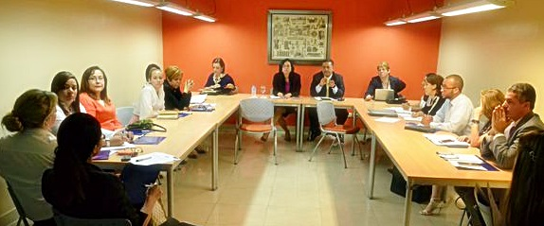
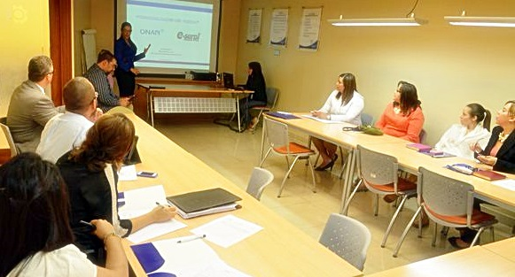
MUJER Y PROPIEDAD INDUSTRIAL EN
REPÚBLICA DOMINICANA
Women are also predominant as IP Lawyers
This year, the Interamerican Association of Intelectual Property (ASIPI) will be presided by the first time by a dominican, Ms María del Pilar Troncoso.

Slide 16
WOMEN AND INDUSTRIAL PROPERTY IN THE DOMINICAN REPUBLIC
MUCHAS GRACIAS

