Slide 1
Measuring women’s participation in intellectual property
Bruno Le Feuvre
Statistical analyst
Economics and Statistics Division
World Intellectual Property Organization
Third International Day of
Women and Girls in Science
8 - 9 February 2018
United Nations Headquarters
New York City

Slide 2
Specialized agency of the United Nations based in Geneva
A global forum for intellectual property policy, services, information and cooperation
Promoting gender equality within its mandate

Slide 3
WIPO reports statistics on the gender of inventors
Created a Worldwide Gender-Name Dictionary in 2016
covering over 6.1 million names valid for 182 countries
Identified the gender of inventors named in international patent applications¹
gender of over 9 million inventors representing 96% of total
Mainstreamed statistics on women’s participation in international patenting
analyzing patent filing trends in economic and statistic reports
¹ Patent Cooperation Treaty (PCT) international applications

Slide 4
Number of international patent applications with women inventors
70,857

Slide 5
Share of international patent applications with women inventors
30.5%

Slide 6
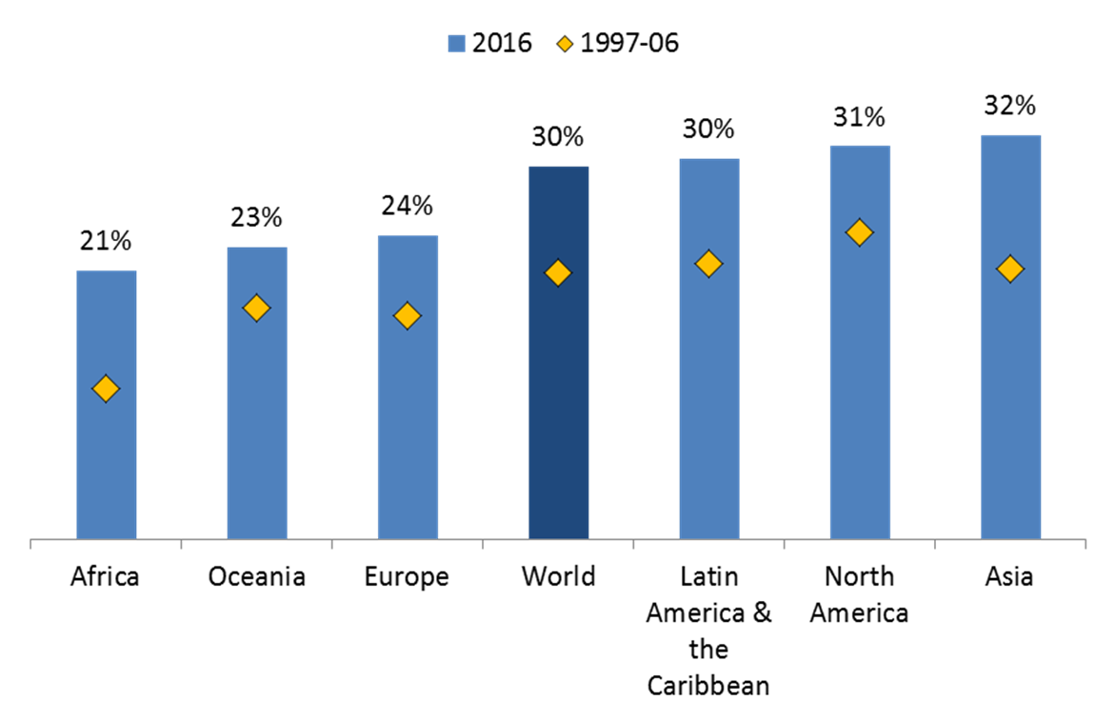
Share of international patent applications with women inventors by region

Slide 7
Share for selected fields of technology
Top 10
Field of technology
Last 5

Slide 8
Resources free-to-use on WIPO website
Statistical reports
Worldwide gender-name dictionary
Economic research working paper

Slide 9
WIPO is exploring further…
Gender of | Intellectual Property Data
Inventors | National Patent collection
Brand holders | International registration of Trademarks
Creators | International registration of Industrial Designs
Lawyers | Agents named in international IP applications

Slide 10
World Intellectual Property Day

