Slide 1
Measuring women’s participation in international patenting
Gema Lax Martínez, University of Lausanne
Bruno Le Feuvre, WIPO, Economics and Statistics Division
Kyle Bergquist, WIPO, Economics and Statistics Division
Geneva
July 6, 2017

Slide 2
Outline
Part I - Research & methodology
Part II - Statistical results
Part III - Further Research

Slide 3
Part I Research & methodology
Gema Lax Martínez, University of Lausanne

Slide 4
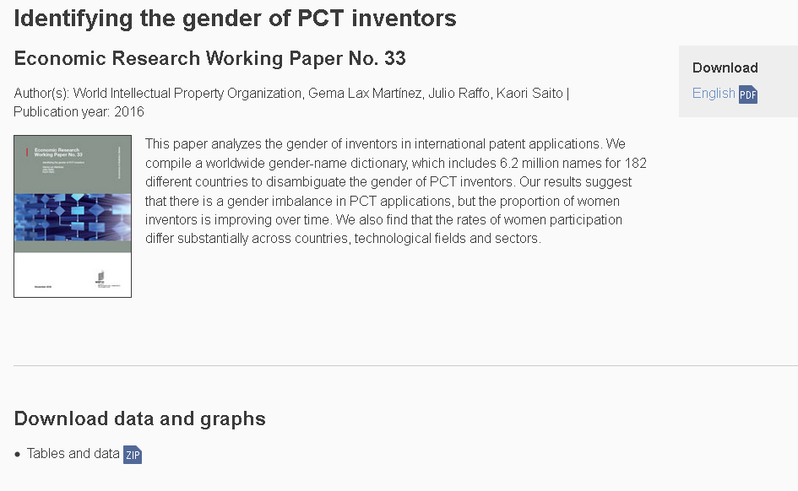
Gender Research

Slide 5
Why it matters?
Women contribute to all fields of creativity, yet they remain underrepresented, including in advanced economies.
“Leaky pipeline”: Gender inequality is increasingly worse along a researcher career
Lack of encouragement and lower position in the hierarchy explain any productivity gap
While women patent less, the quality and impact of their patents are equal or better
All studies pointed to the need for more data broken down by gender.

Slide 6
What can be done?
Direct: Self-declaration
+ Captures information directly at source
– Cannot be applied retroactively
Indirect: Attribution based on secondary source
+ Can be as reliable as primary
– Difficult to collect in multiple countries and years
Indirect: Attribution based on name gender semantics
+ Can be applied retroactively
– Difficult for languages without clear-cut rules.
Indirect: Attribution based on name-gender dictionary
+ Can be applied retroactively
– Depends heavily on the dictionary coverage

Slide 7
What have we done?
World Gender-Name Dictionary
Consolidated 14 different sources
Extended for 12 languages
Contains 6.2 million names
for 182 different countries

Slide 8
What have we done?
Gender attribution by country of residence
We applied the WGND to the patent applications filed through the Patent Cooperation Treaty (PCT) System:
Inventors and individual applicants
9 millions
Gender attribution 96.1%

Slide 9
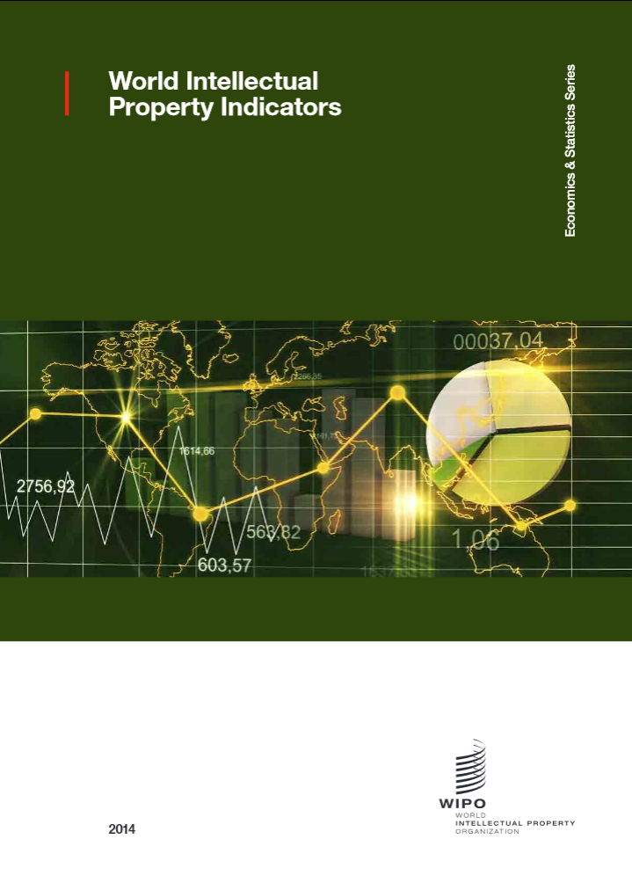
World Intellectual Property Indicators 2016 edition
Special theme
Measuring women’s participation in international patenting

Slide 10
Part II statistical results
Bruno Le Feuvre, WIPO, Economics and Statistics Division

Slide 11
PCT Yearly Review, 2017 edition
Gender Mainstreaming
Statistics on women inventors have become part of the regular reporting on the PCT System

Slide 12
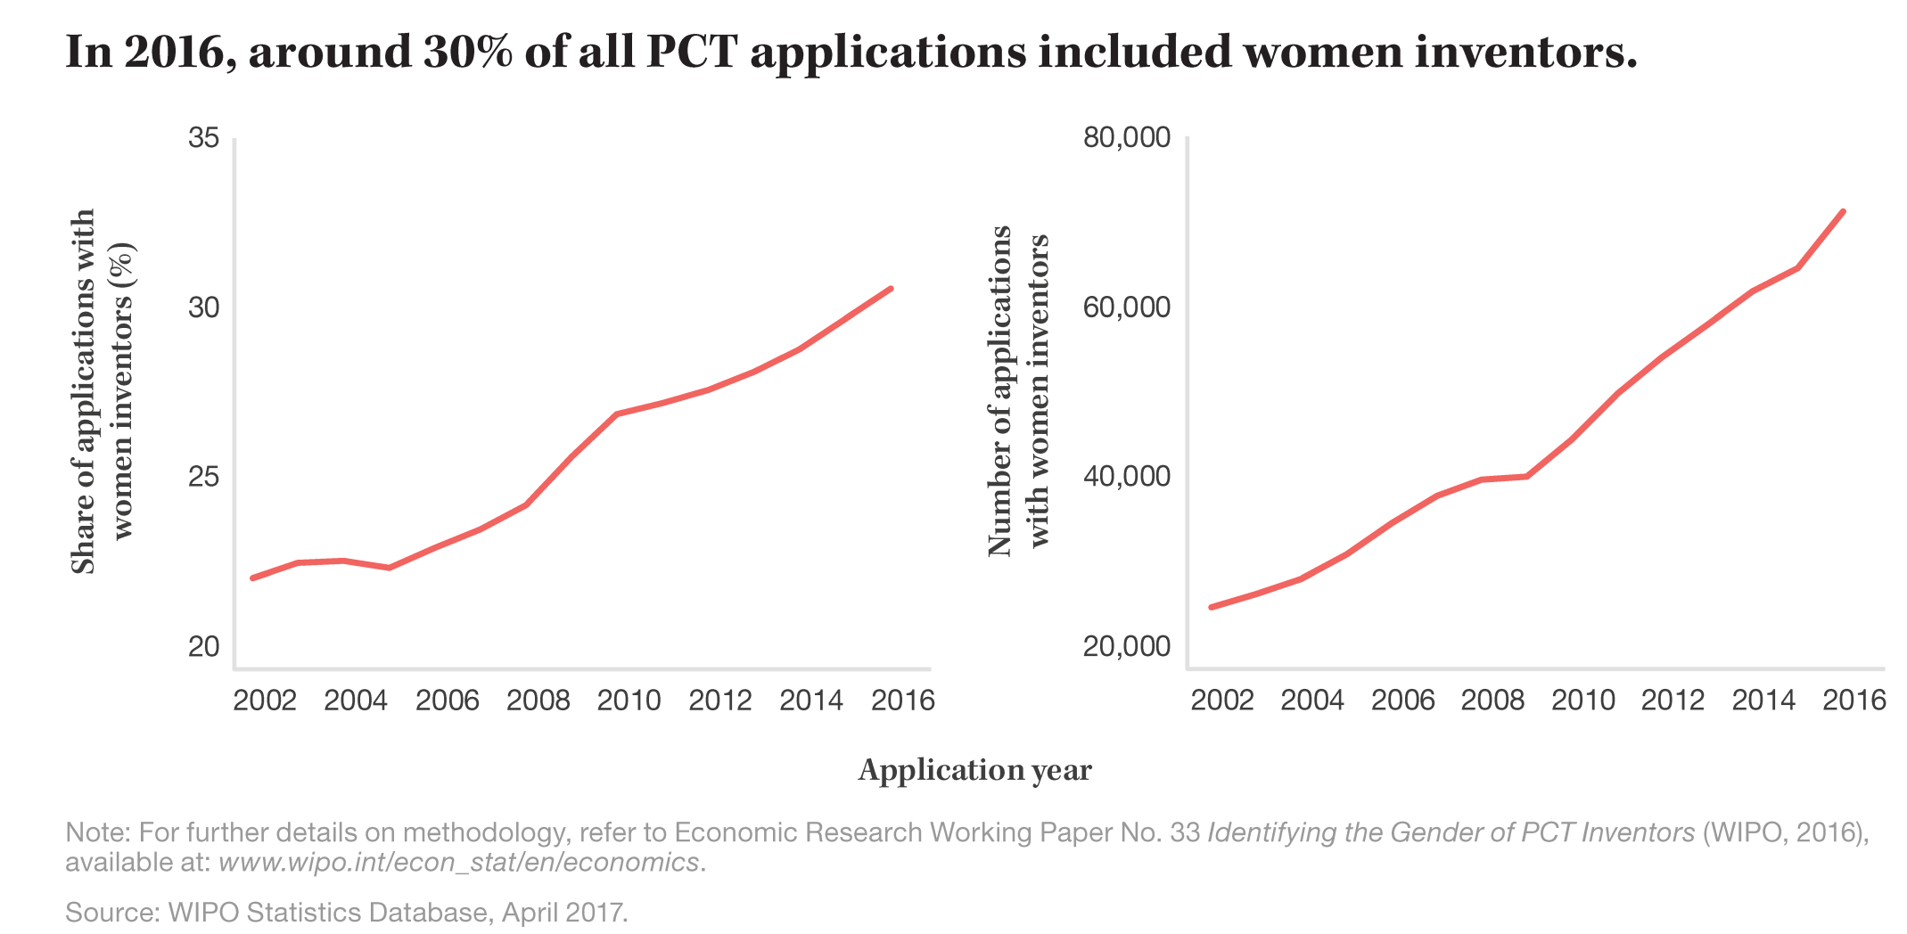
Share and number of PCT applications with women inventors

Slide 13
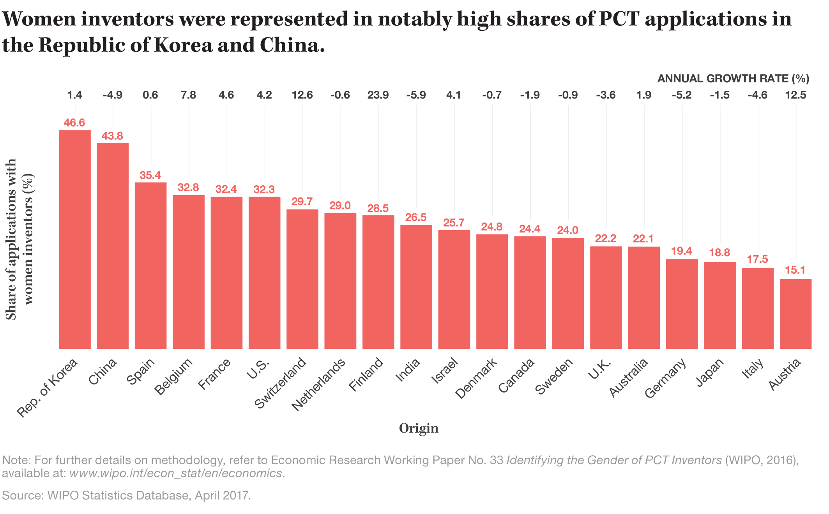
Share of PCT applications with women inventors for the top 20 origins, 2016

Slide 14
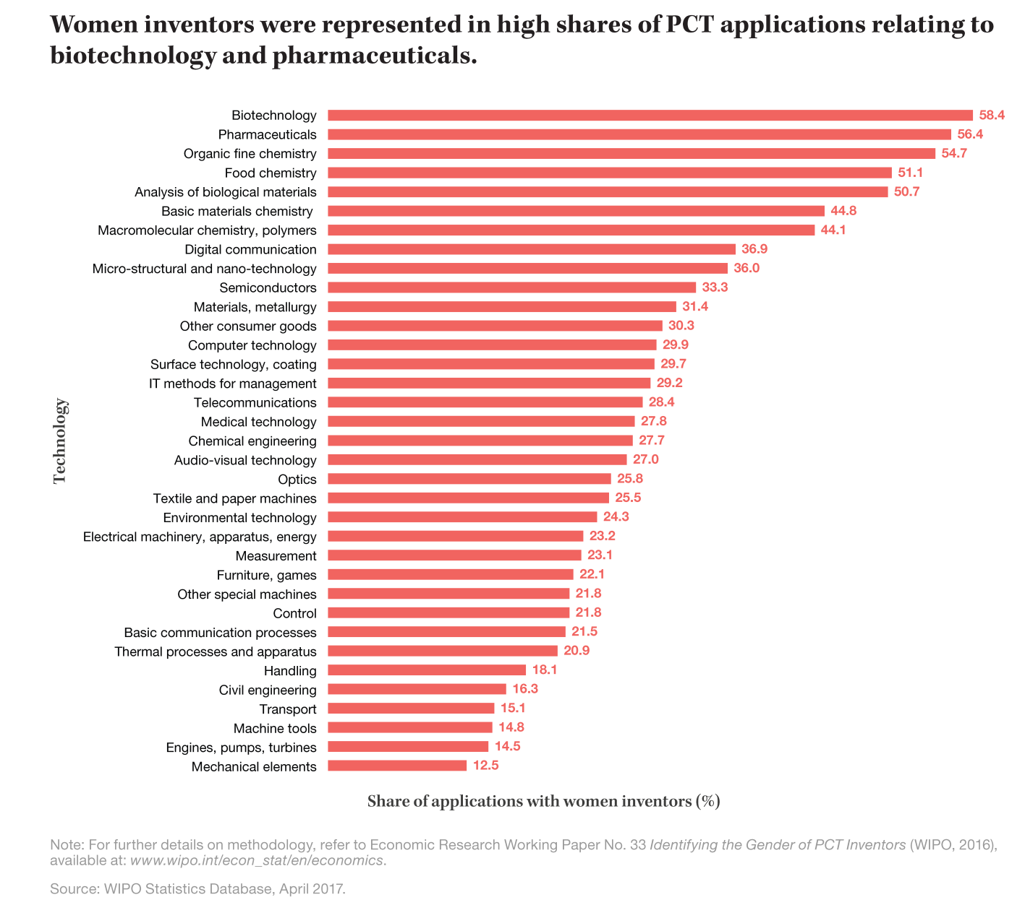
Share for selected fields of technology

Slide 15
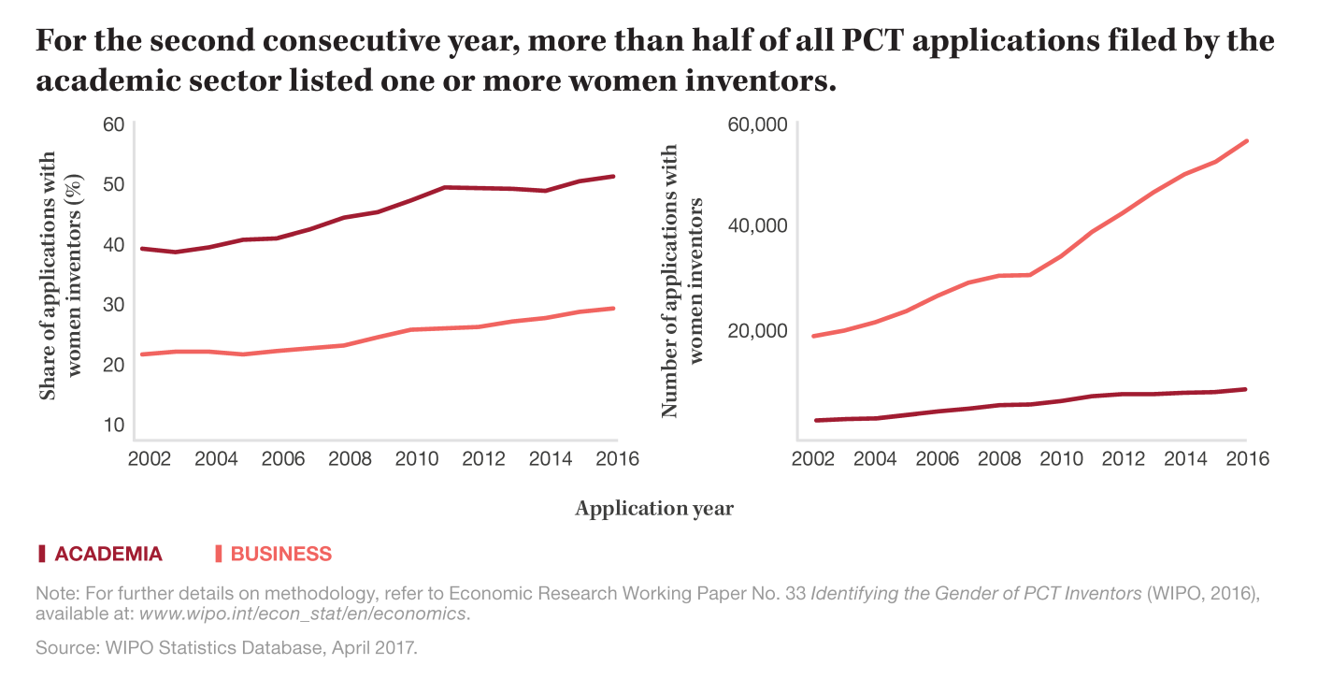
PCT applications with women inventors by institutional sector

Slide 16
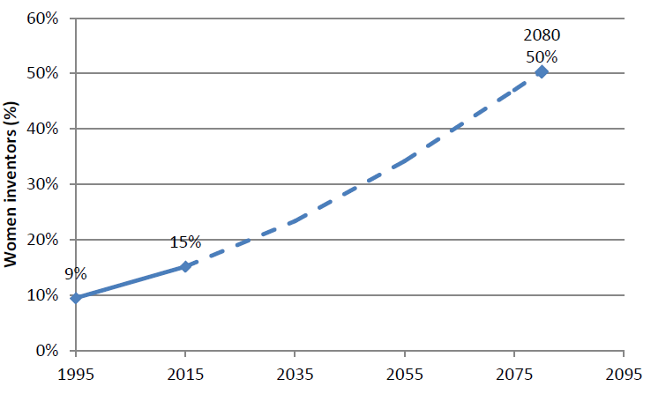
When will we achieve gender balance?

Slide 17
Part III Further Research
Kyle Bergquist, WIPO, Economics and Statistics Division

Slide 18
New developments
Identify gender in Hague and Madrid Systems statistics
Increase sources of World Gender-Name Dictionary
Refine gender indicators
Link to different data sources

Slide 19
Global innovation index, 2017 edition
Identified and ranked global clusters via inventors’ geolocation
Shows the share of women inventors for the top 100 clusters in the world
For example 31.3% of PCT applications filed in Beijing had women inventors

Slide 20
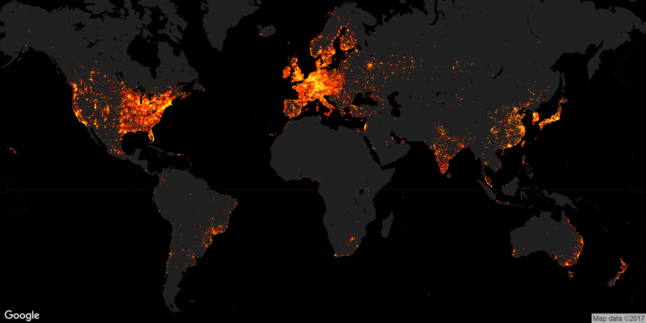
All listed inventors
Seoul
San Jose-
San Francisco
Tokyo-Yokohama
Shenzen-
Hong Kong (China)

Slide 21
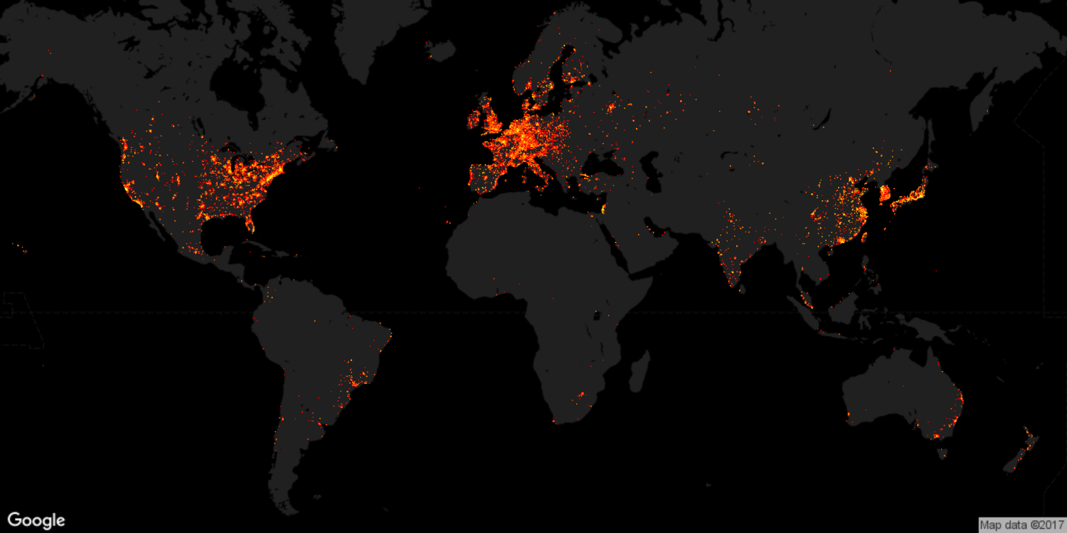
All listed female inventors

Slide 22
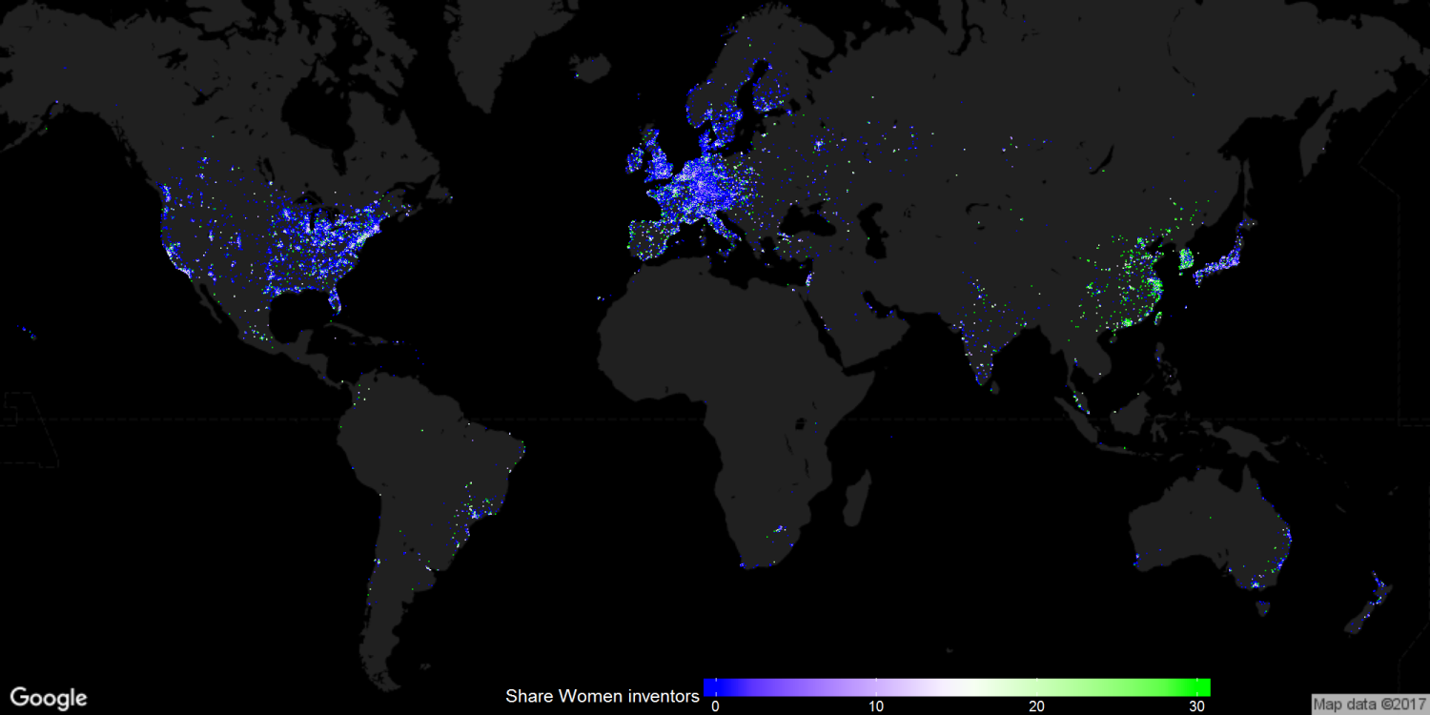
Share of female inventors to all inventors
Seoul
27.5%
San Jose-
San Francisco
15.0%
Tokyo-Yokohama
8.5%
Shenzhen-Hong Kong (China)
28.9%

Slide 23
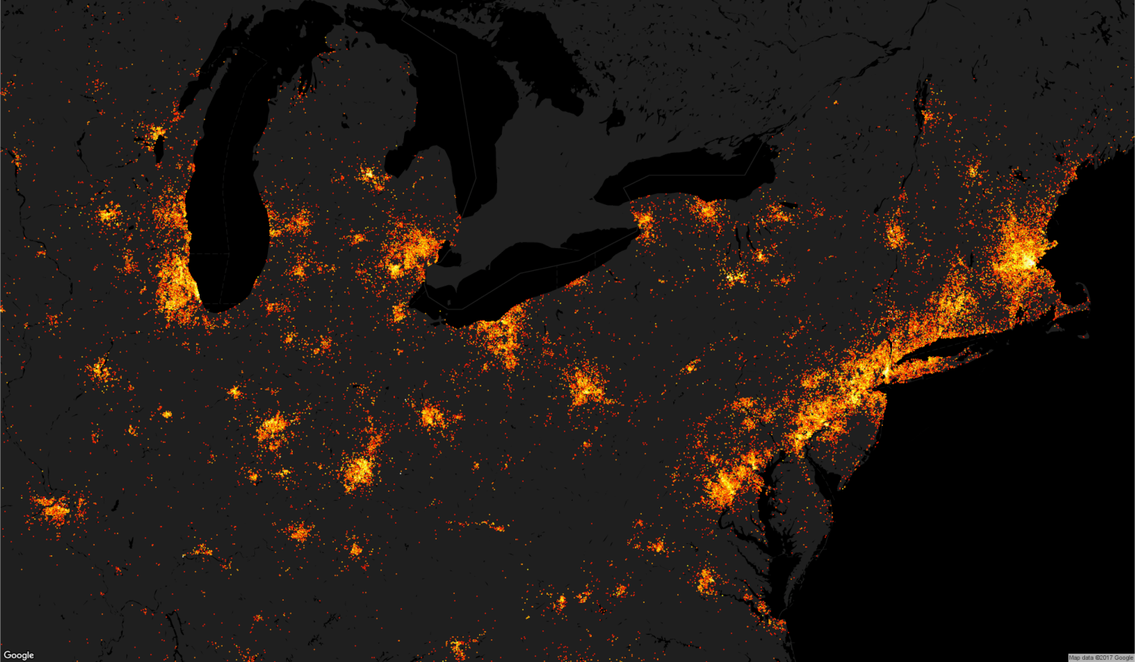
All inventors: Northeast US
Boston-Cambridge, MA
Chicago, IL
Hartford, CT
Cleveland, OH
New York, NY
Philadelphia, PA
Cincinnati, OH
Washington DC

Slide 24
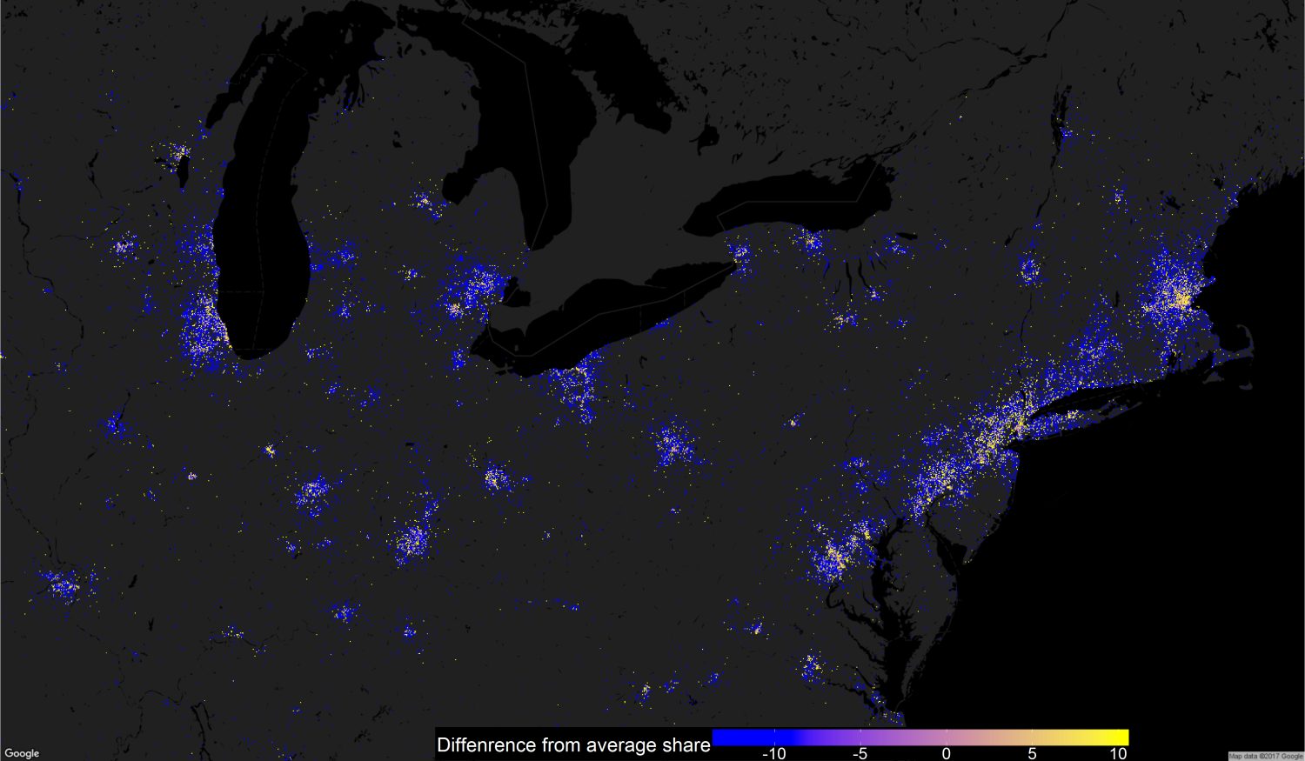
Share of female inventors: Northeast US
Boston-Cambridge
17.4%
Chicago
13.1%
Hartford
9.7%
Cleveland
11.2%
New York
20.0%
Philadelphia
19.6
Cincinnati
14.6%
Washington DC
19.4%

Slide 25
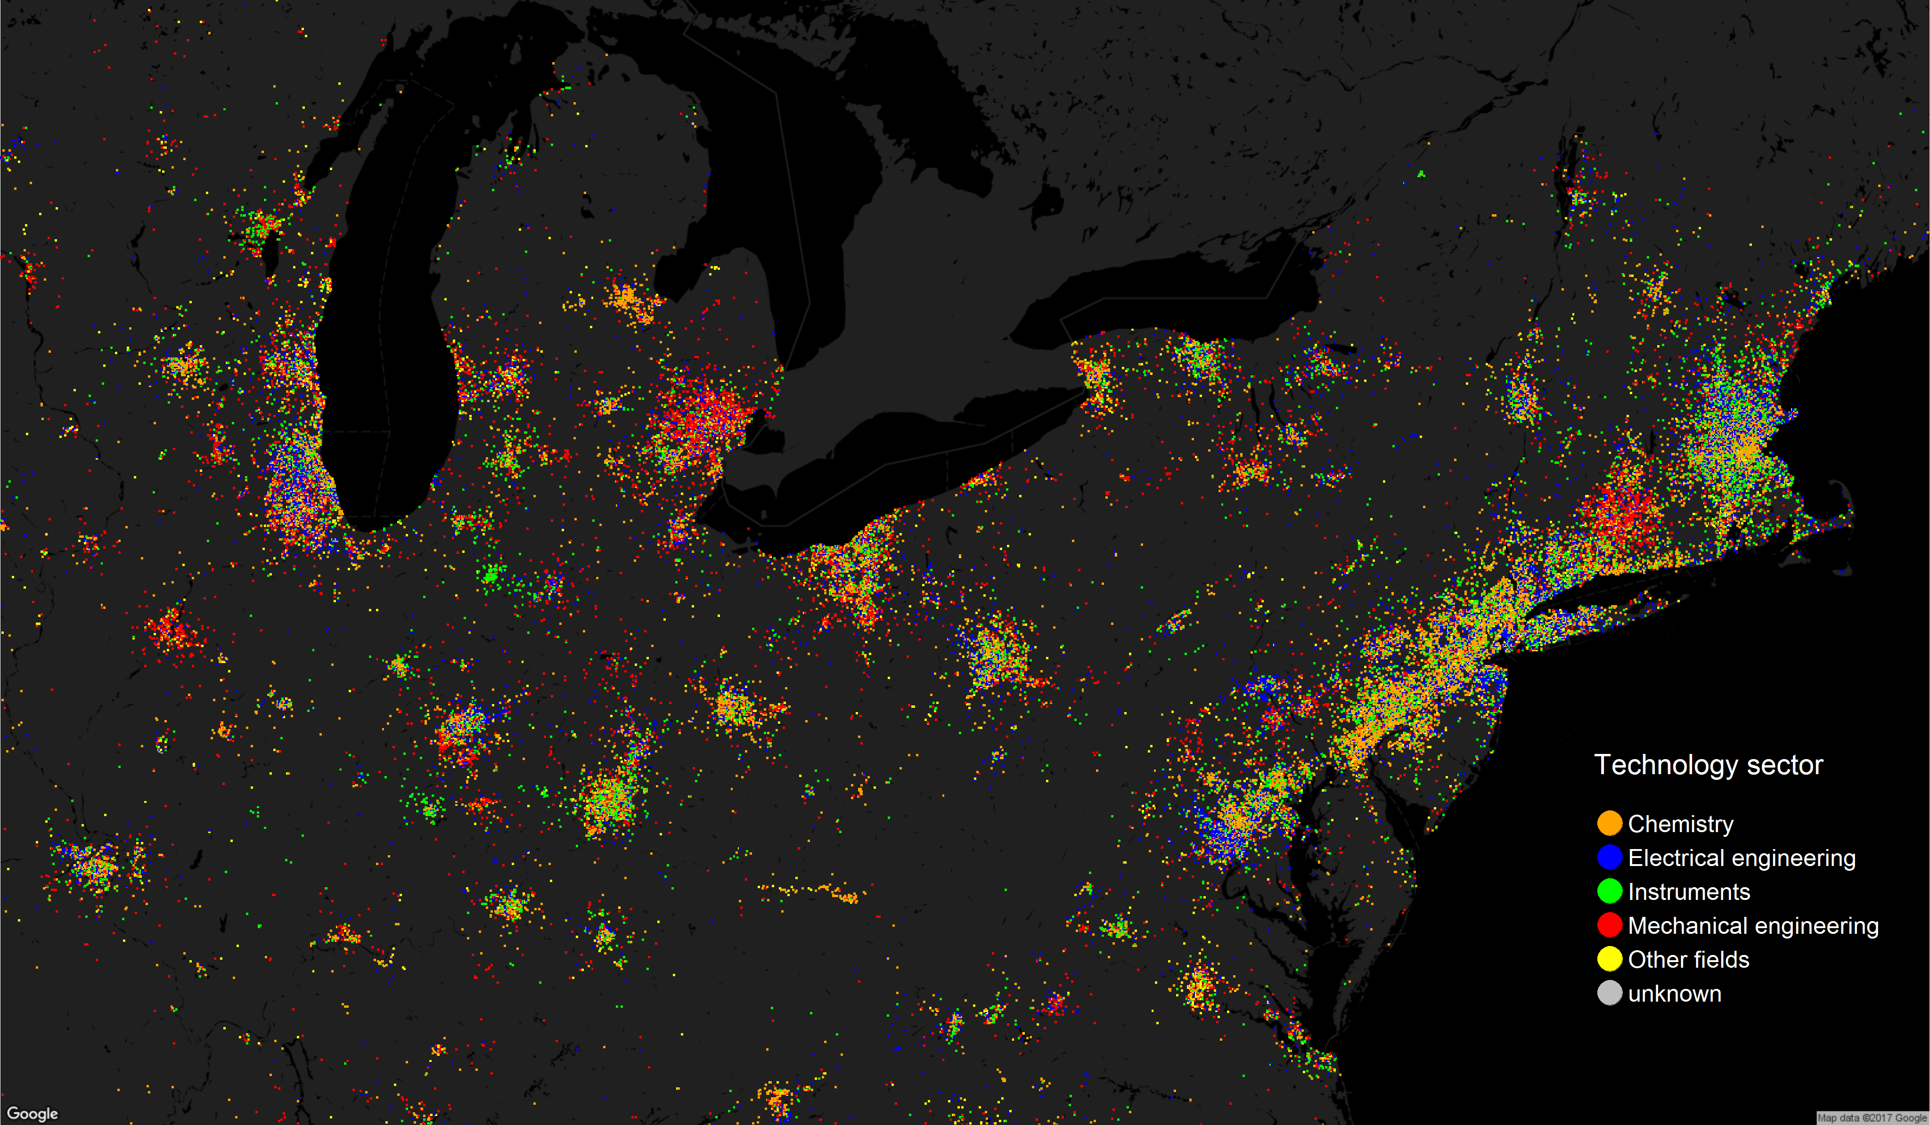
Top technology sector: Northeast US
Boston-Cambridge, MA
Chicago, IL
Hartford, CT
Cleveland, OH
New York, NY
Philadelphia, PA
Cincinnati, OH
Washington DC

Slide 26
Conclusion
The World Gender-Name Dictionary is a valuable contribution to gender studies in multiple areas of research
Gender participation in the IP system is getting better. Progress is observed in most countries, in all technical fields and in both academic institutions and companies
However, it remains far from balanced and women participation in patenting is not equally distributed across countries, technologies and sectors
Possible extensions to statistics of the Madrid and Hague systems & other research (see part III)

Slide 27
Thank you!
Questions?

