Slide 1


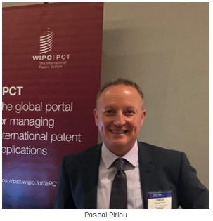
ePCT-Filing - Docx
How to prepare and upload a Docx single specification
https://pct.wipo.int

Slide 2
Agenda
Advantages of Docx and how to check if your RO accepts ePCT-Filings and XML
How to prepare your Docx to be in compliance with Annex F
Attaching your Docx in ePCT-Filing
Help with your Docx and how use the Standalone Application Body Converter
PCT Operations Customer Support Section contact details

Slide 3
Advantages of filing in Docx format (1)
Higher fee reduction than PDF (100 Swiss Francs)
  Docx = - 300 CHF (or equivalents)
More accurate detection of:
  Potential conversion errors
  Article 11 (Description, Claims) and 14 (Title and Abstract) defects
Conversion to an Annex F-compliant XML and to PDF
(Annex F: Standard for Filing and Processing in Electronic Form)
  https://www.wipo.int/export/sites/www/pct/en/texts/pdf/ai_anf.pdf

Slide 4
Advantages of filing in Docx format (2)
Enables full-text processing:
  Easier and more accurate text search of international applications after publication
  Facilitates processing by the International Bureau during the international phase
  Facilitates processing by designated and elected Offices for national phase
  Efficient text extraction by Search engines of the original text of the application as published (no optical character recognition (OCR) errors)
When Docx is available for your applications, try it out, this is the future direction !

Slide 5
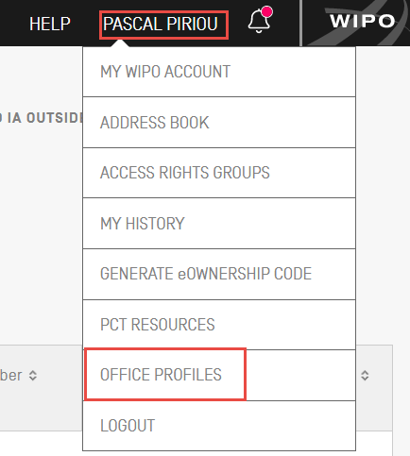
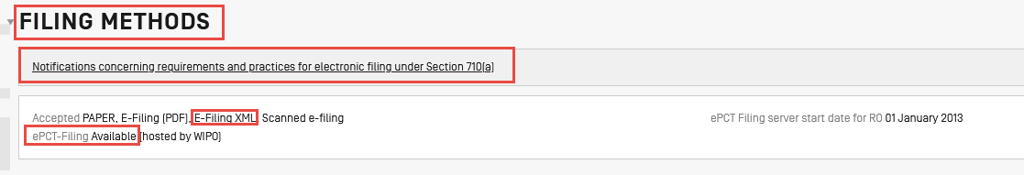
Receiving Offices accepting Docx
Office Profiles
Filing Methods

Slide 6

Exceptions
RO/KR only pure XML no Docx
PCT Applications cannot be filed in XML/Docx with RO/US
Notes:
Break ☺

Slide 7
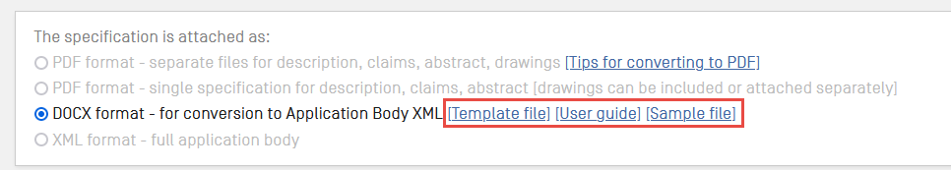
Docx single specification
Single specification only: Description, claims, abstract and drawings (if any) in one document
Template files, sample files, user guide:

Slide 8
Docx information
Sample files: pre-filled examples of a Docx application Body in all 10 languages of publication
Template files: Docx document including the standard Common Application Format (CAF) headings (Technical field, Background Art..) in all publication languages
User guide: instructions, tips and best practice advice
  https://www.wipo.int/export/sites/www/pct/en/epct/pdf/ApplicationBody-Docx-xml-UserGuide.pdf

Slide 9

Docx Preparation: text elements
Show markup signs (MS Word Home tab > )
Mandatory:
  Title of the invention, Description, Claims heading + 1 claim, Abstract heading
Headings (line in bold or underlined of less than 50 characters)
Common Application Format (CAF) headings in all publication languages: https://pctdemo.wipo.int/DocConverter/pages/recognizedHeaders.xhtml
New paragraph : keyboard Enter key

Slide 10

Docx Preparation: other elements (1)
Tables (as image or created in the text editor)
Mathematical equations (as image or created in the text editor)
Chemical formulae (as image only)
Captions ‘Math. ’, ‘Chem. ’, ‘Table ’ are optional. If used, each caption should be followed by a paragraph break (keyboard Enter key) and the related element:

Slide 11
Docx Preparation: other elements (2)
Image formats: jpg, png, tif, emf, wmf, gif
Check thoroughly the rendered PDF if the Docx contains symbols, tables, chemical formulae, mathematical equations and lists
Elements not supported:
  Table in a table (can be inserted as image)
  Hyperlinks (removed during conversion with warning)
  MS Word shapes
  Comments/track changes

Slide 12
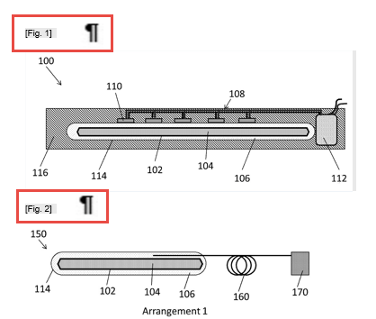
Docx Preparation: figures of the drawings
In the Drawings section, all figures must have a caption before the figure, followed by a paragraph break and the image:
Notes:
Break ☺

Slide 13
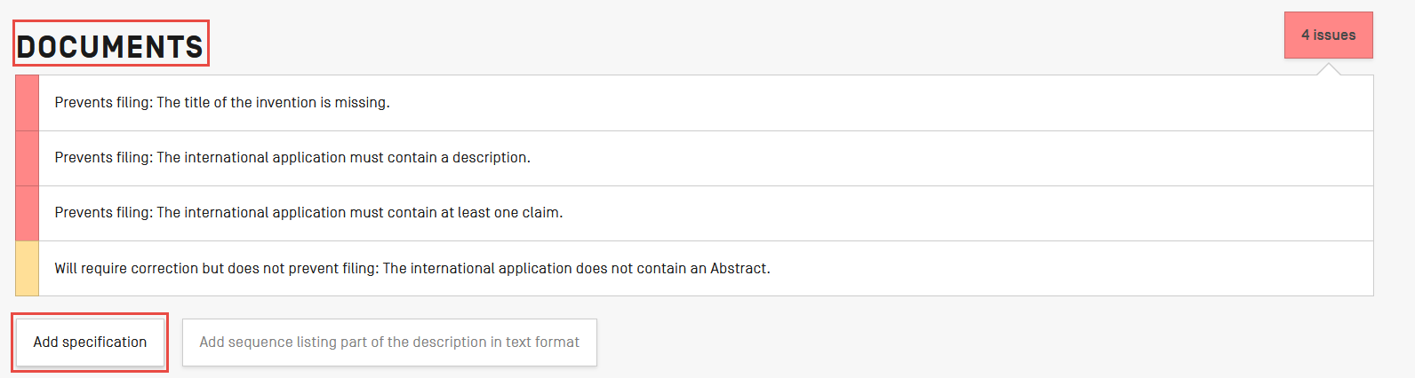
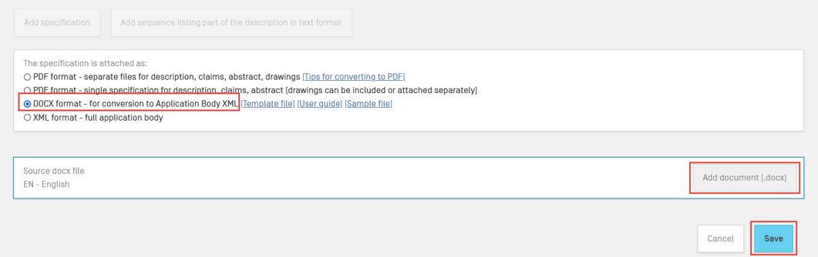
Attaching the Docx specification (1)
Select Docx format

Slide 14
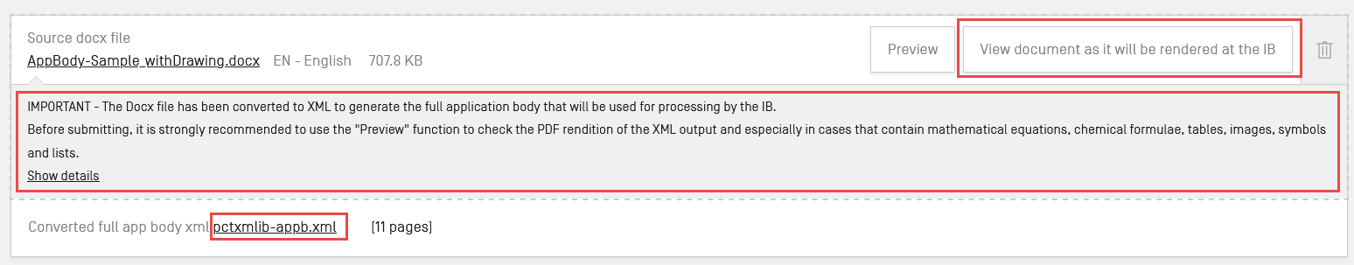
Attaching the Docx specification (2)
After upload check the output
View document as rendered at the IB
Download the generated XML file
The generated XML file is the legal copy after filing
Original Docx pre-conversion file included in the application body as filed (enables correction of any conversion issues)

Slide 15
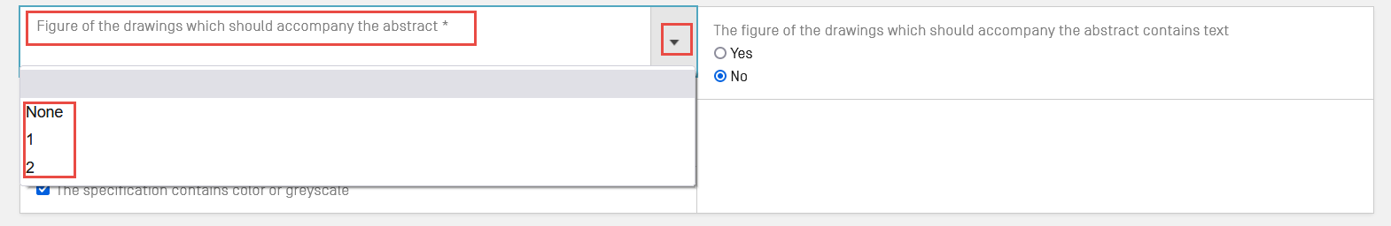
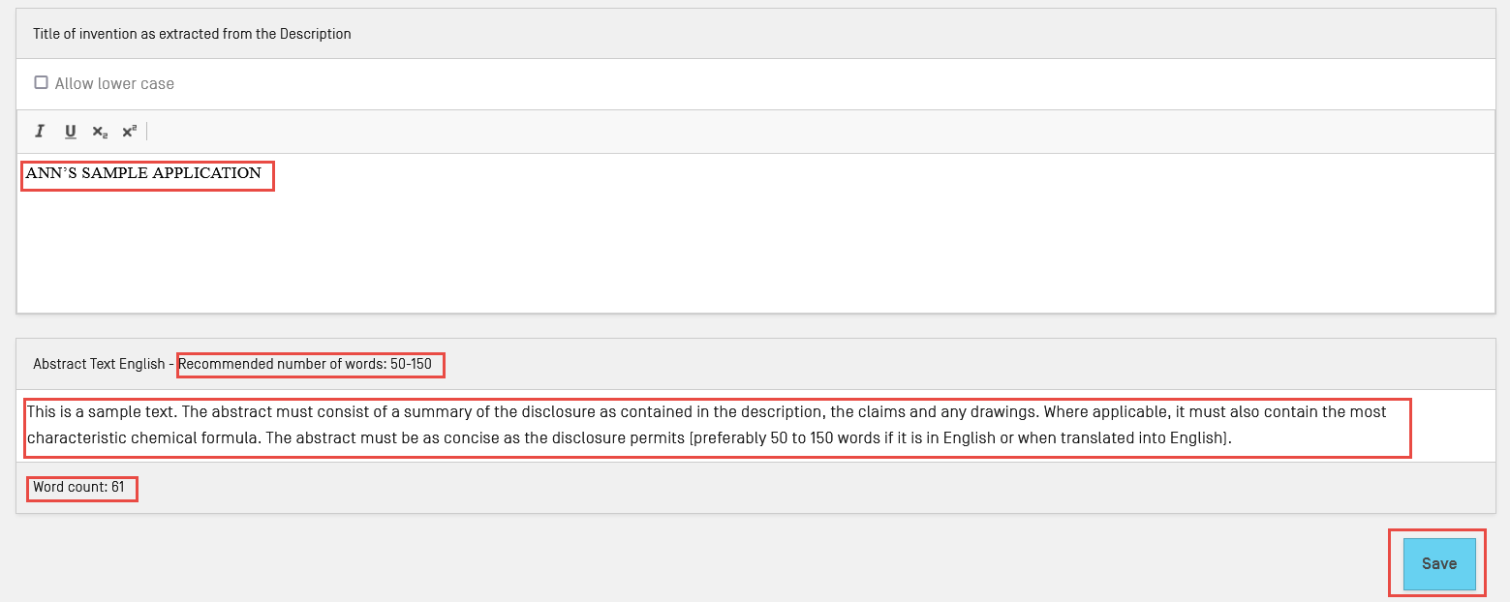
Attaching the Docx specification (3)
Figure of the drawings which should accompany the abstract
Title of the invention and Abstract text
Notes:
Break ☺

Slide 16
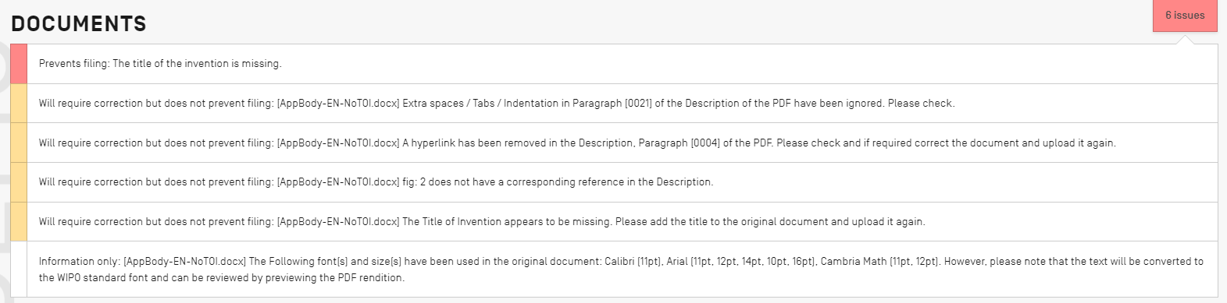
Attaching the Docx specification (4)
Detailed conversion report after attaching the Docx file
Validation levels:
  Informational (does not prevent filing)
  Orange Warning (does not prevent filing)
  Red error (prevents upload or filing)

Slide 17
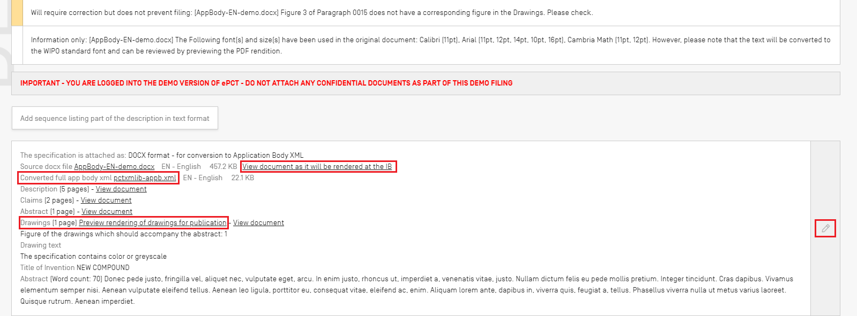
Attaching the Docx specification (5)
After saving the file in ePCT
Notes:
Break ☺

Slide 18
ePCT DEMO mode
ePCT Demo https://pctdemo.wipo.int
Demo environment in which you can practice and familiarize yourself with ePCT
Do not use confidential or sensitive data in the ePCT demo environment
BE CAREFUL NOT TO CONFUSE DEMO MODE WITH PRODUCTION MODE!

Slide 19
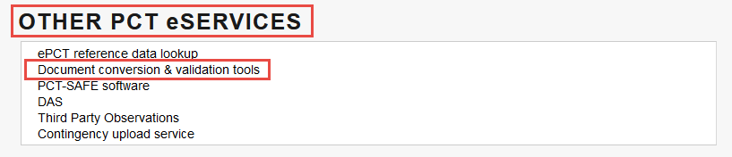
ePCT HELP
Use the ‘HELP’ link in the navigation bar https://www.wipo.int/pct/en/epct/support.html
Specific FAQ article on Document conversion & validation tools
  https://www.wipo.int/pct/en/epct/learnmore.html?N=1595

Slide 20
Standalone Application Body Converter
Practice with standalone Application Body Converter:
  https://pct.wipo.int/DocConverter
Conversion only (no filing possible)
Generates a conversion report
Creates a .zip file containing:
  the application body XML file
  the application body in PDF format (rendered from the XML)
  the application body HTML file (along with images)
Notes:
Break ☺

Slide 21
Contact details
PCT Operations Customer Support Section
  Tel: +41-22-338-9523
  E-mail: pct.eservices@wipo.int
  Monday to Friday, 9am-6pm Geneva time
  Chat feature available

Slide 22


Slide 23
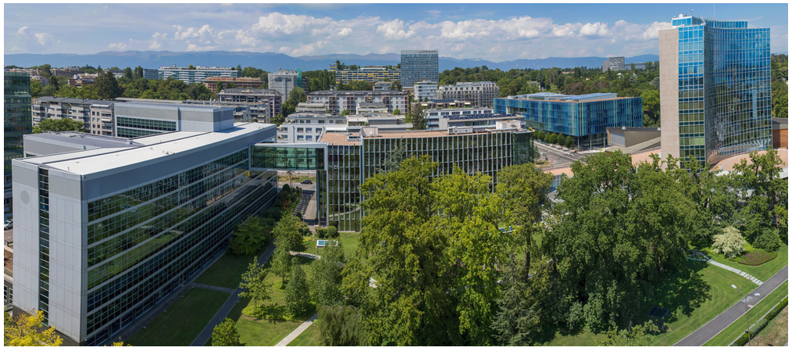
Thank you!

