Slide 1

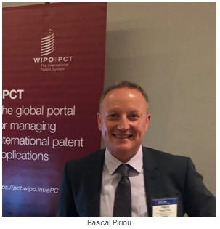
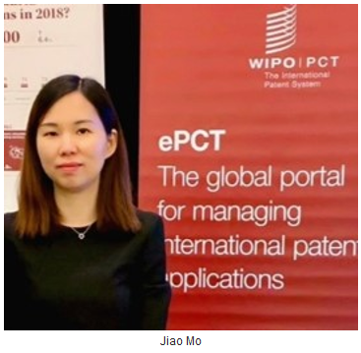
ePCT – eHandshakes-Access Rights-eOwnership
https://pct.wipo.int

Slide 2
Contents
eHandshakes
Access Rights
  Access Rights Groups
  Managing Access Rights
  Practical Advice
eOwnership - Request Access Rights
  Before Publication
  For Published Applications
  As Part of the Filing Process

Slide 3
eHandshakes (1)
First step in sharing access rights to PCT applications
Association and trusted recognition between different WIPO User Accounts with strong authentication, before access rights can be shared
eHandshakes do not directly result in shared access rights which have to be specifically assigned (default access rights options can be pre-defined) https://www.wipo.int/pct/en/epct/learnmore.html?N=695

Slide 4
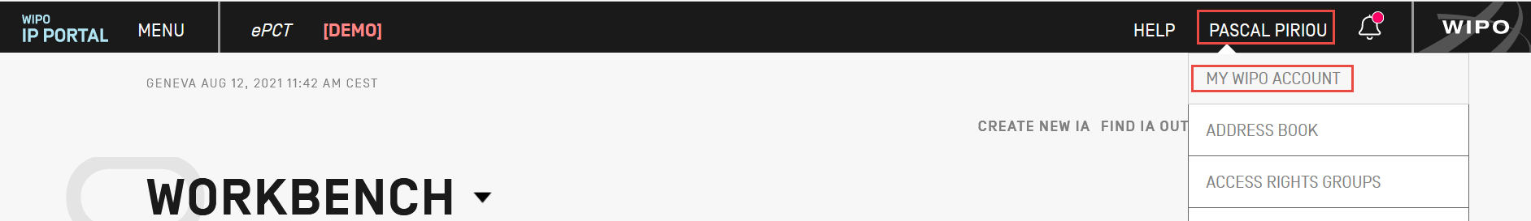
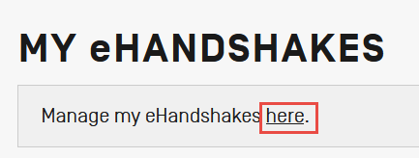
eHandshakes (2)
eHandshakes are managed within your WIPO account: select ‘My WIPO Account’ from the dropdown menu after clicking on your name in the navigation bar

Slide 5
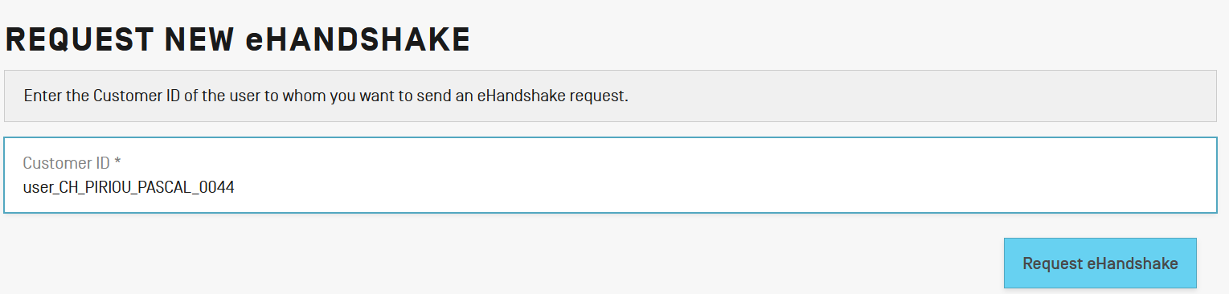
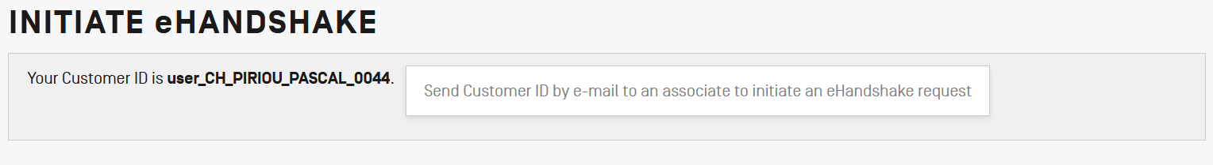
eHandshakes (3)
Request new eHandshake
  If you have the associate’s customer ID, enter it in the corresponding field
  If you do not have the associate’s customer ID, send yours by e-mail so that the associate can initiate the process

Slide 6
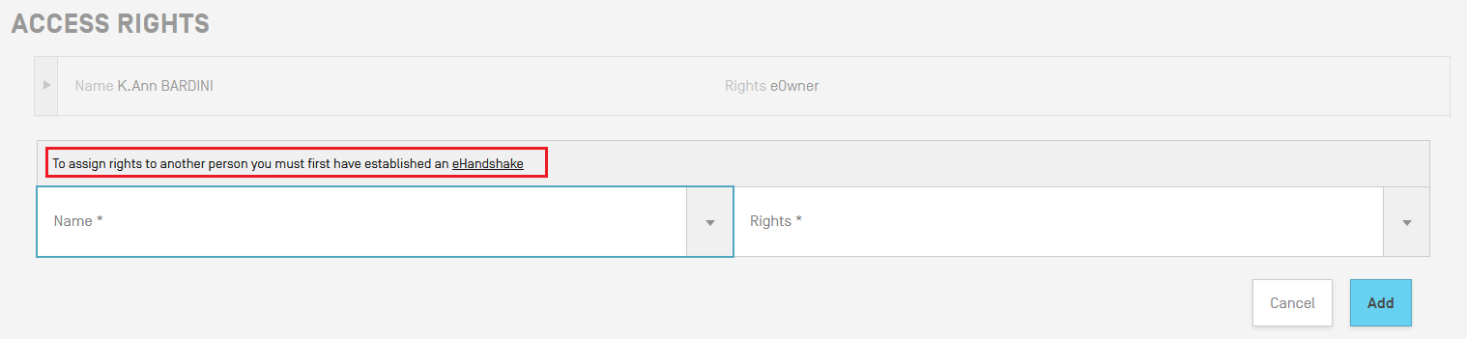
eHandshakes (4)
Shortcut link to eHandshake screen available when editing access rights

Slide 7
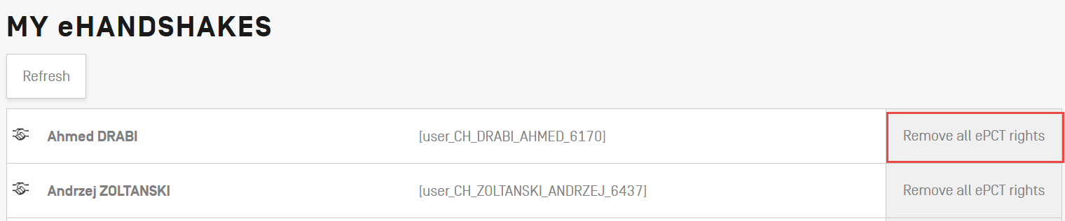
eHandshakes (5)
It is possible, in a single operation, to remove all access rights for a given eHandshake user, including:
  IAs, drafts
  Address Books
  Access Rights Groups
Useful when a person leaves a company or a law firm
If ePCT access rights have to be removed, remove access rights before deleting an eHandshake user

Slide 8
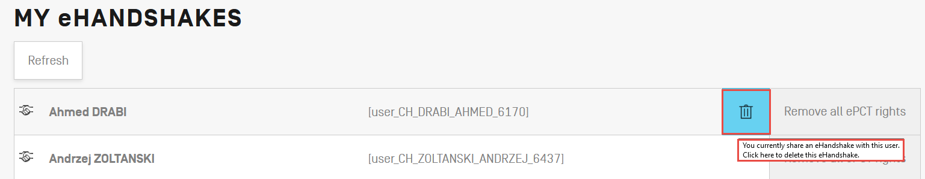
eHandshakes (6)
On ‘My eHandshakes’ list, find the eHandshake contact concerned, then hover your mouse next to ‘Remove all ePCT rights’, click on the ‘delete’ icon appeared to delete the eHandshake
An e-mail notification informs that person that an eHandshake has been deleted
Notes:
P1 END

Slide 9
Types of Access Rights
eOwner
  Complete control over the application in ePCT
  Can be the applicant, agent or another individual (e.g., paralegal, assistant, secretary) who actually filed the PCT application, or an individual to whom access rights were granted by an existing eOwner
eEditor
  Can take all actions except manage access rights
eViewer
  ‘View’ and ‘Download'
https://www.wipo.int/pct/en/epct/learnmore.html?N=694

Slide 10
Access Rights Groups (1)
Set up access rights groups to share access rights https://www.wipo.int/pct/en/epct/learnmore.html?N=542
  at the time of creating a New IA
  when cloning an existing application
  when requesting an eOwnership code for filing using PCT-SAFE, EPO online filing software or JPO PAS
  when editing access rights

Slide 11
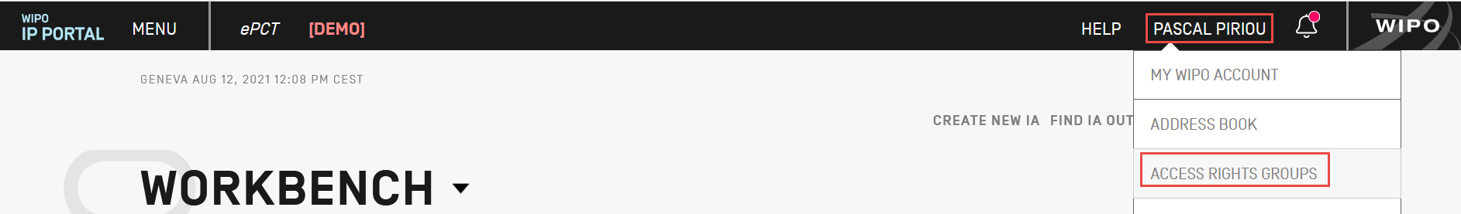
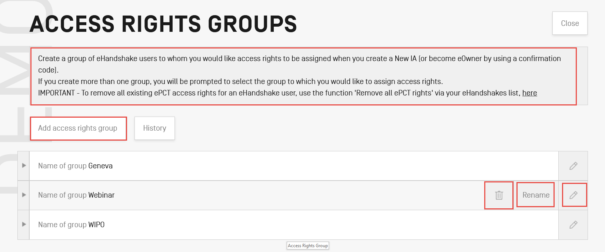
Access Rights Groups (2)

Slide 12
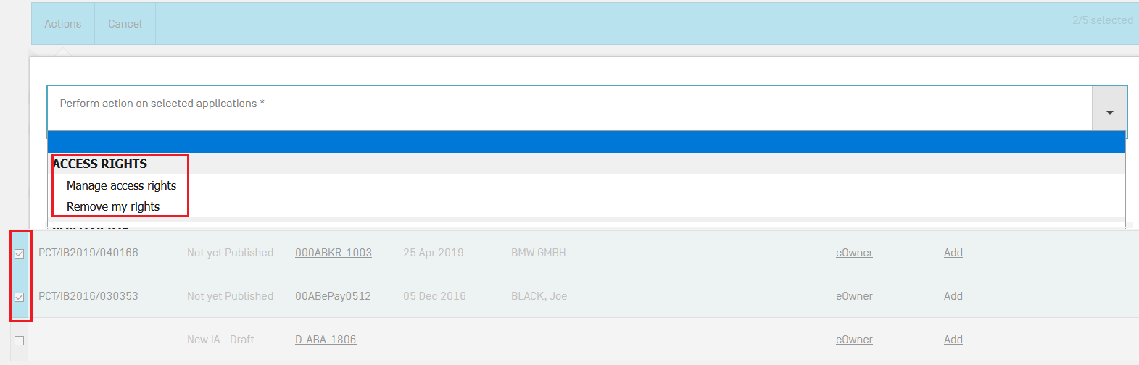
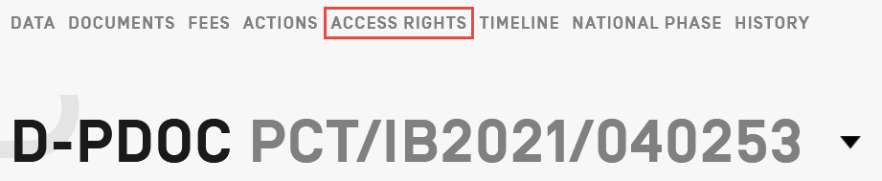
Managing Access Rights (1)
An eOwner can assign/modify/remove access rights via the Workbench (e.g. for multiple applications) or within individual applications via the ‘Access Rights’ section

Slide 13
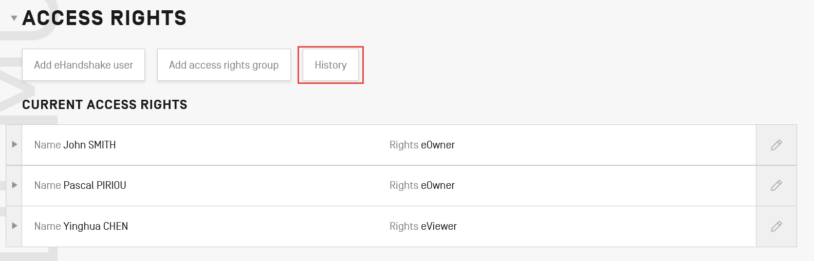
Managing Access Rights (2)
Best practice - always have at least 2 eOwners to facilitate access rights management
Access rights should be removed for ePCT users no longer requiring access (e.g., change of applicant, change of agent, departure of employee, etc.)
Full history of all access rights modifications available
Notes:
P2 END

Slide 14
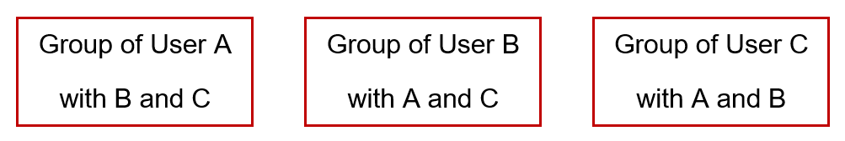
Practical Advice
Access rights group in a large law firm (1)
Each user in a group should create an access group in their account including the same eHandshake users

Slide 15
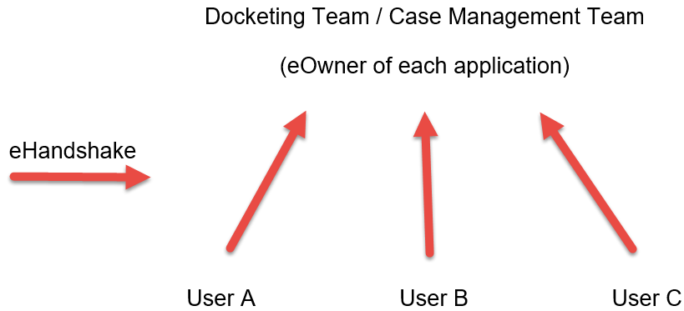
Access rights group in a large law firm (2)
Each user should have an eHandshake with the docketing team/ case management team

Slide 16
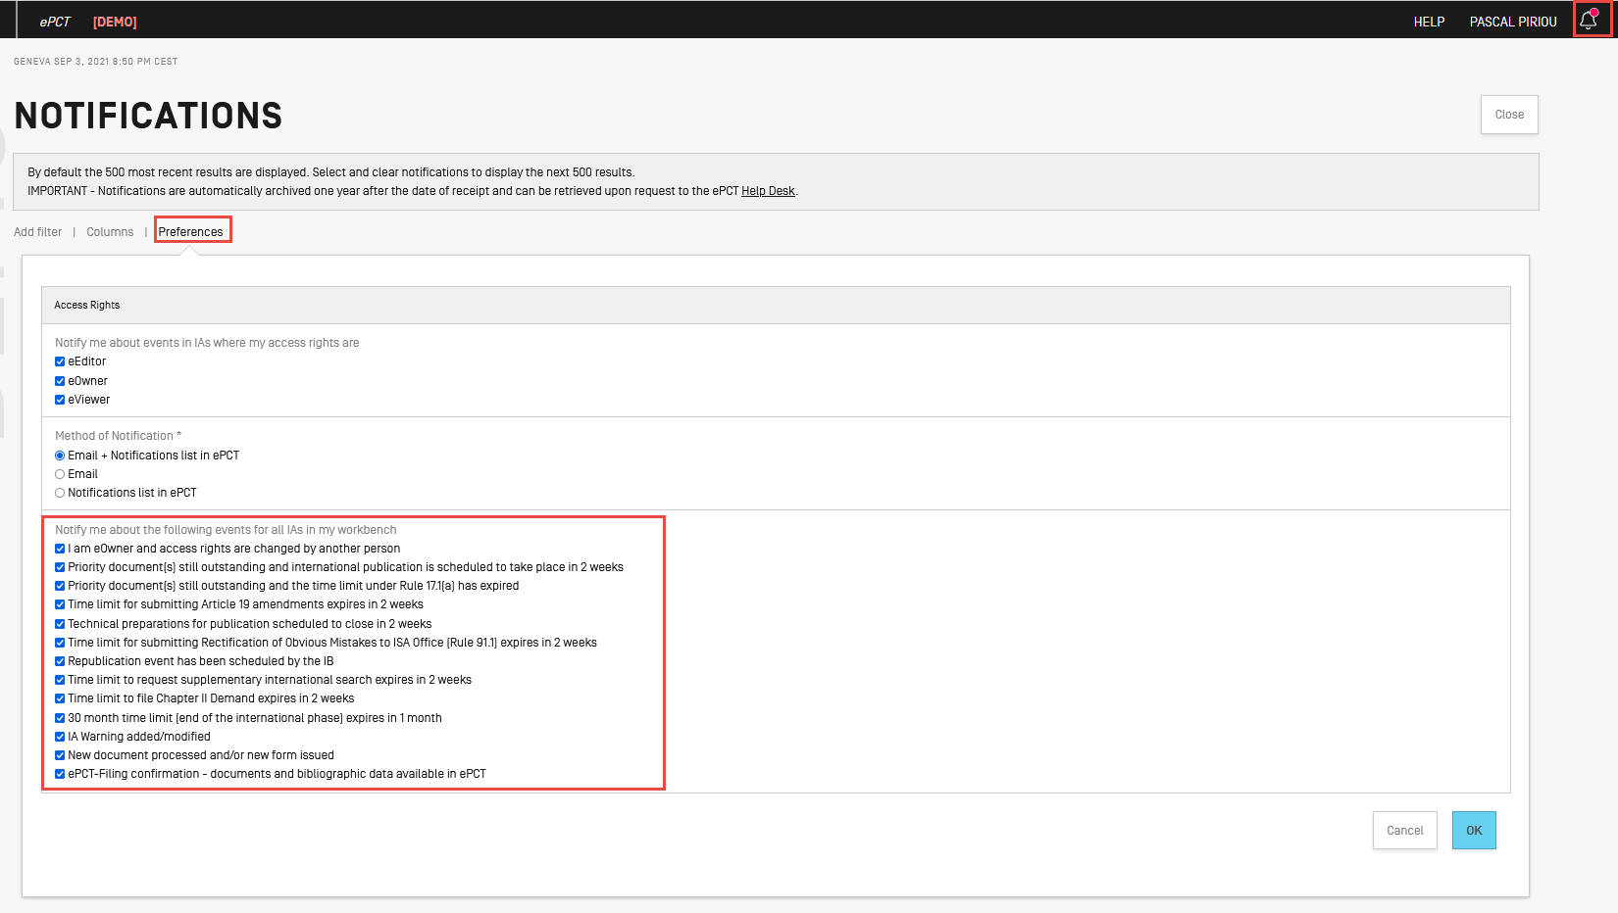
ePCT notifications preferences setting (1)
Docketing team/ case management team is eOwner of each application and receive all ePCT notification

Slide 17
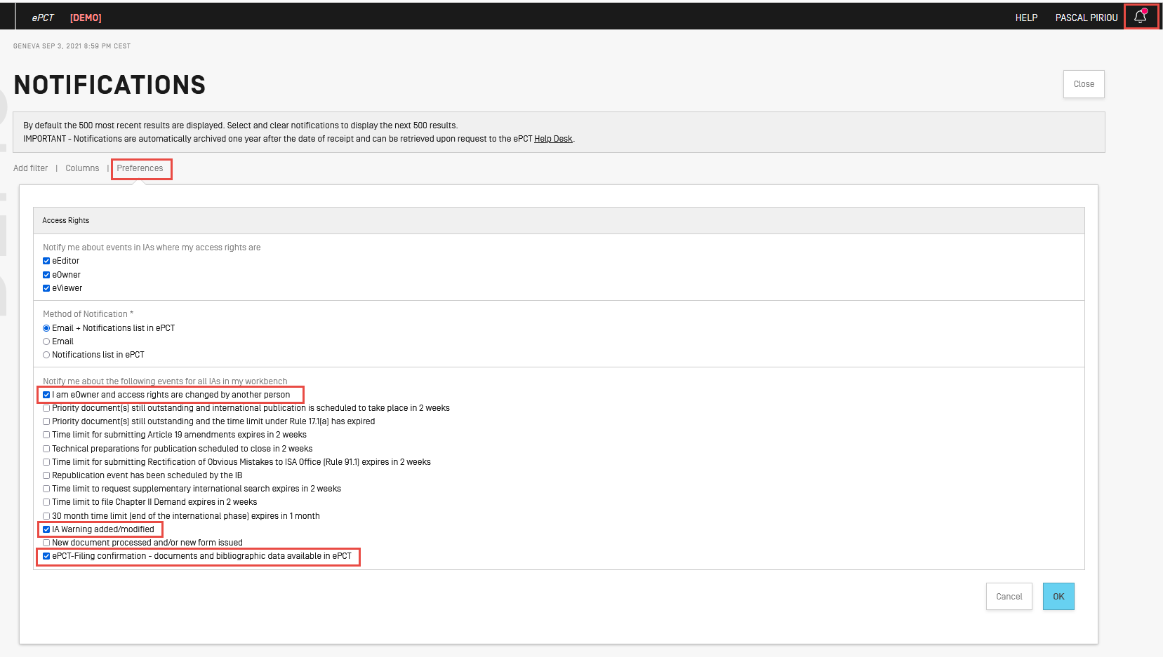
ePCT notifications preferences setting (2)
Paralegals/secretaries who only file but do not monitor applications, untick the unecessary notification options from ‘Preferences’

Slide 18
What should I do if I leave the company (1)
Scenario A: I move to another law firm
  Assign access rights to my eHandshake colleague(s) if I’m the sole eOwner
  Remove my access rights of all my PCT applications
  Delete my eHandshake(s)
  Update my WIPO account with my new contact details, including email address, name of the new company, etc
  No need to create a new WIPO account

Slide 19

What should I do if I leave the company (2)
Scenario B: I retire
  Assign access rights to my eHandshake colleague(s) if I’m the sole eOwner
  Remove my access rights of all my PCT applications
  Delete my eHandshake(s)
  Contact PCT Operations Customer Support Section pct.eservices@wipo.int to deactivate my WIPO account

Slide 20
Taking eOwnership of Applications
Process is automatic when using ePCT-Filing
Access rights can be assigned to eHandshake contacts, including prior to filing
Default access rights can be set up and automatically applied
If ePCT-Filing is not used, additional steps are required to take eOwnership so to gain access rights https://www.wipo.int/pct/en/epct/learnmore.html?N=693

Slide 21
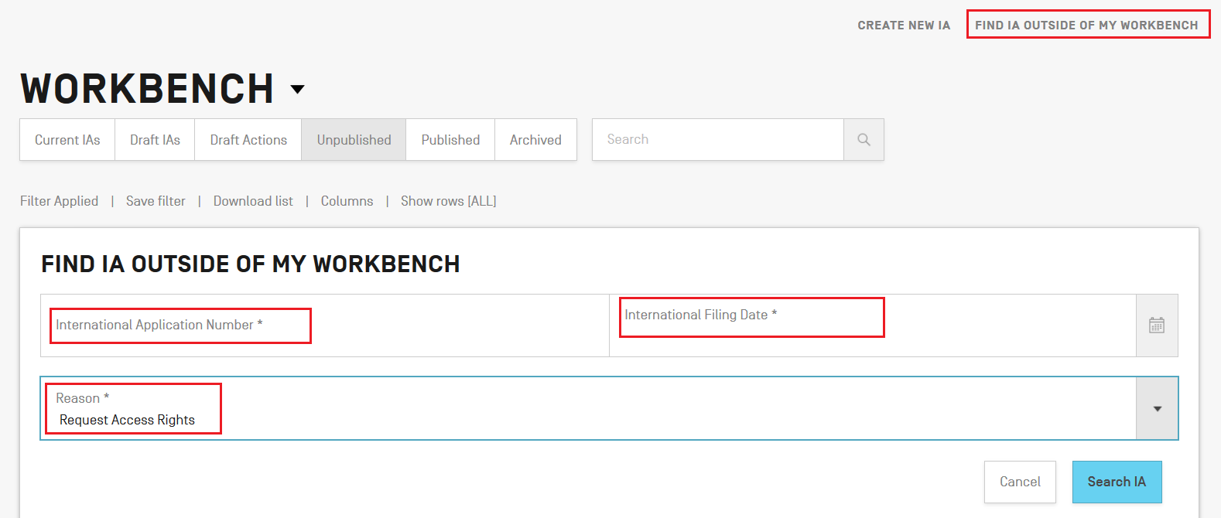
Taking eOwnership - Request Access Rights
Search for application outside of your Workbench and select reason ‘Request Access Rights’
E-mail notification is sent once the request for access rights has been processed by the IB
If Form PCT/IB/345 with the eOwnership code is issued, the code can only be used by the account holder who submitted the request

Slide 22

Confirming eOwnership before publication: e-filing using an ePCT supported digital certificate
Unpublished e-filed applications using a digital certificate supported by ePCT (WIPO digital certificates, EPO smart cards and certificates issued by JPO SECOM) https://www.wipo.int/pct/en/epct/learnmore.html?N=933
  Digital certificate used to file must match the digital certificate uploaded to the user’s WIPO account
  Enter the confirmation code in the bottom right-hand corner of Form PCT/IB/301
  eOwnership automatically assigned

Slide 23
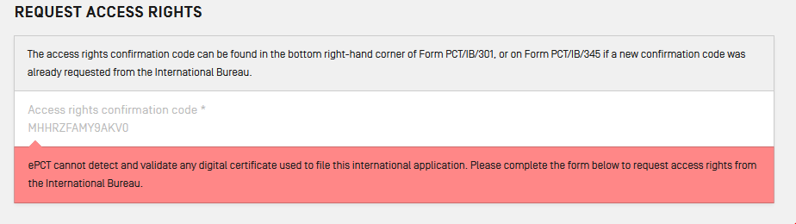
Requesting eOwnership (1) before publication: paper filing or e-filing with a digital certificate not supported by ePCT
Enter confirmation code indicated on Form PCT/IB/301
Fill in an online form to submit a request to the IB
eOwnership granted automatically if approved, or Form PCT/IB/345 sending the eOwnership code to the address for service if refused

Slide 24
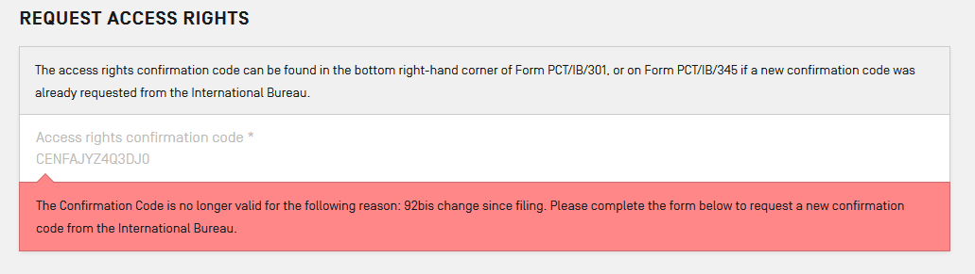
Requesting eOwnership (2) before publication: with a Rule 92bis change request filed in the application
Enter confirmation code indicated on Form PCT/IB/301
Fill in an online form to ‘Request confirmation code’ from the IB
Form PCT/IB/345 with the eOwnership code will be sent to the address for service

Slide 25
Requesting eOwnership (3) before publication: no PCT/IB/301
No Form PCT/IB/301 (e.g. new agent): send ePCT message to the IB to request a copy of the form
https://www.wipo.int/pct/en/epct/learnmore.html?N=938
  Click ‘Search IA outside my Workbench’, enter PCT application number + International filing date, then select the reason ‘View contents’ to go to the application page
  Click ‘send ePCT message’

Slide 26
Requesting eOwnership for Published Applications
Confirmation code on Form PCT/IB/301 is no longer valid after the publication
Fill in an online form to ‘Request confirmation code’ from the IB
Form PCT/IB/345 with the eOwnership code will be sent to the address for service https://www.wipo.int/pct/en/epct/learnmore.html?N=936
Notes:
P3 END

Slide 27
Requesting eOwnership as Part of the Filing Process
Filing using compatible e-filing software, including PCT-SAFE, EPO online filing software and JPO PAS
Generate a one-time eOwnership code in ePCT and paste it into the relevant signature field along with your Customer ID
When the Record Copy is received at the IB, access rights will be automatically assigned to the account holder corresponding to the eOwnership code and Customer ID https://www.wipo.int/pct/en/epct/learnmore.html?N=518

Slide 28
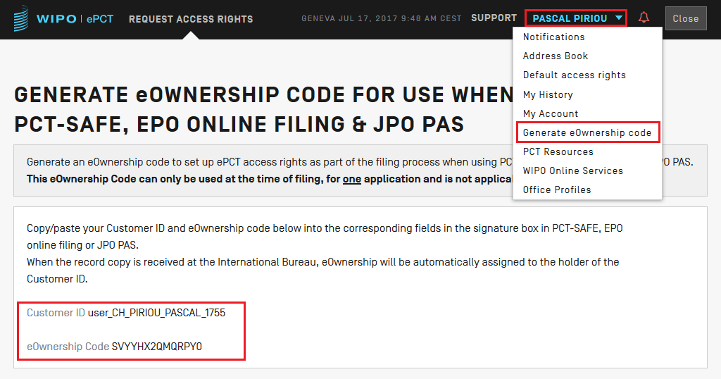
Generating eOwnership Code

Slide 29
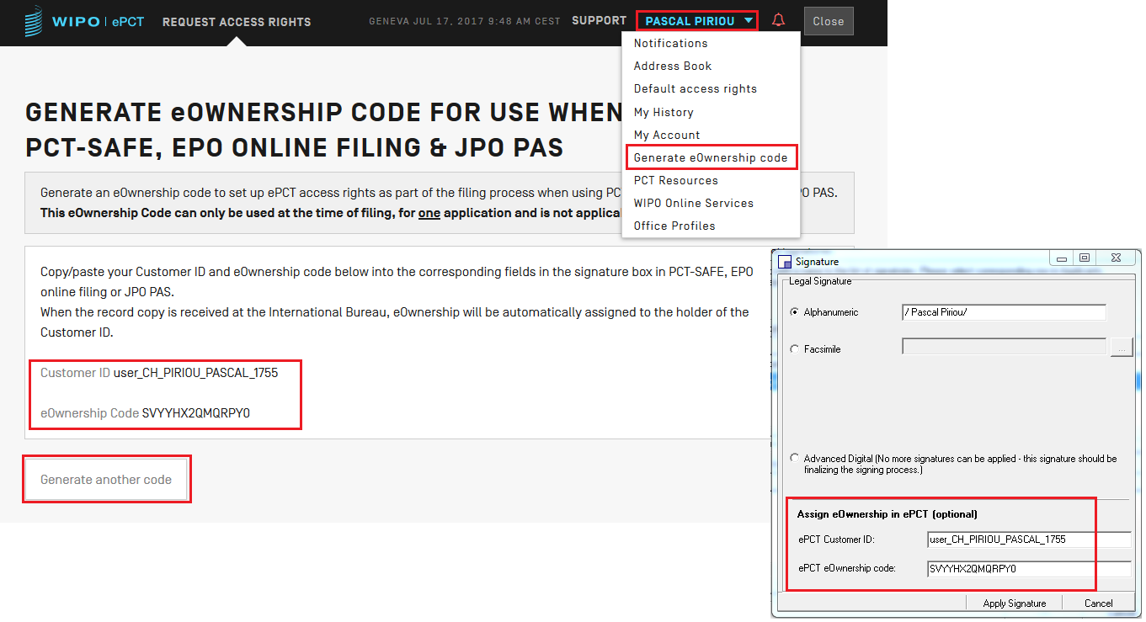
Example - PCT-SAFE Filing
Notes:
P4 END

Slide 30
ePCT HELP (1)
Use the ‘HELP’ link in the navigation bar https://www.wipo.int/pct/en/epct/support.html
FAQs and user documentation
  Database of help information (use ‘Search’ feature to pinpoint a topic)
  Useful ‘How to’ videos
  Live Chat (during business hours) available via FAQ answers
  ePCT Webinars

Slide 31
ePCT HELP (2)
PCT Customer Support Section
  Tel: +41-22-338-9523
  E-mail: pct.eservices@wipo.int
  Monday to Friday, 9am-6pm Geneva time
  Chat feature available

Slide 32

Thank you!

