Slide 1
Overview of PATENTSCOPE
Geneva
April
2018
Sandrine Ammann
Marketing & Communications Officer

Slide 2
Agenda
PATENTSCOPE
  Coverage
  How to search
  The Browse menu
  Other tools
  Options

Slide 3
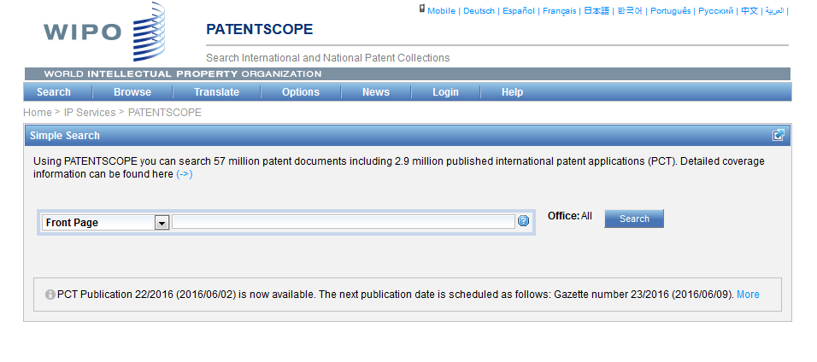
PATENTSCOPE
https://patentscope.wipo.int

Slide 4
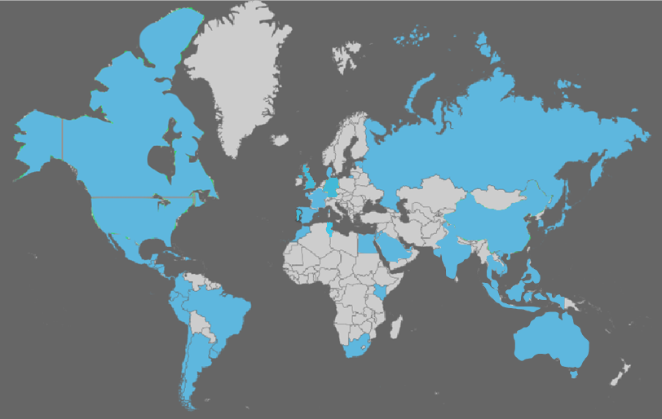
Coverage: what is included?
PCT published applications
National/regional patent collections

Slide 5
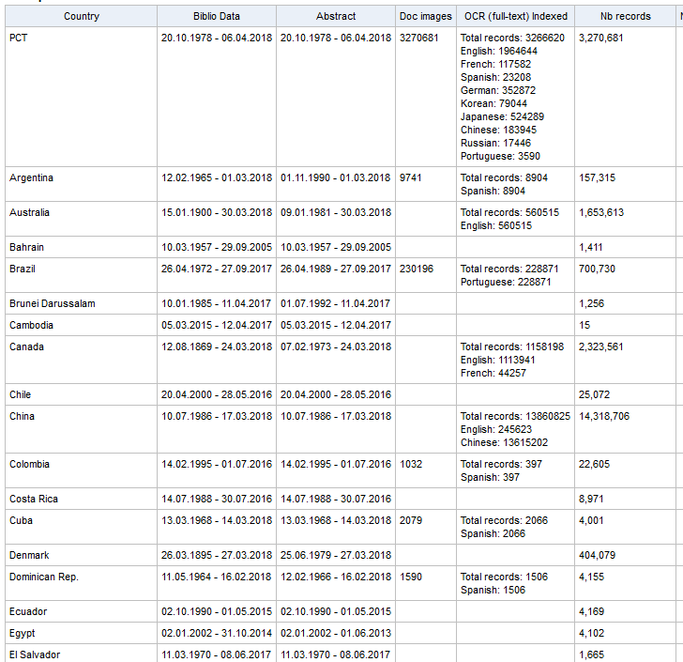
Coverage : Details of collections

Slide 6

Latest collection added

Slide 7
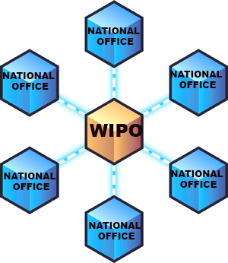
National/regional collections

Slide 8
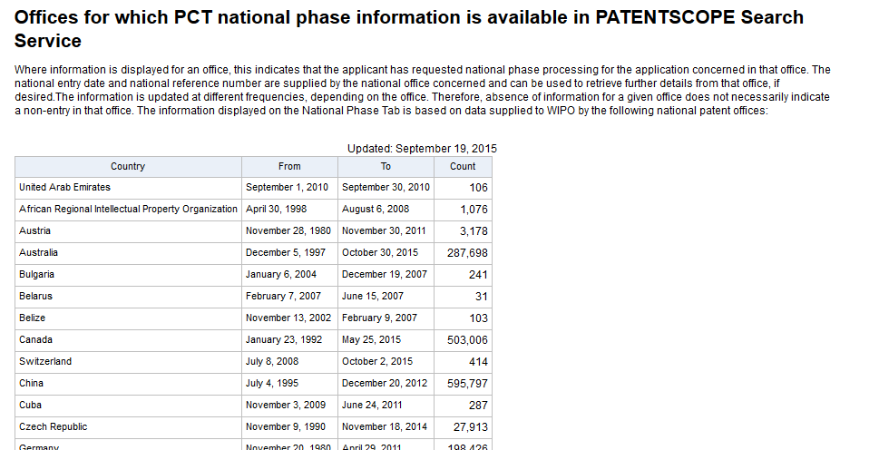
National/regional collections vs national phase
https://patentscope.wipo.int/search/en/nationalphase.jsf

Slide 9

What can you do?

Slide 10

PATENTSCOPE
Search
Browse
Translate

Slide 11
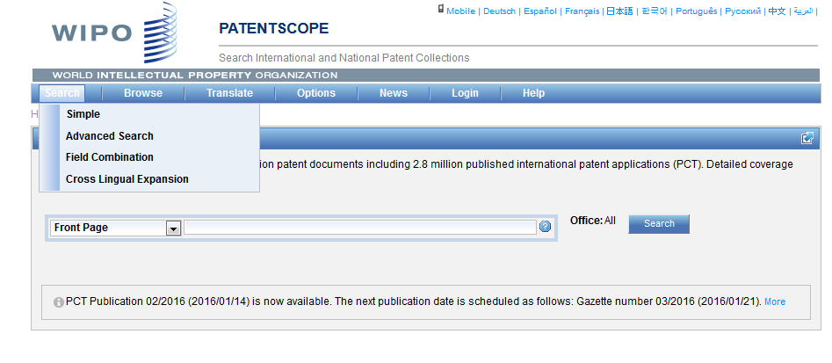
Search

Slide 12
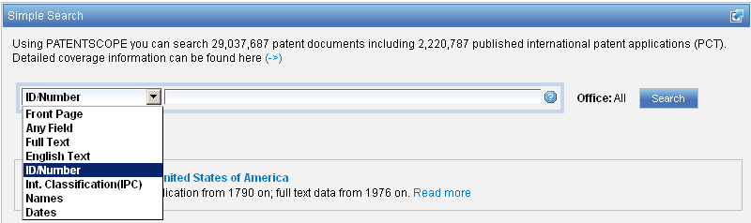
Interface : Simple
Basic search fields are provided

Slide 13
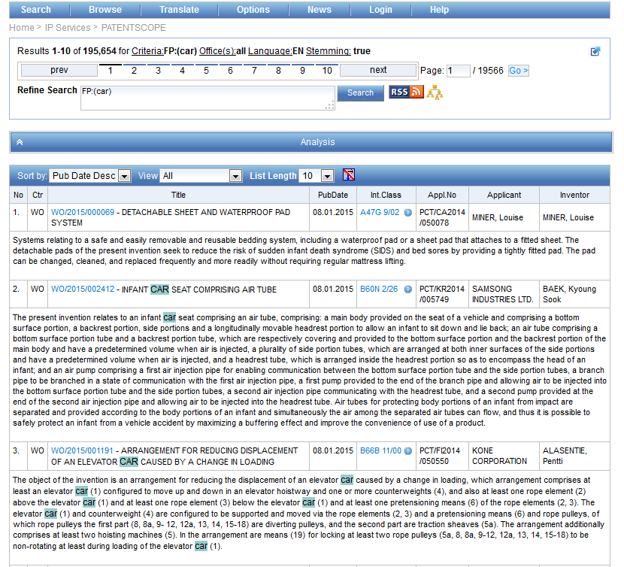
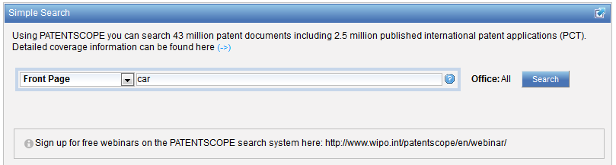
Interface simple - keywords

Slide 14
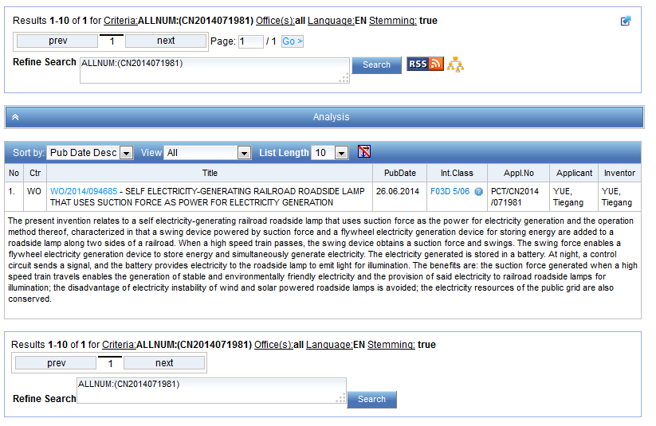
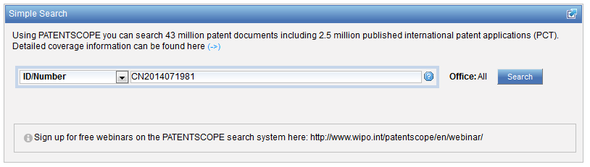
Simple interface - Numbers

Slide 15
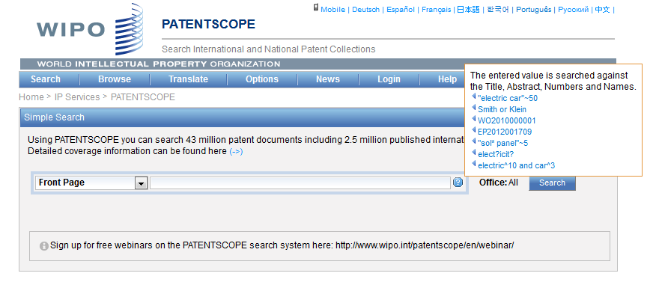
Simple interface - Help

Slide 16
Field Combination

Slide 17
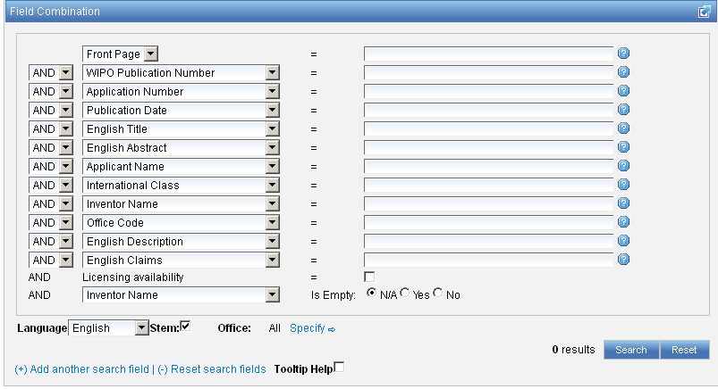
Interface : Field Combination - Structured

Slide 18
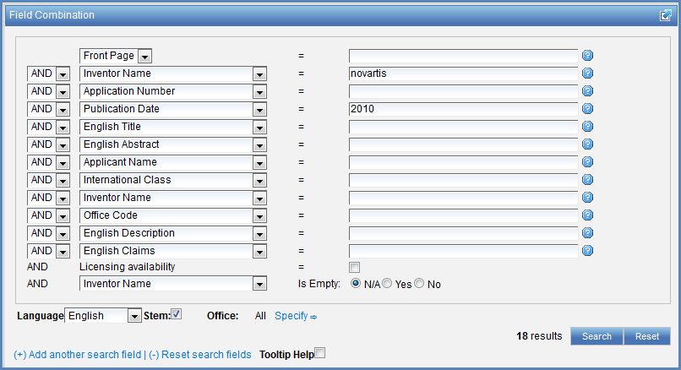

Search examples
Patent documents containing Novartis as inventor and published in 2010
Patent documents without an IPC code
Notes:
18
3. there is also the option to select a field that is empty: for example you could search. On the last line, select the IPC in the drop-down box and tick yes next to empty.

Slide 19
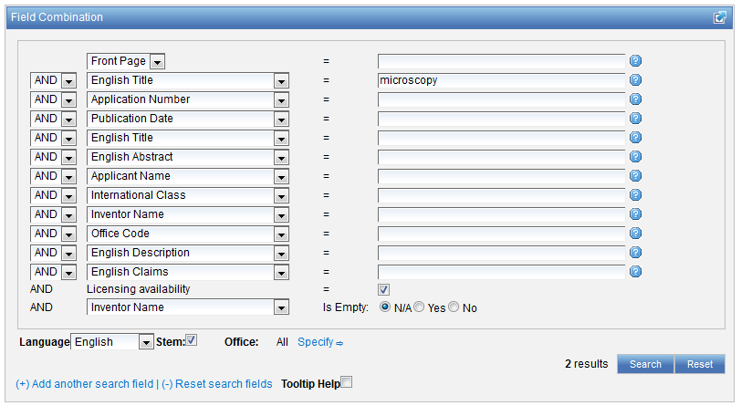
Search examples
Patent documents containing microscopy with licensing availability.
Notes:
19
In the drop-down box, select the field Applicant name and enter Steve Jobs; select AND and the field Publication date and enter 2007
In the drop-down boy, select English description and enter microchip, then tick the Licensing availability box (one before last in the Field Combination interface).

Slide 20
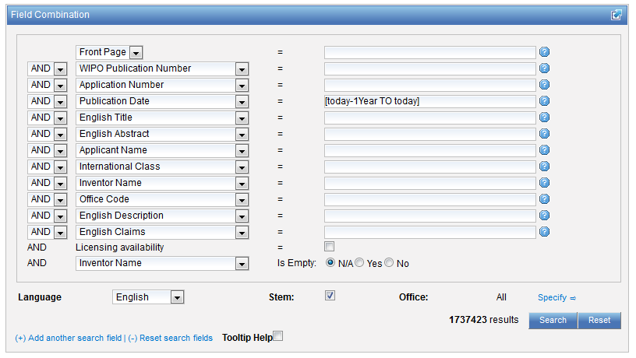

Slide 21
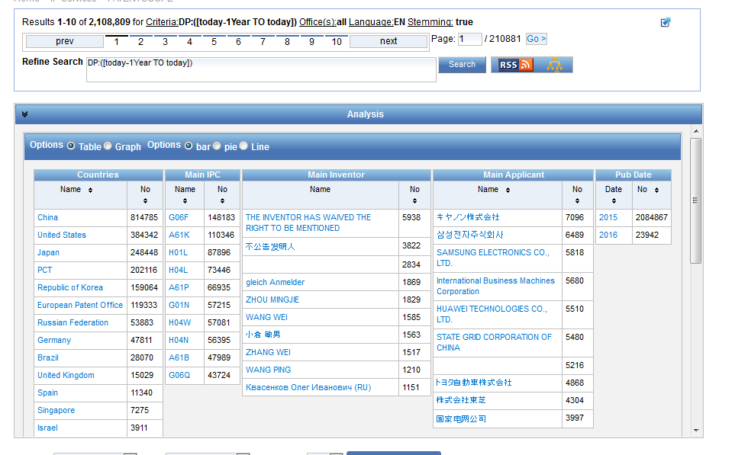

Slide 22
Advanced search interface

Slide 23
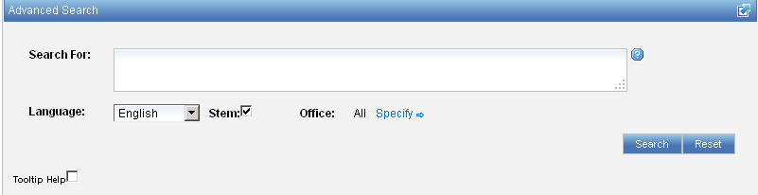
Interface : Advanced
Full flexibilities are enabled

Slide 24
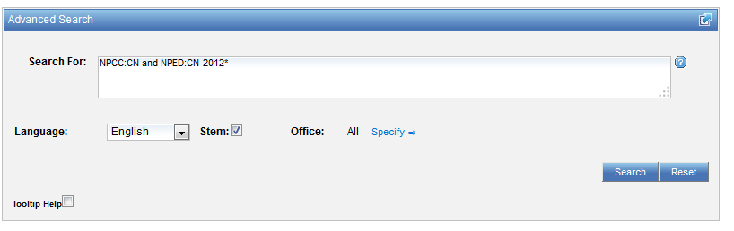
Example: national phase entry
All applications that entered national phase in China in 2012

Slide 25
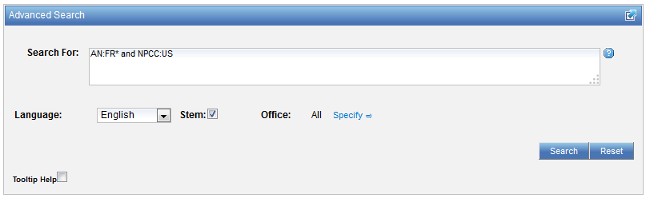
Example: nb of patent applications from France seeking protection in USA

Slide 26
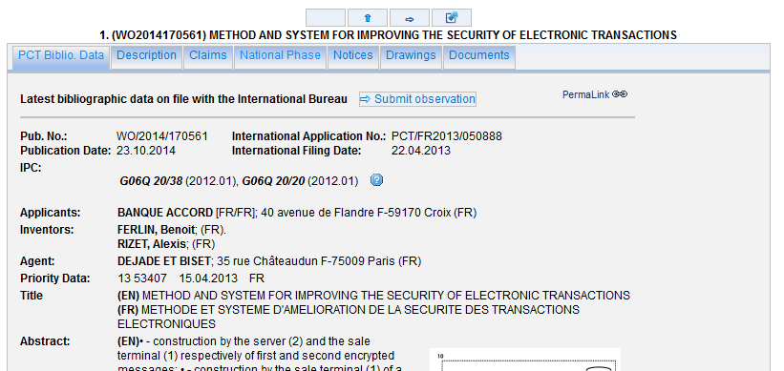
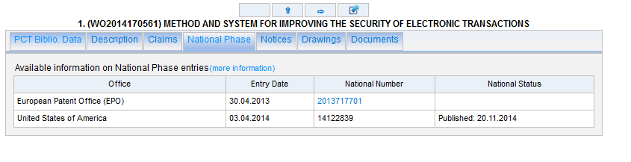

Slide 27
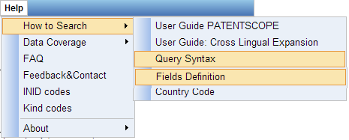
Help menu

Slide 28
CLIR

Slide 29
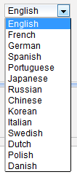
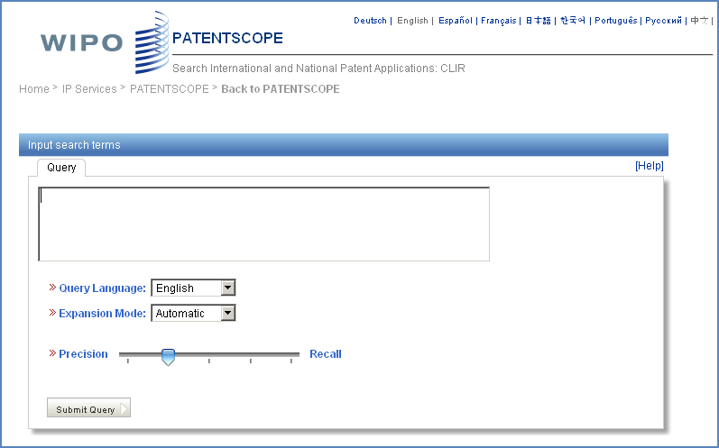
CLIR: the interface
Notes:
29
There is query box
Query language
Expansion mode

Slide 30
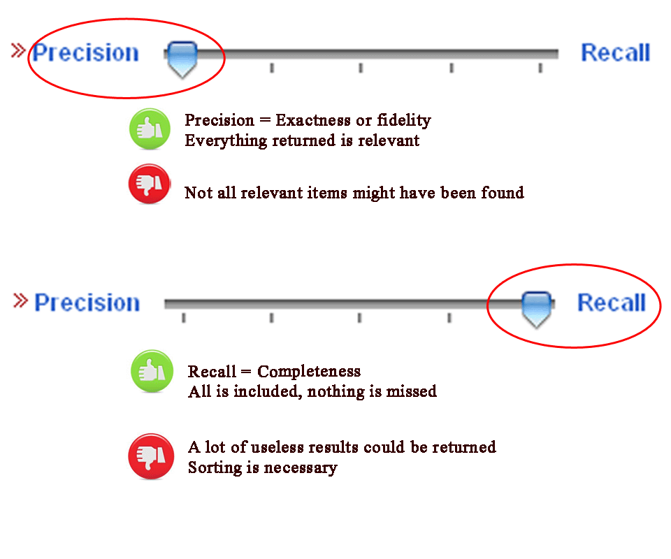
CLIR: precision vs recall

Slide 31
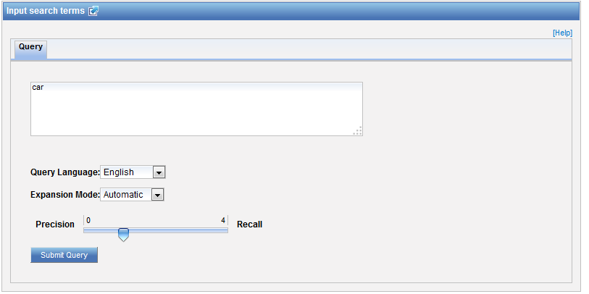
CLIR: an example in automatic mode

Slide 32
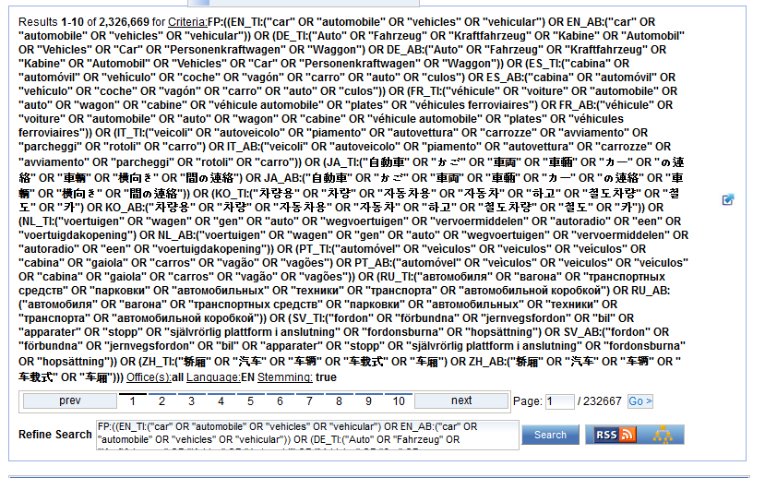
CLIR: an example

Slide 33
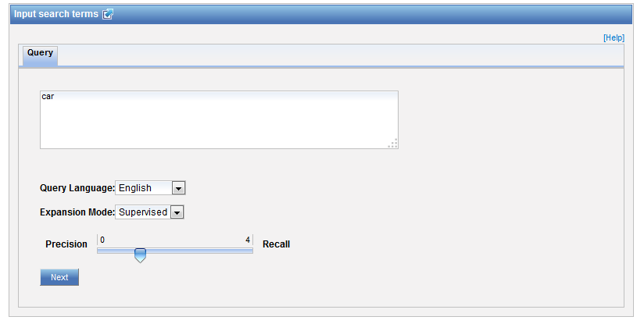
CLIR: an example in supervised mode

Slide 34
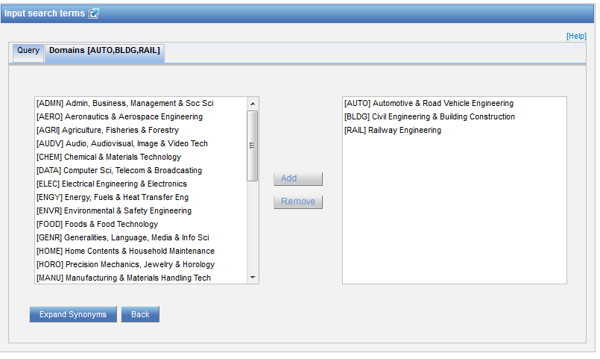
Domain selection

Slide 35
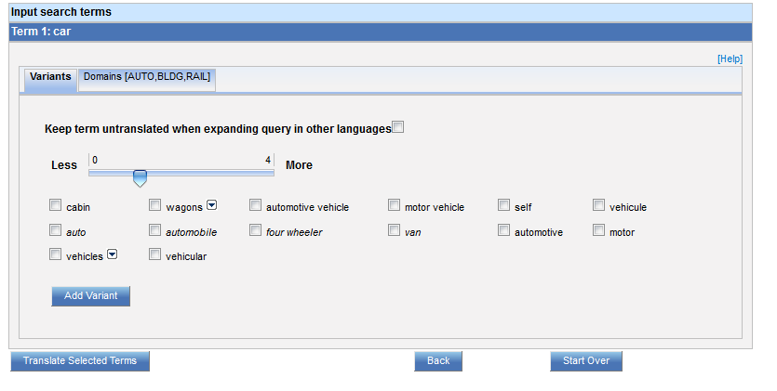
Variants selection

Slide 36
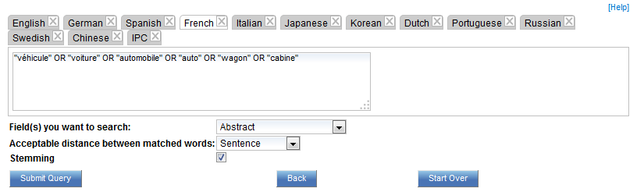
Summary of variants

Slide 37
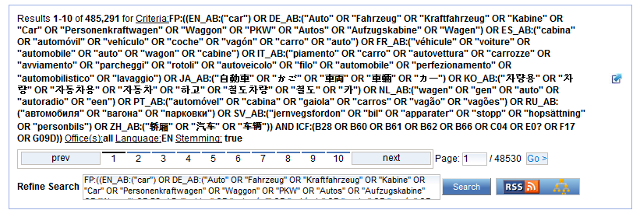
Results

Slide 38
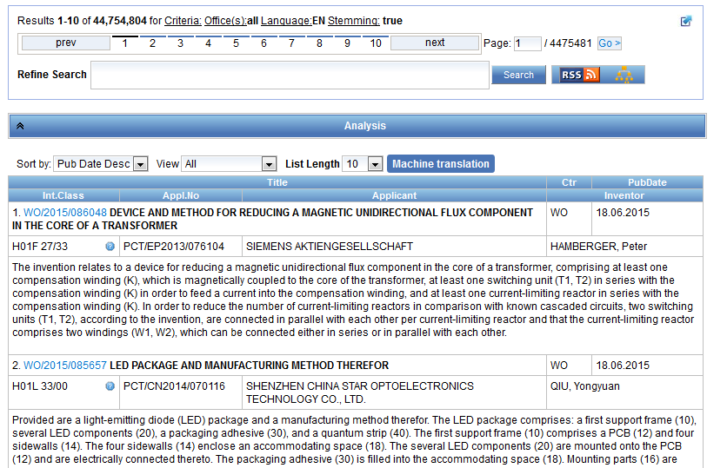
Reading the result list

Slide 39
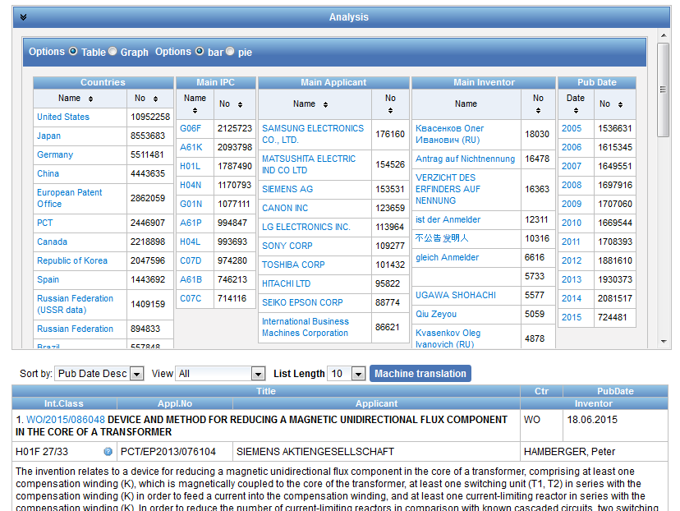
Analysis

Slide 40
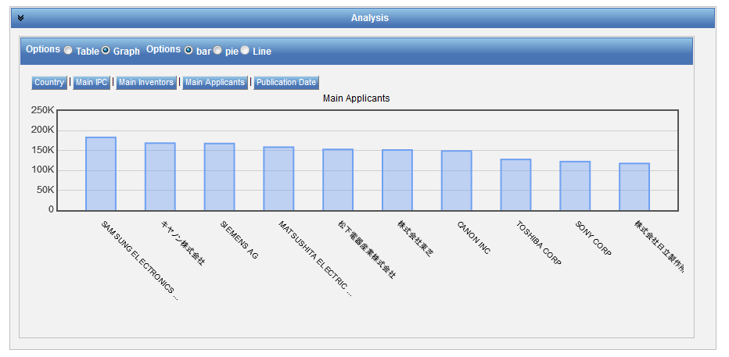
Display options: table/graph –bar/pie

Slide 41
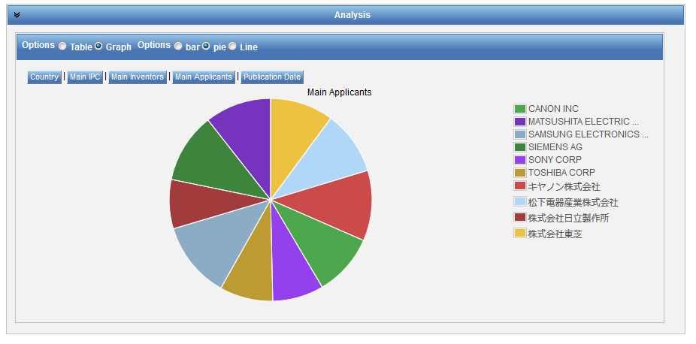
Display options: table/graph –bar/pie
Notes:
41
In both bar and pie options, the tabs allow you to see the information graphically for the Offices, Main IPC, Main Applicant, Main Inventor and Publication Date.
The charts can be saved in GIF format for inclusion in documents or reports by right-clicking in a corner of the image and selecting “Copy image” or “Save image”.

Slide 42
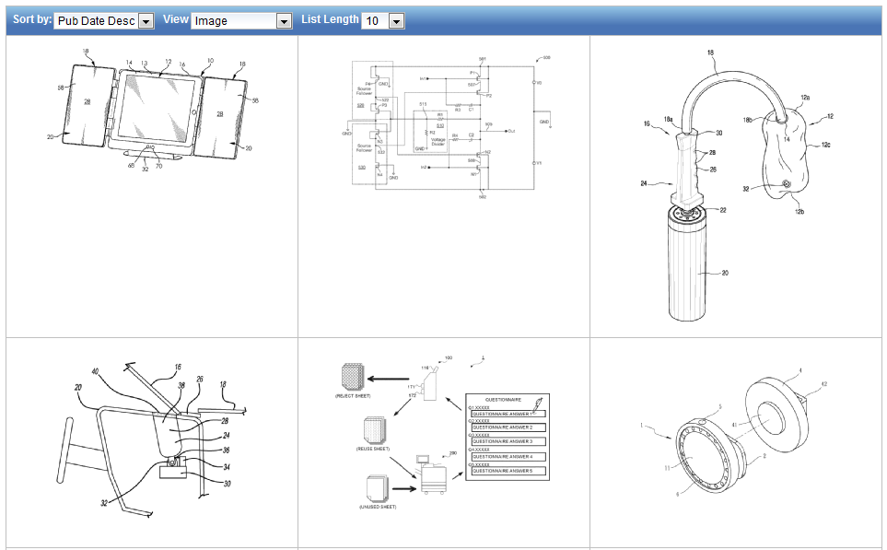
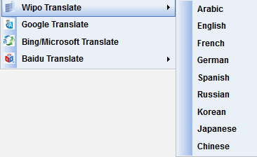
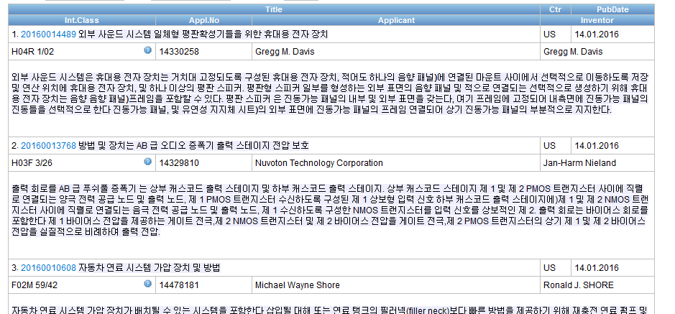
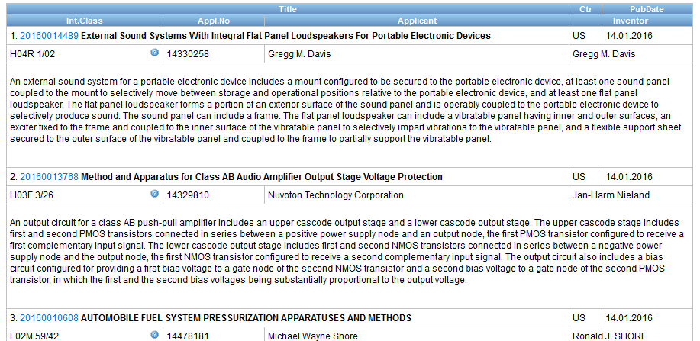



Options

Slide 43
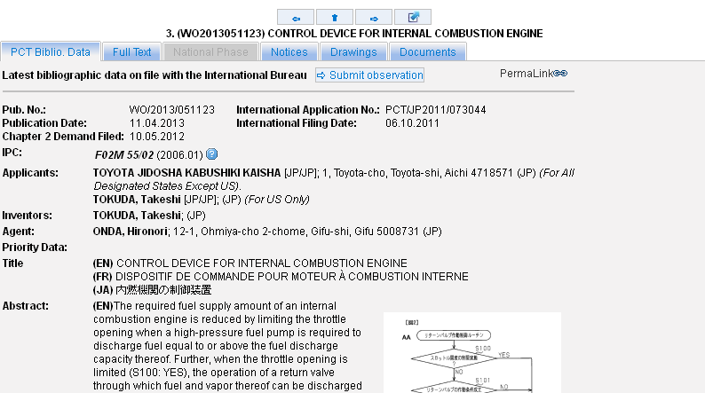
Tabs

Slide 44
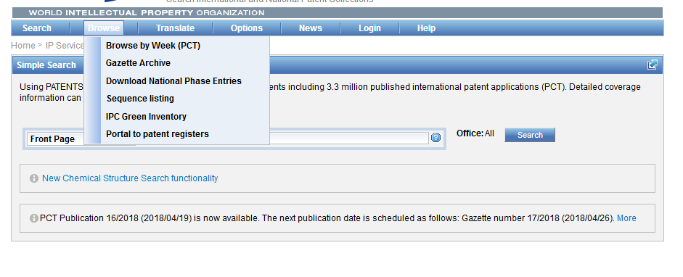
Browse

Slide 45
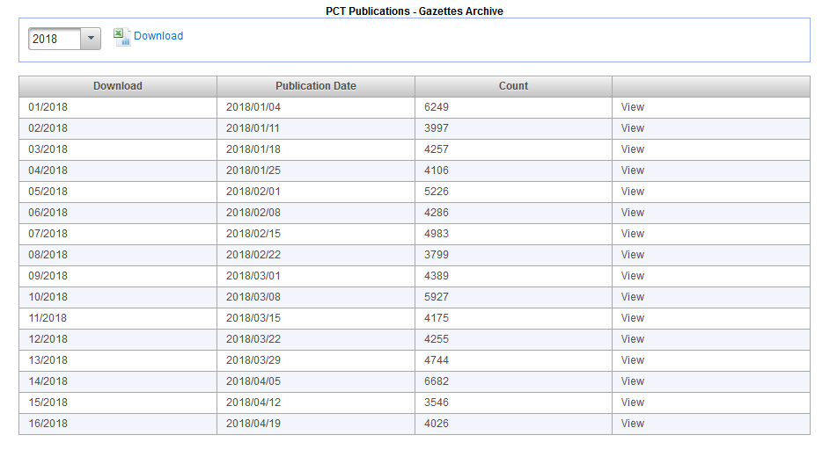
Gazette Archive

Slide 46
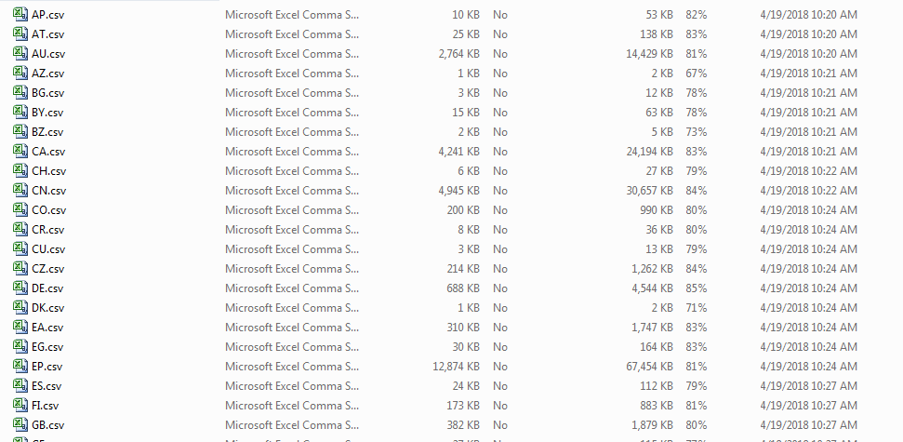
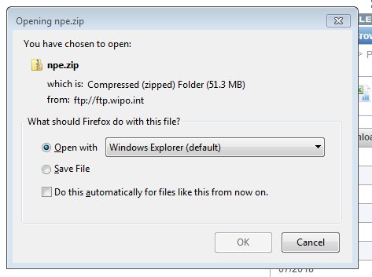
Download national phase entries

Slide 47
Browse by Week (PCT)

Slide 48
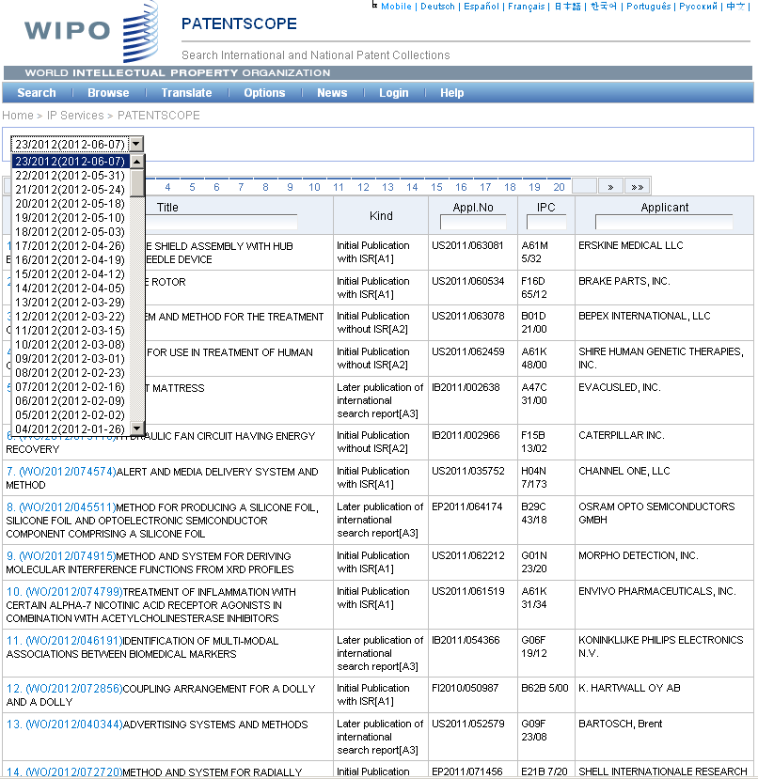

Slide 49
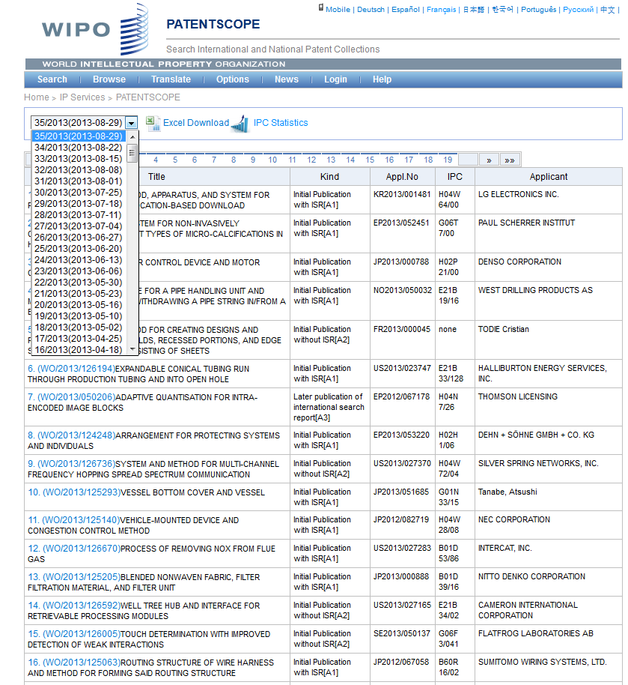

Slide 50
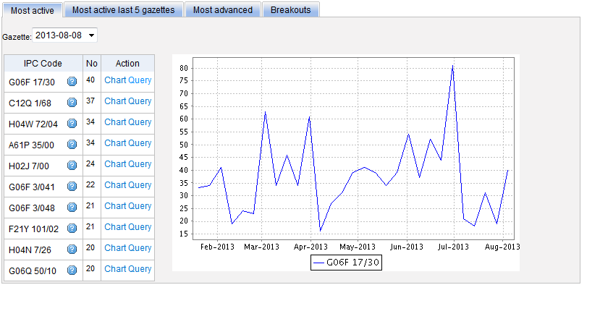
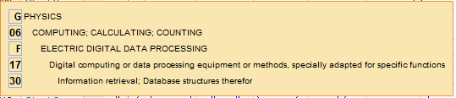
Most active

Slide 51


Slide 52

Most active last 5 gazettes

Slide 53

Most advanced

Slide 54

Breakouts

Slide 55
Sequence listing

Slide 56


Slide 57
IPC Green Inventory

Slide 58

IPC Green Inventory

Slide 59
Portal to patent registers

Slide 60

Patent Register Portal

Slide 61

Translate
Notes:
61
Language pairs available: EN=>FR, FR=>EN, EN=>ZH, ZH=>EN
Technical domain aware system using 32 domains derived from the International Patent Classification

Slide 62

WIPO Translate: the interface

Slide 63

The language pairs

Slide 64

32 Technical domains from the IPC
[ADMN] Admin, Business, Management & Soc Sci
[AERO] Aeronautics & Aerospace Engineering
[AGRI] Agriculture, Fisheries & Forestry
[AUDV] Audio, Audiovisual, Image & Video Tech
[AUTO] Automotive & Road Vehicle Engineering
[BLDG] Civil Engineering & Building Construction
[CHEM] Chemical & Materials Technology
[DATA] Computer Sci, Telecom & Broadcasting
[ELEC] Electrical Engineering & Electronics
[ENGY] Energy, Fuels & Heat Transfer Eng
[ENVR] Environmental & Safety Engineering
[FOOD] Foods & Food Technology
[GENR] Generalities, Language, Media & Info Sci
[HOME] Home Contents & Household Maintenance
[HORO] Precision Mechanics, Jewelry & Horology
[MANU] Manufacturing & Materials Handling Tech
[MARI] Marine Engineering
[MEAS] Standards, Units, Metrology & Testing
[MECH] Mechanical Engineering
[MEDI] Medical Technology
[METL] Metallurgy
[MILI] Military Technology
[MINE] Mining, Oil & Gas Extraction & Minerals
[NANO] Nano Technology
[PACK] Packaging & Distribution of Goods
[PRNT] Printing & Paper
[RAIL] Railway Engineering
[SCIE] Optical Engineering
[SPRT] Sports, Leisure, Tourism & Hospitality
[TEXT] Textile & Clothing Industries
[TRAN] Transportation

Slide 65

WIPO Translate: how does it work?

Slide 66


Slide 67


Slide 68

WIPO Pearl

Slide 69

WIPO Pearl http://www.wipo.int/wipopearl/search/home.html

Slide 70

WIPO Pearl
WIPO’s online terminology database
17’000 concepts, 115’000 terms
10 languages
Contents validated by WIPO language experts and terminologists

Slide 71

Example: bicycle fork

Slide 72


Slide 73


The Interface

Slide 74


Slide 75
PATENTSCOPE what’s new?
Addition of chemical compound search:
  Recognize chemical compounds in patent texts and from embedded drawings included in patent texts;
  Standardize all the different representations of chemical structures into Inchikeys;
  Implement search functions for Inchikeys that can be used by non chemists

Slide 76

Chemical Search function

Slide 77


Slide 78


Slide 79
Timeline
Production date: October 3rd 2016
Step 1: chemical compounds in PCT applications published in English or German;
Next steps: other languages and national patent collections

Slide 80


Slide 81

Languages of the interface

Slide 82

Interface in Chinese

Slide 83

PATENTSCOPE account

Slide 84

Signing up

Slide 85

Once logged-in

Slide 86

Saved queries

Slide 87

Downloading the results

Slide 88

Downloaded results

Slide 89

Account customization

Slide 90


Monthly webinar
http://www.wipo.int/patentscope/en/webinar/

Slide 91

Future/past webinars:
wipo.int/patentscope/en/webinar

Slide 92
May webinar: PATENTSCOPE for beginners
Tue, May 29
8:30 AM - 9:30 AM CEST
Thu, May 31
5:30 PM - 6:30 PM CEST
To sign up: http://www.wipo.int/patentscope/en/webinar/

Slide 93
Global Brand Database: webinar
How to find a brand in the Global Brand Database
  May 2 at 9:30 am CET
  https://attendee.gotowebinar.com/rt/8931489472329613057

Slide 94
Global Design Database: webinar
How to find a design using the Global Design Database
  May 23 at 9:30 am CET
  https://attendee.gotowebinar.com/rt/3487977827684331265

Slide 95


Slide 96

patentscope@wipo.int

