Slide 1
Complex queries in the PATENTSCOPE search system
Cyberspace
September
2013
Sandrine Ammann
Marketing & Communications Officer

Slide 2
Agenda
What’s new?
Complex queries
  Advanced search interface
  “tools” available to build complex queries
  1 example
  CLIR
Q & A

Slide 3


What’s new?
Addition of the Chinese national patent collection

Slide 4
Chinese data in PATENTSCOPE
From 1985 to 1995 included:
  Bibliographic data in English
From 1996
  Bibliographic data in English and Chinese
  Claims in Chinese
  Description in Chinese
  = about 2.8 million full-text

Slide 5



Also new
Addition of national patent collections of
  Bahrain
  UAE
  Egypt

Slide 6
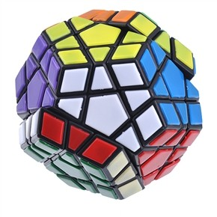
COMPLEX QUERIES

Slide 7
Search efficiency optimization
3 elements have therefore to be defined:
  a .The database/s + technical tools to be used
  b. The precise scope of the search and
  c. The search strategy

Slide 8
Complex queries
1. Advanced search interface
2. Stemming
3. Operators
4. Field codes
5. Grouping-nesting
6. Caret -wildcard –fuzzy search
7. Date search
8. CLIR

Slide 9
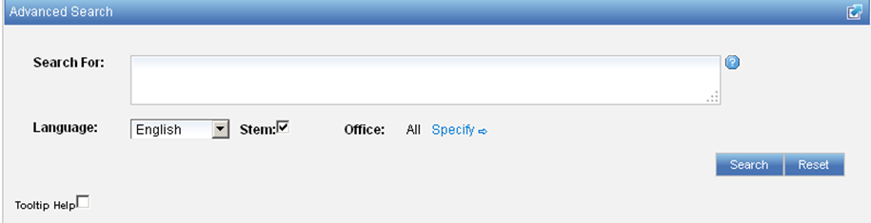
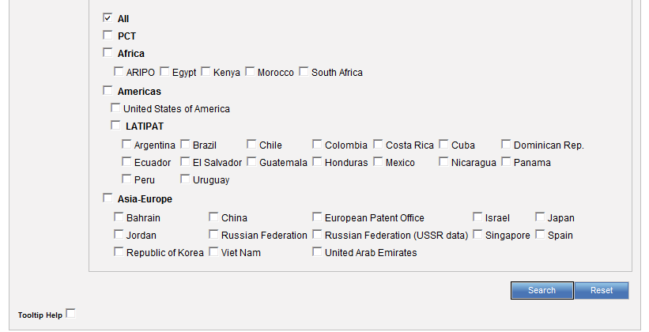
1. Advanced search interface

Slide 10
2. Stemming
Notes:
Once familair with keywords, classification and operator, which part of document to search
Names, application/pub nb, classidfication, priority data, ti, ab, de
Combined with basic fields such as FP or all nub

Slide 11
Stemming
Process that removes common ending from words by English Snowball algorithm
electric¦al = electric
electric¦ity = electric
electron¦ics = electron

Slide 12
A complex query

Slide 13
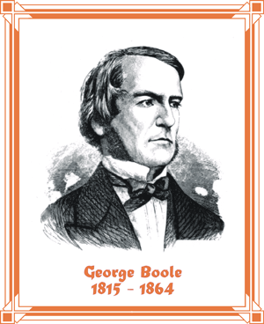
3. Boolean operators
OR
AND
NOT
XOR
By default….

Slide 14
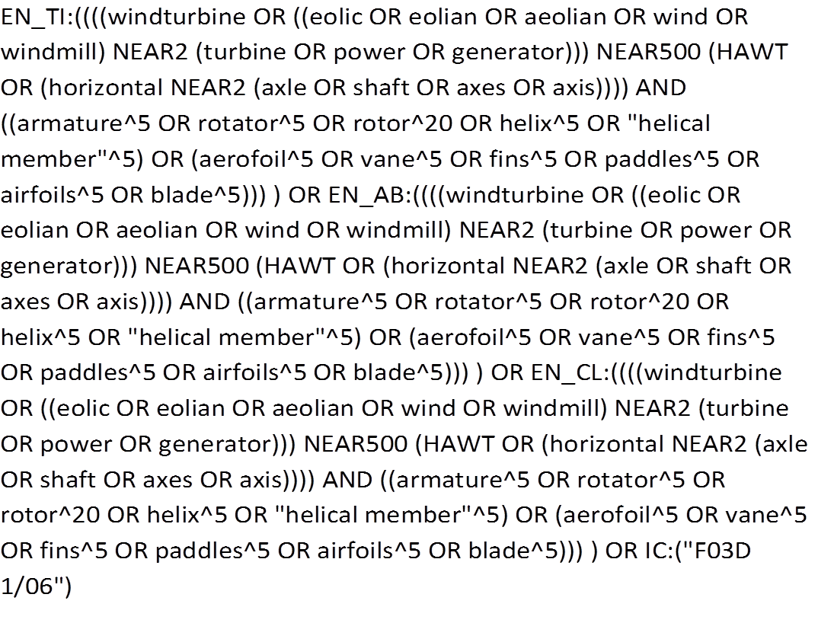
The complex query

Slide 15
3. Proximity operators: NEAR + "…"
" …."
«horizontal axle» = horizontal NEAR1 axle
NEAR
By default: 5 words between entered keywords
A NEAR B = B NEAR A
horizontal NEAR2 axle = "horizontal axle" ~2

Slide 16
3. Proximity operators: BEFORE
BEFORE define positions of search term
horizontal BEFORE axle

Slide 17
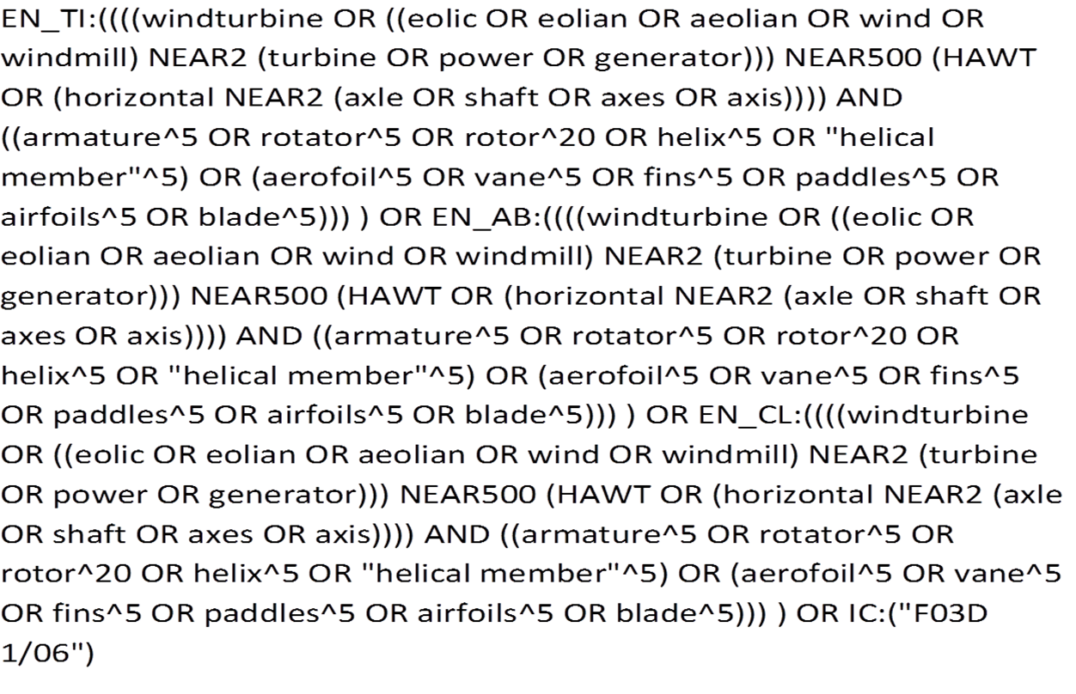
The complex query

Slide 18
4. Field codes
Basic fields: elements of a patent document
Derived fields
2 letter code = individual field
EN_TI FR_AB ES_DE_S
Convention: language specified by 2 letters
if not specified all languages
S = stemmed
: to separate term without any space

Slide 19
4. Field codes
FP = front page
ALL = all fields
ALL_TEXT/ALL_NAMES = all text/names
IC = IPC
DP = publication date
CTR = country either WO or country from nat collection
NPCC= national phase entry
AN = origin of PCT
http://patentscope.wipo.int/search/en/help/fieldsHelp.jsf

Slide 20
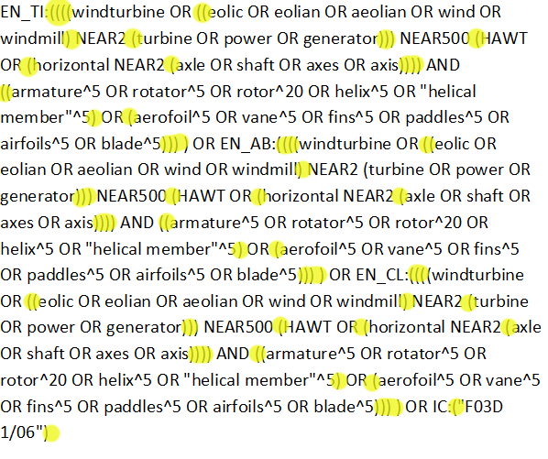
The complex query

Slide 21
5. Grouping/nesting
Solar OR (wind AND turbine)
(solar OR wind) AND turbine
EN_TI: electric car
electric will be searched in English title but car in all fields
EN_TI: (electric car)
Both electric and car will be searched in the English title

Slide 22

5. Grouping/nesting
Not all combinations work:
(electric AND car) NEAR power X
power NEAR (electric AND car) X
power NEAR (vehicle OR car)
EN_AB: hearing NEAR aid X
EN_AB: (hearing NEAR aid)
Notes:
Composition rules of operators
Avoid ambiguity

Slide 23
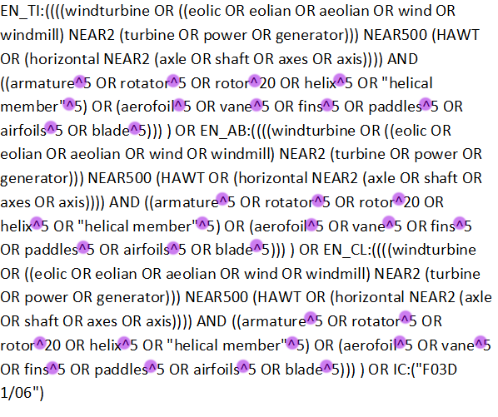
The complex query

Slide 24
6. Caret ^
Boosting to control relevance of a term
Boost factor (number): the higher the more relevant the keyword

Slide 25
6. Wildcards
  te?t = text or test
  elec*ty
  elect*
Notes:
? = singhle character search
Multi character search
Can t be used as first character
Wider than stemming, encourage to use stemmer, very reliable

Slide 26
6. Fuzzy searches
Use of the tilde: ~
Examples:
roam~ foam / roams
Roam~0.8
Notes:
Smilar in spelling

Slide 27
7. Date searches
Simple: based on year, month or day
  DP: 01.02.2000
  DP: 2003
Range: value are between the lower and upper bound
  DP:[01.01.2000 TO 31.12.2000]
  DP: [2000 TO 2010]

Slide 28


Slide 29
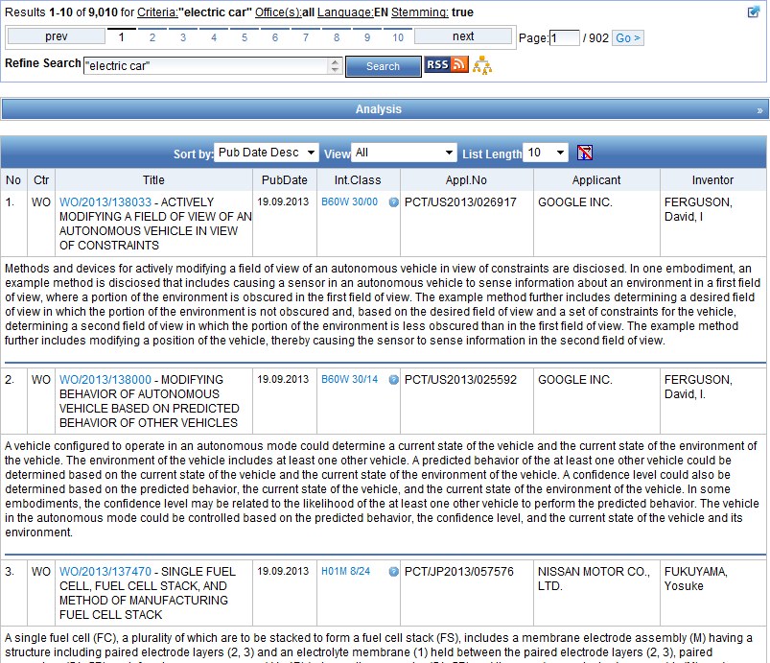
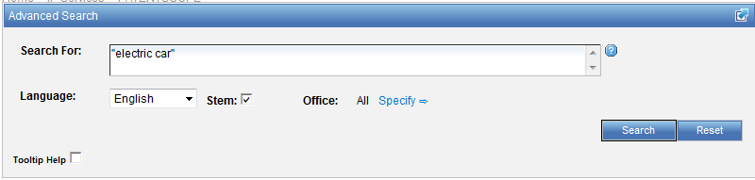

Slide 30
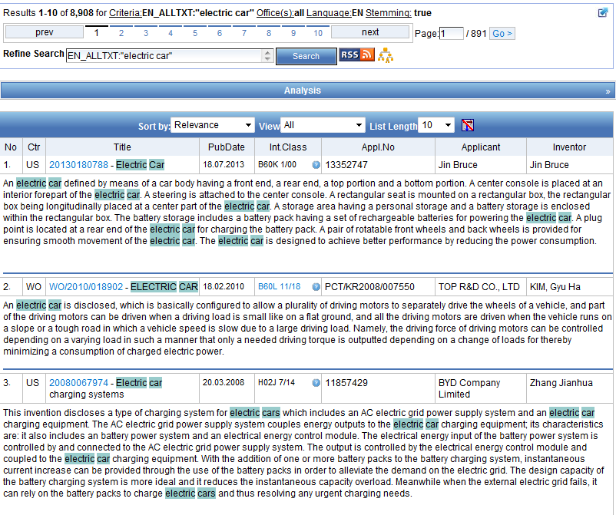
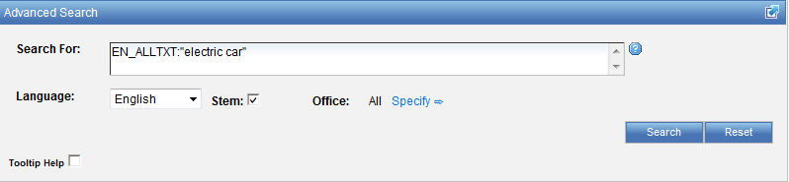

Slide 31
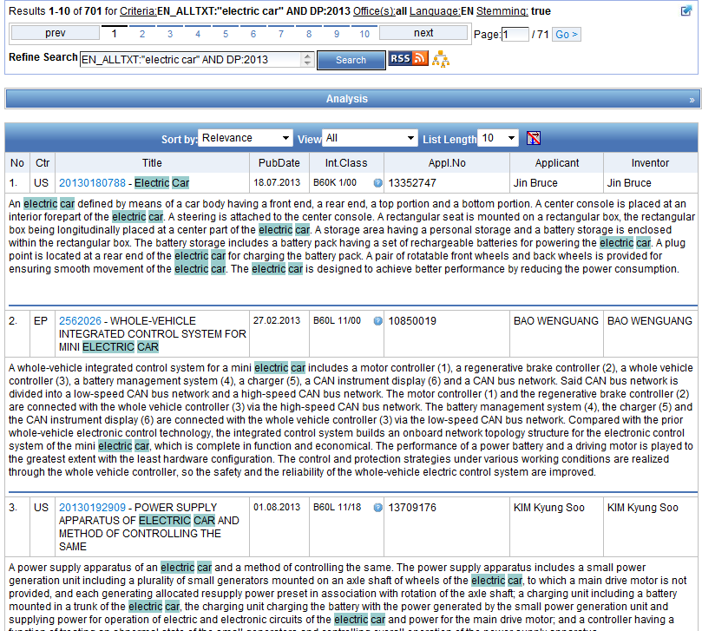
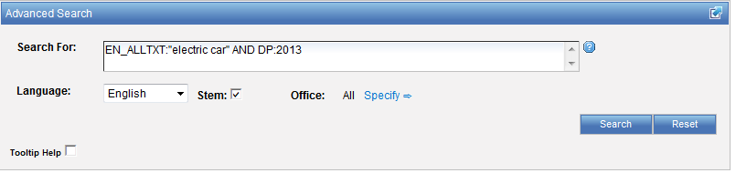

Slide 32
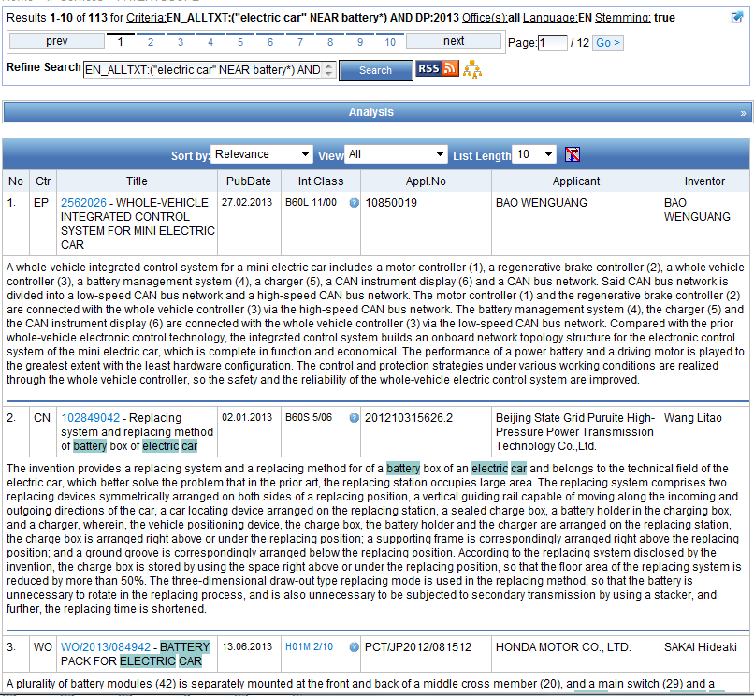
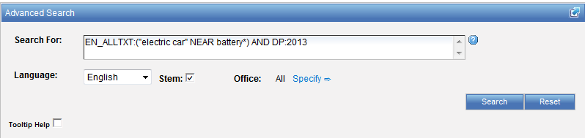

Slide 33
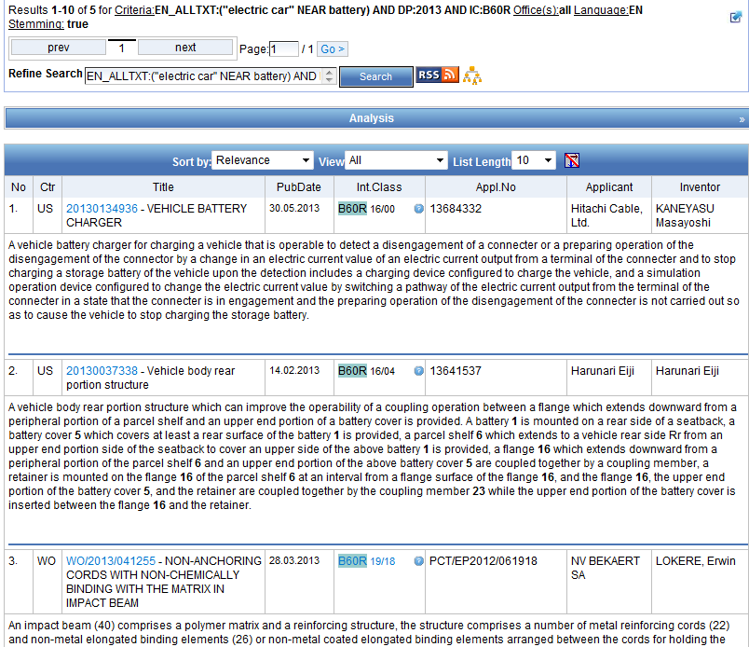
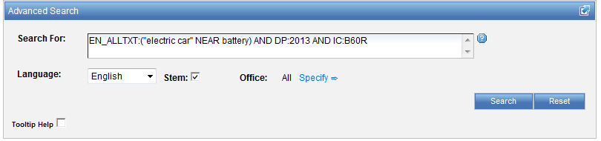

Slide 34
CLIR
CLIR stands for Cross Lingual Information Retrieval and will allow you to search a term or a phrase and its variants in:
Chinese
Dutch
English
French
German
Italian
Japanese
Korean
Portuguese
Russian
Spanish and
Swedish
Notes:
34
You will use this tool in order to:
-Find synonyms in order to retrieve comprehensive results
-To search in a language that one does know

Slide 35
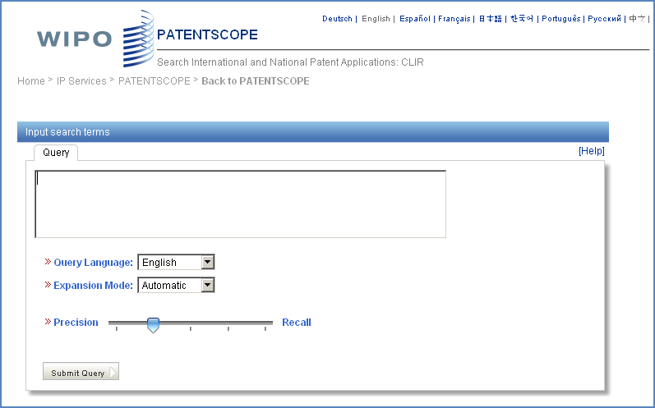
CLIR: the interface
Notes:
35
There is query box
Query language
Expansion mode

Slide 36
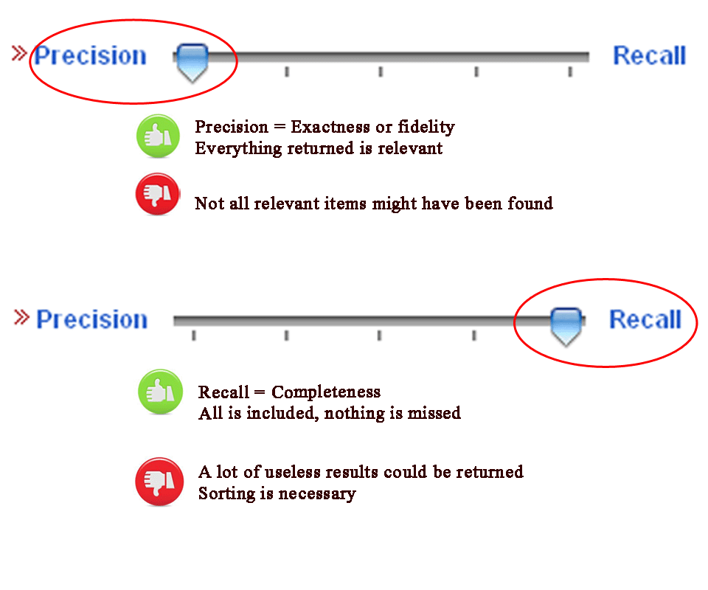
CLIR: precision vs recall

Slide 37
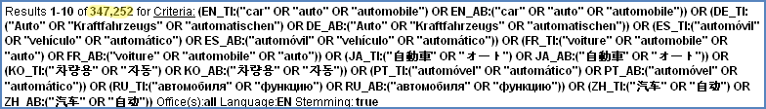
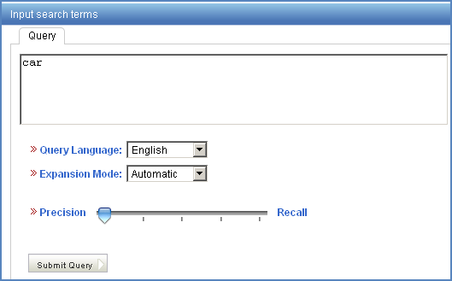
Example: precision

Slide 38
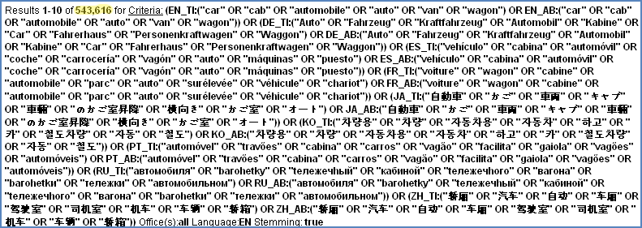
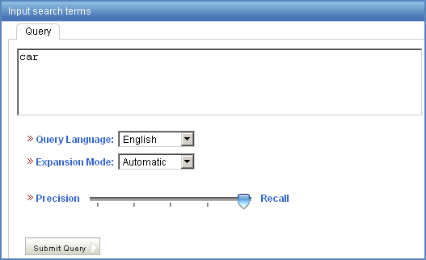
Example: recall

Slide 39
CLIR: supervised mode
2 modes: automatic and supervised
Automatic: 1 step
Supervised: 4 steps

Slide 40
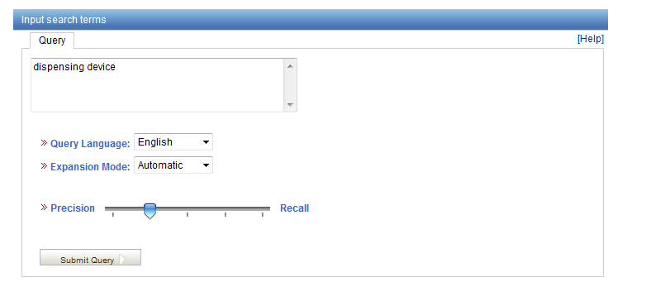
Automatic mode

Slide 41
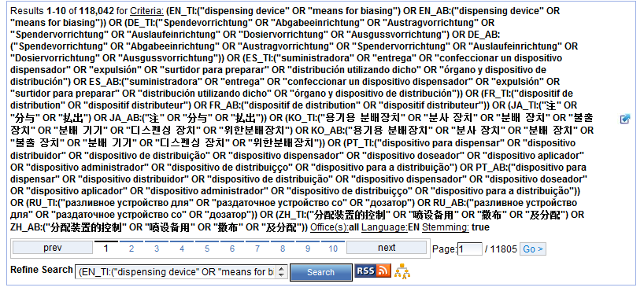
Automatic mode: results

Slide 42
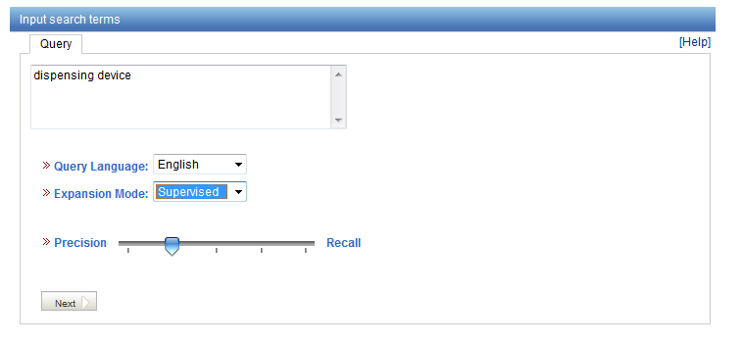
Supervised mode

Slide 43
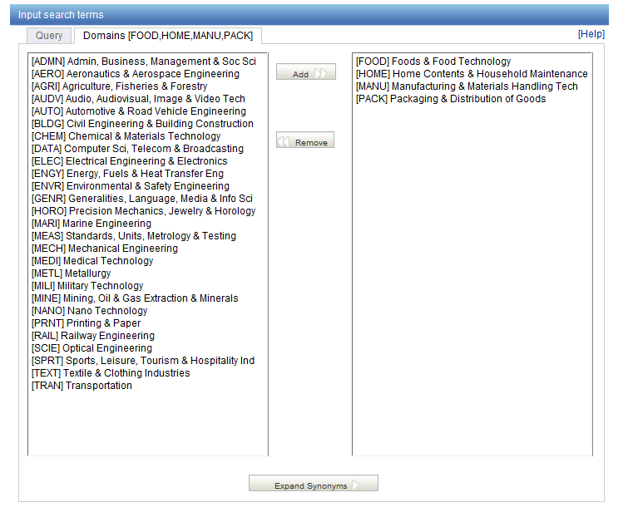
Domain selection

Slide 44
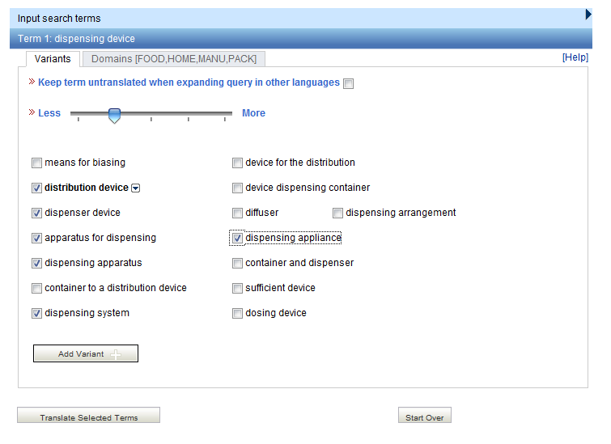
Variant selection

Slide 45
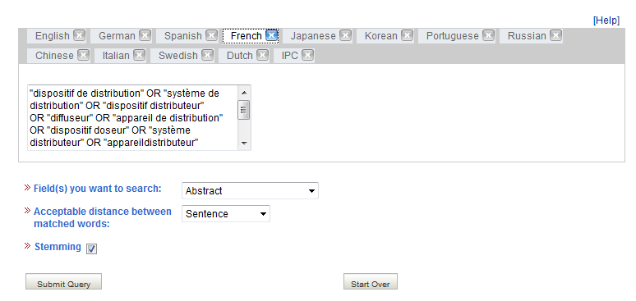
Translations

Slide 46
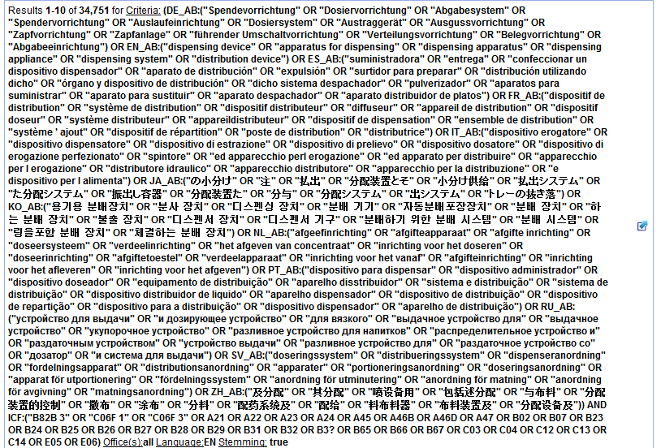
New query

Slide 47
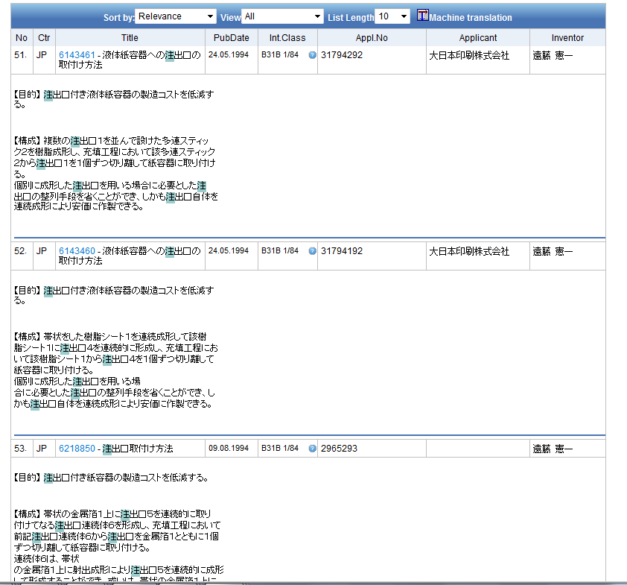

Slide 48
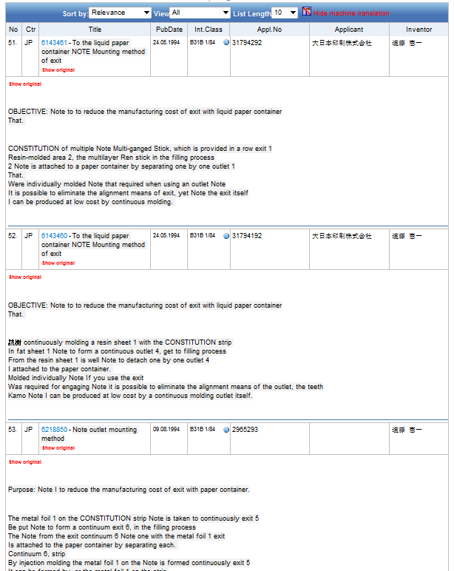

Slide 49
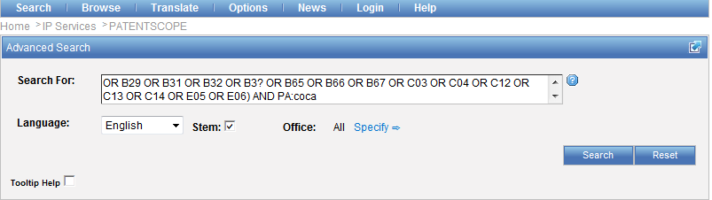
Editing in the Advanced search

Slide 50
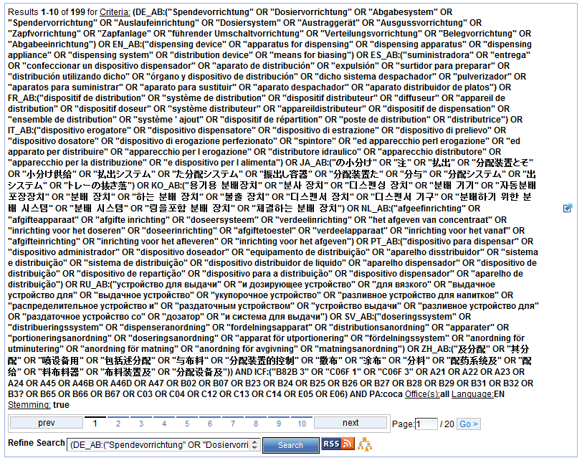

Slide 51
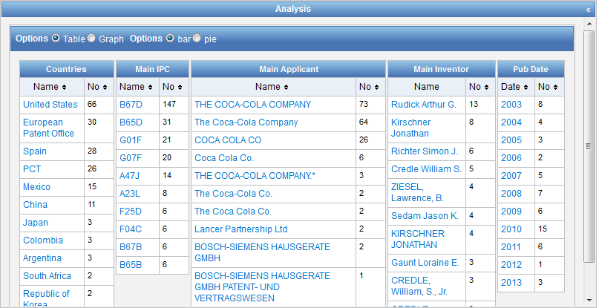

Slide 52


Slide 53
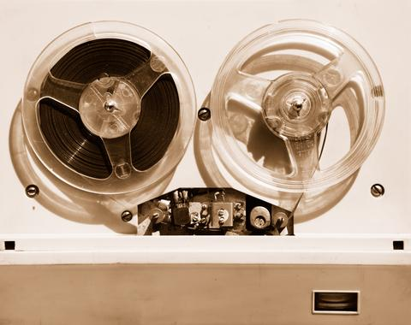

Slides and recording
+
www.wipo.int/patentscope/en/webinar/index.html

Slide 54
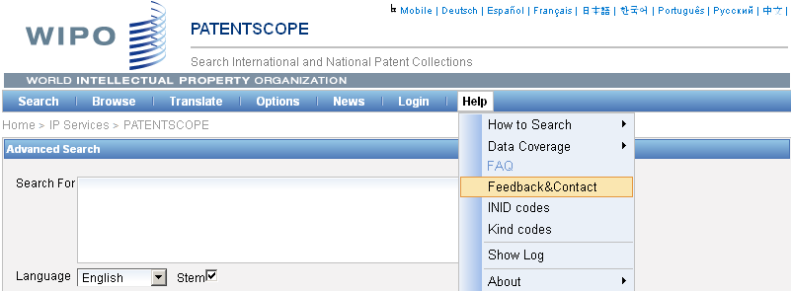

patentscope@wipo.int

Slide 55


mulțumesc
mulțumesc

