Slide 1
Retrospective 2017 & Future Plans
Internet
December
2017
Sandrine Ammann
Marketing & Communications Officer

Slide 2



To the PATENTSCOPE search system webinar
Complex queries

Slide 3
Agenda
2017
Future plans
Suggestions, requests
Q&A

Slide 4

Photo by Jake weirick on Unsplash

Slide 5
Dossier Content
Non-confidential documents:
  search reports;
  office actions;
  correspondence

Slide 6
Dossier content
AU
CA
EU
JP
US

Slide 7
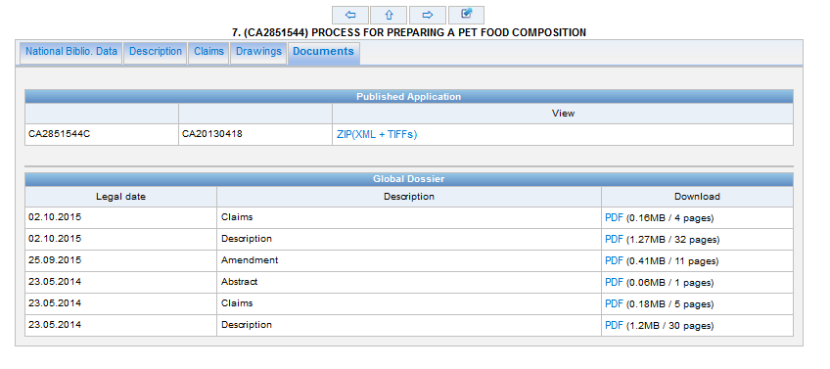
Dossier content

Slide 8

User Satisfaction Survey
Photo by Anas Alshanti on Unsplash

Slide 9
10 new collections
Denmark
Australia
France
Saudi Arabia
ASEAN:
  Brunei Darussalam
  Cambodia
  Philippines
  Indonesia
  Malaysia
  Thailand
  Viet Nam updated

Slide 10

Neural Machine Translation

Slide 11
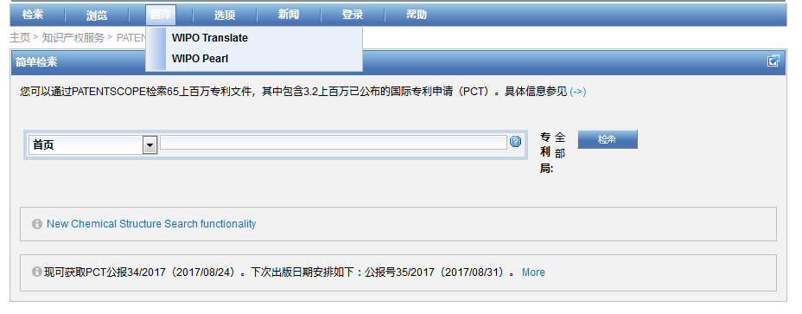
WIPO Translate

Slide 12


18 Language pairs
Arabic – English English-Arabic
Chinese – English English - Chinese
French – English English - French
German – English English - German
Japanese – English English - Japanese
Korean – English English - Korean
Portuguese – English English - Portuguese
Russian – English English - Russian
Spanish – English English - Spanish

Slide 13
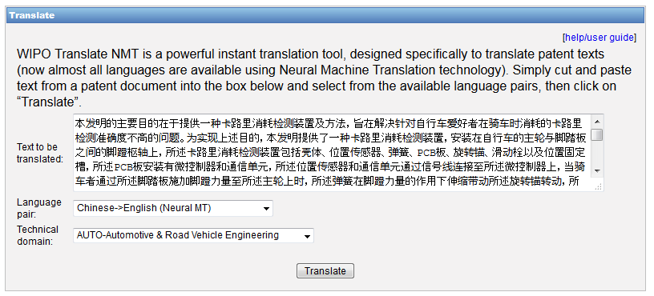
WIPO Translate: an example

Slide 14
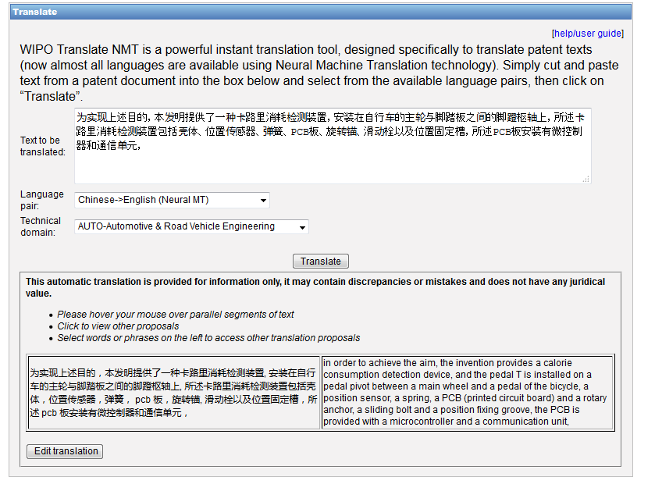

Slide 15
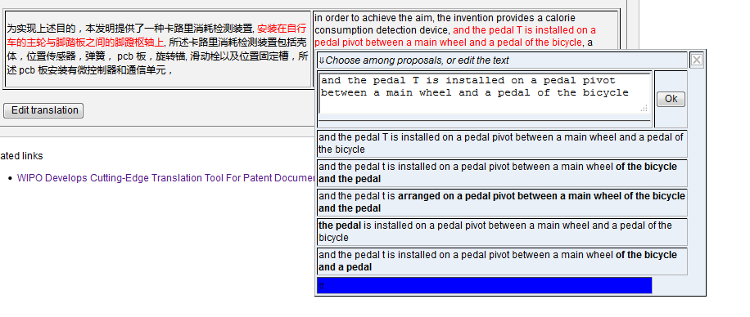

Slide 16
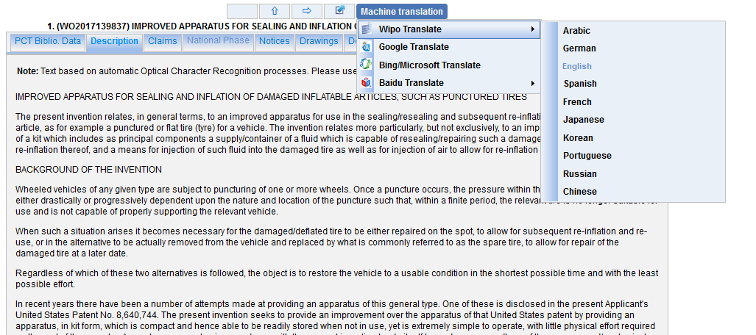
WIPO Translate: description/claims

Slide 17
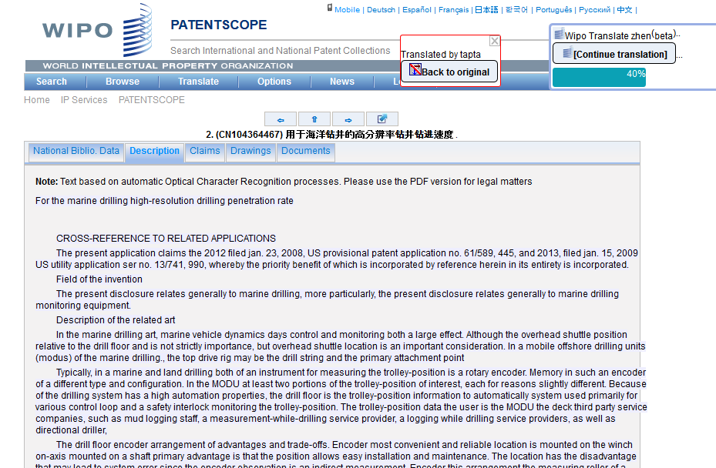

Slide 18

Description/claims: 18 language pairs
Arabic – English English-Arabic
Chinese – English English - Chinese
French – English English - French
German – English English - German
Japanese – English English - Japanese
Korean – English English - Korean
Portuguese – English English - Portuguese
Russian – English English - Russian
Spanish – English English - Spanish

Slide 19
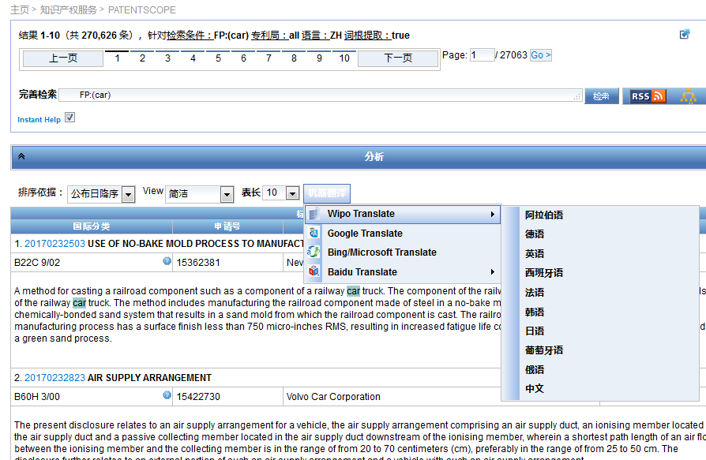
Result list

Slide 20
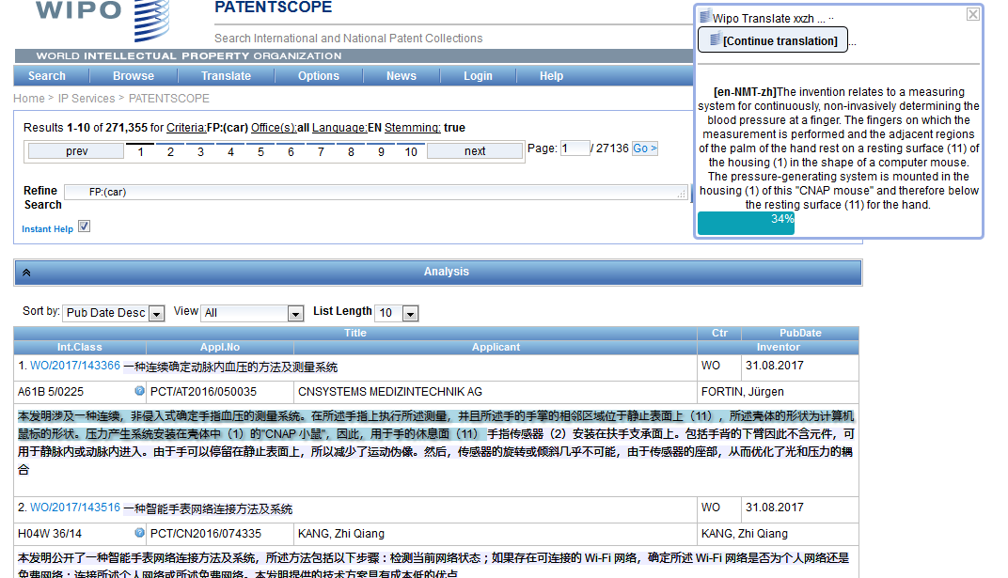

Slide 21

Photo by Samuel Zeller on Unsplash

Slide 22
WIPO Translate
  On PATENTSCOPE:
    Improve NMT models in Japanese, Korean, French, German, Portuguese, Russian…
    Domain adaptation
  Evaluate properly the impact (incl. quality estimation on SMT and NMT)
  Strengthen our team
  Keep monitoring technology

Slide 23
New Collections
Georgia
Romania
India
Netherland

Slide 24
Chemsearch
New collections
New languages

Slide 25
New design
Responsive
Better visualization

Slide 26
What would you like?

Slide 27
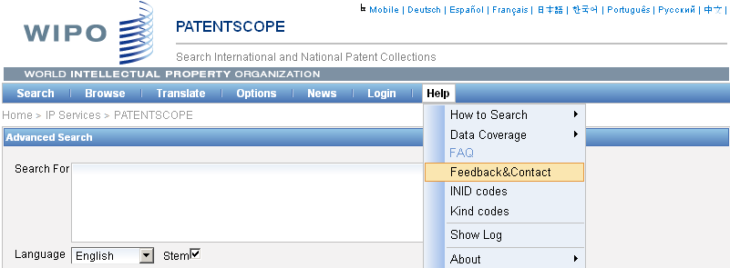

patentscope@wipo.int

Slide 28
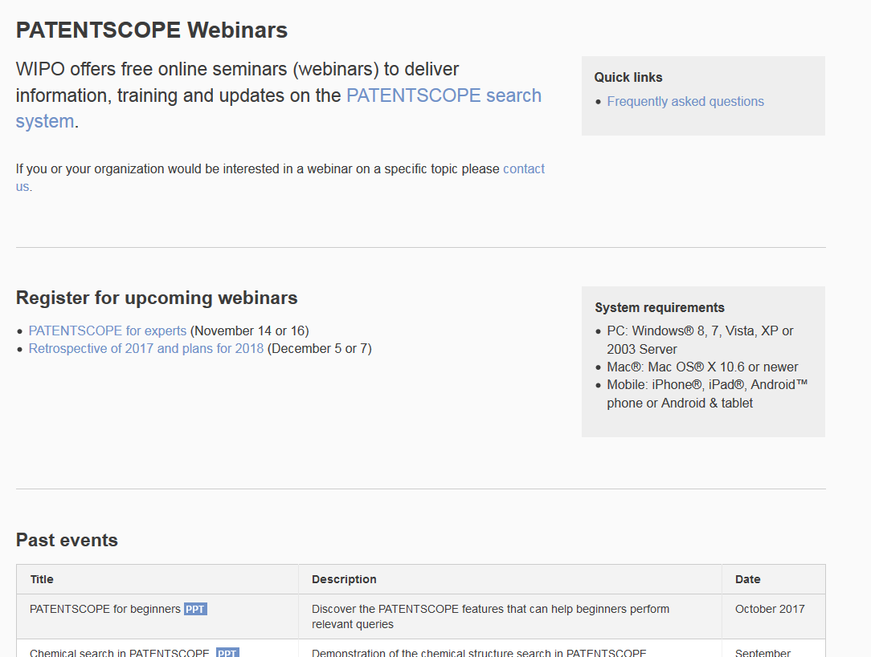
Future/past webinars:
wipo.int/patentscope/en/webinar

Slide 29


Slide 30

patentscope@wipo.int

