Slide 1
Retrospective 2018 & Future Plans
Internet
December
2018
Sandrine Ammann
Marketing & Communications Officer

Slide 2
Agenda
2018
Future plans
Suggestions, requests
Q&A

Slide 3

Photo by Jake weirick on Unsplash

Slide 4
6 National collections added in 2018
India
Georgia
Italy
Bulgaria
Laos
Romania

Slide 5
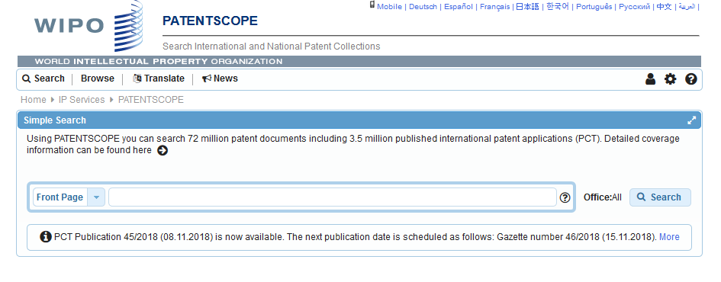
Interface: new look and feel

Slide 6
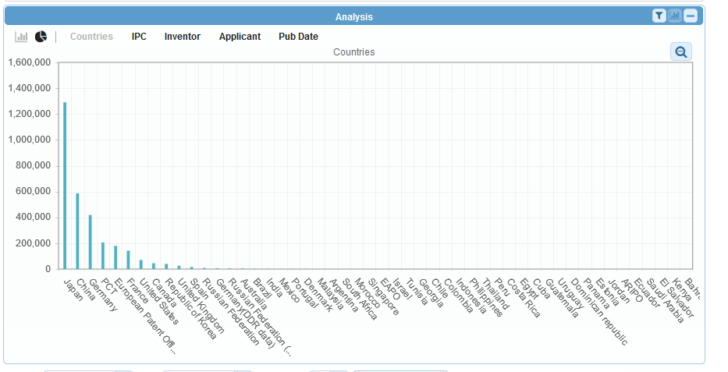
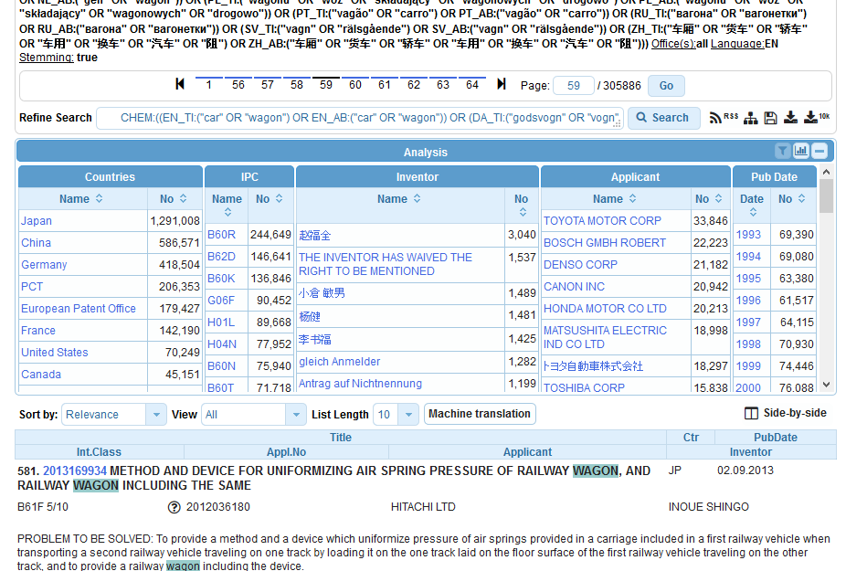
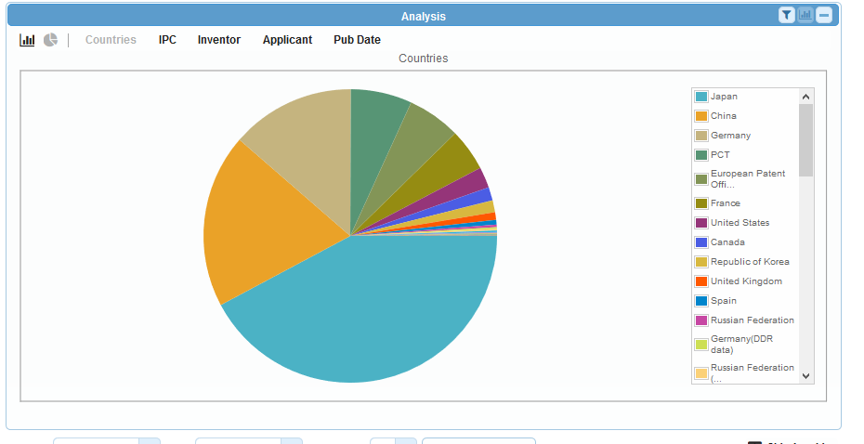

Slide 7
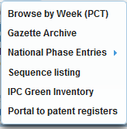
New items in the Browse menu

Slide 8
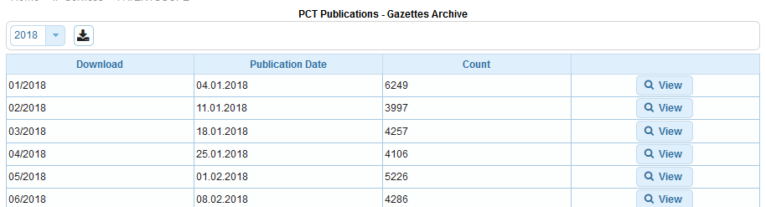
Gazette Archive

Slide 10
National Phase Entries

Slide 12

Patent Register Portal video

Slide 13
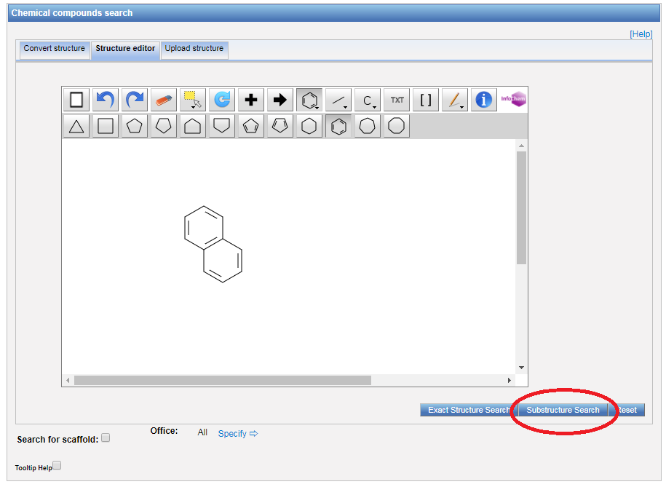
Substructure search

Slide 14
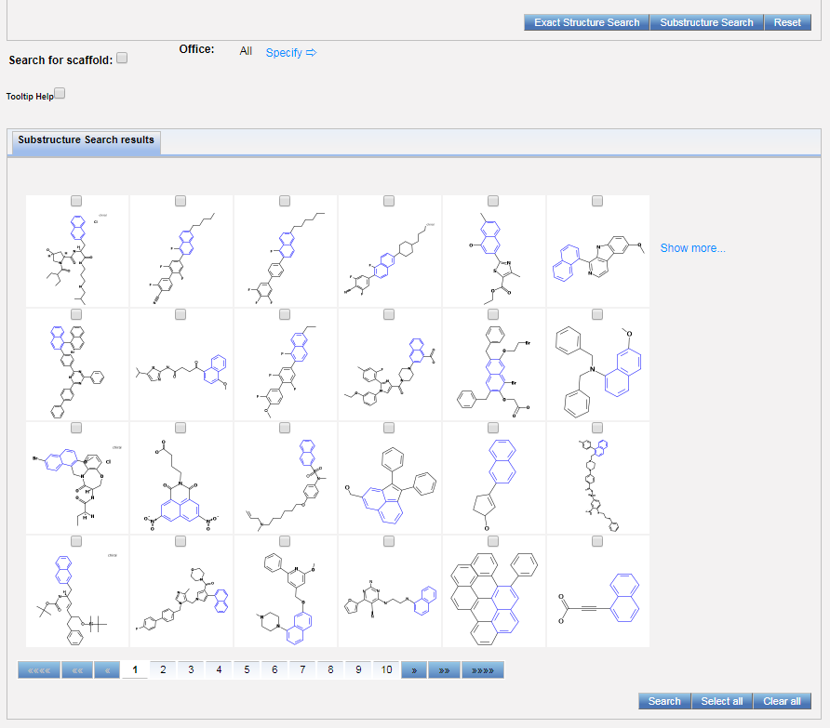
Substructure search result

Slide 15
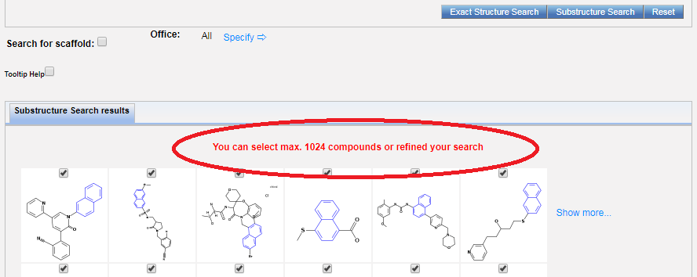
Max selections

Slide 16
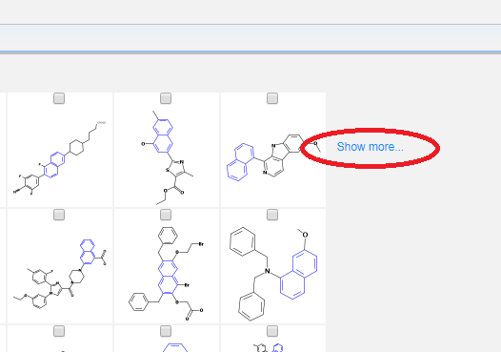
Show more

Slide 17


Photo by Jon Tyson on Unsplash

Slide 18
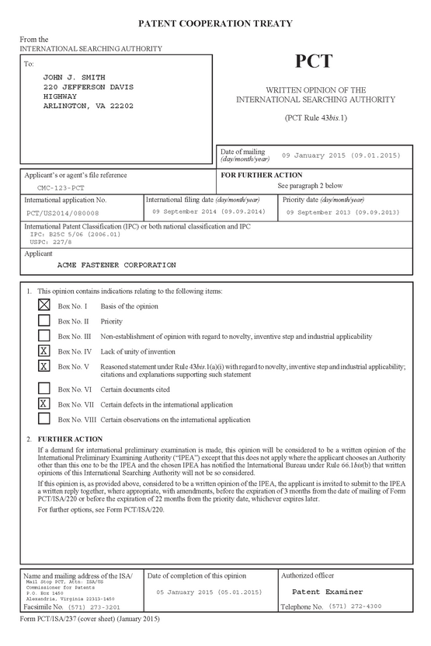
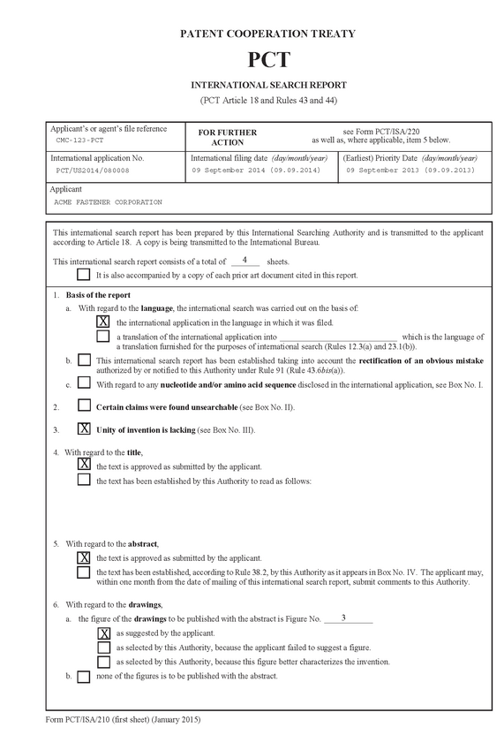
ISR, WOSA and art.17.2 in XML

Slide 19
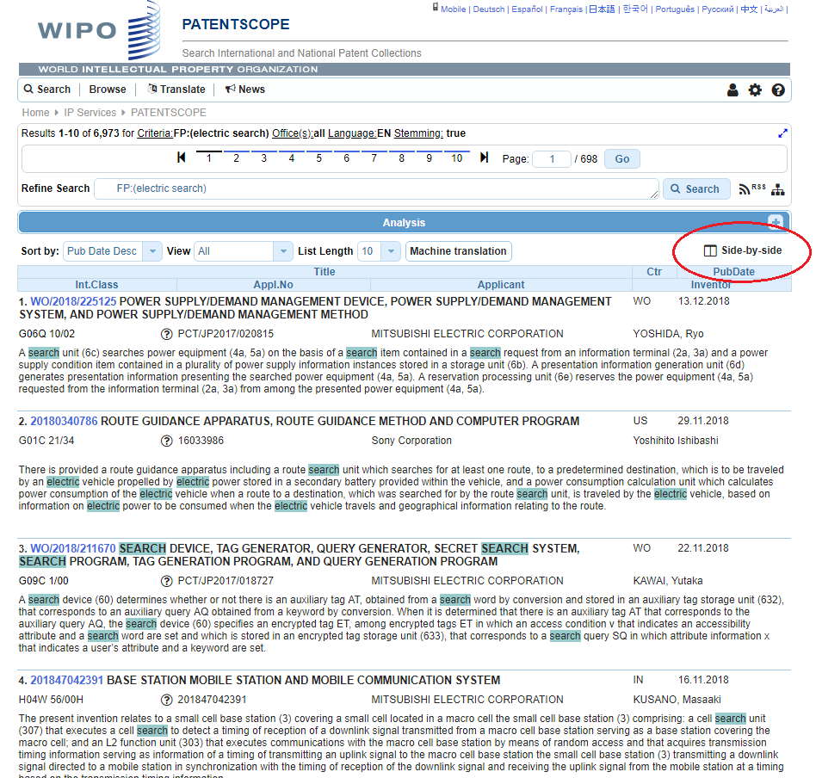
Wide-view

Slide 20
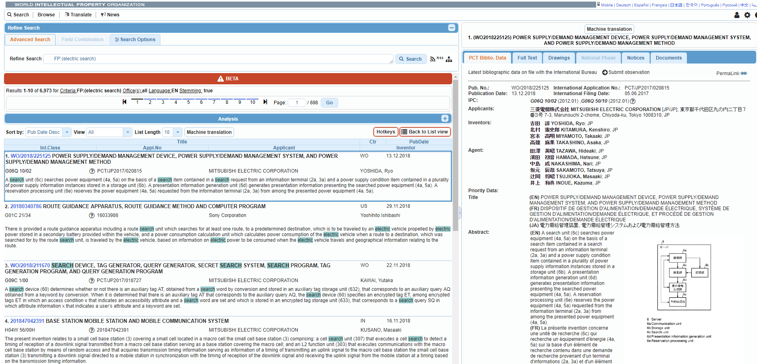

Slide 21
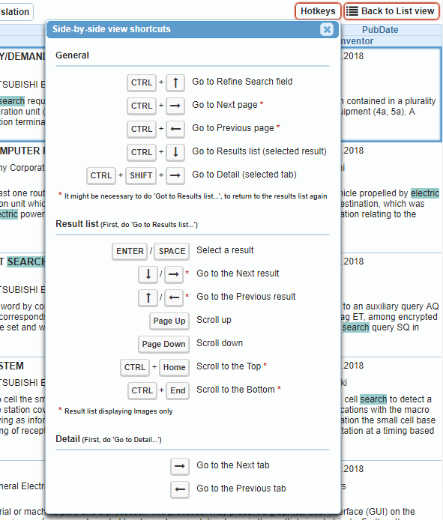

Slide 22
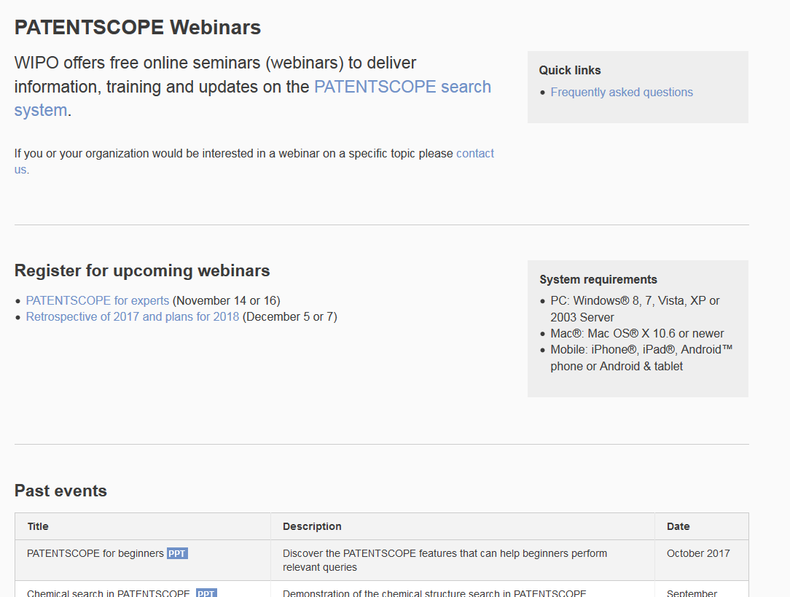
Future/past webinars:
wipo.int/patentscope/en/webinar

Slide 23

Photo by Aaron Burden on Unsplash

Slide 24
Contact us
patentscope@wipo.int

Slide 25

patentscope@wipo.int

