Slide 1
PATENTSCOPE
Result list and analysis tools
Web
April
2017
Sandrine Ammann
Marketing & Communications Officer

Slide 2



To the PATENTSCOPE search system webinar
Complex queries

Slide 3
Agenda
What’s news
Search result list
Translation tools
IPC statistics
Quiz
Q&A

Slide 4
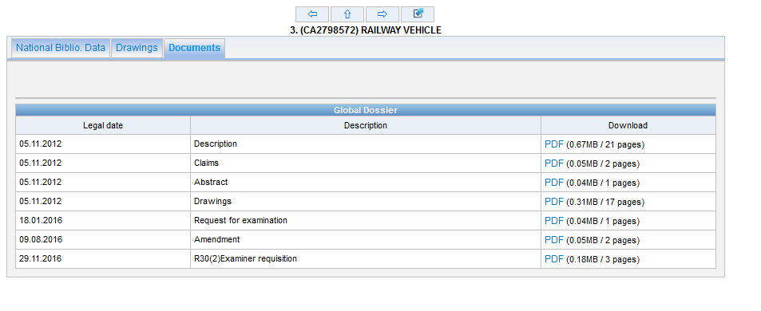
What’s new?
Dossier content available

Slide 5
New data coverage
Australia
Denmark
France
Saudi Arabia

Slide 6
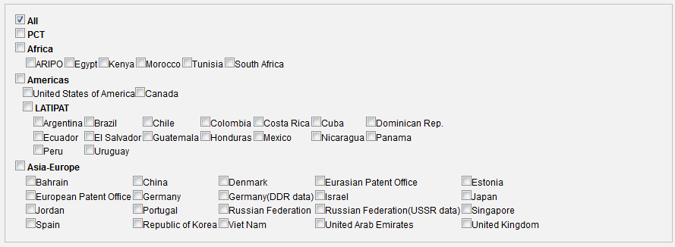
CTR:FR / AU/ SA

Slide 7
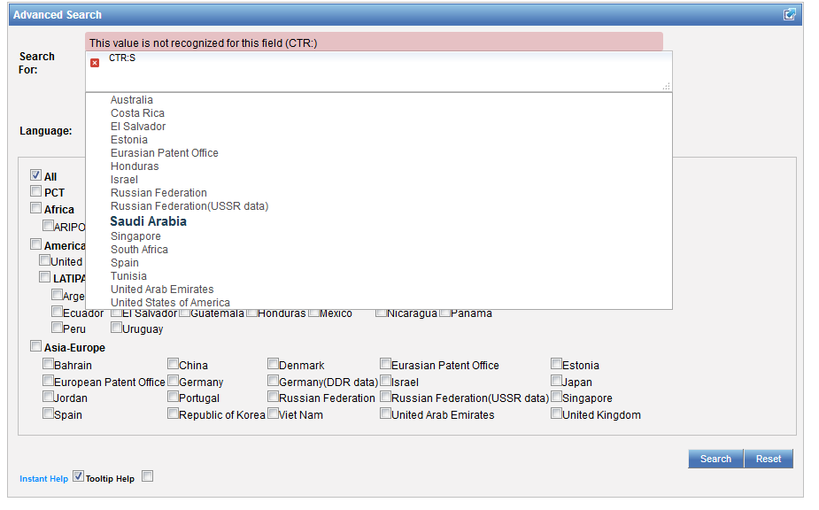
Example: Saudi Arabia

Slide 8
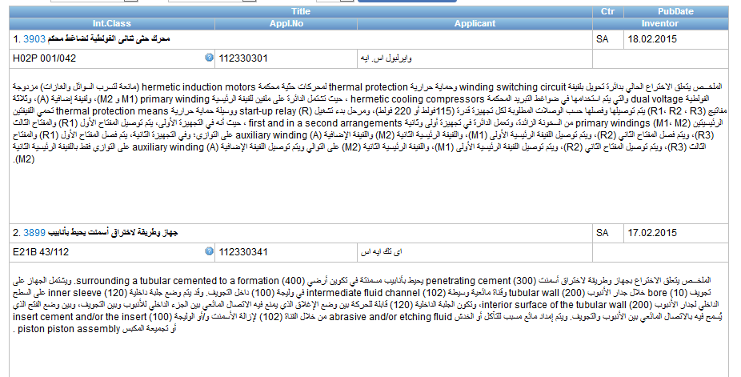

Slide 9
Kind codes search
  DTY: latest kind code
  DTY_M: first and the last kind code
PCT applications = A

Slide 10
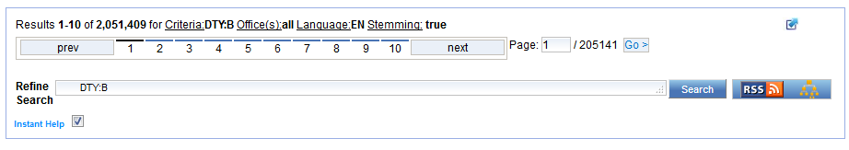
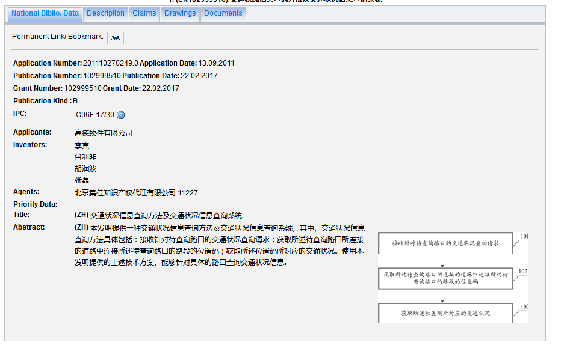

Slide 11
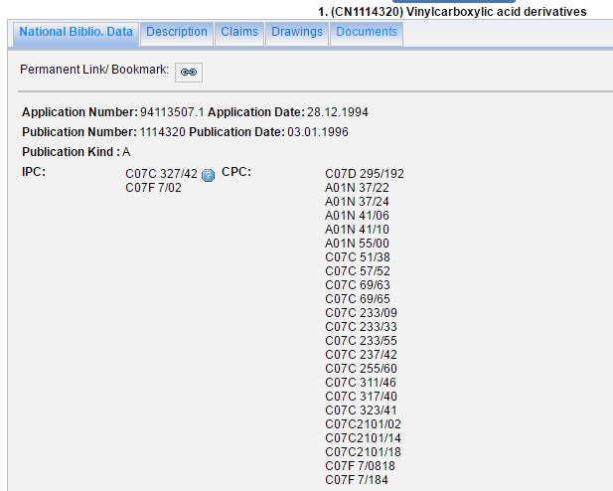
CPC soon available

Slide 12

Search result list

Slide 13
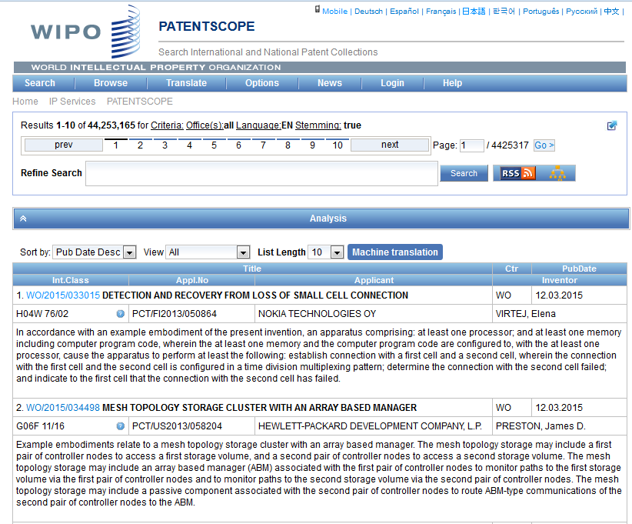

Slide 14
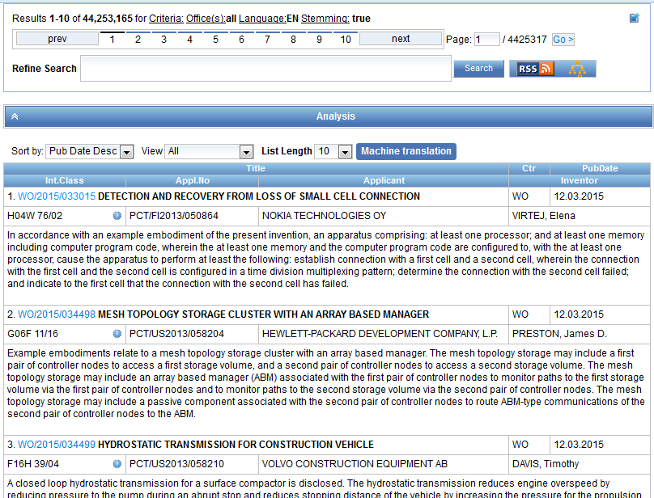

Slide 15
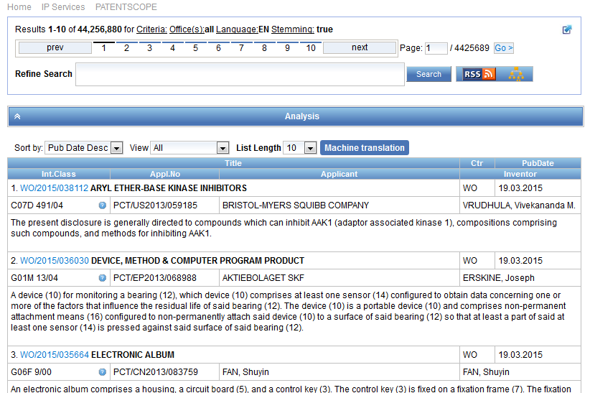
Result list

Slide 16
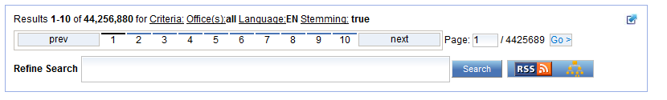
The first box

Slide 17
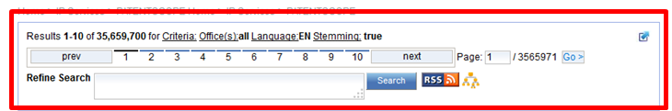
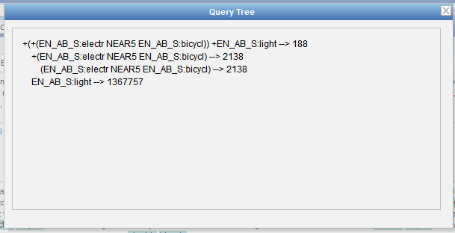

Slide 18
Stemming
Process that removes common ending from words by English Snowball algorithm
electric¦al = electric
electric¦ity = electric
electron¦ics = electron
More accurate results than wildcards:
elect* electoral, etc.

Slide 19
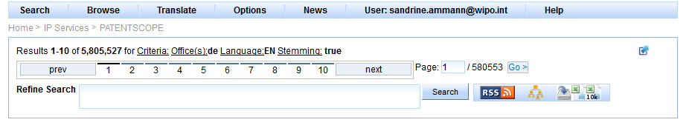
When logged-in

Slide 20
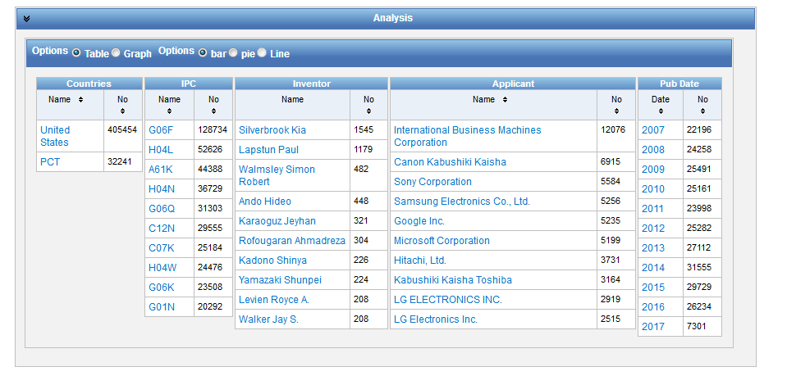
Analysis bar

Slide 21
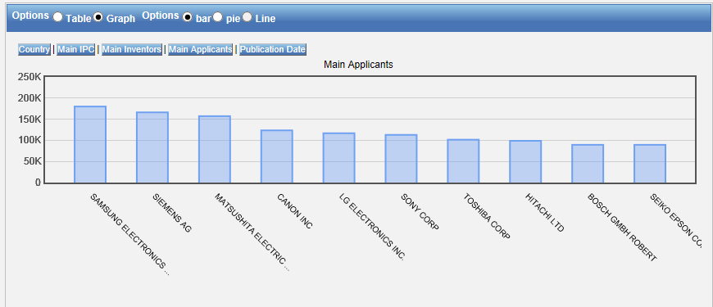
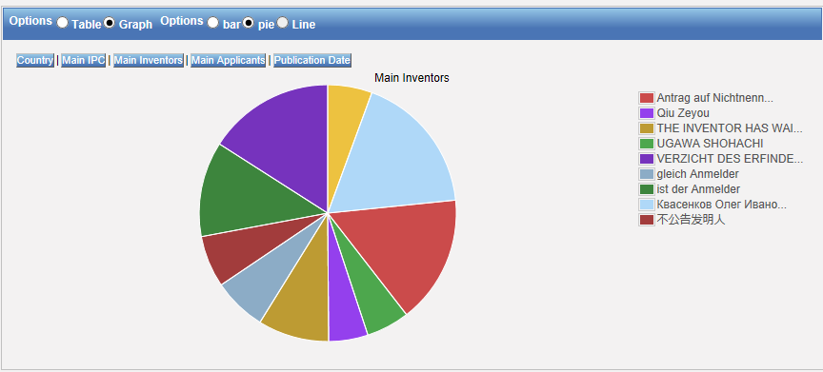
Table – Graph: pie or bar

Slide 22
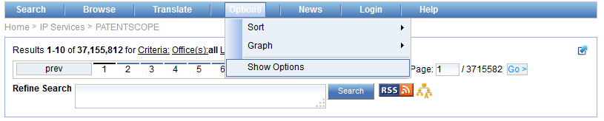
Table/graph customization

Slide 23
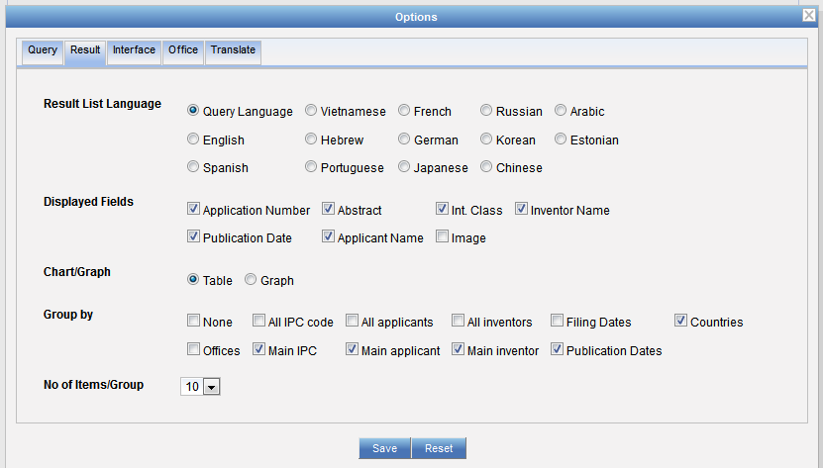
Table/graph customization

Slide 24
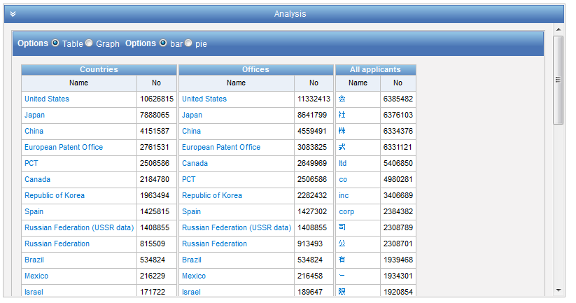

Slide 25
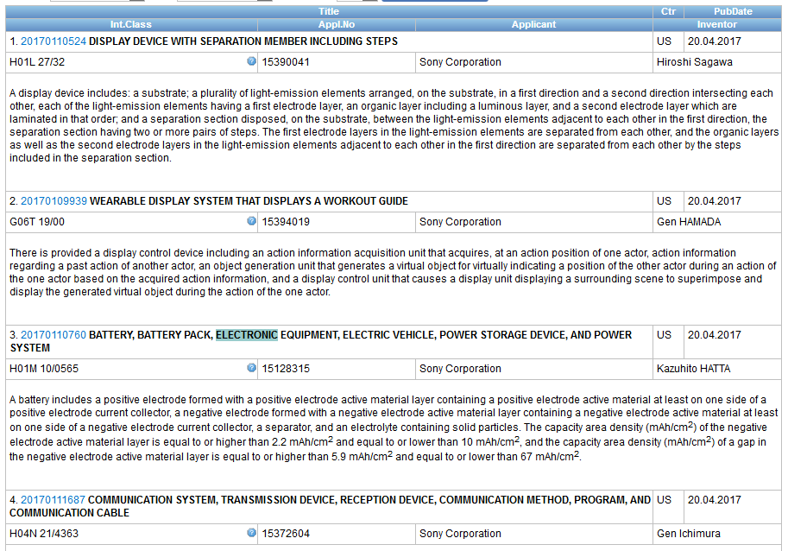
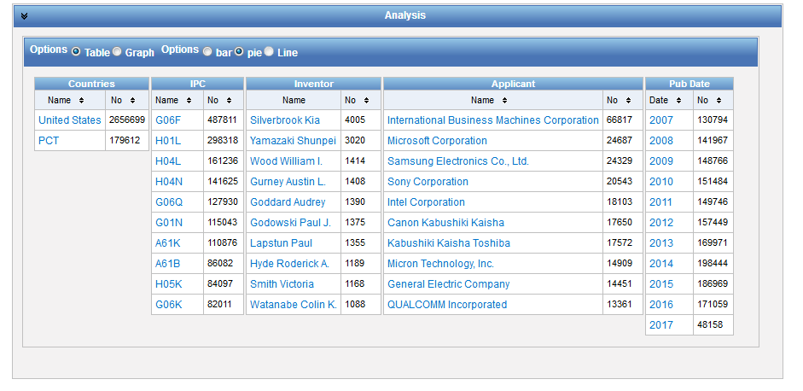

Slide 26
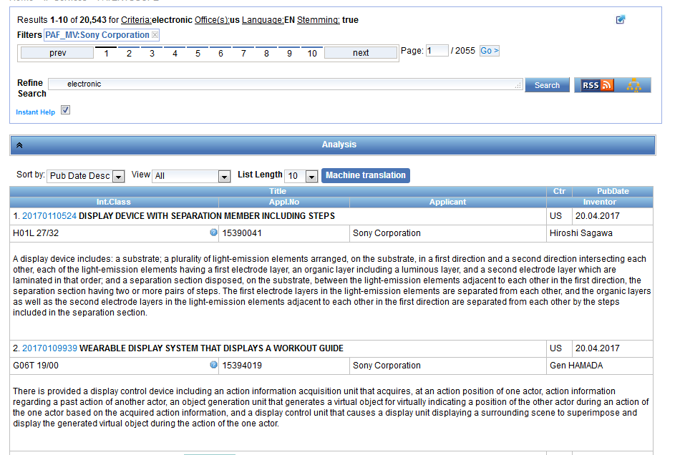

Slide 27
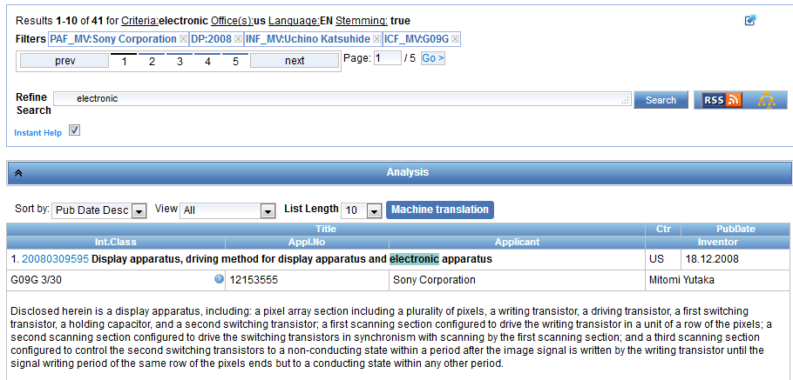

Slide 28
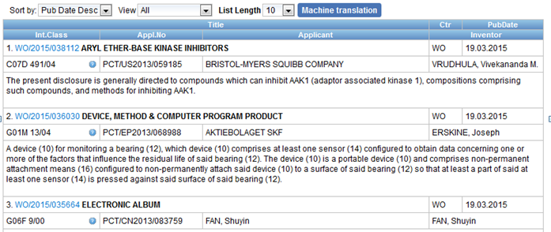

Slide 29
Customization

Slide 30
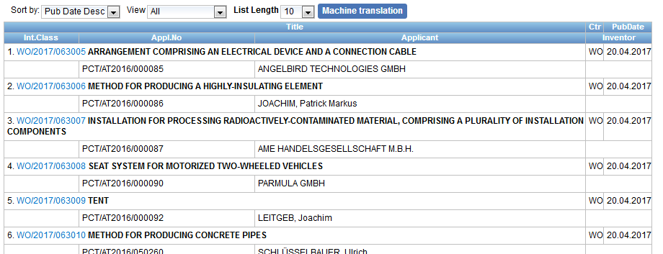

Slide 31
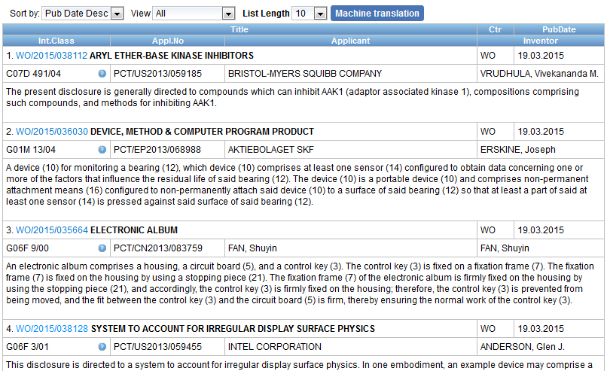
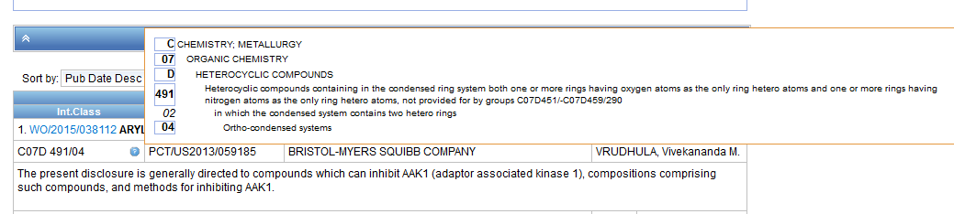

Slide 32
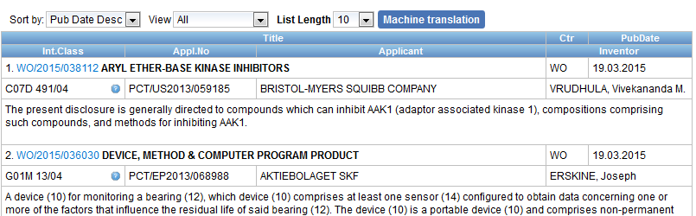
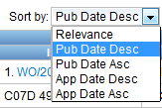
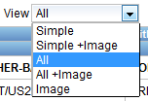
Display options

Slide 33
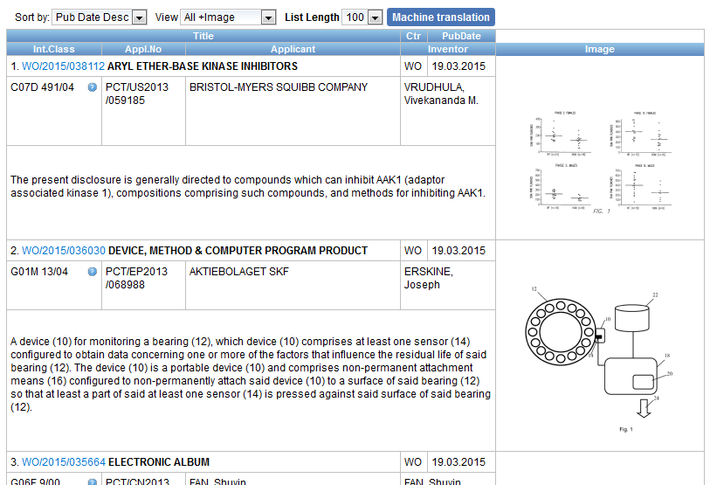
Display with images

Slide 34
Integrated MT

Slide 35
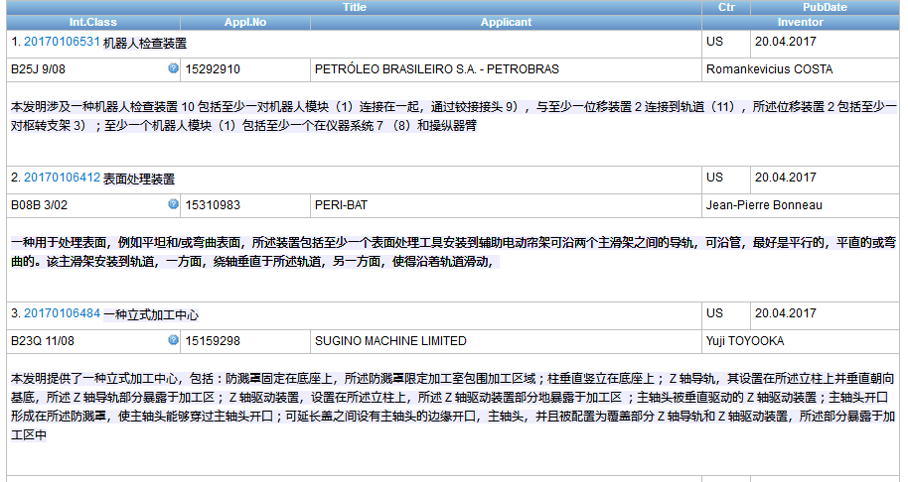
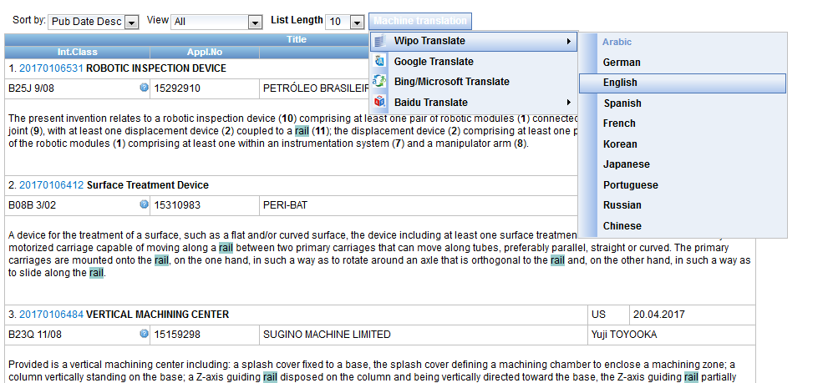
In the search result list

Slide 36
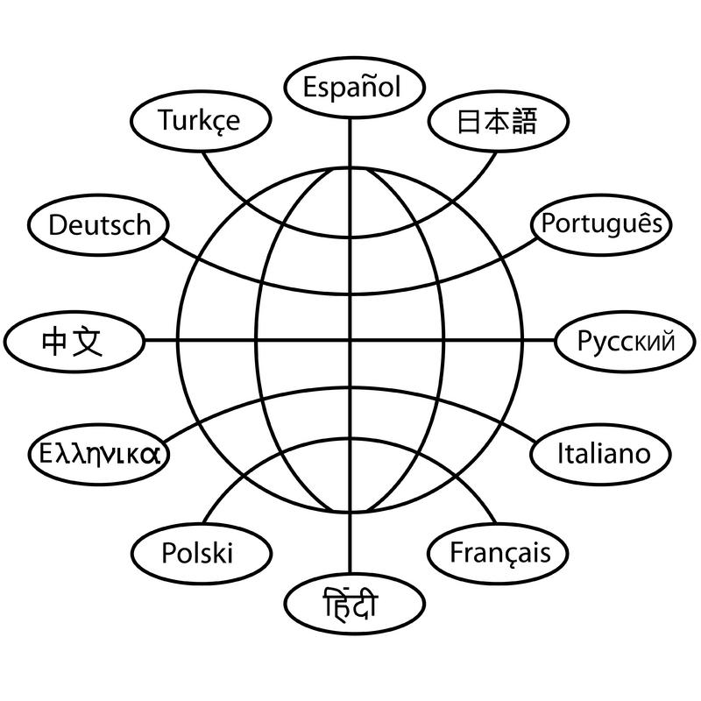
Translation tools

Slide 37
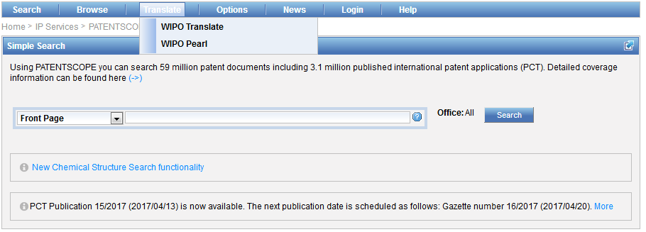
WIPO Translate

Slide 38


Slide 39
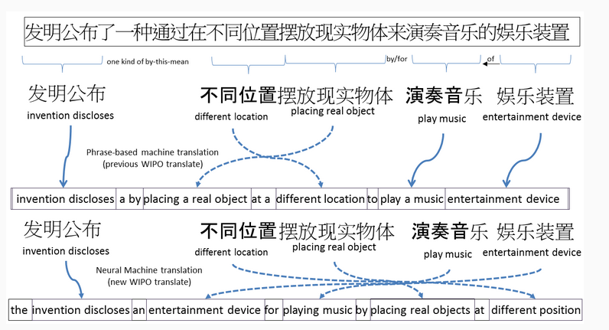

Slide 40
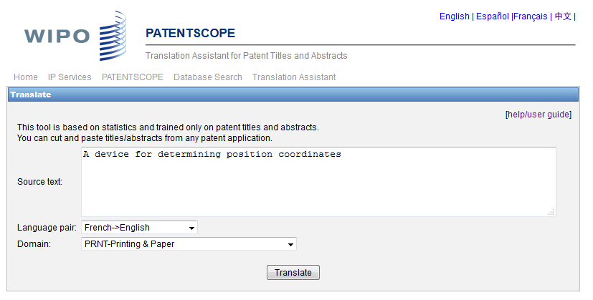
WIPO translate: interface

Slide 41

32 Technical domains from the IPC
[ADMN] Admin, Business, Management & Soc Sci
[AERO] Aeronautics & Aerospace Engineering
[AGRI] Agriculture, Fisheries & Forestry
[AUDV] Audio, Audiovisual, Image & Video Tech
[AUTO] Automotive & Road Vehicle Engineering
[BLDG] Civil Engineering & Building Construction
[CHEM] Chemical & Materials Technology
[DATA] Computer Sci, Telecom & Broadcasting
[ELEC] Electrical Engineering & Electronics
[ENGY] Energy, Fuels & Heat Transfer Eng
[ENVR] Environmental & Safety Engineering
[FOOD] Foods & Food Technology
[GENR] Generalities, Language, Media & Info Sci
[HOME] Home Contents & Household Maintenance
[HORO] Precision Mechanics, Jewelry & Horology
[MANU] Manufacturing & Materials Handling Tech
[MARI] Marine Engineering
[MEAS] Standards, Units, Metrology & Testing
[MECH] Mechanical Engineering
[MEDI] Medical Technology
[METL] Metallurgy
[MILI] Military Technology
[MINE] Mining, Oil & Gas Extraction & Minerals
[NANO] Nano Technology
[PACK] Packaging & Distribution of Goods
[PRNT] Printing & Paper
[RAIL] Railway Engineering
[SCIE] Optical Engineering
[SPRT] Sports, Leisure, Tourism & Hospitality
[TEXT] Textile & Clothing Industries
[TRAN] Transportation

Slide 42
Language pairs
Chinese-English; English –Chinese
French-English; English – French
German-English; English-German
Japanese-English; English-Japanese
Korean-English; Korean –English
Russian-English; English-Russian
Spanish-English; English Spanish

Slide 43
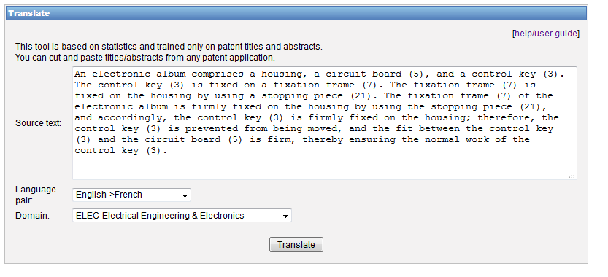
WIPO Translate: an example

Slide 44
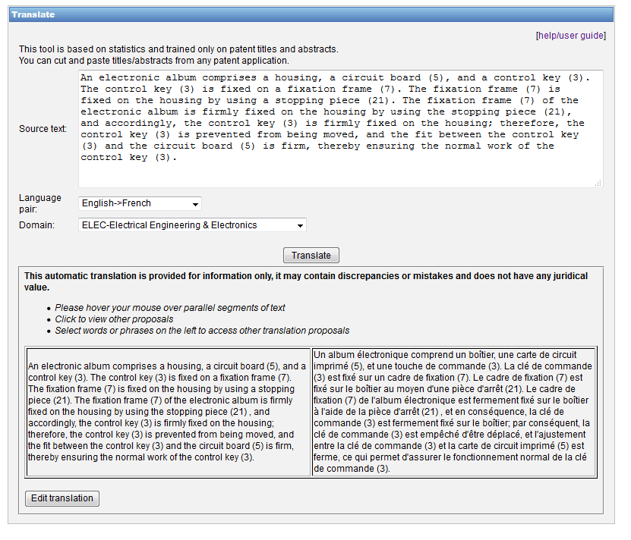

Slide 45
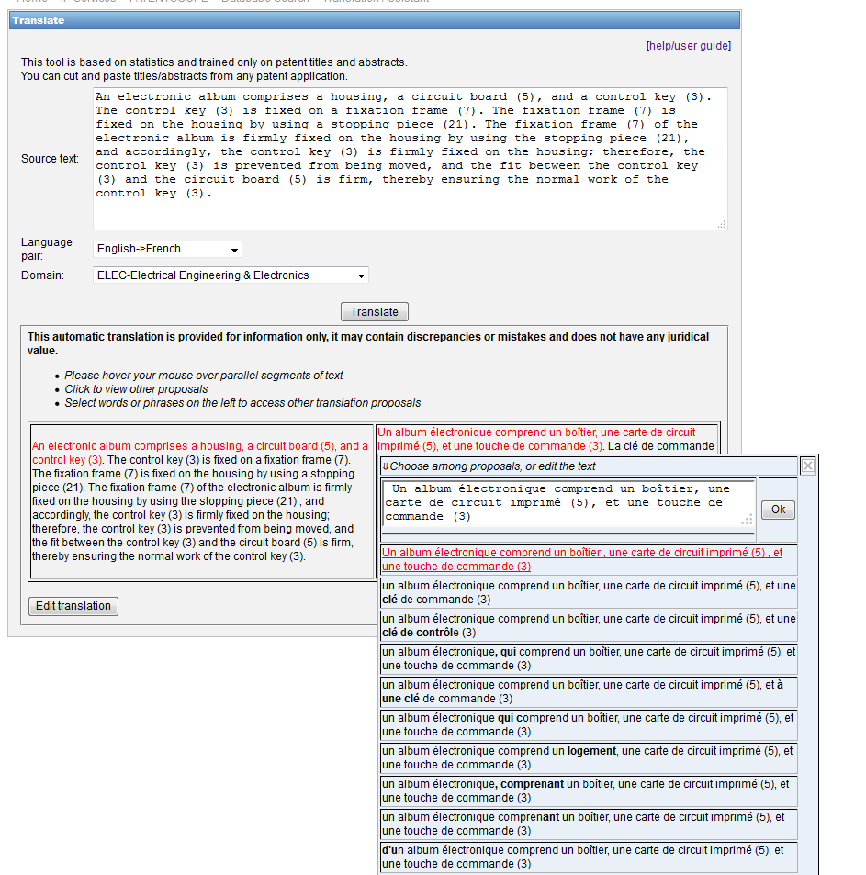

Slide 46
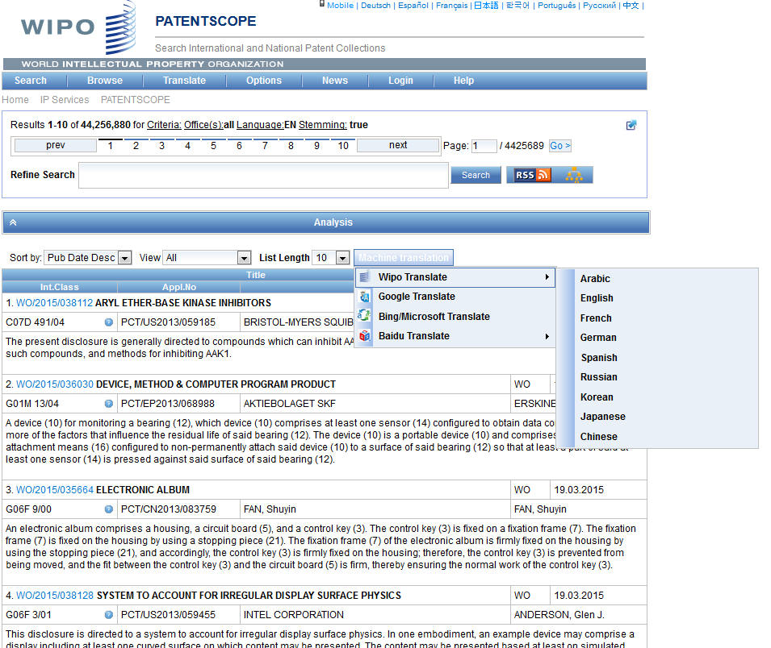
WIPO Translate: search result list

Slide 47
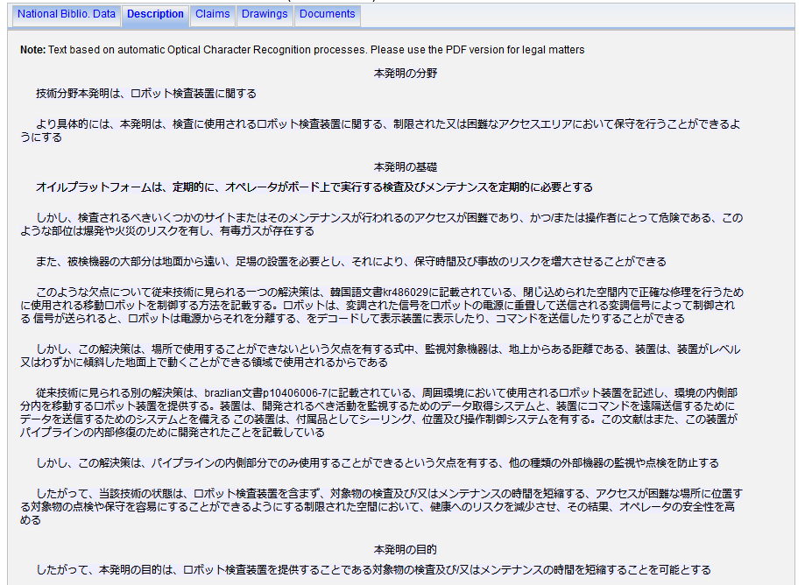
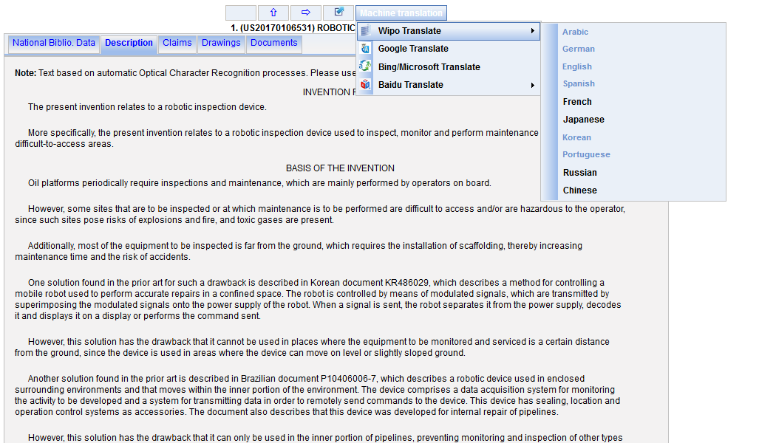
WIPO Translate: description/claims

Slide 48
WIPO Pearl

Slide 49

WIPO Pearl
WIPO’s online terminology database
17’000 concepts, 115’000 terms
10 languages
Contents validated by WIPO language experts and terminologists

Slide 50
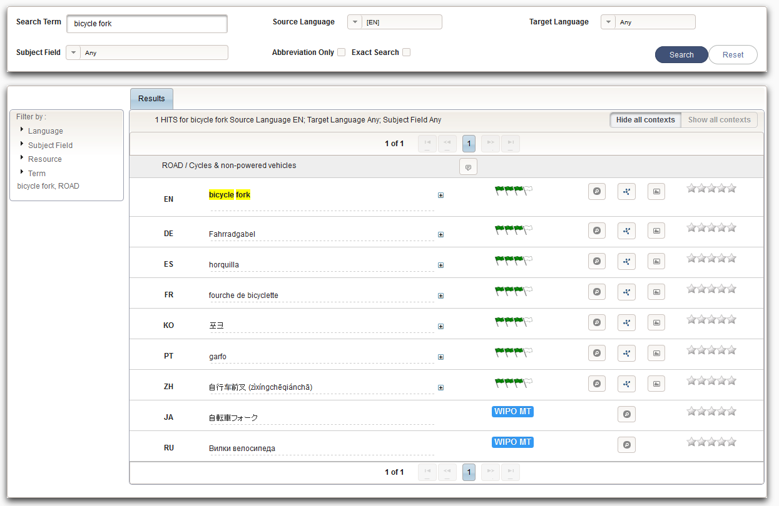
Example: bicycle fork

Slide 51
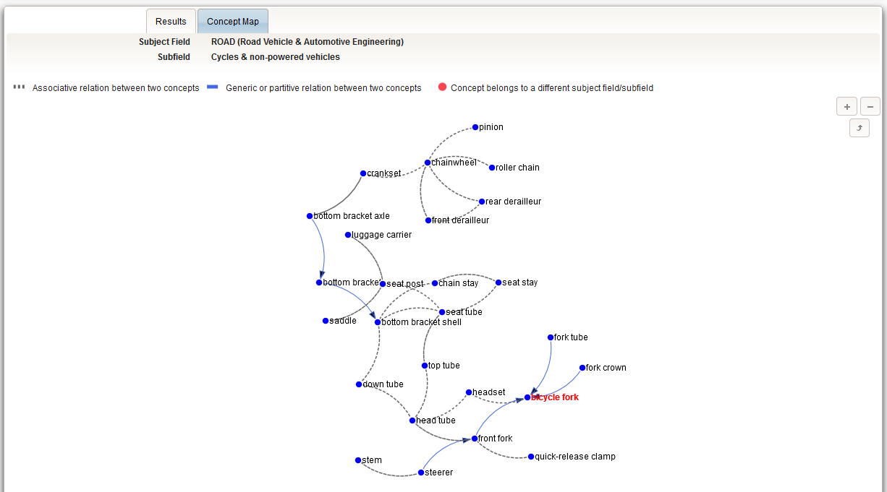

Slide 52
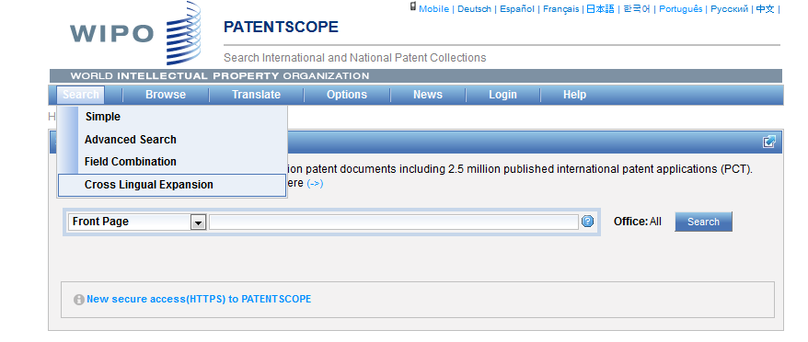
CLIR

Slide 53
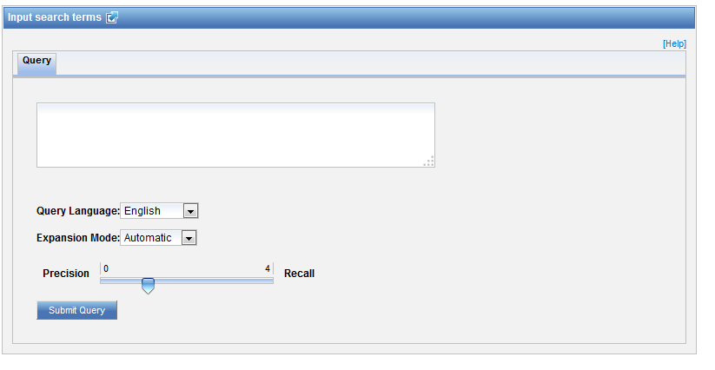
CLIR: interface

Slide 54
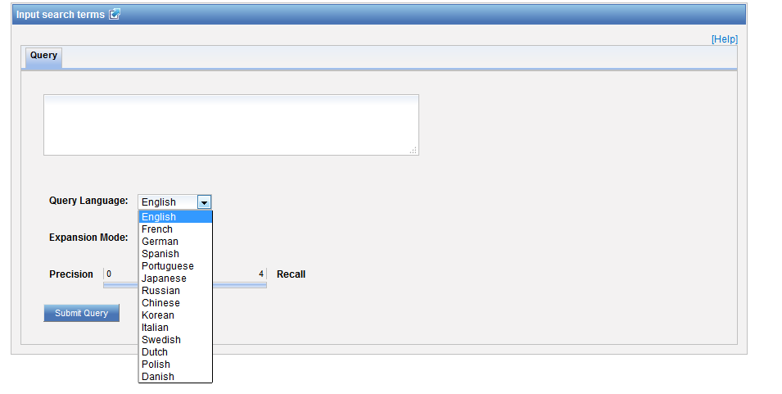
CLIR: query language

Slide 55
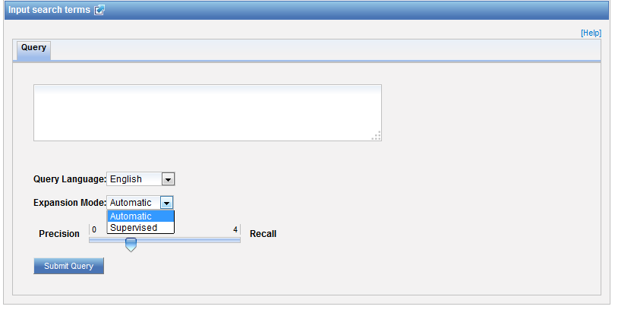
CLIR: expansion mode

Slide 56

CLIR: an example

Slide 57

CLIR: an example

Slide 58

CLIR: supervised

Slide 59

Domain selection

Slide 60

Variants selection

Slide 61

Summary of variants

Slide 62

Results

Slide 63

IPC statistics

Slide 64


Slide 65



Slide 66


Slide 67

Most active last 5 gazettes

Slide 68

Most advanced

Slide 69

Breakouts

Slide 70


Slide 71
Q1: How can you increase the number of items shown in the analysis bar?
A
By clicking on the different columns
B
It is not possible
C
Options menu

Slide 72

Q1: How can you increase the number of items shown in the analysis bar?
A
By clicking on the different columns
B
It is not possible
C
Options menu

Slide 73
Q2: How can you translate into Chinese a patent abstract in English?
A
CLIR
B
WIPO Translate

Slide 74
Q2: How can you translate into Chinese a patent abstract in English?
A
CLIR
B
WIPO Translate

Slide 75
Q3: Where are the IPC statistics available?
A
In the result list
B
In the Analysis bar
C
In the Browse menu
D
In the Help menu

Slide 76
Q3: Where are the IPC statistics available?
A
In the result list
B
In the Analysis bar
C
In the Browse menu
D
In the Help menu

Slide 77

www.wipo.int/patentscope/en/webinar/index.html

Slide 78


patentscope@wipo.int

Slide 79
May webinar:
CLIR in PATENTSCOPE
Tue, May 9
5:30 PM - 6:30 PM CEST
Thu, May 11
8:30 AM - 9:30 AM CEST
To sign up: http://www.wipo.int/patentscope/en/webinar/

Slide 80
Global Design Database: webinar
The Global Design Database: an introduction
  May 9 at 5:30pm CET
  https://attendee.gotowebinar.com/rt/1986878364931494145
  May 11 at 8:30 am CET
  https://attendee.gotowebinar.com/rt/1986878364931494145

Slide 81
Global Brand Database: webinar
The Global Brand Database: an introduction
  May 2 at 5:30pm CET
  https://attendee.gotowebinar.com/rt/1986878364931494145
  May 4 at 8:30 am CET
  https://attendee.gotowebinar.com/rt/1986878364931494145

Slide 82


Slide 83

patentscope@wipo.int

