Slide 1
How to make the most of the IPC in PATENTSCOPE
Cyberworld
October
2014
Sandrine Ammann
Marketing & Communications Officer

Slide 2

Today
Focus on the IPC in the PATENTSCOPE search system:
  Presentation of the IPC
  Latest development in the IPC
  IPC in action
  Q & A session

Slide 3

What is IPC?
International Patent Classification
Codes are assigned in order to classify technical subject matter, mainly patent literature

Slide 4
What is classified?
► 2 types of information
1. Invention information:
Technical information worth granting a patent
2. Additional information:
Supplementary non-invention information
the classifier/examiner considers interesting
> obligatory classification
> discretionary classification
Notes:
Patent documents contain a lot of technical information and not all of it is directly linked to the invention but merely explains the state of the art. The rules of the IPC require all new and non-obvious technical information, i.e. the disclosed information that is eventually worth granting a patent must be classified.
Any additional information, that need not be new but may be useful for search purposes, can also be classified, at the discretion of the classifier.

Slide 5
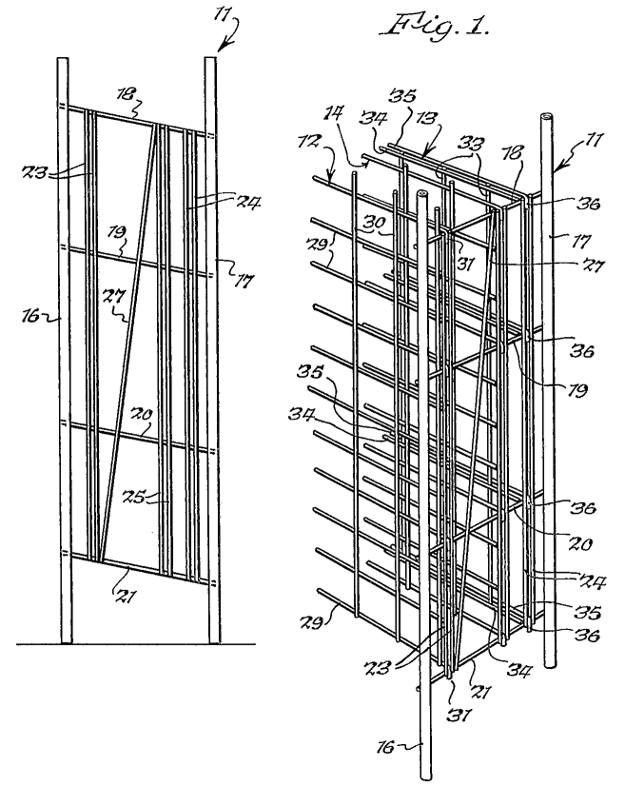
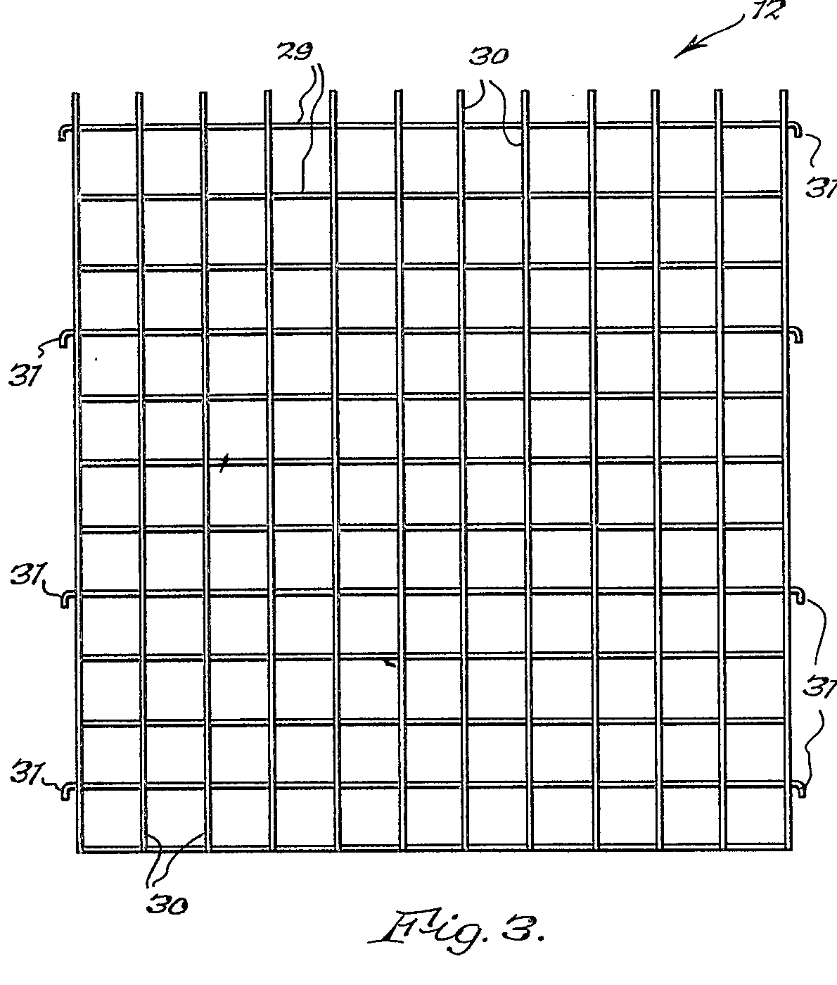
Example: A metal rod wine rack
1.Invention Information
A wine rack which is easily dismantled (claim)
2.Additional Information
A rigid wine rack made of “wire”
Int. Cl.
A47B 73/00 (2006.01)
A47B 47/02 (2006.01)
A47B 55/02 (2006.01)
5
Notes:
5

Slide 6
The IPC serves as a
instrument for the orderly arrangement of patent documents in order to facilitate access to the technological and legal information contained therein;
basis for selective dissemination of information to all users of patent information;
basis for investigating the state of the art in given fields of technology;
basis for the preparation of industrial property statistics which in turn permit the assessment of technological development in various areas.

Slide 7

How does it work?
Tree type
hierarchical structure

Slide 8
Symbols and Titles
70,000 entries
Each place/entry (Section, Class, Subclass, Group) is characterized by a symbol and a title
  Symbol = succession of upper case letters and numbers
  Title = phrase describing the technical content (scope) of the place
Notes:
Symbol is a succession of upper case letters and numbers.
Title is a phrase or succession of phrases

Slide 9
Tree type hierarchical structure
Sections
8
Classes
Classes
Classes
129
Subclasses
Subclasses
Subclasses
Subclasses
Subclasses
640
Groups
Groups
Groups
Groups
Groups
Groups
Groups
Groups
Groups
70,000

Slide 10
IPC layout: SECTIONS
1 A HUMAN NECESSITIES
2 B PERFORMING OPERATIONS; TRANSPORTING
3 C CHEMISTRY; METALLURGY
4 D TEXTILES; PAPER
5 E FIXED CONSTRUCTIONS
6 F MECHANICAL ENGINEERING; LIGHTING; HEATING; WEAPONS; BLASTING
7 G PHYSICS
8 H ELECTRICITY

Slide 11
IPC layout: SUBSECTIONS
A HUMAN NECESSITIES
AGRICULTURE
FOODSTUFFS; TOBACCO
PERSONAL OR DOMESTIC ARTICLES
HEALTH; LIFE SAVINGS; AMUSEMENT

Slide 12
Tree type hierarchical structure
Sections
8
Classes
Classes
Classes
129
Subclasses
Subclasses
Subclasses
Subclasses
Subclasses
640
Groups
Groups
Groups
Groups
Groups
Groups
Groups
Groups
Groups
70,000

Slide 13
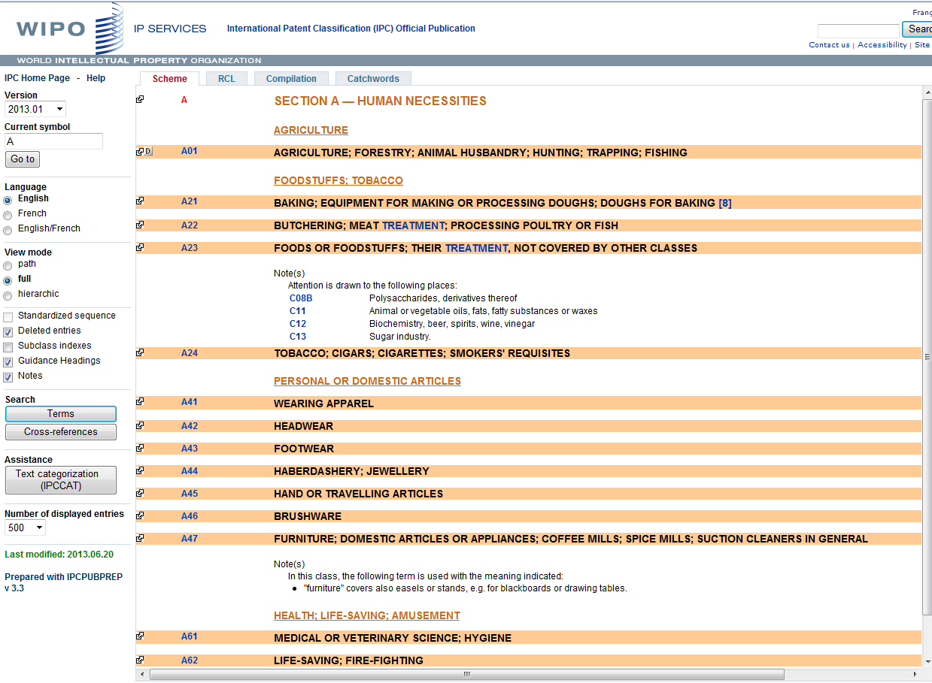
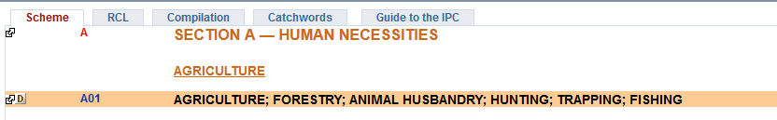
IPC layout: CLASS
Class = second hierarchical level
Class symbol: 2 digit number
Class title: indication of the content of the class

Slide 14
Tree type hierarchical structure
Sections
8
Classes
Classes
Classes
129
Subclasses
Subclasses
Subclasses
Subclasses
Subclasses
640
Groups
Groups
Groups
Groups
Groups
Groups
Groups
Groups
Groups
70,000

Slide 15
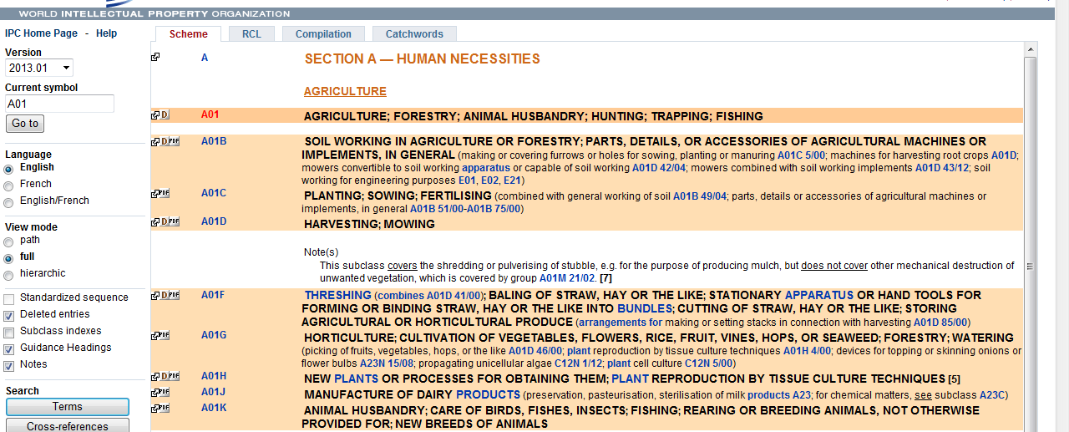
IPC layout: SUBCLASS
Subclass = 3rd hierarchical level
Subclass symbol: capital letter
Subclass title: indicates content of subsclass

Slide 16
Tree type hierarchical structure
Sections
8
Classes
Classes
Classes
129
Subclasses
Subclasses
Subclasses
Subclasses
Subclasses
640
Groups
Groups
Groups
Groups
Groups
Groups
Groups
Groups
Groups
70,000

Slide 17
IPC group symbols
► Two types of groups: Main groups
Subgroups of main groups
A23G 9/00 ........... Main group xxx/00
xxx= 1 to 999
A23G 9/02 ........... Subgroup xxx/yy (yy ≠ 00)
xxx/yyyyyy
Notes:
Accordingly, there are two different types of groups: main groups and subgroups. If only "groups" are mentioned in the following, both types of groups are addressed.
Main groups always have "00" after the slash; subgroups have any other combination of digits.
Currently, main group symbols have between 1 and 3 digits on the left hand side although WIPO Standard ST.8 allows up to 4 digits.
For the subgroup part, up to six digits can be used. At least two digits have to be used.
It should be noted that patent documents are usually classified either by using main group or subgroup symbols.
Very few countries make use of the option to use only subclass symbols - an option that is possible according to the Strasbourg Agreement.
The symbols of sections, classes or subclasses are usually only used in the scheme for describing its hierarchical structure.

Slide 18
IPC group symbols
A23D 9/02
► complete group symbol; consists of different components
A ....................... Section (A, B, ... H)
A23 ....................... Class (any 2 digits)
A23D ....................... Subclass (any letter)
A23D 9/02 ............ Group
Main group part
Subgroup part

Slide 19
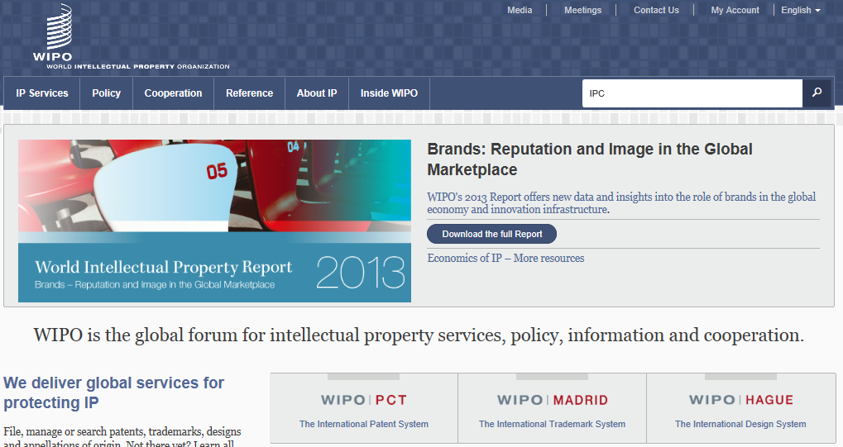
WIPO Homepage

Slide 20
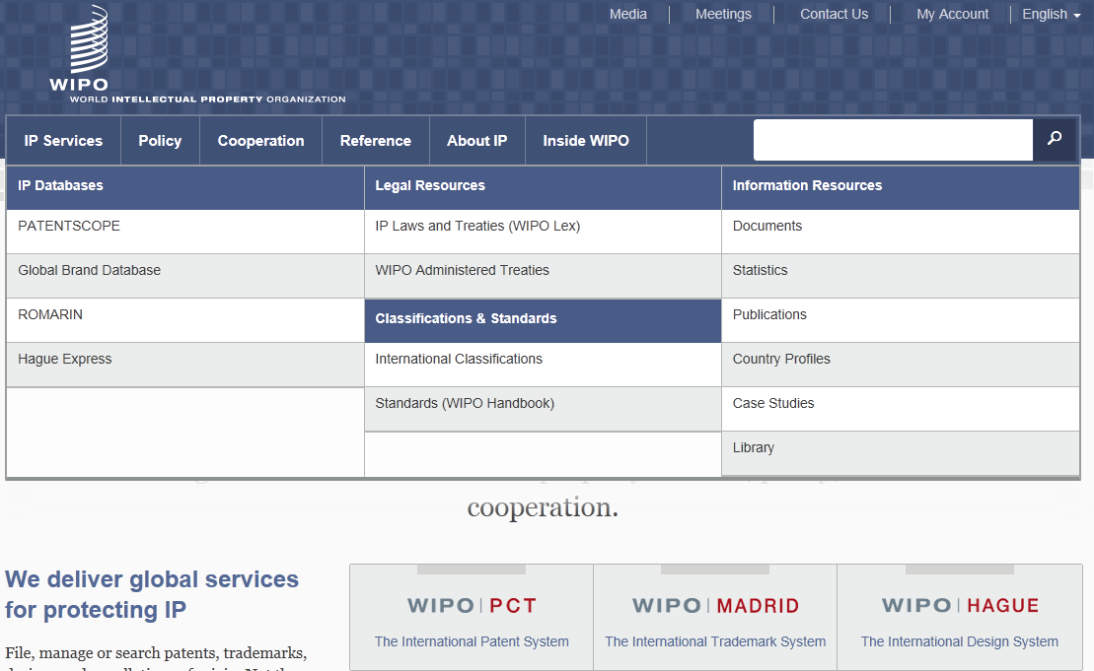
WIPO Homepage > Reference

Slide 21
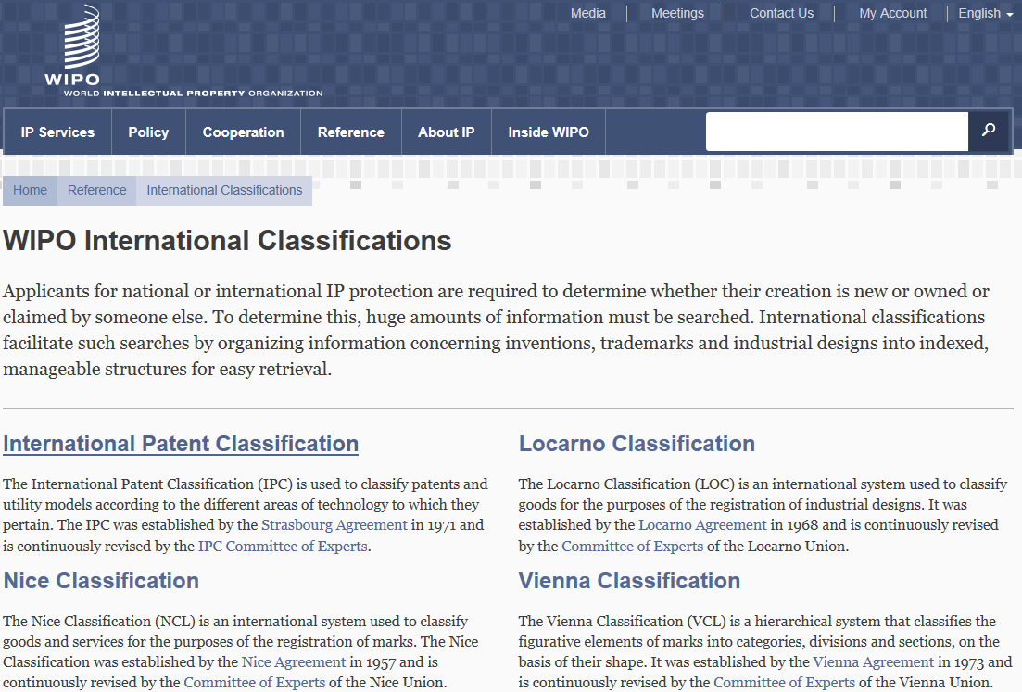
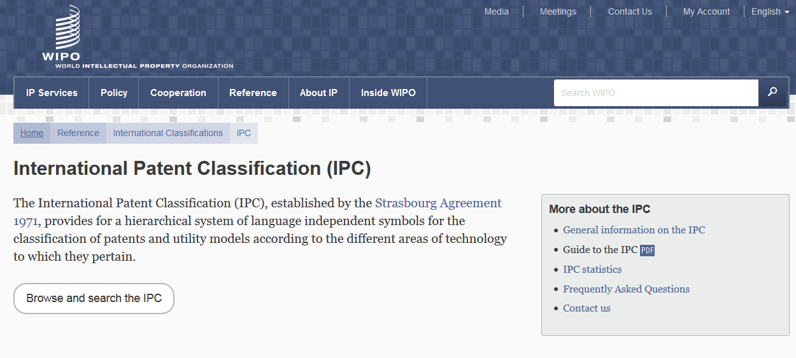
International Classifications

Slide 22
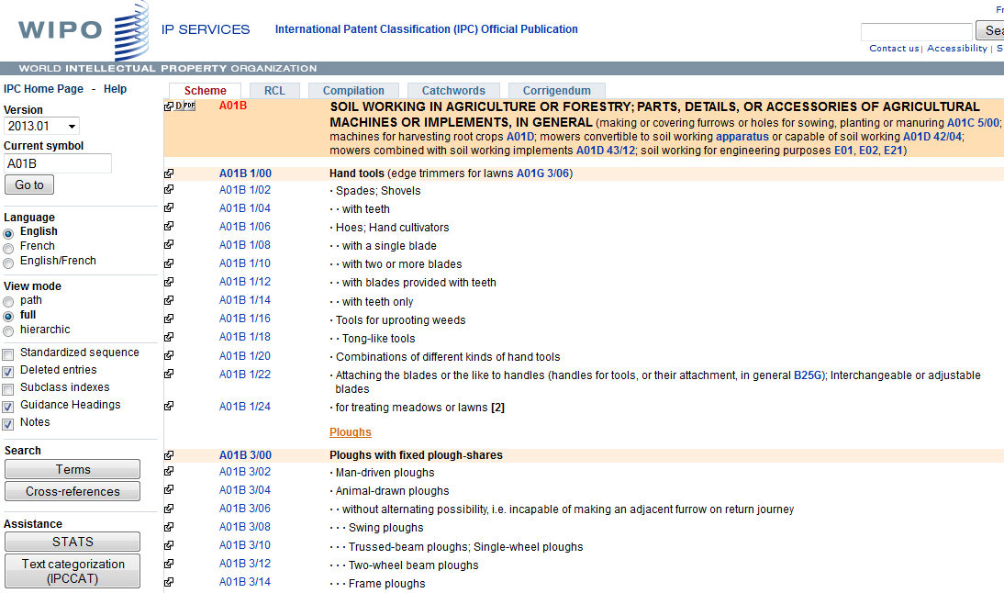
IPC Official Publication: http://web2.wipo.int/ipcpub/#refresh=page
Scheme tab (default)
Help
IPC version and IPC symbol
View mode (path/full/hierarchic)
Display option (Subclass indexes, Guidance Headings, Notes, etc.)

Slide 23
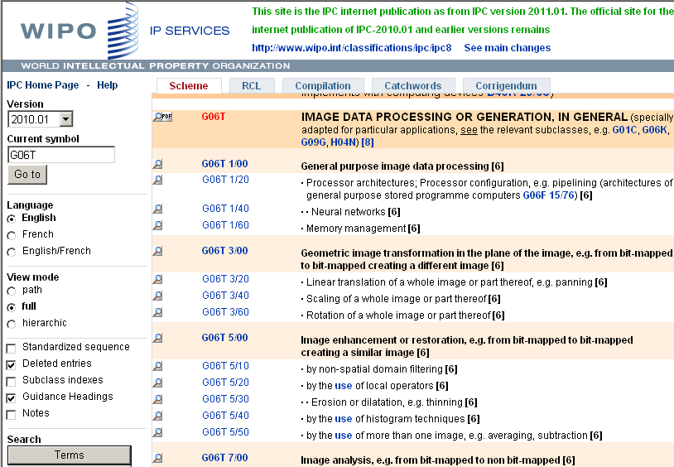
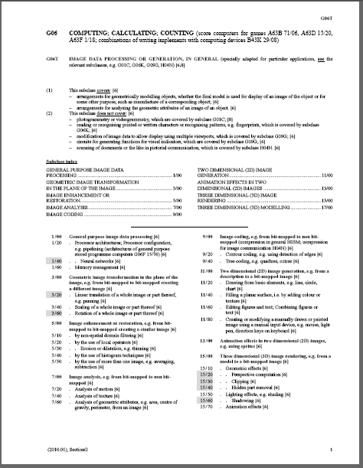
IPC Scheme - PDF file
Download IPC scheme (PDF file)
  All PDF files are available at Download and IT support area:
    http://www.wipo.int/classifications/ipc/en/support/

Slide 24
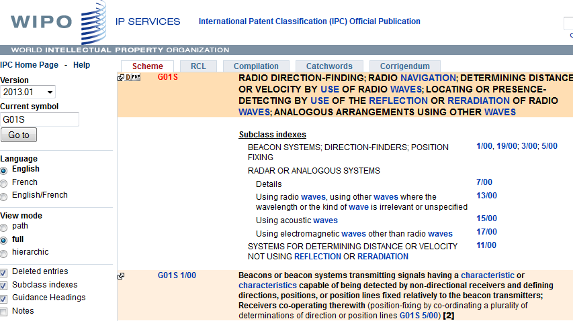
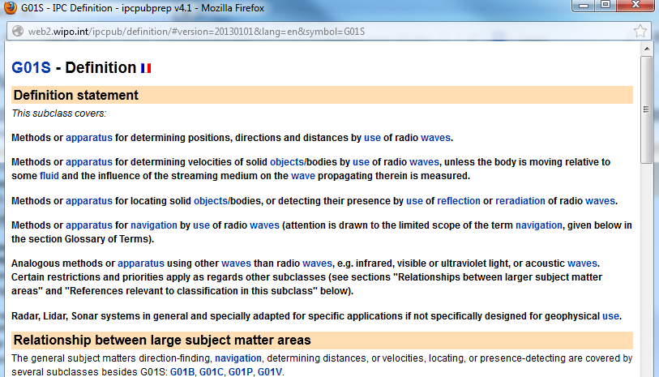
Definitions

Slide 25
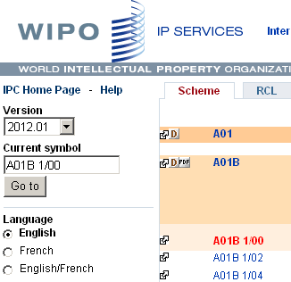
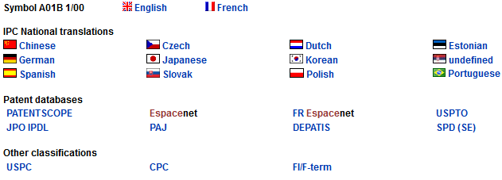
Bridge

Slide 26
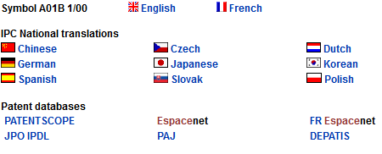
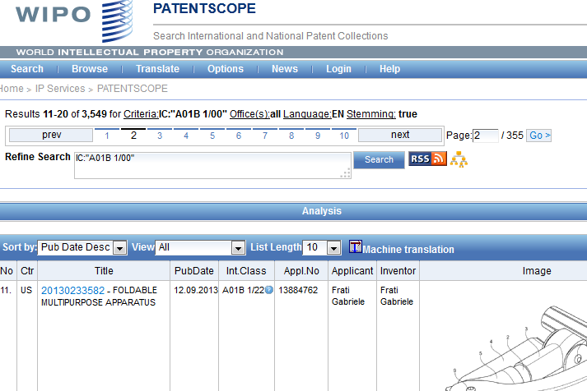
Bridge

Slide 27
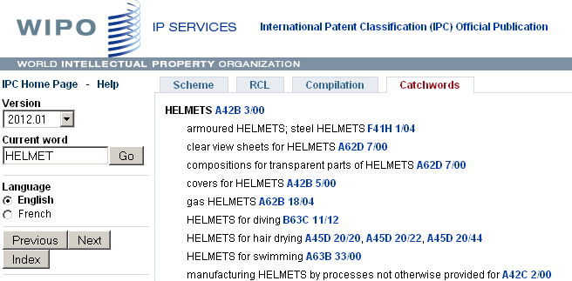
Catchword Index

Slide 28
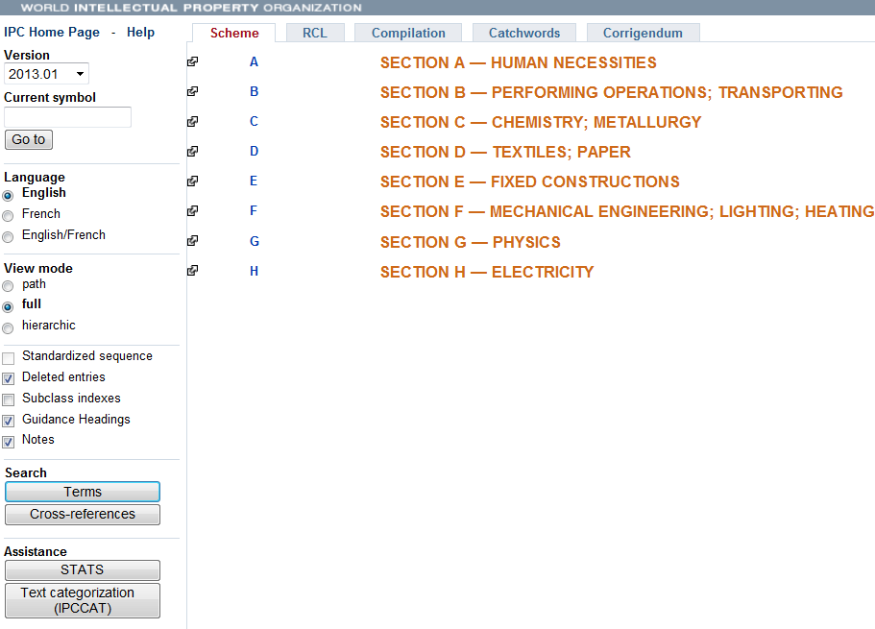
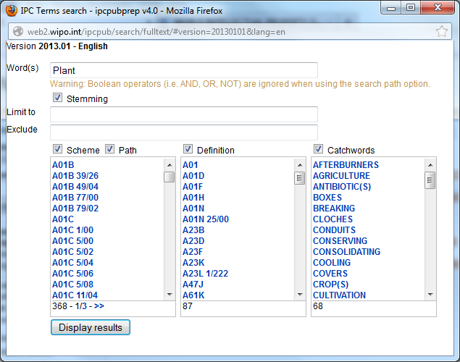
Terms (text search of the IPC)

Slide 29
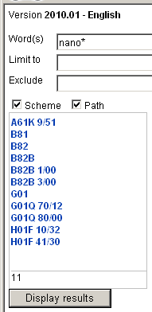
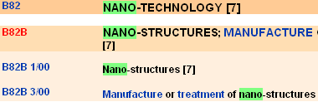
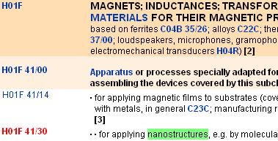
Terms
1. Input keyword (e.g. “ nano* ”)
2. Display results
3. Links to the IPC scheme

Slide 30
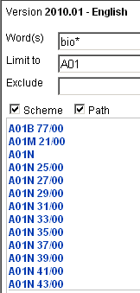
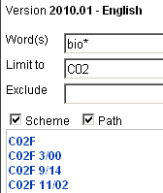
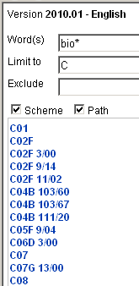
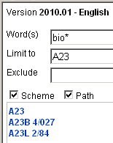
Terms
Limit to
A01=“Agriculture”
Limit to
C02=“Treatment of water, etc.”
Limit to
C=“Chemistry”
Limit to
A23=“Food or foodstuffs”

Slide 31
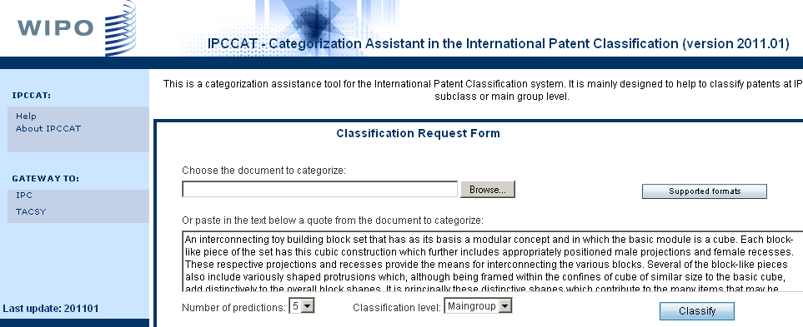
IPCCAT

Slide 32
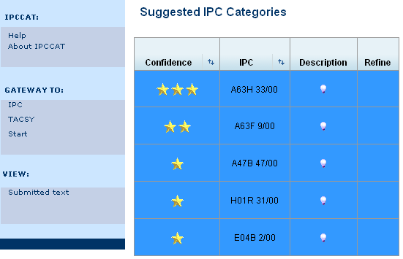
IPCCAT

Slide 33
STATS (Statistical approach)
Identifies IPC entries most frequently referenced in the PATENTSCOPE database searched by particular terms
Statistical presentation of the search results is performed according to IPC subclasses and groups
Search by simple terms and multi-term (combination of simple terms separated by a space) in all patent collections of the PATENTSCOPE

Slide 34
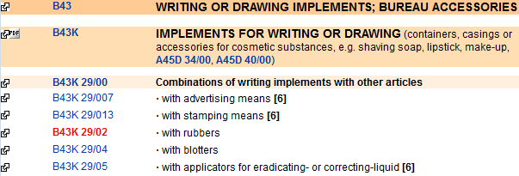
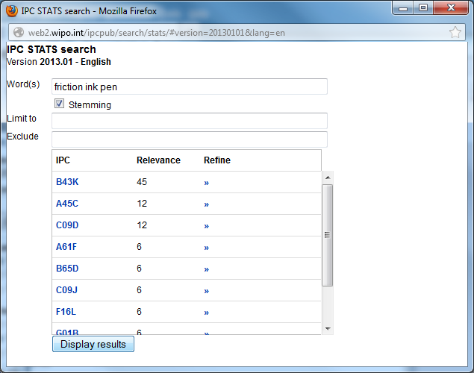
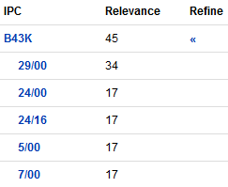
STATS

Slide 35
Parallel Viewer
Optional function to display CPC/FI entries under the parent IPC
CPC/FI view is not the official version of CPC/FI
    e.g. CPC warning and notes, Y section, 2000 series are not displayed
    use Bridge function to check the official version of CPC/FI
Versions of CPC/FI are indicated in left bottom
  e.g. CPC version: 2014.02
  FI version: 2013.11.01
CPC:Cooperative Patent Classification jointly developed by EPO&USPTO
FI: File Index - Japanese patent classification

Slide 36
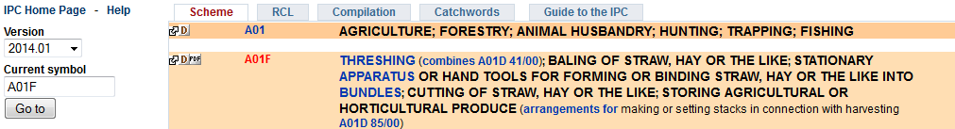
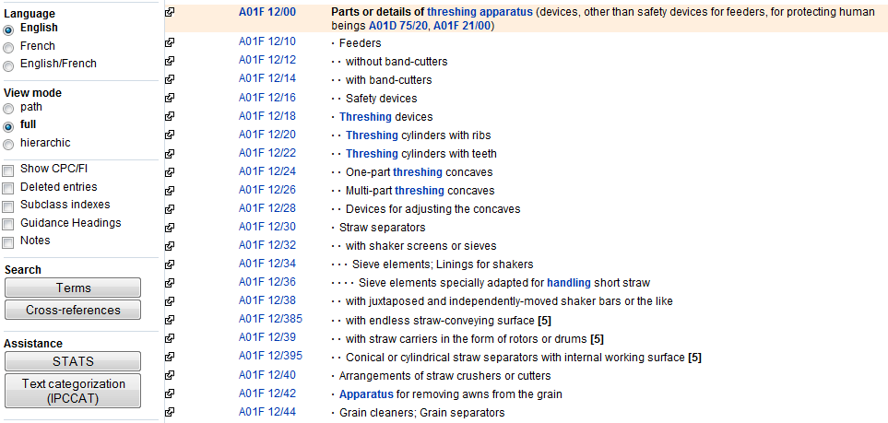
Parallel Viewer
Show CPC/FI

Slide 37
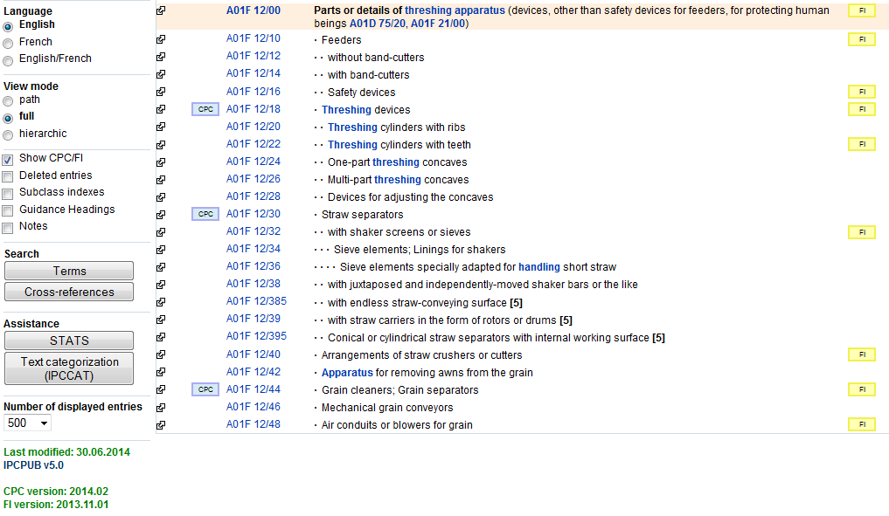
Parallel Viewer
FI entries
CPC entries
CPC/FI version

Slide 38
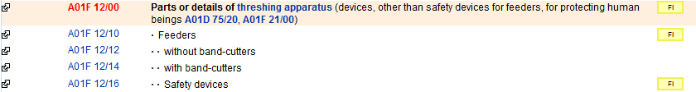
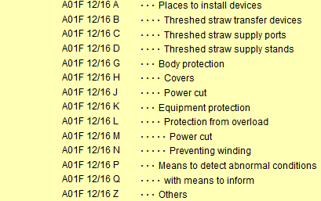

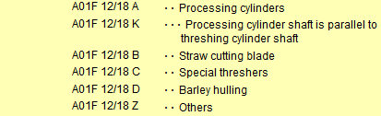
Parallel Viewer
FI entries
CPC entries

Slide 39
Guide to the IPC
The official Guide to the IPC provides comprehensive information on the IPC. It is available for download on the WIPO website of the IPC at:
http://www.wipo.int/classifications/ipc/en/general/
Notes:
see the slide

Slide 40
Why is it useful?
Primary purpose:
  effective search tool for the retrieval of patent information:
  ordering patent documents (similar technical content)
  searching patent literature
Other purposes:
  selective dissemination of information
  investigation of the state of the art
  preparation of industrial property statistics

Slide 41
Summary of the advantages of using IPC
  Language independent
  Terminology / ”jargon” independent
  Standardized application to documents (by experts of patent offices)
  Available for (old) patent documents where no full text of claims / description is available
  Concept search

Slide 42
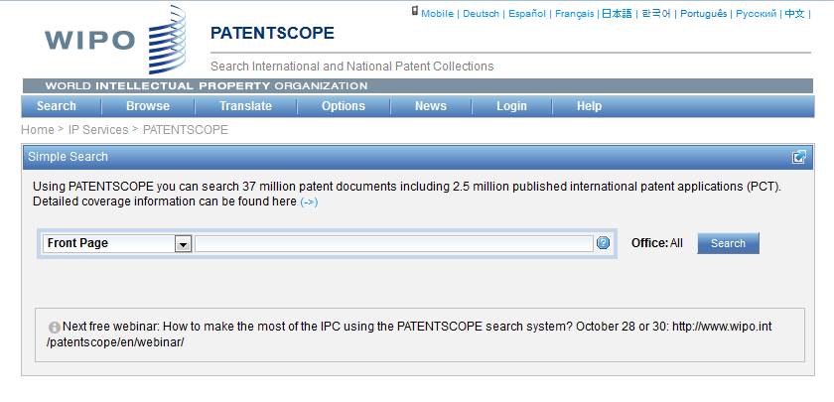
IPC in PATENTSCOPE
Statistics in the Browse by week option
Search IPC with simple, advanced, field combination
IPC in the result list

Slide 43
Statistics in the Browse by week
Beta version
Idea:
  Show global trends
    Main/new actors

Slide 44
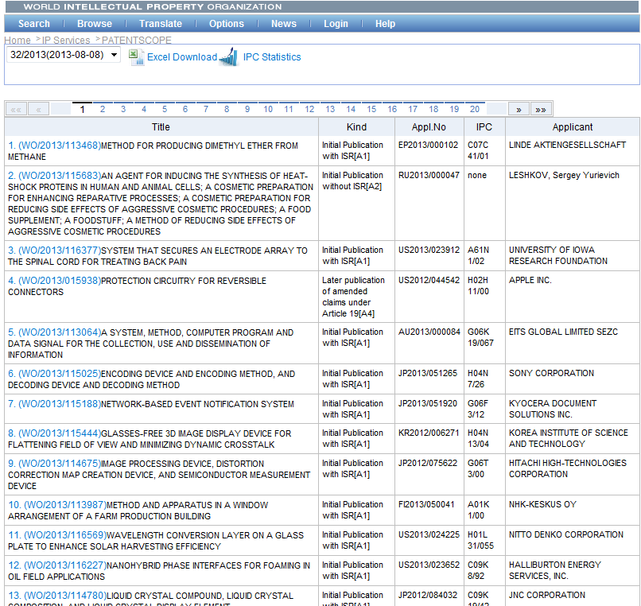

Slide 45
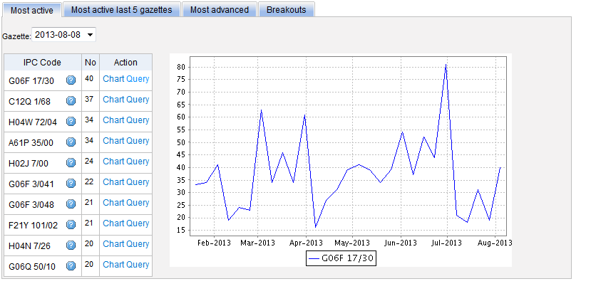
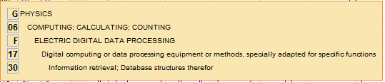
Most active

Slide 46
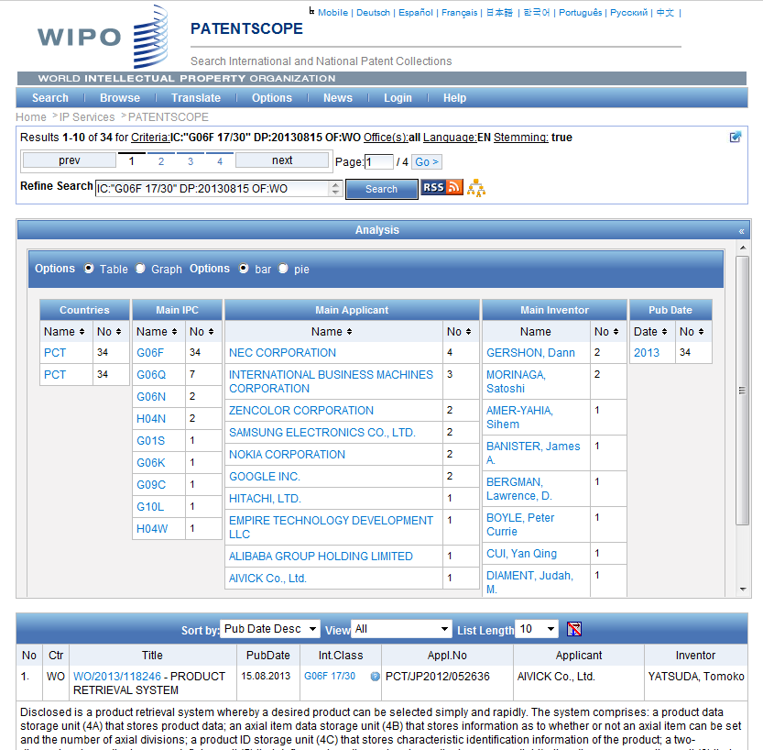

Slide 47
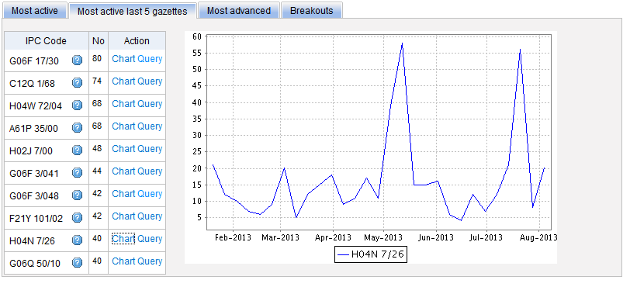
Most active last 5 gazettes

Slide 48
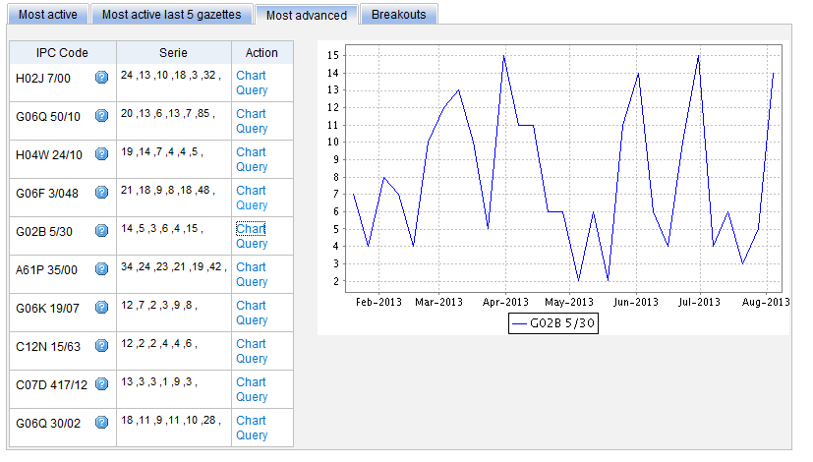
Most advanced

Slide 49
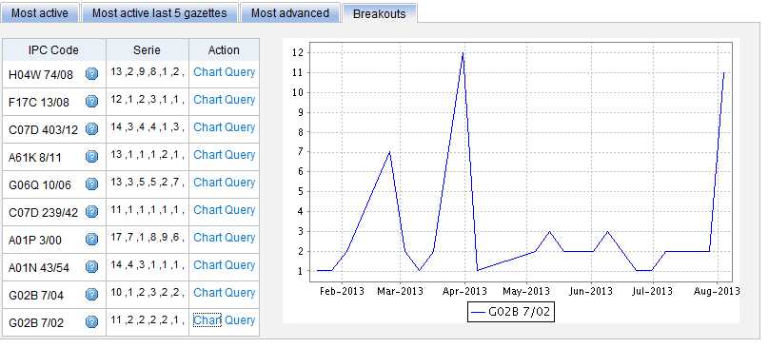
Breakouts

Slide 50
IPC search in PATENTSCOPE
Searching and Grouping now by complete IPC codes:
H04B 1/06 will include by default
H04B 1/08
1/10
1/16

Slide 51
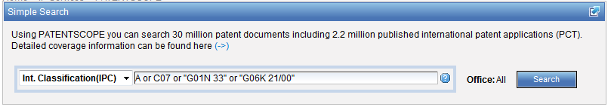
IPC search: Simple search

Slide 52
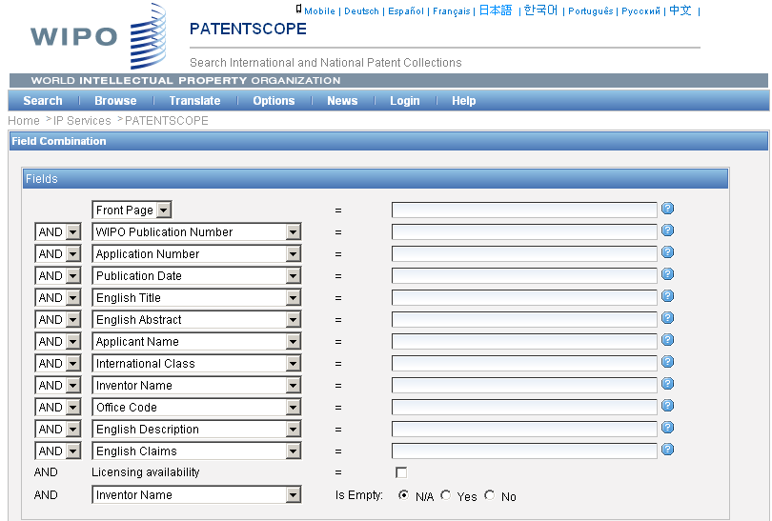
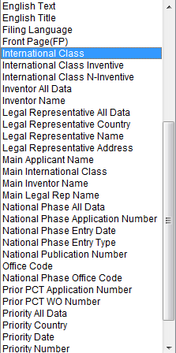
IPC search: Field combination

Slide 53


Slide 54

IPC search: Advanced search
http://patentscope.wipo.int/search/en/help/fieldsHelp.jsf

Slide 55


Slide 56
IC / ICI / ICN
IC = International Classification
ICI = International Classification Inventive
ICN = International Classification Non-inventive
IC_EX ICI_EX ICN_EX = no subgroup

Slide 57


Slide 58


Slide 59

IPC in the result list

Slide 60


Slide 61




Slide 62



Slide 63


Slide 64


Slide 65


patentscope@wipo.int

Slide 66

mulțumesc
mulțumesc

