Slide 1
PATENTSCOPE
Result list & translation tools
March
2015
Sandrine Ammann
Marketing & Communications Officer

Slide 2
To the PATENTSCOPE search system webinar
Result list & translation tools

Slide 3
Agenda
Latest and future developments
Result list
Translation tools
Quiz
Q&A session

Slide 4
Latest developements

Slide 5
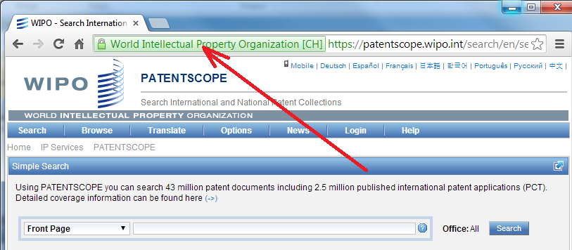
New: https

Slide 6
National patent collections be added in the future
UK
DK
AU
NZ

Slide 7
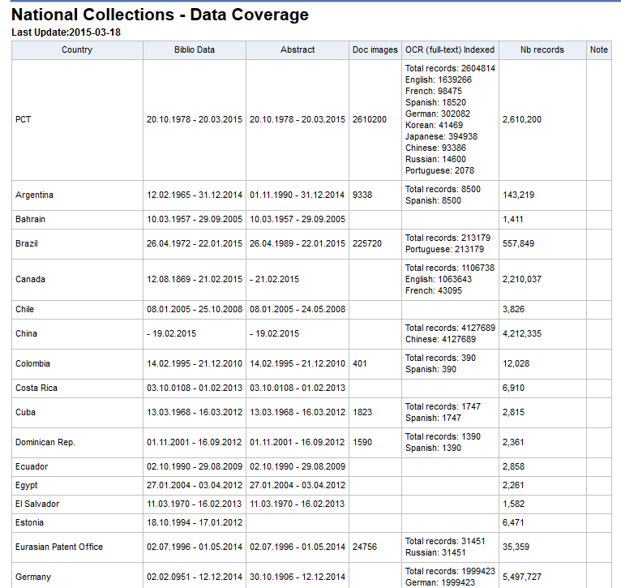
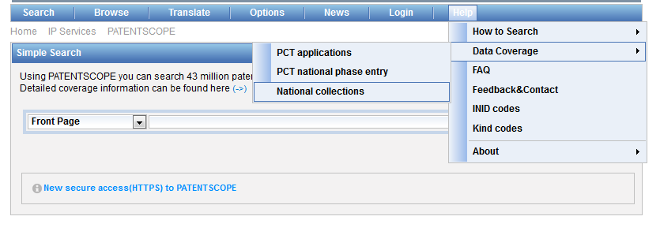
Data coverage

Slide 8
Search results list

Slide 9
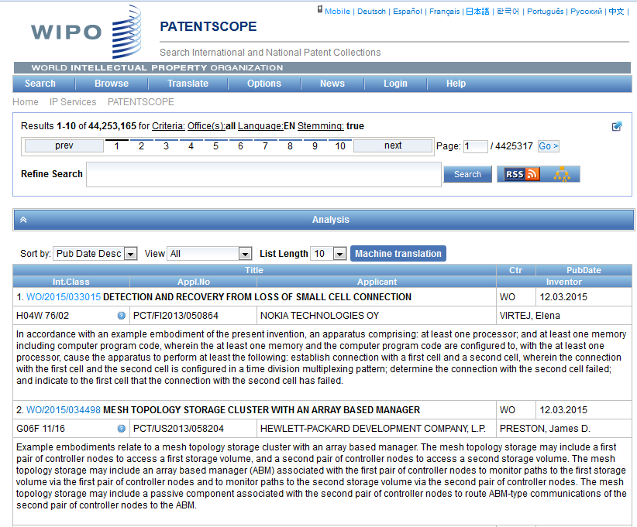

Slide 10
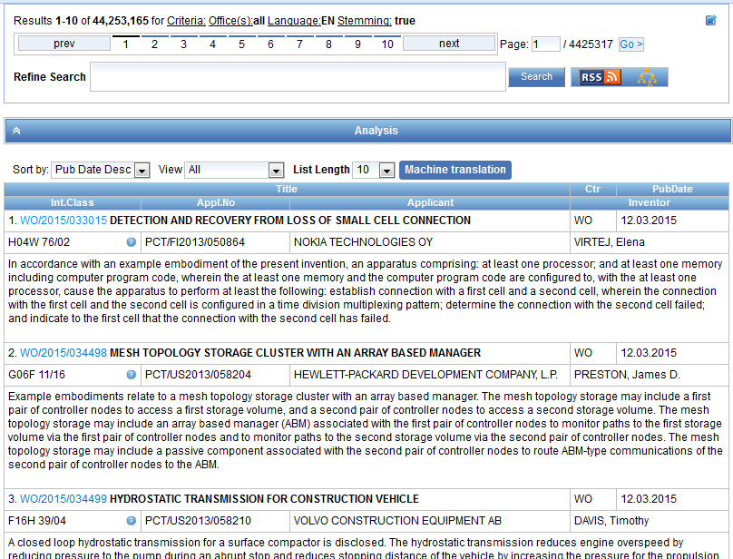

Slide 11
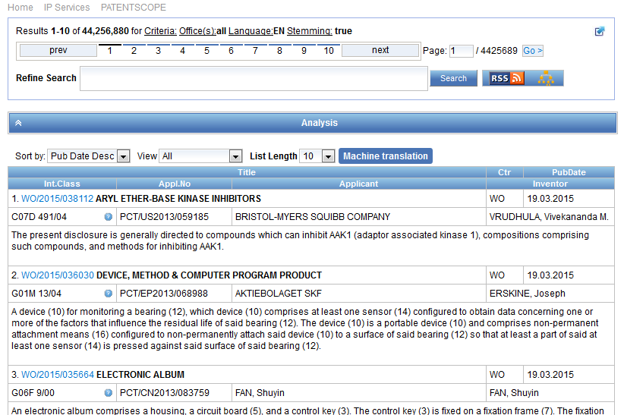
Result list

Slide 12
The first box

Slide 13
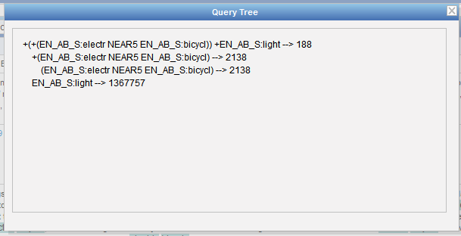

Slide 14
Stemming
Process that removes common ending from words by English Snowball algorithm
electric¦al = electric
electric¦ity = electric
electron¦ics = electron
More accurate results than wildcards:
elect* electoral, etc.

Slide 15
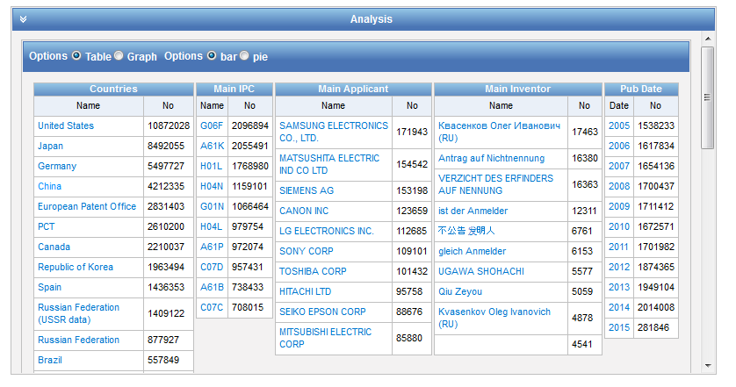
Analysis

Slide 16
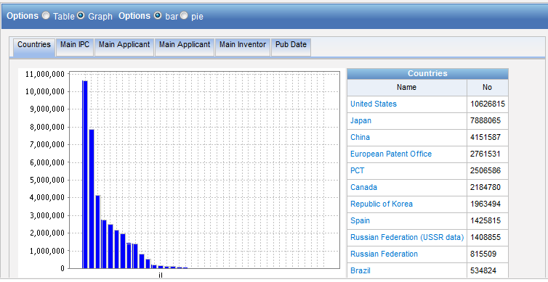
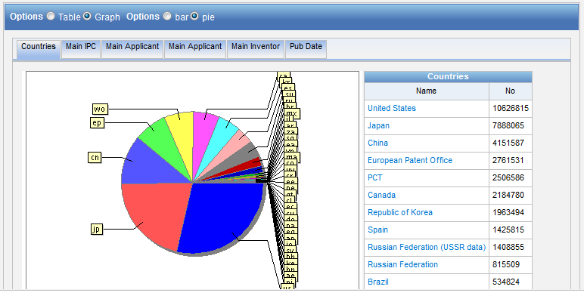
Table – Graph: pie or bar

Slide 17
Table/graph customization

Slide 18
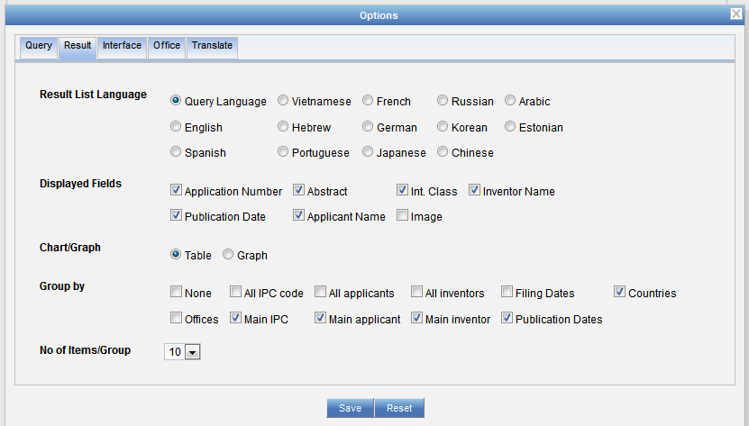
Table/graph customization

Slide 19
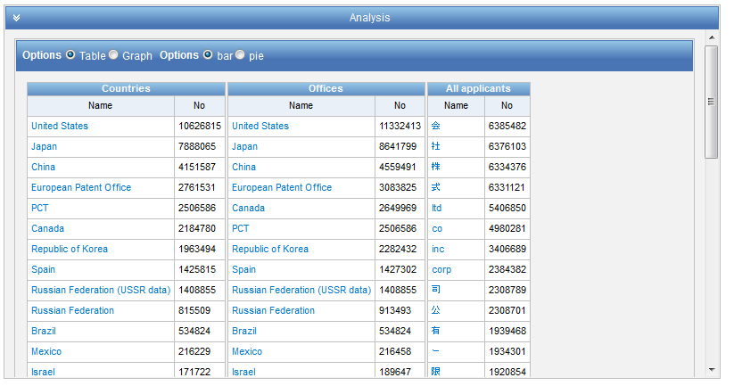

Slide 20
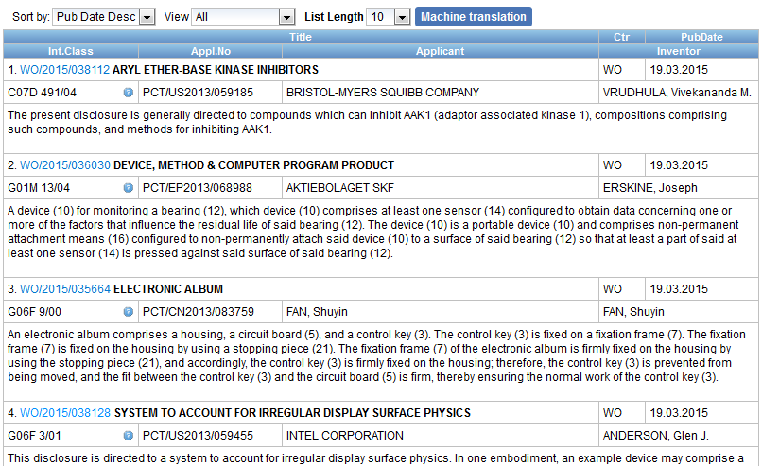

Slide 21
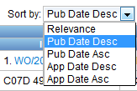
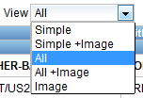
Display options

Slide 22
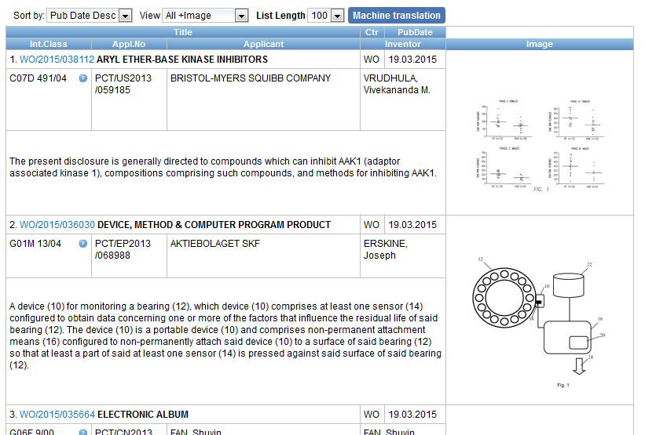
Display with images

Slide 24
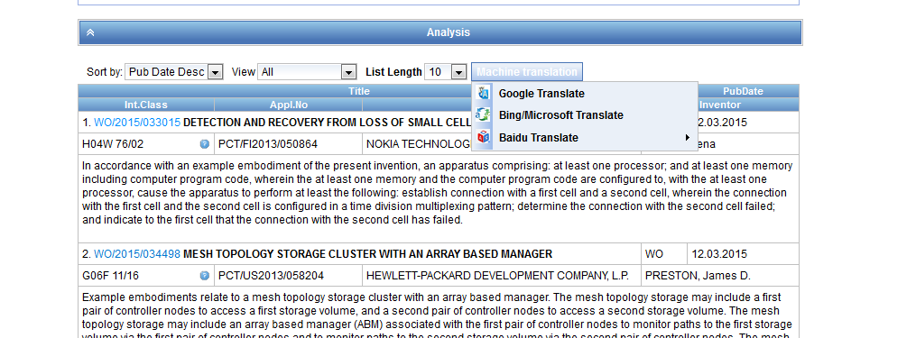

Slide 26
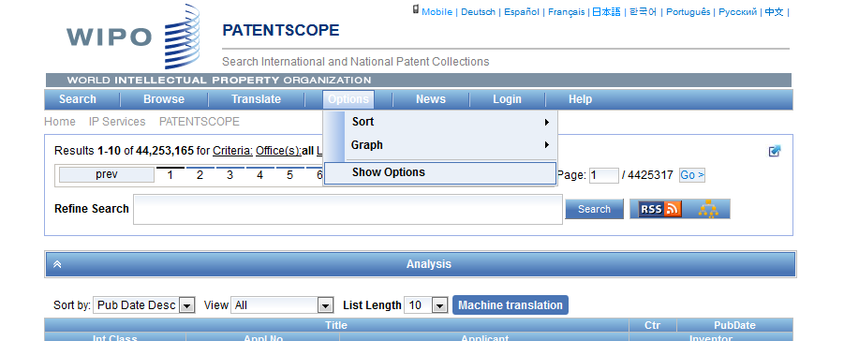
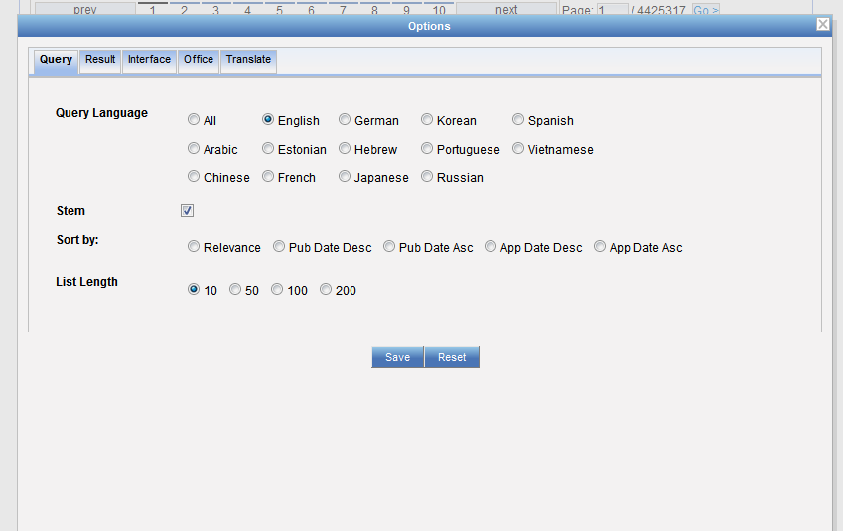

Slide 27
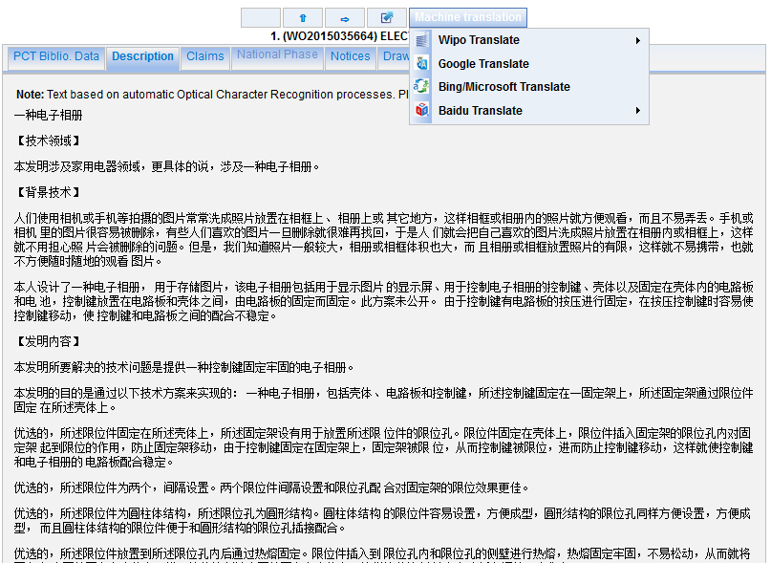

Slide 28
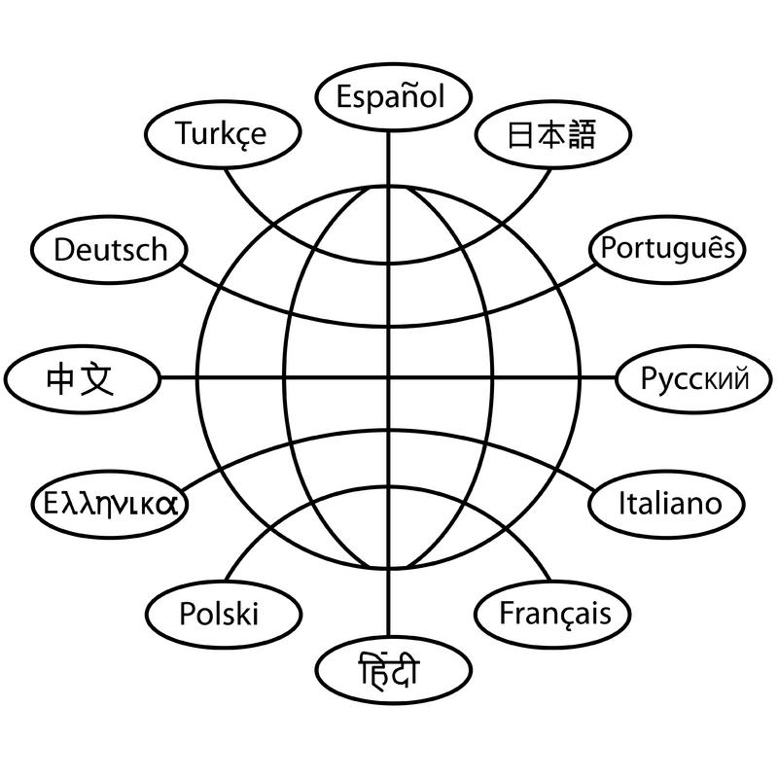
Translation tools

Slide 29
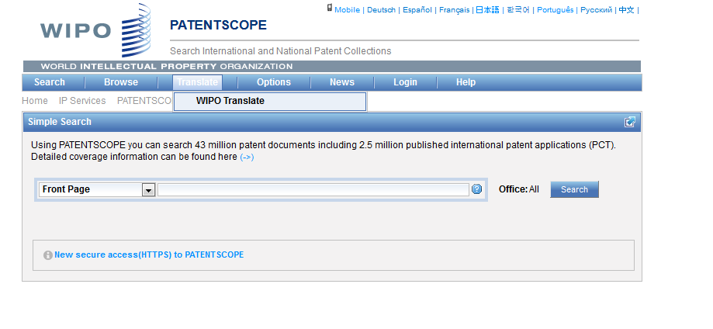
WIPO Translate

Slide 30
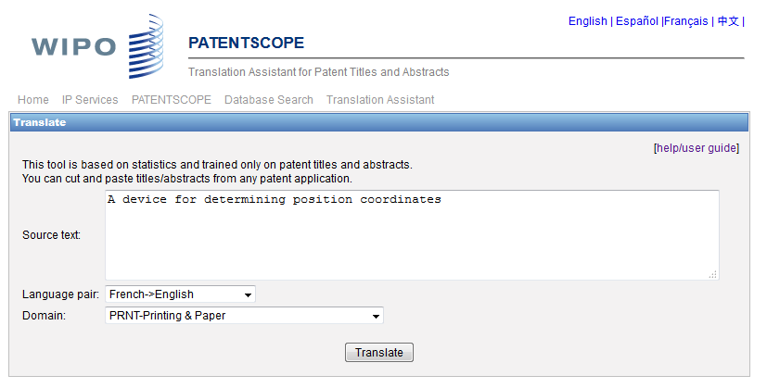
WIPO translate: interface

Slide 31
32 Technical domains from the IPC
[ADMN] Admin, Business, Management & Soc Sci
[AERO] Aeronautics & Aerospace Engineering
[AGRI] Agriculture, Fisheries & Forestry
[AUDV] Audio, Audiovisual, Image & Video Tech
[AUTO] Automotive & Road Vehicle Engineering
[BLDG] Civil Engineering & Building Construction
[CHEM] Chemical & Materials Technology
[DATA] Computer Sci, Telecom & Broadcasting
[ELEC] Electrical Engineering & Electronics
[ENGY] Energy, Fuels & Heat Transfer Eng
[ENVR] Environmental & Safety Engineering
[FOOD] Foods & Food Technology
[GENR] Generalities, Language, Media & Info Sci
[HOME] Home Contents & Household Maintenance
[HORO] Precision Mechanics, Jewelry & Horology
[MANU] Manufacturing & Materials Handling Tech
[MARI] Marine Engineering
[MEAS] Standards, Units, Metrology & Testing
[MECH] Mechanical Engineering
[MEDI] Medical Technology
[METL] Metallurgy
[MILI] Military Technology
[MINE] Mining, Oil & Gas Extraction & Minerals
[NANO] Nano Technology
[PACK] Packaging & Distribution of Goods
[PRNT] Printing & Paper
[RAIL] Railway Engineering
[SCIE] Optical Engineering
[SPRT] Sports, Leisure, Tourism & Hospitality
[TEXT] Textile & Clothing Industries
[TRAN] Transportation

Slide 32
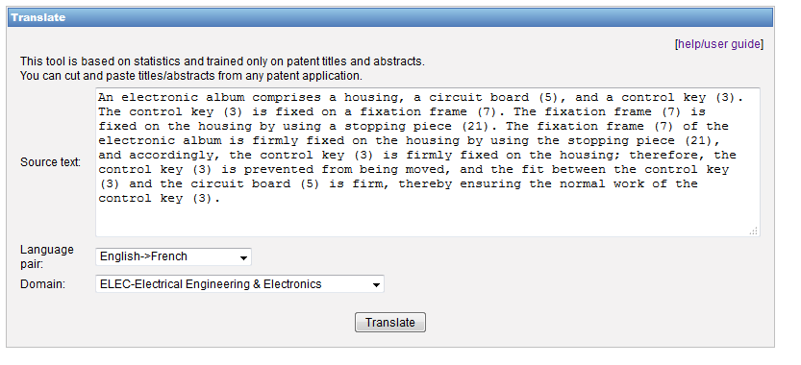
WIPO Translate: an example

Slide 33
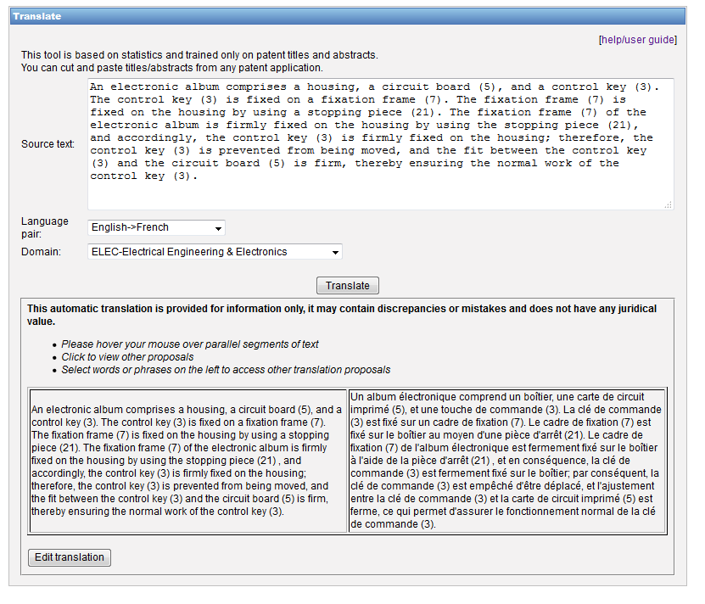

Slide 34
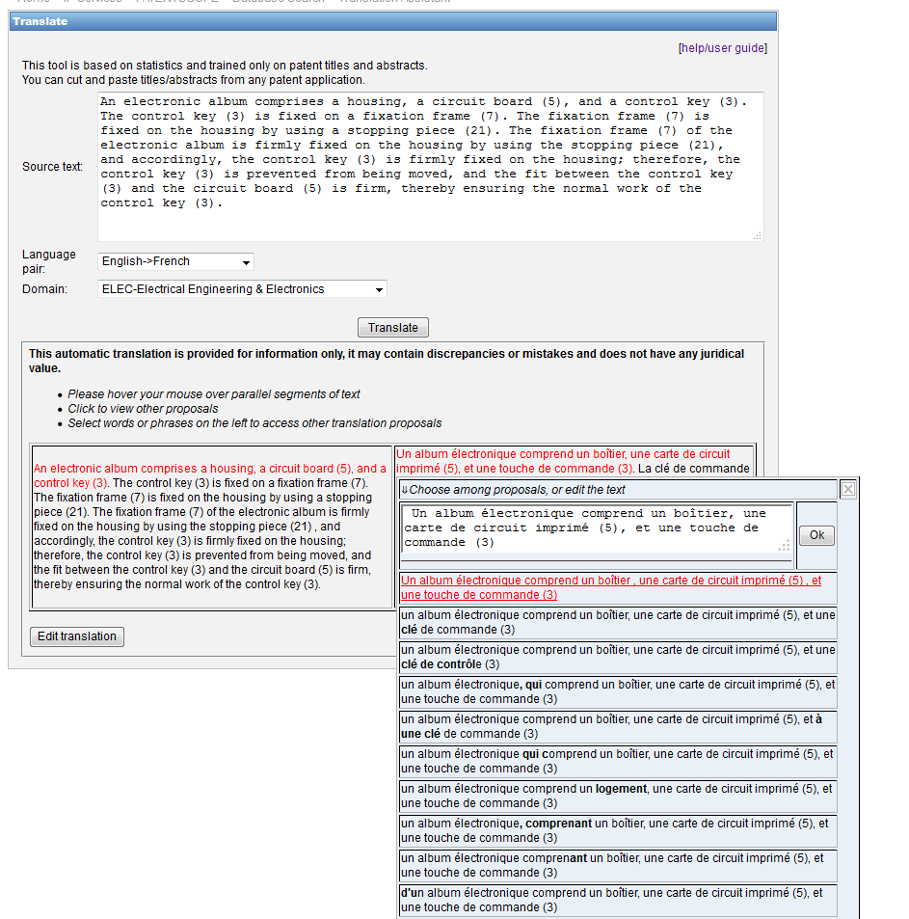

Slide 35
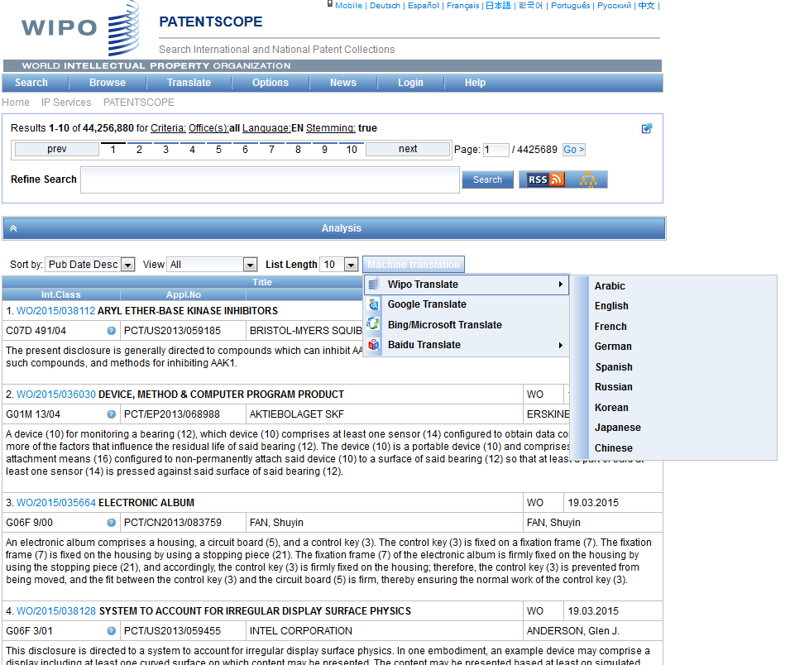
WIPO Translate: search result list

Slide 36
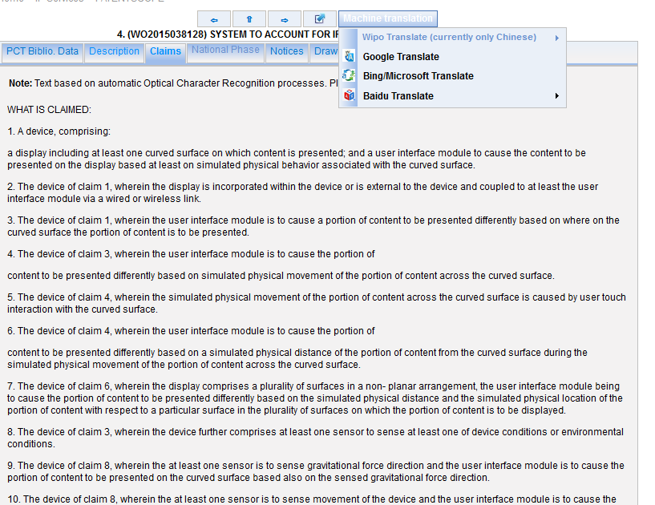
WIPO Translate: description/claims

Slide 37
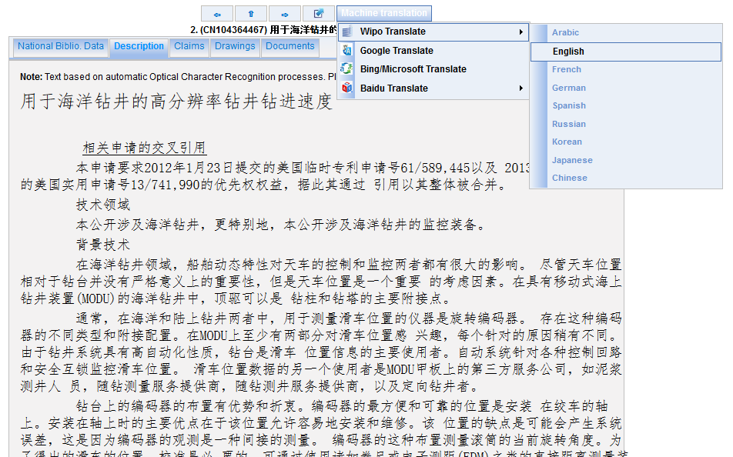

Slide 38
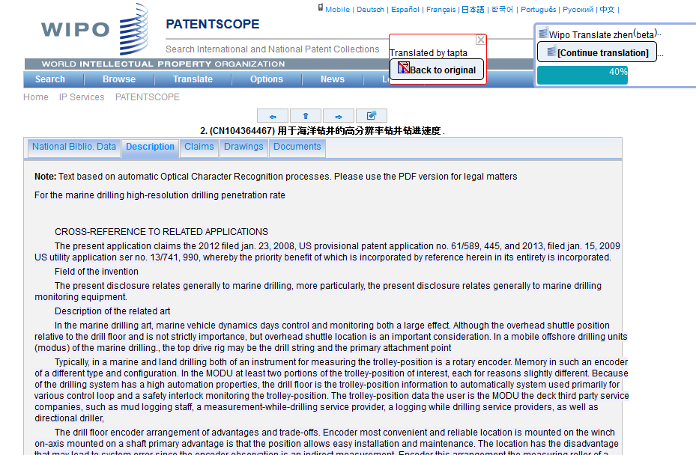

Slide 39
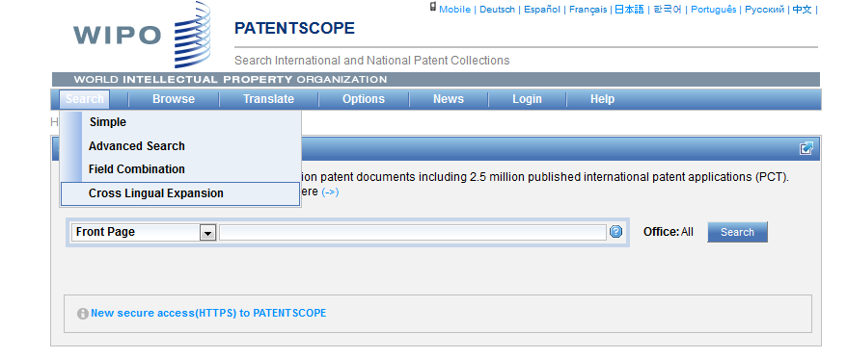
CLIR

Slide 40
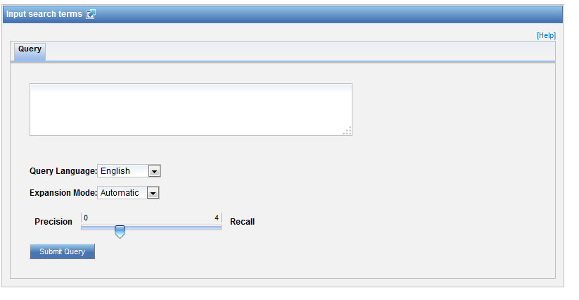
CLIR: interface

Slide 41
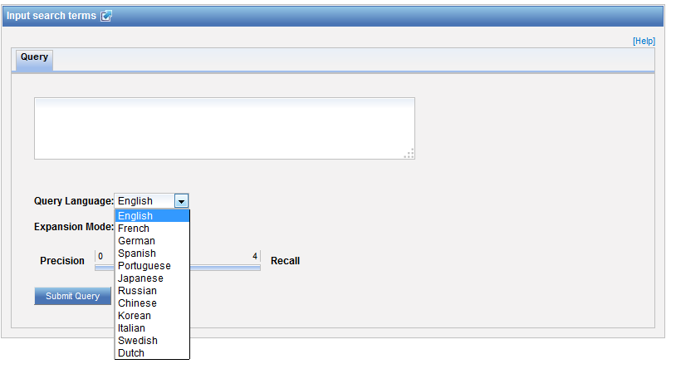
CLIR: query language

Slide 42
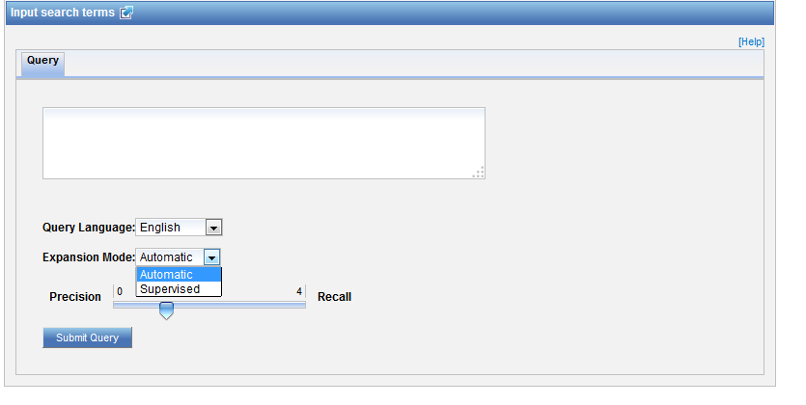
CLIR: expansion mode

Slide 43
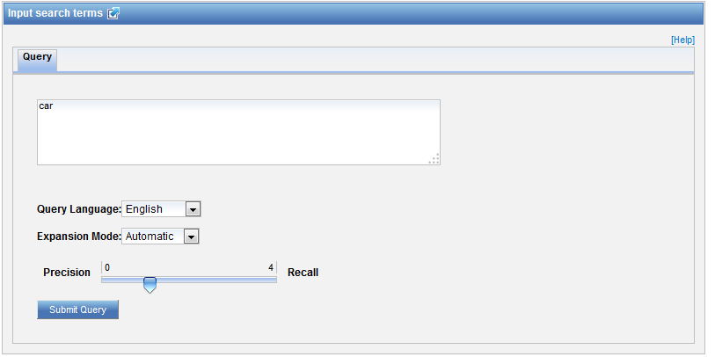
CLIR: an example

Slide 44
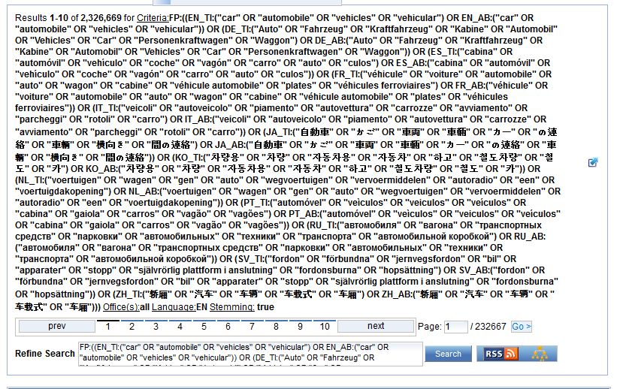
CLIR: an example

Slide 45
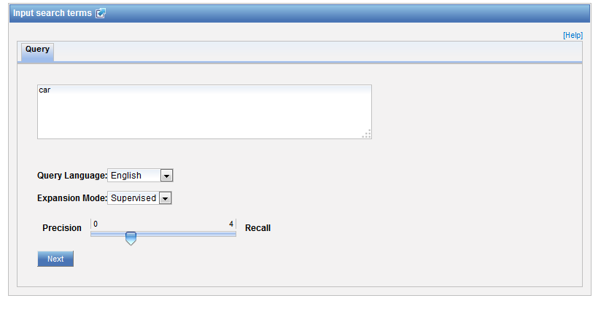
CLIR: supervised

Slide 46
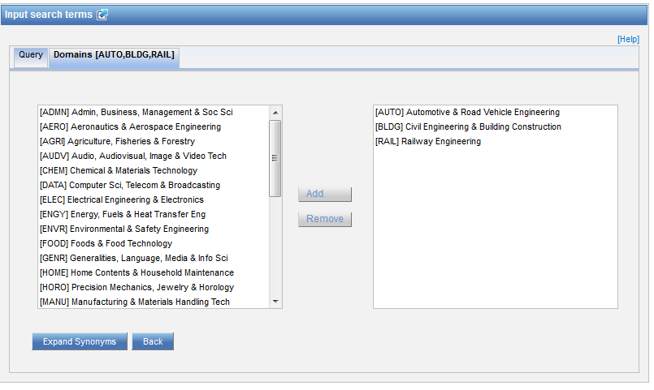
Domain selection

Slide 47
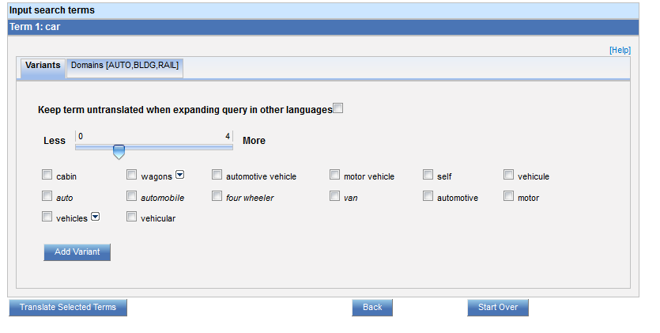
Variants selection

Slide 48
Summary of variants

Slide 49
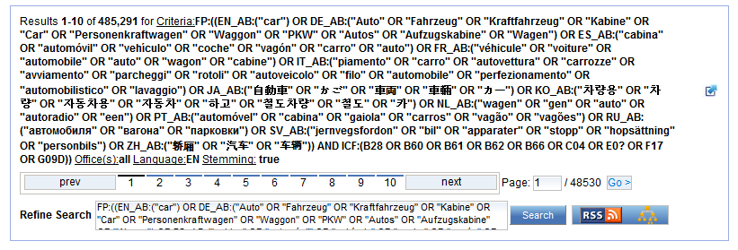
Results

Slide 51
Q:1: which translation tools are available in the result list?
A
Bing
B
WIPO translate
C
Baidu
D
Google

Slide 52
Q:1: which translation tools are available in the result list?
A
Bing
B
WIPO translate
C
Baidu
D
Google
Spain

Slide 53
Q:2: About latest developments …
A
Some fee-based search features
B
Secure https protocol

Slide 54
Q: 2: About latest developments …
A
Some fee-based search features
B
The secure https protocol

Slide 55
Q:3 which tool is available to find synonyms?
A
Baidu Translate
B
WIPO Translate
C
CLIR
D
Google Translate

Slide 56
Q:3 which tool is available to find synonyms?
A
Baidu Translate
B
WIPO Translate
C
CLIR
D
Google Translate

Slide 58
patentscope@wipo.int

Slide 59
April webinar: CLIR
Tue, Apr 28
5:30 PM - 6:30 PM CEST
Thu, Apr 30
8:30 AM - 9:30 AM CEST
To sign up: http://www.wipo.int/patentscope/en/webinar/

Slide 60
mulțumesc
mulțumesc

