Slide 1
Translation tools
Cyberworld
June 2014
Sandrine Ammann
Marketing & Communications Officer

Slide 2


To the PATENTSCOPE search system webinar
Translation tools

Slide 3
Questions/concerns
patentscope@wipo.int

Slide 4
Agenda
What’s new
  EAPO collection
  Patent register portal
Translation tools
  In-house
    CLIR
    Tapta
  Machine translation tools such as Google Translate
Q & A

Slide 5
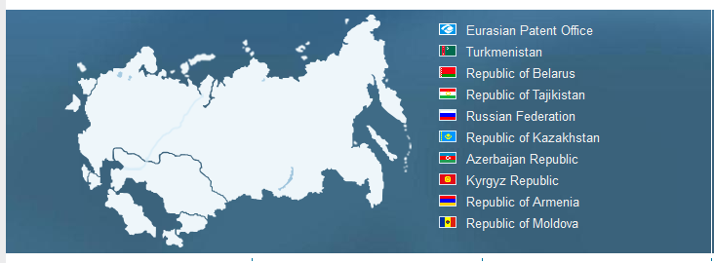
What’s new
EAPO collection now available

Slide 6
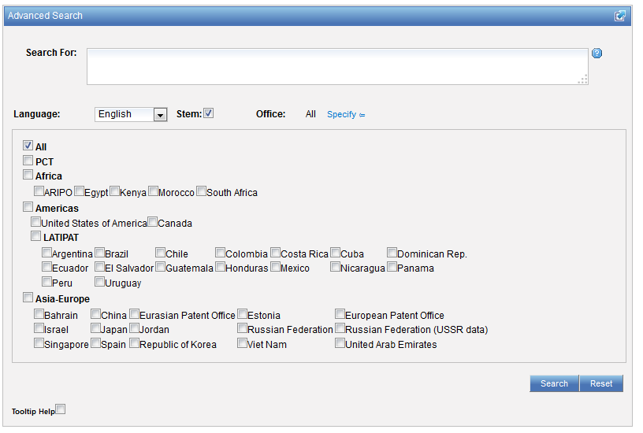
EAPO

Slide 7
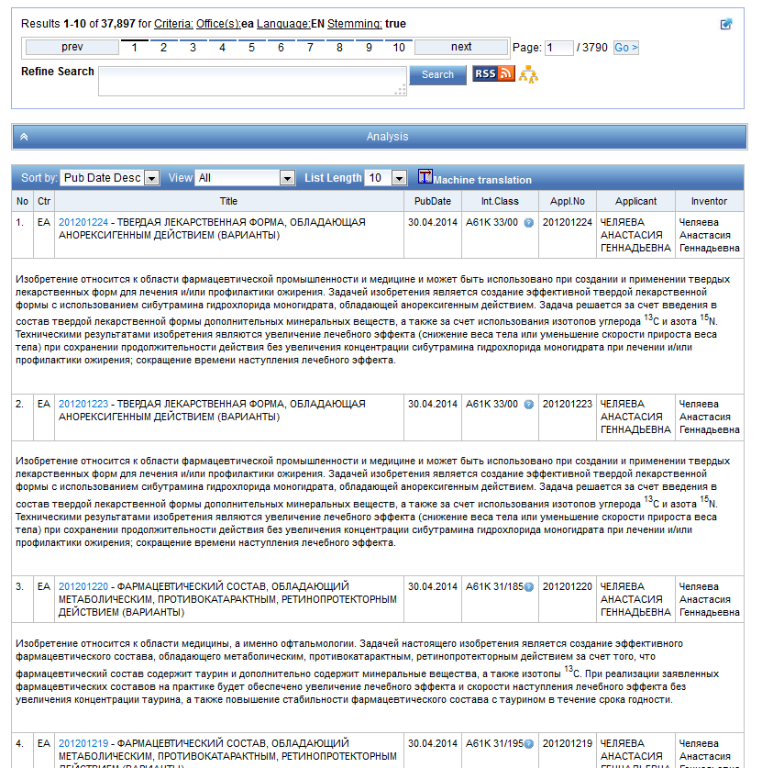
EAPO

Slide 8
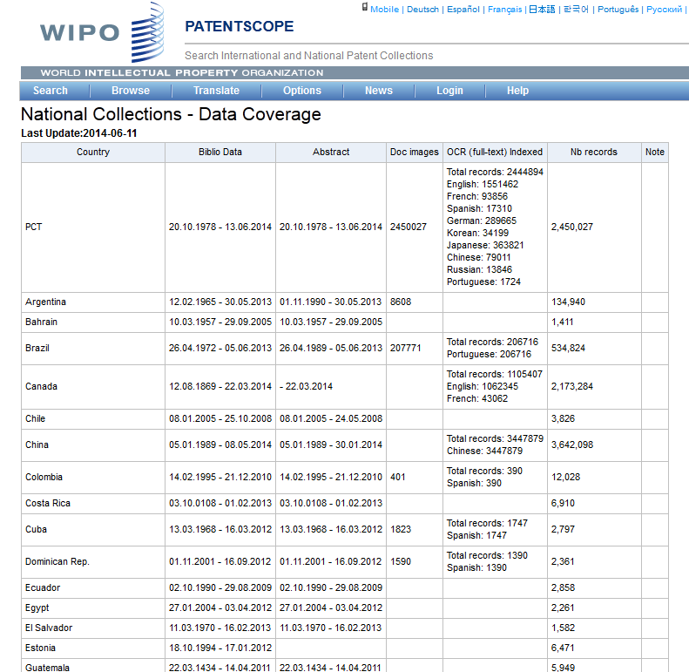
Available collections in details
http://patentscope.wipo.int/search/en/help/data_coverage.jsf

Slide 9
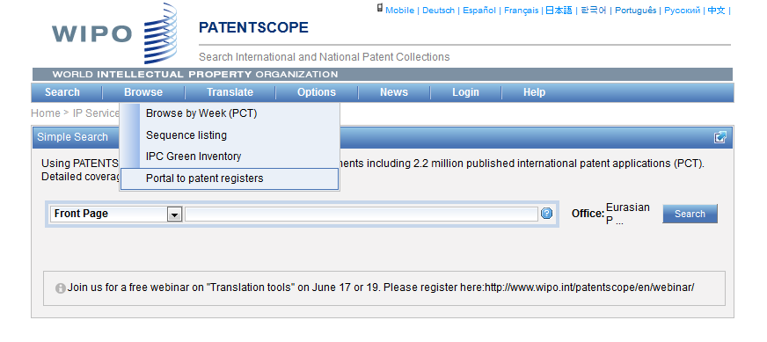
What’s news
Portal to patent registers

Slide 10
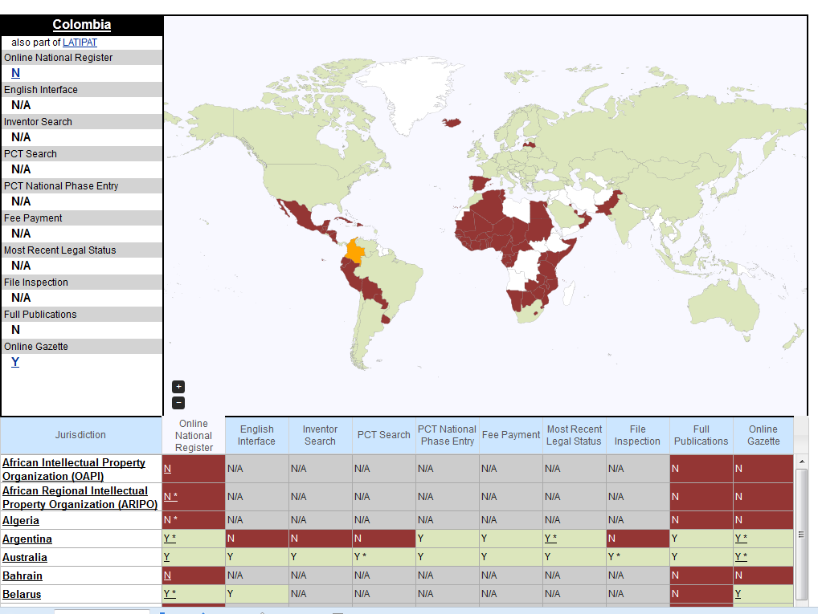
Portal to patent registers

Slide 11
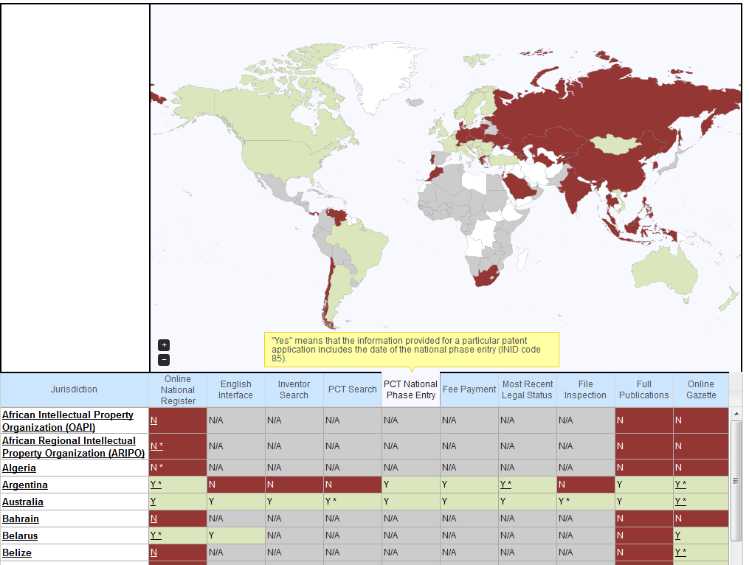
Portal to patent registers

Slide 12
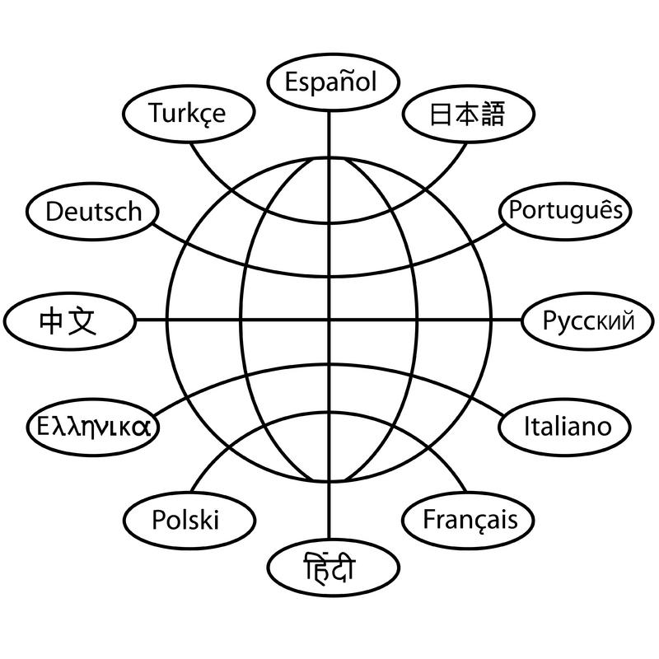
Translation tools

Slide 13
CLIR
CLIR stands for Cross Lingual Information Retrieval and will allow you to search a term or a phrase and its variants in:
Chinese
Dutch
English
French
German
Italian
Japanese
Korean
Portuguese
Russian
Spanish and
Swedish
Notes:
13
You will use this tool in order to:
-Find synonyms in order to retrieve comprehensive results
-To search in a language that one does know

Slide 14
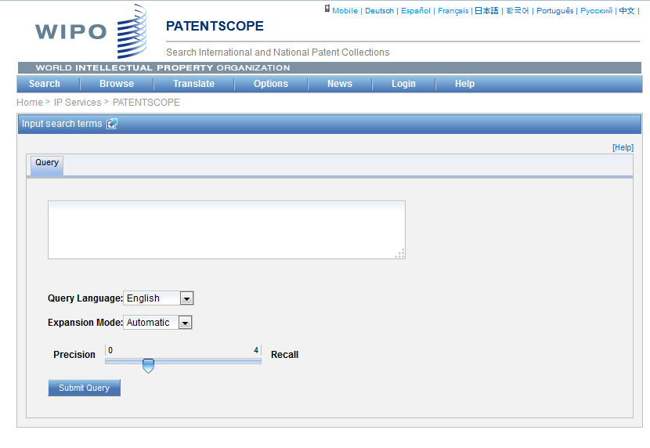
CLIR: the interface
Notes:
14
There is query box
Query language
Expansion mode

Slide 15
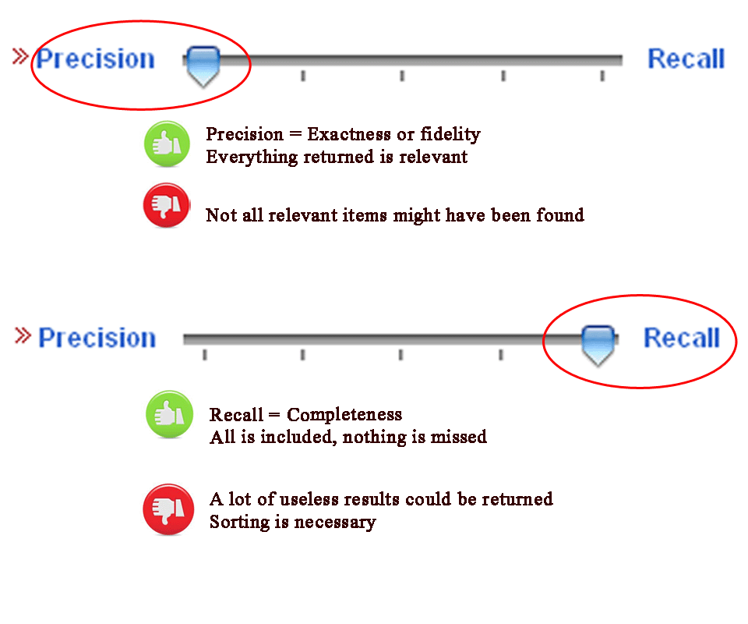
CLIR: precision vs recall

Slide 16
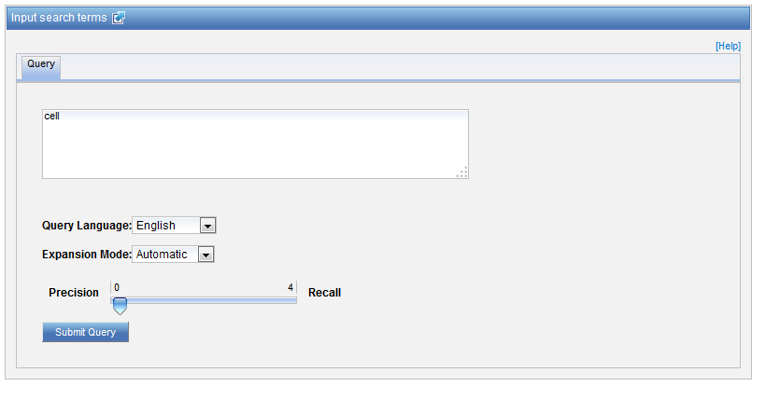
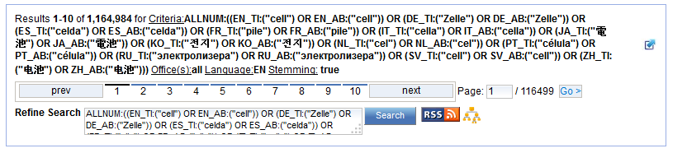
Example: precision

Slide 17
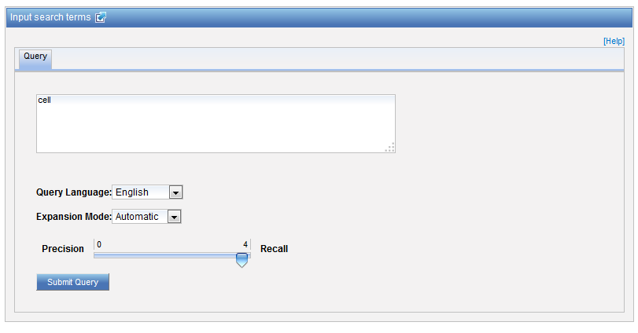
Example: recall

Slide 18
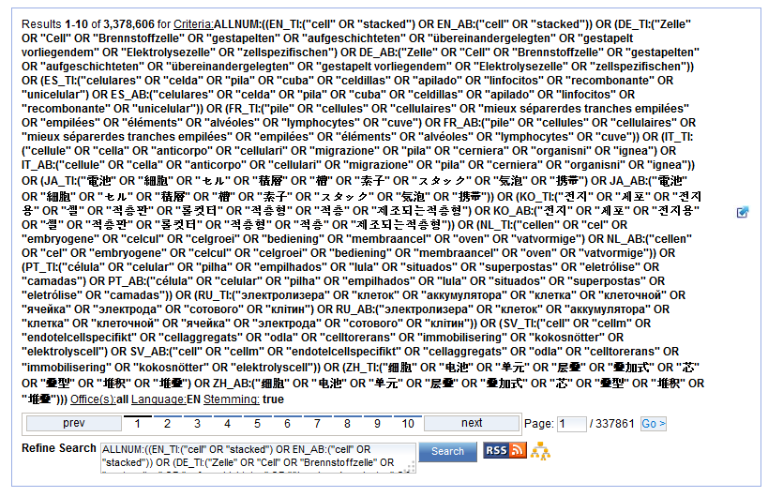
Example: recall

Slide 19
CLIR: supervised mode
2 modes: automatic and supervised
Automatic: 1 step
Supervised: 4 steps

Slide 20
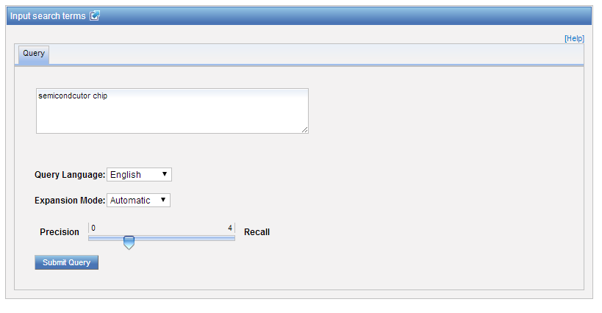
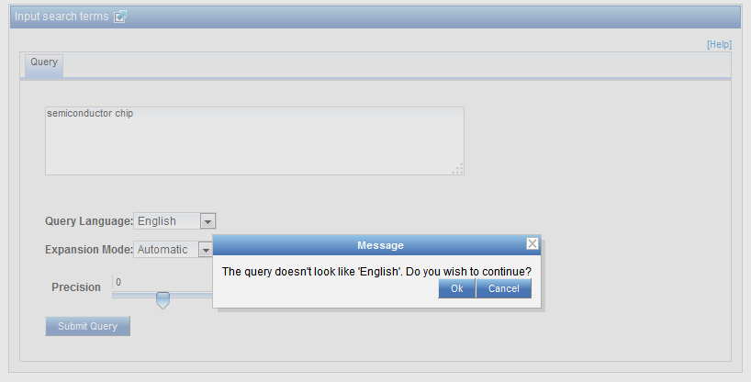
Automatic mode

Slide 21
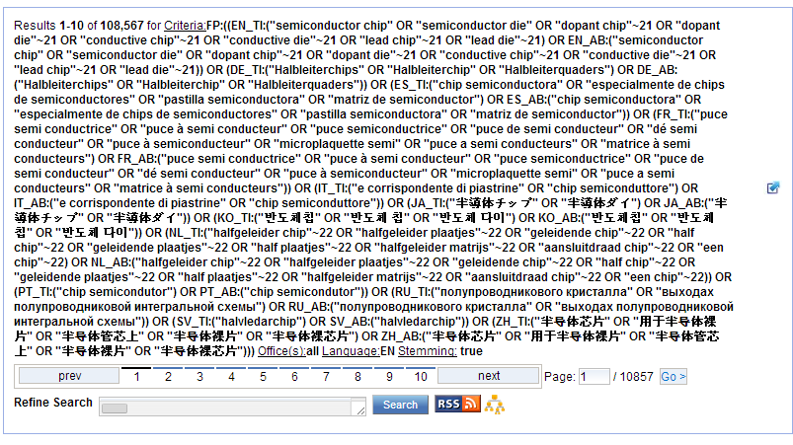
Automatic mode: results

Slide 22
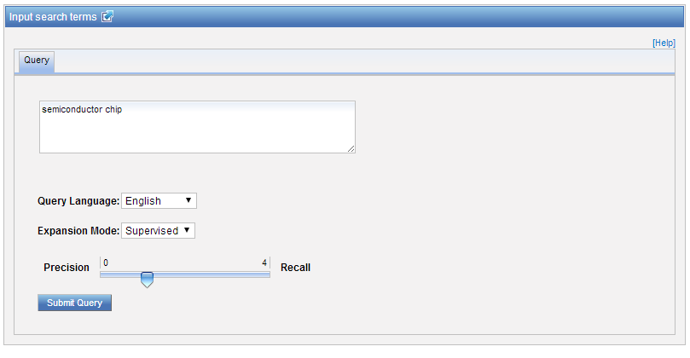
Supervised mode: 1 of 4 steps

Slide 23
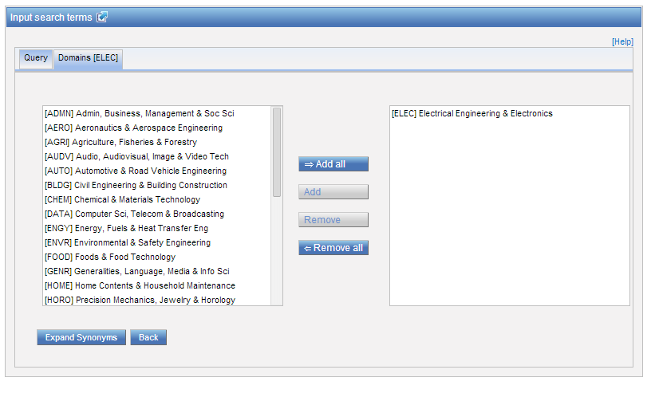
Supervised mode : 2 of 4 steps

Slide 24
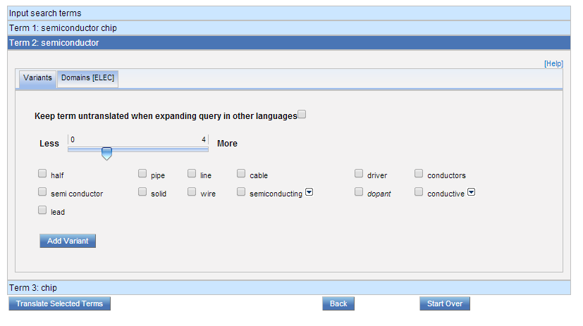
Supervised mode : 3 of 4 steps

Slide 25
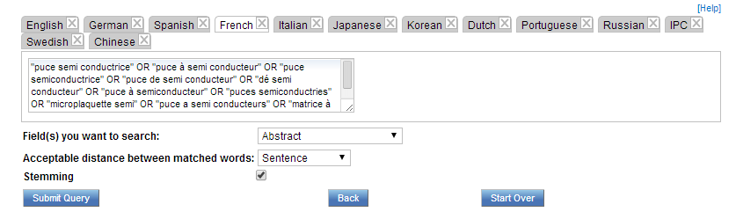
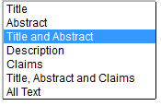

Supervised mode : 4 of 4 steps

Slide 26
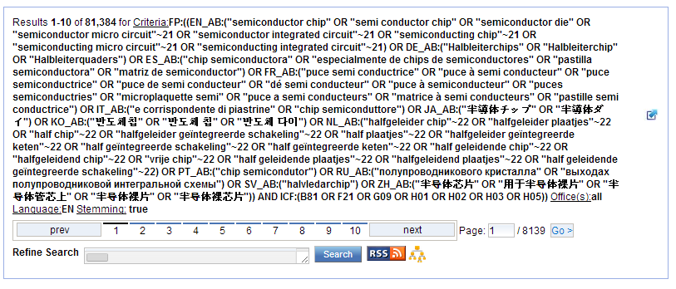
Supervised mode: results

Slide 27
Search examples: clothes for sport
Entering “sports clothes” in the Simple search interface will return 11 results
Entering “sports clothes” in the CLIR interface (in automatic mode) will return 791 results
Entering “sports clothes” in the CLIR interface (in supervised mode) will return 455 results
Notes:
27
CLIR will provide you with synonyms of both terms composing the query “sport” and “clothing” and synonyms of “sport clothing” in 11 languages which will allow you to find documents in Japanese for example.
The nb of results in the supervised mode is less because there are more relevant in fact in the auto mode you neter your query and the system retrieves results while in the supervised mode you need to paricpate actively in the selection process

Slide 28
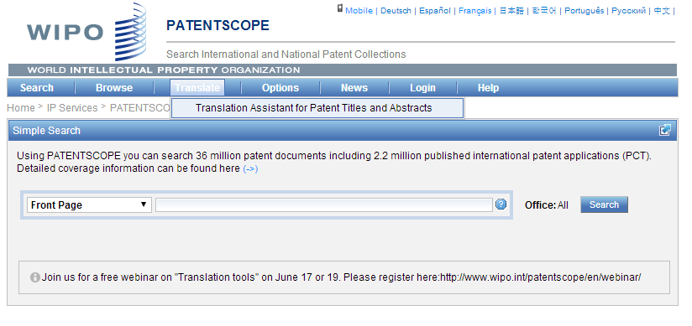
TAPTA

Slide 29

32 Technical domains from the IPC
[ADMN] Admin, Business, Management & Soc Sci
[AERO] Aeronautics & Aerospace Engineering
[AGRI] Agriculture, Fisheries & Forestry
[AUDV] Audio, Audiovisual, Image & Video Tech
[AUTO] Automotive & Road Vehicle Engineering
[BLDG] Civil Engineering & Building Construction
[CHEM] Chemical & Materials Technology
[DATA] Computer Sci, Telecom & Broadcasting
[ELEC] Electrical Engineering & Electronics
[ENGY] Energy, Fuels & Heat Transfer Eng
[ENVR] Environmental & Safety Engineering
[FOOD] Foods & Food Technology
[GENR] Generalities, Language, Media & Info Sci
[HOME] Home Contents & Household Maintenance
[HORO] Precision Mechanics, Jewelry & Horology
[MANU] Manufacturing & Materials Handling Tech
[MARI] Marine Engineering
[MEAS] Standards, Units, Metrology & Testing
[MECH] Mechanical Engineering
[MEDI] Medical Technology
[METL] Metallurgy
[MILI] Military Technology
[MINE] Mining, Oil & Gas Extraction & Minerals
[NANO] Nano Technology
[PACK] Packaging & Distribution of Goods
[PRNT] Printing & Paper
[RAIL] Railway Engineering
[SCIE] Optical Engineering
[SPRT] Sports, Leisure, Tourism & Hospitality
[TEXT] Textile & Clothing Industries
[TRAN] Transportation

Slide 30
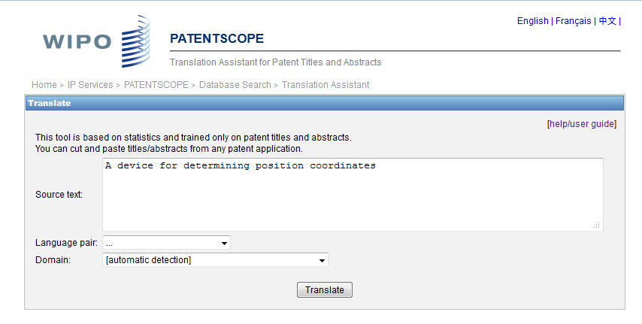
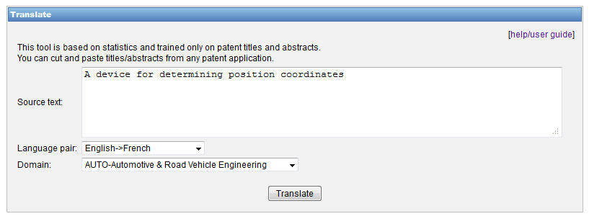
TAPTA: how does it work?

Slide 31
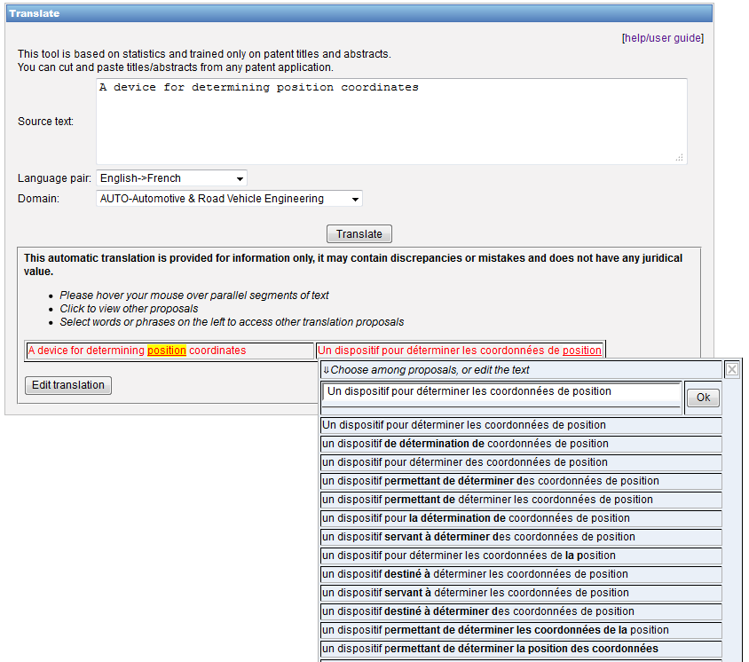

Slide 32
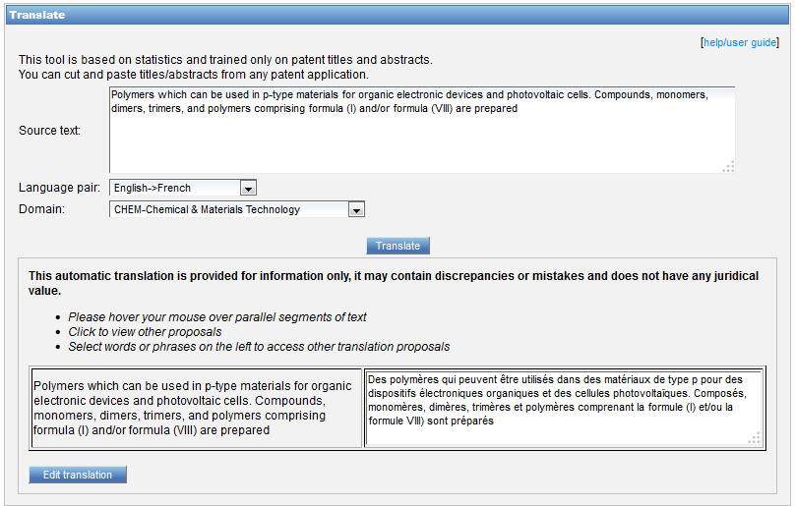
TAPTA: post-editing & exporting

Slide 33
How well does it work?
To evaluate machine translated text, BLEU is used.
BLEU (Bilingual Evaluation Understudy) is an algorithm for evaluating the quality of text which has been machine-translated from one natural language .
Quality = the correspondence between a machine's output and that of a human
Scores are calculated for individual translated segments—generally sentences—by comparing them with a set of good quality reference translations.
Notes:
: "the closer a machine translation is to a professional human translation, the better it is" - this is the central idea behind BLEU
Those scores are then averaged over the whole corpus to reach an estimate of the translation's overall quality. Intelligibility or grammatical correctness are not taken into account.

Slide 34
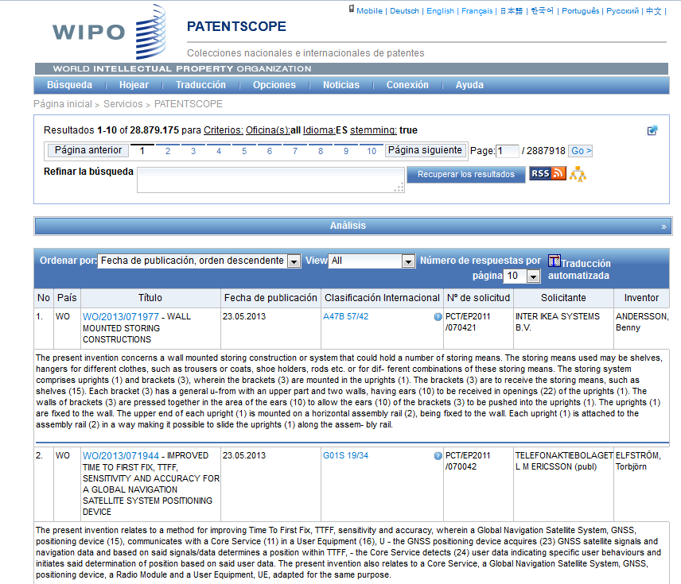
MT in result list

Slide 35
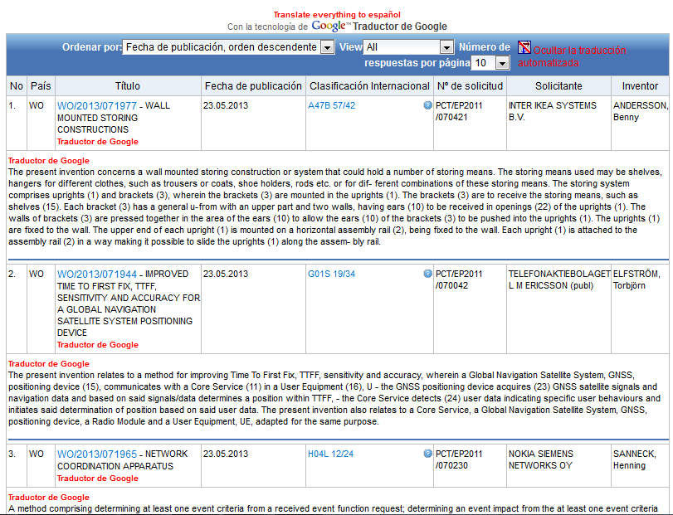

Slide 36
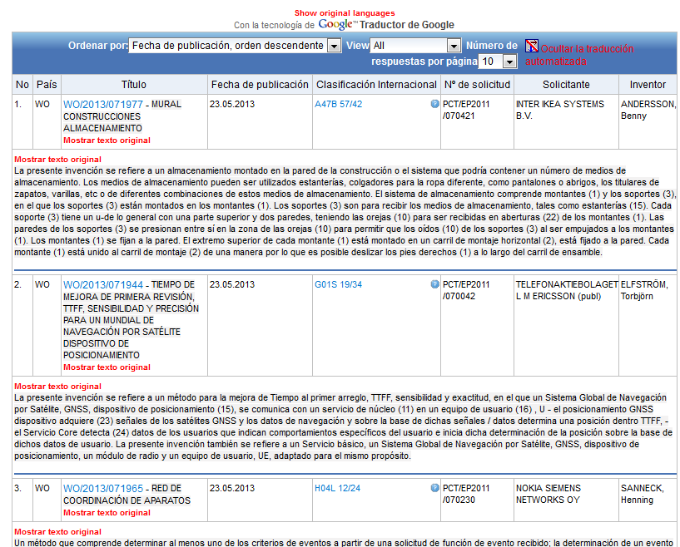

Slide 37
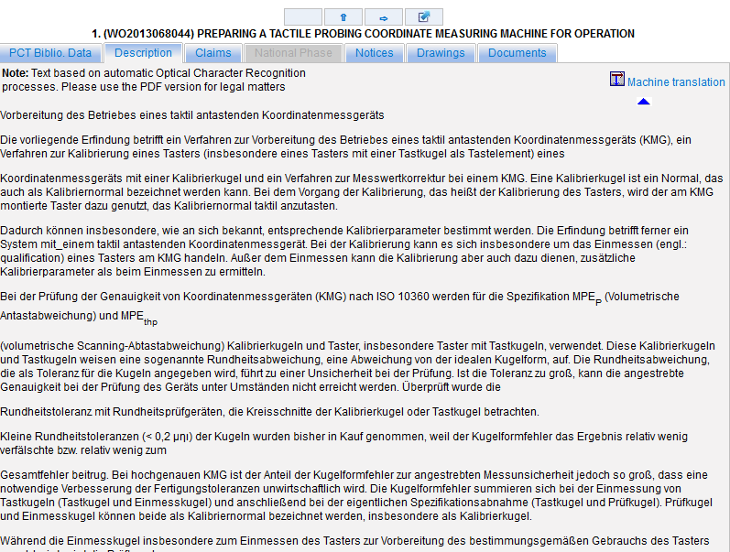
MT in description/claims/full-text

Slide 38
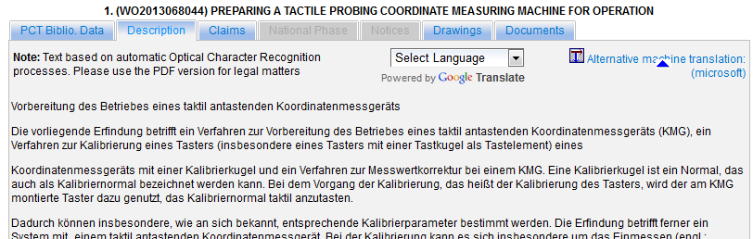

Slide 39
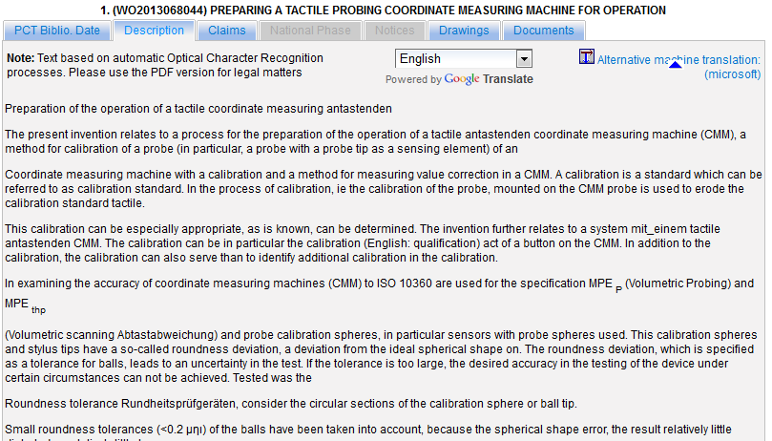
Google

Slide 40
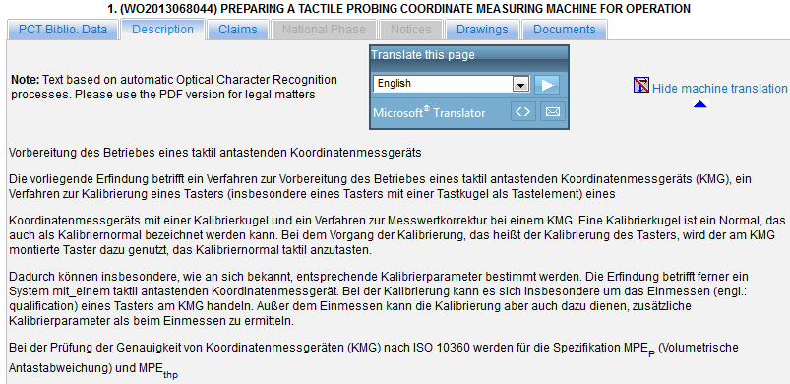
Microsoft

Slide 41
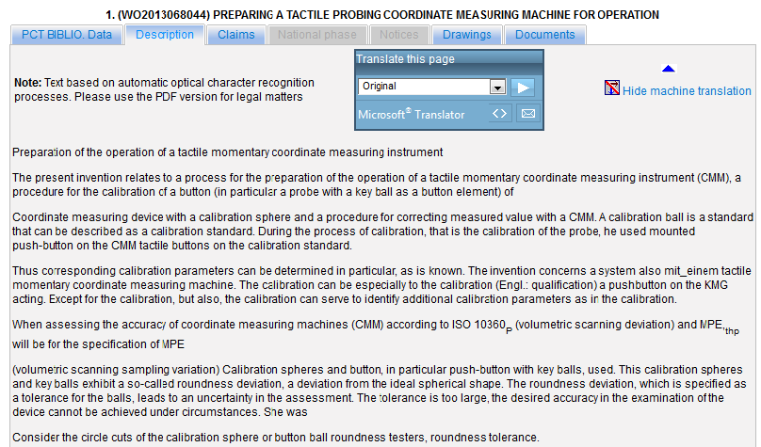

Slide 42
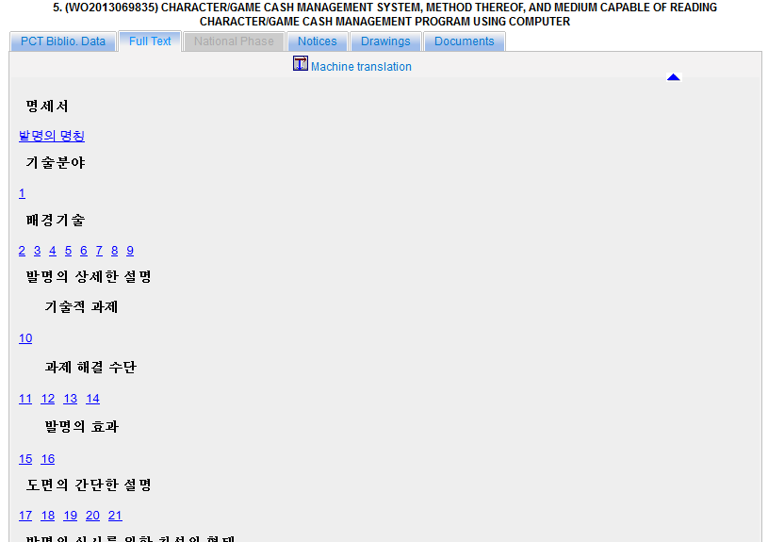
Full-text

Slide 43
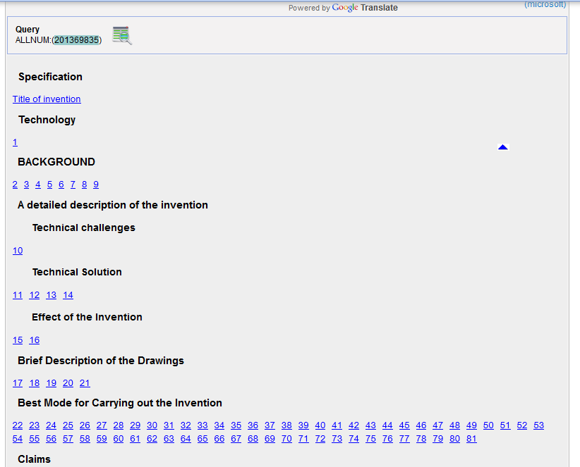

Slide 44
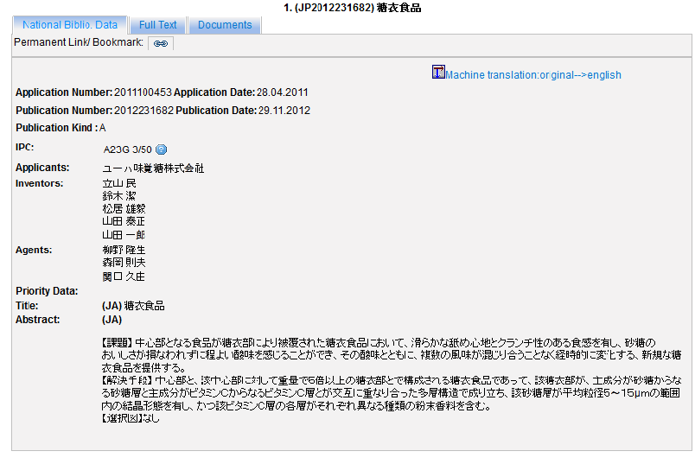
TAPTA

Slide 45
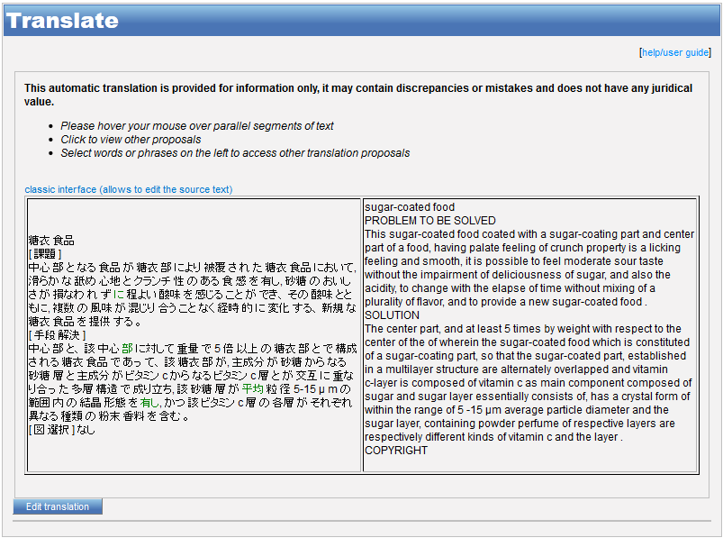

Slide 46
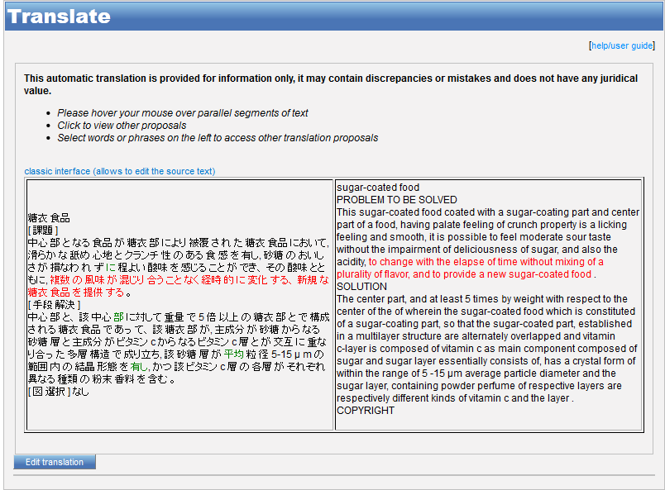

Slide 47
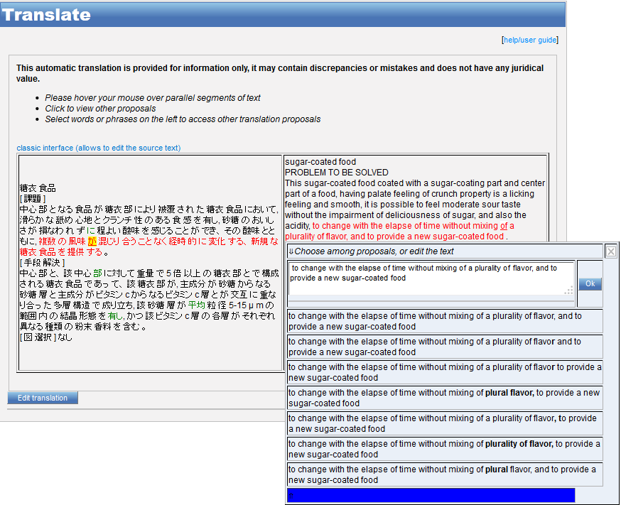

Slide 48
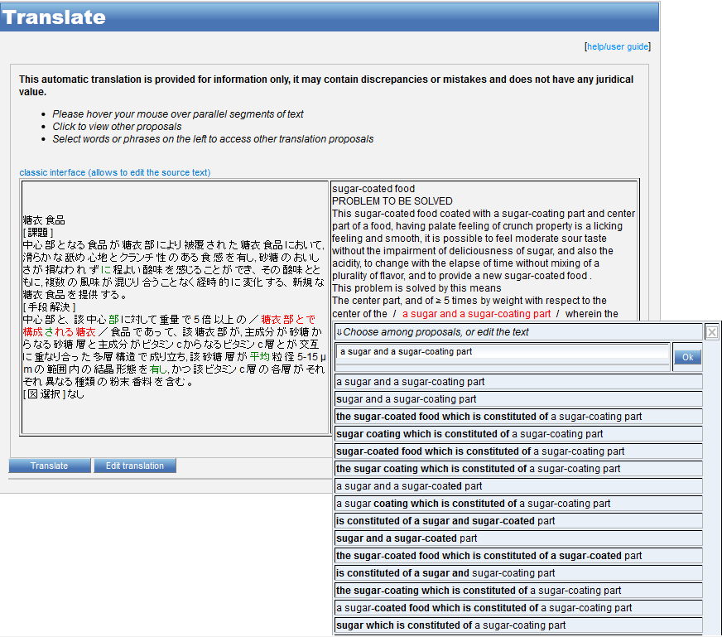

Slide 49
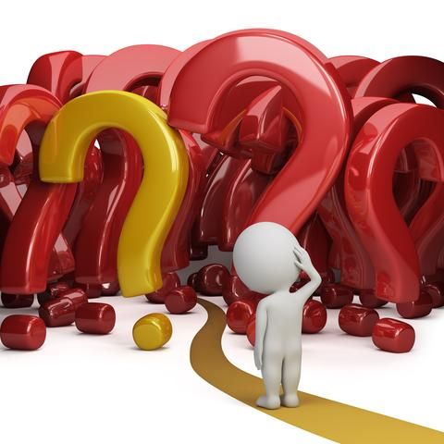

Slide 50
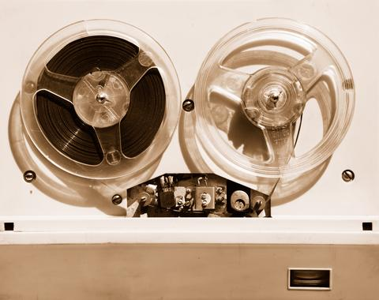

Slides and recording
+
www.wipo.int/patentscope/en/webinar/index.html

Slide 51
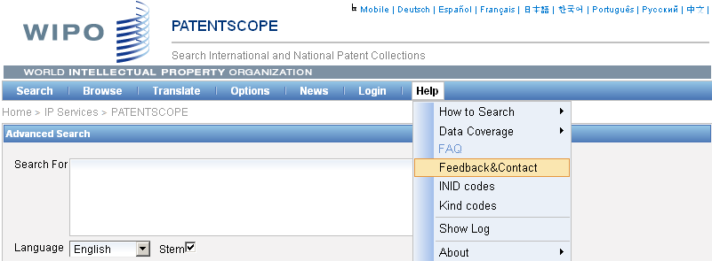

patentscope@wipo.int

Slide 52

mulțumesc
mulțumesc

