Slide 1
PATENTSCOPE Overview
Cyber world
June
2015
Sandrine Ammann
Marketing & Communications Officer

Slide 2


To the PATENTSCOPE search system webinar
Overview

Slide 3
Agenda
Focus on the search system:
  Coverage
  Interfaces
  Account
  How to search/browse
  Reading the results
  Multilingual tools
  Latest developments
  Q & A session

Slide 4

THE COVERAGE

Slide 5
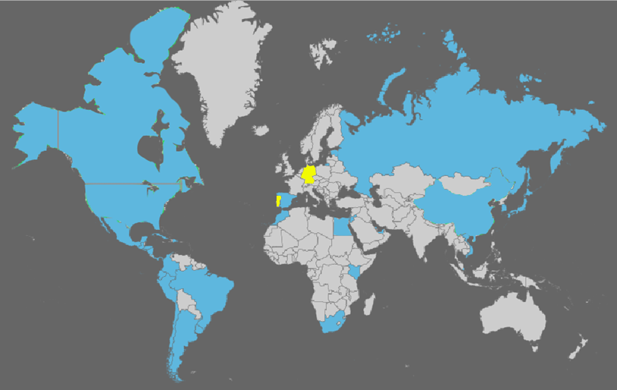
Coverage : Collections
As well as PCT applications, the ARIPO, EPO and LATIPAT collections
Notes:
ARIPO: African Regional IP Org
PCT: 1st publication worldwide

Slide 6
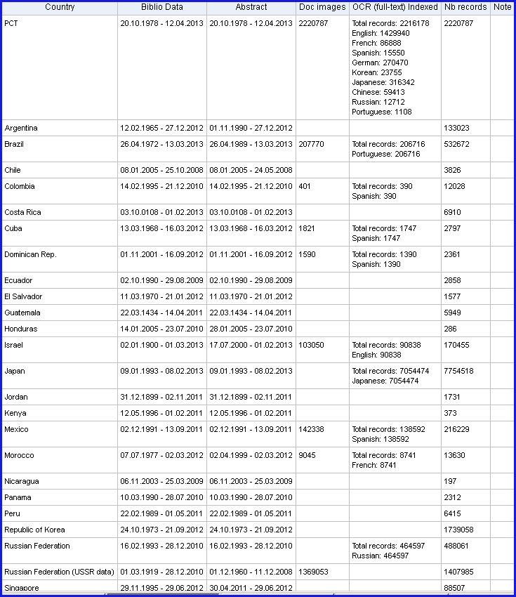
Coverage : Details of collections

Slide 7
To be added in the future
UK
DK
AU
NZ

Slide 8
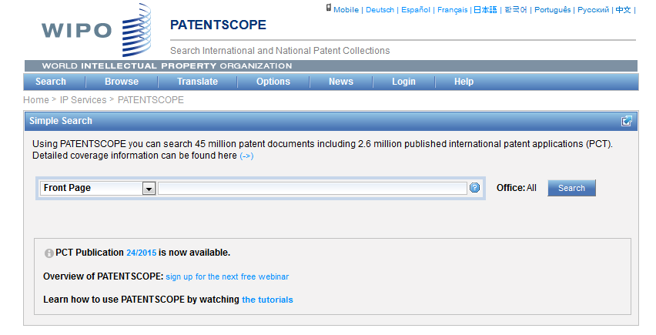
Languages of the interface

Slide 9
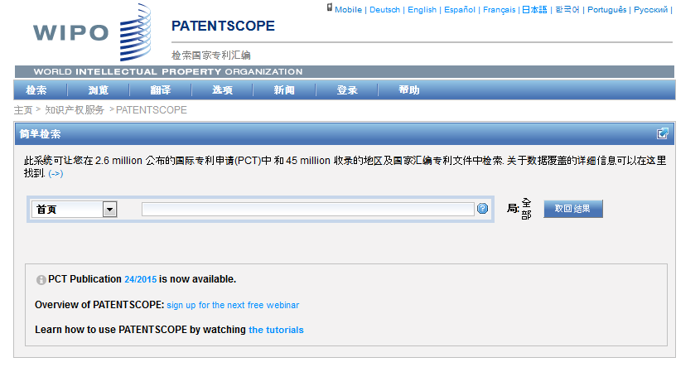
Interface in Chinese

Slide 10
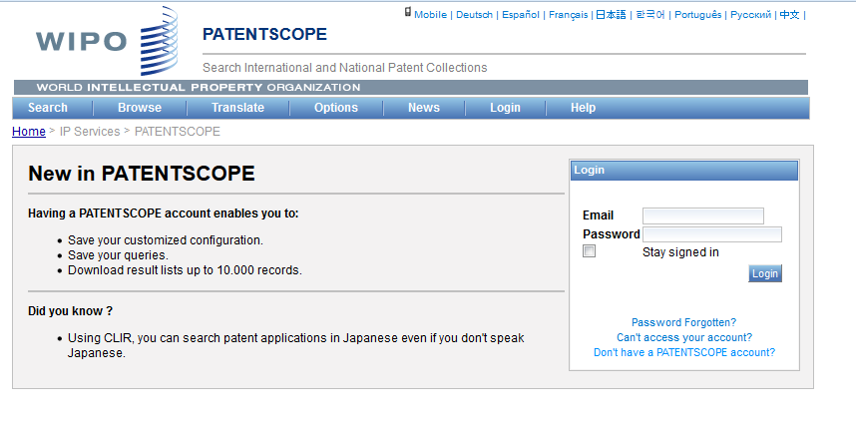
PATENTSCOPE account

Slide 11
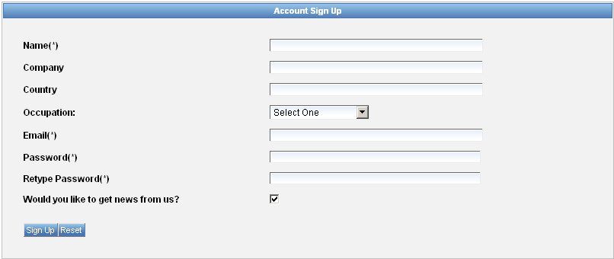
Signing up

Slide 12
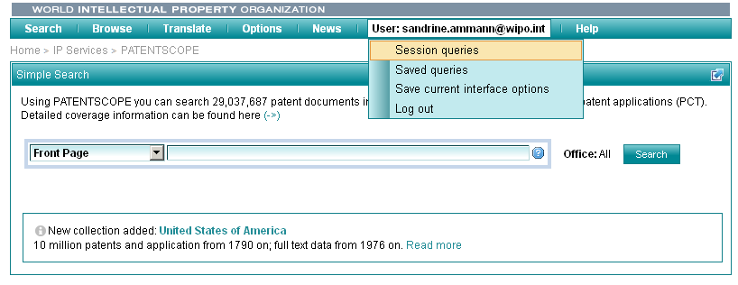
Once logged-in

Slide 13
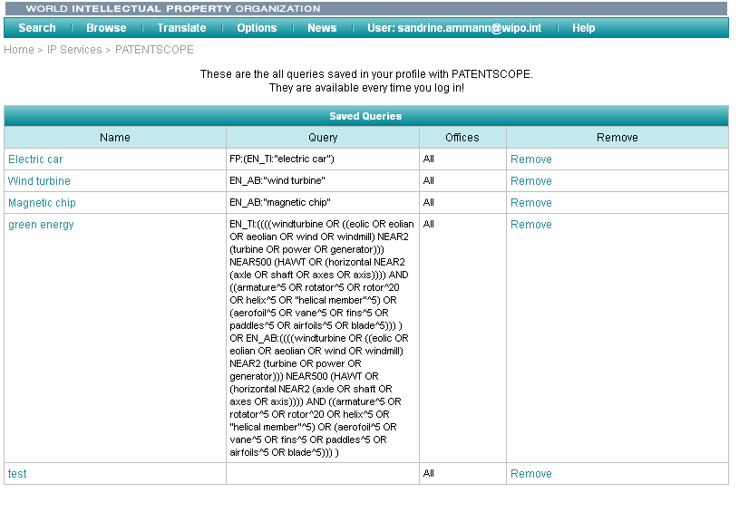
Saved queries

Slide 14
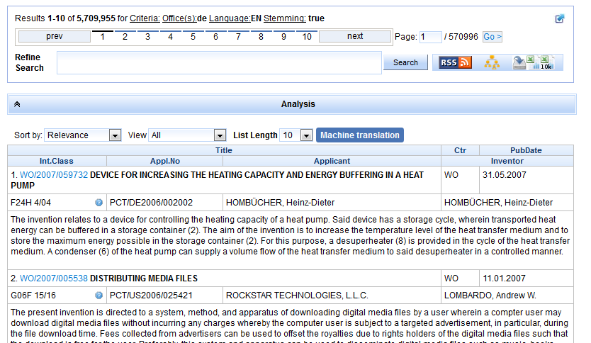
Downloading the results

Slide 15
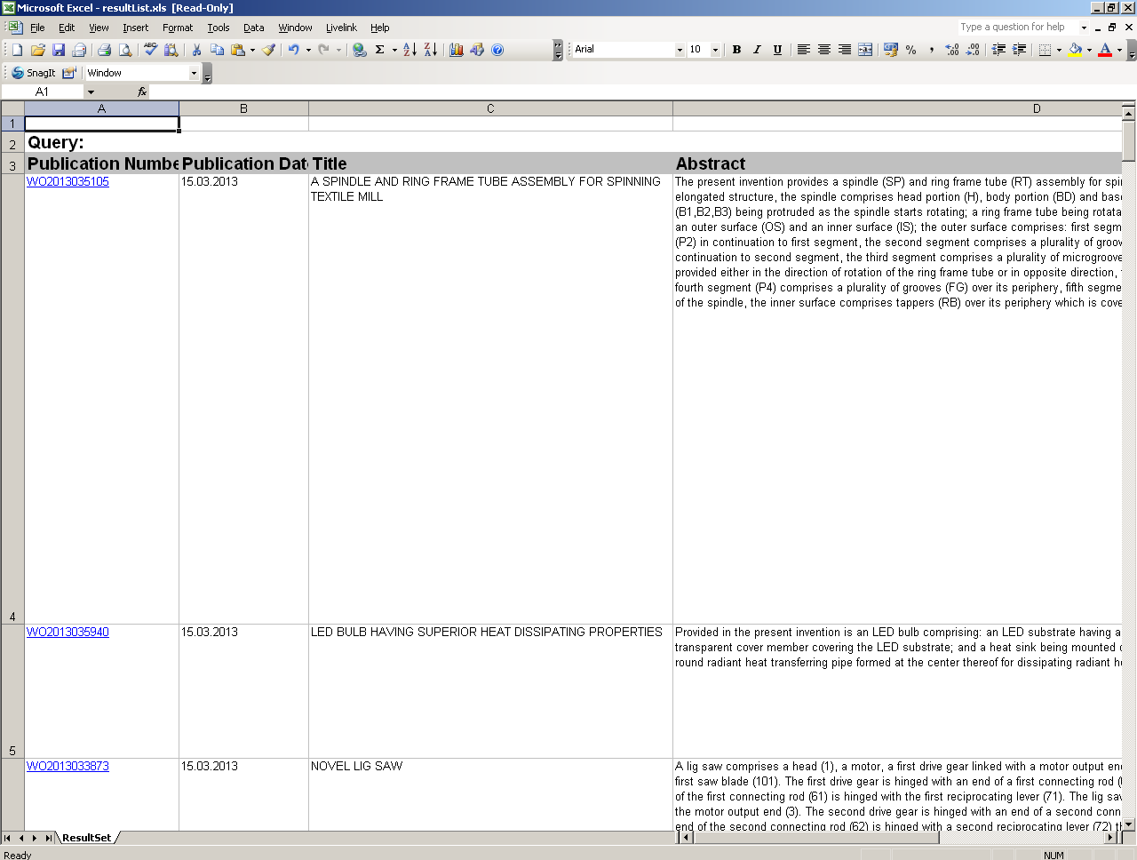
Downloaded results

Slide 16
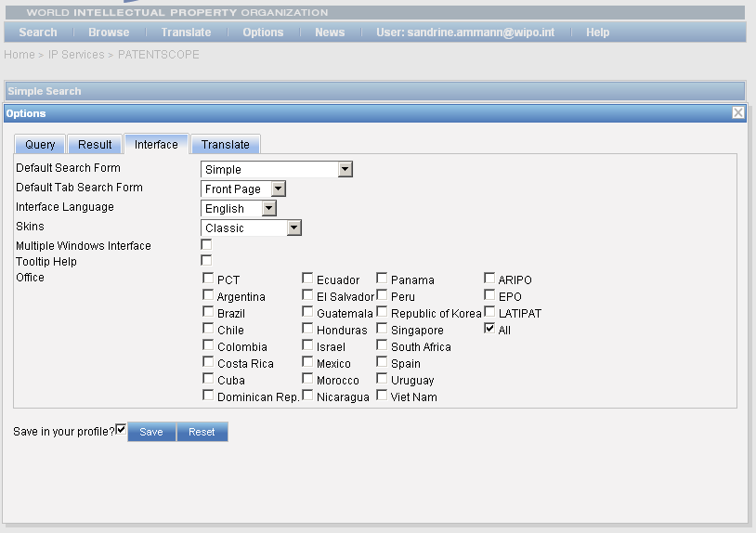
Account customization

Slide 17
PATENTSCOPE: how to search
Browse by week or sequence listing
Search patent documents:
  Simple
  Advanced
  Field combination
  CLIR

Slide 18
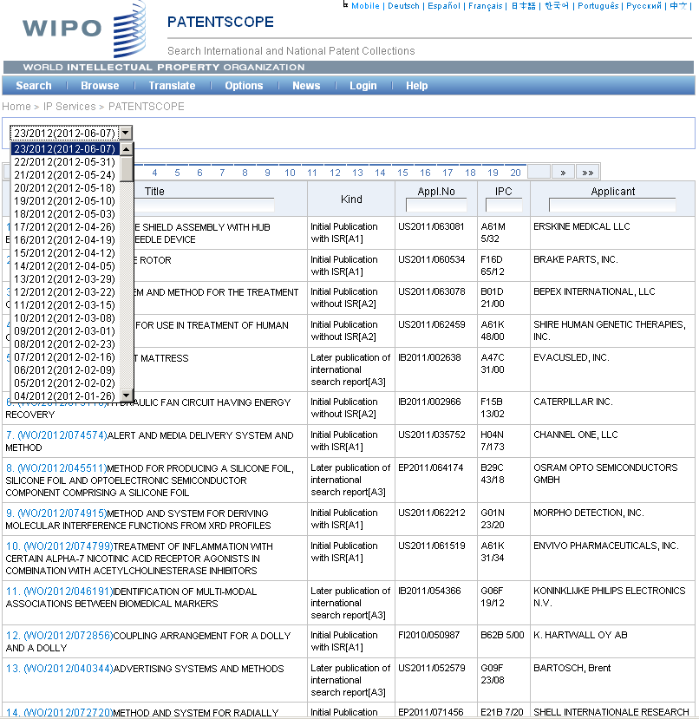

Slide 19
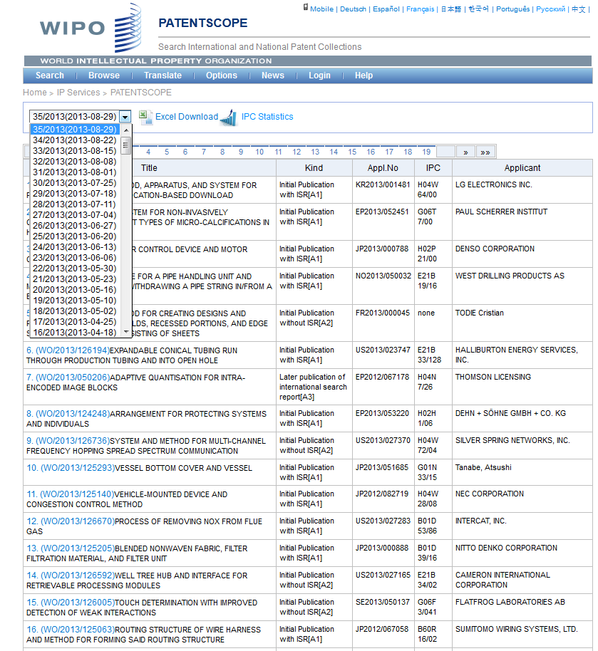

Slide 20
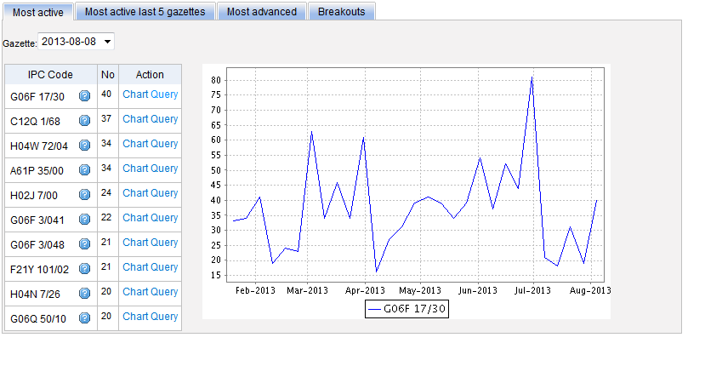
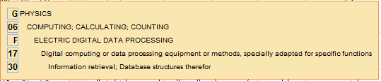
Most active

Slide 21
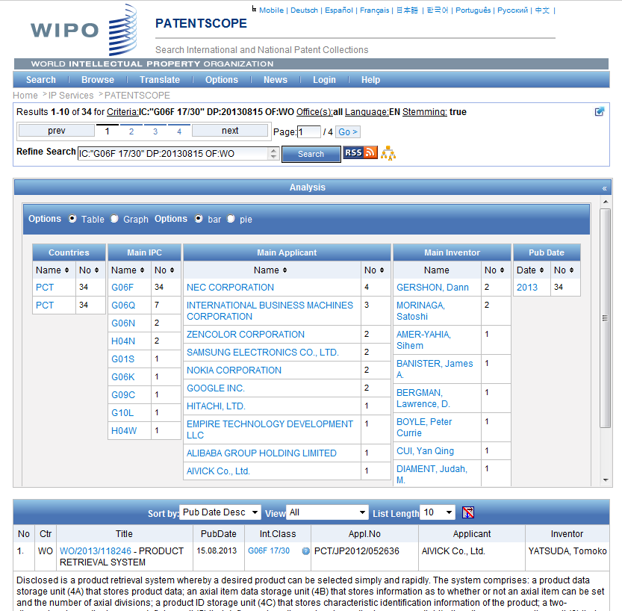

Slide 22
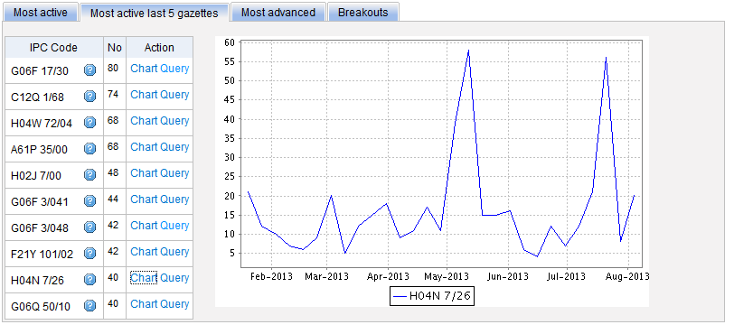
Most active last 5 gazettes

Slide 23
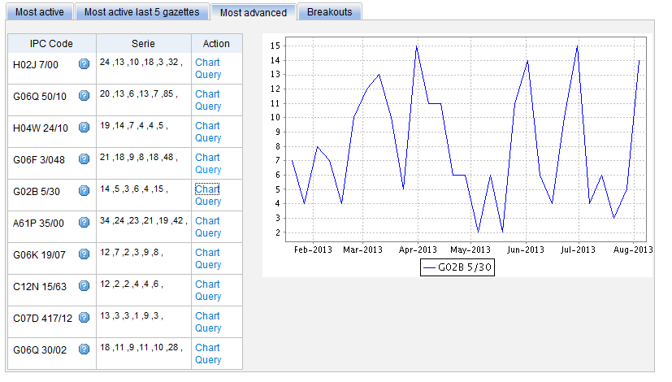
Most advanced

Slide 24
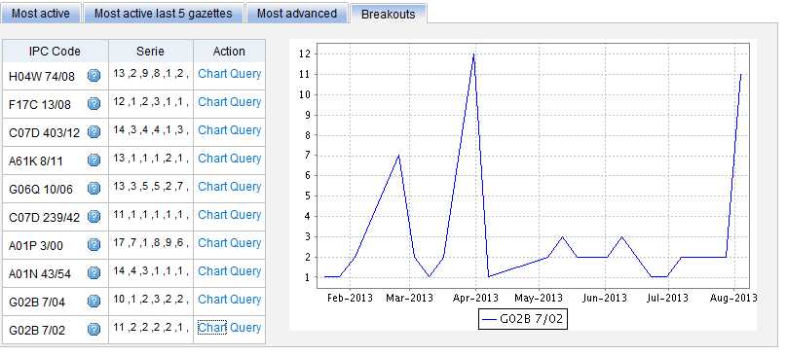
Breakouts

Slide 25
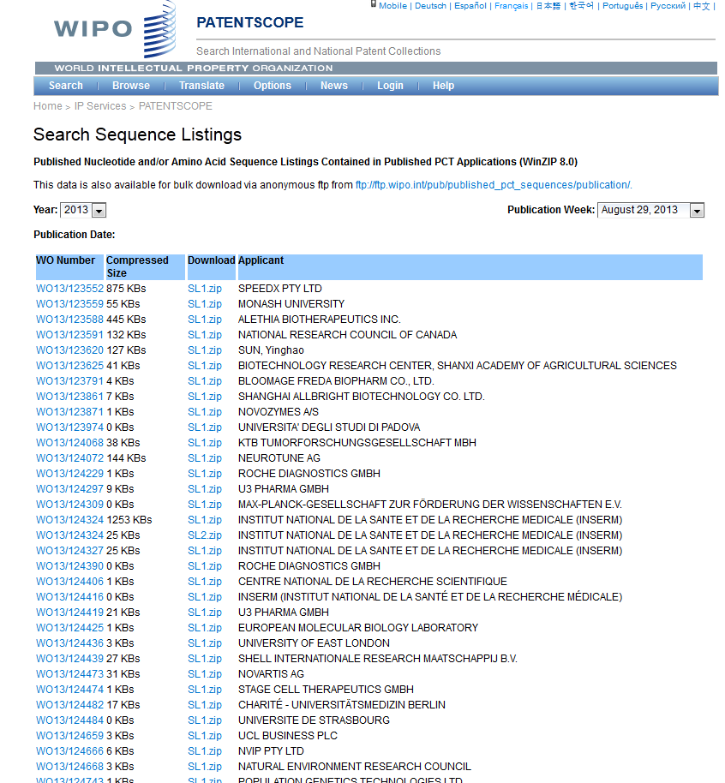

Slide 26
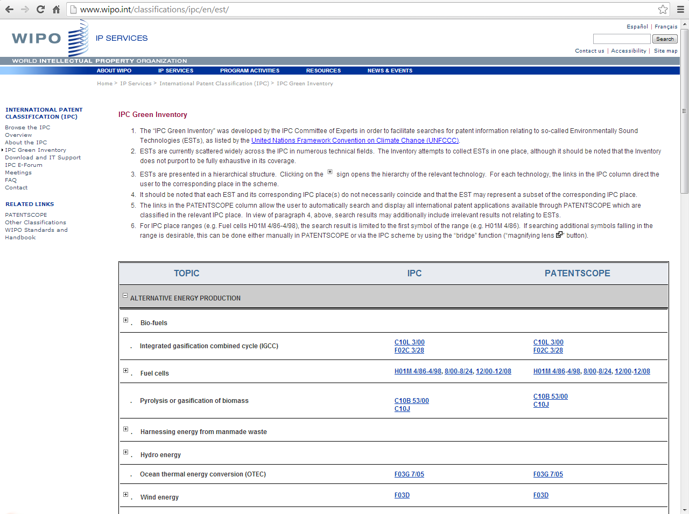
IPC Green Inventory

Slide 27
PATENTSCOPE: how to search
Browse by week or sequence listing
Search patent documents:
  Simple
  Advanced
  Field combination
  CLIR

Slide 28
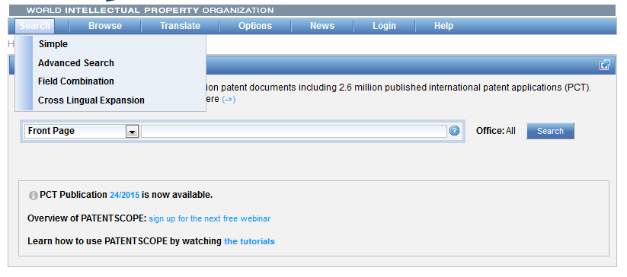
4 ways to search

Slide 29
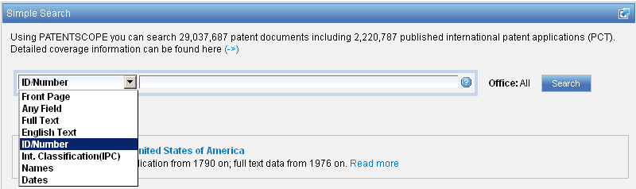
Interface : Simple
Basic search fields are provided

Slide 30
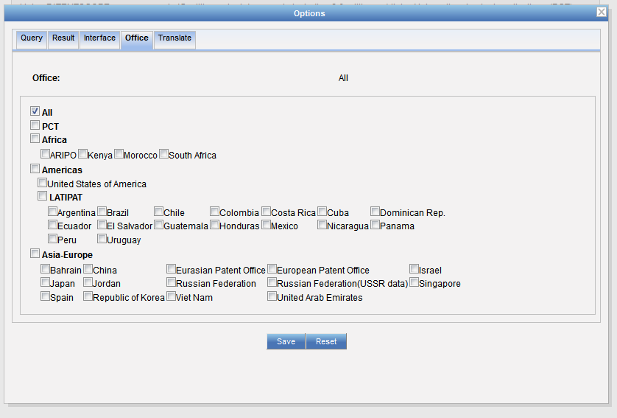
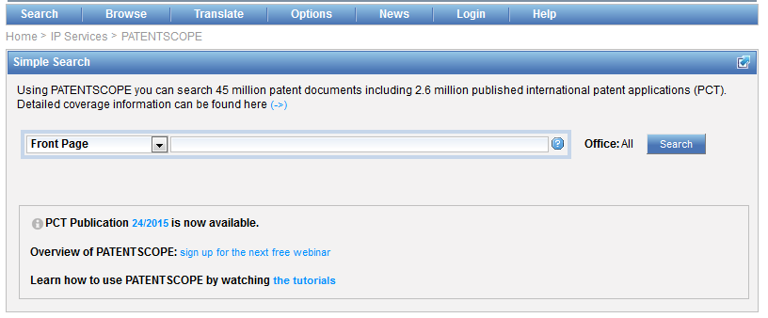
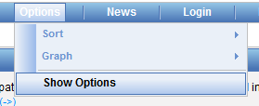
Collection selection

Slide 31
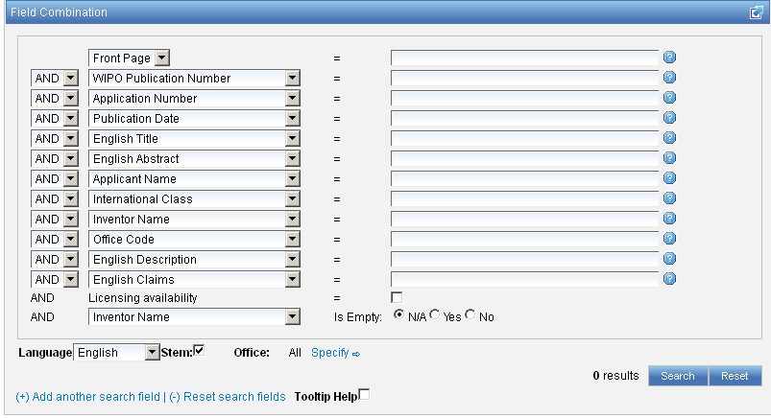
Interface : Field Combination - Structured
Additional search fields can be selected

Slide 32
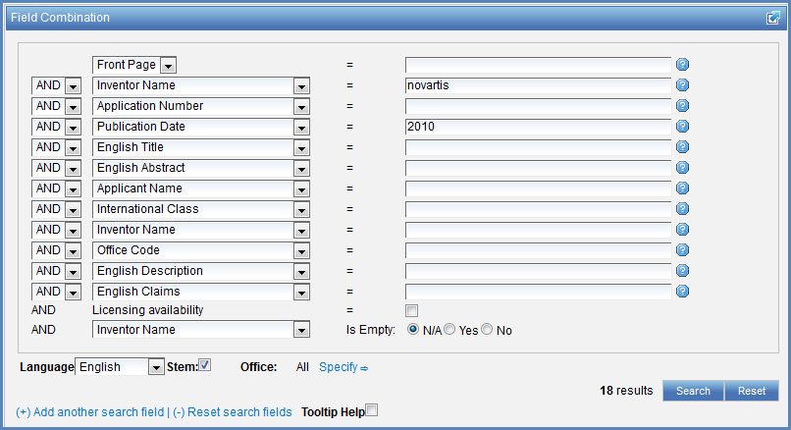

Search examples
Patent documents containing Novartis as inventor and published in 2010
Patent documents without an IPC code
Notes:
32
3. there is also the option to select a field that is empty: for example you could search. On the last line, select the IPC in the drop-down box and tick yes next to empty.

Slide 33
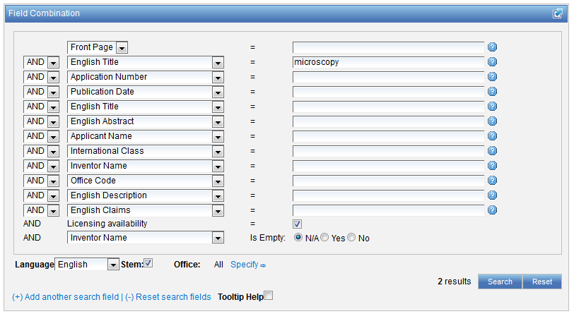
Search examples
Patent documents containing microscopy with licensing availability.
Notes:
33
In the drop-down box, select the field Applicant name and enter Steve Jobs; select AND and the field Publication date and enter 2007
In the drop-down boy, select English description and enter microchip, then tick the Licensing availability box (one before last in the Field Combination interface).

Slide 34
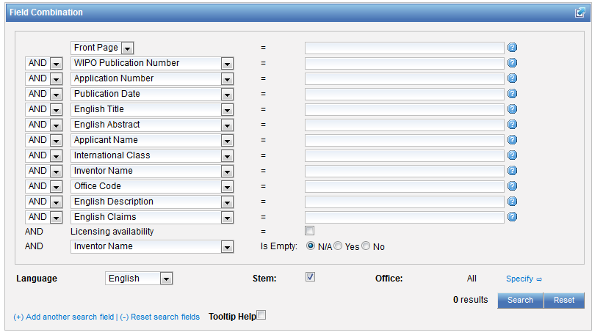
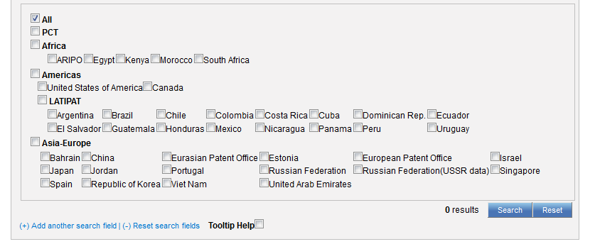
Collection selection

Slide 35
Stemming
Process that removes common ending from words by English Snowball algorithm
electric¦al = electric
electric¦ity = electric
electron¦ics = electron
More accurate results than wildcards:
elect* electoral, etc.

Slide 36
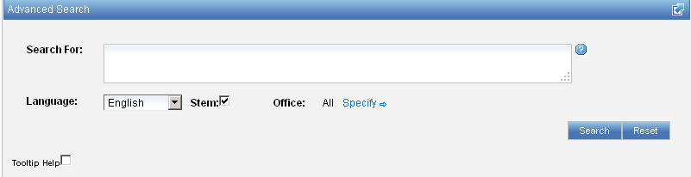
Interface : Advanced
Full flexibilities are enabled

Slide 37
To help you fine-tune your search
1. Boolean operators
2. Proximity operators
3. Field codes
4 .Stemming/wildcard/fuzzy searches
5. Grouping/nesting
6. Date searches

Slide 38
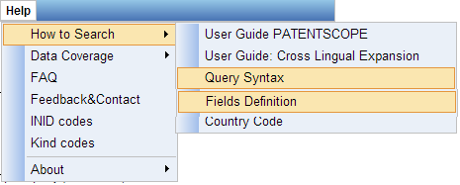
Help menu

Slide 39
Search examples: field code, Boolean and range operator
Inventions made by Steve Jobs published during the period from 2007 to 2009 comprising the keyword “touch” in the description.
IN:(Jobs) AND DP:[2007 TO 2009] AND EN_DE:(touch)
This search query uses field codes, a Boolean operator, and a range operator.
The field codes are IN for inventor, DP for publication date, and EN_DE for English description.
The Boolean operator AND is used to ensure that all search terms are included in the search results (i.e. that the results are for Jobs as inventor, within the given publication date range, and using the word “touch”).
The range operator TO is used to define a range of publication date values.
Notes:
39
Searching for..

Slide 40
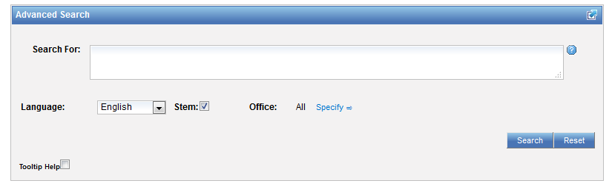
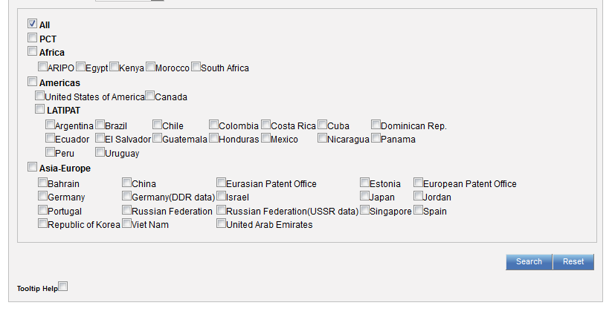
Collection selection

Slide 41
CLIR
CLIR stands for Cross Lingual Information Retrieval and will allow you to search a term or a phrase and its variants in:
Chinese
Dutch
English
French
German
Italian
Japanese
Korean
Portuguese
Russian
Spanish and
Swedish
Notes:
41
You will use this tool in order to:
-Find synonyms in order to retrieve comprehensive results
-To search in a language that one does know

Slide 42
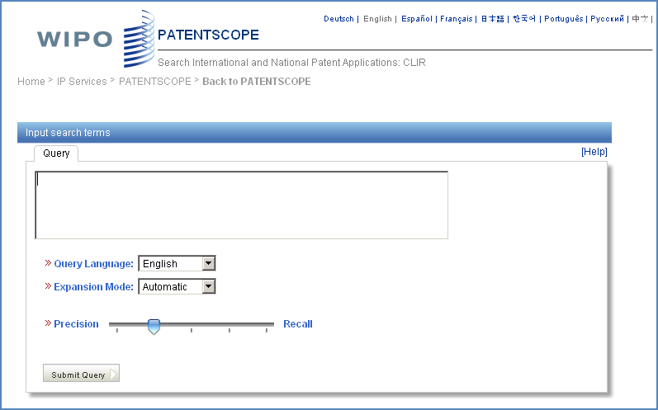
CLIR: the interface
Notes:
42
There is query box
Query language
Expansion mode

Slide 43
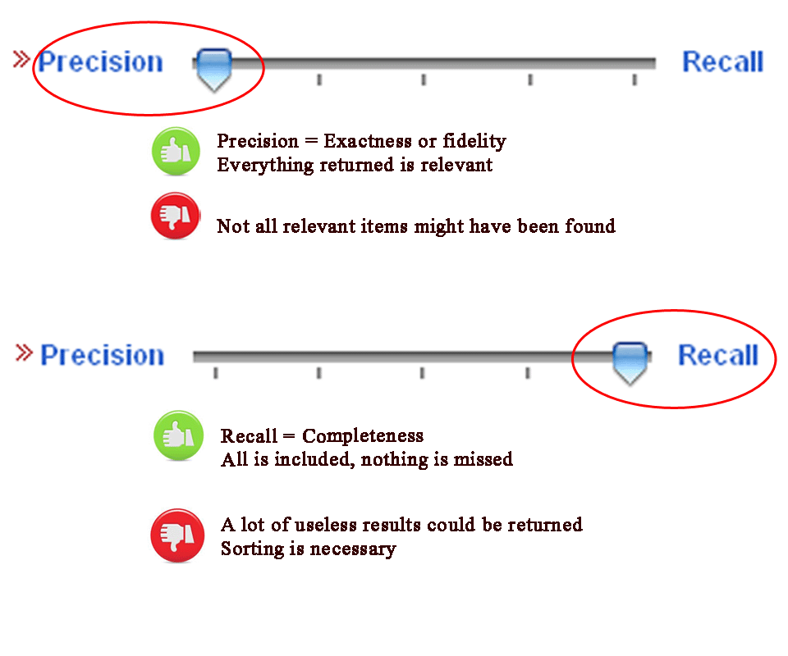
CLIR: precision vs recall

Slide 44
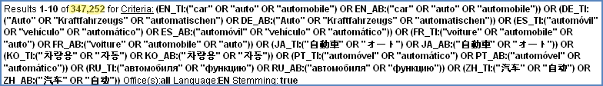
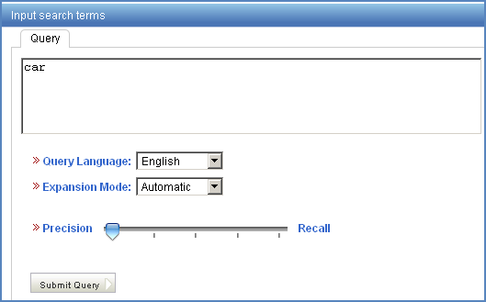
Example: precision

Slide 45
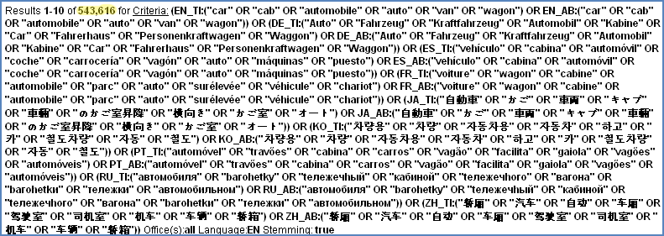
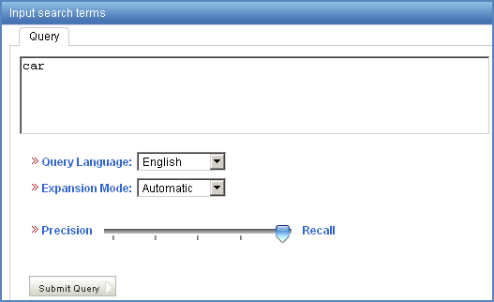
Example: recall

Slide 46
CLIR: supervised mode
2 modes: automatic and supervised
Automatic: 1 step
Supervised: 4 steps

Slide 47
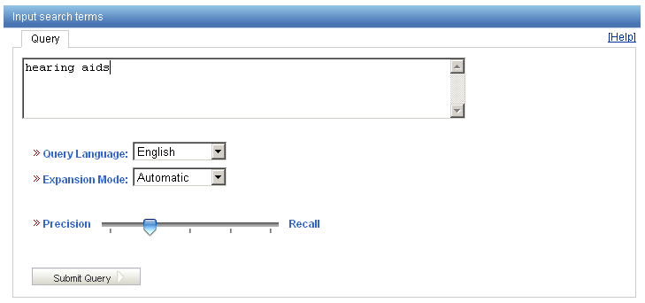
Automatic mode

Slide 48
Automatic mode: results
(EN_TI:("hearing aids" OR "hearing prosthetic"~21 OR "auditory aids"~21 OR "auditory prosthetic"~21) OR EN_AB:("hearing aids" OR "hearing prosthetic"~21 OR "auditory aids"~21 OR "auditory prosthetic"~21)) OR (DE_TI:("Hörgeräte" OR "Hörhilfegeräten") OR DE_AB:("Hörgeräte" OR "Hörhilfegeräten")) OR (ES_TI:("audífonos") OR ES_AB:("audífonos")) OR (FR_TI:("audioprothèses" OR "appareils de correction auditive" OR "production d'appareils auditifs") OR FR_AB:("audioprothèses" OR "appareils de correction auditive" OR "production d'appareils auditifs")) OR (JA_TI:("穴形補聴器") OR JA_AB:("穴形補聴器")) OR (KO_TI:("보청") OR KO_AB:("보청")) OR (PT_TI:("audiofone" OR "auxìlio de audição") OR PT_AB:("audiofone" OR "auxìlio de audição")) OR (RU_TI:("слуха протезно"~22 OR "прослушивания протезно"~22 OR "слуха спидом"~22 OR "слуха наведения"~22 OR "прослушивания спидом"~22 OR "прослушивания наведения"~22 OR "слухоулучшающих протезно"~22 OR "слуховой протезно"~22 OR "слухоулучшающих спидом"~22) OR RU_AB:("слуха протезно"~22 OR "прослушивания протезно"~22 OR "слуха спидом"~22 OR "слуха наведения"~22 OR "прослушивания спидом"~22 OR "прослушивания наведения"~22 OR "слухоулучшающих протезно"~22 OR "слуховой протезно"~22 OR "слухоулучшающих спидом"~22)) OR (ZH_TI:("助听器") OR ZH_AB:("助听器"))

Slide 49
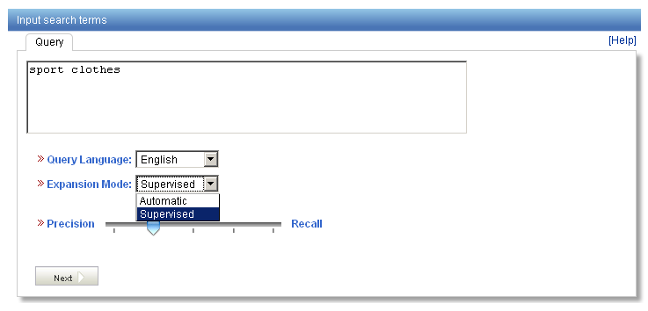
Supervised mode: 1 of 4 steps

Slide 50
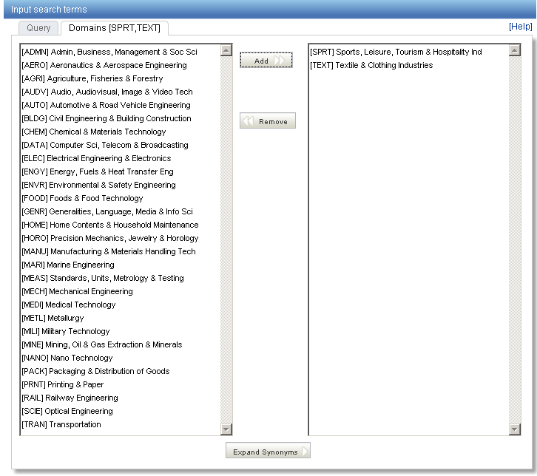
Supervised mode : 2 of 4 steps

Slide 51
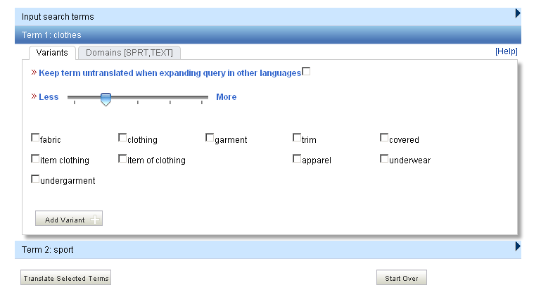
Supervised mode : 3 of 4 steps

Slide 52
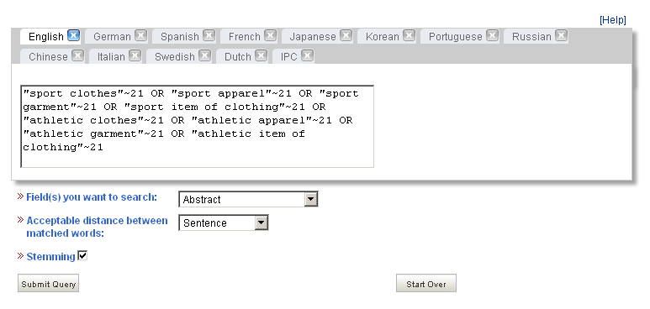
Supervised mode : 4 of 4 steps

Slide 53
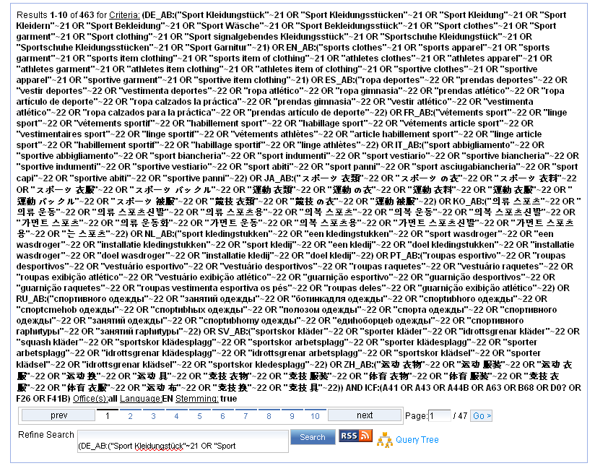
Supervised mode: results

Slide 54
Search examples: clothes for sport
Entering “sports clothes” in the Simple search interface will return 11 results
Entering “sports clothes” in the CLIR interface (in automatic mode) will return 791 results
Entering “sports clothes” in the CLIR interface (in supervised mode) will return 455 results
Notes:
54
CLIR will provide you with synonyms of both terms composing the query “sport” and “clothing” and synonyms of “sport clothing” in 11 languages which will allow you to find documents in Japanese for example.
The nb of results in the supervised mode is less because there are more relevant in fact in the auto mode you neter your query and the system retrieves results while in the supervised mode you need to paricpate actively in the selection process

Slide 55
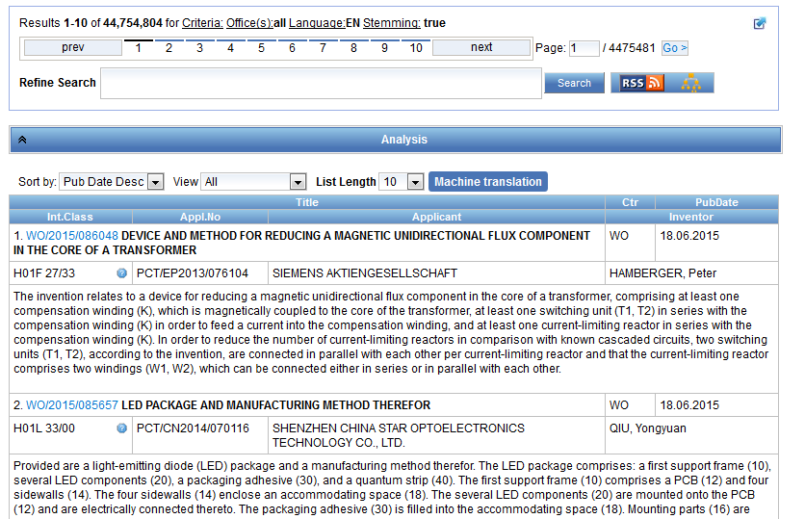
Reading the result list

Slide 56
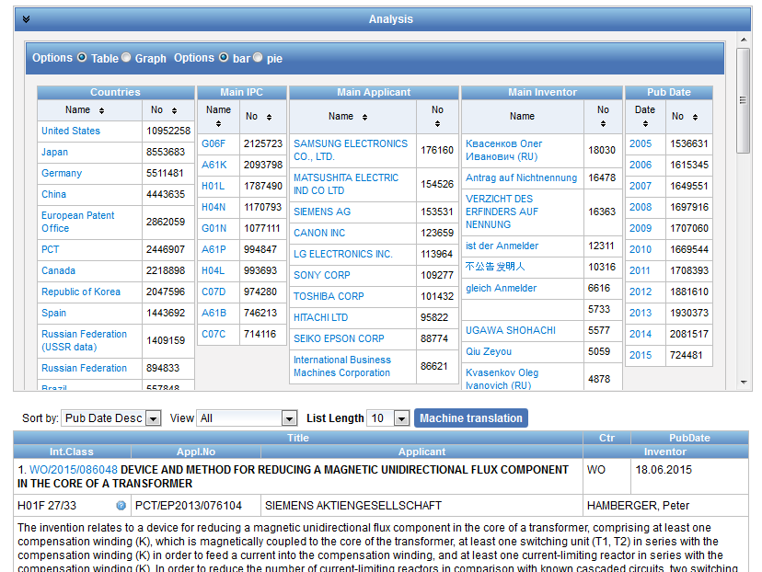
Analysis

Slide 57
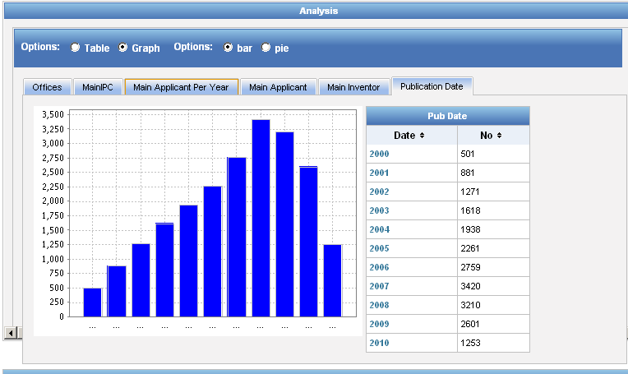
Display options: table/graph –bar/pie

Slide 58

Display options: table/graph –bar/pie
Notes:
58
In both bar and pie options, the tabs allow you to see the information graphically for the Offices, Main IPC, Main Applicant, Main Inventor and Publication Date.
The charts can be saved in GIF format for inclusion in documents or reports by right-clicking in a corner of the image and selecting “Copy image” or “Save image”.

Slide 59




Options

Slide 60

Tabs

Slide 61




Documents tab

Slide 62

PDFs

Slide 63

Multilingual tools

Slide 64

WIPO Translate
Notes:
64
Language pairs available: EN=>FR, FR=>EN, EN=>ZH, ZH=>EN
Technical domain aware system using 32 domains derived from the International Patent Classification

Slide 65

32 Technical domains from the IPC
[ADMN] Admin, Business, Management & Soc Sci
[AERO] Aeronautics & Aerospace Engineering
[AGRI] Agriculture, Fisheries & Forestry
[AUDV] Audio, Audiovisual, Image & Video Tech
[AUTO] Automotive & Road Vehicle Engineering
[BLDG] Civil Engineering & Building Construction
[CHEM] Chemical & Materials Technology
[DATA] Computer Sci, Telecom & Broadcasting
[ELEC] Electrical Engineering & Electronics
[ENGY] Energy, Fuels & Heat Transfer Eng
[ENVR] Environmental & Safety Engineering
[FOOD] Foods & Food Technology
[GENR] Generalities, Language, Media & Info Sci
[HOME] Home Contents & Household Maintenance
[HORO] Precision Mechanics, Jewelry & Horology
[MANU] Manufacturing & Materials Handling Tech
[MARI] Marine Engineering
[MEAS] Standards, Units, Metrology & Testing
[MECH] Mechanical Engineering
[MEDI] Medical Technology
[METL] Metallurgy
[MILI] Military Technology
[MINE] Mining, Oil & Gas Extraction & Minerals
[NANO] Nano Technology
[PACK] Packaging & Distribution of Goods
[PRNT] Printing & Paper
[RAIL] Railway Engineering
[SCIE] Optical Engineering
[SPRT] Sports, Leisure, Tourism & Hospitality
[TEXT] Textile & Clothing Industries
[TRAN] Transportation

Slide 66

WIPO Translate: how does it work?

Slide 67


Slide 68


Slide 69


Slide 70

Latest developements

Slide 71

New: https

Slide 72

Translation tools

Slide 73


Slide 74

Documents tab: new section

Slide 75


patentscope@wipo.int

Slide 76

mulțumesc
mulțumesc

