Slide 1
PATENTSCOPE
Browse menu
July
2016
Sandrine Ammann
Marketing & Communications Officer

Slide 2
Agenda
News
Browse menu
Quiz
Next webinar
Q&A session

Slide 4
Chemical Search function - Timeline
Target production date: August 2016
Step 1: chemical compounds in PCT applications published in English or German;
Next steps: other languages and national patent collections

Slide 5
Browse menu

Slide 6
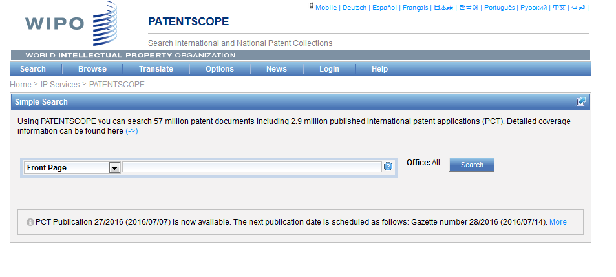
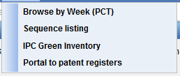

Slide 7
Browse by week (PCT)
Access PCT published applications by week
View IPC statistics

Slide 8
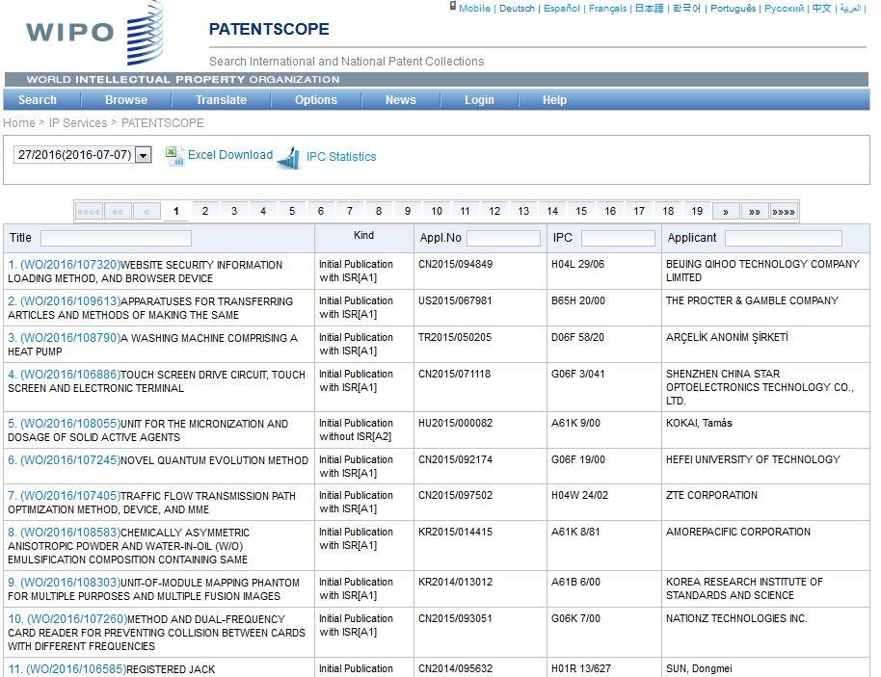

Slide 9
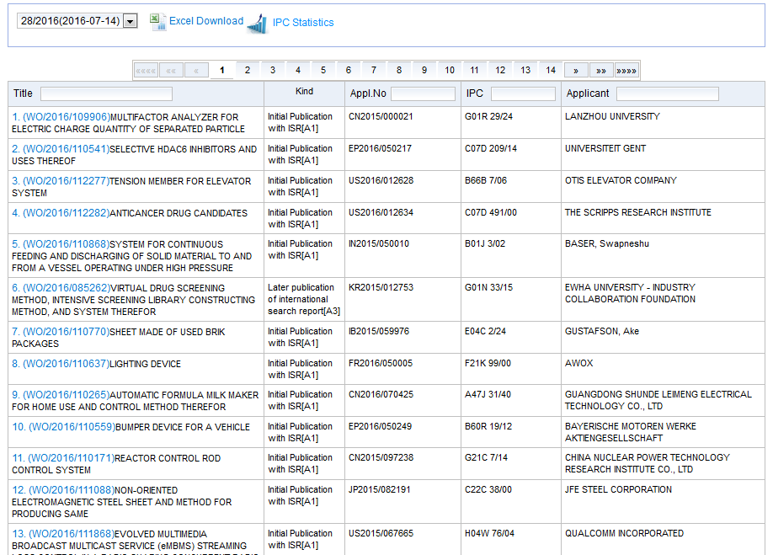
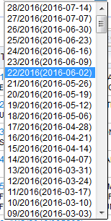
Access weekly publication

Slide 10
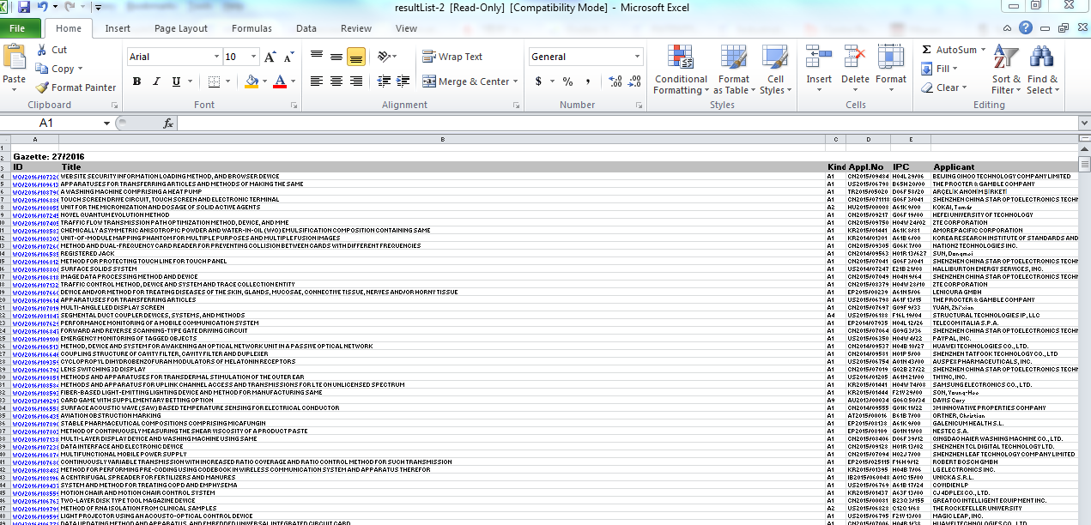
Downloaded list

Slide 11
IPC statistics

Slide 12
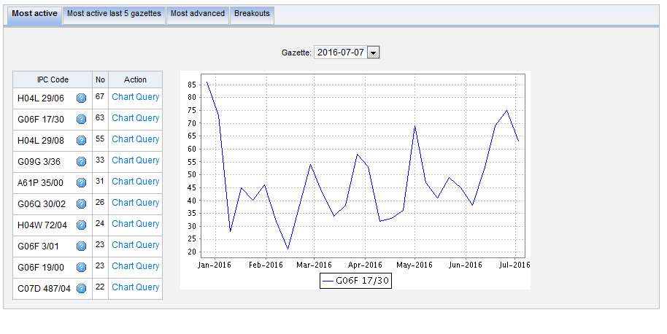
Most active

Slide 13
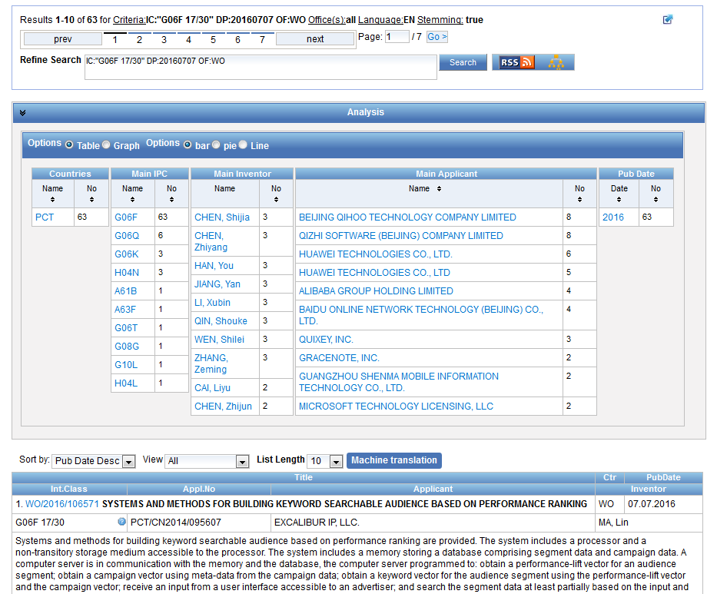

Slide 14
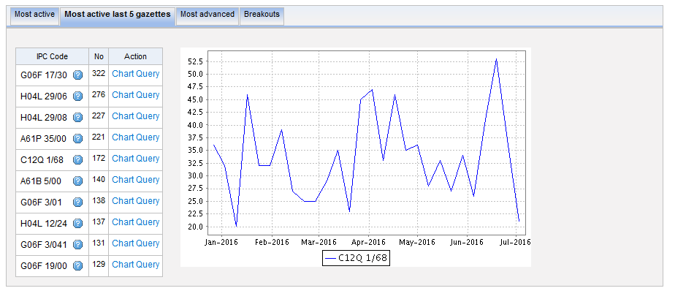
Most active last 5 gazettes

Slide 15
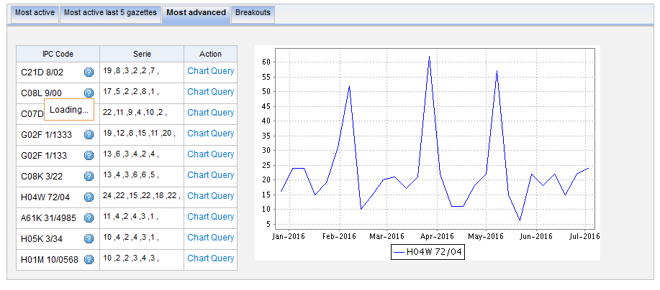
Most advanced

Slide 16
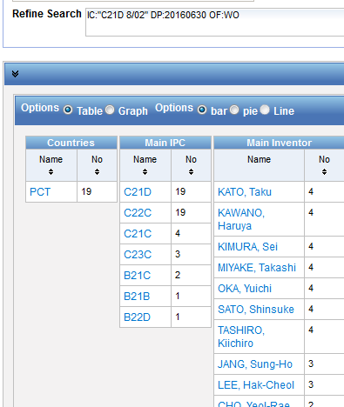
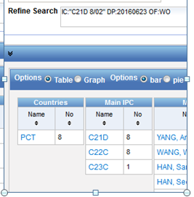
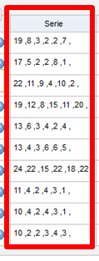
Serie column
6 last publications, nb of IPC per publication

Slide 17
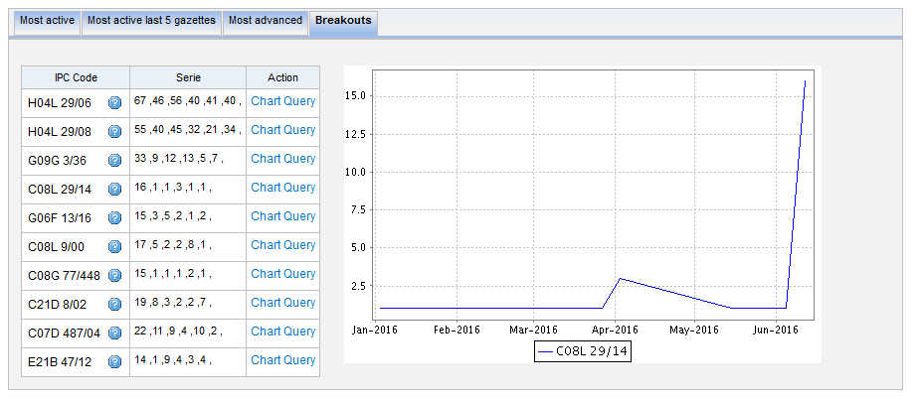
Breakouts

Slide 18
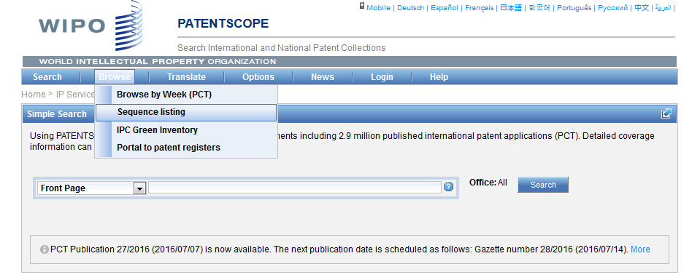
Sequence Listing (SL)

Slide 19
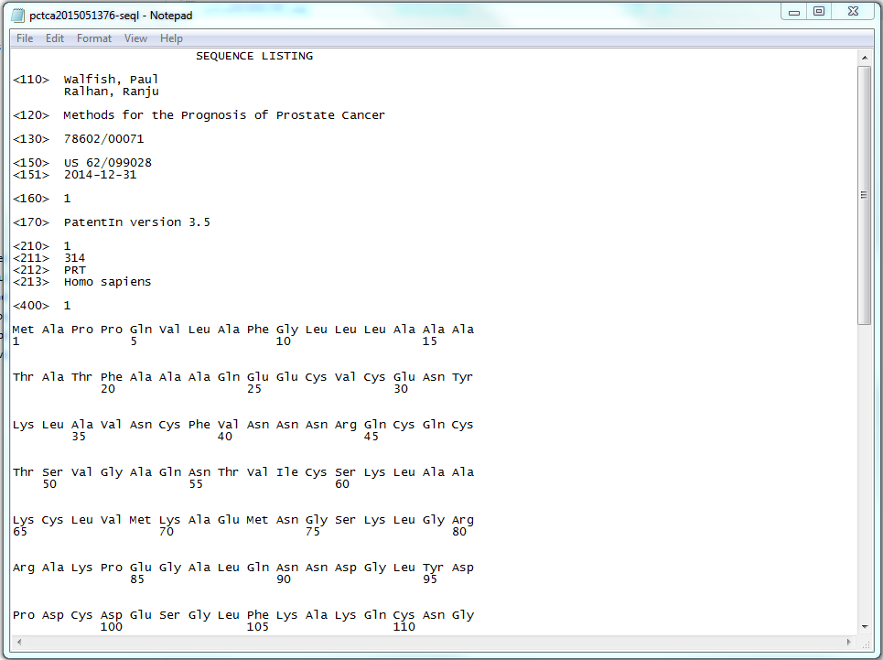
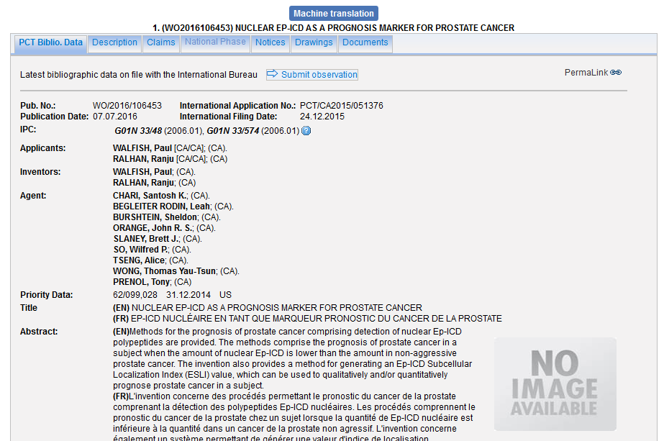
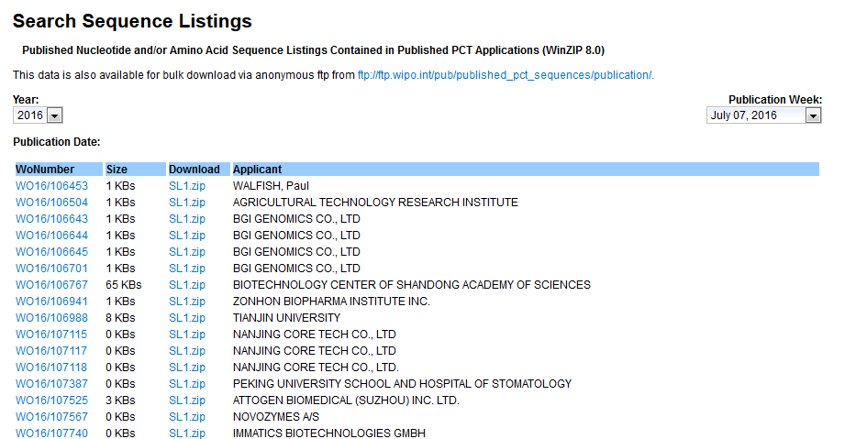
Sequence listing

Slide 20
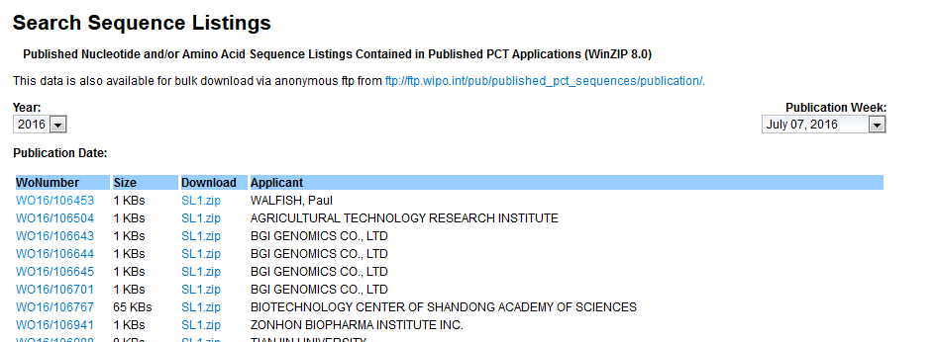
SL bulk downloading

Slide 21
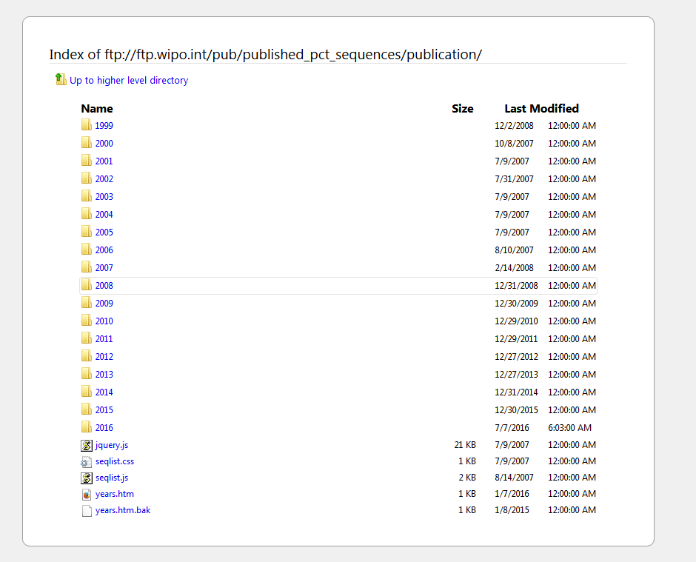

Slide 22
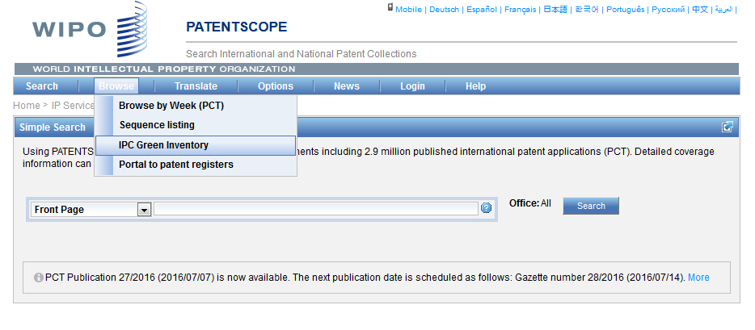
IPC Green Inventory

Slide 23
IPC Green Inventory
facilitates searches for patent information relating to so-called Environmentally Sound Technologies (ESTs)
collects ESTs in one place: ESTs are currently scattered widely across the IPC in numerous technical fields

Slide 24
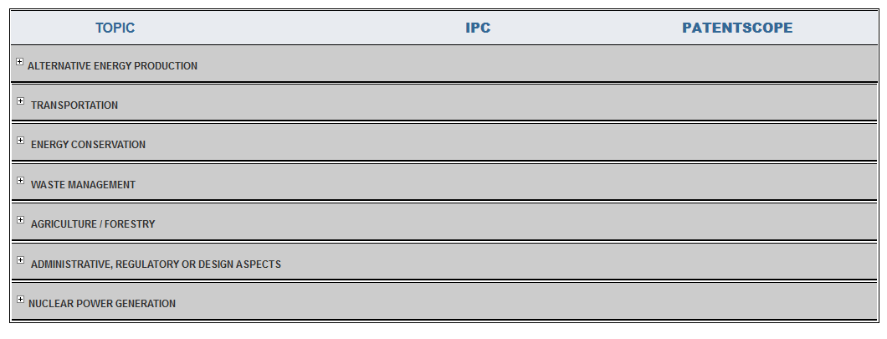
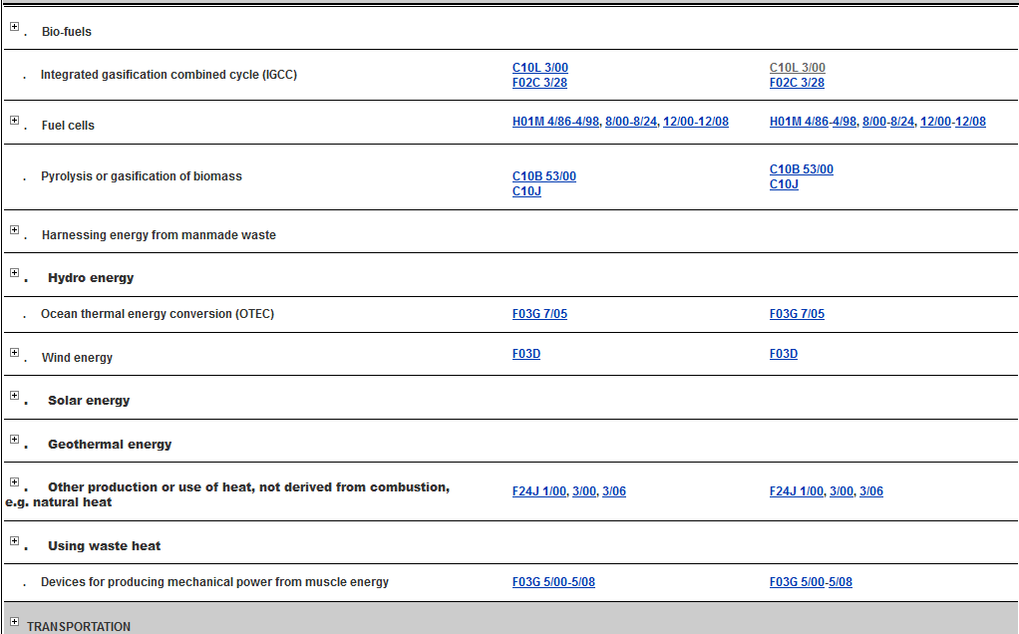

Slide 25
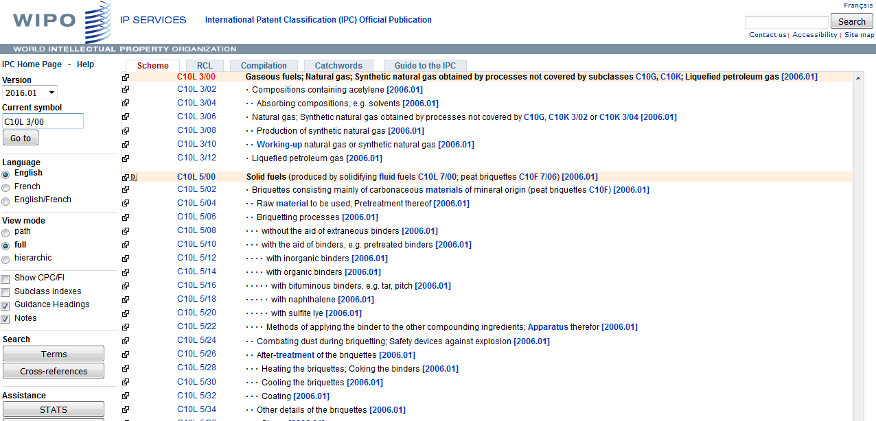

Slide 27
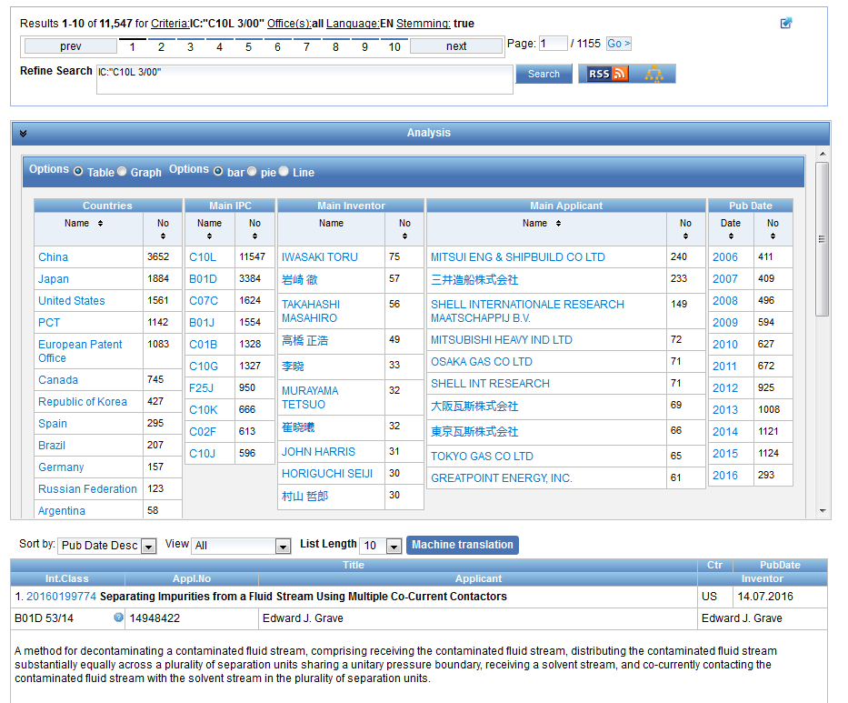

Slide 28
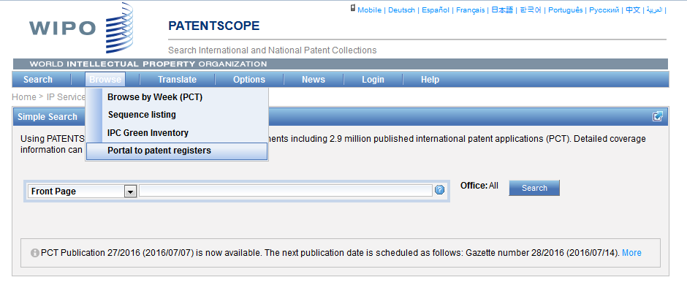
Portal to patent registers

Slide 29
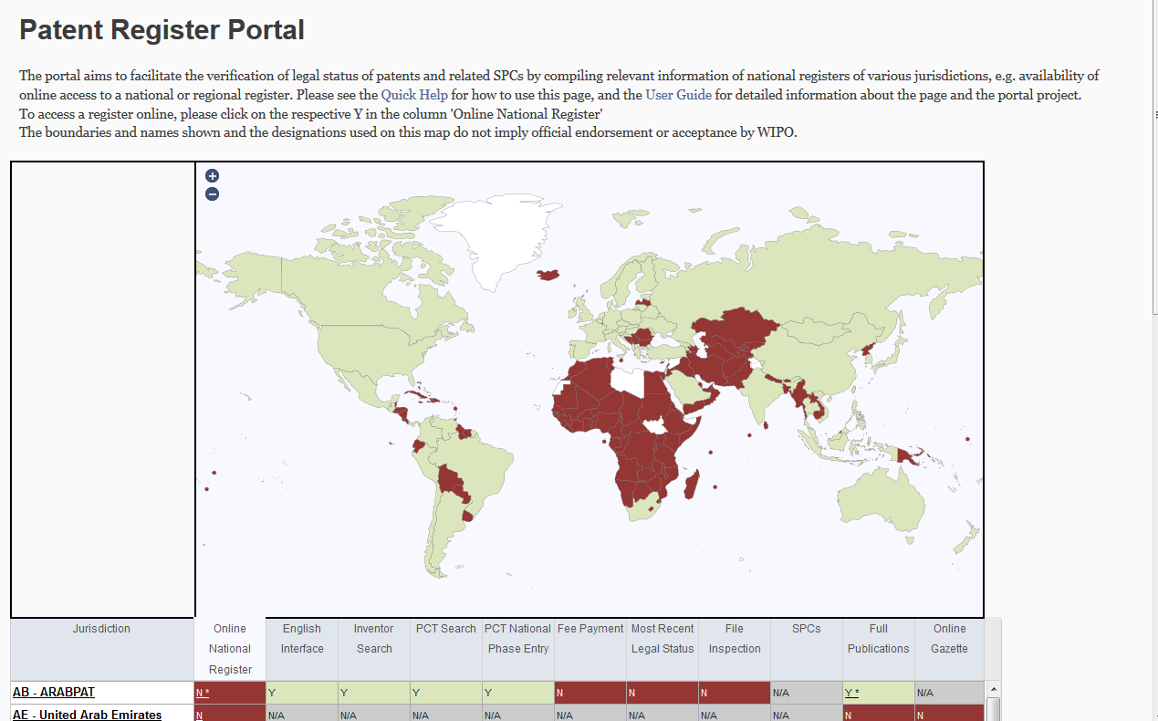

Slide 30
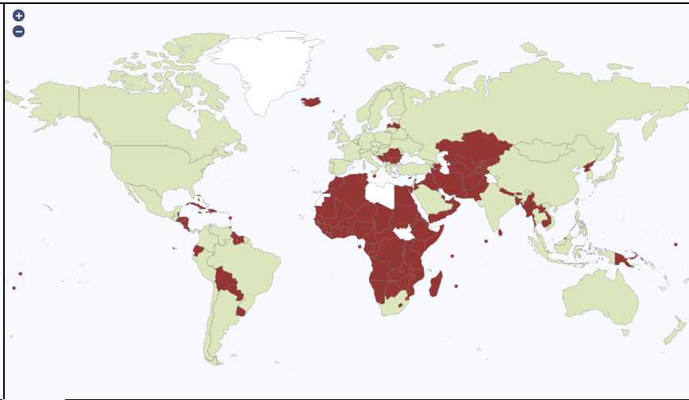
The map

Slide 31
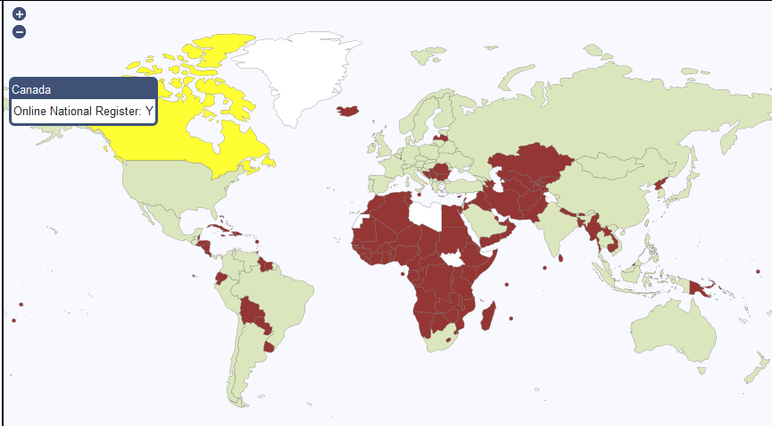
Specific country

Slide 32
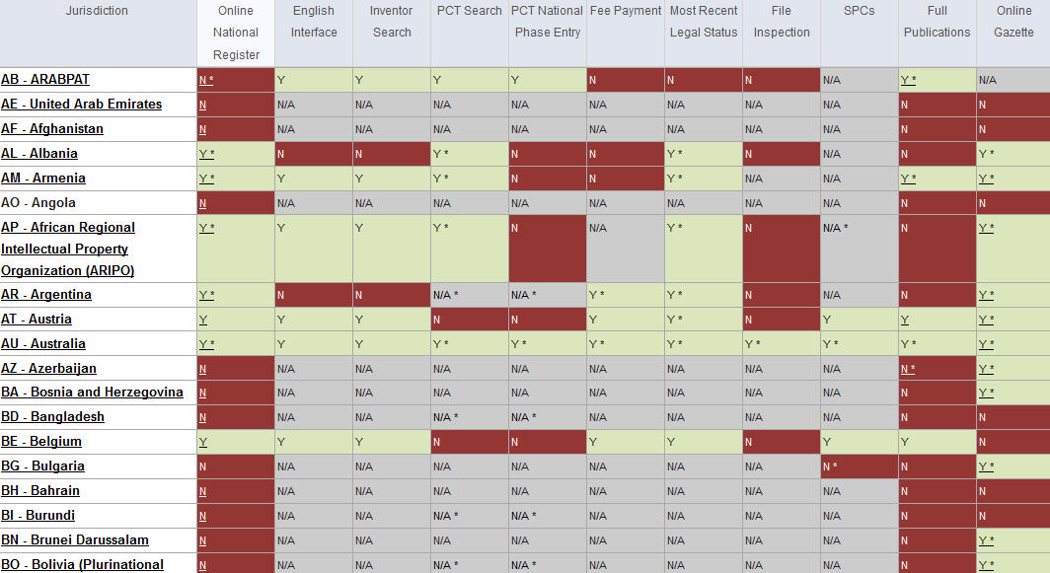

Slide 33
The table

Slide 35
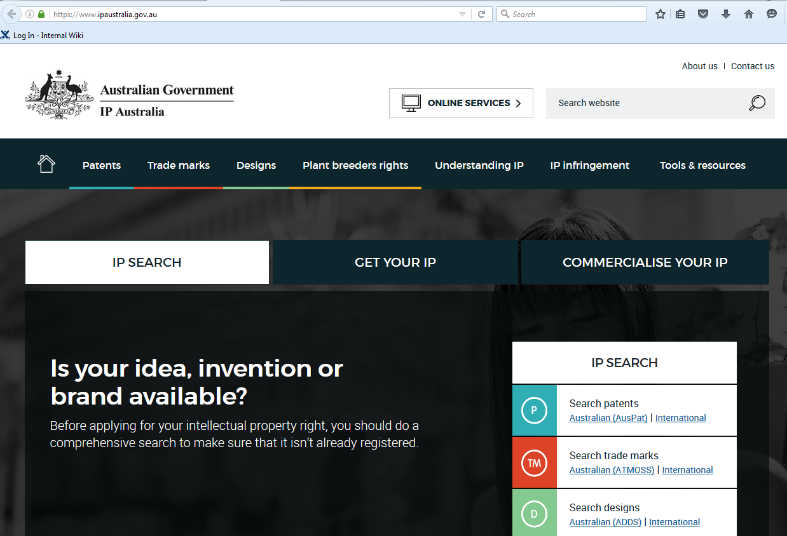

Slide 37
Q:1. In the Browse menu, you can access:
A
Sequence Listing
B
IPC Green Inventory
C
Weekly PCT Publication
D
IPC Statistics

Slide 38
Q:1. In the Browse menu, you can access:
A
Sequence Listing
B
IPC Green Inventory
C
Weekly PCT Publication
D
IPC Statistics
Spain

Slide 39
Q:2. Where can IPC statistics be accessed from?
A
Search menu
B
Options menu
C
Browse menu
D
IPC website

Slide 40
Q:2. Where can IPC statistics be accessed from?
A
Search menu
B
Options menu
C
Browse menu
D
IPC website

Slide 41
Q:3. What feature will be available soon?
A
Family-based searches
B
Chemical structure search

Slide 42
Q:3. What feature will be available soon?
A
Family-based searches
B
Chemical structure search

Slide 44
www.wipo.int/patentscope/en/webinar/index.html

Slide 45
patentscope@wipo.int

Slide 46
August webinar: IPC & PATENTSCOPE
Tue, August 16
5:30 PM - 6:30 PM CEST
Thu, August 18
8:30 AM - 9:30 AM CEST
To sign up: http://www.wipo.int/patentscope/en/webinar/

Slide 47
mulțumesc
mulțumesc

