Slide 1
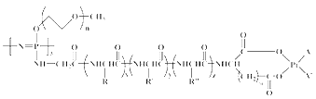
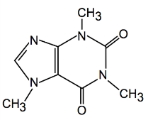
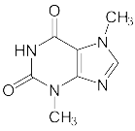

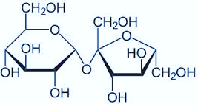
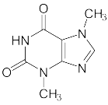
Chemical structure search in
PATENTSCOPE
January 2016
Sandrine Ammann
Marketing & Communications Officer

Slide 2


To this webinar:
Chemical structure search

Slide 3
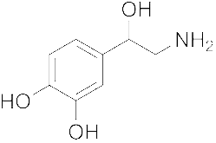
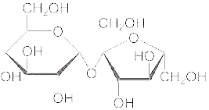
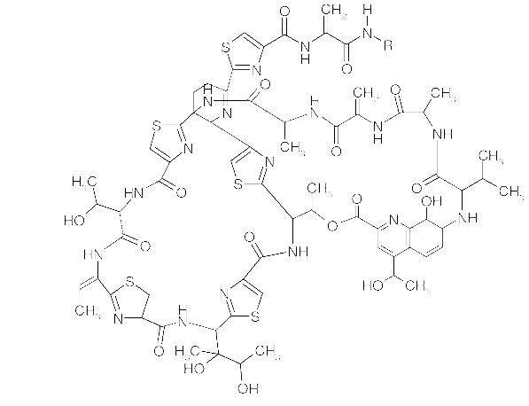
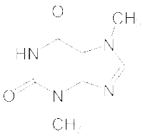
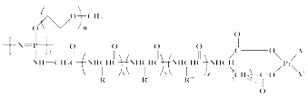
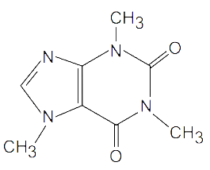
Agenda
Chemical structure search
Access
How does it work?
Future plans
Q&A

Slide 4
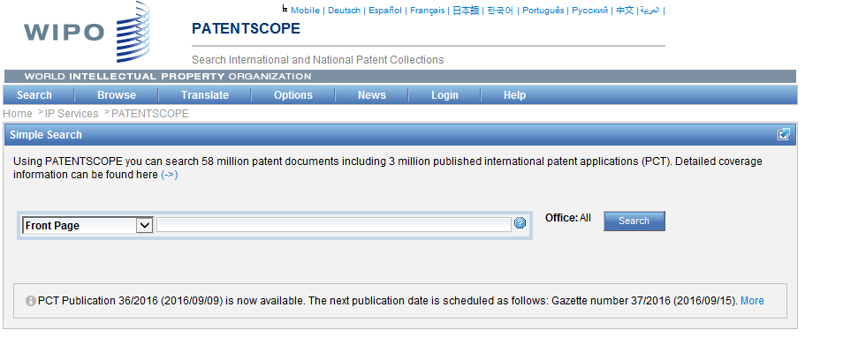
Access
Available at https://patentscope.wipo.int
Access only with a PATENTSCOPE account

Slide 5
The concept
Recognize the names of chemical compounds in patent texts and their structures from embedded drawings included in patent texts
Standardize all the different representations of chemical structures into InchIkeys
Implement search functions using InchIkeys that can be used by non chemists

Slide 6
InchIkeys
Definition: a short, fixed-length character signature based on a hash code of the InChI string.
  InChIkeys provide a precise, robust, IUPAC* approved structure-derived tag for a chemical substance.
*International Union of Pure and Applied Chemistry

Slide 7
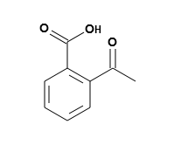
Example: InchI – InchIKey for aspirin
InChIKey = a fixed-length (27-character) condensed digital representation of an InChI
InChI = is a textual identifier developed to make it easy to perform web searches for chemical structures

Slide 8
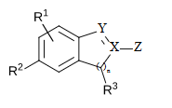
Scope
Works on developed exact formulas ≠ Markush structures (-R) that are chemical symbols used to indicate a collection of chemicals with similar structures.
PCT and US national collections
Languages: English and German

Slide 9
Limitations
Long automated procedures, no supervision
Will not recognize 100%! Same drawbacks as the OCR
Depend on OCR quality for PCT applications
Does not work with simple formulas such H2O
Notes:
Simple formulae like H2O are not captured to avoid information overload (and they can be searched by keywords).

Slide 10
Why is it useful?
Common names such as “aspirin”, “paracetamol” might not be used in patent documents
There are many ways of representing formulas

Slide 11
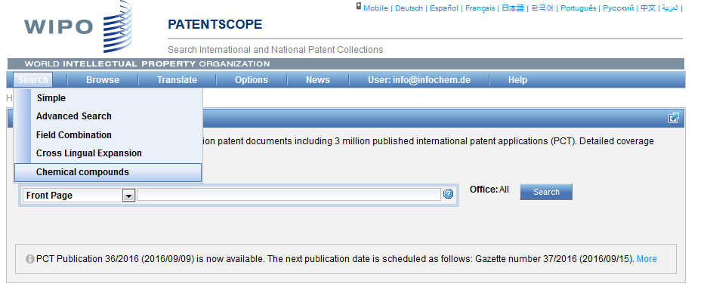
How does it work?

Slide 12
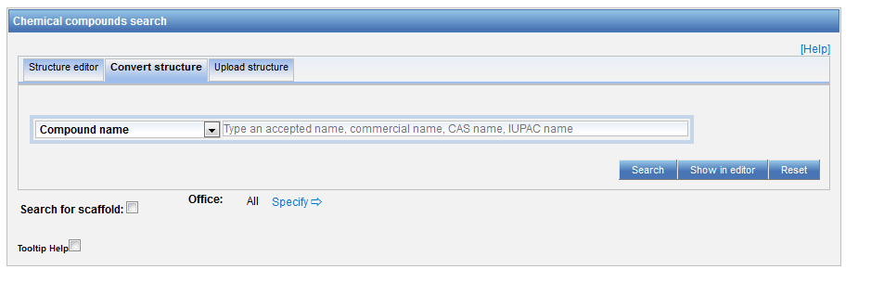
3 options

Slide 13
Scaffold
Basic skeleton of a molecule to which further groups and moieties are attached

Slide 14
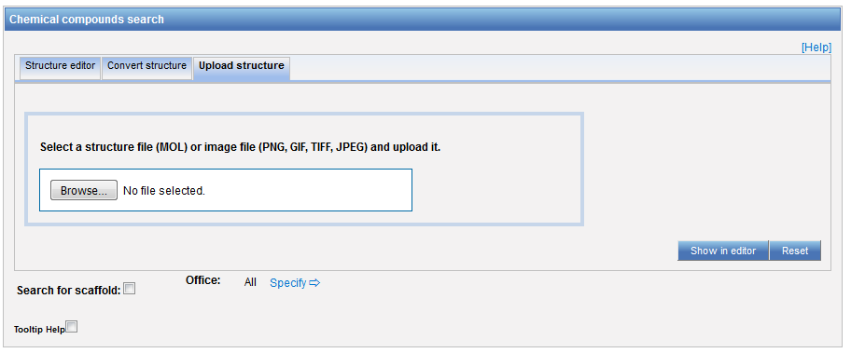
Upload a structure

Slide 15
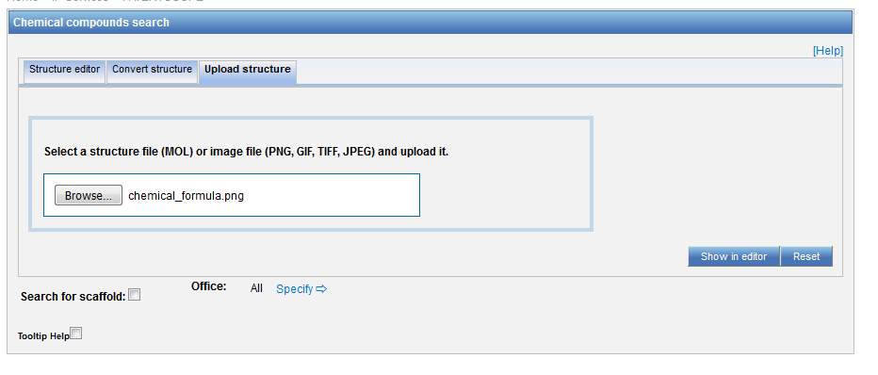
Example

Slide 16
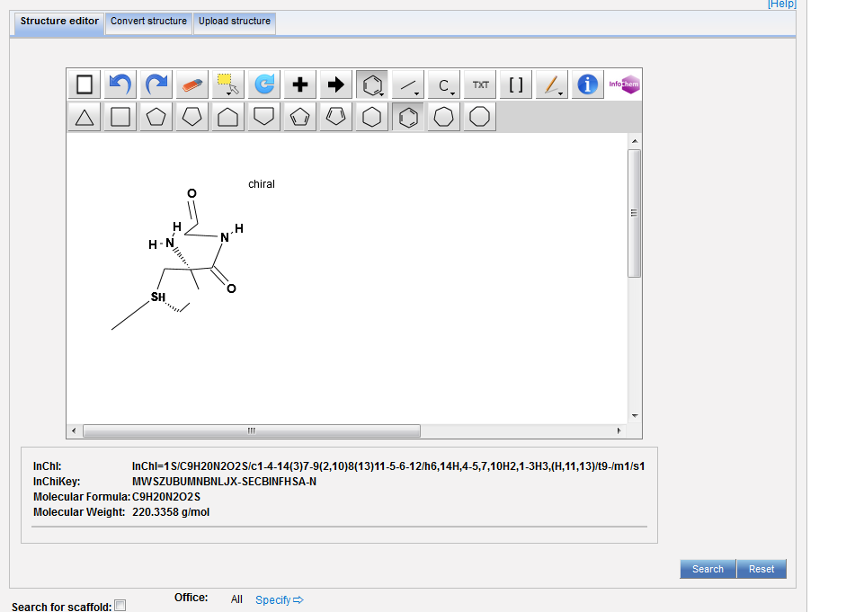

Slide 17
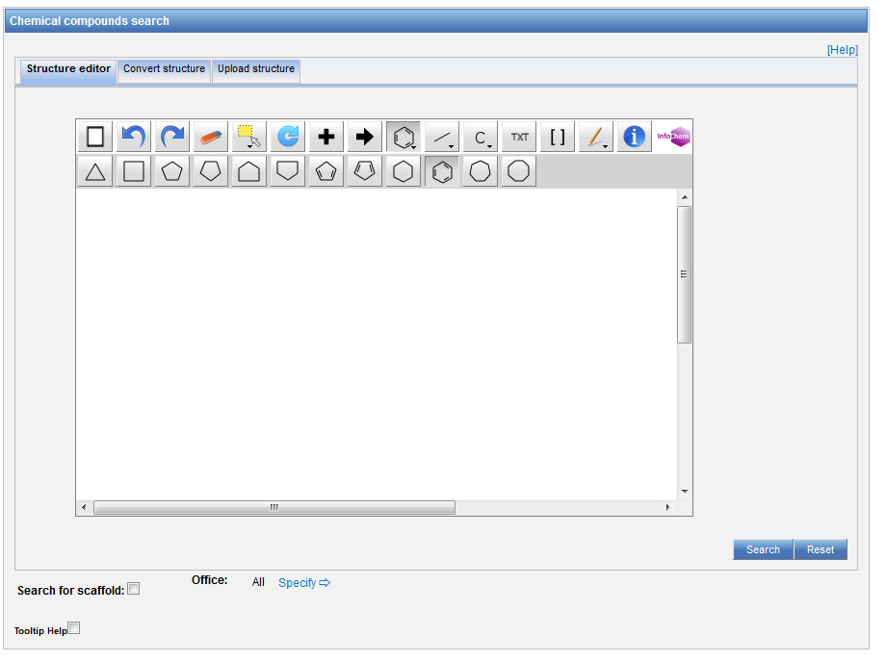
Structure editor

Slide 18
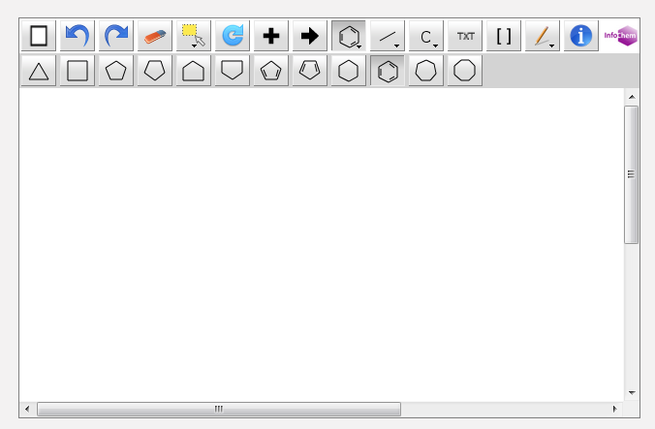

Example

Slide 19
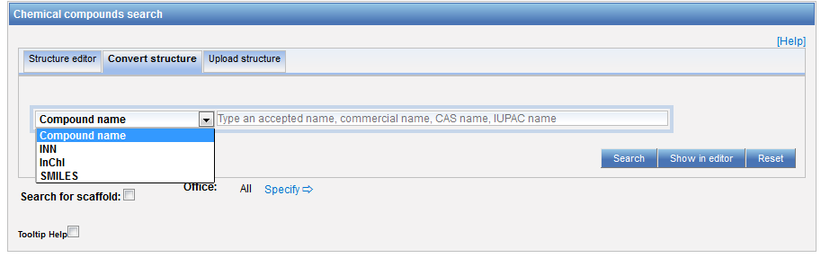
Convert a structure

Slide 20
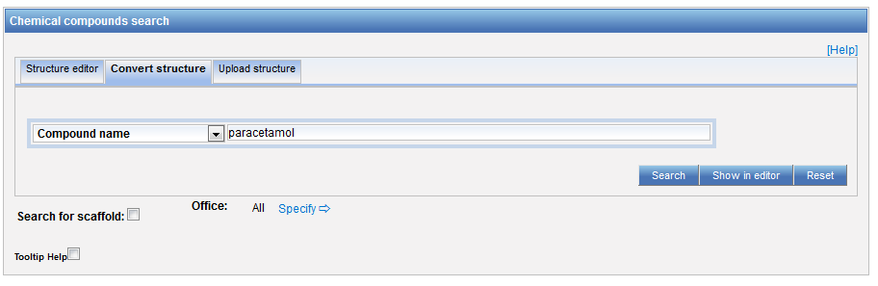
Convert structure: ex.: paracetamol

Slide 21
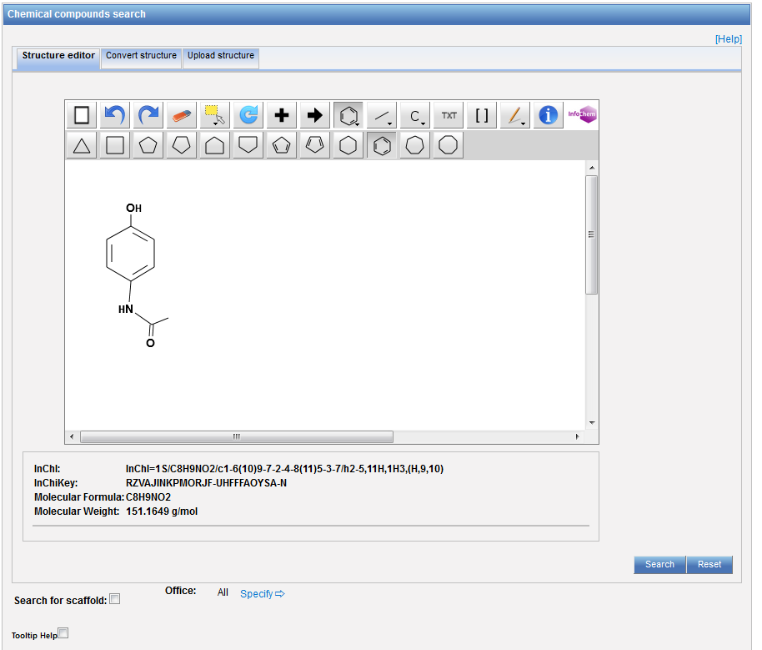

Slide 22
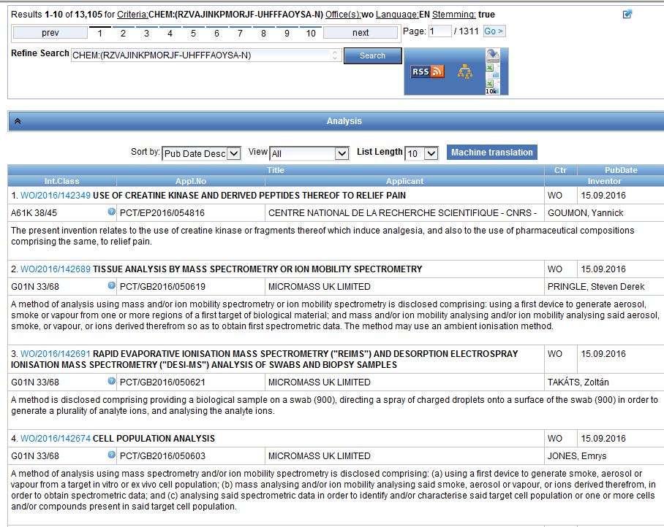
Results

Slide 23
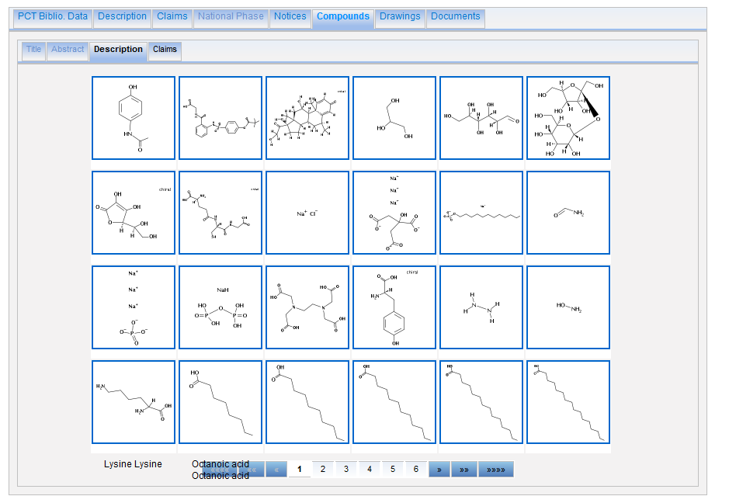

Slide 24
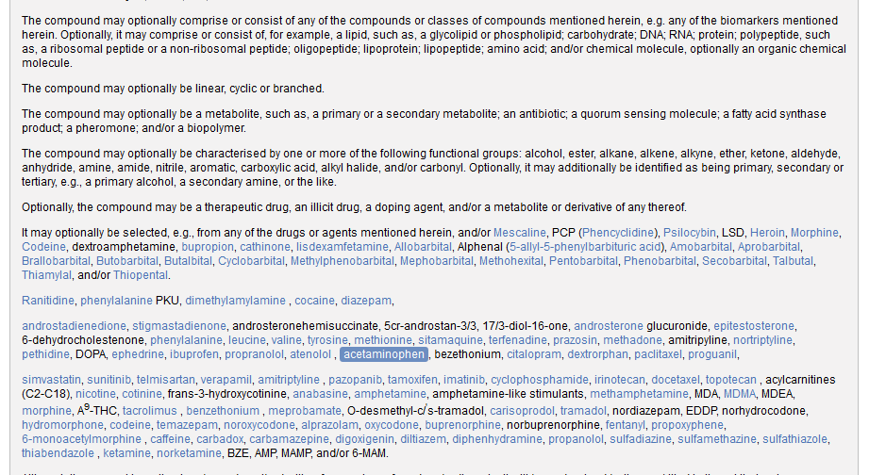

Slide 25
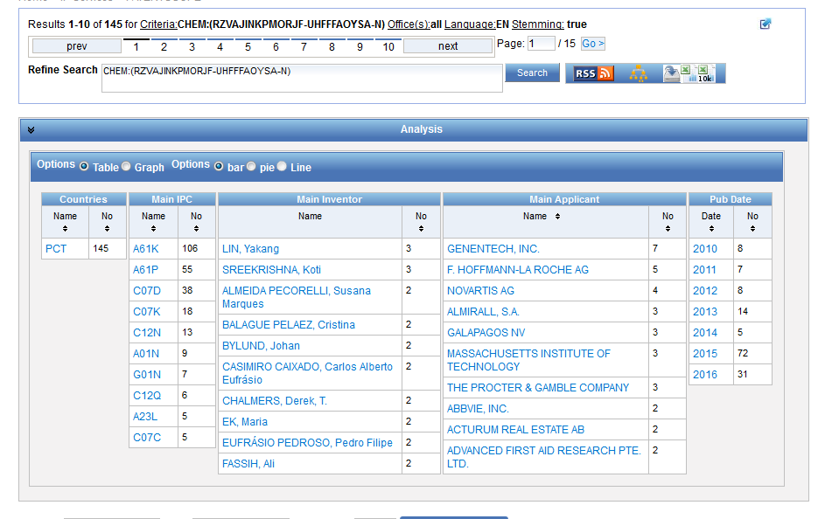
Analysis

Slide 26
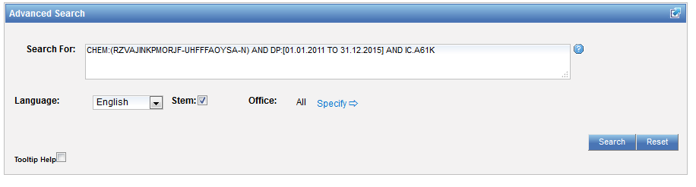
Combine results with searches

Slide 27
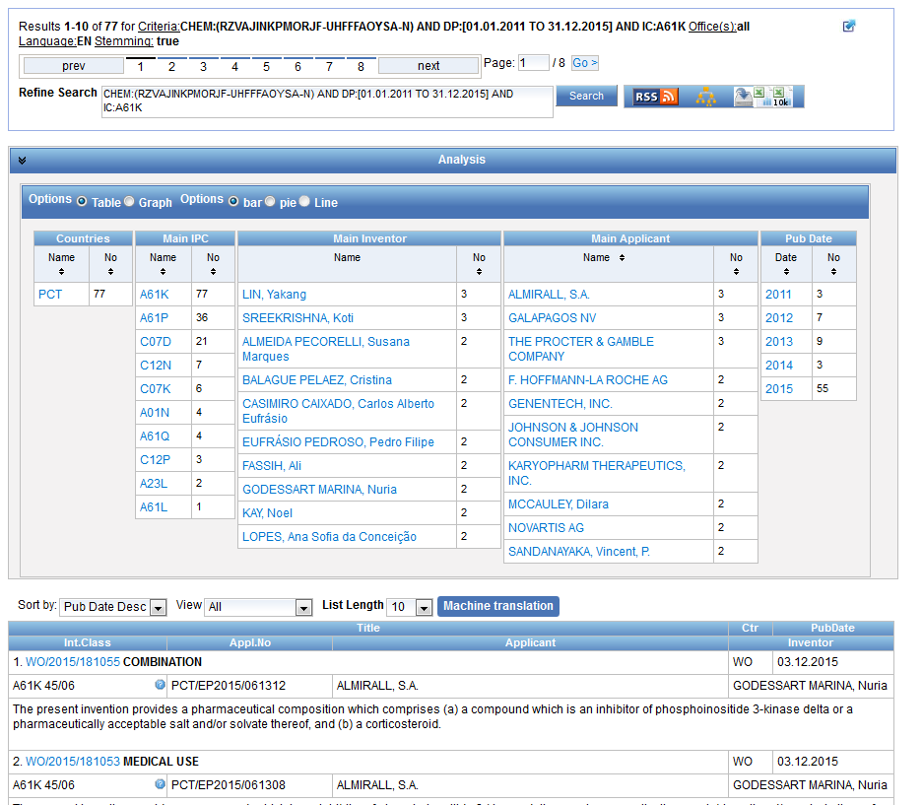

Slide 28
Example: fluoxetine hydrochloride
Its chemical formula is C₁₇H₁₉ClF₃NO
the first highly specific serotonin uptake inhibitor. It is used as an antidepressant and often has a more acceptable side-effects profile than traditional antidepressants.
Synonyms: Prozac, Sarafem

Slide 29
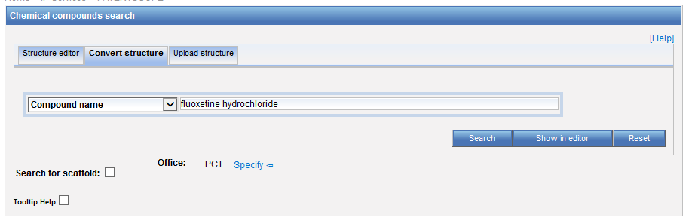
Chemical compound search

Slide 30
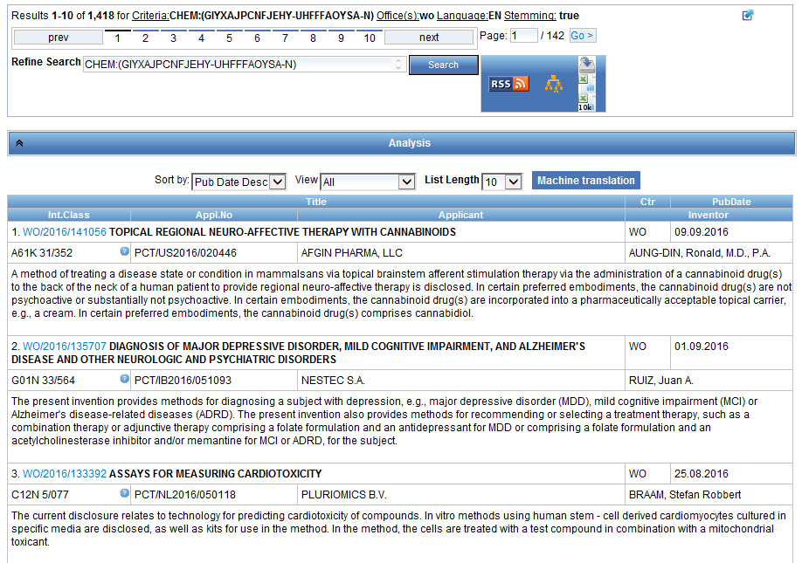

Slide 31
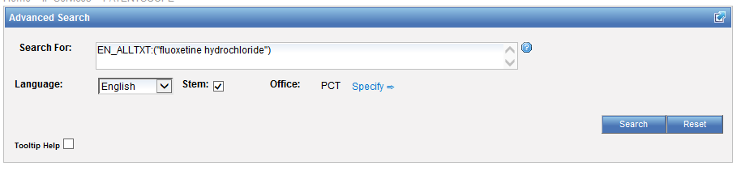
Advanced search

Slide 32
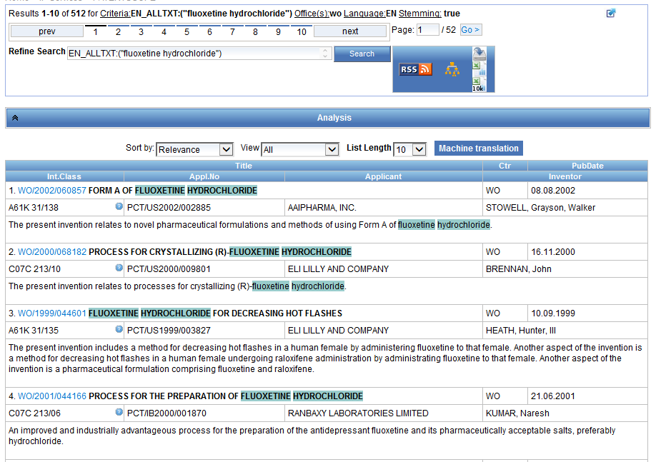

Slide 33
Example: Viagra
Chemical names: Sildenafil; 139755-83-2; Revatio; VIAGRA; Sildenafil [INN:BAN]; CHEMBL192
Molecular formula: C₂₂H₃₀N₆O₄S

Slide 34
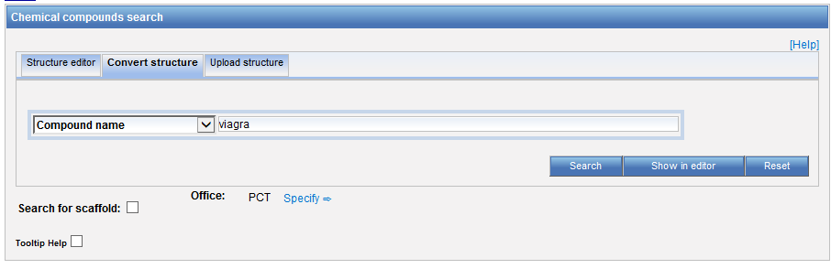
Chemical compound search

Slide 35
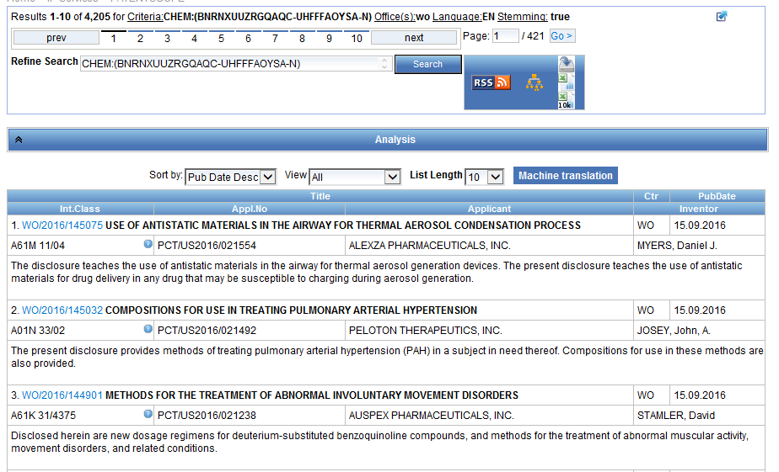

Slide 36
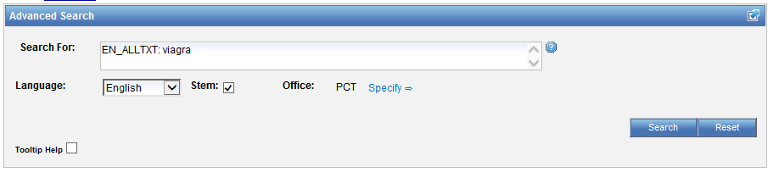
Advanced search

Slide 37
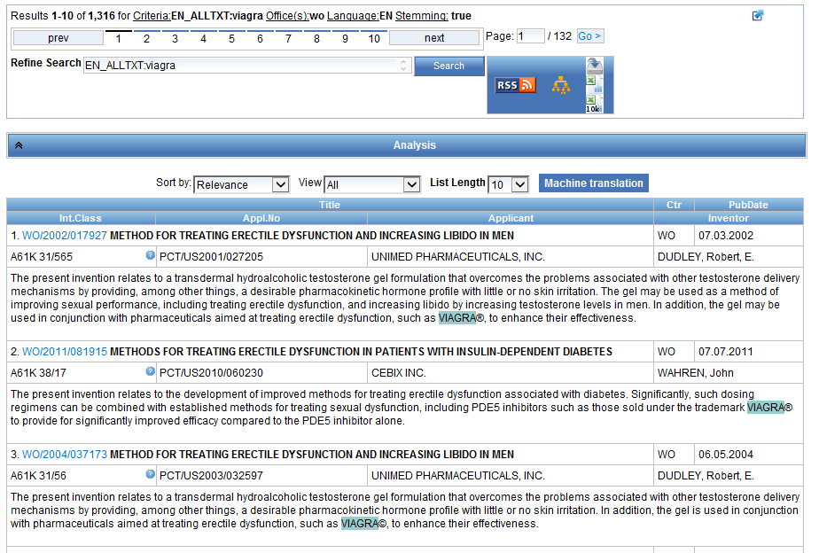

Slide 38
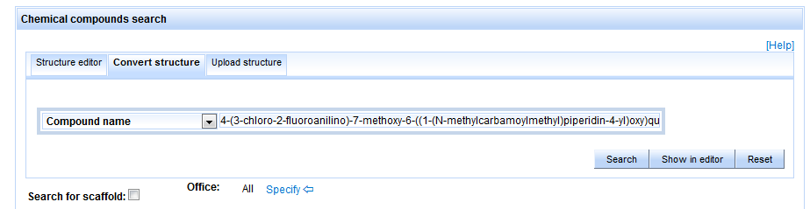
Example: more complex formula
4-(3-chloro-2-fluoroanilino)-7-methoxy-6-((1-(N-methylcarbamoylmethyl)piperidin-4-yl)oxy)quinazoline

Slide 39
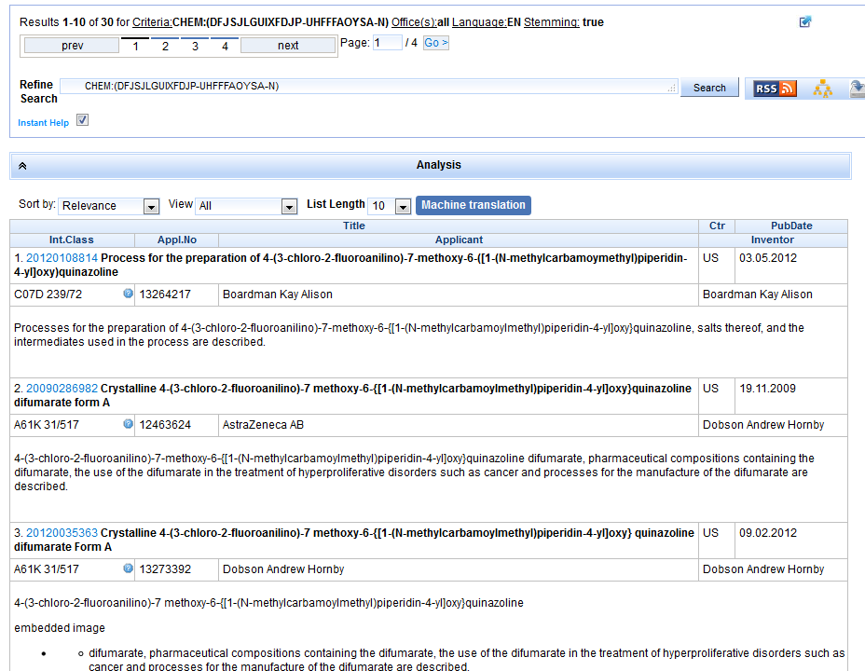

Slide 40
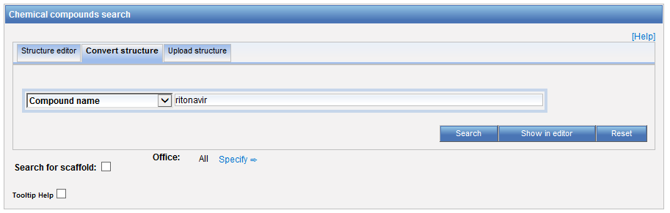
Example: Ritonavir

Slide 41
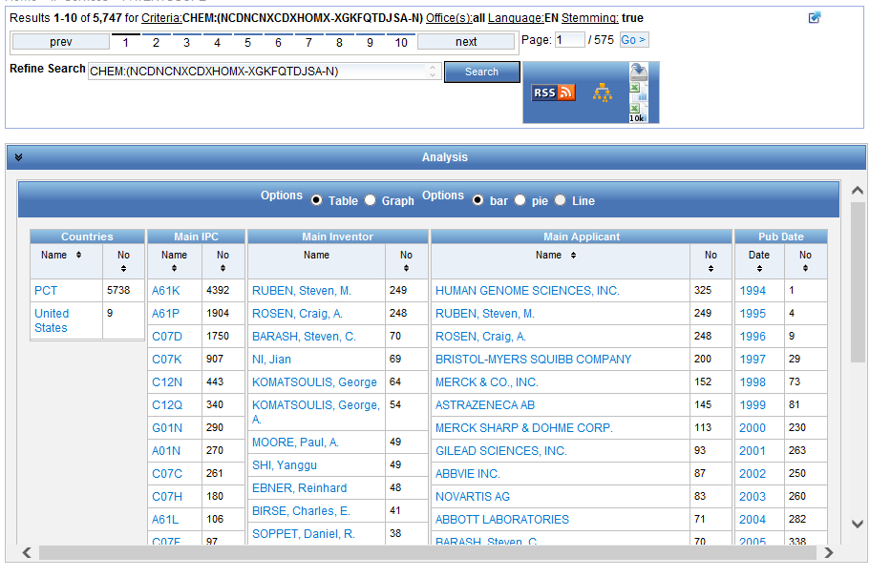

Slide 42
Patent landscape Report on Ritonavir- October 2011 http://www.wipo.int/edocs/pubdocs/en/patents/946/wipo_pub_946.pdf
Ritonavir is an antiretroviral drug from the protease inhibitor class used to treat HIV infection and AIDS. Ritonavir is included in the WHO Model List of Essential Medicines (EML)1.
The originator company is Abbott Laboratories, which markets Ritonavir under the brand name Norvir, or in combination with the protease inhibitor Lopinavir, as Kaletra or Aluvia. The U.S. Food and Drug Administration (FDA) approved the drug in March 1996 for oral solution and in June 1999 for capsules.

Slide 43
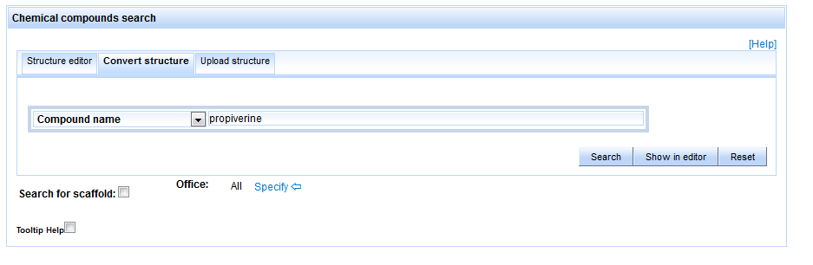
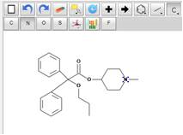
A specific case: Propiverine
Draw/convert Structure

Slide 44
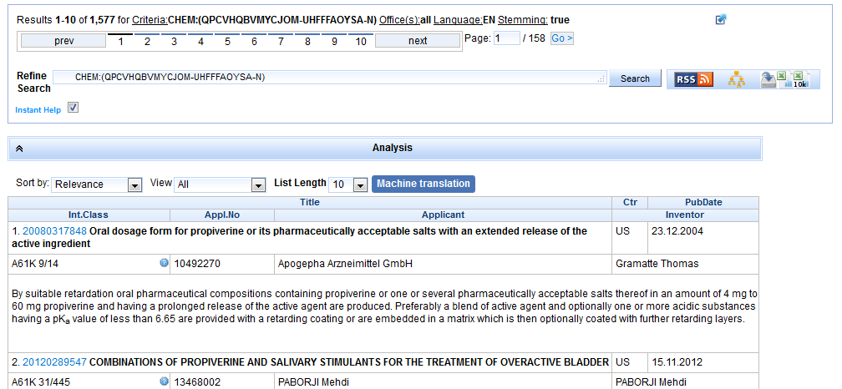
Results

Slide 45
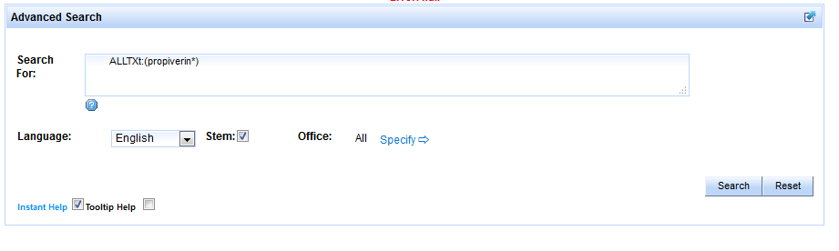
Propiverin* in Advanced Search

Slide 46
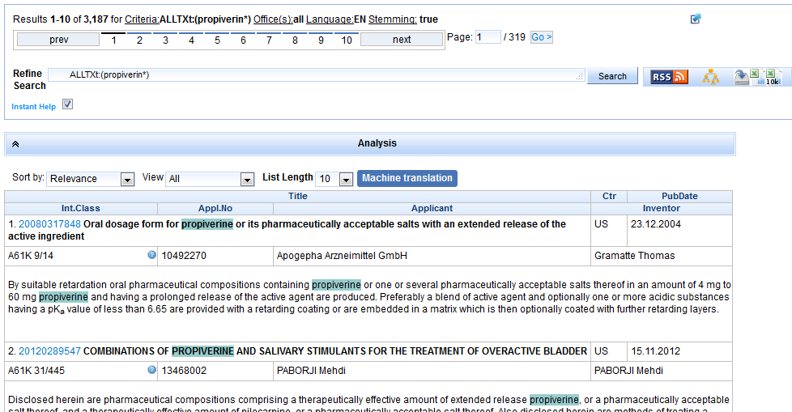
Results

Slide 47
Difference in nb of results
Chemical structure search only works:
  only PCT and US collections
  with at least 1 IPC code related to chemistry
  for titles, abstracts, descriptions and claims in English or German
  for drawings included in description and claims (all languages)

Slide 48
Future plans
Make the chemical search feature available for other collections and languages

Slide 49


Slide 50
Next webinar
Overview of the PATENTSCOPE search system
  February 14 at 5:30 pm
  https://attendee.gotowebinar.com/rt/5509443139183672322
  February 16 at 8:30 am
  https://attendee.gotowebinar.com/rt/5509443139183672322

Slide 51
Global Brand Database: webinar
Performing effective searches in the Global Brand Database
  February 21 at 5:30pm CET
  https://attendee.gotowebinar.com/register/8516192925204831491
  February 23 at 8:30 am CET
  https://attendee.gotowebinar.com/register/8516192925204831491

Slide 52
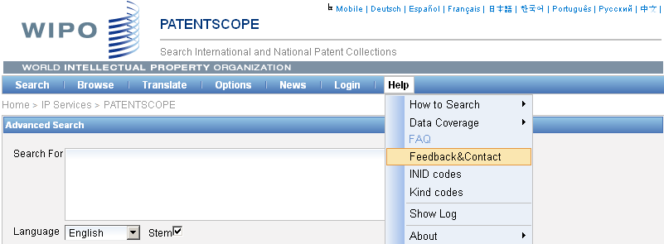

patentscope@wipo.int

Slide 53

mulțumesc
mulțumesc

