Slide 1
IPC & PATENTSCOPE
Intranet
August
2016
Sandrine Ammann
Marketing & Communications Officer

Slide 2
Agenda
  IPC introduction
  IPC in PATENTSCOPE:
    search
    in the result list
    in CLIR
    statistics in the Browse menu
  Quiz
  Q & A session

Slide 3

What is IPC? International Patent Classification

Slide 4
What is classified?
► 2 types of information
► 1. Invention information:
Technical information worth granting a patent
► 2. Additional information:
Supplementary non-invention information
the classifier/examiner considers interesting
> obligatory classification
> discretionary classification
Notes:
Patent documents contain a lot of technical information and not all of it is directly linked to the invention but merely explains the state of the art. The rules of the IPC require all new and non-obvious technical information, i.e. the disclosed information that is eventually worth granting a patent must be classified.
Any additional information, that need not be new but may be useful for search purposes, can also be classified, at the discretion of the classifier.

Slide 5
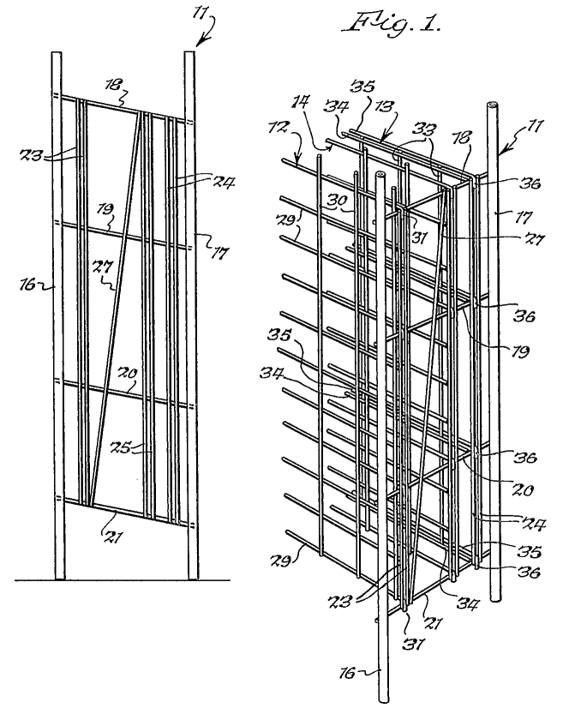
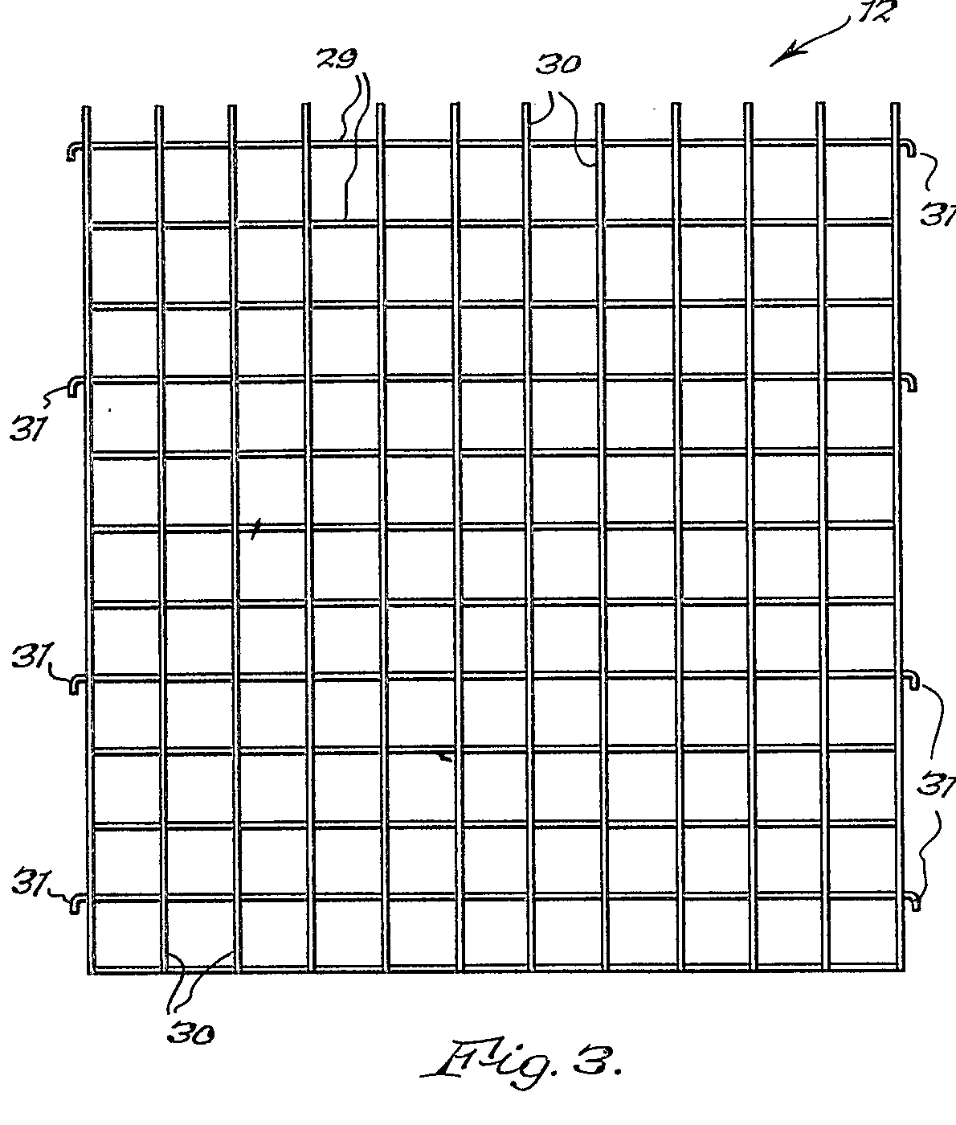
Example: A metal rod wine rack
1.Invention Information
A wine rack which is easily dismantled (claim)
2.Additional Information
A rigid wine rack made of “wire”
Int. Cl.
A47B 73/00 (2006.01)
A47B 47/02 (2006.01)
A47B 55/02 (2006.01)
5
Notes:
5

Slide 6
The IPC serves as a:
tool to classify patent documents in order to make their technological and legal content accessible;
basis for selective dissemination of information to all users of patent information;
basis for investigating the state of the art in given fields of technology;
basis for the preparation of industrial property statistics

Slide 7

How does it work? Tree type structure

Slide 8
Symbols and Titles
70,000 entries
Each place/entry (Section, Class, Subclass, Group) is characterized by a symbol and a title
  Symbol = succession of upper case letters and numbers
  Title = phrase describing the technical content (scope) of the place
  Example:
Notes:
Symbol is a succession of upper case letters and numbers.
Title is a phrase or succession of phrases

Slide 9
Tree type hierarchical structure
Sections
8
Classes
Classes
Classes
129
Subclasses
Subclasses
Subclasses
Subclasses
Subclasses
640
Groups
Groups
Groups
Groups
Groups
Groups
Groups
Groups
Groups
70,000

Slide 10
IPC layout: SECTIONS
1 A HUMAN NECESSITIES
2 B PERFORMING OPERATIONS; TRANSPORTING
3 C CHEMISTRY; METALLURGY
4 D TEXTILES; PAPER
5 E FIXED CONSTRUCTIONS
6 F MECHANICAL ENGINEERING; LIGHTING; HEATING; WEAPONS; BLASTING
7 G PHYSICS
8 H ELECTRICITY

Slide 11
IPC layout: SUBSECTIONS
A HUMAN NECESSITIES
AGRICULTURE
FOODSTUFFS; TOBACCO
PERSONAL OR DOMESTIC ARTICLES
HEALTH; LIFE SAVINGS; AMUSEMENT

Slide 12
Tree type hierarchical structure
Sections
8
Classes
Classes
Classes
129
Subclasses
Subclasses
Subclasses
Subclasses
Subclasses
640
Groups
Groups
Groups
Groups
Groups
Groups
Groups
Groups
Groups
70,000

Slide 13
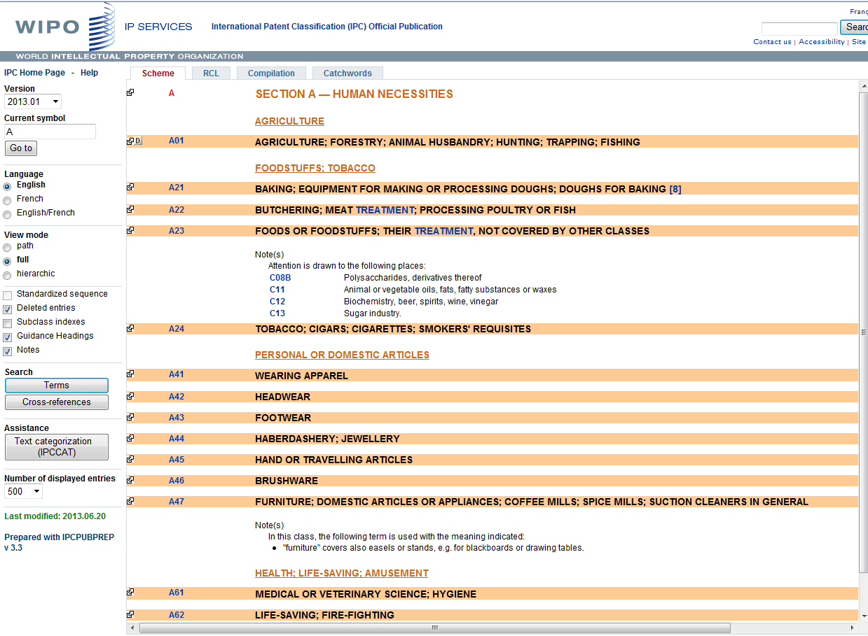
IPC layout: CLASS
A HUMAN NECESSITIES
Class = second hierarchical level
Class symbol: 2 digit number
Class title: indication of the content of the class

Slide 14
Tree type hierarchical structure
Sections
8
Classes
Classes
Classes
129
Subclasses
Subclasses
Subclasses
Subclasses
Subclasses
640
Groups
Groups
Groups
Groups
Groups
Groups
Groups
Groups
Groups
70,000

Slide 15
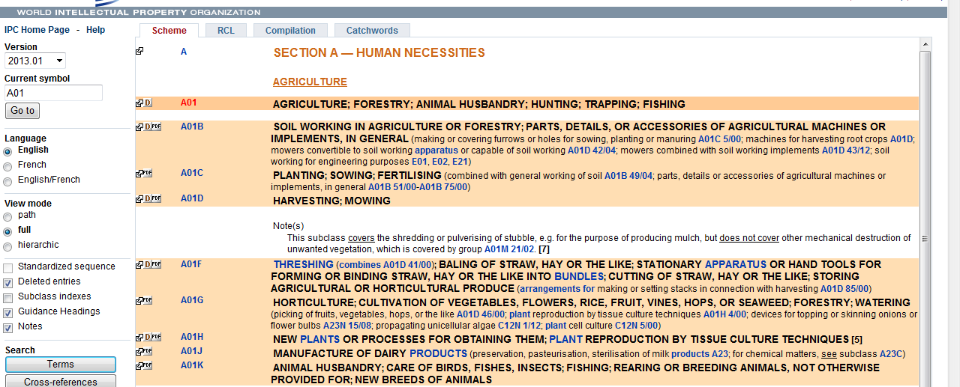
IPC layout: SUBCLASS
Subclass = 3rd hierarchical level
Subclass symbol: capital letter
Subclass title: indicates content of subsclass

Slide 16
Tree type hierarchical structure
Sections
8
Classes
Classes
Classes
129
Subclasses
Subclasses
Subclasses
Subclasses
Subclasses
640
Groups
Groups
Groups
Groups
Groups
Groups
Groups
Groups
Groups
70,000

Slide 17
IPC group symbols
► Two types of groups: Main groups
Subgroups of main groups
A23G 9/00 ........... Main group xxx/00
xxx= 1 to 999
A23G 9/02 ........... Subgroup xxx/yy (yy ≠ 00)
xxx/yyyyyy
Notes:
Accordingly, there are two different types of groups: main groups and subgroups. If only "groups" are mentioned in the following, both types of groups are addressed.
Main groups always have "00" after the slash; subgroups have any other combination of digits.
Currently, main group symbols have between 1 and 3 digits on the left hand side although WIPO Standard ST.8 allows up to 4 digits.
For the subgroup part, up to six digits can be used. At least two digits have to be used.
It should be noted that patent documents are usually classified either by using main group or subgroup symbols.
Very few countries make use of the option to use only subclass symbols - an option that is possible according to the Strasbourg Agreement.
The symbols of sections, classes or subclasses are usually only used in the scheme for describing its hierarchical structure.

Slide 18
IPC group symbols
A23G 9/02
► complete group symbol; consists of different components
A ....................... Section (A, B, ... H)
A23 ....................... Class (any 2 digits)
A23G ....................... Subclass (any letter)
A23G 9/02 ............ Group
Main group part
Subgroup part
Notes:
A23G 9/02 is a symbol representing an IPC group. Any group symbol consists of different components:
The first letter indicates the section of the IPC to which it belongs; there are 8 sections represented by the letters A, B,..H.
The section letter and the following two digits represent a class symbol.
Adding another letter to the class symbol generates the symbol of a subclass being part of the class.
After this subclass part of the symbol follows the group part which consist of two different elements separated by a stroke: the main group part and the subgroup part.
The formatting shown above with a space between the subclass part and the group parts and a slash between the two group parts is the offical format of IPC symbols that should be used for presenting IPC symbols. However, sometimes different presentations can be found or used for searching databases, e.g. no space after the subclass part, or a dash instead of a stroke.

Slide 19
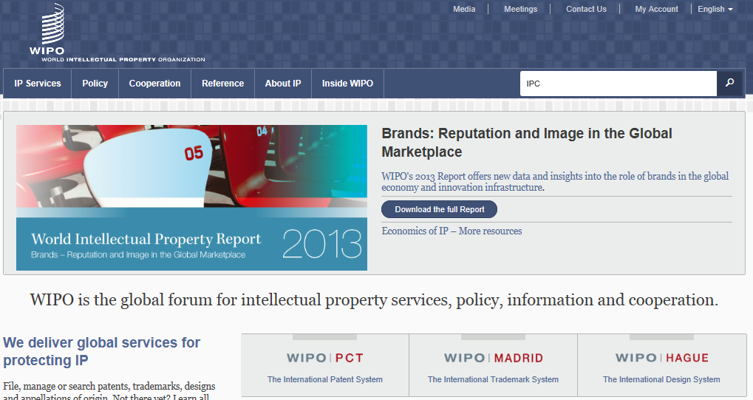
WIPO Homepage

Slide 20
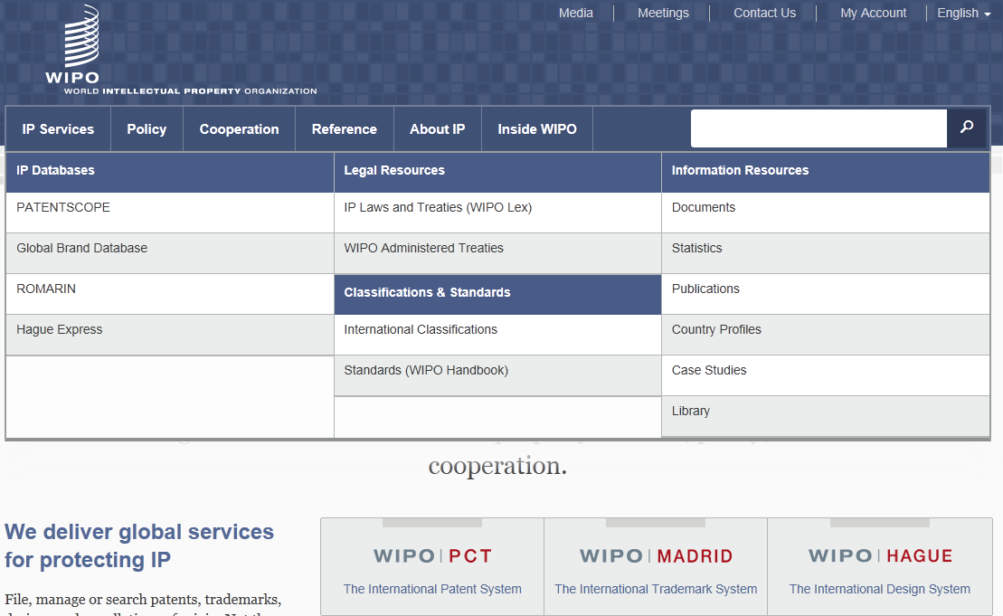
WIPO Homepage > Reference

Slide 21
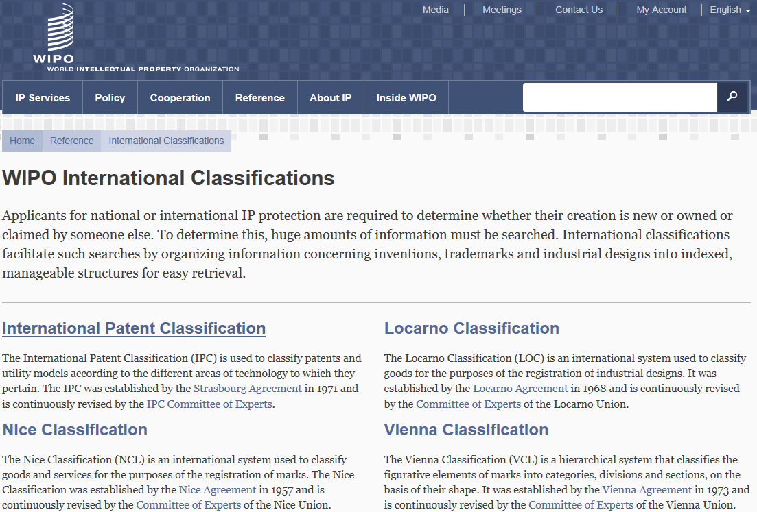
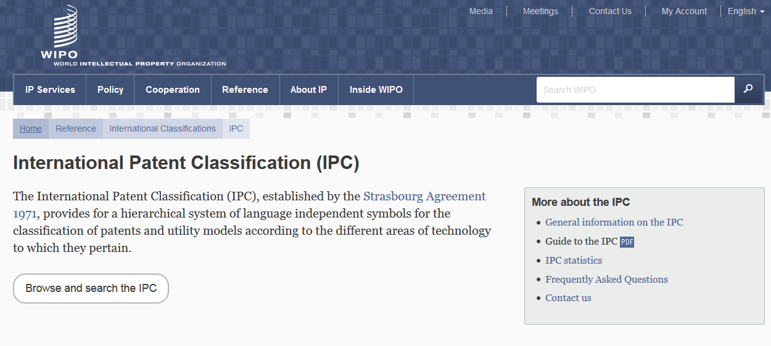
International Classifications

Slide 22
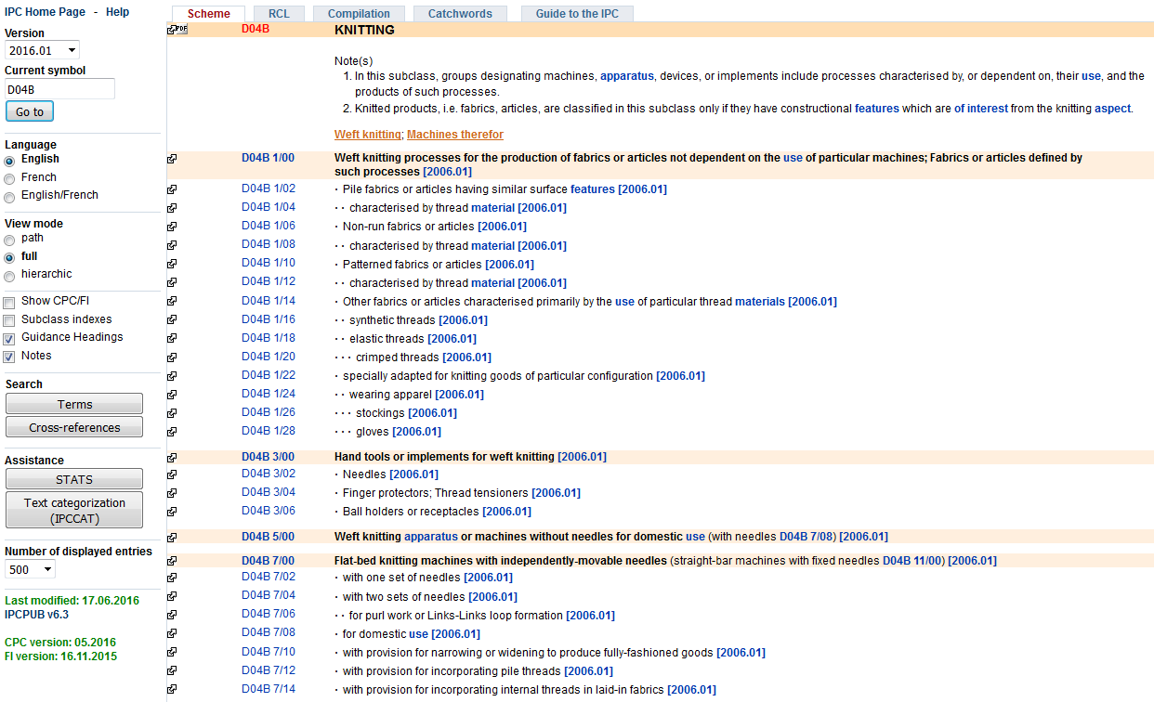
Help
IPC version and IPC symbol
View mode (path/full/hierarchic)
Display option (Subclass indexes, Guidance Headings, Notes, etc.)

Slide 23
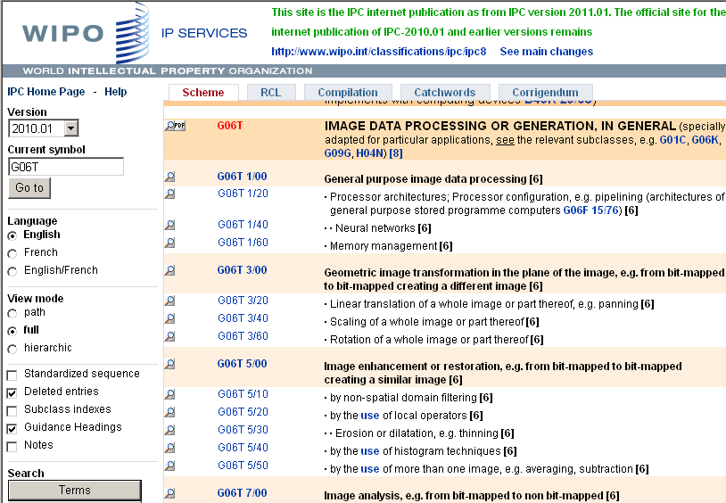
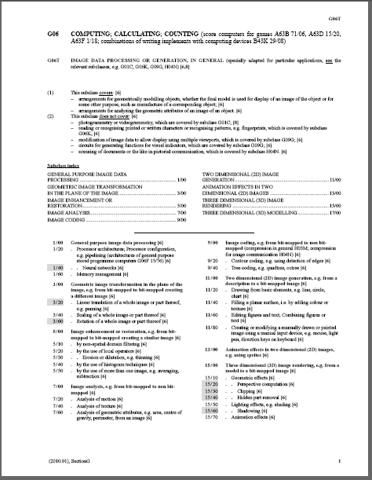
IPC Scheme - PDF file
Download IPC scheme (PDF file)
  All PDF files are available at Download and IT support area:
    http://www.wipo.int/classifications/ipc/en/support/

Slide 24
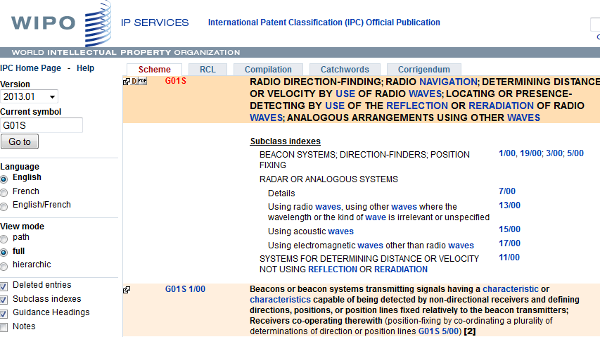
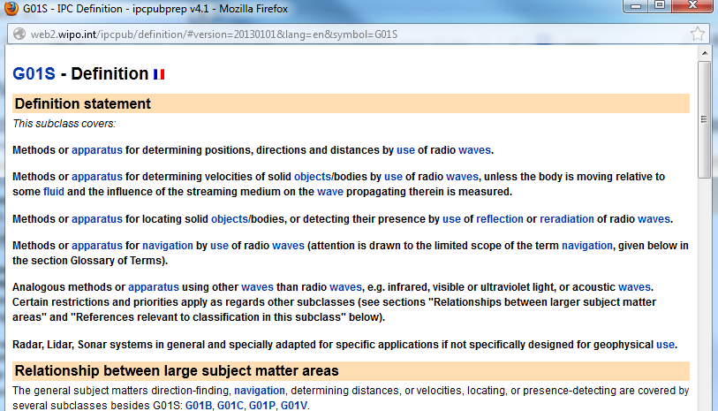
Definitions

Slide 25
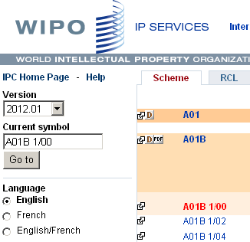
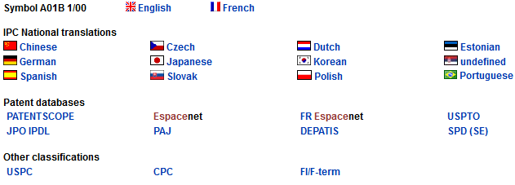
Bridge

Slide 26
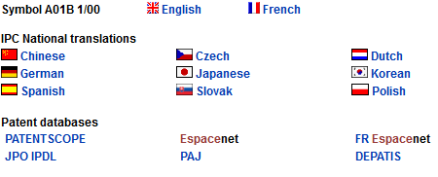
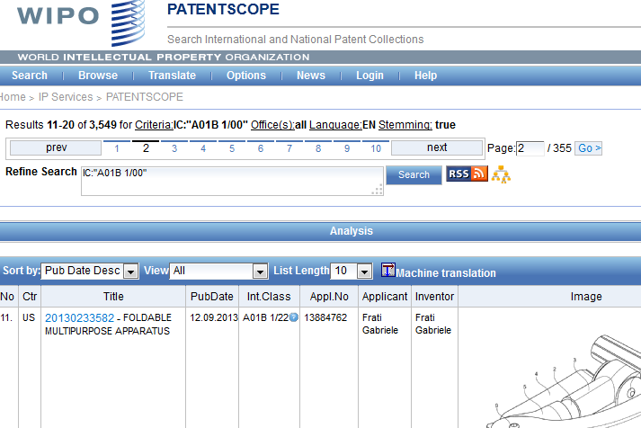
Bridge

Slide 27
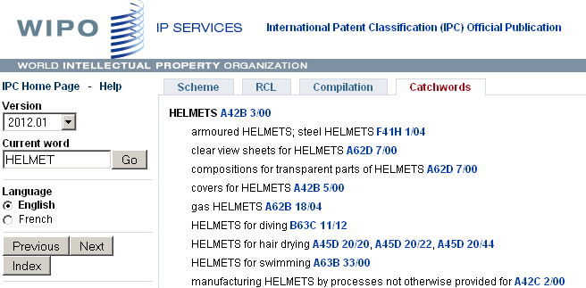
Catchword Index

Slide 28
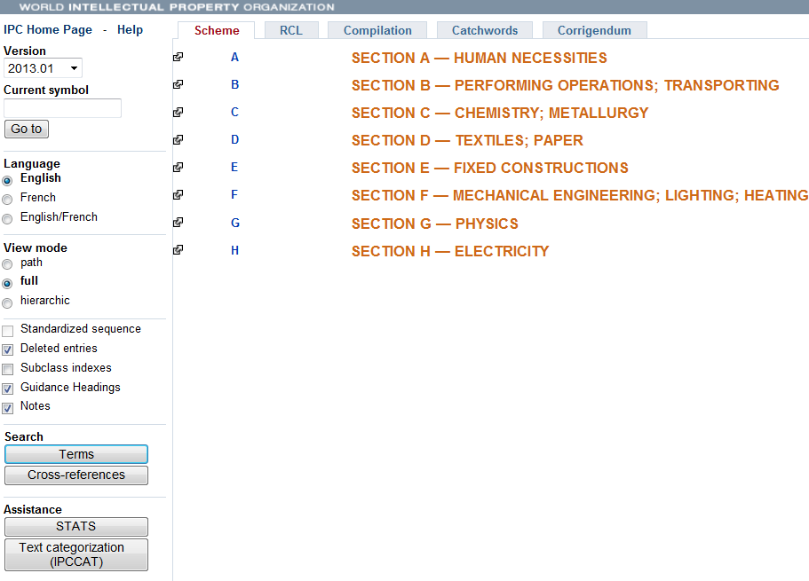
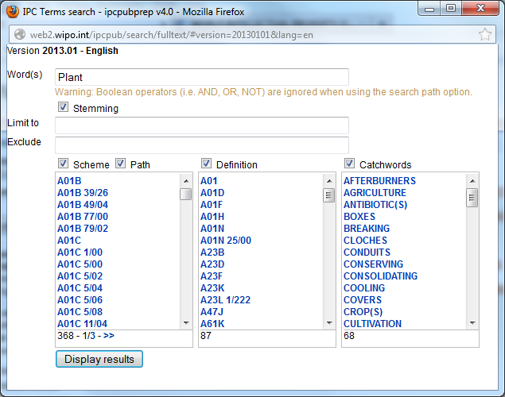
Terms (text search of the IPC)

Slide 29
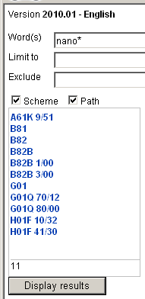
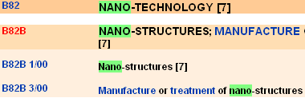
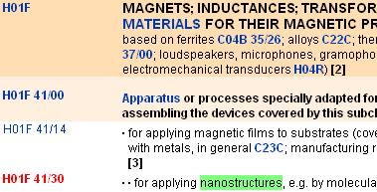
Terms
1. Input keyword (e.g. “ nano* ”)
2. Display results
3. Links to the IPC scheme

Slide 30
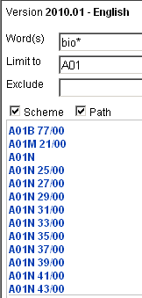
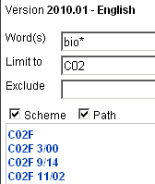
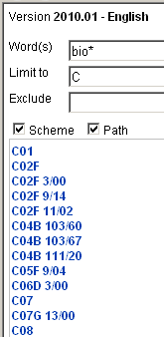
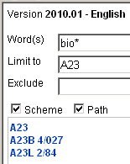
Terms
Limit to
A01=“Agriculture”
Limit to
C02=“Treatment of water, etc.”
Limit to
C=“Chemistry”
Limit to
A23=“Food or foodstuffs”

Slide 31
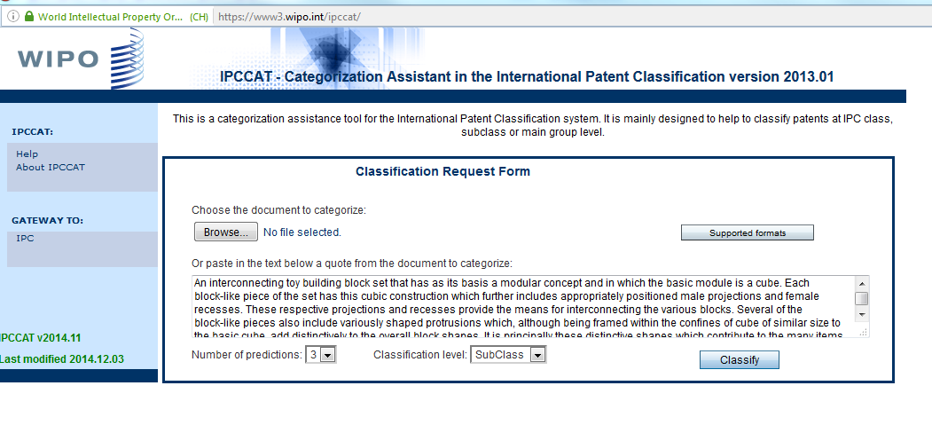
IPCCAT

Slide 32
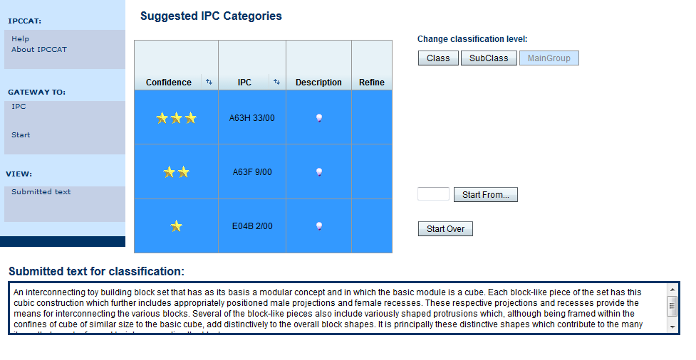
IPCCAT

Slide 33
STATS (Statistical approach)
Identifies IPC entries most frequently referenced in the PATENTSCOPE database searched by particular terms
Statistical presentation of the search results is performed according to IPC subclasses and groups
Search by simple terms and multi-term (combination of simple terms separated by a space) in all patent collections of the PATENTSCOPE

Slide 34
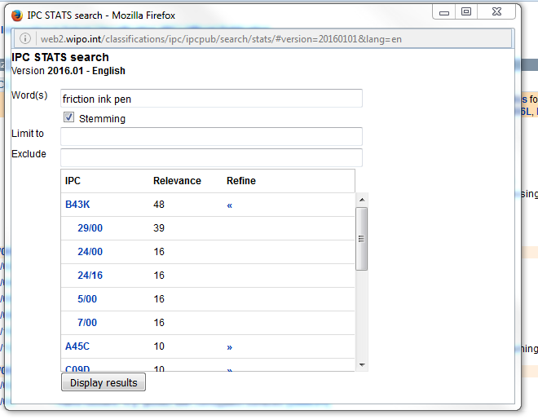
STATS

Slide 35
Parallel Viewer
Optional function to display CPC/FI entries under the parent IPC
CPC/FI view is not the official version of CPC/FI
    e.g. CPC warning and notes, Y section, 2000 series are not displayed
    use Bridge function to check the official version of CPC/FI
Versions of CPC/FI are indicated in left bottom
  e.g. CPC version: 05.2016
  FI version: 16.11.2015
CPC:Cooperative Patent Classification jointly developed by EPO&USPTO
FI: File Index - Japanese patent classification

Slide 36
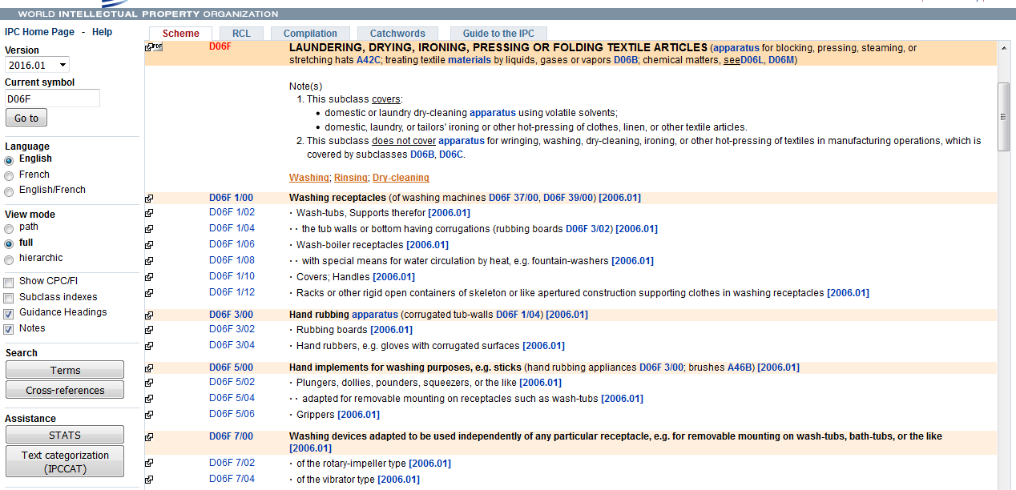
Parallel Viewer

Slide 37
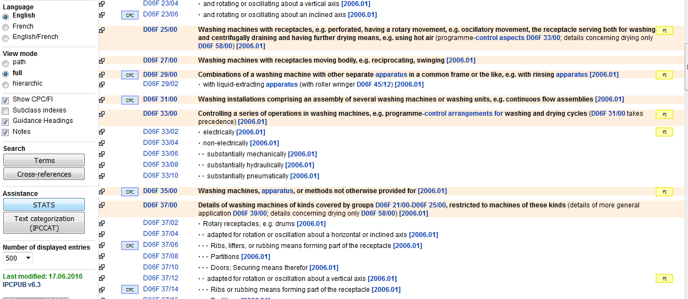

Slide 38
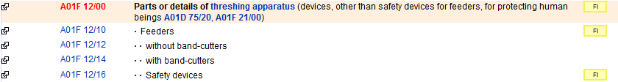
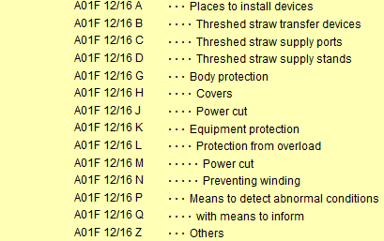

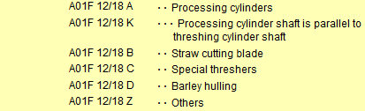
FI entries
CPC entries

Slide 39
Guide to the IPC
The official Guide to the IPC provides comprehensive information on the IPC. It is available for download on the WIPO website of the IPC at:
http://www.wipo.int/classifications/ipc/en/general/
Notes:
see the slide

Slide 40
Why is it useful?
Primary purpose:
  effective search tool for the retrieval of patent information:
  ordering patent documents (similar technical content)
  searching patent literature
Other purposes:
  selective dissemination of information
  investigation of the state of the art
  preparation of industrial property statistics

Slide 41
Summary of the advantages of using IPC
  Language independent
  Terminology / ”jargon” independent
  Standardized application to documents (by experts of patent offices)
  Available for (old) patent documents where no full text of claims / description is available
  Concept search

Slide 42
IPC 2017.01
early publication is now available for consultation
http://web2.wipo.int/classifications/ipc/ipcpub7?notion=scheme&version=20170101&symbol=A&menulang=en&lang=en&viewmode=f&fipcpc=no&showdeleted=yes&indexes=no&headings=yes&notes=yes&direction=o2n&initial=A&cwid=none&tree=no

Slide 43
Any questions related to IPC/CPC
ipc.mail@wipo.int

Slide 44
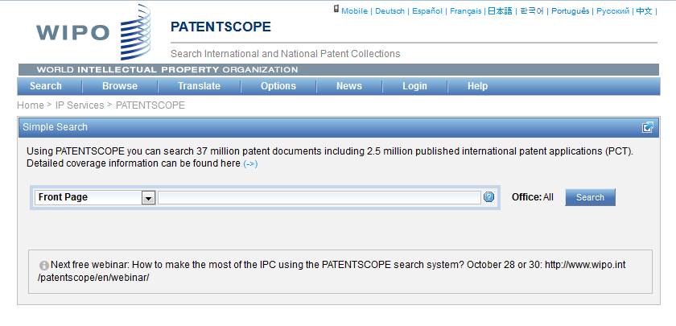
IPC in PATENTSCOPE
Statistics in the Browse by week option
Search IPC with simple, advanced, field combination
IPC in the result list
IPC in CLIR

Slide 45
Statistics in the Browse by week
  Show global trends
    Main/new actors

Slide 46
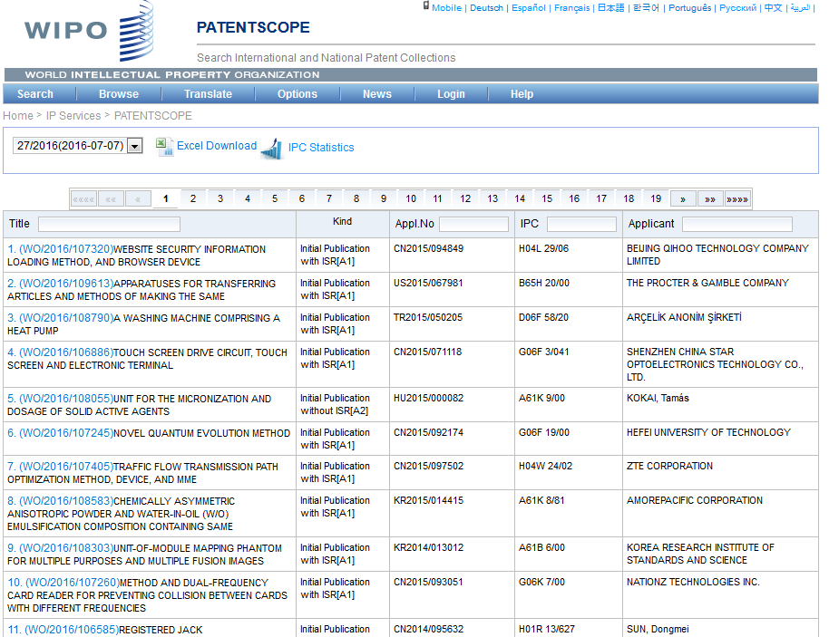
IPC statistics

Slide 47
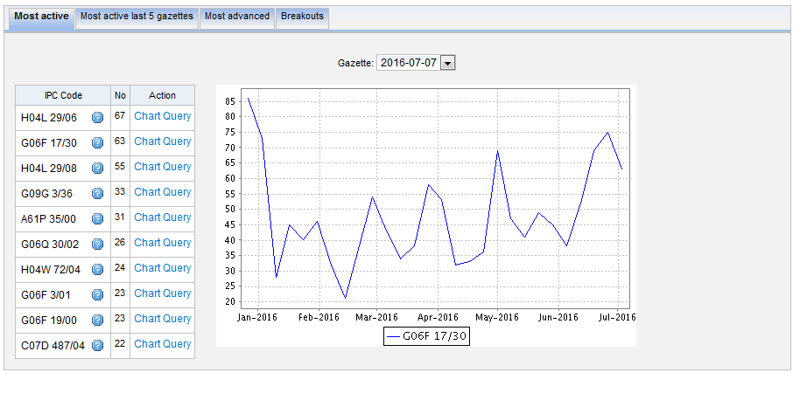
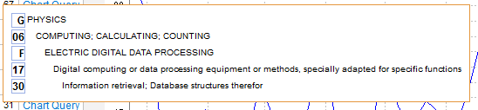
Most active

Slide 48
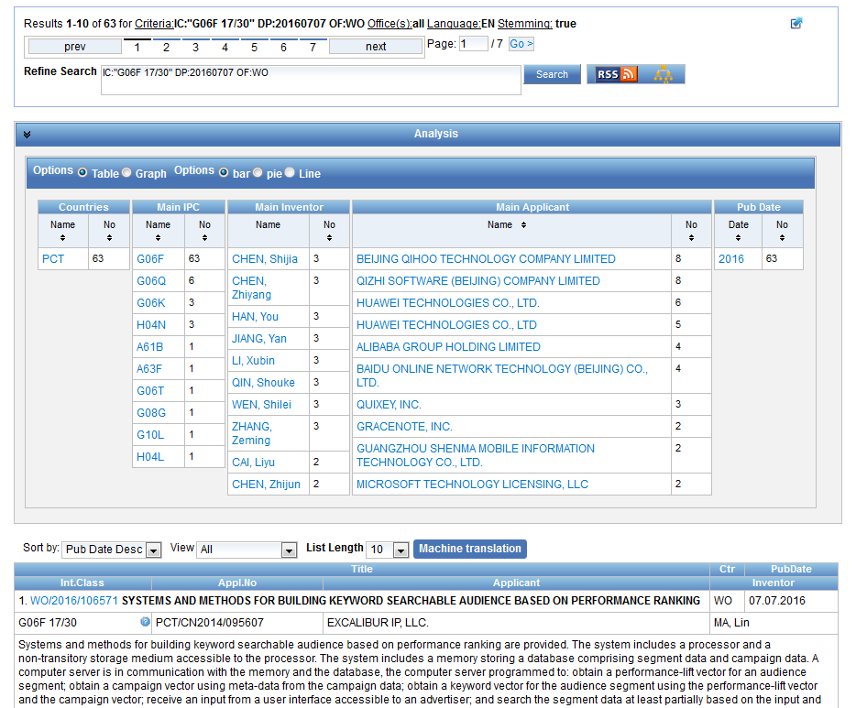

Slide 49
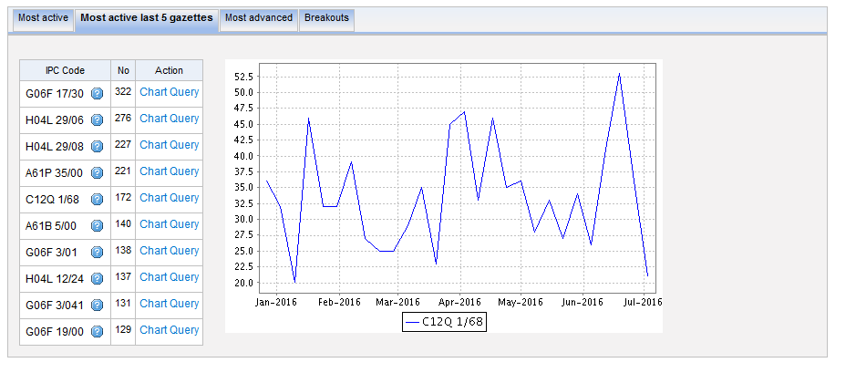
Most active last 5 gazettes

Slide 50
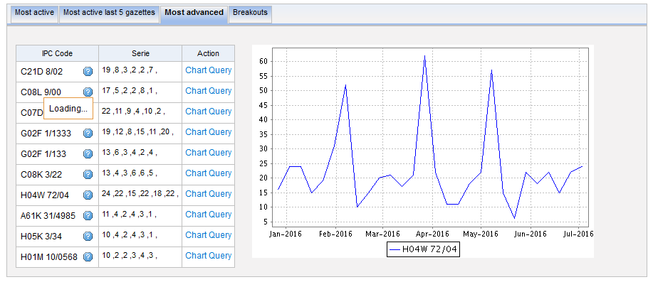
Most advanced

Slide 51
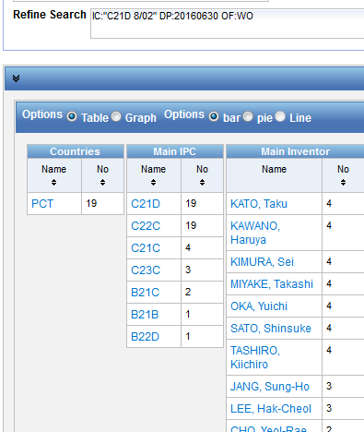
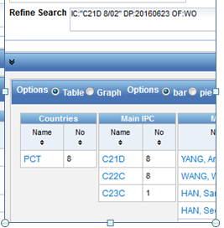
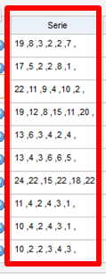
Serie column
6 last publications, nb of IPC per publication

Slide 52
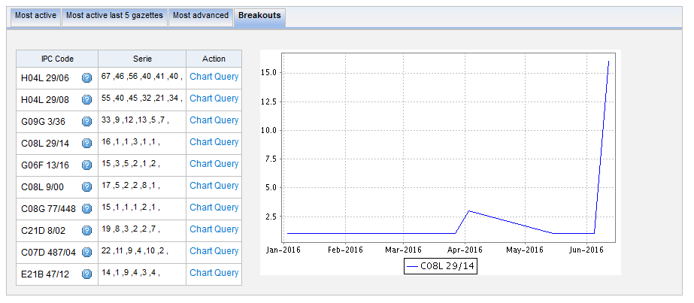
Breakouts

Slide 53

IPC searching in PATENTSCOPE

Slide 54
IPC search in PATENTSCOPE
Searching and Grouping now by complete IPC codes:
D06F 1/06 will include by default
D06F 1/08
1/10
1/16

Slide 55
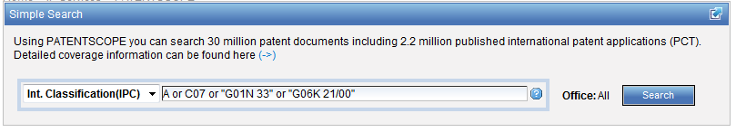
IPC search: Simple search

Slide 56
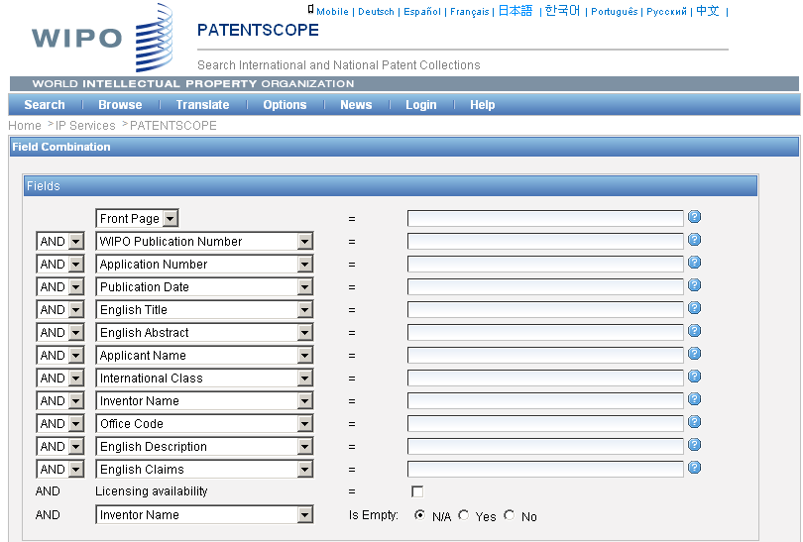
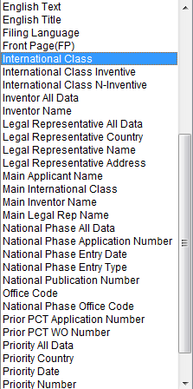
IPC search: Field combination

Slide 57
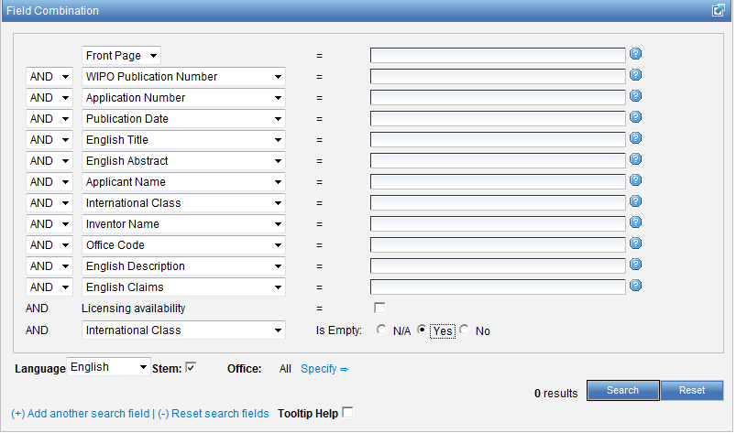

Slide 58

IPC search: Advanced search
http://patentscope.wipo.int/search/en/help/fieldsHelp.jsf

Slide 59


Slide 60
IC / ICI / ICN
IC = International Classification
ICI = International Classification Inventive
ICN = International Classification Non-inventive
IC_EX ICI_EX ICN_EX = no subgroup

Slide 61


Example

Slide 62


Slide 63


Slide 64
Combined search
Retrieve results that are specific "A23B 4/00“ and date range:
AD:[01.06.2012 TO 24.06.2016] AND IC_EX:("A23B 4/00")

Slide 65


Search for D06F1/06

Slide 66
Caution
Use of (…) and […]
Use of " … "
(IC: A or B or C)
AD:([01.06.2012 TO 24.06.2016]) AND IC:("A23B 4/00")

Slide 67


Slide 68


Slide 69

IPC in the result list

Slide 70


Slide 71


Slide 72


Slide 73




Slide 74



Slide 75


Slide 76

IPC CLIR

Slide 77


Supervised mode

Slide 78


Technical domains

Slide 79

IPC

Slide 80


Slide 81
Q:1: IPC statistics are available in the
A
Search menu
B
Browse menu

Slide 82

Q: 1: IPC statistics are available in the
A
Search menu
B
Browse menu

Slide 83
Q:2: To find an IPC code, you can use
A
The IPC website
B
PATENTSCOPE CLIR
C
PATENTSCOPE Simple and Advanced
D
PATENTSCOPE Field Combination

Slide 84
Q:2: To find an IPC code, you can use
A
The IPC website
B
PATENTSCOPE CLIR
C
PATENTSCOPE Simple and Advanced
D
PATENTSCOPE Field Combination
Spain

Slide 85
Q:3 Why is the IPC so useful in patent searches?
A
Not standarized
B
Language-independent

Slide 86
Q:3: Why is the IPC so useful in patent searches?
A
Not standarized
C
Language-independent

Slide 87


Slide 88
Next webinar
Chemical structure search
  September 27 at 5:30 pm
  https://attendee.gotowebinar.com/rt/6570654375885586692
  September 29 at 8:30 am
  https://attendee.gotowebinar.com/rt/6570654375885586692

Slide 89


patentscope@wipo.int

Slide 90

mulțumesc
mulțumesc

