Slide 1
Overview of PATENTSCOPE
Internet
February
2017
Sandrine Ammann
Marketing & Communications Officer

Slide 2


Slide 3
Agenda
PATENTSCOPE:
  What is it?
  What you can do?
  How to do it?
  Options
  Q & A session

Slide 4
Q1: How often do you PATENTSCOPE?
A
A few times a year
B
Every month
C
Every week
D
Every day

Slide 5

What is it?

Slide 6
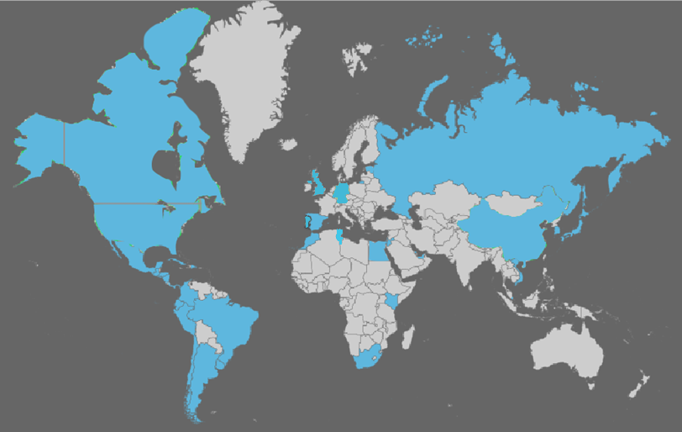
Coverage: what is included?
PCT published applications
National/regional patent collections

Slide 7
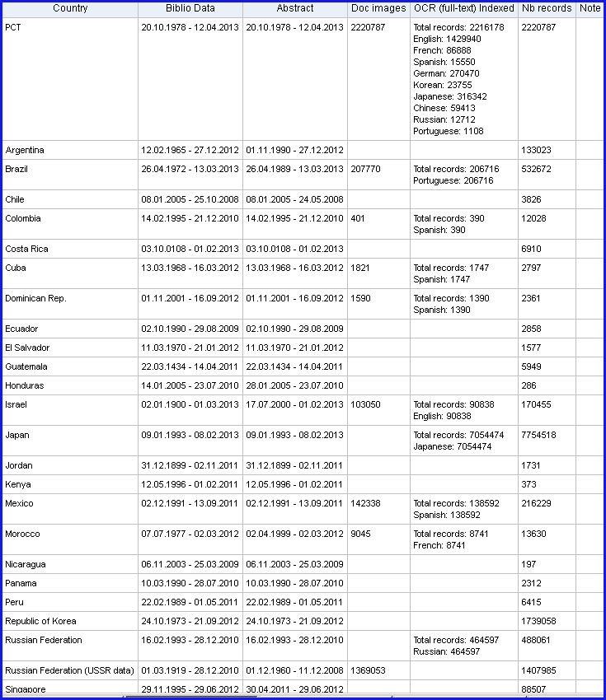
Coverage : Details of collections

Slide 8
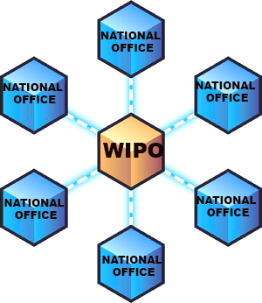
National/regional collections

Slide 9
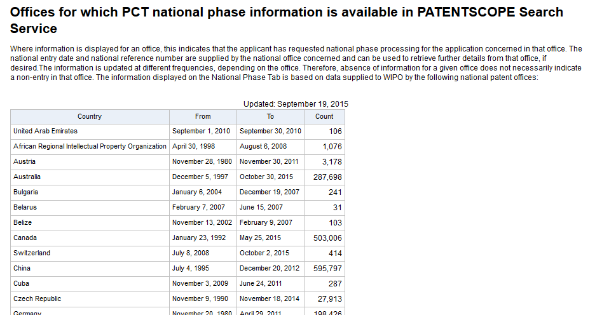
National/regional collections vs national phase
https://patentscope.wipo.int/search/en/nationalphase.jsf

Slide 10
Q2:Were you aware of this difference?
A
Yes
B
NO

Slide 11


Slide 12

PATENTSCOPE
Search
Browse
Translate

Slide 13
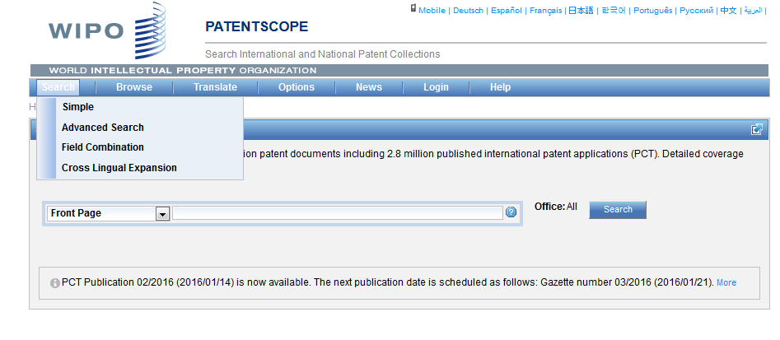
Search

Slide 14
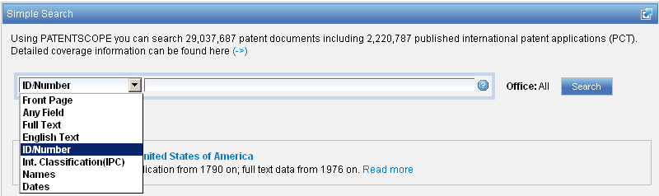
Interface : Simple
Basic search fields are provided

Slide 15
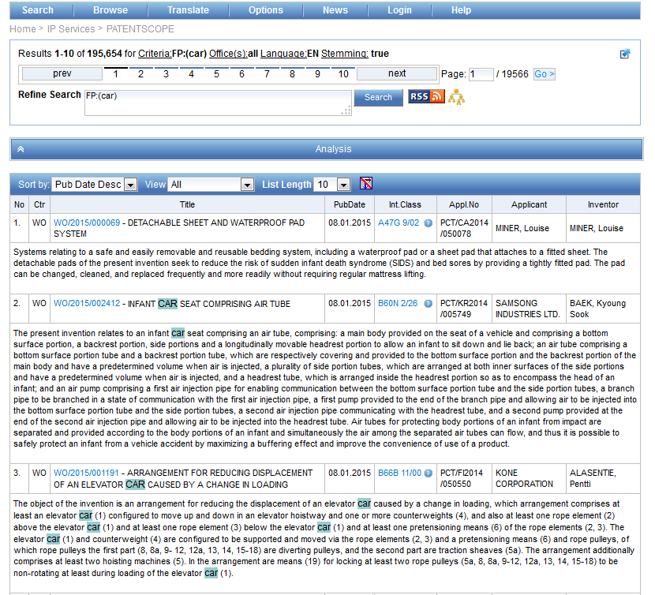
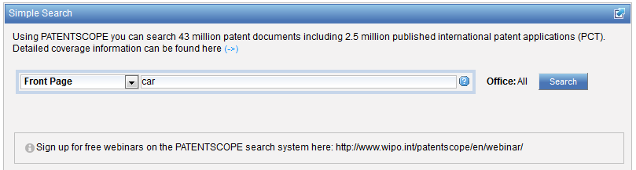
Interface simple - keywords

Slide 16
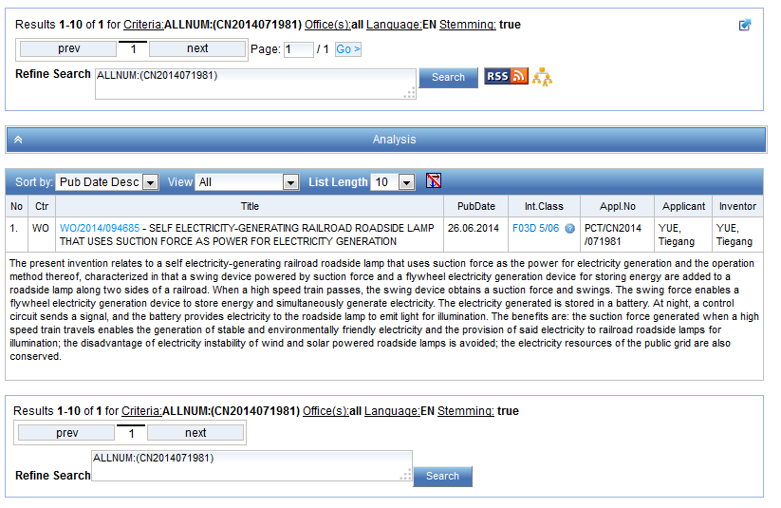
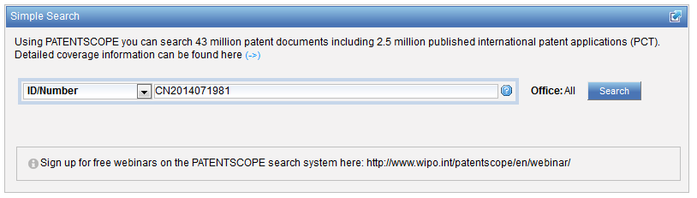
Simple interface - Numbers

Slide 17
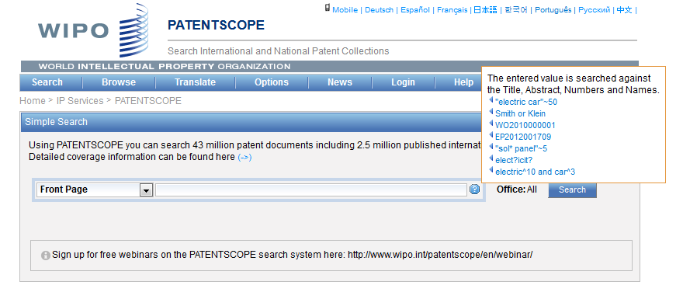
Simple interface - Help

Slide 18
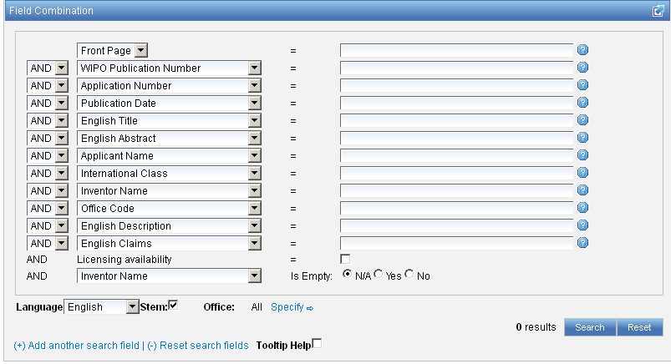
Interface : Field Combination - Structured
Additional search fields can be selected

Slide 19
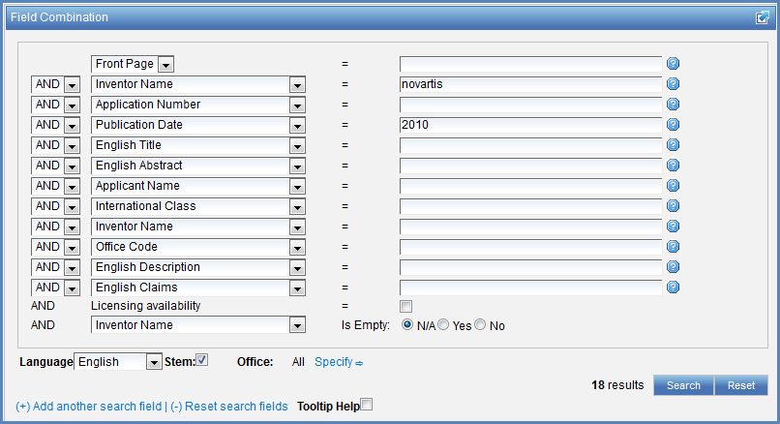

Search examples
Patent documents containing Novartis as inventor and published in 2010
Patent documents without an IPC code
Notes:
19
3. there is also the option to select a field that is empty: for example you could search. On the last line, select the IPC in the drop-down box and tick yes next to empty.

Slide 20
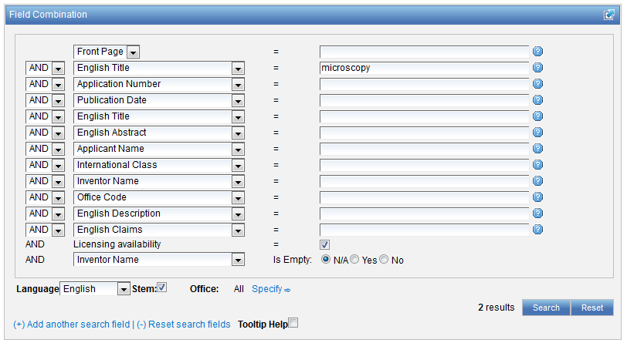
Search examples
Patent documents containing microscopy with licensing availability.
Notes:
20
In the drop-down box, select the field Applicant name and enter Steve Jobs; select AND and the field Publication date and enter 2007
In the drop-down boy, select English description and enter microchip, then tick the Licensing availability box (one before last in the Field Combination interface).

Slide 21
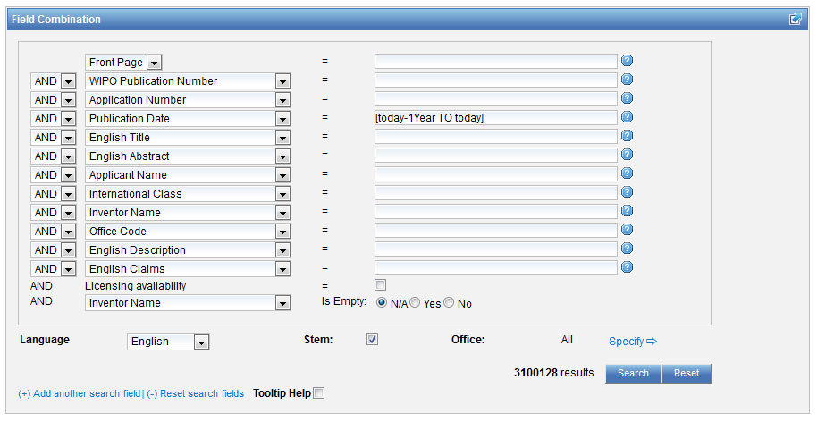

Slide 22
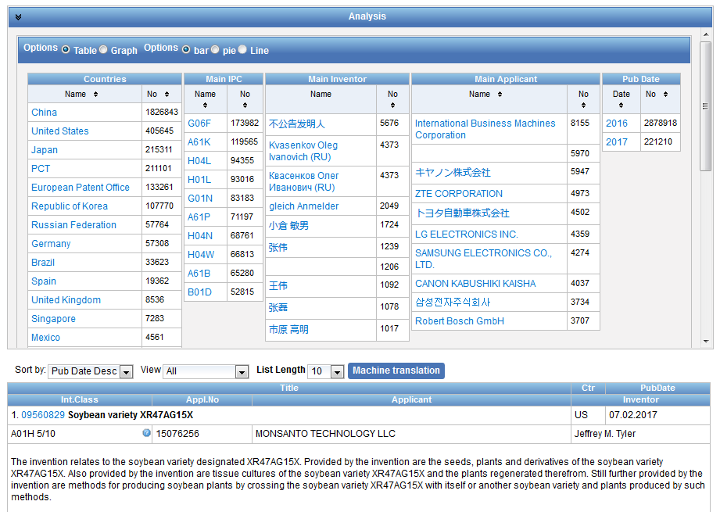

Slide 23
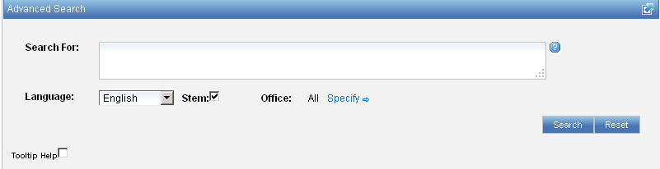
Interface : Advanced

Slide 24
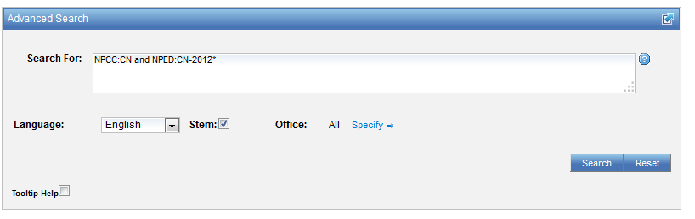
Example: national phase entry
All applications that entered national phase in China in 2012

Slide 25
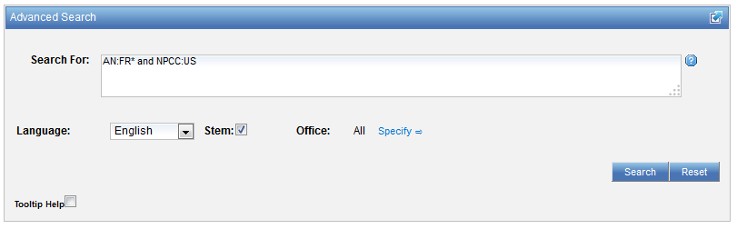
Example: nb of patent applications from France seeking protection in USA

Slide 26
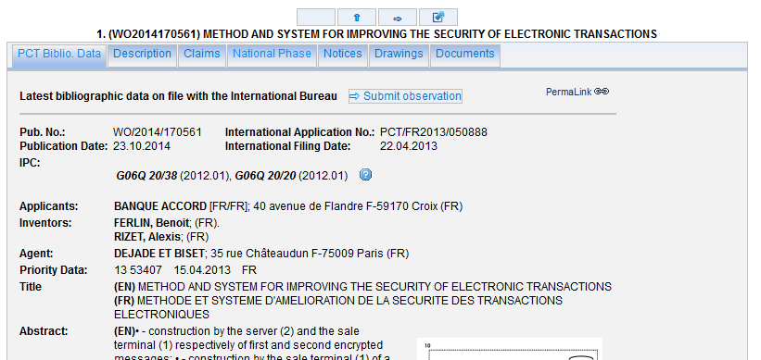
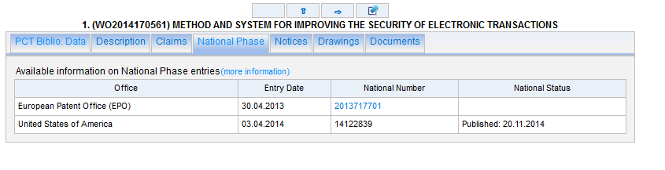

Slide 27
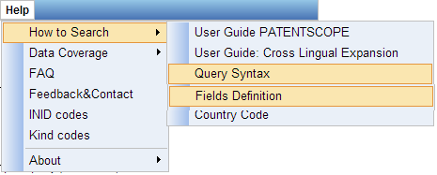
Help menu

Slide 28
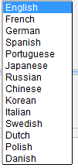
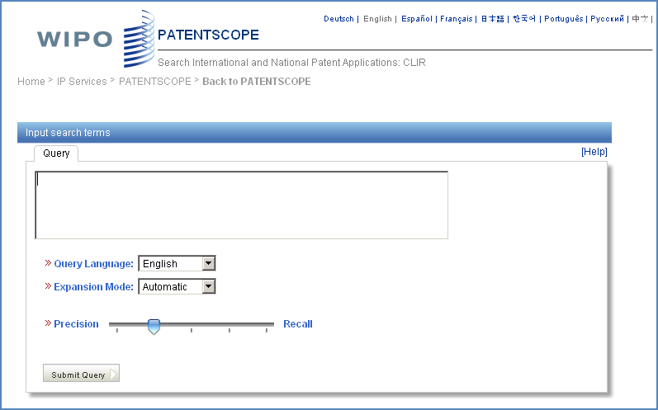
CLIR: the interface
Notes:
28
There is query box
Query language
Expansion mode

Slide 29
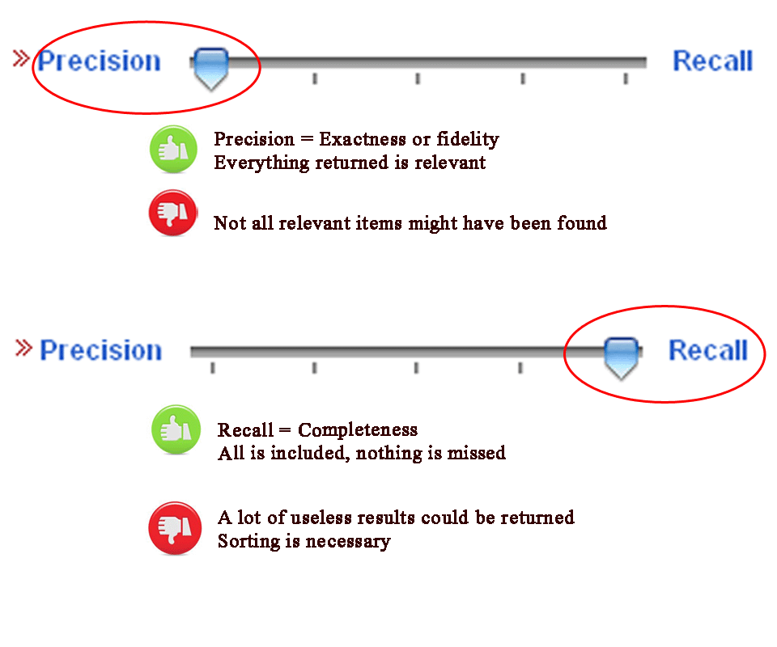
CLIR: precision vs recall

Slide 30
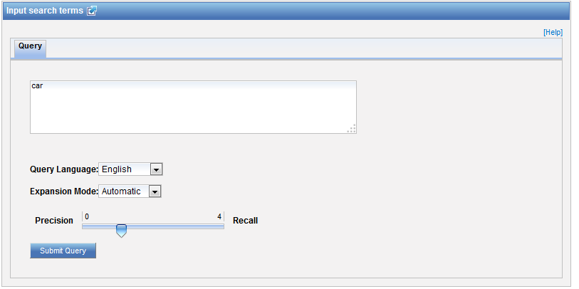
CLIR: an example in automatic mode

Slide 31
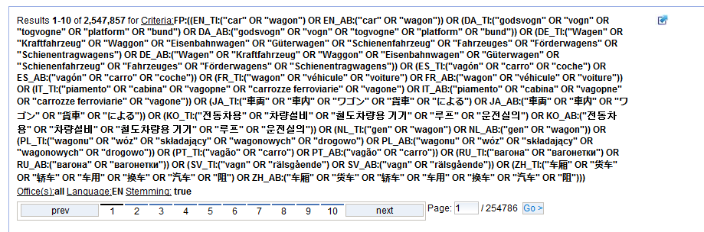
CLIR: an example

Slide 32
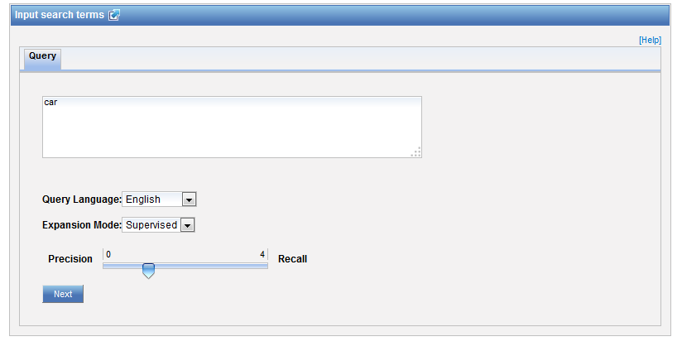
CLIR: an example in supervised mode

Slide 33
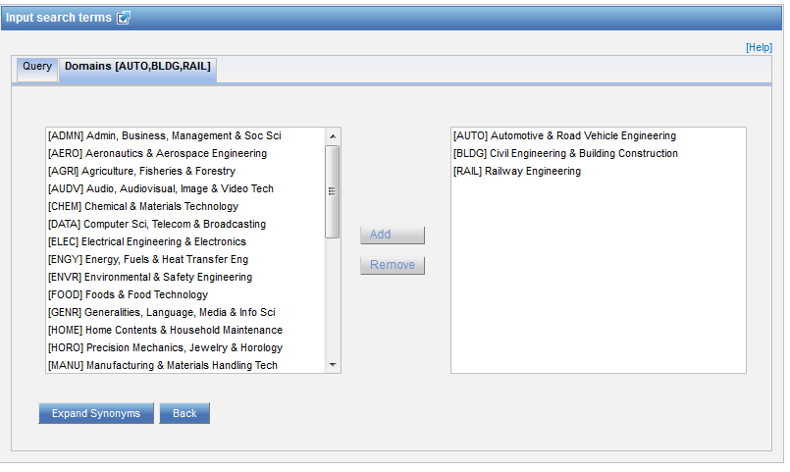
Domain selection

Slide 34
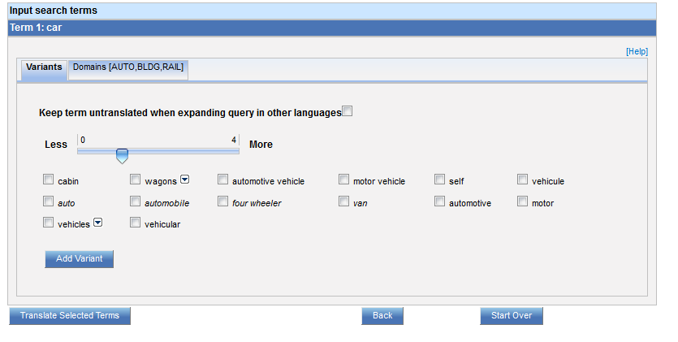
Variants selection

Slide 35
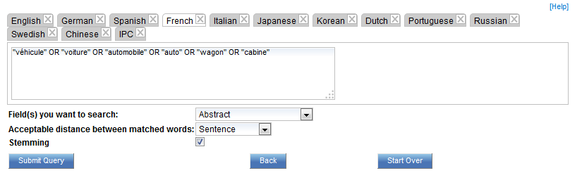
Summary of variants

Slide 36
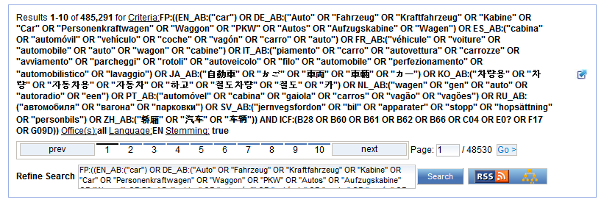
Results

Slide 37
Q3: Had you used CLIR before?
A
Yes
B
No and will not use it in the future
C
No but I will used in the future

Slide 38
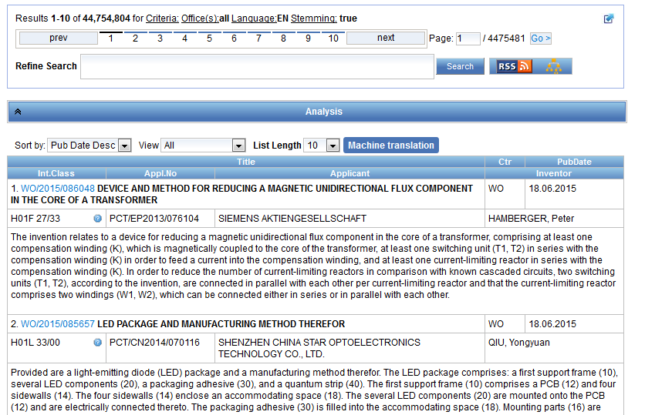
Reading the result list

Slide 39
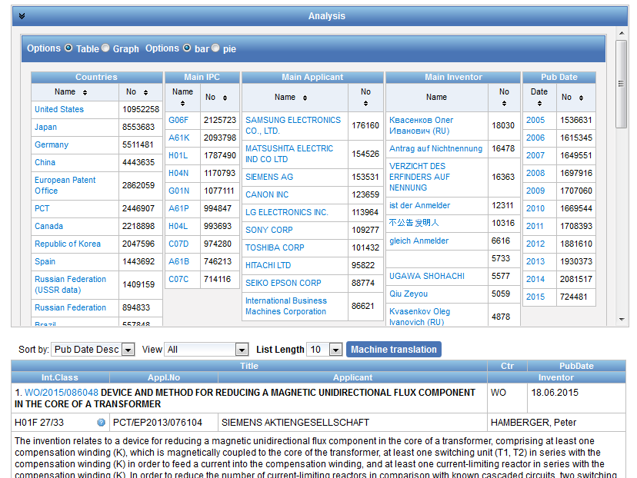
Analysis

Slide 40
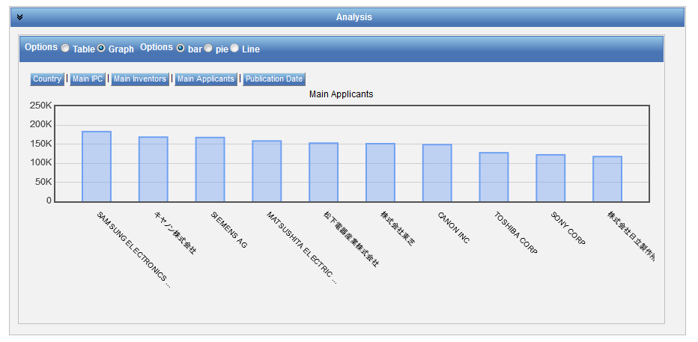
Display options: table/graph –bar/pie

Slide 41
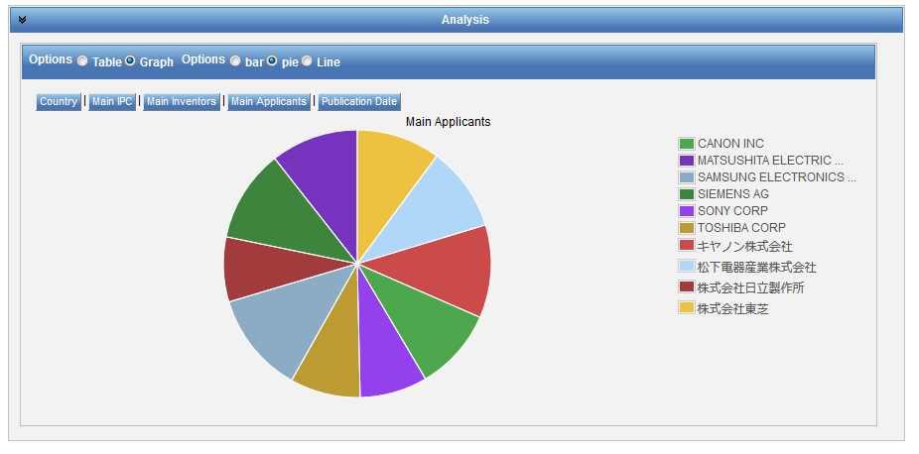
Display options: table/graph –bar/pie
Notes:
41
In both bar and pie options, the tabs allow you to see the information graphically for the Offices, Main IPC, Main Applicant, Main Inventor and Publication Date.
The charts can be saved in GIF format for inclusion in documents or reports by right-clicking in a corner of the image and selecting “Copy image” or “Save image”.

Slide 42
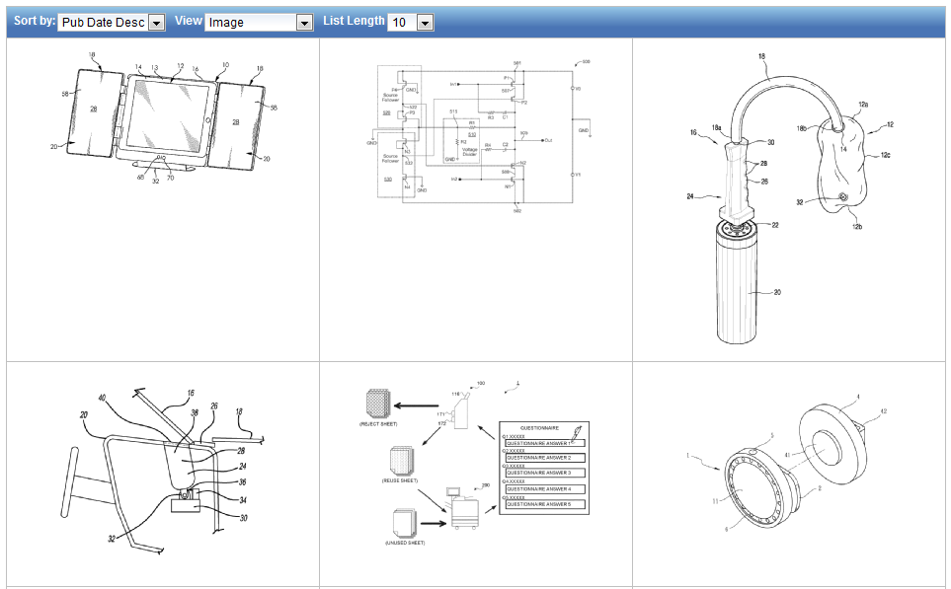
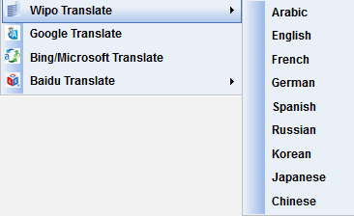
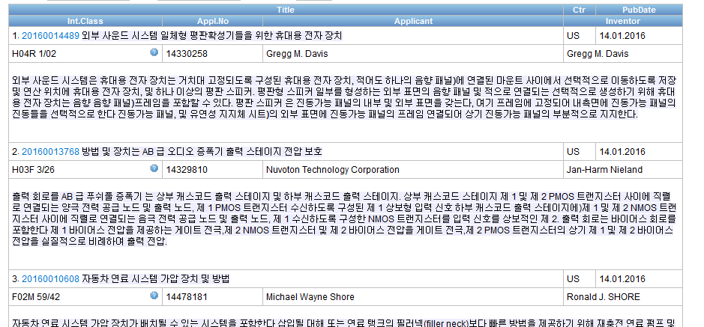
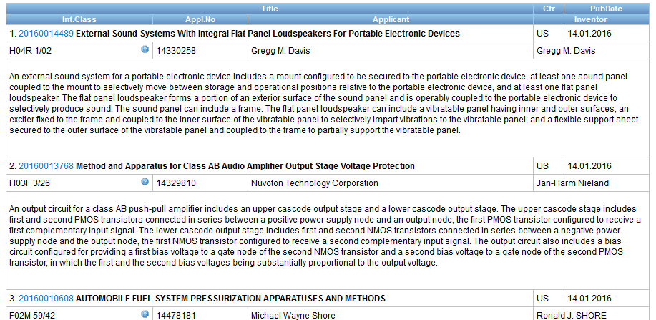



Options

Slide 43
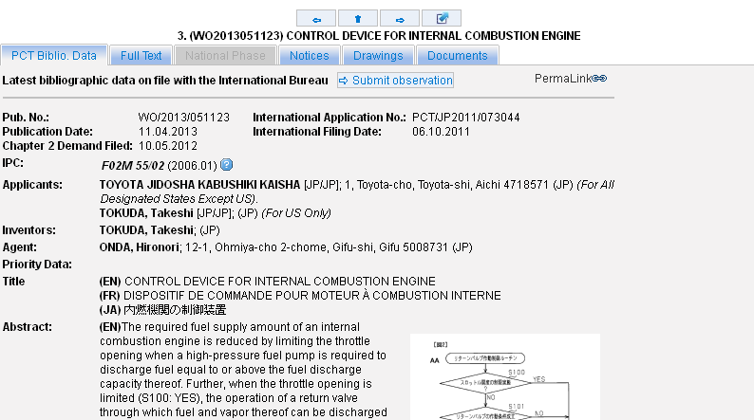
Tabs

Slide 44
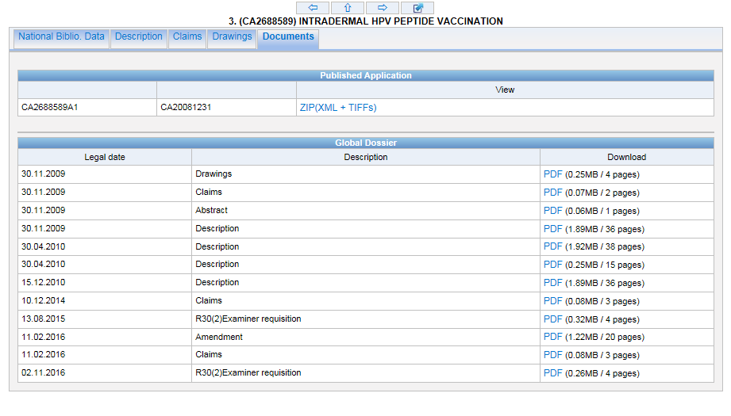
Documents tab

Slide 45
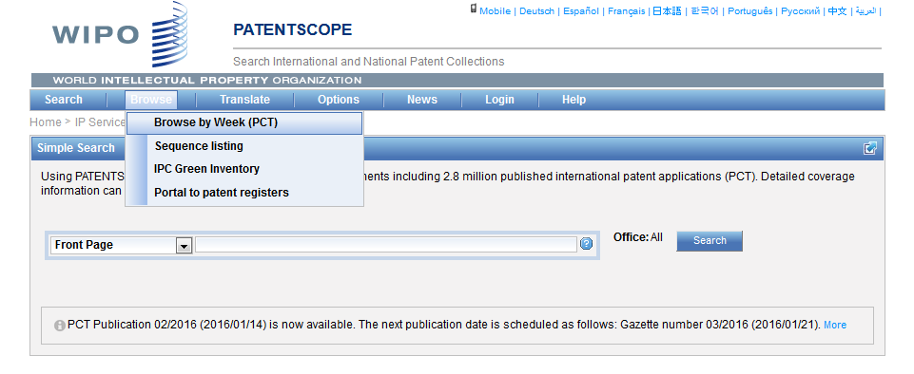
Browse

Slide 46
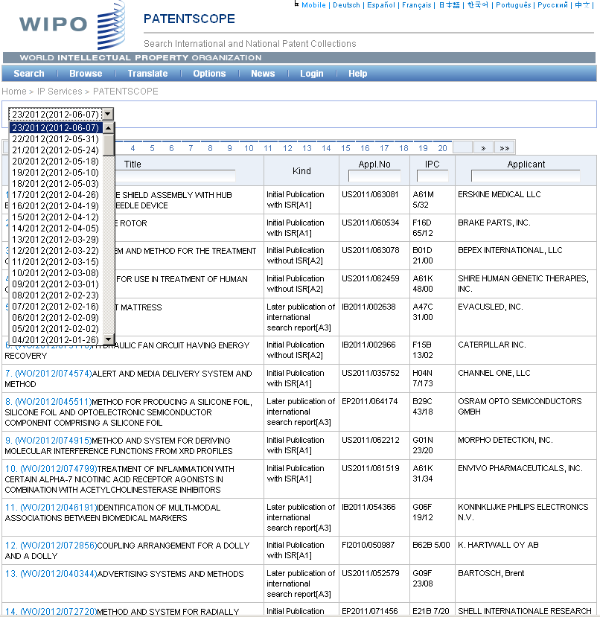

Slide 47
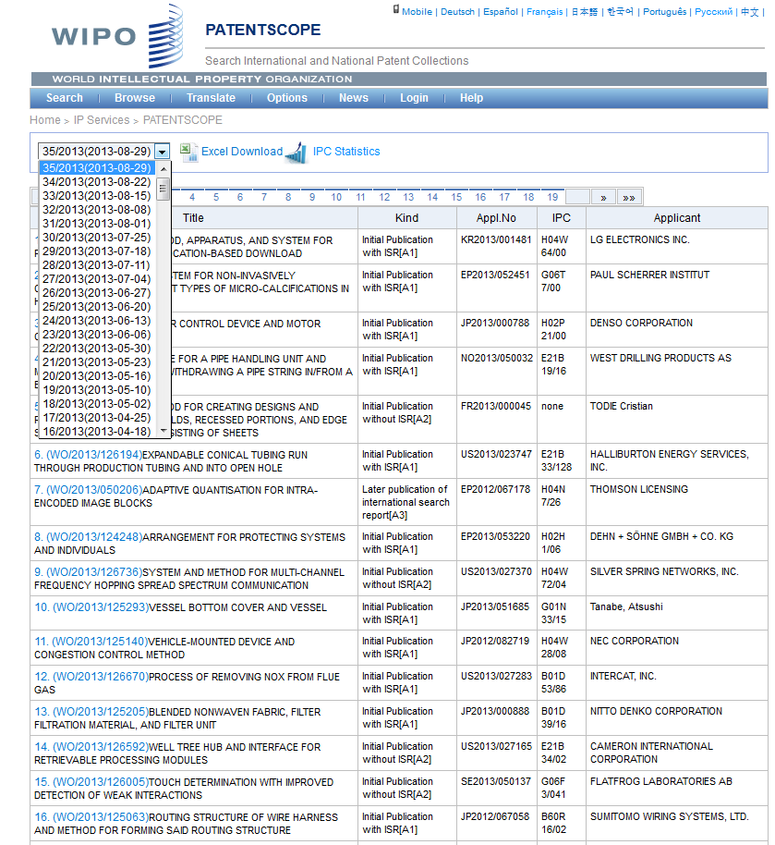

Slide 48
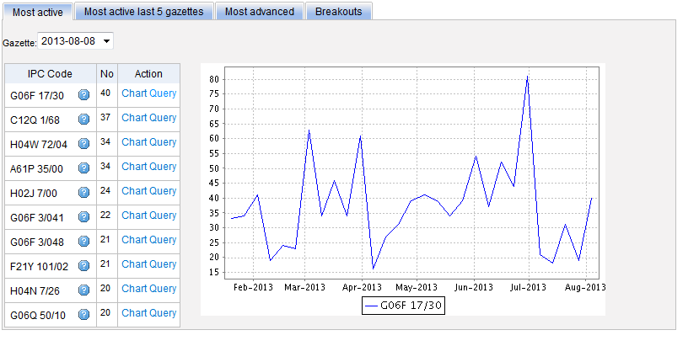
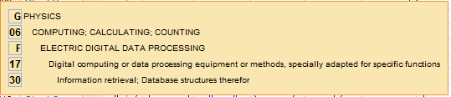
Most active

Slide 49
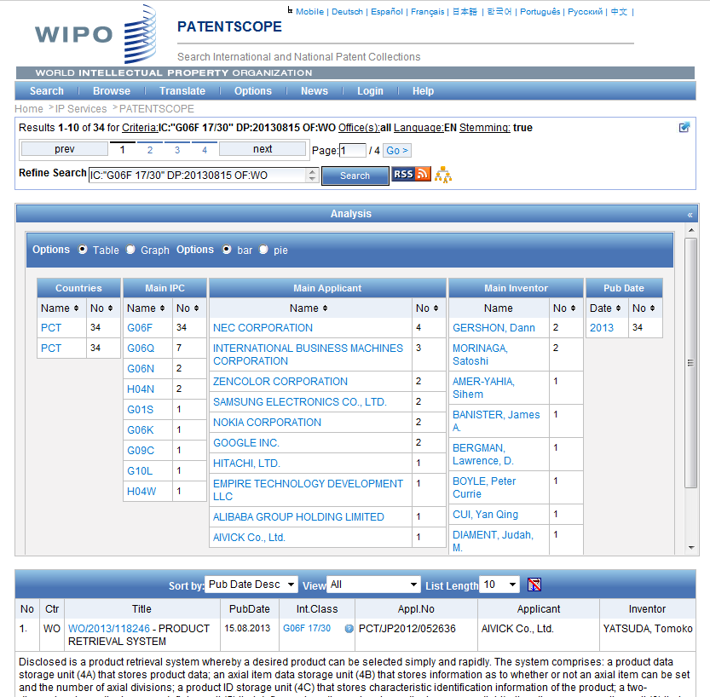

Slide 50
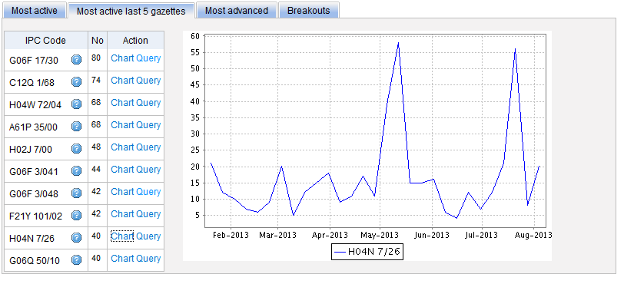
Most active last 5 gazettes

Slide 51
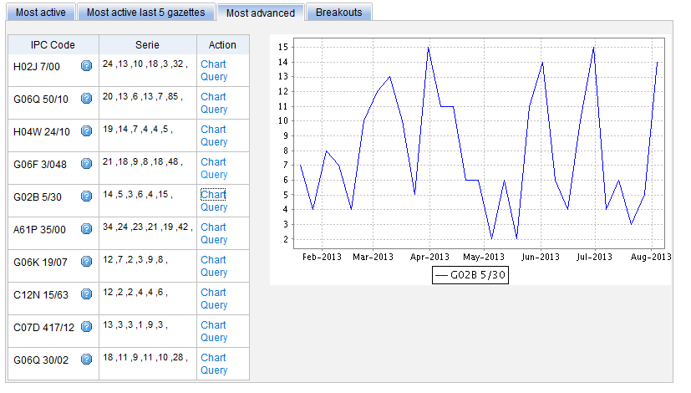
Most advanced

Slide 52

Breakouts

Slide 53


Slide 54

IPC Green Inventory

Slide 55

Patent Register Portal

Slide 56

Translate
Notes:
56
Language pairs available: EN=>FR, FR=>EN, EN=>ZH, ZH=>EN
Technical domain aware system using 32 domains derived from the International Patent Classification

Slide 57

32 Technical domains from the IPC
[ADMN] Admin, Business, Management & Soc Sci
[AERO] Aeronautics & Aerospace Engineering
[AGRI] Agriculture, Fisheries & Forestry
[AUDV] Audio, Audiovisual, Image & Video Tech
[AUTO] Automotive & Road Vehicle Engineering
[BLDG] Civil Engineering & Building Construction
[CHEM] Chemical & Materials Technology
[DATA] Computer Sci, Telecom & Broadcasting
[ELEC] Electrical Engineering & Electronics
[ENGY] Energy, Fuels & Heat Transfer Eng
[ENVR] Environmental & Safety Engineering
[FOOD] Foods & Food Technology
[GENR] Generalities, Language, Media & Info Sci
[HOME] Home Contents & Household Maintenance
[HORO] Precision Mechanics, Jewelry & Horology
[MANU] Manufacturing & Materials Handling Tech
[MARI] Marine Engineering
[MEAS] Standards, Units, Metrology & Testing
[MECH] Mechanical Engineering
[MEDI] Medical Technology
[METL] Metallurgy
[MILI] Military Technology
[MINE] Mining, Oil & Gas Extraction & Minerals
[NANO] Nano Technology
[PACK] Packaging & Distribution of Goods
[PRNT] Printing & Paper
[RAIL] Railway Engineering
[SCIE] Optical Engineering
[SPRT] Sports, Leisure, Tourism & Hospitality
[TEXT] Textile & Clothing Industries
[TRAN] Transportation

Slide 58


WIPO Translate: how does it work?

Slide 59


Slide 60


Slide 61


Slide 62

WIPO Pearl

Slide 63


WIPO Pearl
WIPO’s online terminology database
17’000 concepts, 115’000 terms
10 languages
Contents validated by WIPO language experts and terminologists

Slide 64

Example: bicycle fork

Slide 65


Slide 66


Slide 67

Languages of the interface

Slide 68

Interface in Chinese

Slide 69

PATENTSCOPE account

Slide 70

Signing up

Slide 71

Once logged-in

Slide 72

Saved queries

Slide 73

Downloading the results

Slide 74

Downloaded results

Slide 75

Chemical structure search

Slide 76

3 options

Slide 77

Upload a structure

Slide 78

Example

Slide 79


Slide 80

Structure editor

Slide 81


Example

Slide 82

Convert a structure

Slide 83

Convert structure: ex.: paracetamol

Slide 84


Slide 85

Results

Slide 86


Slide 87


Slide 88

Account customization

Slide 89

Https protocol

Slide 90
Conclusion
The most complete and up to date place to search for PCT publications including their related documents
Searchable descriptions and claims
Facilitated patent search in languages not familiar to the user
Powerful Search Operators
Data Analytic Tools

Slide 91


Slide 92


Future/past webinars:
wipo.int/patentscope/en/webinar

Slide 93
Global Brand Database: webinar
Performing effective searches in the Global Brand Database
  February 21 at 5:30pm CET
  https://attendee.gotowebinar.com/register/8516192925204831491
  February 23 at 8:30 am CET
  https://attendee.gotowebinar.com/register/8516192925204831491

Slide 94
Global Design Database: webinar
The Global Design Database: an introduction
  April 4 at 5:30pm CET
  https://attendee.gotowebinar.com/rt/2144154707191893761
  April 6 at 8:30 am CET
  https://attendee.gotowebinar.com/rt/2144154707191893761

Slide 95

Forum

Slide 96

patentscope@wipo.int

