Slide 1
PATENTSCOPE:
Simple & Field Combination
Cyber world
January
2015
Sandrine Ammann
Marketing & Communications Officer

Slide 2


To the PATENTSCOPE search system webinar
Simple search – Field Combination

Slide 3
Questions/concerns
patentscope@wipo.int

Slide 4
Agenda
Webinars in 2015
Focus on the search interface:
  Coverage
  Account
  How to search
  How to use the Browse menu
  How to search using the Simple & Field Combination
  Q & A session

Slide 5

Webinars in 2015
Monthly
Announced here: http://www.wipo.int/patentscope/en/webinar/
On specific features/functionalities or overview
Special requests: patentscope@wipo.int
Quiz at the end of each section

Slide 6

THE COVERAGE

Slide 7
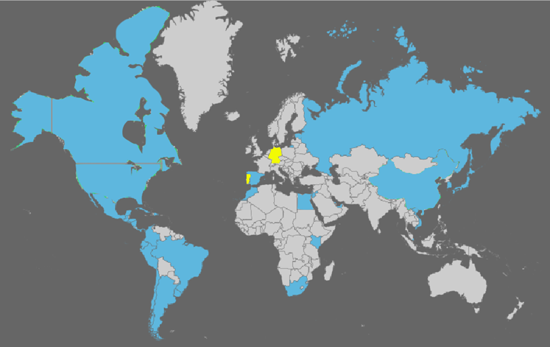
Coverage : Collections
PCT applications, ARIPO, EP, EAPO and LATIPAT collections
Notes:
ARIPO: African Regional IP Org
PCT: 1st publication worldwide

Slide 8
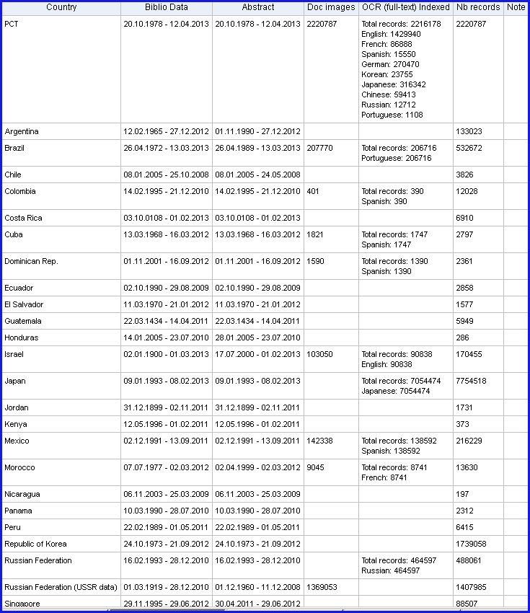
Coverage : Details of collections

Slide 9


Slide 10
Q:1: which national collections were added last in the system?
A
Norway
B
Butan
C
Germany
D
Portugal

Slide 11

Q:1: which national collection was added last in the system?
A
Norway
B
Butan
C
Germany
D
Portugal
Spain

Slide 12
Q:2: are those data of PCT entering into national phase or patent data from those countries?
A
National phase entries
B
National collections

Slide 13
Q: 2: are those data of PCT entering into national phase or patent data from those countries?
A
National phase entries
B
National collections

Slide 14
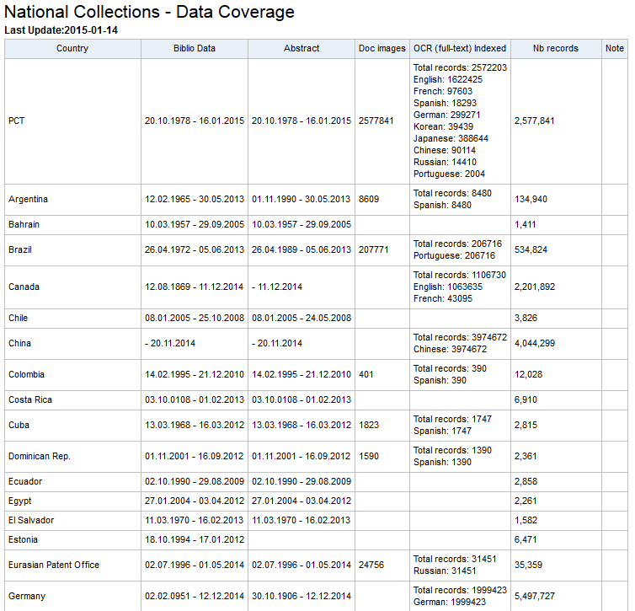
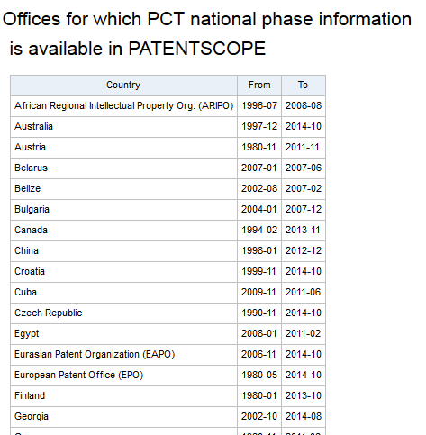
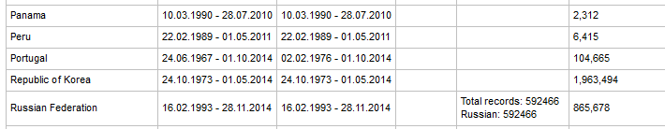
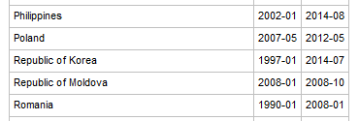
National collections/National phase entries

Slide 15


Slide 16
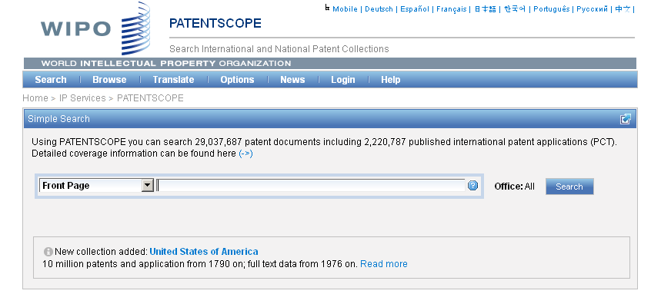
Languages of the interface

Slide 17
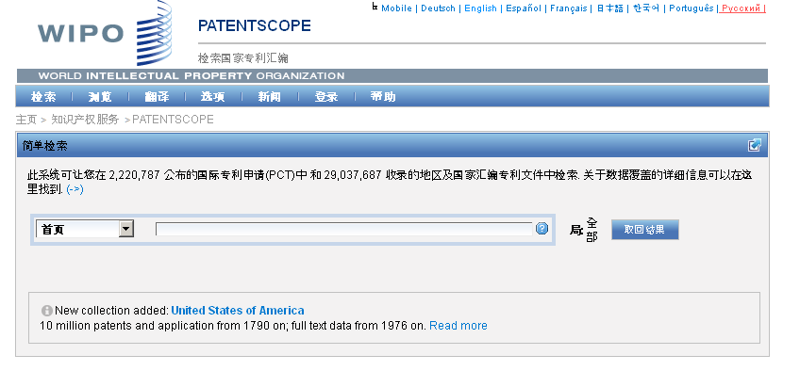
Interface in Chinese

Slide 18
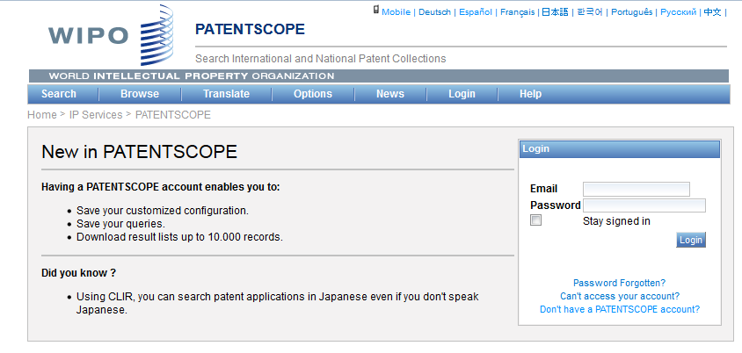
PATENTSCOPE account

Slide 19
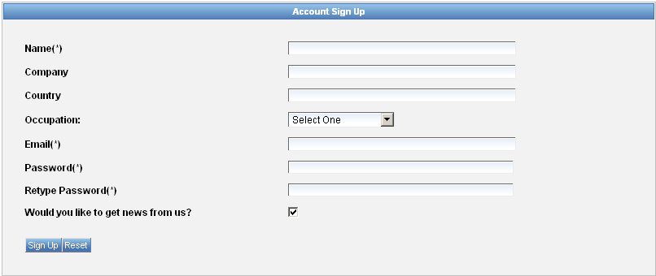
Signing up

Slide 20
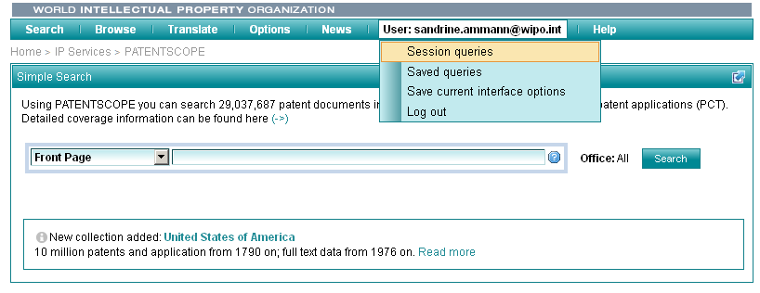
Once logged-in

Slide 21
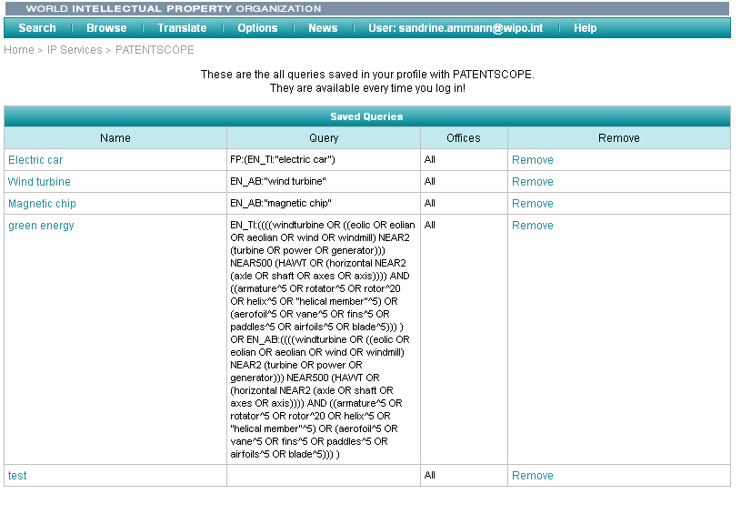
Saved queries

Slide 22
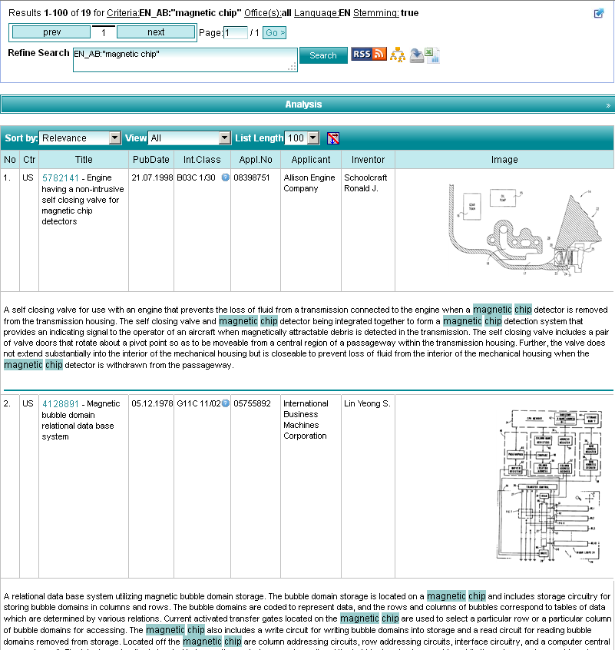
Downloading the results

Slide 23
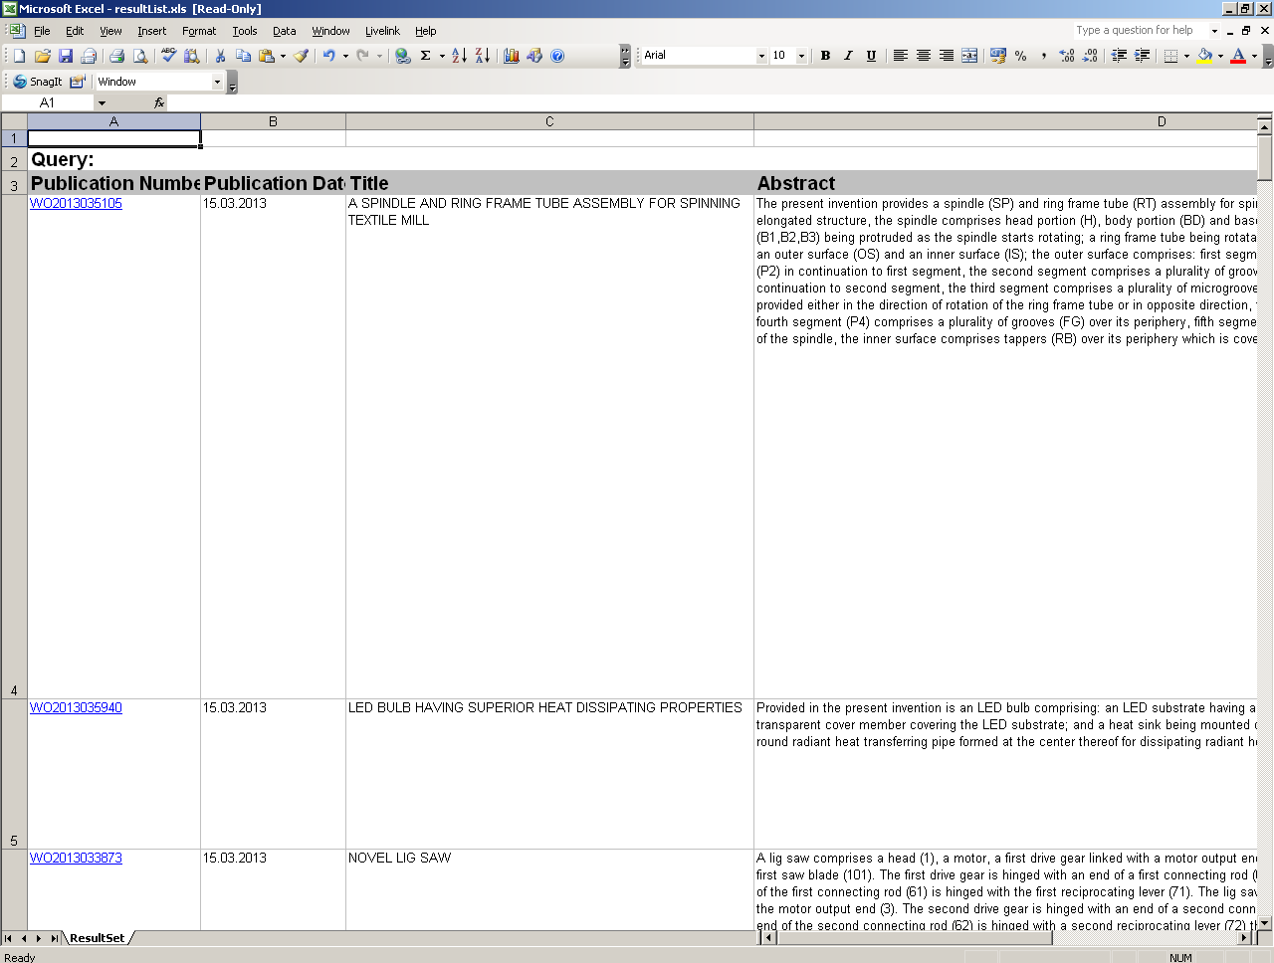
Downloaded results

Slide 24
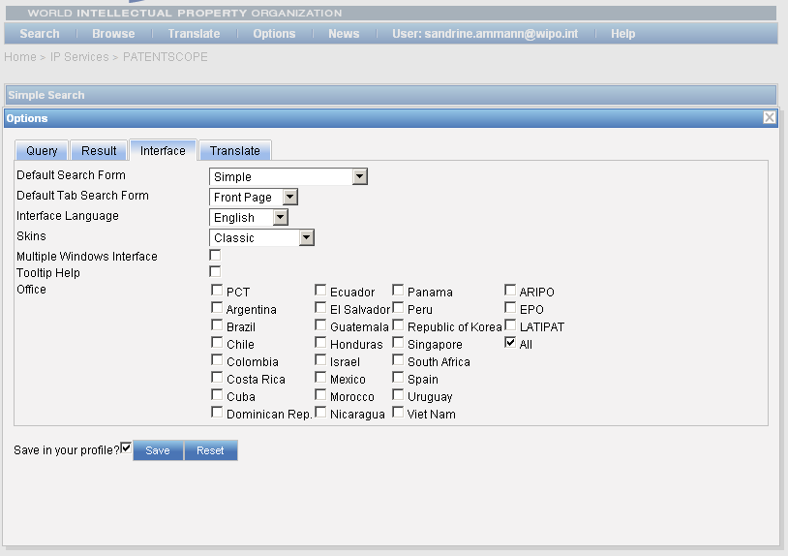
Account customization

Slide 26
Q:1: What are the advantages of having a
PATENTSCOPE account?
A
Download the result list
B
Save your preferred settings
C
Save your queries
D
Download the entire database

Slide 27
Q:1: What are the advantages of having a
PATENTSCOPE account?
A
Download the result list
B
Save your preferred settings
C
Save your queries
D
Download the entire database

Slide 28
PATENTSCOPE: how to search
Browse by week or sequence listing
Search patent documents:
  Simple
  Field combination

Slide 29
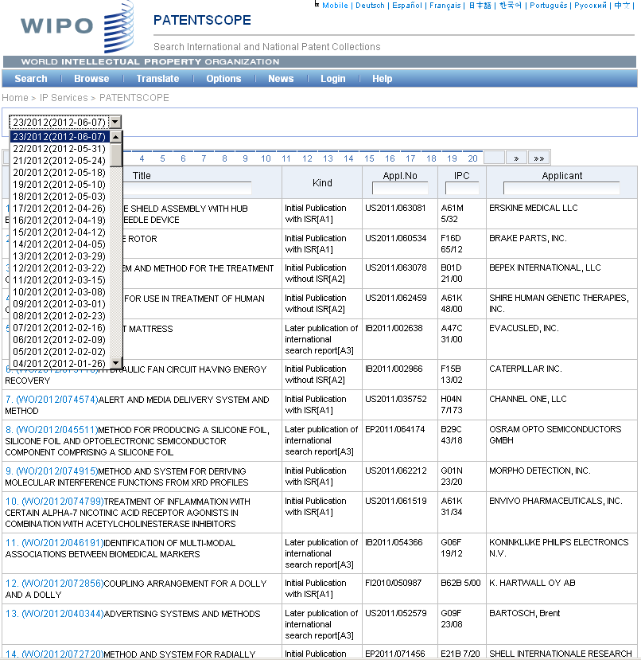

Slide 30
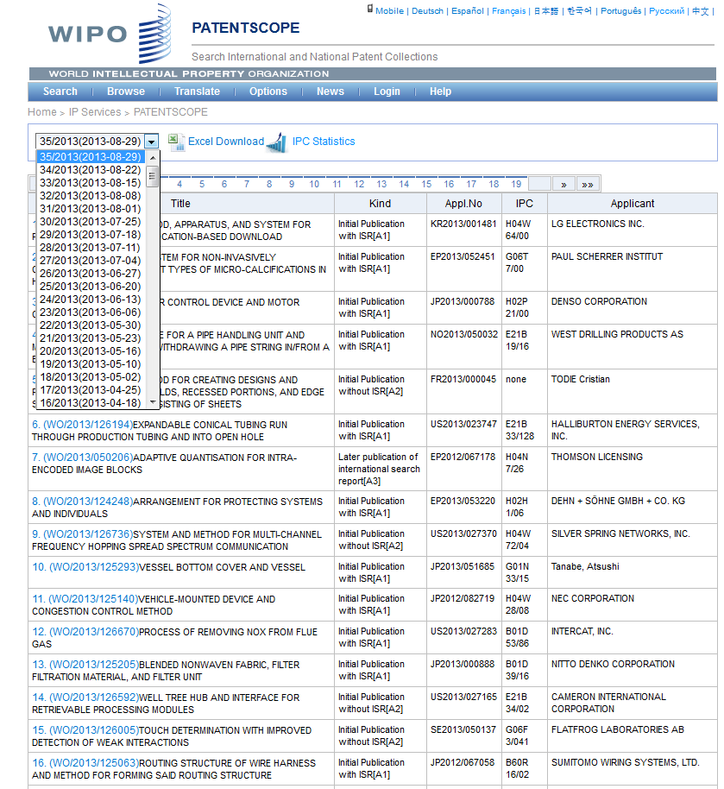

Slide 31
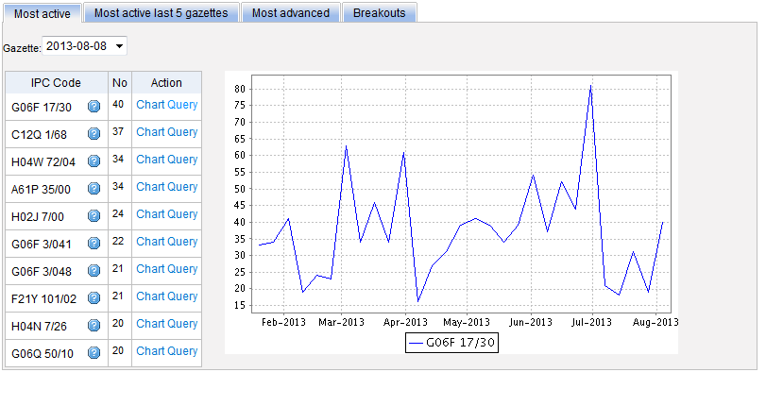
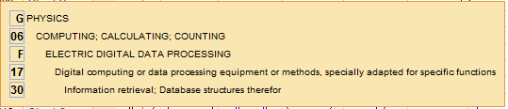
Most active

Slide 32
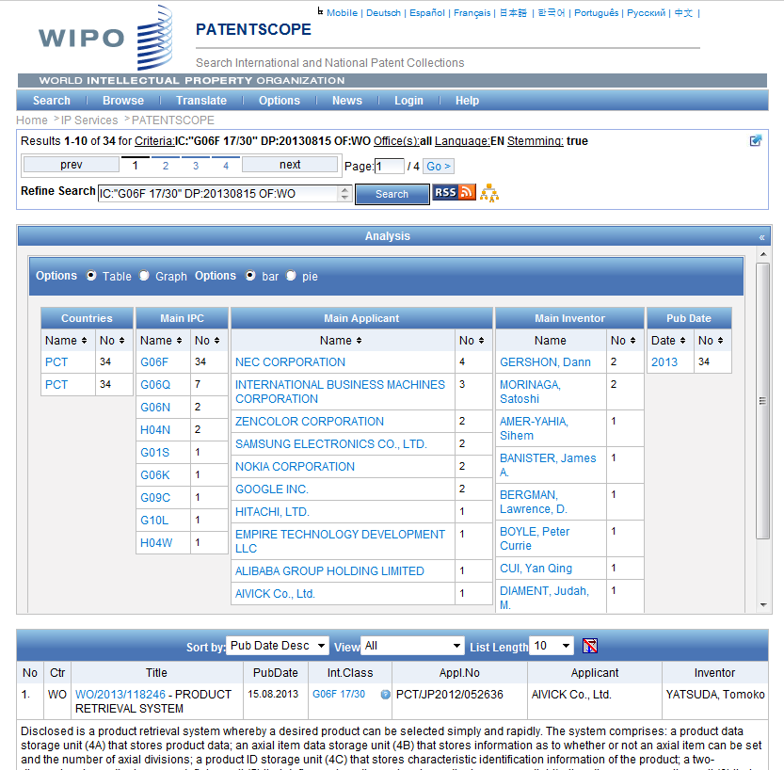

Slide 33
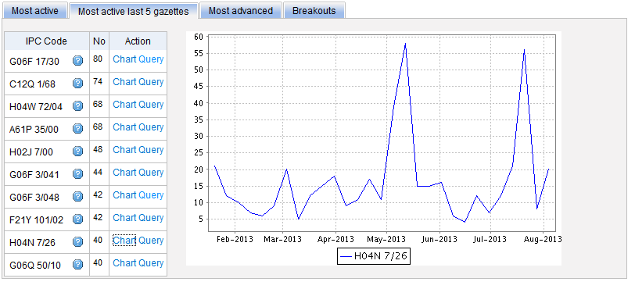
Most active last 5 gazettes

Slide 34
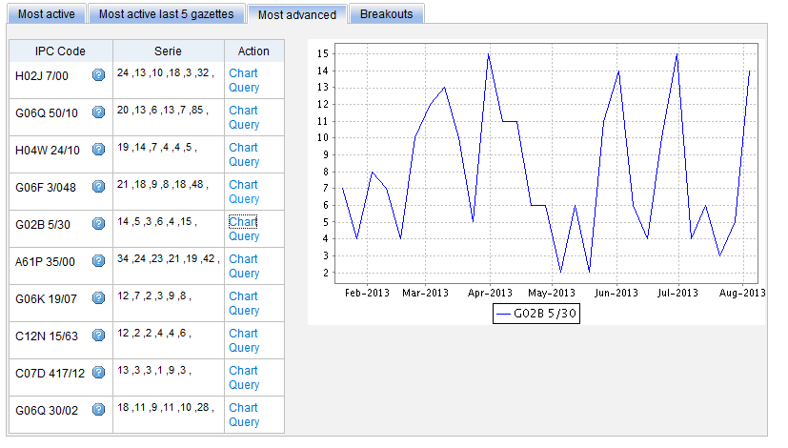
Most advanced

Slide 35
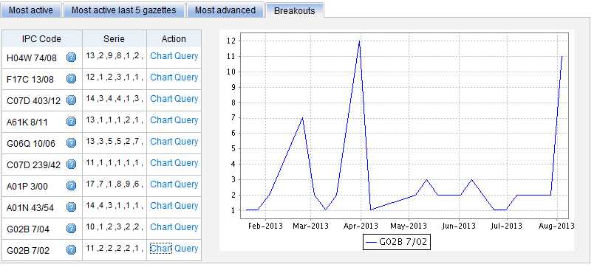
Breakouts

Slide 36
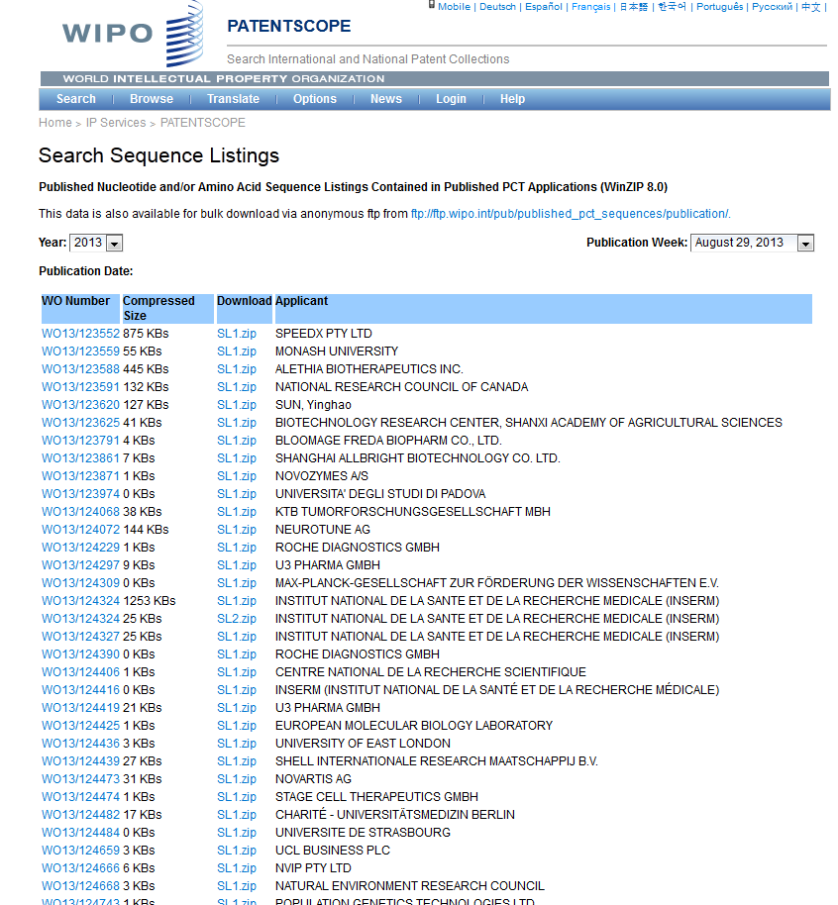

Slide 37
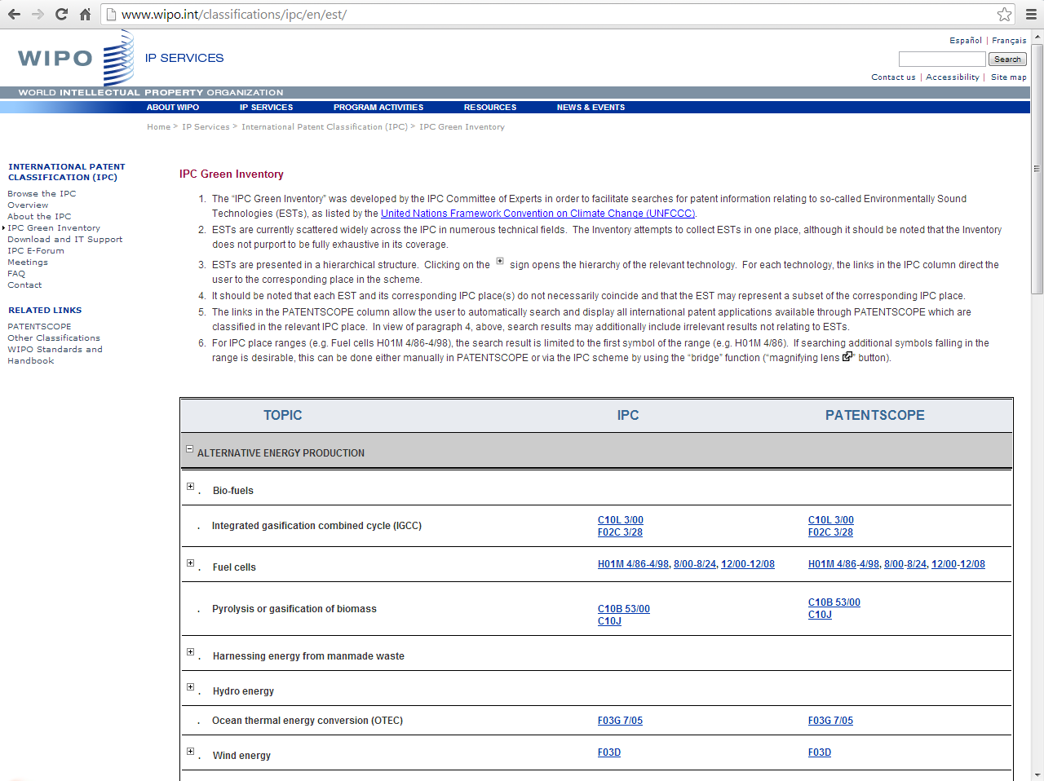
IPC Green Inventory

Slide 39
Q:1: Where are IPC statistics available?
A
Simple search interface
B
Field combination interface
C
Browse menu

Slide 40

Q:1: Where are IPC statistics available?
A
Simple search interface
B
Field combination interface
C
Browse menu

Slide 41
PATENTSCOPE: how to search
Browse by week or sequence listing
Search patent documents:
  Simple
  Field combination

Slide 42
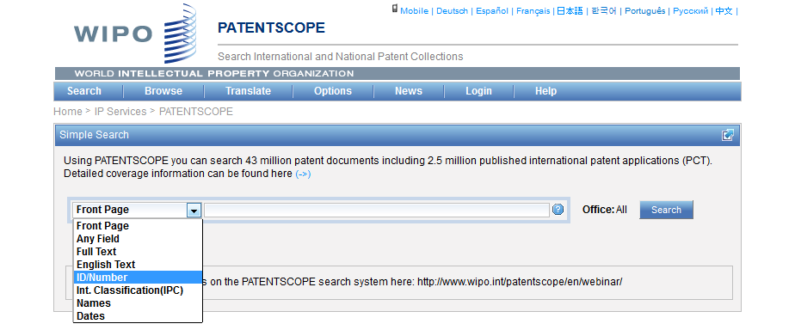
Interface : Simple
Basic search fields are provided

Slide 43
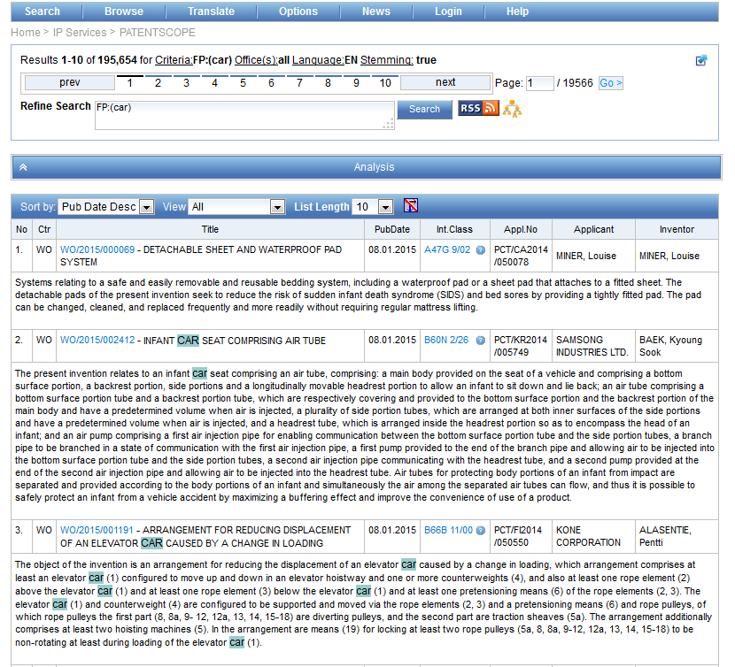
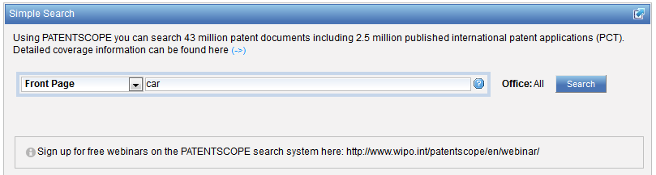
Interface simple - keywords

Slide 44
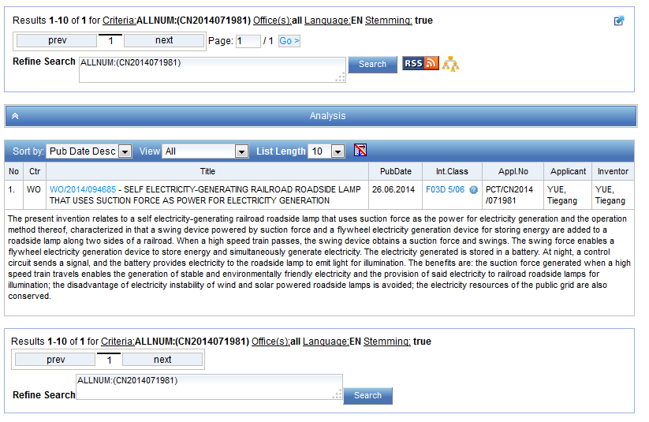
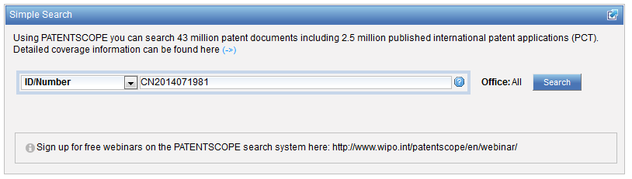
Simple interface - Numbers

Slide 45
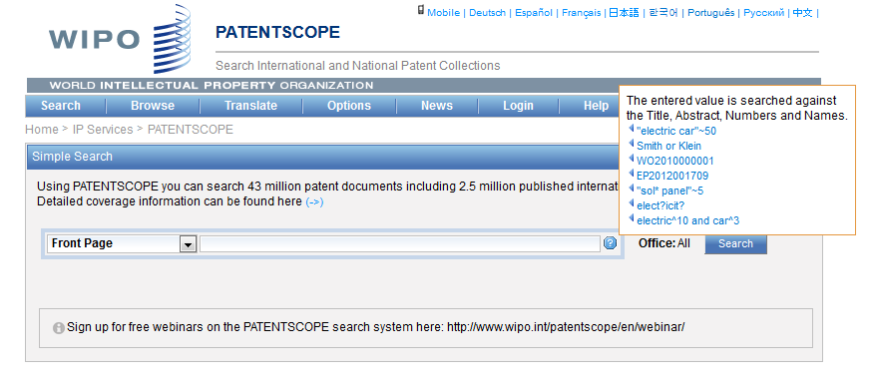
Simple interface - Help

Slide 46
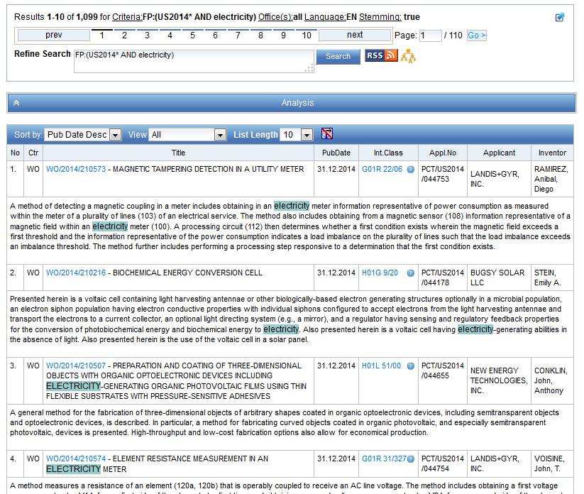
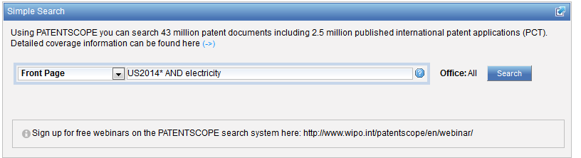
Simple interface: more complex queries

Slide 47
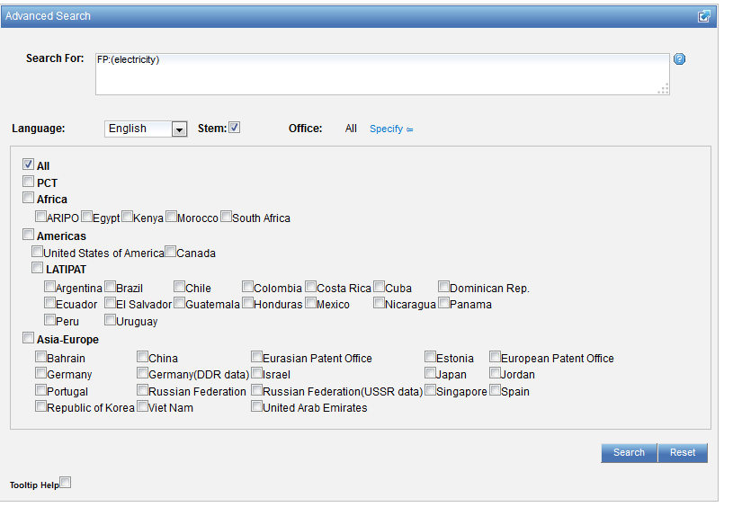
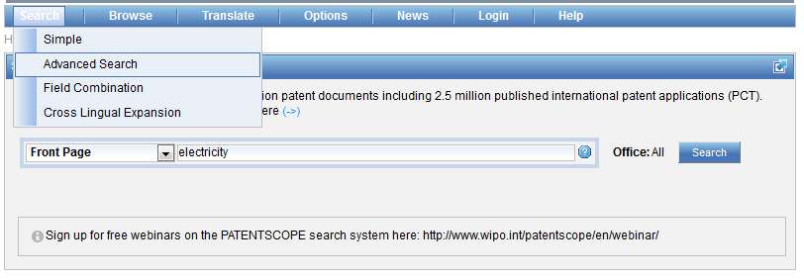
Simple interface: tips
  Select patent collection/s

Slide 48
PATENTSCOPE: how to search
Browse by week or sequence listing
Search patent documents:
  Simple
  Field combination

Slide 49
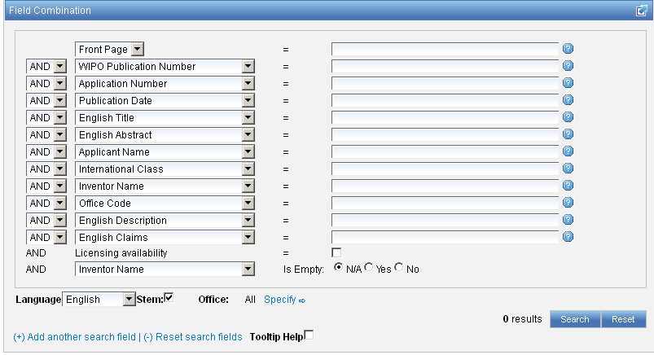
Interface : Field Combination - Structured
Additional search fields can be selected

Slide 50
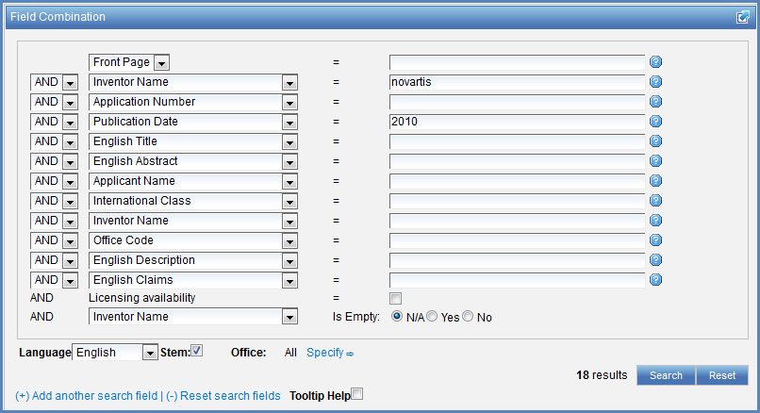

Search examples
Patent documents containing Novartis as inventor and published in 2010
Patent documents without an IPC code
Notes:
50
3. there is also the option to select a field that is empty: for example you could search. On the last line, select the IPC in the drop-down box and tick yes next to empty.

Slide 51
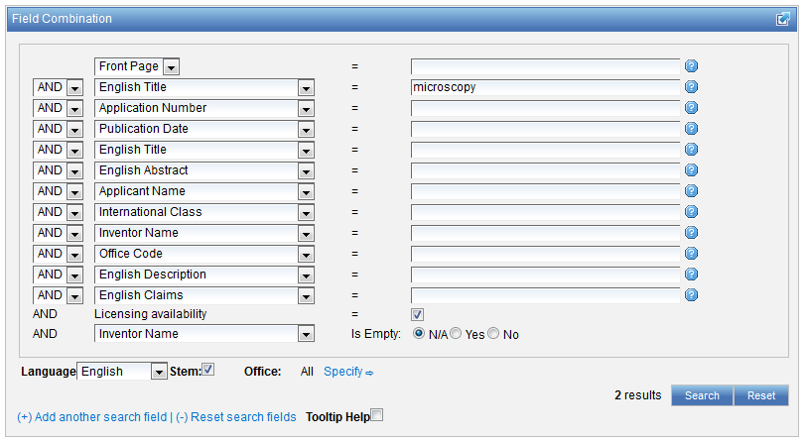
Search examples
Patent documents containing microscopy with licensing availability.
Notes:
51
In the drop-down box, select the field Applicant name and enter Steve Jobs; select AND and the field Publication date and enter 2007
In the drop-down boy, select English description and enter microchip, then tick the Licensing availability box (one before last in the Field Combination interface).

Slide 52
In the Publication Date field:
Examples
DP:today
DP:today-3days
DP:today-1Week
DP:today-2Years
Time ranges:
DP:[today-1Year TO today]
DP:[today-3Years TO today-1year]
Simplified time period ranges :
DP:Last3Days
DP:Last2Weeks
DP:Last1Year
Last Publications published :
DP:pct_lastpubdate
DP:pct_lastpubdate and PA:"University of Paris"
Notes:
DP:Last3Days --> returns all the record that were published by the national/international authority in the last 3 days
Last Publications published Also, the following query returns all the PCT applications published the last time, very useful for implementing RSS queries:

Slide 53
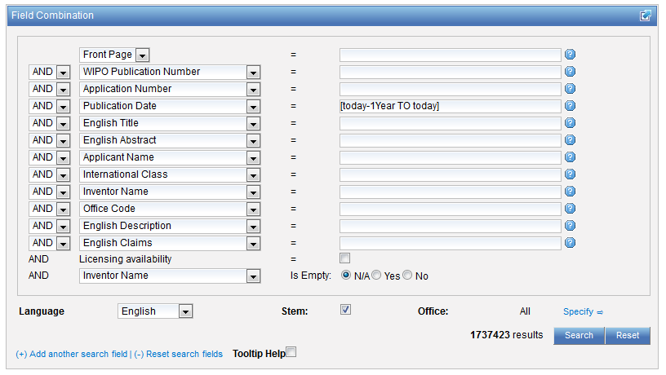

Slide 54
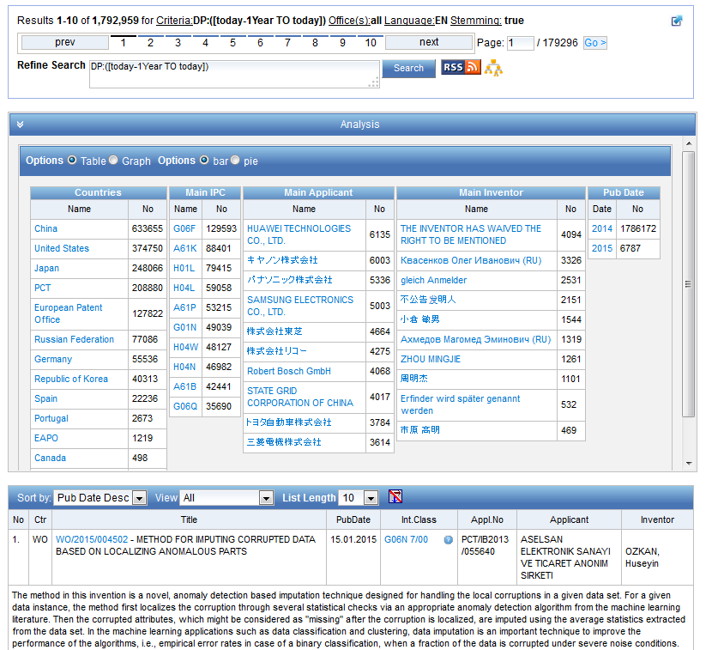

Slide 55
Stemming
Process that removes common ending from words by English Snowball algorithm
electric¦al = electric
electric¦ity = electric
electron¦ics = electron
More accurate results than wildcards:
elect* electoral, etc.

Slide 57
Q:1: which fields are not pre-defined fields in the Simple search interface?
A
Applicant nationality
B
Filing language
C
National phase data
D
Front page

Slide 58
Q:1: which fields are not pre-defined fields in the Simple search interface?
A
Applicant nationality
B
Filing language
C
National phase data
D
Front page

Slide 59
Q:2: if I’m interested in finding PCT applications containing 3rd party observation, which interface do I need to use?
A
Simple
B
Field Combination

Slide 60
Q: 2: if I’m interested in finding PCT applications containing 3rd party observation, which interface do I need to use?
A
Simple
B
Field Combination

Slide 61
Q:3: I’m looking for a specific patent document – I have a reference number, which interface should I use?
A
Simple
B
Field Combination

Slide 62
Q:3: I’m looking for a specific patent document – I have a reference number- which interface should I use?
A
Simple
B
Field Combination

Slide 63
Next webinar
February 17 or 19: Avanced search interface
To register: http://www.wipo.int/patentscope/en/webinar/

Slide 64
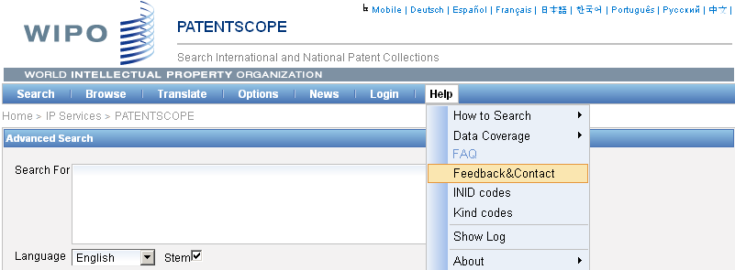

patentscope@wipo.int

Slide 65

mulțumesc
mulțumesc

