Slide 1
Retrospective of 2016
& plans for 2017
Online
December
2016
Sandrine Ammann
Marketing & Communications Officer

Slide 2
To the PATENTSCOPE search system webinar
Retrospective of 2016 & plans for 2017

Slide 3
Agenda
Retrospective 2016
Plans for 2017
Next webinars
Q&A

Slide 4
2016

Slide 5
New collection - additions
Tunisia
UK Full-text
CN Utility models

Slide 6
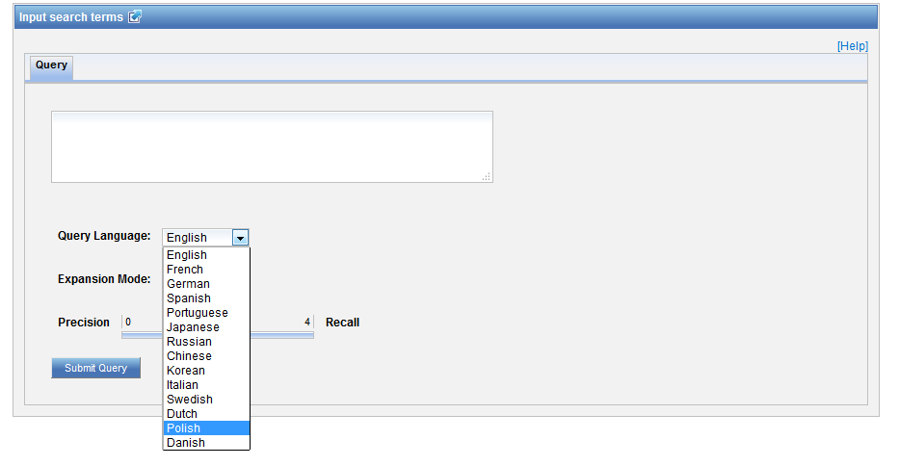
New language in CLIR

Slide 7
New search fields
ISA: International Search Authority
ISR: International Search Report
IPE: International Preliminary Examination
SIS: Supplementary International Search

Slide 8
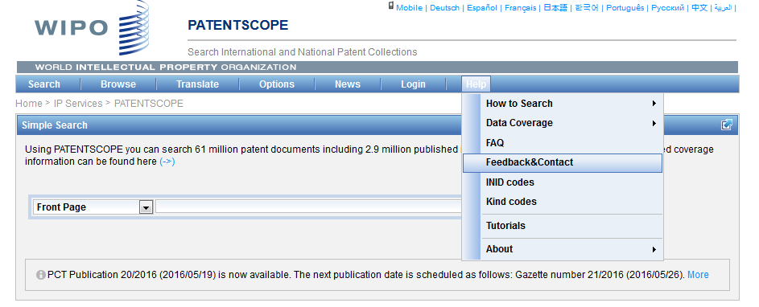
The Forum

Slide 9
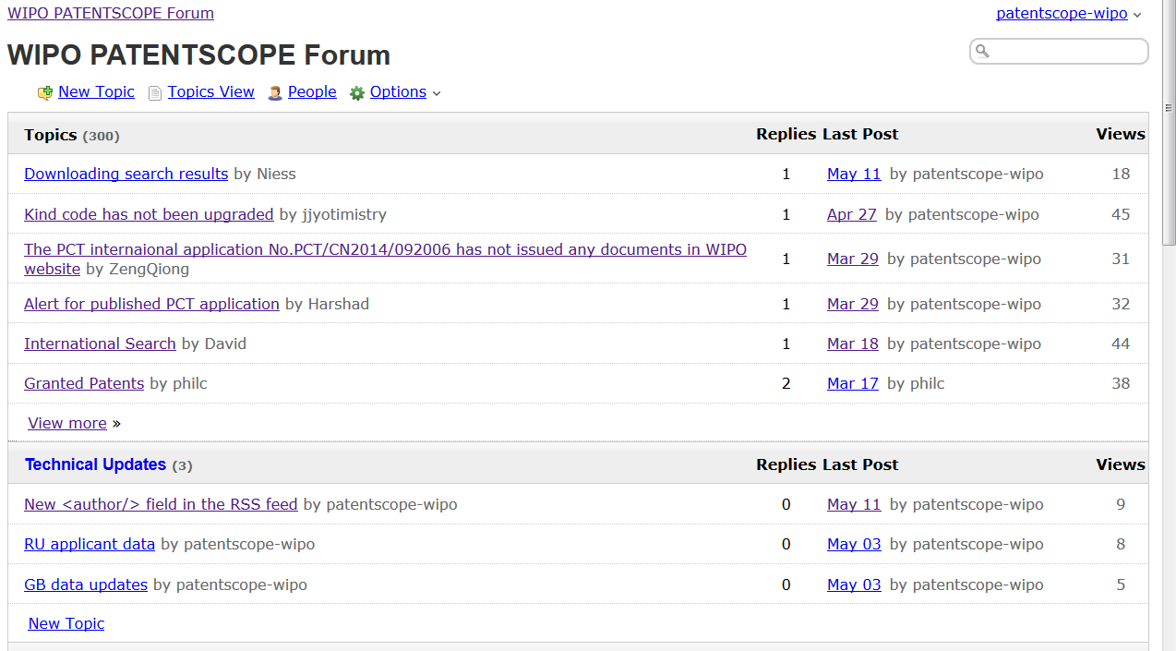

Slide 10
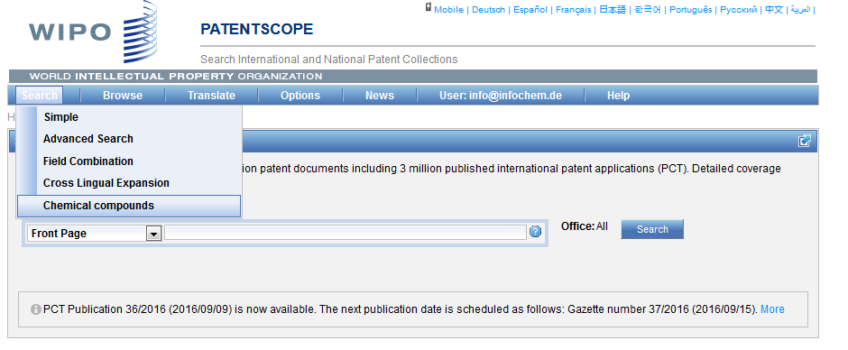
Chemical structure search

Slide 11
3 options

Slide 12
Convert structure: ex.: paracetamol

Slide 13
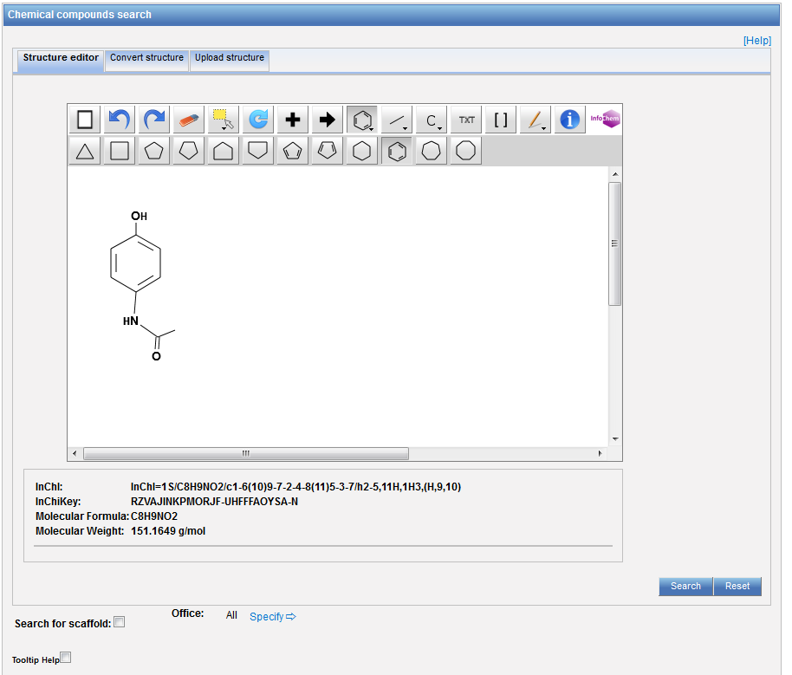

Slide 14
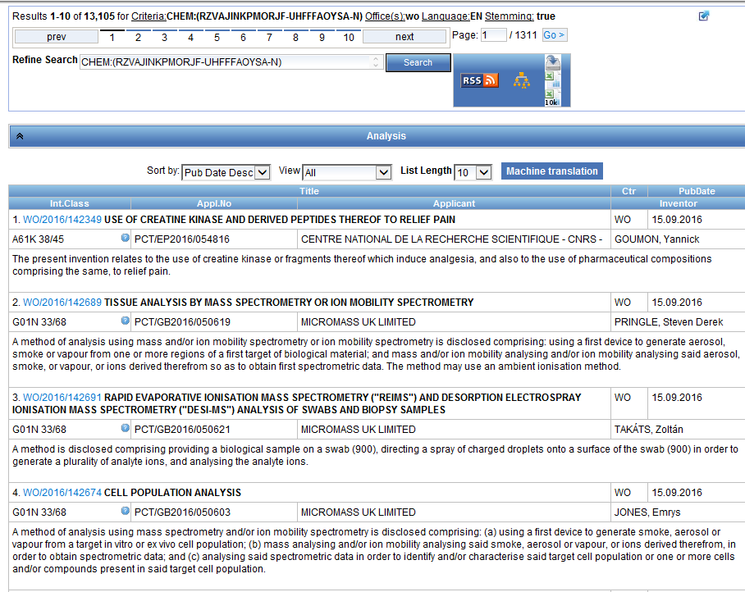
Results

Slide 15
Instant help
Validates search query
Suggests terms
Provides:
List of IPC codes
List of countries

Slide 17
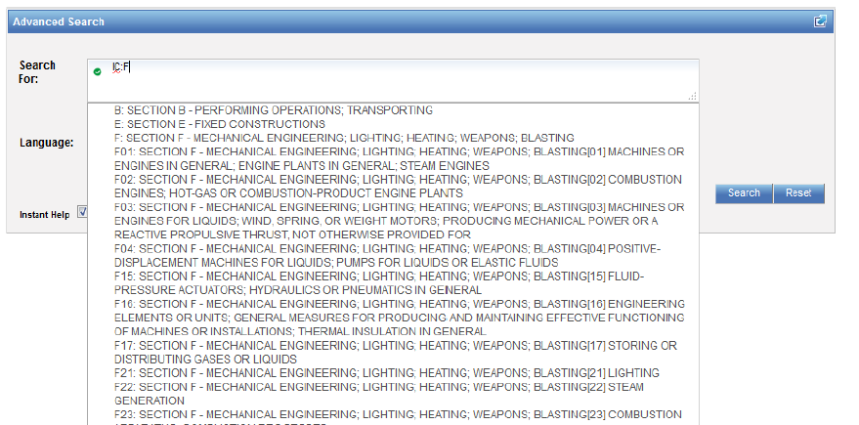

Slide 18
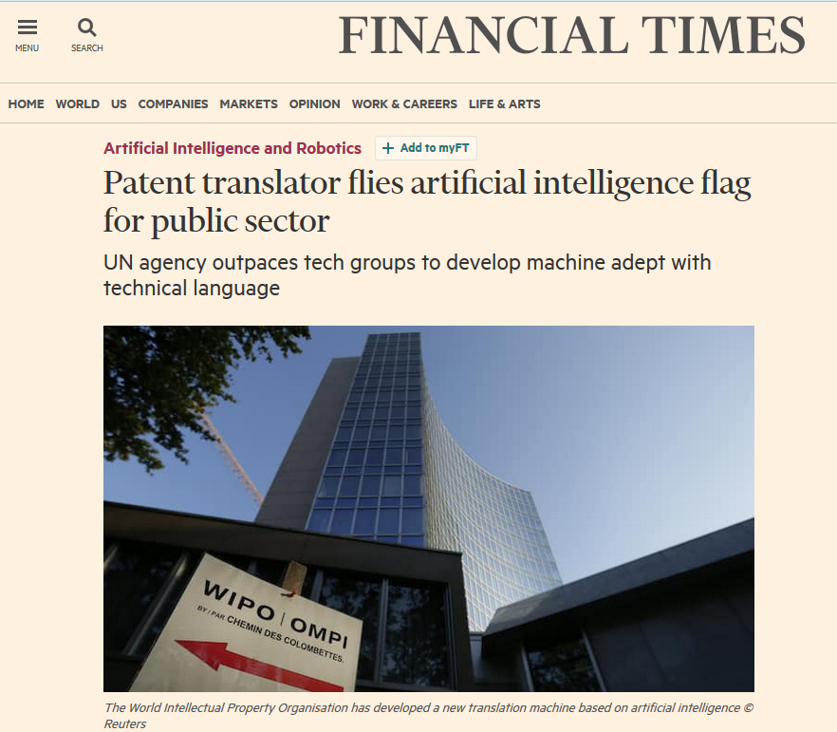
WIPO Translate in FT

Slide 19
Integration of artifial intelligence
“neural network” technology that accurately translates the technical language of patents while preserving a more natural word order than previous systems;
better results than Google Translate on patent translations

Slide 20
Future plans

Slide 21
Chemical structure search
Available for other collections and languages:
Chinese
Japanese
Korean

Slide 22
National/regional collections
Add new national/regional collections:
Australia
France
New Zealand

Slide 23
New features
Integration of Global Dossier
Neuronal machine-translation for descriptions and claims in JP-EN and KR-EN

Slide 24
Next webinar - 2017
January 24 or 26: Chemical structure search https://attendee.gotowebinar.com/rt/269558848807832578
February 14 or 16: Overview of PATENTSCOPE https://attendee.gotowebinar.com/rt/5509443139183672322
March 14 or 16: Complex queries in PATENTSCOPE https://attendee.gotowebinar.com/rt/6583739666799904258
April 25 or 27: Result list and analysis tools in PATENTSCOPE
https://attendee.gotowebinar.com/rt/3051306774409543428
May 9 or 11: Cross-lingual Information Retrieval tool (CLIR) in details:
https://attendee.gotowebinar.com/rt/524572978687305220

Slide 25
patentscope@wipo.int

Slide 27
mulțumesc
mulțumesc

