Slide 1
The PATENTSCOPE search system
2014 Retrospective
Cyberworld
December
2013
Sandrine Ammann
Marketing & Communications Officer

Slide 2
Agenda
Retrospective 2014
  New collections
  User account
  Tapta
    2015
Q&A

Slide 3


New collections added

Slide 4
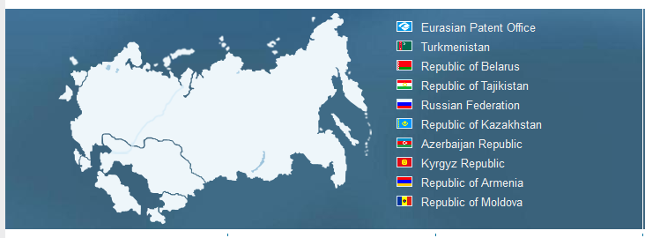
EAPO

Slide 5
National German collection
Germany and the former DDR
over 2,000,000 full-text documents
about 4.5 million older full-text documents were also uploaded but not indexed because the quality of the OCR is not reliable

Slide 6

And very soon
On December 15th

Slide 7
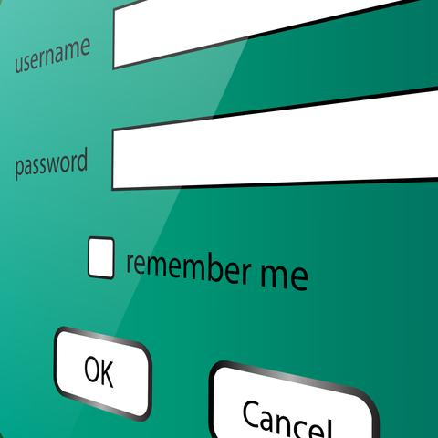
PATENTSCOPE account

Slide 8
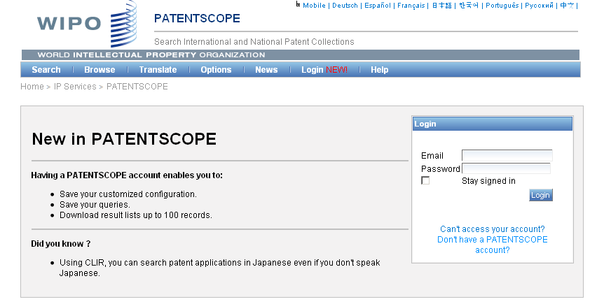
PATENTSCOPE account

Slide 9
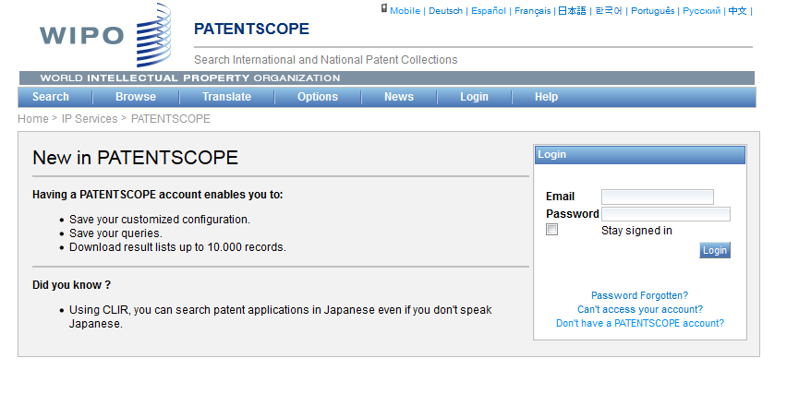
PATENTSCOPE account

Slide 10
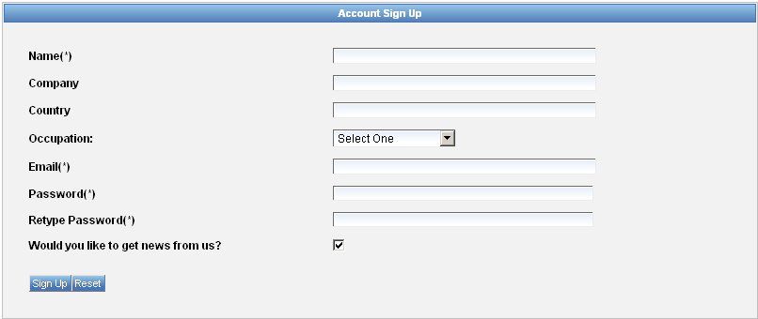
Signing up

Slide 11
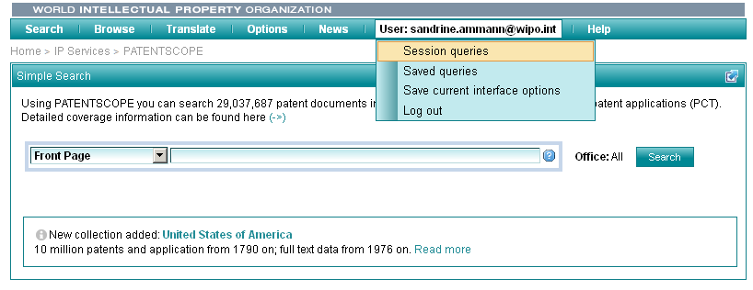
Once logged-in

Slide 12

Search result list – translation tools

Slide 13
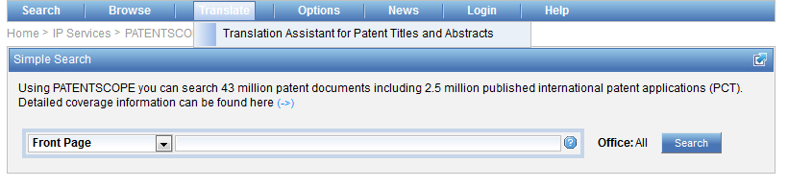
Tapta

Slide 14
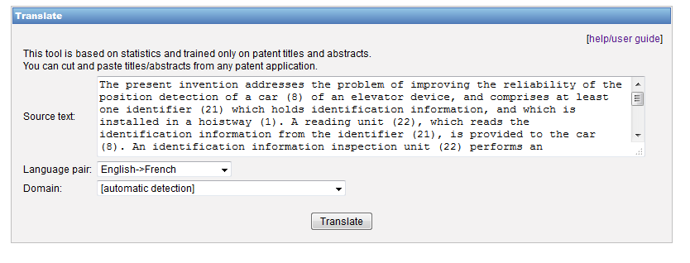
Step 1

Slide 15
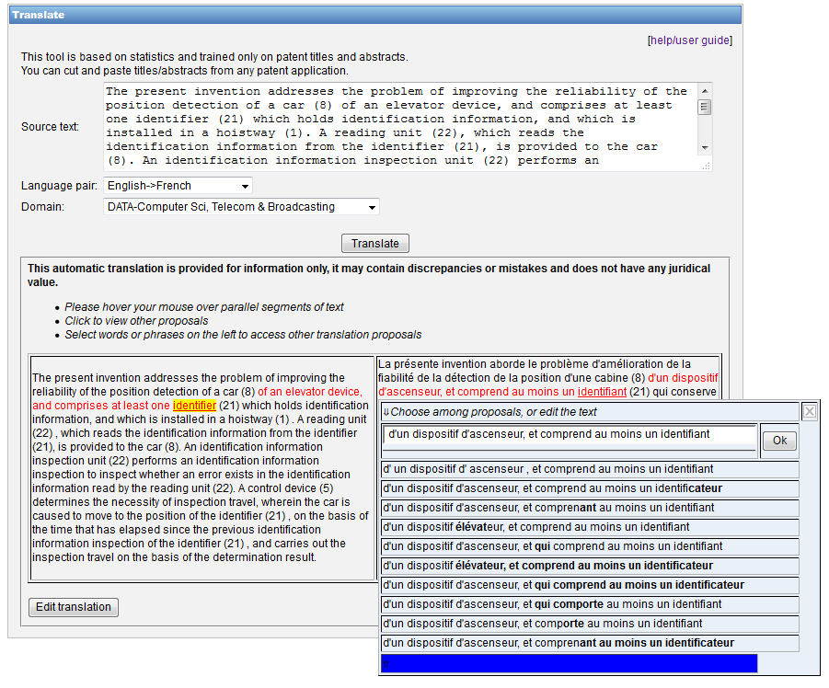
Step 2

Slide 16
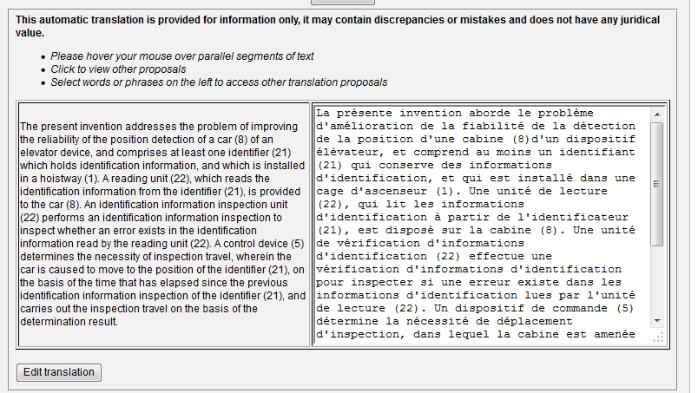
Step 3

Slide 17
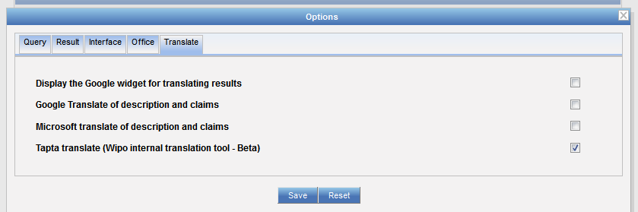
New!

Slide 18
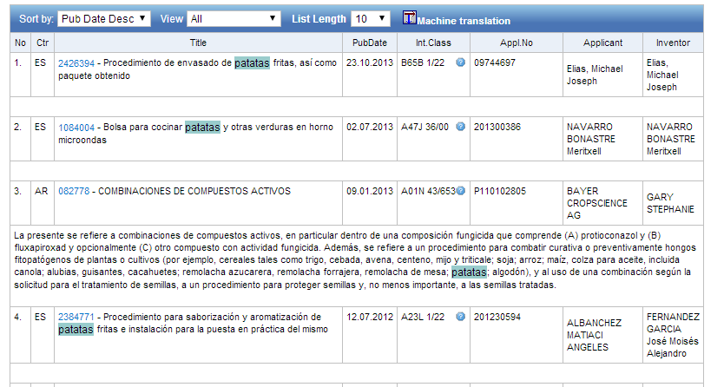

Slide 19
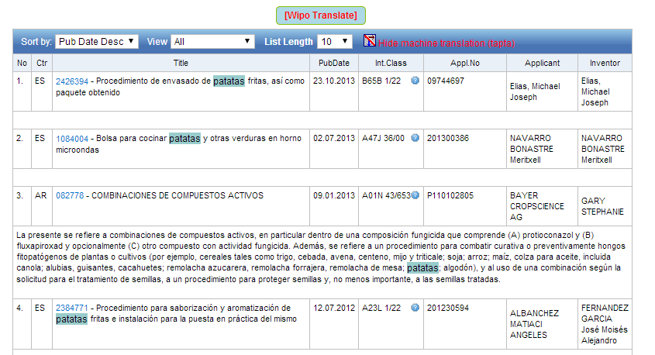

Slide 20
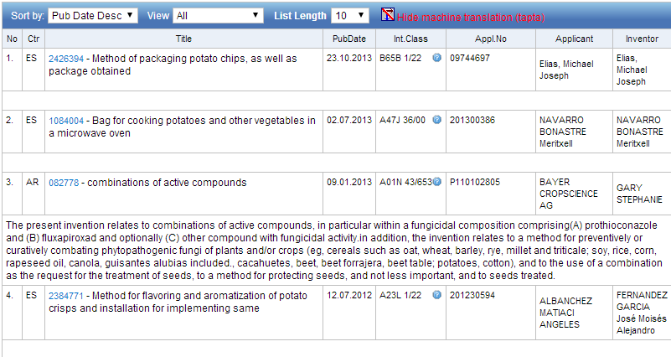

Slide 21
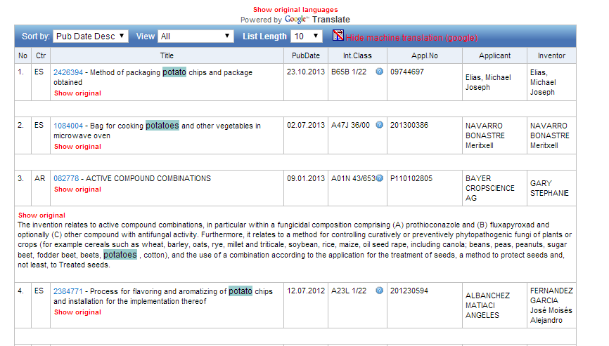

Slide 22
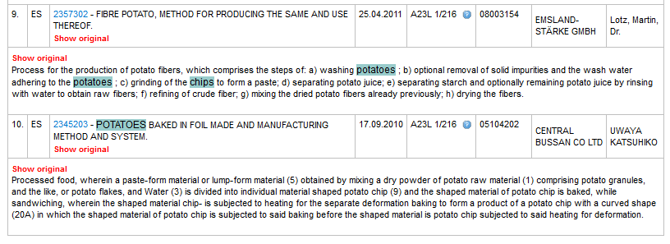
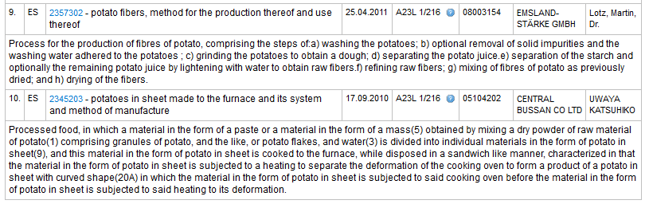

Slide 23
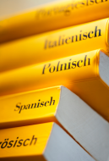
32 Technical domains from the IPC
[ADMN] Admin, Business, Management & Soc Sci
[AERO] Aeronautics & Aerospace Engineering
[AGRI] Agriculture, Fisheries & Forestry
[AUDV] Audio, Audiovisual, Image & Video Tech
[AUTO] Automotive & Road Vehicle Engineering
[BLDG] Civil Engineering & Building Construction
[CHEM] Chemical & Materials Technology
[DATA] Computer Sci, Telecom & Broadcasting
[ELEC] Electrical Engineering & Electronics
[ENGY] Energy, Fuels & Heat Transfer Eng
[ENVR] Environmental & Safety Engineering
[FOOD] Foods & Food Technology
[GENR] Generalities, Language, Media & Info Sci
[HOME] Home Contents & Household Maintenance
[HORO] Precision Mechanics, Jewelry & Horology
[MANU] Manufacturing & Materials Handling Tech
[MARI] Marine Engineering
[MEAS] Standards, Units, Metrology & Testing
[MECH] Mechanical Engineering
[MEDI] Medical Technology
[METL] Metallurgy
[MILI] Military Technology
[MINE] Mining, Oil & Gas Extraction & Minerals
[NANO] Nano Technology
[PACK] Packaging & Distribution of Goods
[PRNT] Printing & Paper
[RAIL] Railway Engineering
[SCIE] Optical Engineering
[SPRT] Sports, Leisure, Tourism & Hospitality
[TEXT] Textile & Clothing Industries
[TRAN] Transportation

Slide 24
How well does it work?
To evaluate machine translated text, BLEU is used.
BLEU (Bilingual Evaluation Understudy) is an algorithm for evaluating the quality of text which has been machine-translated from one natural language .
Quality = the correspondence between a machine's output and that of a human
Scores are calculated for individual translated segments—generally sentences—by comparing them with a set of good quality reference translations.
Notes:
: "the closer a machine translation is to a professional human translation, the better it is" - this is the central idea behind BLEU
Those scores are then averaged over the whole corpus to reach an estimate of the translation's overall quality. Intelligibility or grammatical correctness are not taken into account.

Slide 25
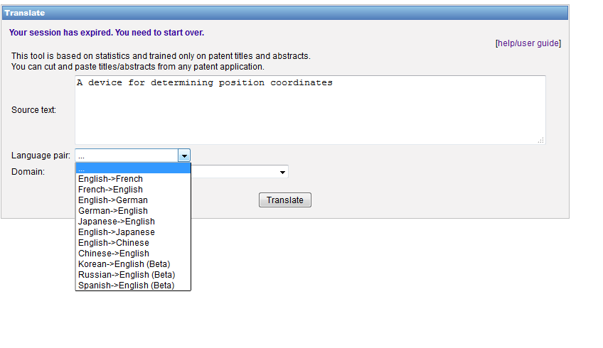
Tapta: new in 2014

Slide 26
2015
New national/regional collections
Improve current features

Slide 27
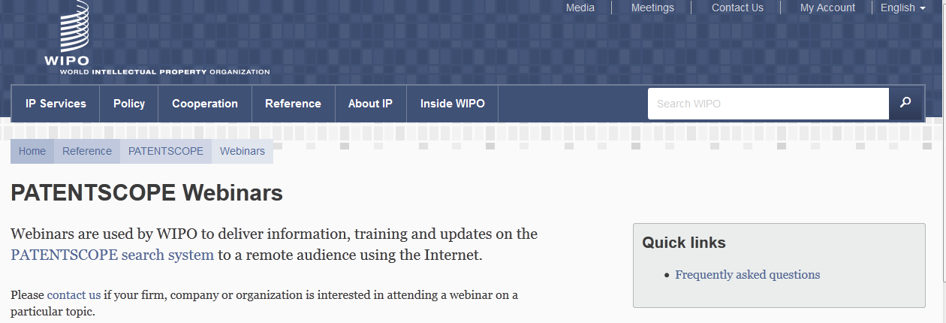
Monthly webinar

Slide 28


Slide 29
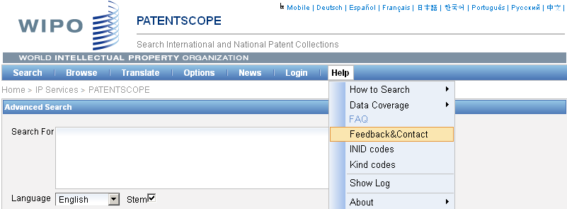

patentscope@wipo.int

Slide 30

SEASON’S GREETINGS
WITH
ALL GOOD WISHES FOR THE NEXT YEAR

Slide 31


mulțumesc
mulțumesc

