Slide 1
Complex queries in the PATENTSCOPE search system
Online
October
2018
Sandrine Ammann
Marketing & Communications Officer

Slide 2
Agenda
Interfaces
Search fields
Syntax
Combination of interfaces
Q&A

Slide 3
Complexity
“Complexity” of queries depends on:

Slide 4
Q:Would consider yourself as a
A
Beginner seacher
B
Expert searcher

Slide 5
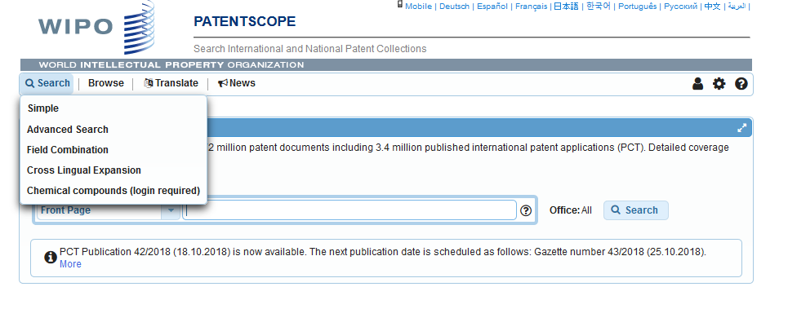
2 interfaces

Slide 6
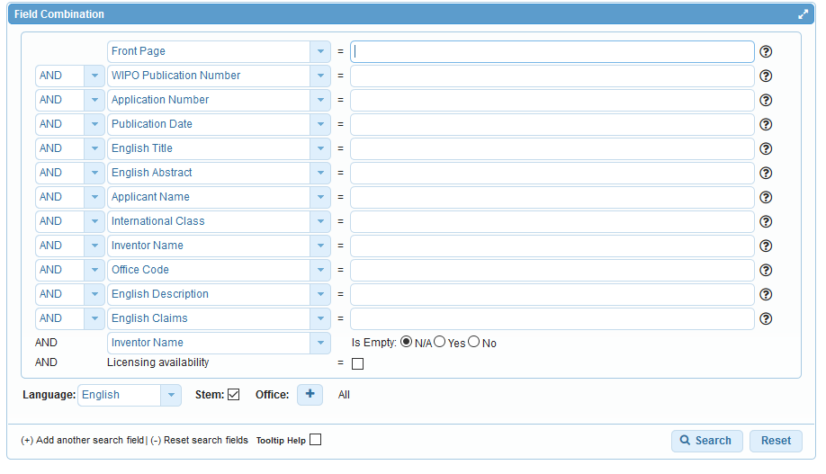
Advanced or Field Combination

Slide 7
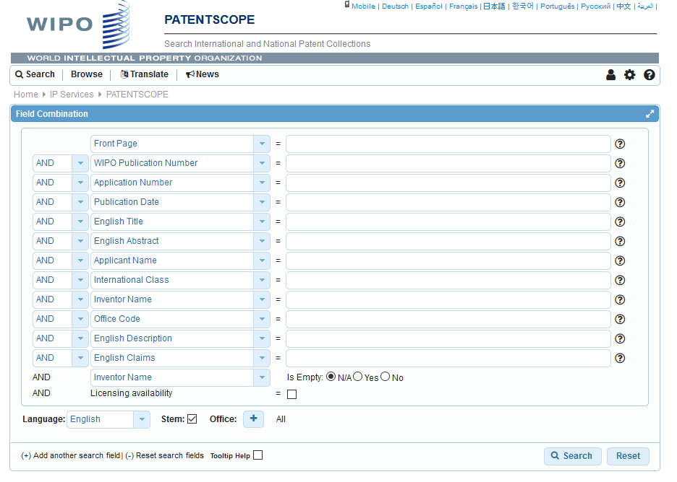

Slide 8
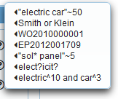
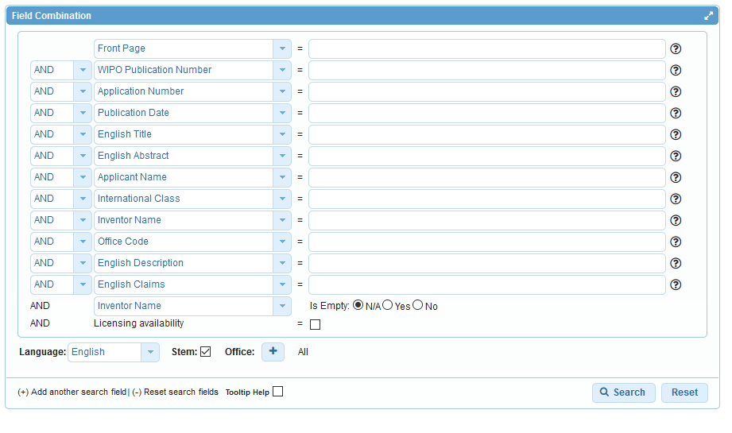
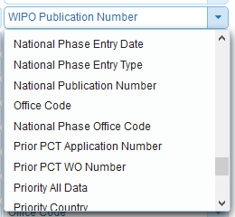

Slide 9
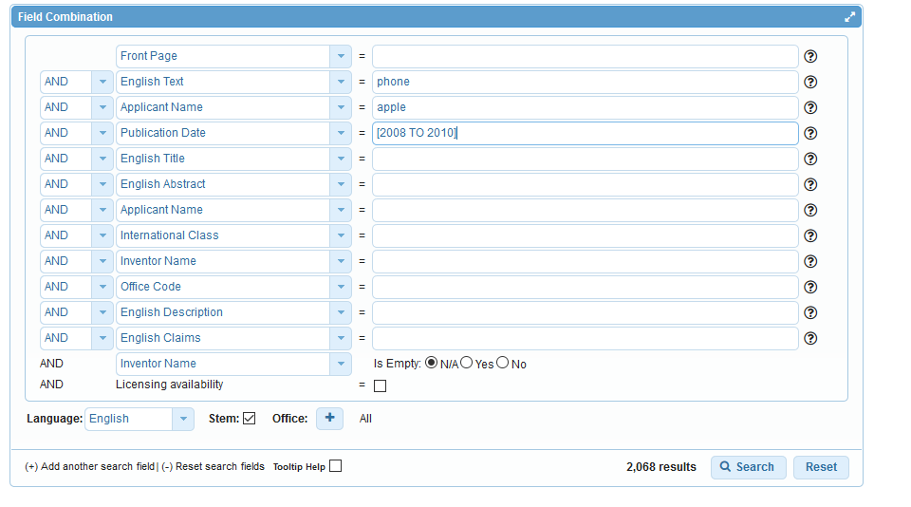
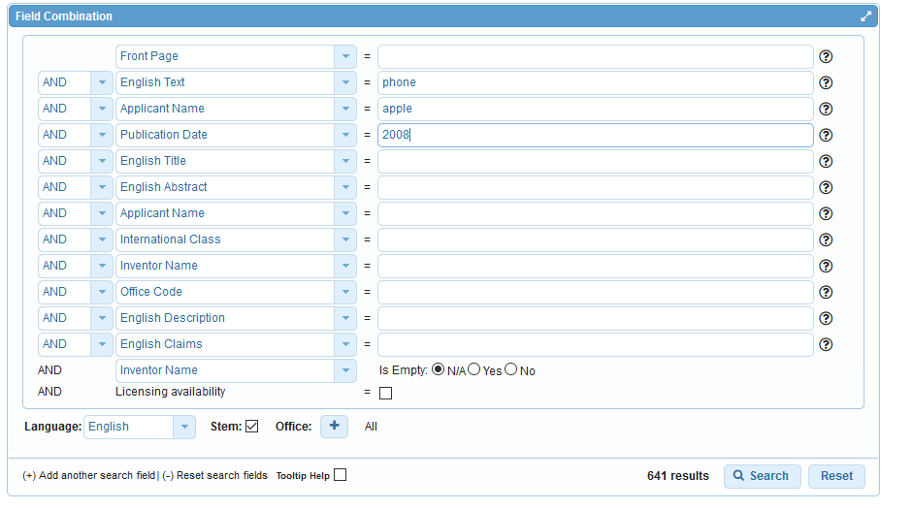

Slide 10
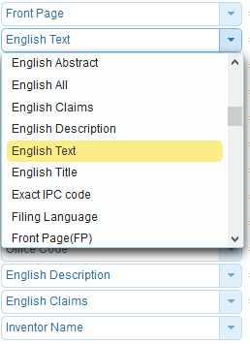
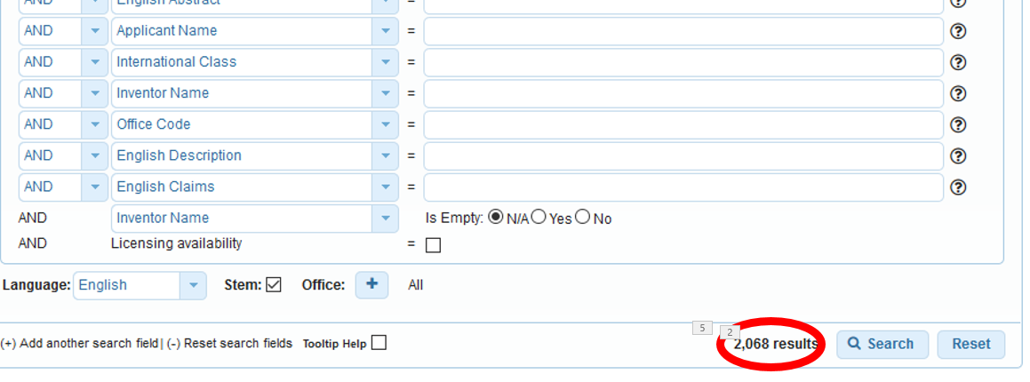
Field Combination - pros
Predefined fields
Immediate results on the same page

Slide 11
Field combination - cons

Slide 12
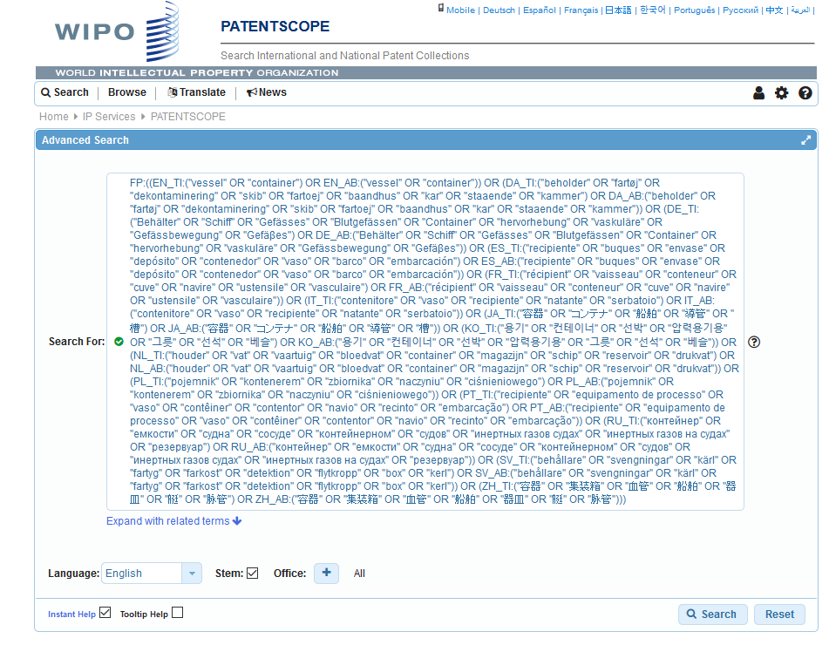
Interface: Advanced search

Slide 13
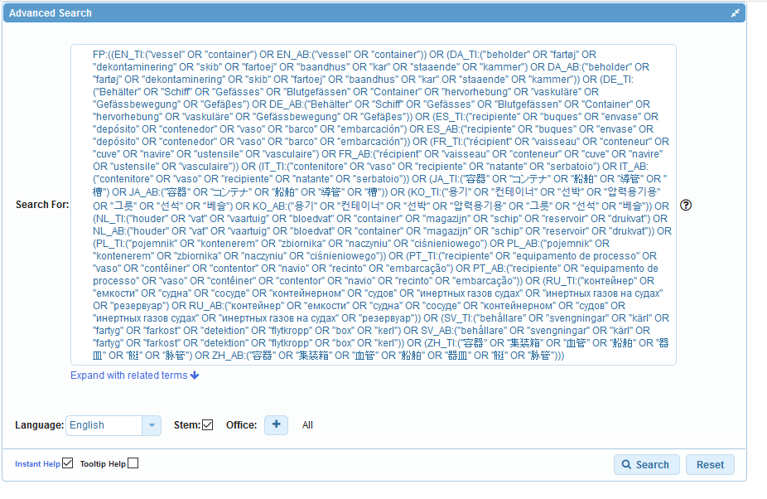

Slide 15
How to build your queries
EN_ALLTXT; PA; DP = fields
AND = operator

Slide 16
Fields: where to search Source: http://spicewallpaper.blogspot.ch/2012/08/green-fields-with-blue-sky.html

Slide 17
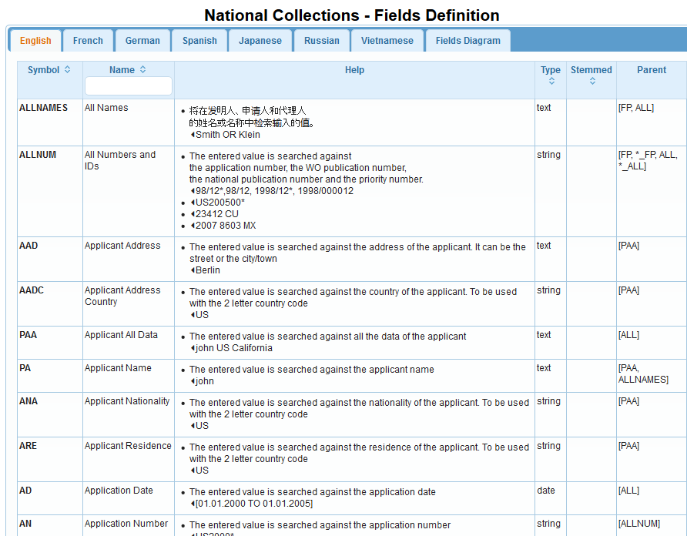

Slide 18
Examples
FP = front page
ALL = all fields
ALL_NAMES = all names
IC = IPC
DP = publication date
CTR = country either WO or country from nat collection
NPCC= national phase entry
AN = origin of PCT

Slide 19
Date search
Simple:
DP:01.02.2000
DP:20000201
DP:02.2000
DP:200002
DP:2000

Slide 20
Example: IPC
IC = International Classification
IC :A
IC :A47
IC :A47L
IC :A47L1
IC:A47L11
IC:A47L11/03

Slide 21
D06F 1/06 will include by default
D06F 1/08
1/10
1/16
To exclude subgroup: IC_EX
ICI = International Classification Inventive
ICN = International Classification Non-inventive
ICI_EX ICN_EX = no subgroup

Slide 22
Example: grant

Slide 23
PCT related Fields
ISA
ST.3 Office code of the patent authority that performed the preliminary search report
ISA:US and OF:WO
ISR
For an ISR document in status filed (ISR): Report ; if there is an Article 17(2)(a) declaration in status filed (A172A): Declaration
ISR:declaration and OF:WO
SIS
If any Supplementary International Search Report has been received, show status “report”;If no SIS Reports or Declarations are on file, show status “None” SIS:report and OF:WO
IPE
If there is an IPER in status filed (IPER or IPRP2) and the time limit for making the report visible i PATENTSCOPE has passed: Report
IPE:report and OF:WO

Slide 24
Fields rules
Basic fields: elements of a patent document
Derived fields
2 letter code = individual field
EN_TI FR_AB ES_DE_S
Convention: language specified by 2 letters
if not specified all languages
S = stemmed
: to separate term without any space

Slide 25
Intuitive queries
PCTHavingThirdPartyObservations
PCTPublishedLastWeek
PCTHavingApplicantFromUS
DP:Last1Year
DP:[Today-1Week TO Today]

Slide 26
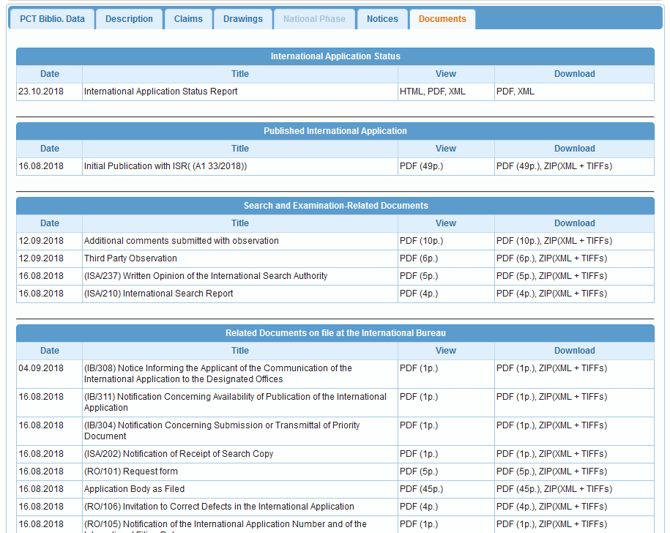

Slide 27
Fields: golden rules
EN_ALL = default field field indicator not required
Field name followed by : ":" or "/"
The field is only valid for the term that it directly precedes, so the query:
EN_TI:("wind turbine" AND electric) solar
"wind turbine" AND electric in the title field "solar" in the default field (EN_ALL ).

Slide 28
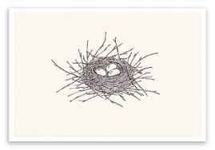
Grouping- nesting

Slide 29
Grouping/nesting
Solar OR (wind AND turbine)
(solar OR wind) AND turbine
EN_TI: electric car
electric will be searched in English title but car in all fields
EN_TI: (electric car)
Both electric and car will be searched in the English title

Slide 30
Range search
Range:
DP:[01.01.2000 TO 01.01.2001]
Can also be used to search non-date fields
IN: {Smith to Terence}

Slide 31
How to build your queries
EN_ALLTXT; PA; DP = fields
AND = operator

Slide 32
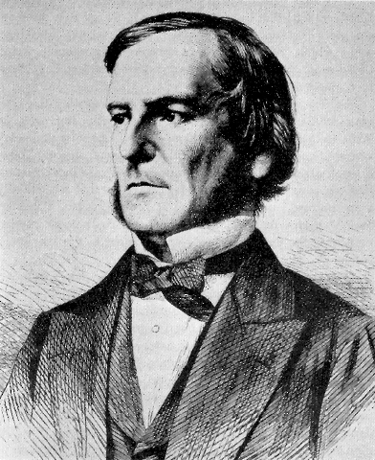
Boolean operators
AND
OR
NOT
ANDNOT

Slide 33
ANDNOT - NOT
Use ANDNOT when searching A excluding B
Ex: bicycle ANDNOT boat
Use NOT when searching all documents except A
Ex:NOT(car AND bicycle AND boat)

Slide 34
Proximity operator NEAR
Finds words that are next to each other
NEAR3 3 = the max nb of word gaps between 2 search terms

Slide 35
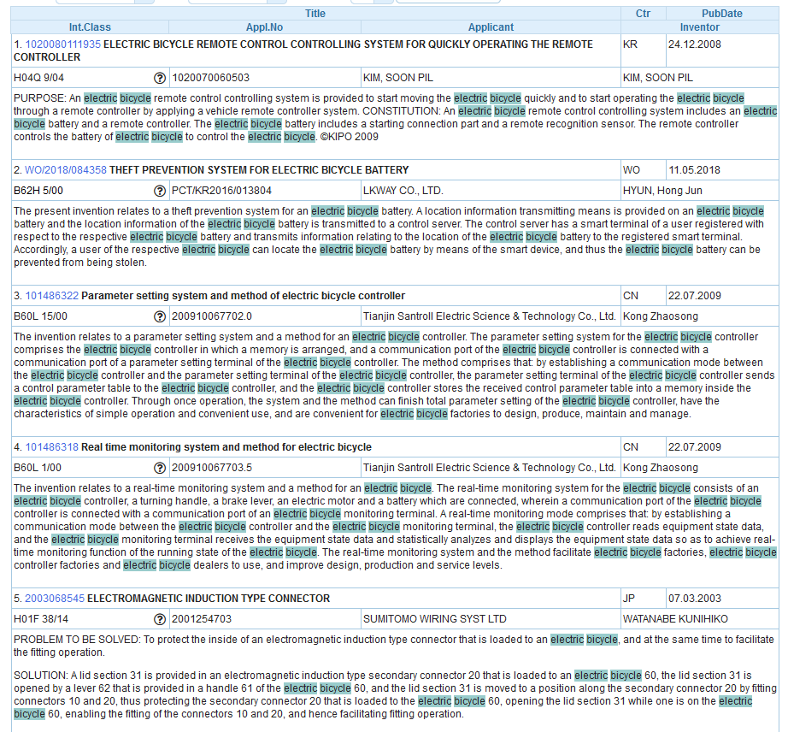
Example

Slide 36
Proximity search: BEFORE
the order of terms is significant.
keywordA BEFORE keywordB

Slide 37
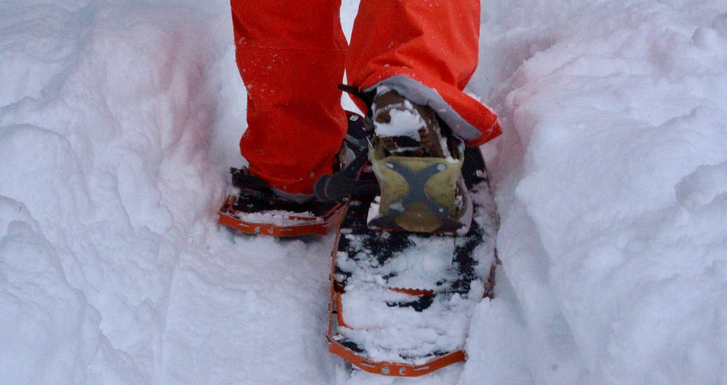
An example

Slide 38
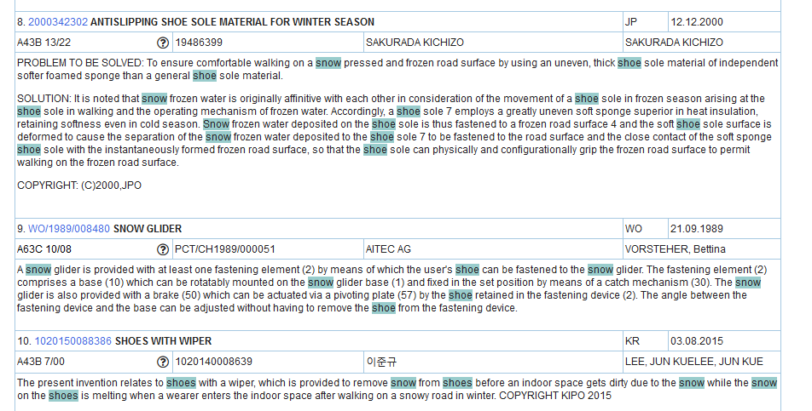

Slide 39
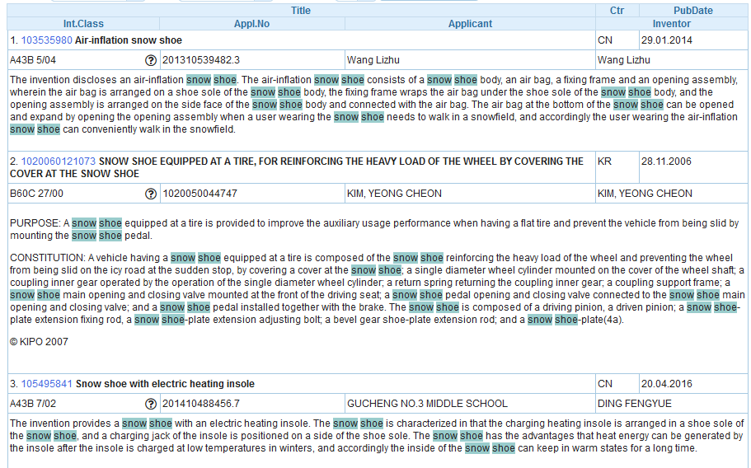

Slide 41
Keywords
Stemming
Wildcard
Truncation
Fuzzy

Slide 42
Stemming

Slide 43
Stemming
Stem = stemming
Process that removes common endings from words.
critical critically criticism each word is reduced to ‘critic’
criticisms critics

Slide 44
Stemming
no dictionary includes the necessary technical terms to express patent concepts
Porter Stemming Algorithm finds words that contain common roots
Save time and effort

Slide 45
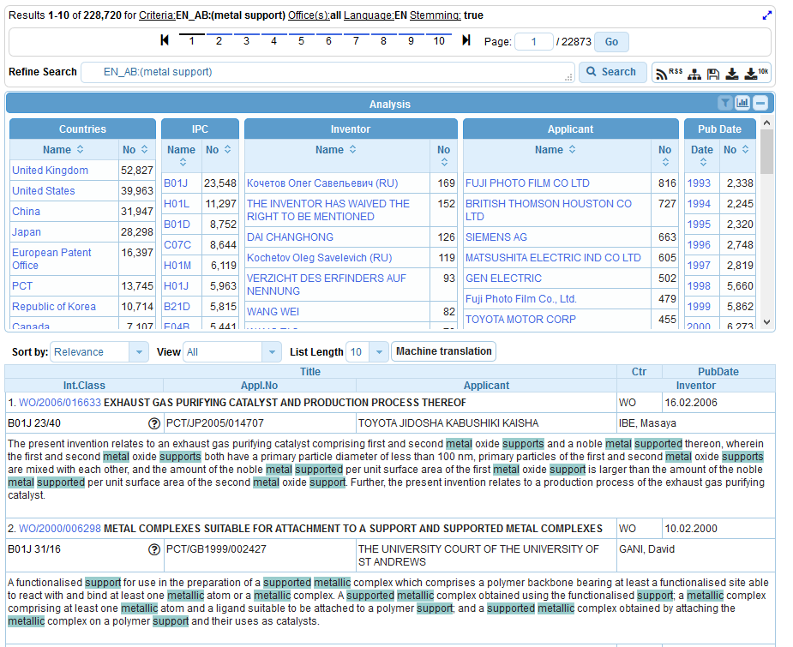

Slide 46
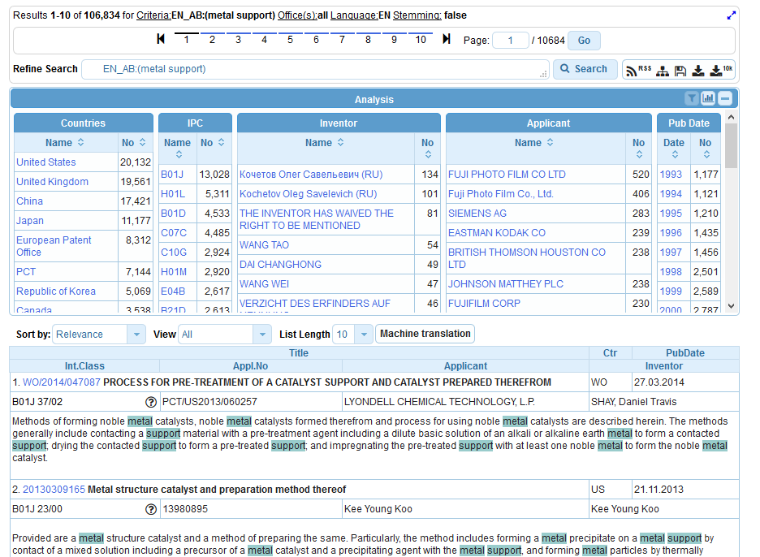

Slide 47
Wildcards/truncation : ? *
* stands for 0 or more characters
? stands single character
te?t = test or text
electric* = electrical; electricity
behavi*r = behaviour or behavior
micro?p* = microspeaker, microsporidial

Slide 48
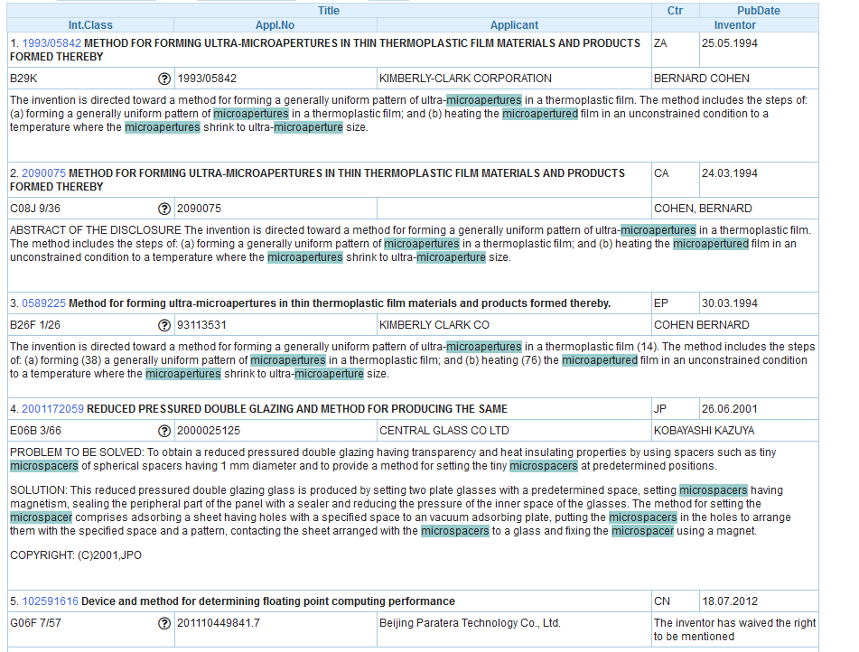
An example

Slide 49
Use of wildcards
Spelling uncertainty (plural, tenses, foreign words):
tyre vs. tire t*re
University vs Universität Universit* Stuttgart
Multiple spelling variants are known:
color vs. colour col*
Preferred option over stemming:
electric vs. electricity electri*

Slide 50
Wildcard vs stemming
Logic results:
navy, navies or naval if nav* = navigating, navigation,
electricity or electric if elect* = electoral

Slide 51
Fuzzy searches
Use of the tilde: ~
Examples:
roam~ foam / roams
Roam~0.8
Useful to find misstpyed, misspelt or mis-OCRed words
Notes:
Smilar in spelling

Slide 52
Q: when you use wildcard, …
A
The results retrieved are all relevant
B
Stemming is turned off

Slide 53
Q: when you use wildcards, …
A
The results retrieved are all relevant
B
Stemming is turned off

Slide 54
^ caret = weighting factor
Same result but ranking will be different
touch^3 AND polarize

Slide 55
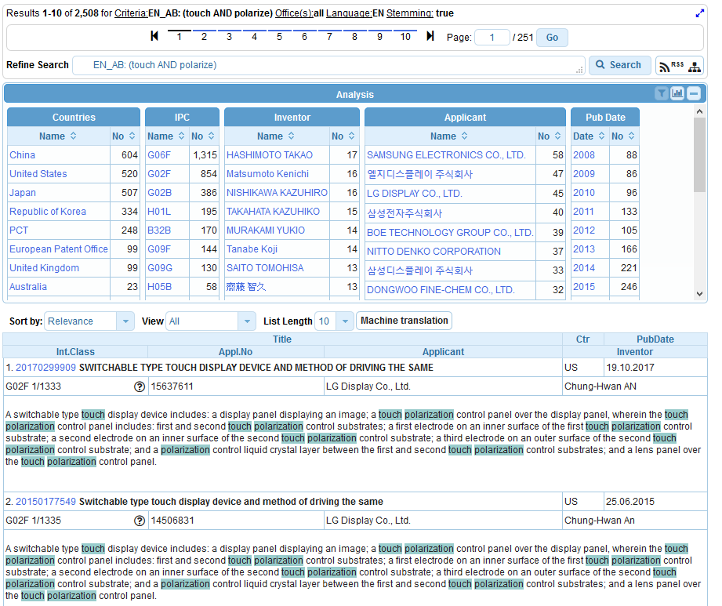

Slide 56
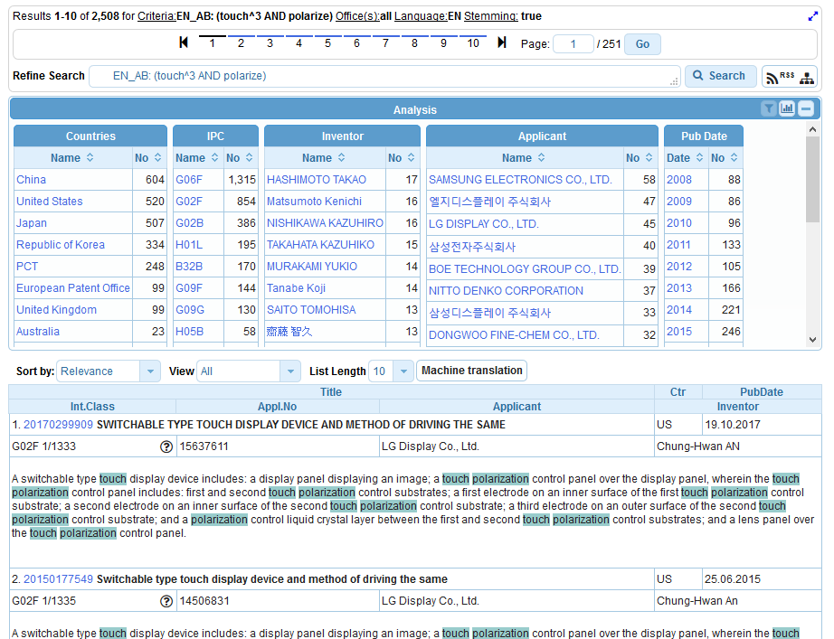

Slide 57
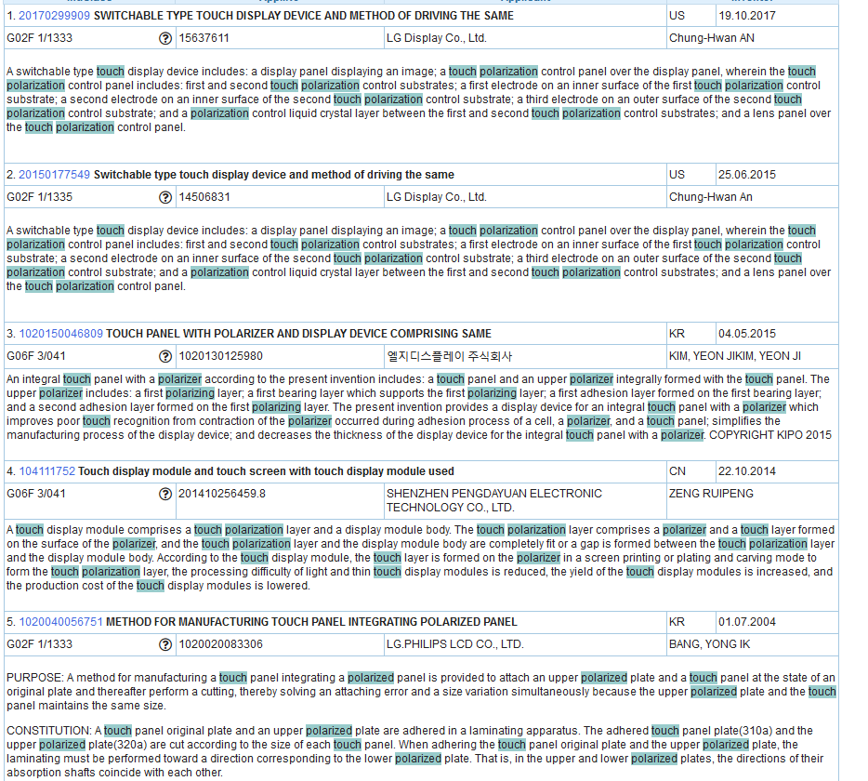

Slide 58
Advanced search interface
Search syntax
Search fields

Slide 59
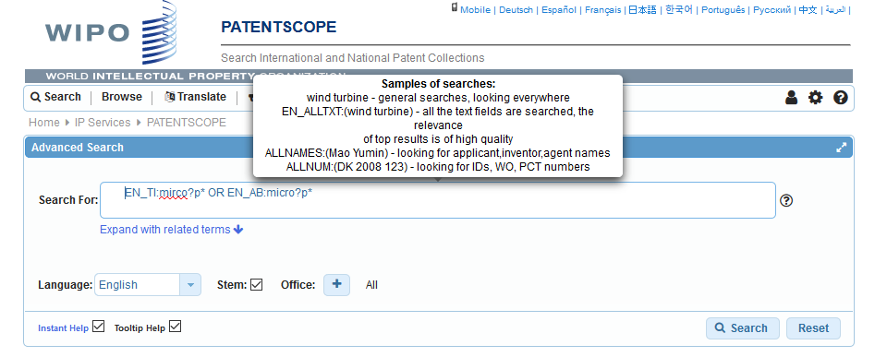
Tooltip help

Slide 60
Help

Slide 61
Instant help
Validates search query
Suggests terms
Provides list of:
IPC codes
countries

Slide 64
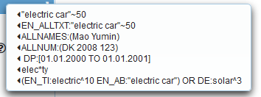
Question mark help

Slide 66
Result combination
Combine search with chemical structure search
Combine search with CLIR

Slide 67
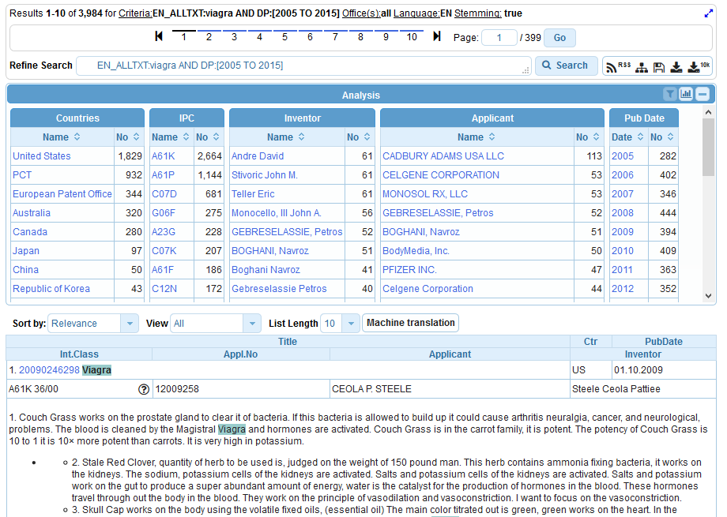
Queries with compounds

Slide 68
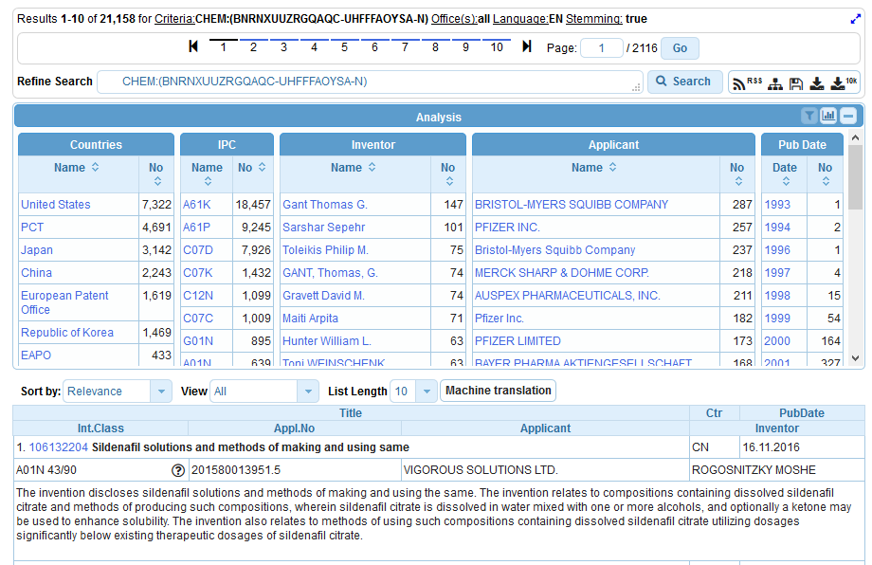

Slide 69
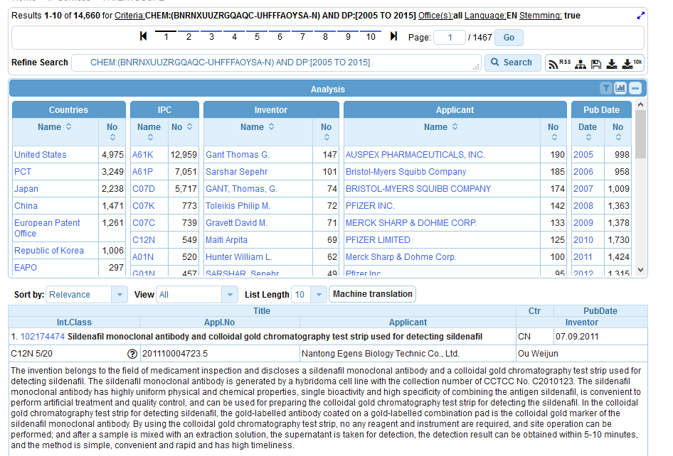

Slide 70
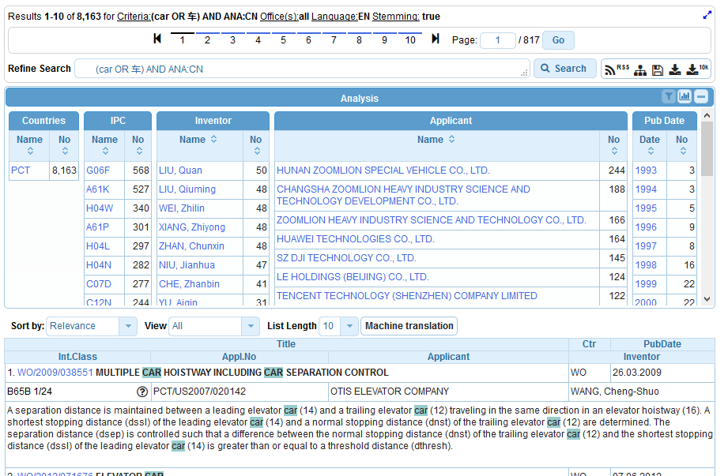
Combining with CLIR

Slide 71
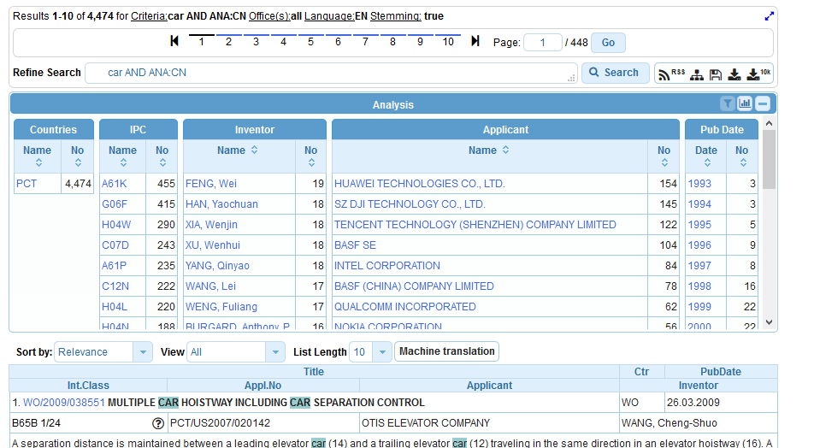

Slide 72
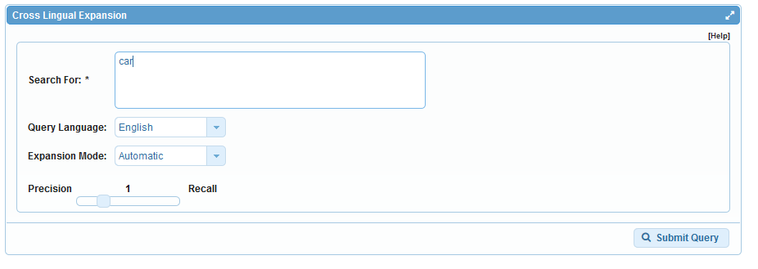

Slide 73
Most common errors
(….) "…"
" not “
Field name
No space
Wildcard at the beginning of a word

Slide 75
Q: how to build a query in order to retrieve 1. published PCT applications between 2000 and 2008 2. with Swiss or American 3. by the company Kudelski
A
Kudelski AND Swiss AND American AND 2000 AND 2008
B
IN:Kudelski AND INA: Swiss AND American AND DP: 2000 TO 2008
C
IADC: (CH OR US) AND PA:Kudelski AND DP: [2000 TO 2008]
D
CTR: Swiss OR America AND IN: Kudelski AND 2000-2008

Slide 76
Q: how to build a query in order to retrieve 1. published PCT applications between 2000 and 2008 2. with Swiss or American 3. by the company Kudelski
A
Kudelski AND Swiss AND American AND 2000 AND 2008
B
IN:Kudelski AND INA: Swiss AND American AND DP: 2000 TO 2008
C
IADC: (CH OR US) AND PA:Kudelski AND DP: [2000 TO 2008]
D
CTR: Swiss OR America AND IN: Kudelski AND 2000-2008

Slide 77
Next webinar: November 13 or 15
Overview of PATENTSCOPE
To register: http://www.wipo.int/patentscope/en/webinar/

Slide 78
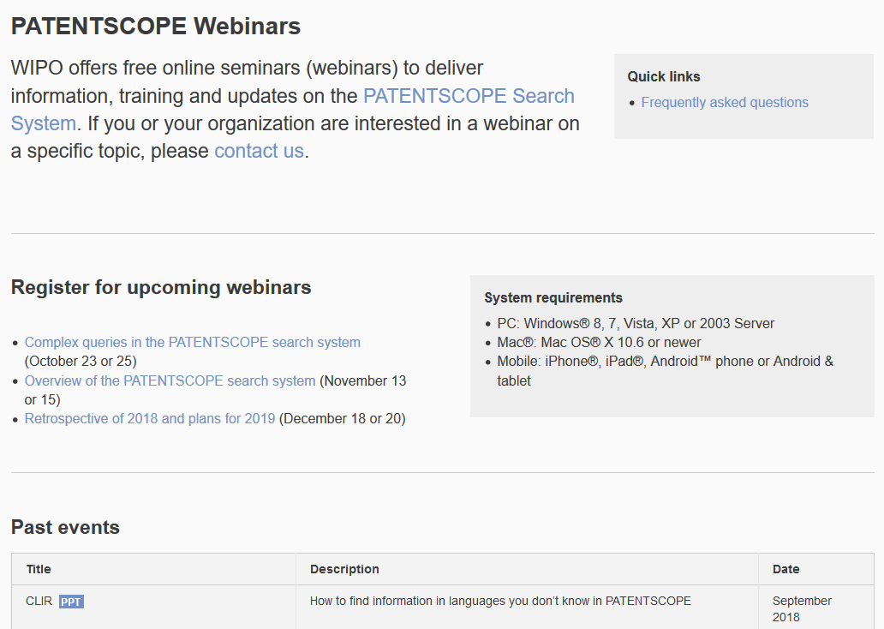
Future/past webinars
wipo.int/patentscope/en/webinar

Slide 79
Global Design Database: webinar
How to perform a search in the Global Design Database
November 14 at 5:30pm CET
http://www.wipo.int/reference/en/designdb/webinar/index.html

Slide 80
patentscope@wipo.int

Slide 82
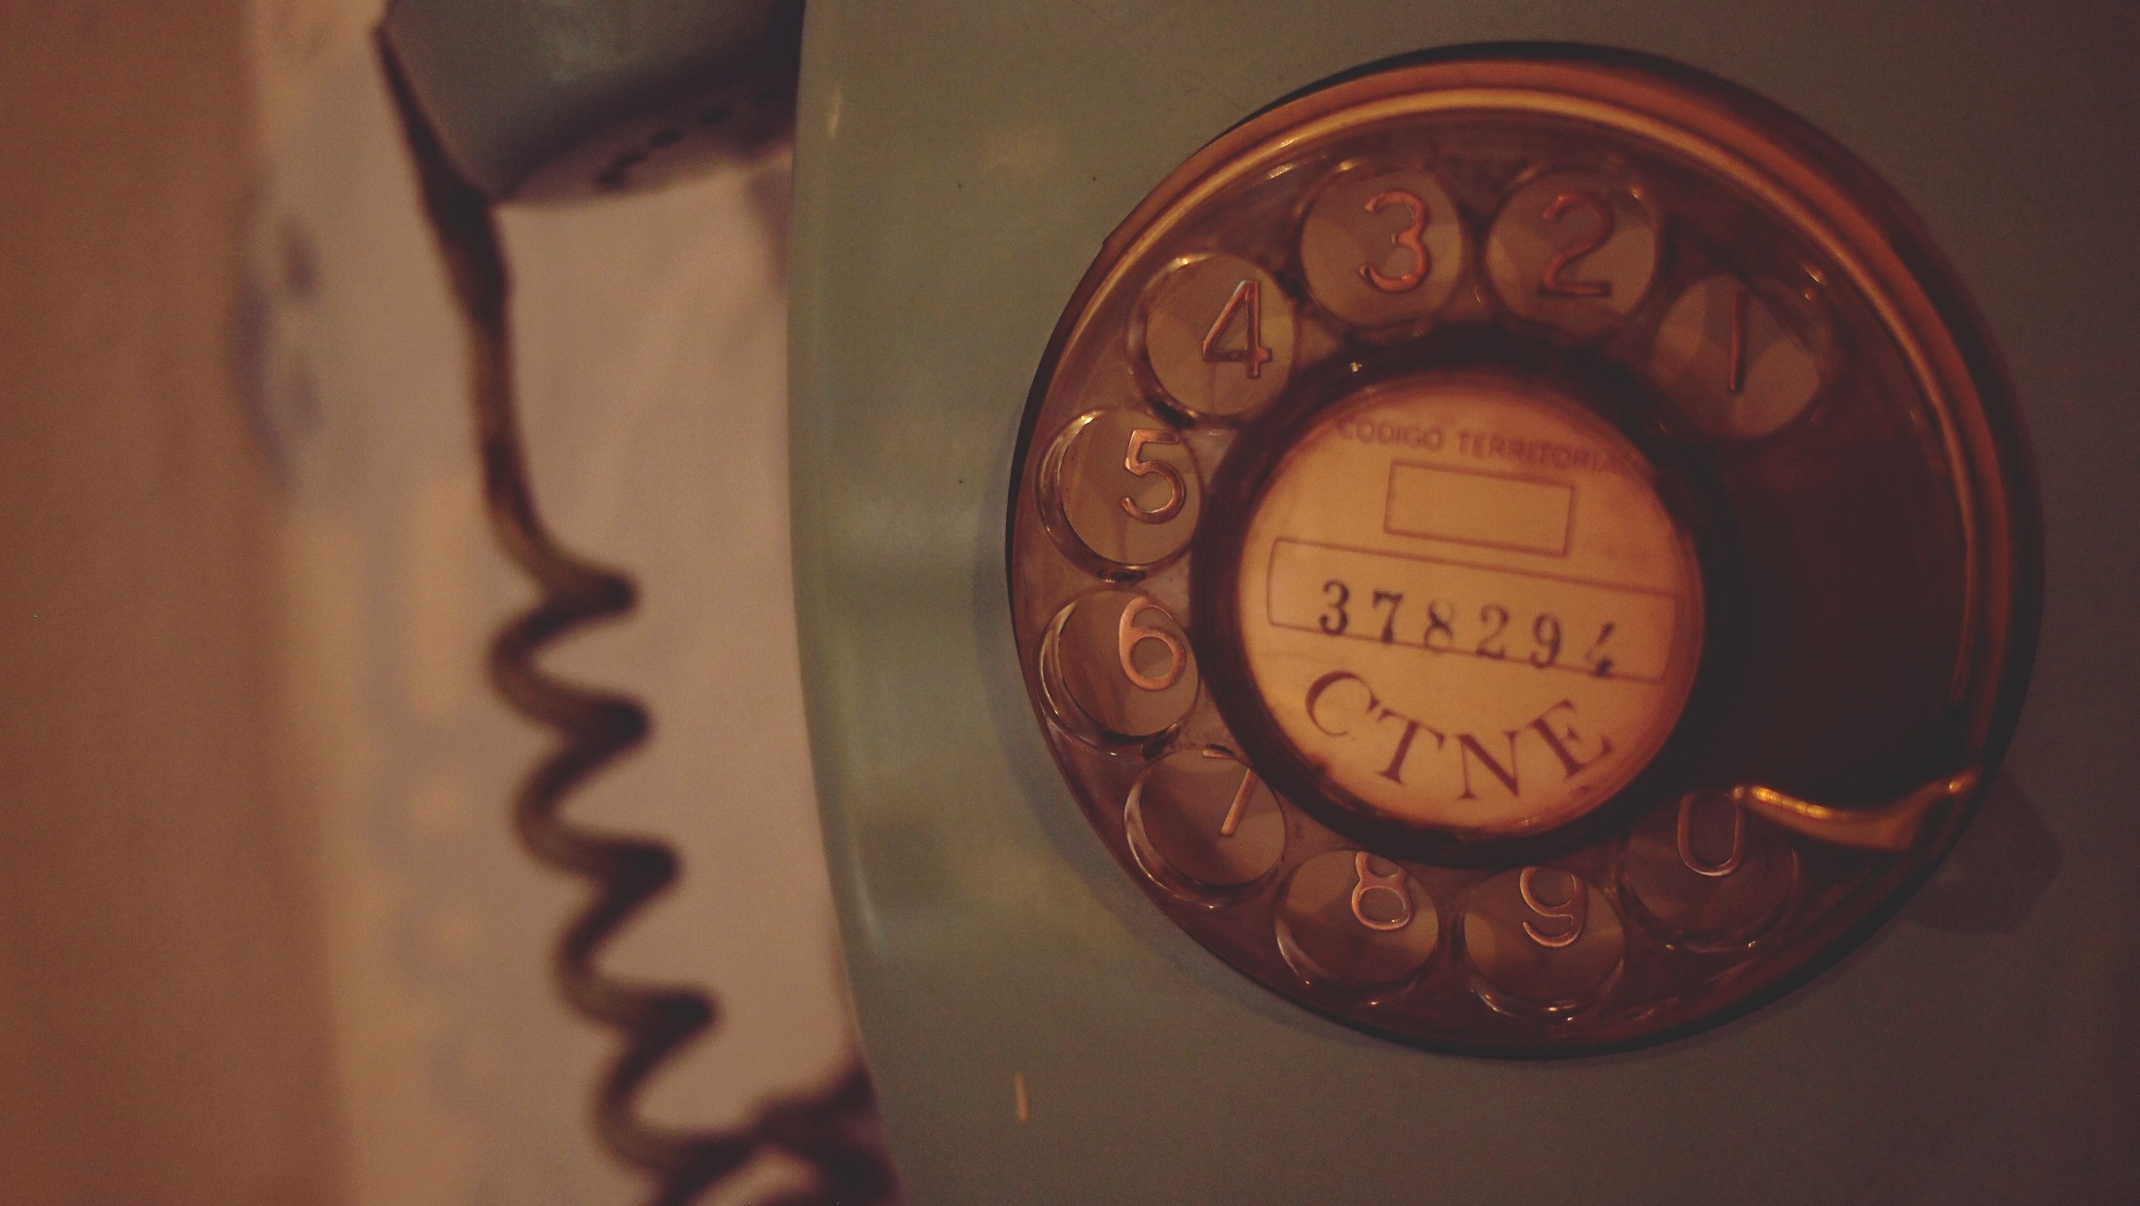
patentscope@wipo.int

