Slide 1


Slide 2
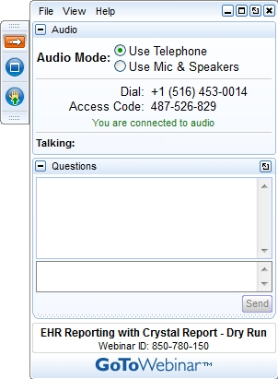
Click this button if you can hear my voice and see my screen

Slide 3


Slide 4
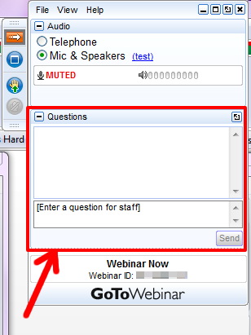

Slide 5
Questions/concerns
patentscope@wipo.int

Slide 6
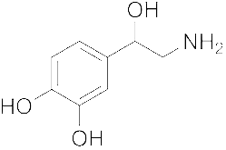
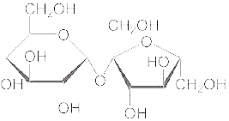
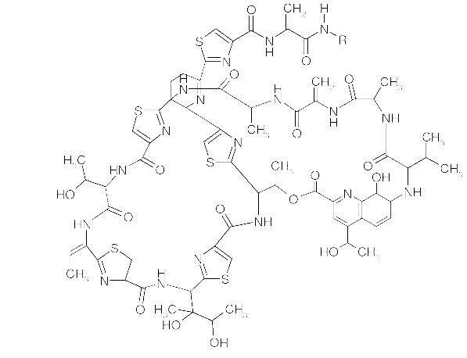
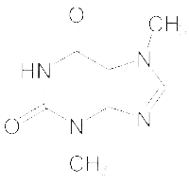
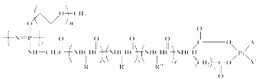
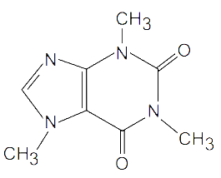
Agenda
Chemical structure search
Access
How does it work?
Q&A

Slide 7
Access
Available at https://patentscope.wipo.int
Access only with a PATENTSCOPE account

Slide 8
Structure search - the concept
Recognize the names of chemical compounds in patent texts and their structures from embedded drawings included in patent texts
Standardize all the different representations of chemical structures into InchIkeys
Implement search functions using InchIkeys that can be used by non chemists

Slide 9
InchI and Inchikeys
Definition: a short, fixed-length character signature based on a hash code of the InChI string.
  InChIkeys provide a precise, robust, IUPAC* approved structure-derived tag for a chemical substance.
*International Union of Pure and Applied Chemistry

Slide 10
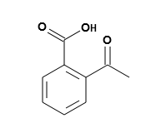
Example: InchI – InchIKey for aspirin
InChIKey = a fixed-length (27-character) condensed digital representation of an InChI
InChI = is a textual identifier developed to make it easy to perform web searches for chemical structures

Slide 11
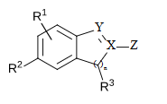
Scope
Works on developed exact formulas ≠ Markush structures (-R) that are chemical symbols used to indicate a collection of chemicals with similar structures.

Slide 12
Coverage
Collections filtered by IPC codes:
  PCT
  IP5
  Russia
  Eurasian Patent Office
Fields:
  Title
  Abstract
  Description
  Claim

Slide 13
Limitations
Long automated procedures, no supervision
Will not recognize 100%! Same drawbacks as the OCR
Depends on OCR quality for PCT applications
Does not work with simple formulas such H2O
Not all collections and related languages
Notes:
Simple formulae like H2O are not captured to avoid information overload (and they can be searched by keywords).

Slide 14
Why is it useful?
Common names such as “aspirin”, “paracetamol” might not be used in patent documents
There are many ways of representing formulas
Expand your searches with the substrcture search

Slide 15
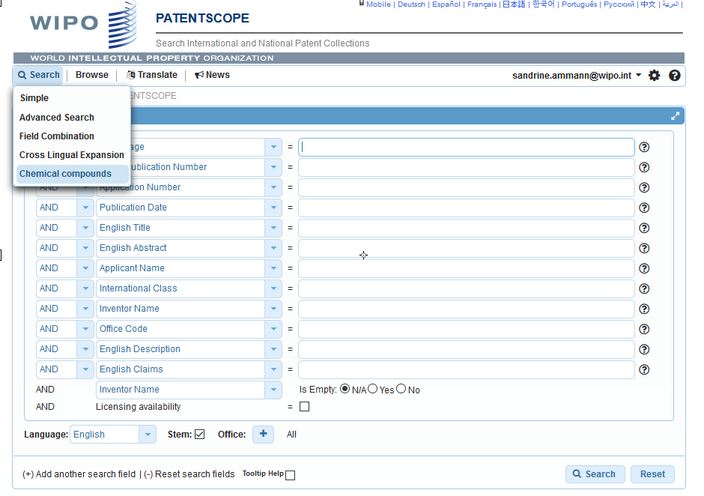
How does it work?

Slide 16
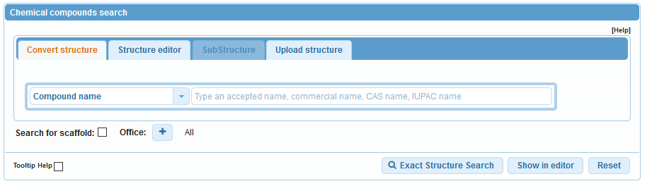
4 options

Slide 17
Scaffold
Basic skeleton of a molecule to which further groups and moieties are attached
Secondary information is ignored

Slide 18
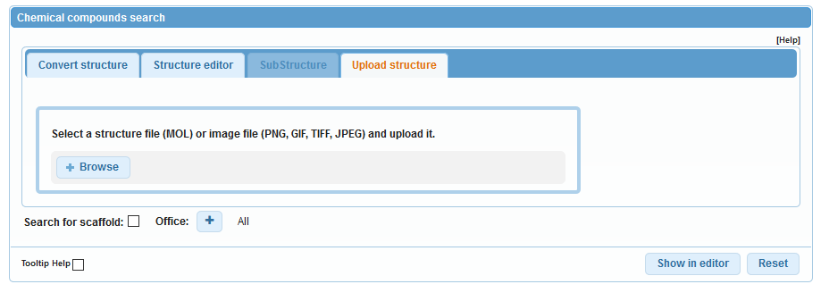
Upload a structure

Slide 19
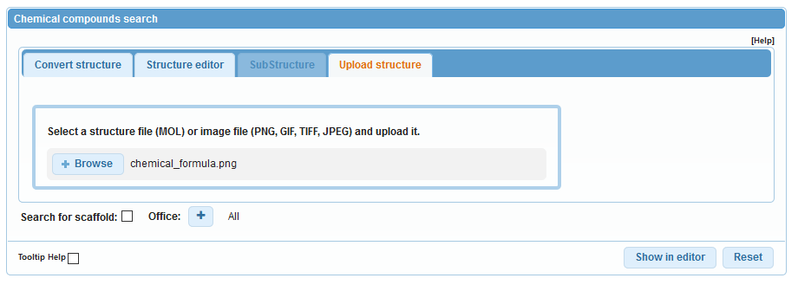
Example

Slide 20
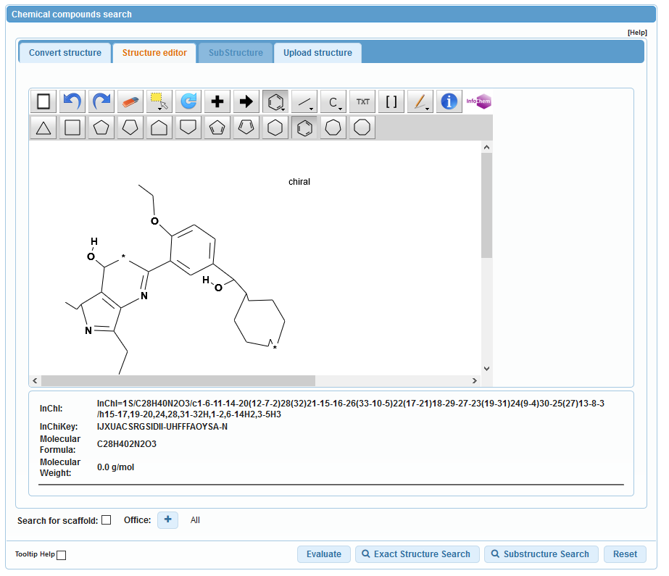

Slide 21
Structure editor

Slide 22
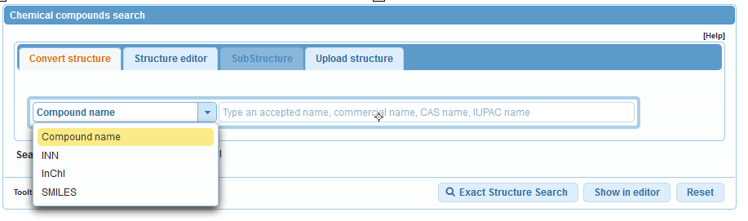
Convert a structure

Slide 23
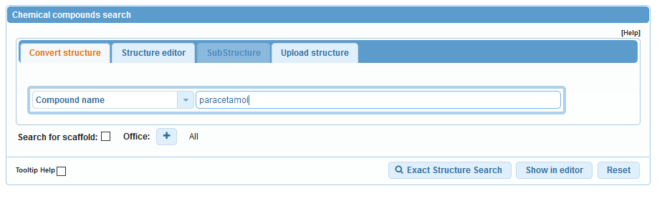
Convert structure: ex.: paracetamol

Slide 24
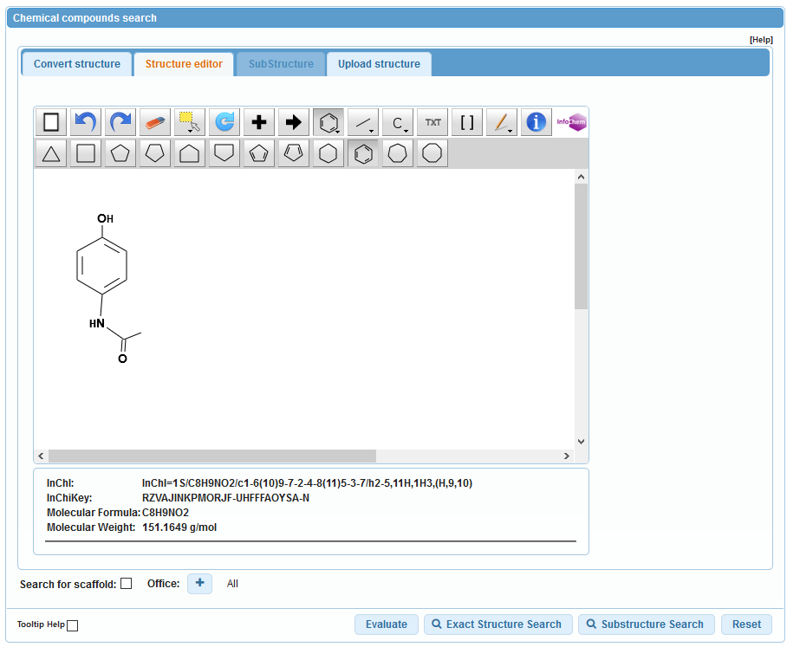

Slide 25
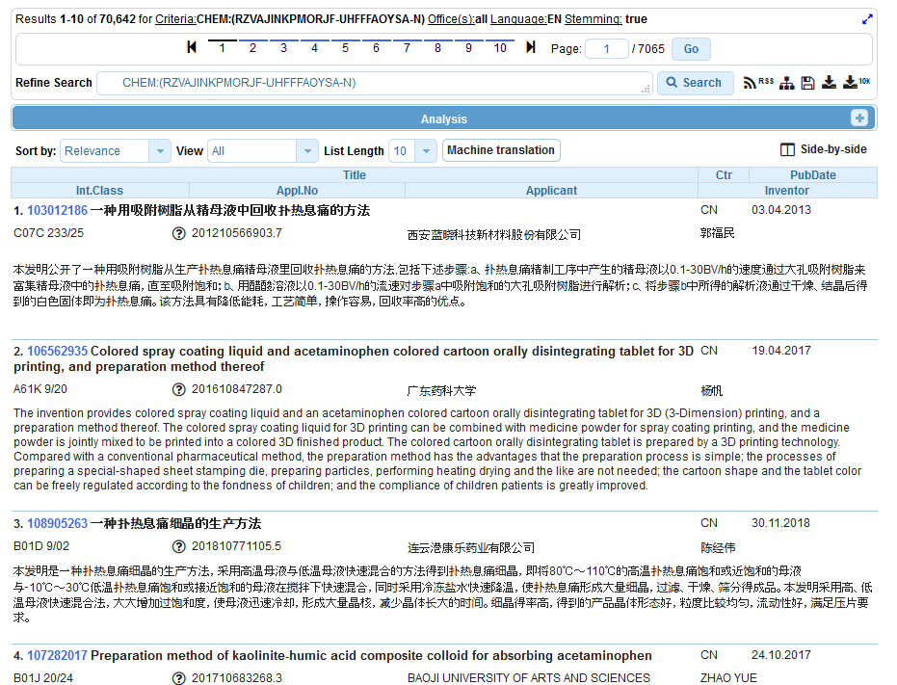
Results

Slide 26
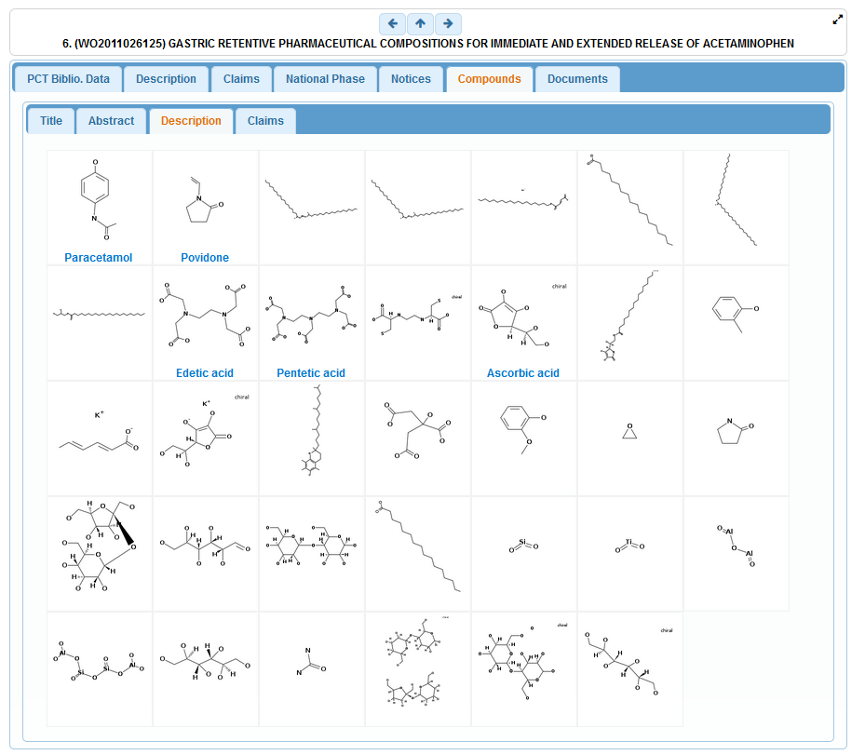

Slide 27
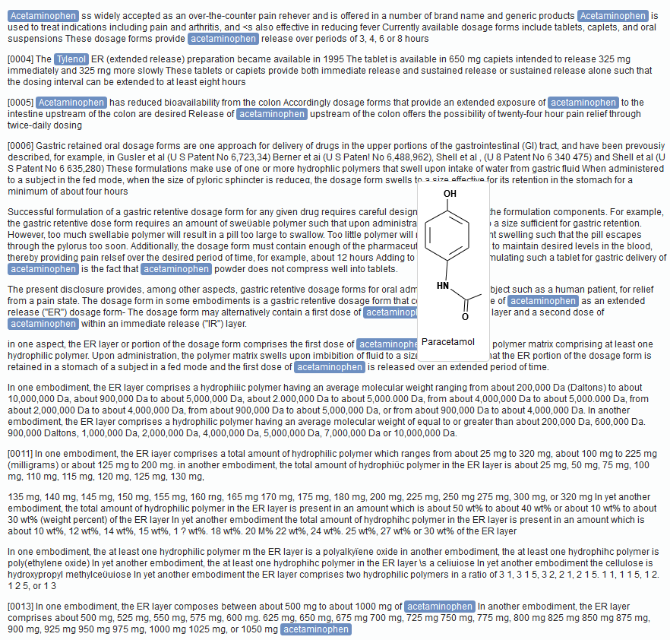

Slide 28
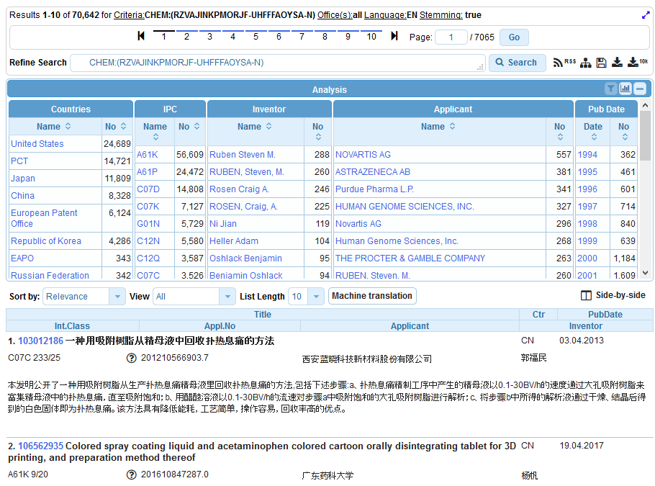
Analysis

Slide 29
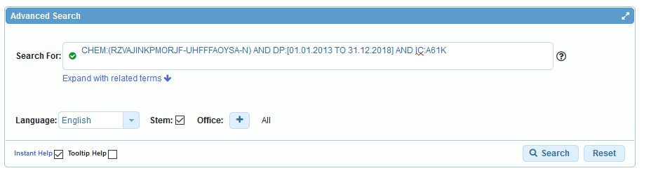
Combine results with searches

Slide 30
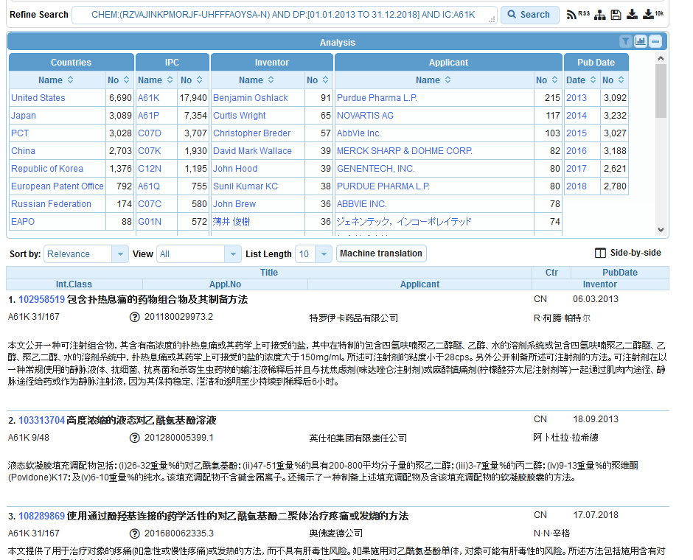

Slide 31

Search example: Theobromine
Its chemical formula is C₇H₈N₄O₂ and IUPAC name:
3,7-dimethyl-1H-purine-2,6-dione
Theobromine is found in the seeds of the plant Theobroma Cacao, which is the well-known source of chocolate and cocoa. It has a bitter flavor, which gives dark chocolate its typical bitter taste.
Notes:
I will now show you how to use the system with the example of theobromine.
The IUPAC name of theobromine is 3,7 dimethyl 1H purine 2,6 dione. It can be found in dark chocolate and is responsible for it’s bitter taste.
31

Slide 32
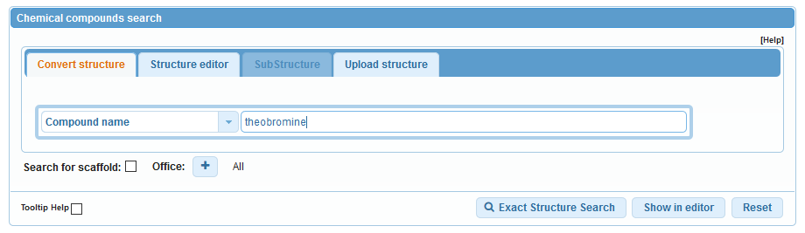
Convert structure
Notes:
I enter theobromine in the search by component name text field but instead of clicking the search button directly, I click the «show in editor» button to show you the information the system can find about this name.

Slide 33
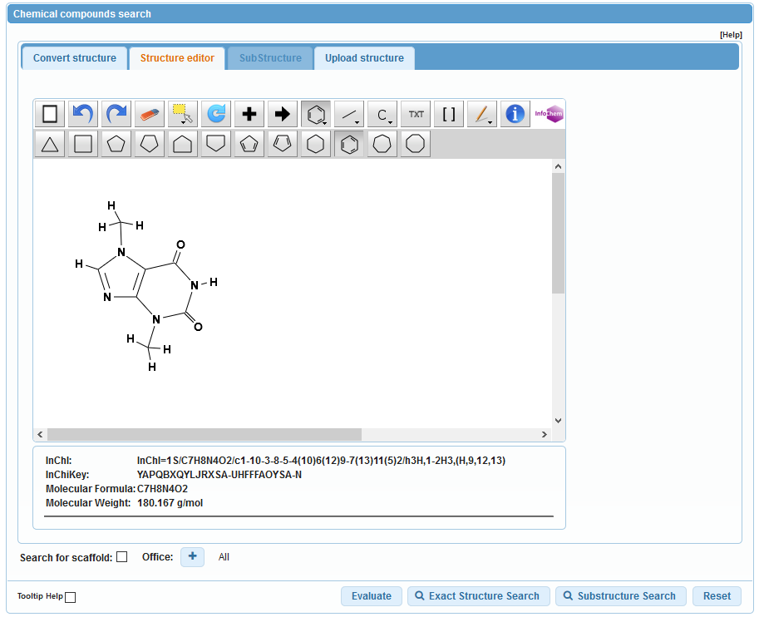
Notes:
We see indeed that theobromine is a recognized compound, we have even a drawing of its formula but more importantly we have the corresponding Inchi key which is displayed here. Now, we click on the Search button.

Slide 34
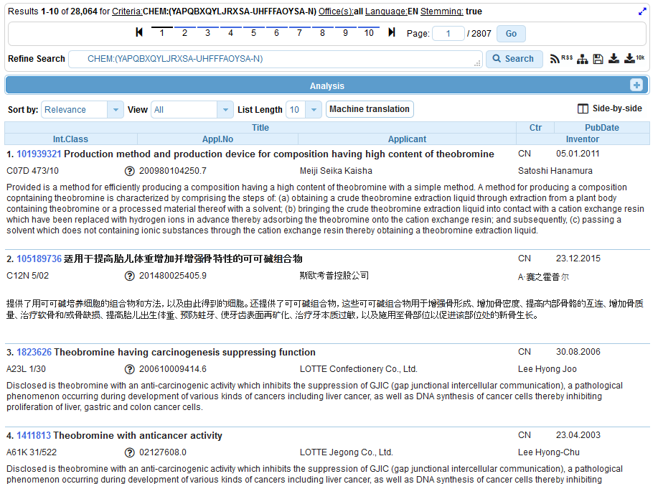
Notes:
And the system displays the results list of the PATENTSCOPE documents citing theobromine or any of its other representations in the title or abstract or description or claims. We see here that there are almost 6000 results and we see here the new PATENTSCOPE indexed field called CHEM that has been used to perform the search.
As with most PATENTSCOPE queries, the result list can be sorted by relevancy, which will show first the documents citing the compound the most frequently.
Now, let us click on the first result to see the details of the retrieved patent application.

Slide 35
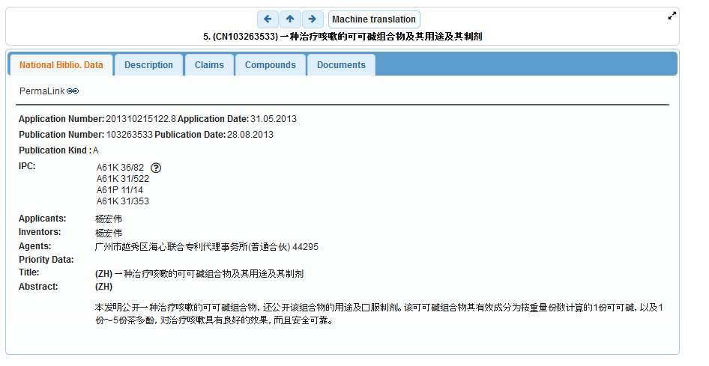

Slide 36
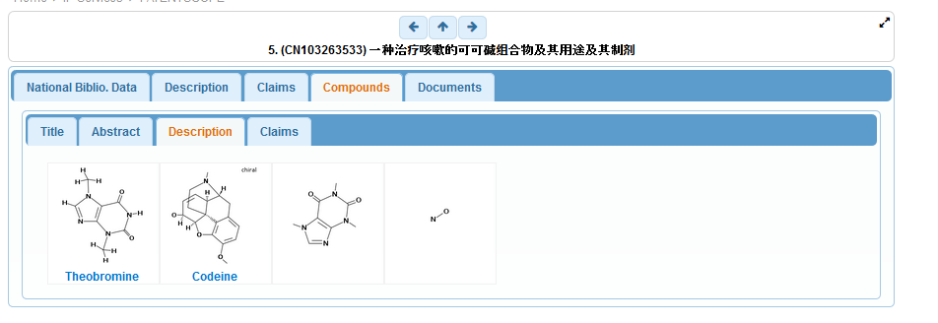
Notes:
Well, as expected, it shows the compounds detected in the document respectîvely in the title, abstract, description and claims of the application.
If we click on theobromine,

Slide 37
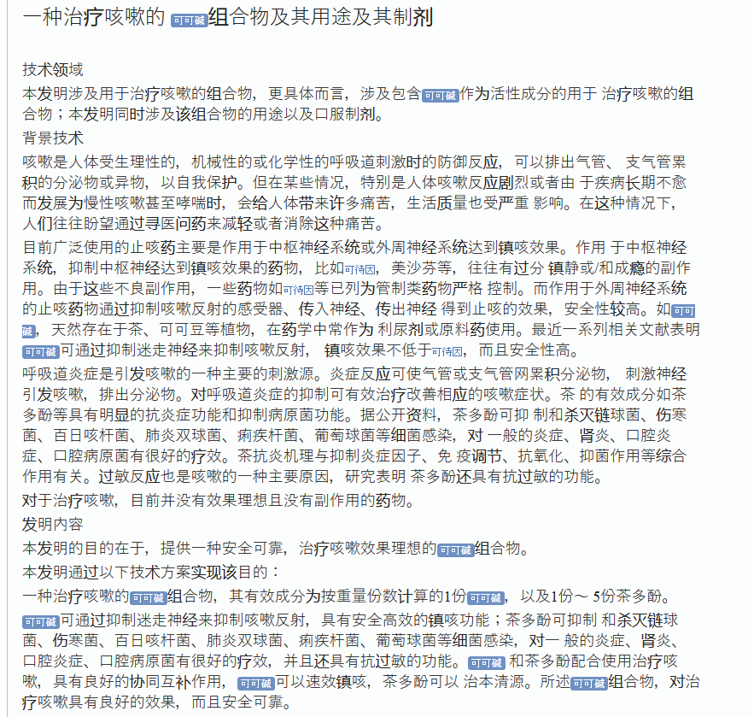
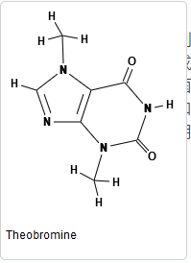
Notes:
Then the system opens the corresponding part of the document containing the compound, here the description.
If you move your mouse over the compound representation in the text, then the system displays the drawing of the formula. All recognized formulae are displayed also in blue and can be examined the same way, for example this is caffeine.

Slide 38
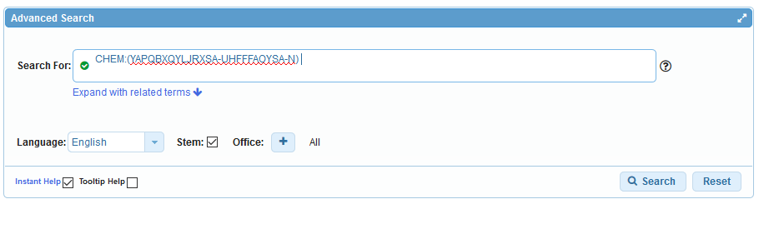
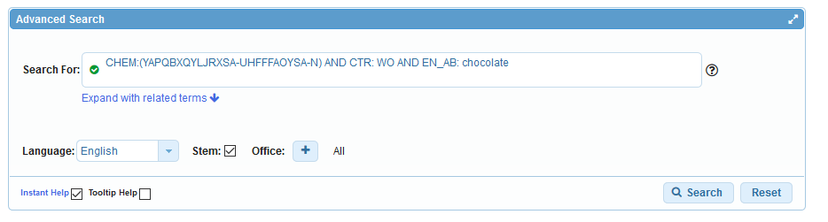
Add search criteria
PCT applications
Chocolate in English abstract
Notes:
Now let us imagine we want to restrict our search to PCT applications citing chocolate in their abstract.
This is done by combining the chemical compound search with other criteria using boolean logic as displayed here and now we only have 9 results to look at.

Slide 39
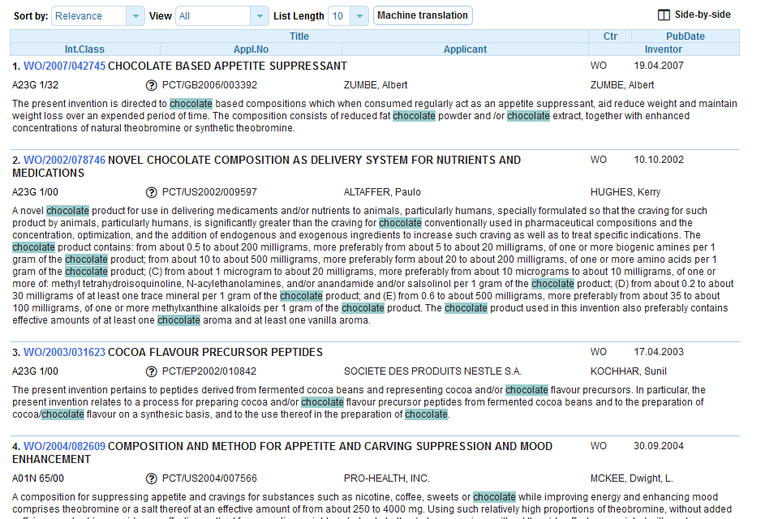

Slide 40
Example: fluoxetine hydrochloride
Its chemical formula is C₁₇H₁₉ClF₃NO
the first highly specific serotonin uptake inhibitor. It is used as an antidepressant and often has a more acceptable side-effects profile than traditional antidepressants.
Synonyms: Prozac, Sarafem

Slide 41
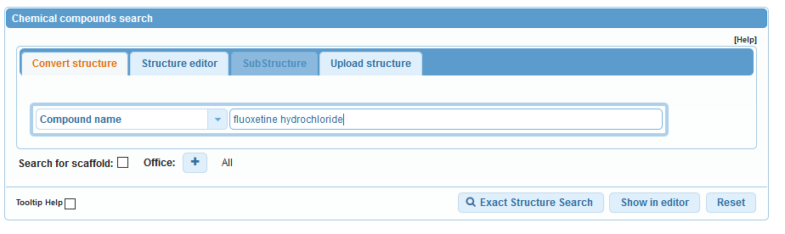
Chemical compound search

Slide 42
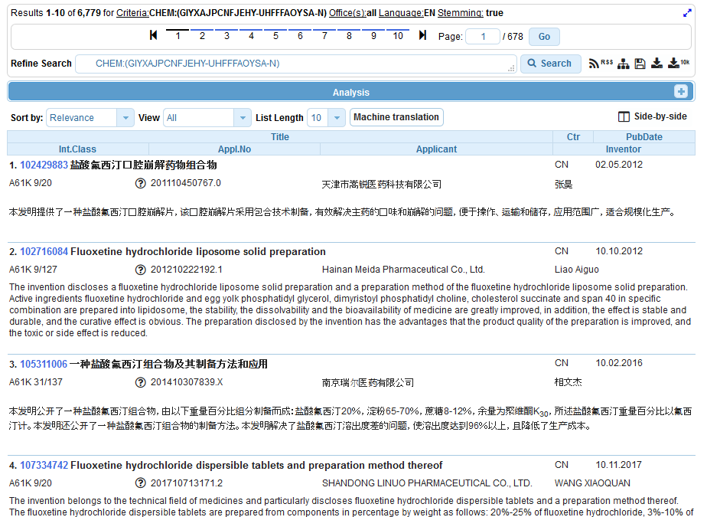

Slide 43
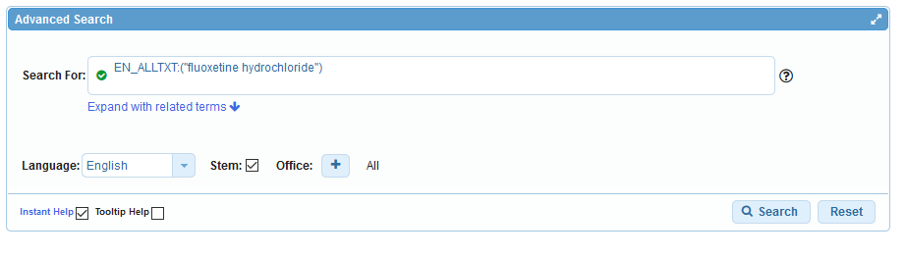
Advanced search

Slide 44
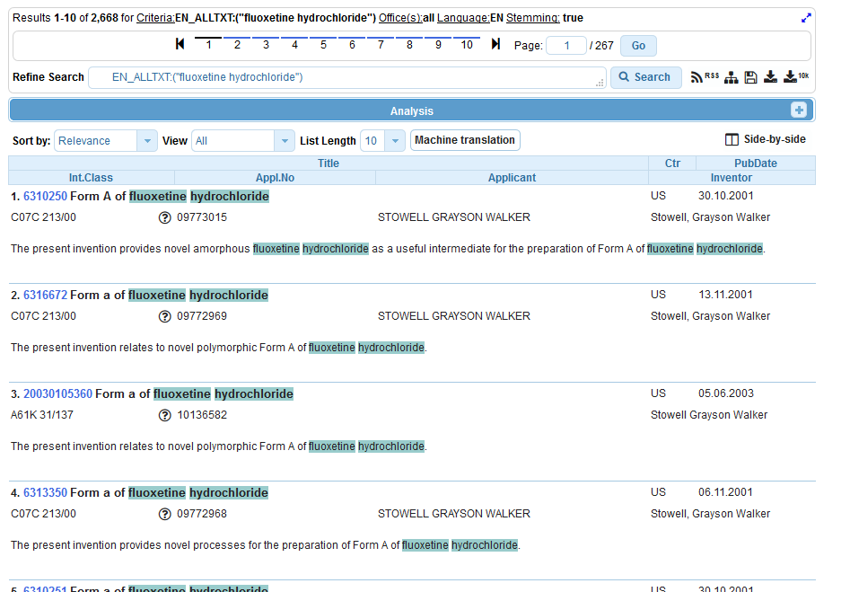

Slide 45
Example formula searching
4-(3-chloro-2-fluoroanilino)-7-methoxy-6-((1-(N-methylcarbamoylmethyl)piperidin-4-yl)oxy)quinazoline

Slide 46
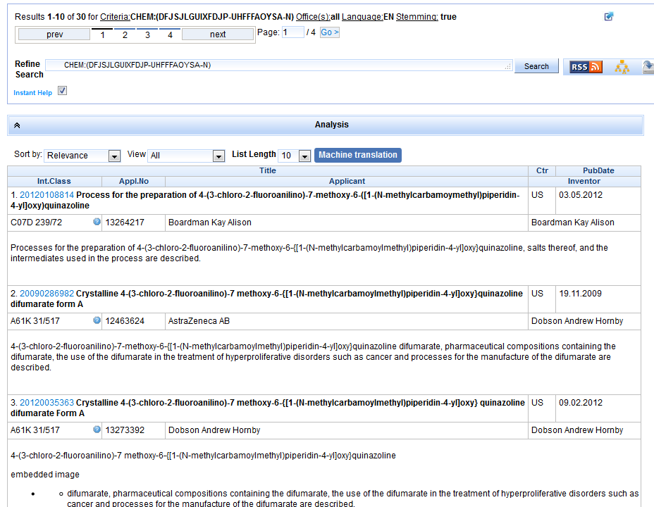

Slide 47
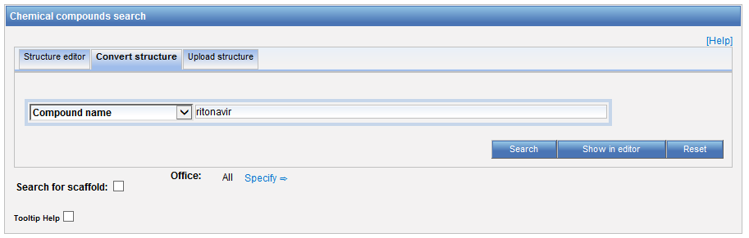
Example: Ritonavir

Slide 48
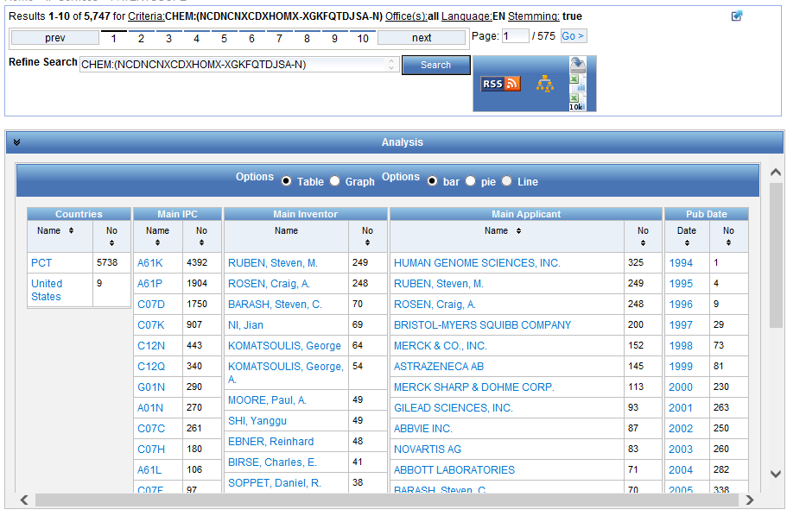

Slide 49
Patent landscape Report on Ritonavir-
Ritonavir is an antiretroviral drug from the protease inhibitor class used to treat HIV infection and AIDS. Ritonavir is included in the WHO Model List of Essential Medicines (EML)1.
The originator company is Abbott Laboratories, which markets Ritonavir under the brand name Norvir, or in combination with the protease inhibitor Lopinavir, as Kaletra or Aluvia. The U.S. Food and Drug Administration (FDA) approved the drug in March 1996 for oral solution and in June 1999 for capsules.
http://www.wipo.int/edocs/pubdocs/en/patents/946/wipo_pub_946.pdf

Slide 50
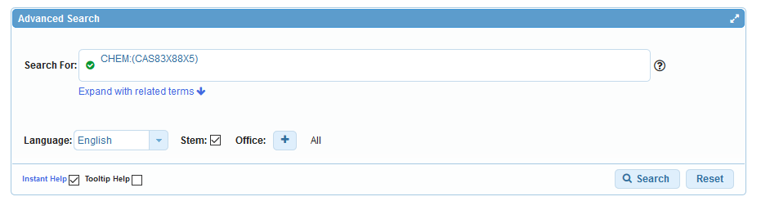
Search by CAS number
CAS83-88-5

Slide 51
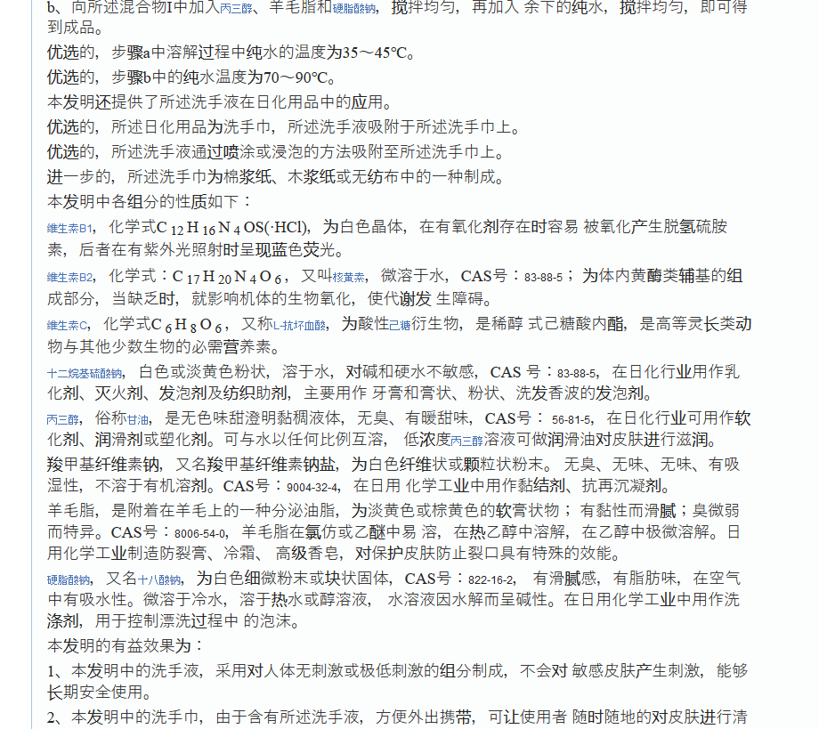
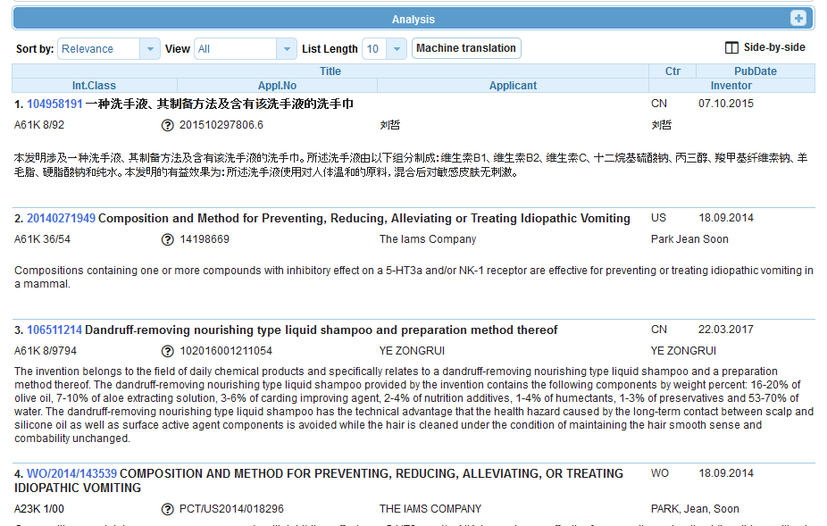

Slide 52
Sub-structure search – the concept
Identification of elements in larger structures
Notes:
Back in October 2016, we added the chemical search tool
It’s was developed on by InfoChem
You can draw the molecule or can search by compound name, INN, Inchi, SMILES or upload a MOL of images file
Chemical annotation of PATENTSCOPE full-text documents using InfoChem’s ICANNOTATOR

Slide 53
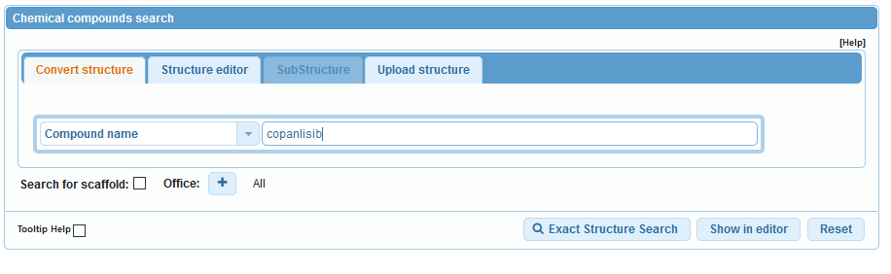
Substructure search

Slide 54
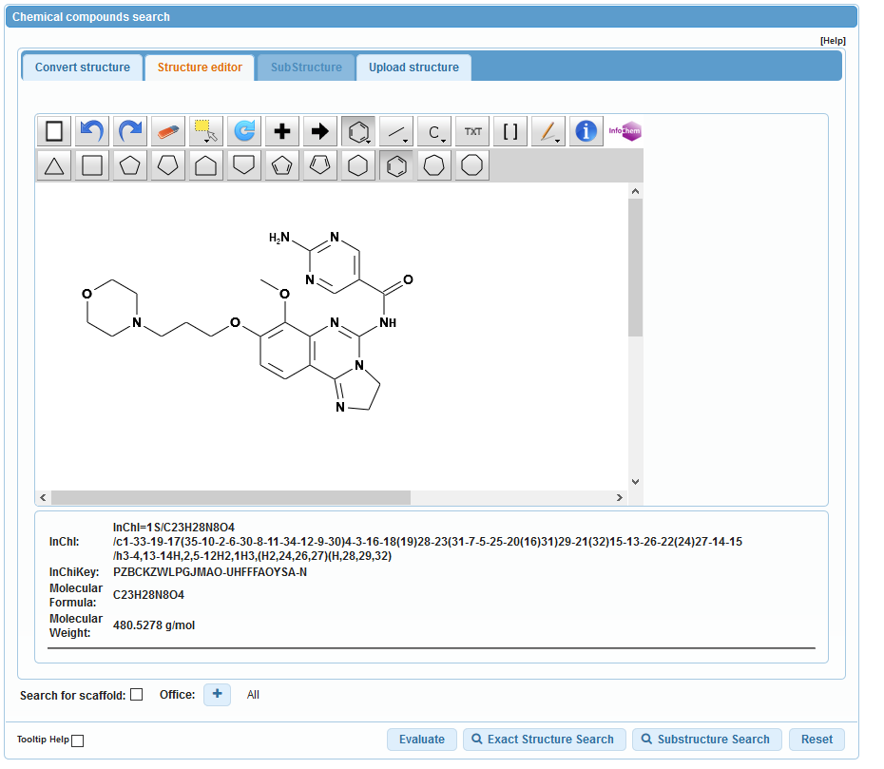

Slide 55
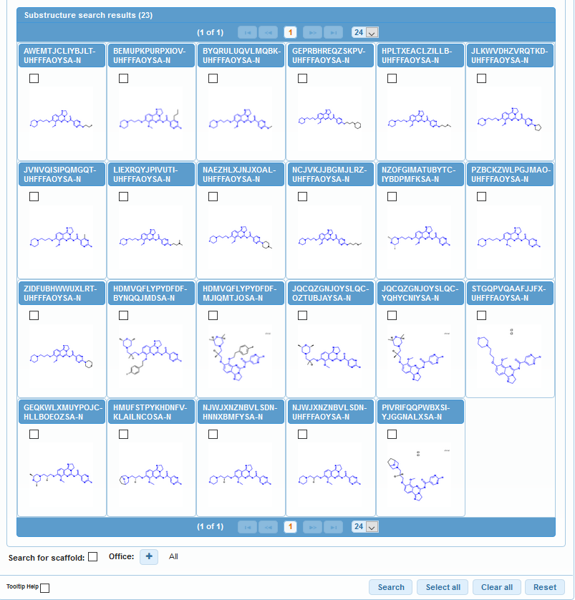

Slide 56
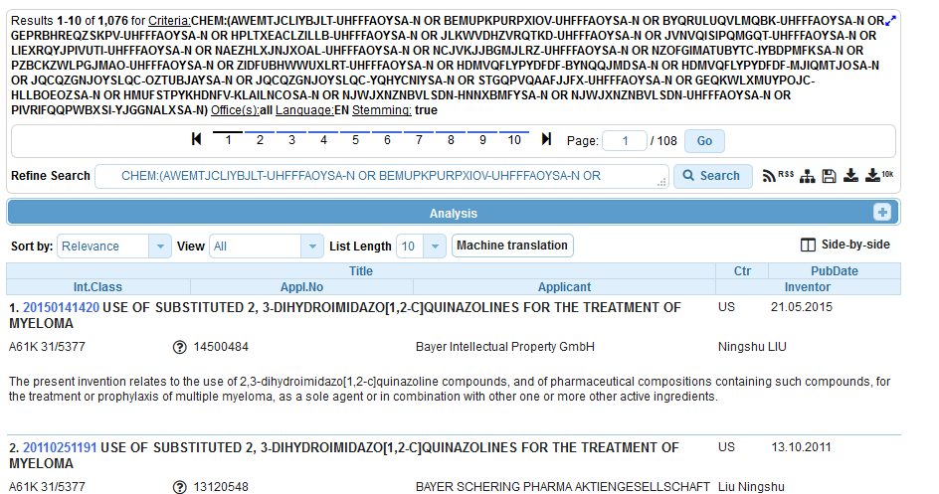

Slide 57
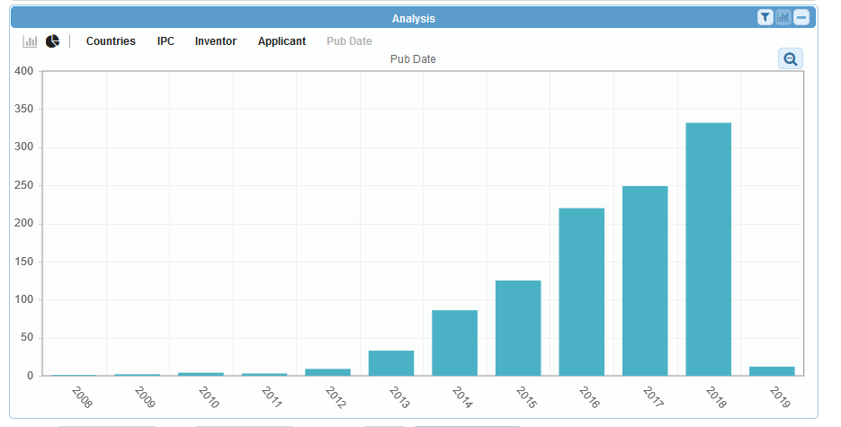

Slide 58
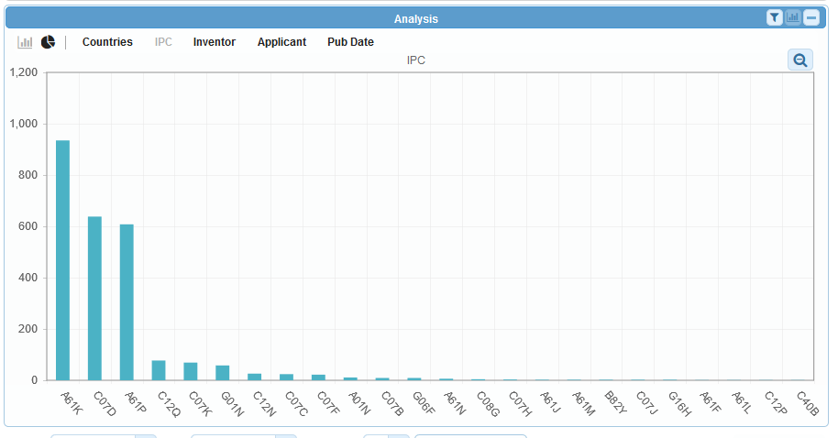

Slide 59

Photo by Ani Kolleshi on Unsplash

Slide 60


Slide 61


Slide 62


Slide 63



Slide 64


Slide 65


Slide 66
Can I search?
Stereoisomer
Monomer
Enantiomer
CAS name
Polymer, Poly(vinyl alcohol)
Inorganic cluster
Metal-organic framework
Transformable into InchI reactions
Reaction search
DNA sequence listing
Reaction search

Slide 67
Restrict to the claims field
CHEM:( Inchikey BEFORE10000 description)

Slide 68

Future/past webinars:
wipo.int/patentscope/en/webinar

Slide 69
Next webinar
PATENTSCOPE for beginners
  March 19 at 5:30 pm
  https://register.gotowebinar.com/rt/1363658697274907139
  March 21 at 8:30 am
  https://register.gotowebinar.com/rt/1363658697274907139

Slide 70
Global Brand Database: webinar
How to read, save and share your results in the Global Brand Database
  March 12 at 5:30 pm CET
  https://attendee.gotowebinar.com/register/4587178300327453186

Slide 71
Global Design Database: webinar
How to perform a search in the Global Design Database
  March 13 at 5:30 pm CET
  https://attendee.gotowebinar.com/register/2379638227706712578

Slide 72


Slide 73

patentscope@wipo.int

