Slide 1
PATENTSCOPE
Result list and analysis tools
Web
May
2016
Sandrine Ammann
Marketing & Communications Officer

Slide 2
Agenda
What’s news
Search result list
Translation tools
IPC statistics
Quiz
Q&A

Slide 3
What’s new?
New languages available in CLIR
New search fields
Our Forum

Slide 4
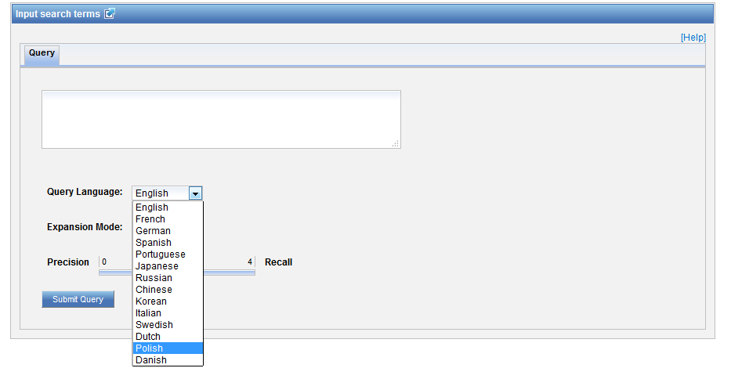
New languages in CLIR

Slide 5
New search fields
ISA: International Search Authority
ISR: International Search Report
IPE: International Preliminary Examination
SIS: Supplementary International Search

Slide 6
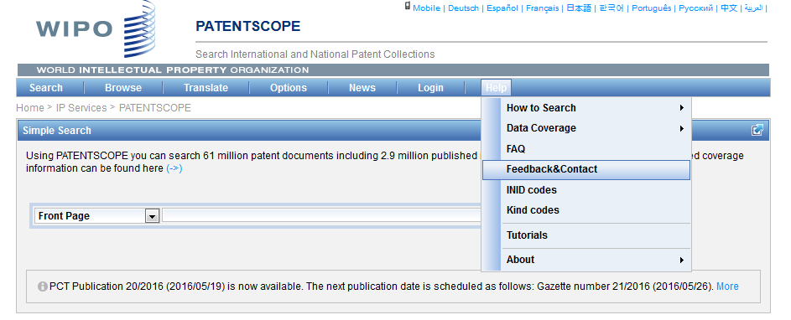
The Forum

Slide 7
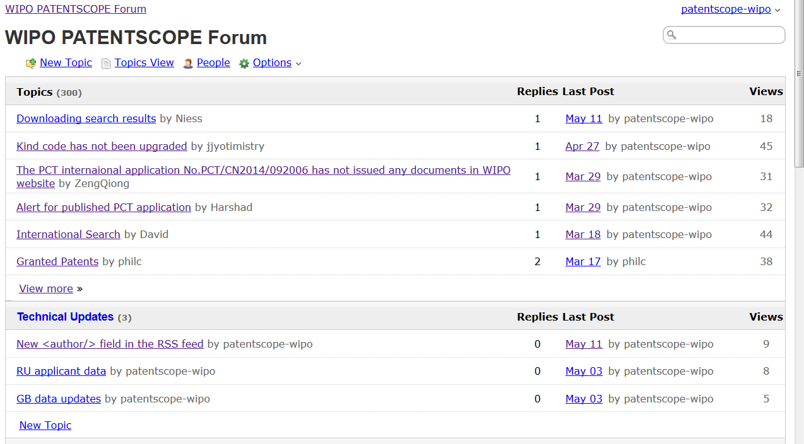

Slide 8
Search results list

Slide 9
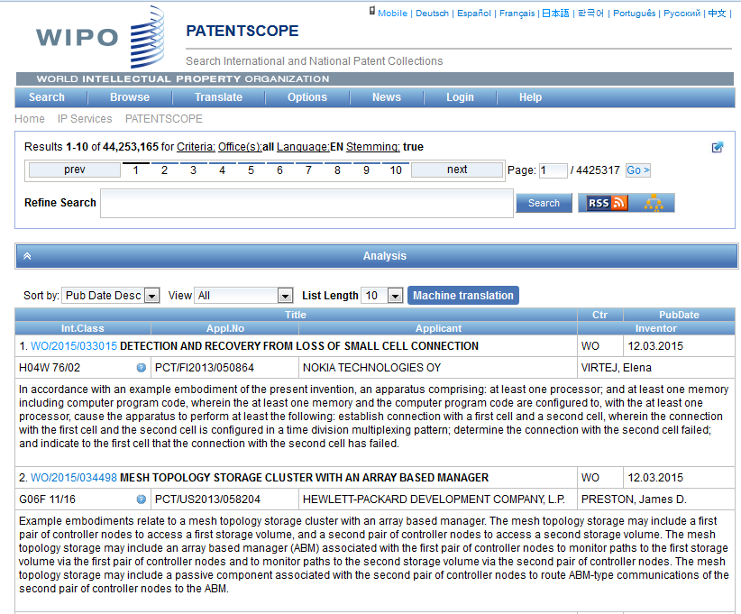

Slide 10
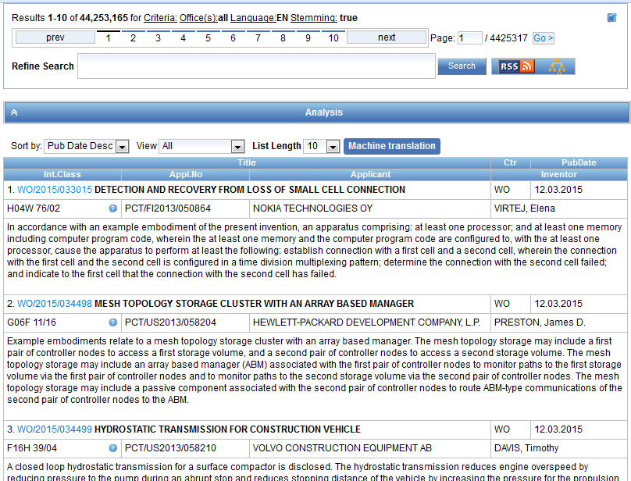

Slide 11
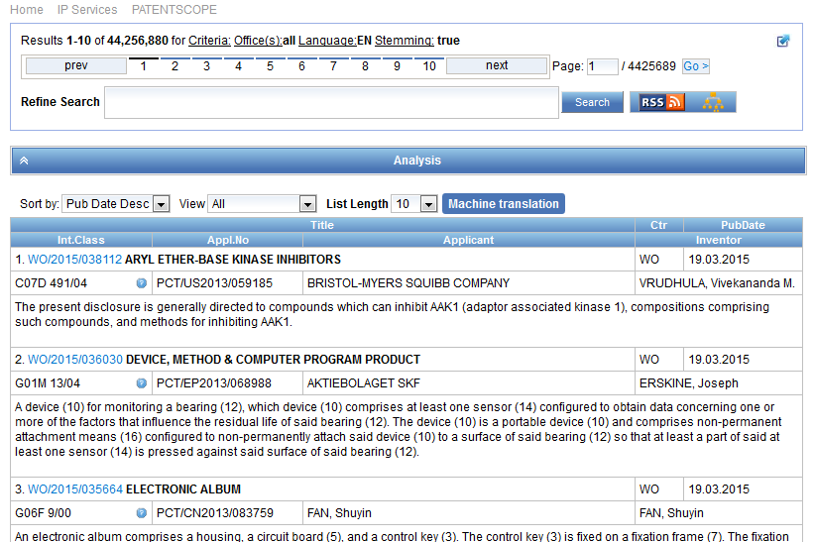
Result list

Slide 12
The first box

Slide 13
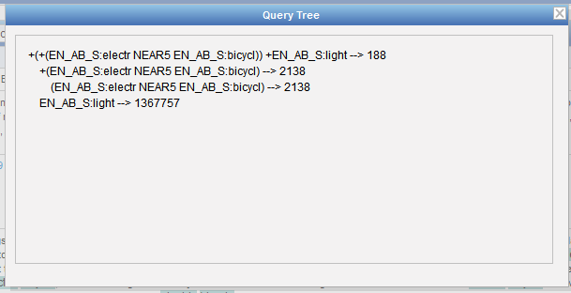

Slide 14
Stemming
Process that removes common ending from words by English Snowball algorithm
electric¦al = electric
electric¦ity = electric
electron¦ics = electron
More accurate results than wildcards:
elect* electoral, etc.

Slide 15
When logged-in

Slide 16
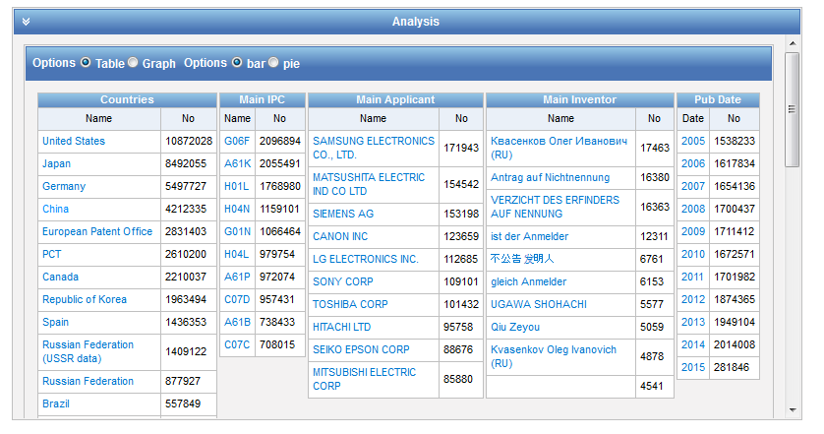
Analysis

Slide 17
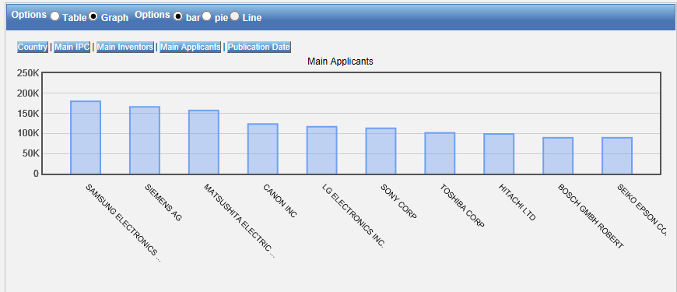
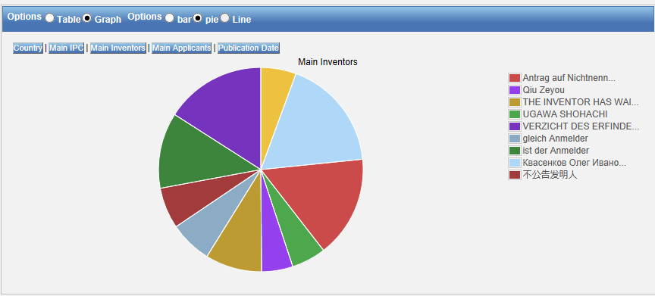
Table – Graph: pie or bar

Slide 18
Table/graph customization

Slide 19
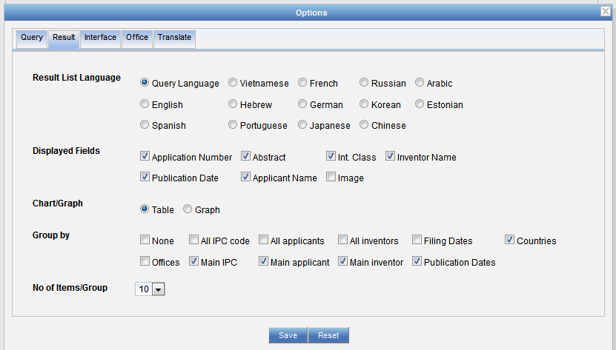
Table/graph customization

Slide 20
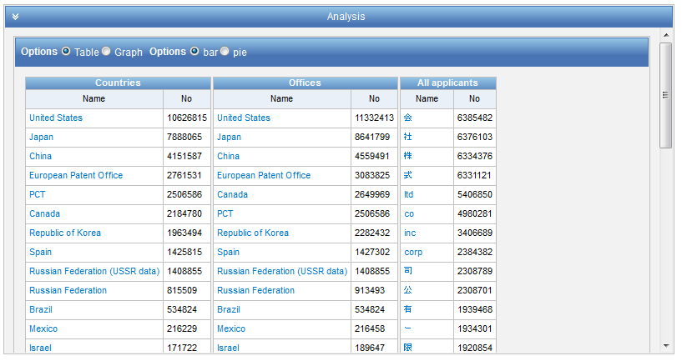

Slide 21
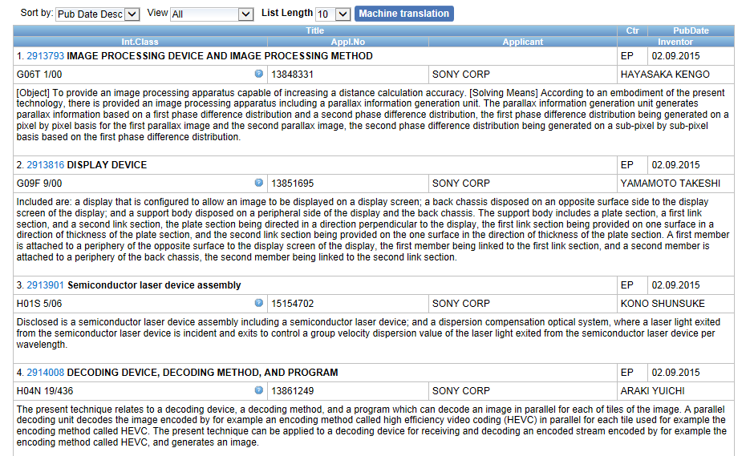
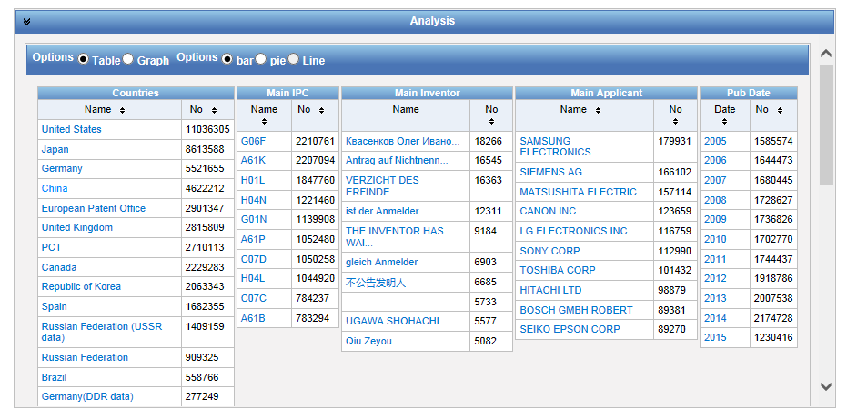
Narrow down your results

Slide 22
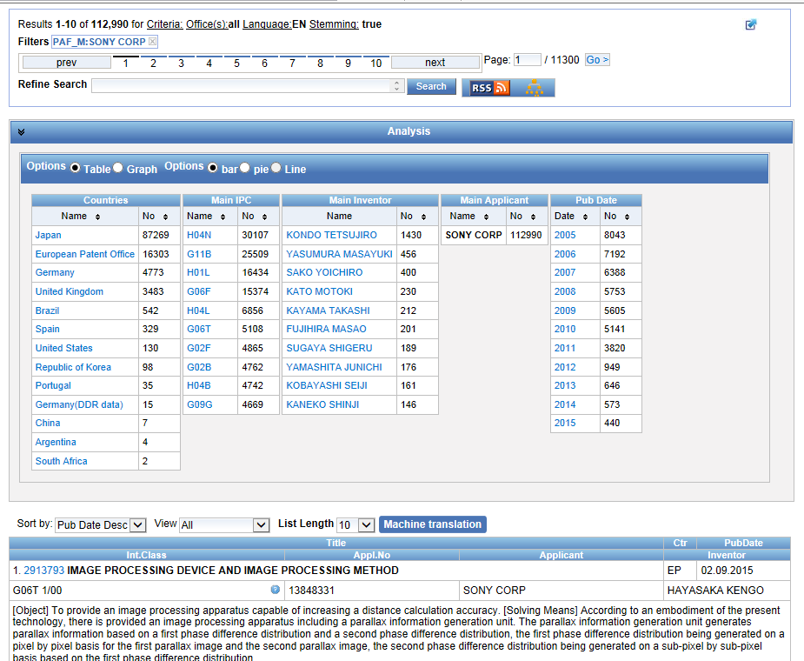

Slide 23
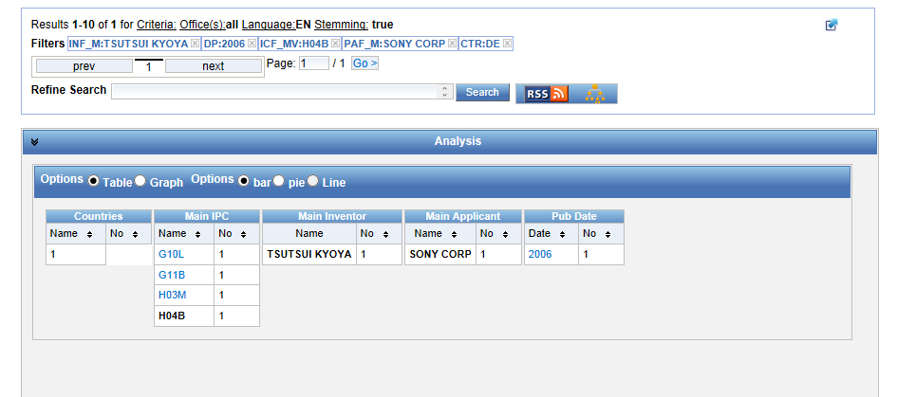

Slide 24
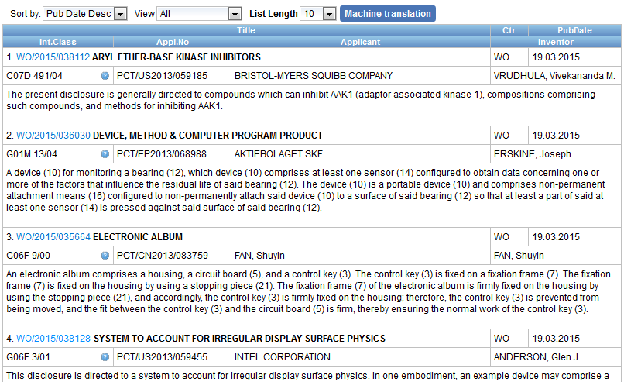

Slide 25
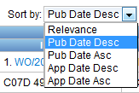
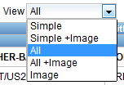
Display options

Slide 26
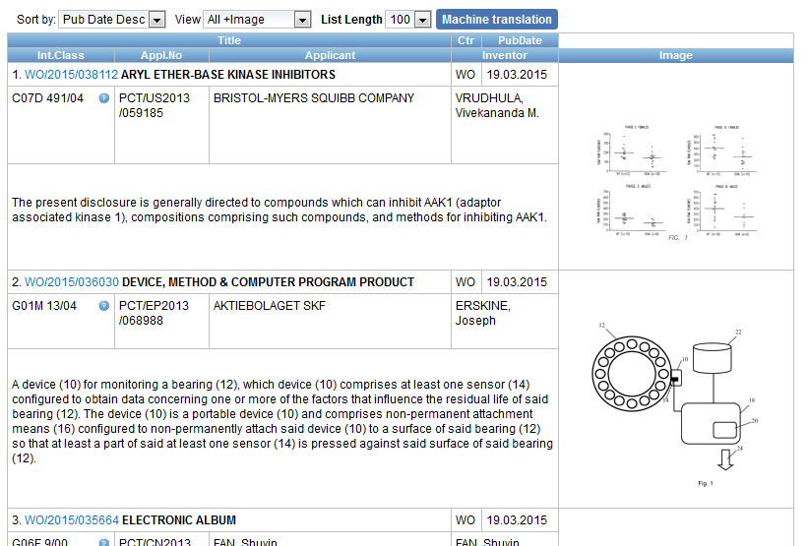
Display with images

Slide 27
Translation tools integrated
Search result list
Description
Claims
Full-text

Slide 29
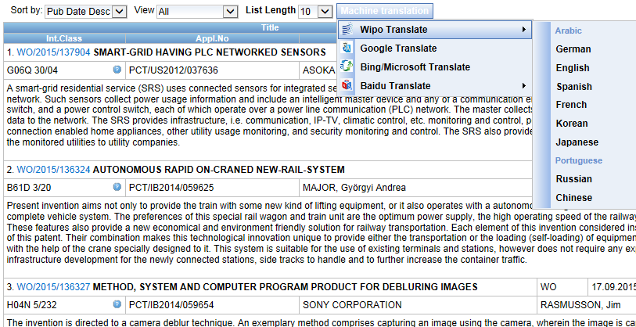
In the search result list

Slide 30
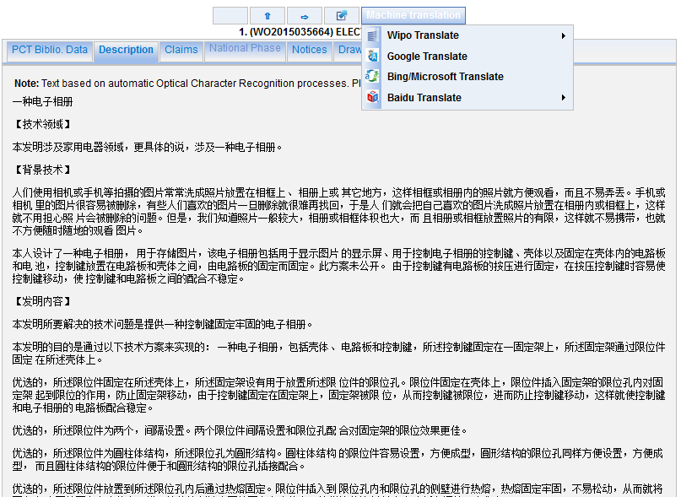

Slide 31
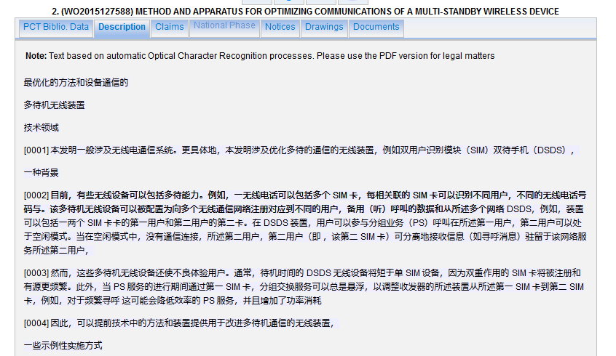
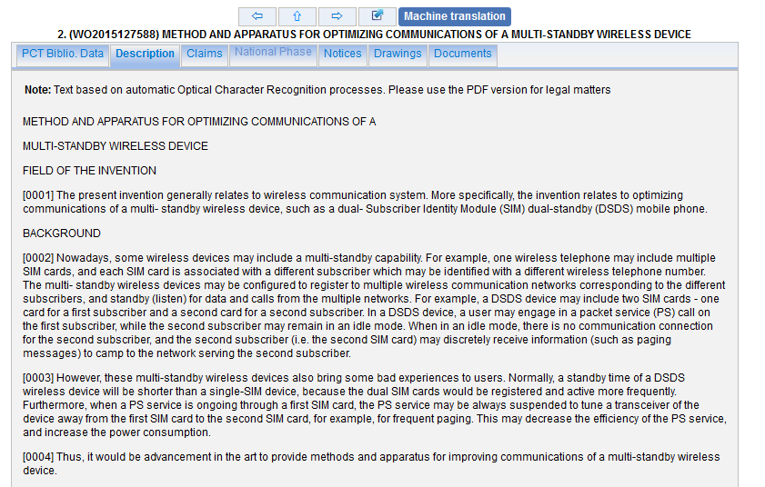
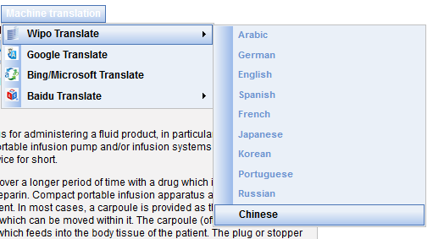

Slide 32
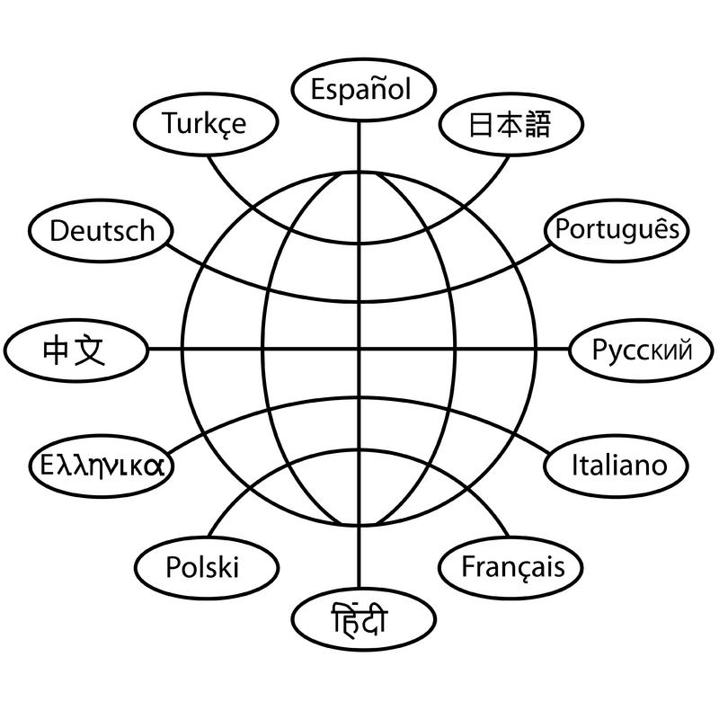
Translation tools

Slide 33
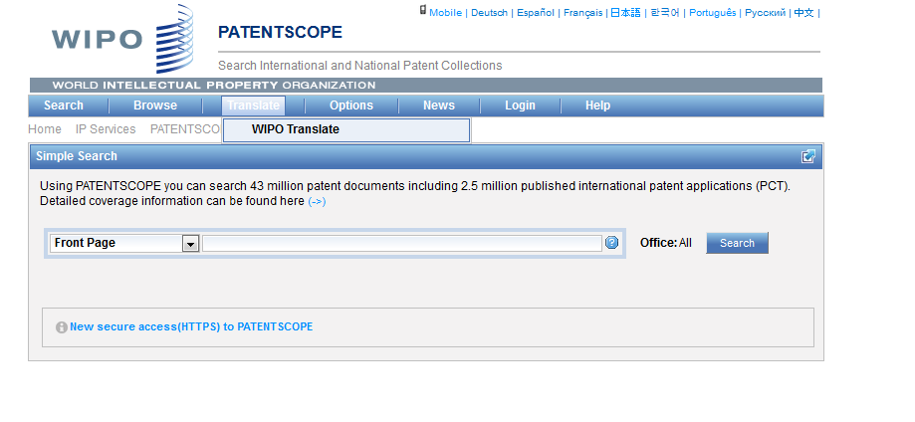
WIPO Translate

Slide 34
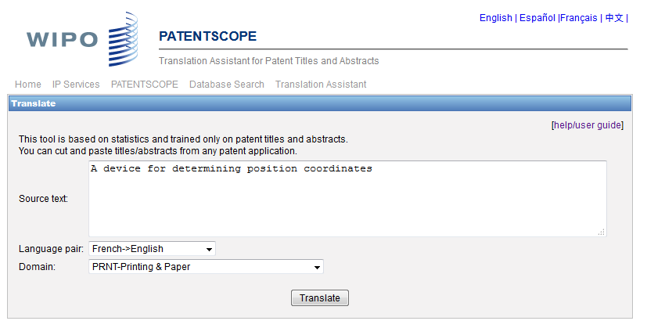
WIPO translate: interface

Slide 35
32 Technical domains from the IPC
[ADMN] Admin, Business, Management & Soc Sci
[AERO] Aeronautics & Aerospace Engineering
[AGRI] Agriculture, Fisheries & Forestry
[AUDV] Audio, Audiovisual, Image & Video Tech
[AUTO] Automotive & Road Vehicle Engineering
[BLDG] Civil Engineering & Building Construction
[CHEM] Chemical & Materials Technology
[DATA] Computer Sci, Telecom & Broadcasting
[ELEC] Electrical Engineering & Electronics
[ENGY] Energy, Fuels & Heat Transfer Eng
[ENVR] Environmental & Safety Engineering
[FOOD] Foods & Food Technology
[GENR] Generalities, Language, Media & Info Sci
[HOME] Home Contents & Household Maintenance
[HORO] Precision Mechanics, Jewelry & Horology
[MANU] Manufacturing & Materials Handling Tech
[MARI] Marine Engineering
[MEAS] Standards, Units, Metrology & Testing
[MECH] Mechanical Engineering
[MEDI] Medical Technology
[METL] Metallurgy
[MILI] Military Technology
[MINE] Mining, Oil & Gas Extraction & Minerals
[NANO] Nano Technology
[PACK] Packaging & Distribution of Goods
[PRNT] Printing & Paper
[RAIL] Railway Engineering
[SCIE] Optical Engineering
[SPRT] Sports, Leisure, Tourism & Hospitality
[TEXT] Textile & Clothing Industries
[TRAN] Transportation

Slide 36
Language pairs
Chinese-English; English –Chinese
French-English; English – French
German-English; English-German
Japanese-English; English-Japanese
Korean-English; Korean –English
Russian-English; English-Russian
Spanish-English; English Spanish

Slide 37
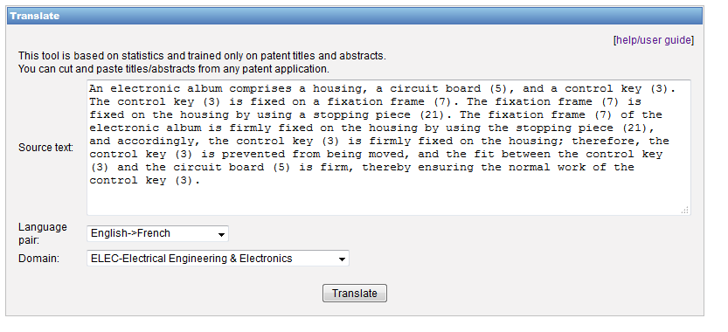
WIPO Translate: an example

Slide 38
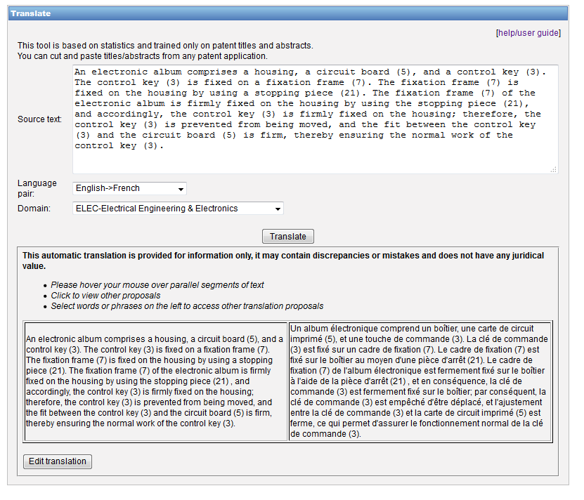

Slide 39
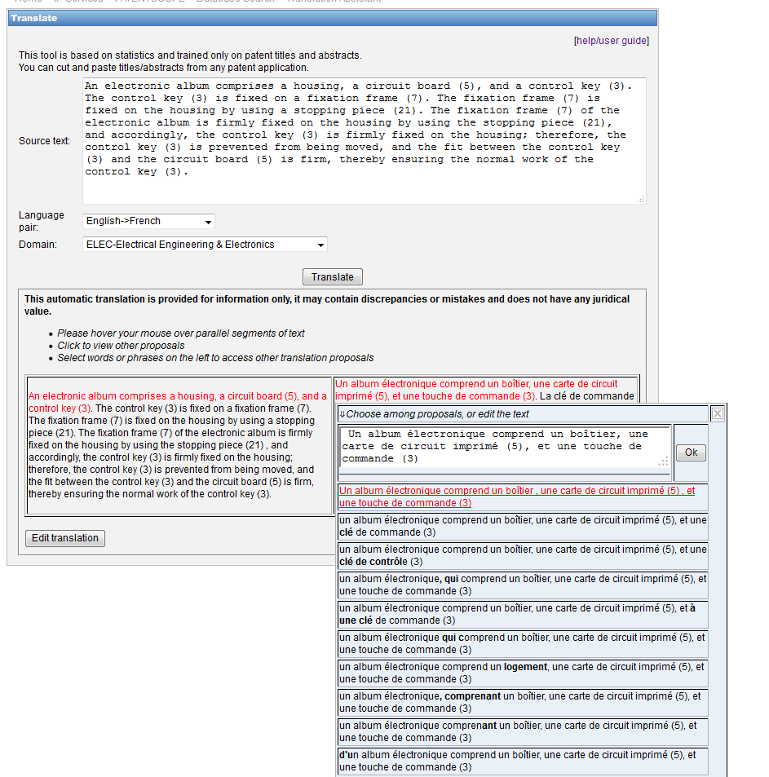

Slide 40
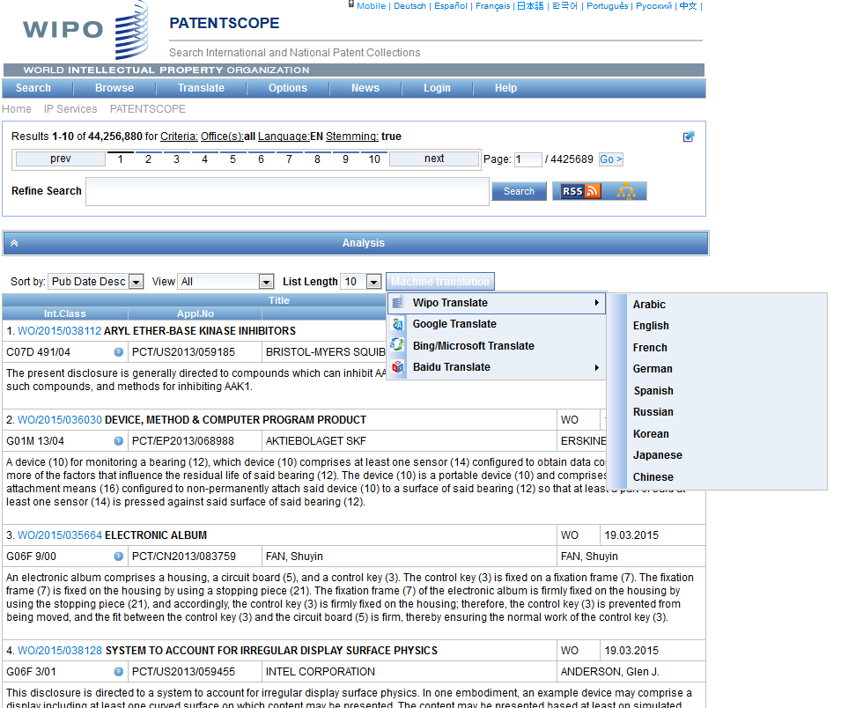
WIPO Translate: search result list

Slide 41
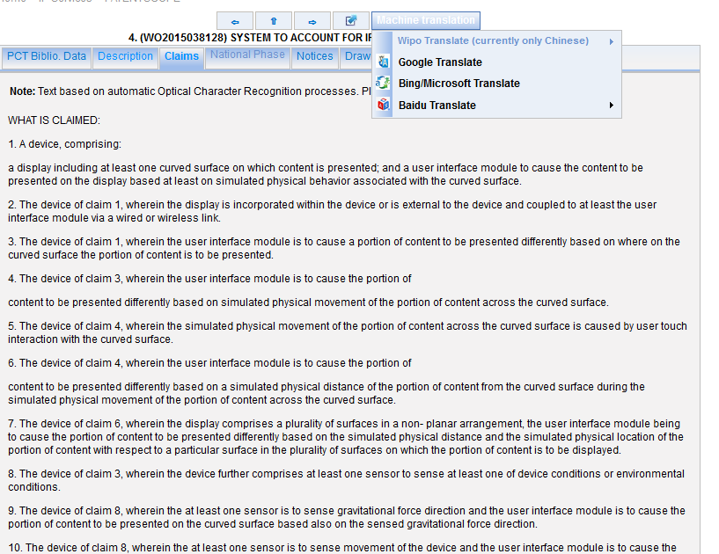
WIPO Translate: description/claims

Slide 42
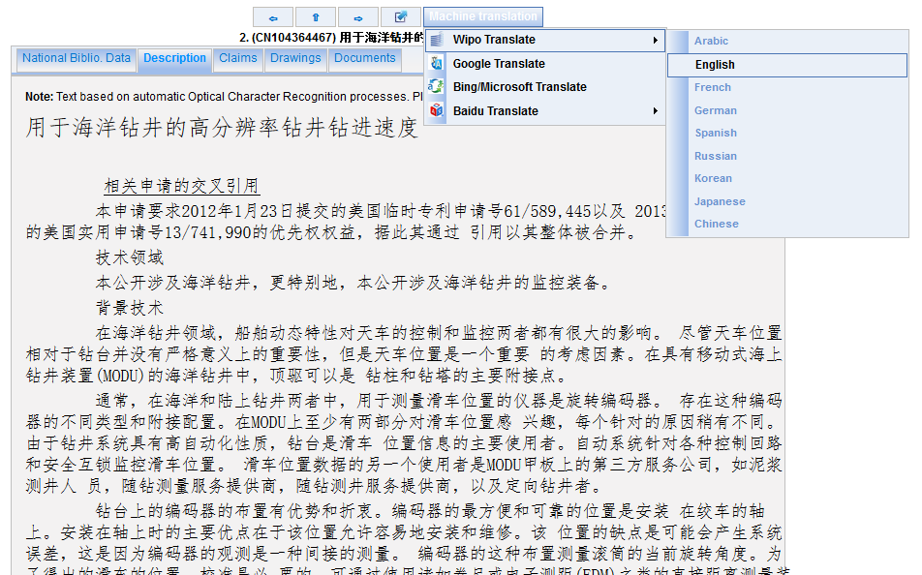

Slide 43
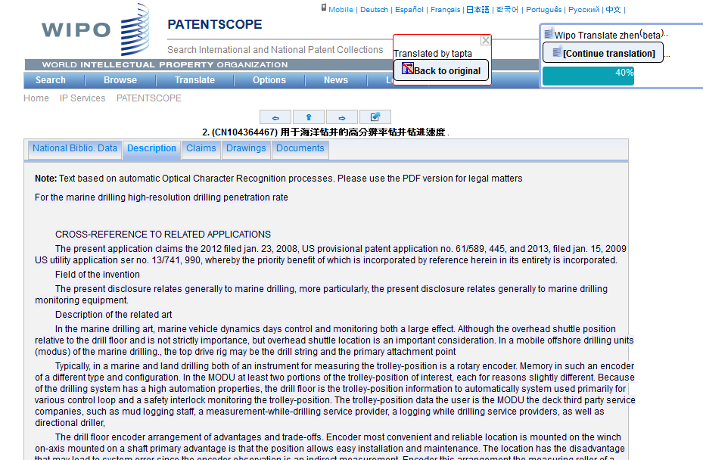

Slide 44
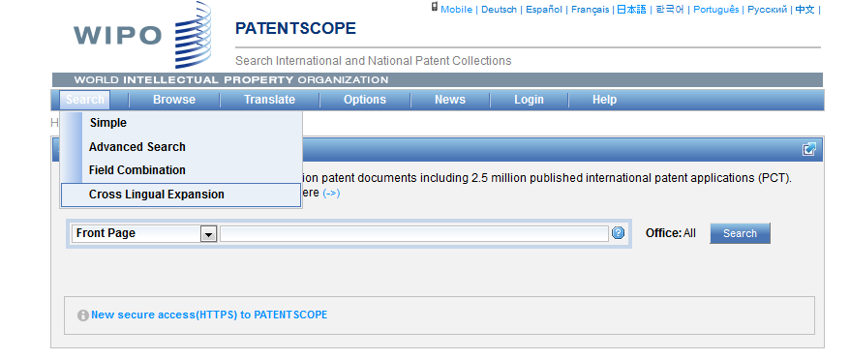
CLIR

Slide 45
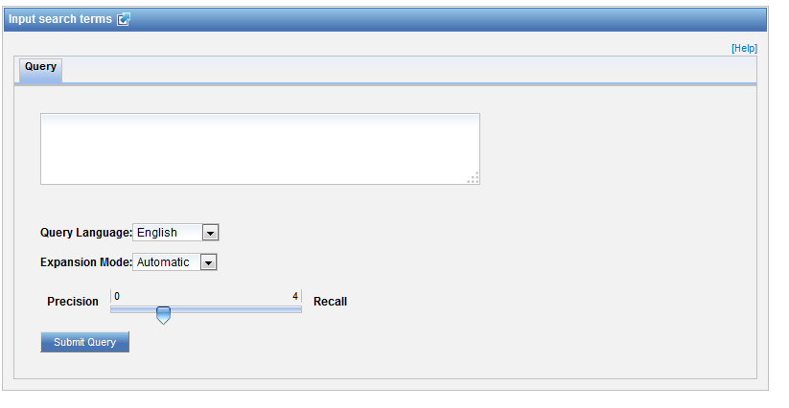
CLIR: interface

Slide 46
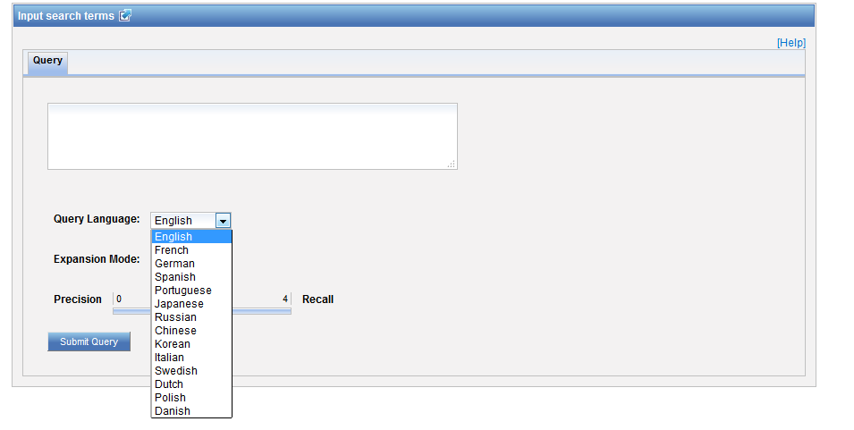
CLIR: query language

Slide 47
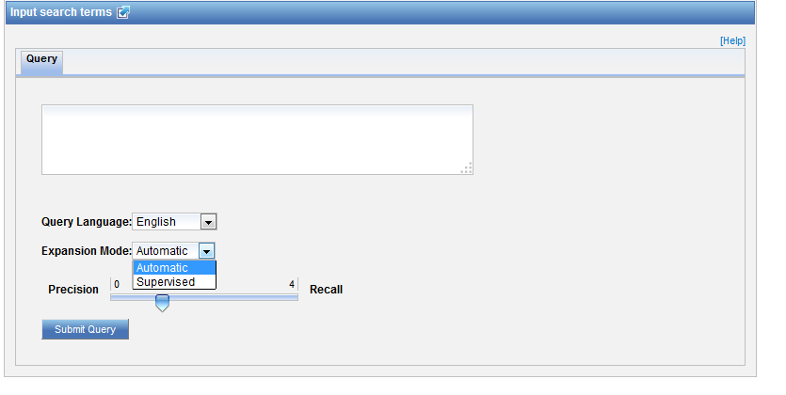
CLIR: expansion mode

Slide 48
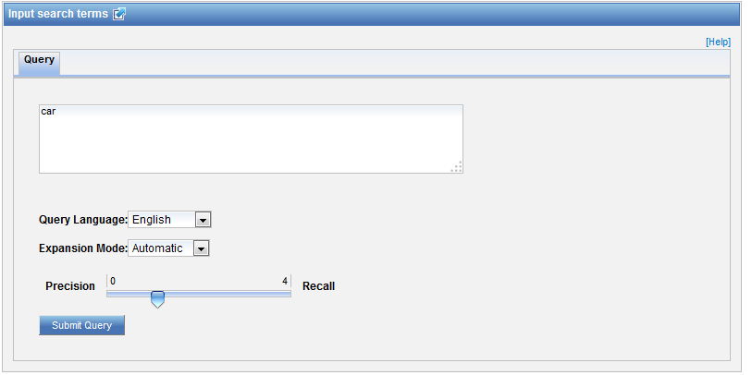
CLIR: an example

Slide 49
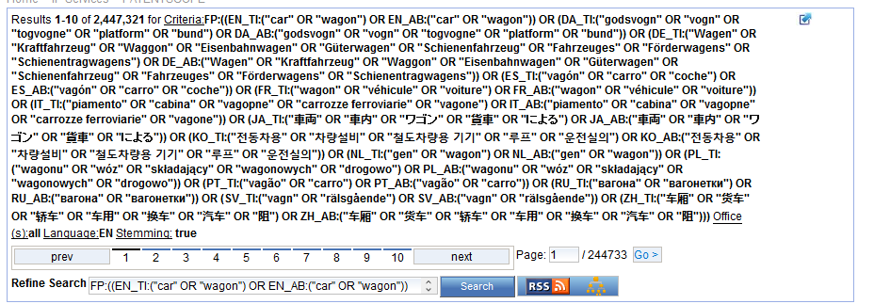
CLIR: an example

Slide 50
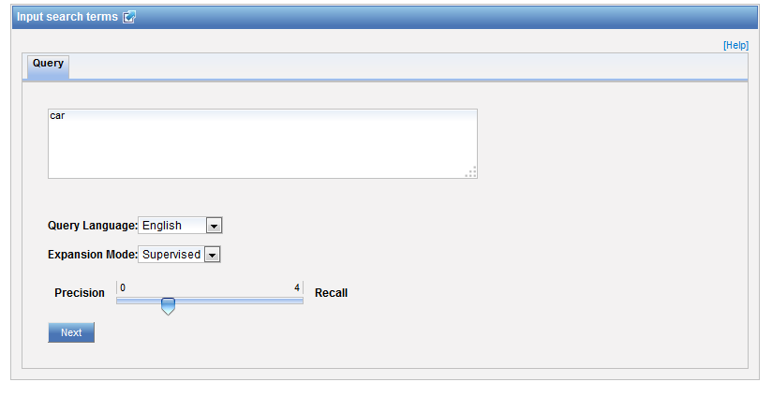
CLIR: supervised

Slide 51
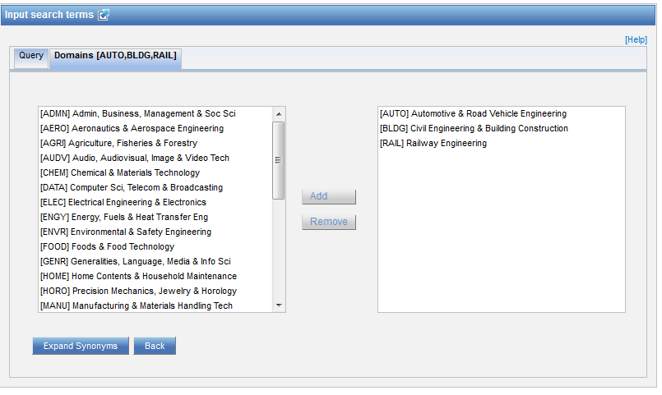
Domain selection

Slide 52
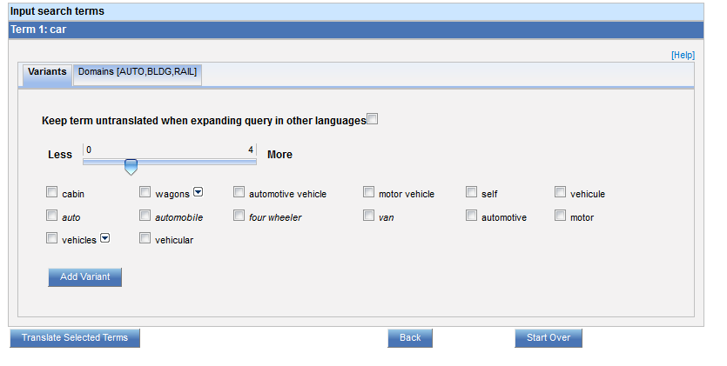
Variants selection

Slide 53
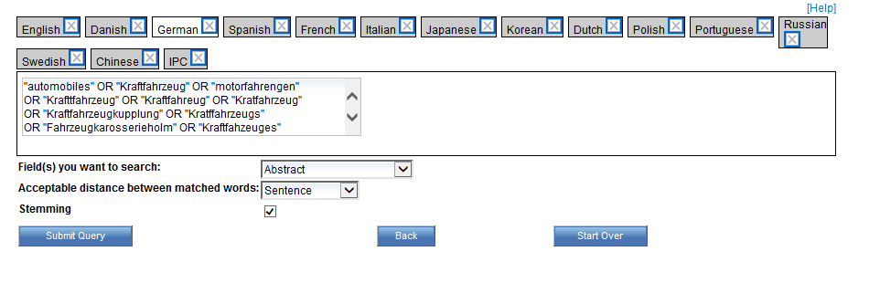
Summary of variants

Slide 54
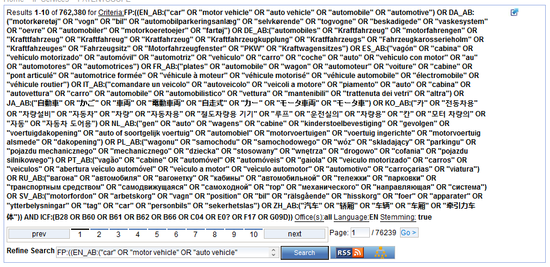
Results

Slide 55
IPC statistics

Slide 56
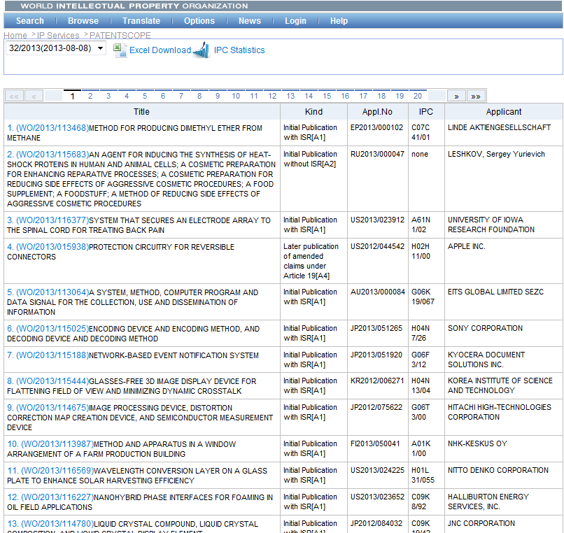

Slide 57
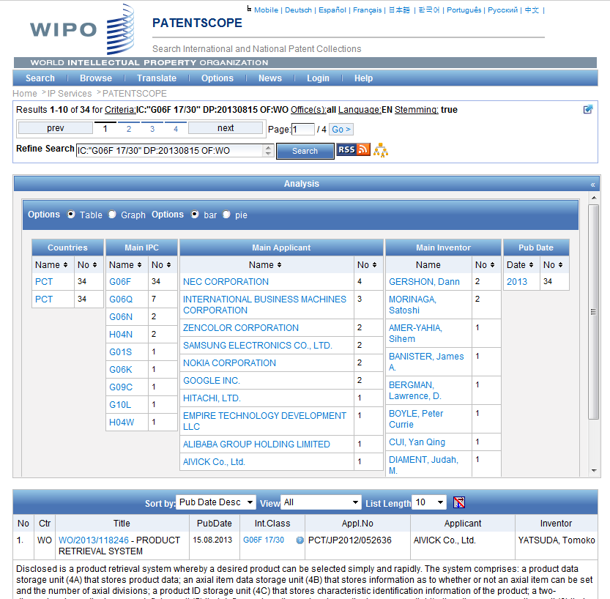

Slide 58
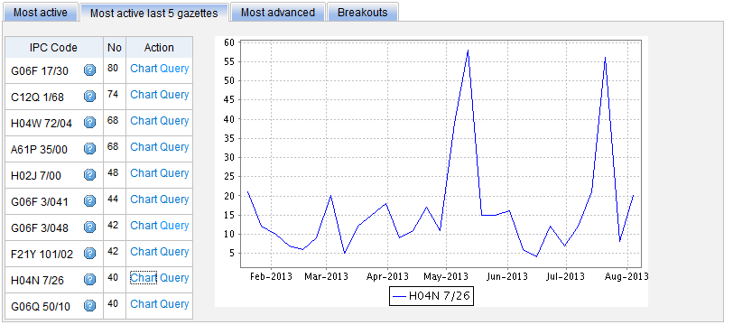
Most active last 5 gazettes

Slide 59
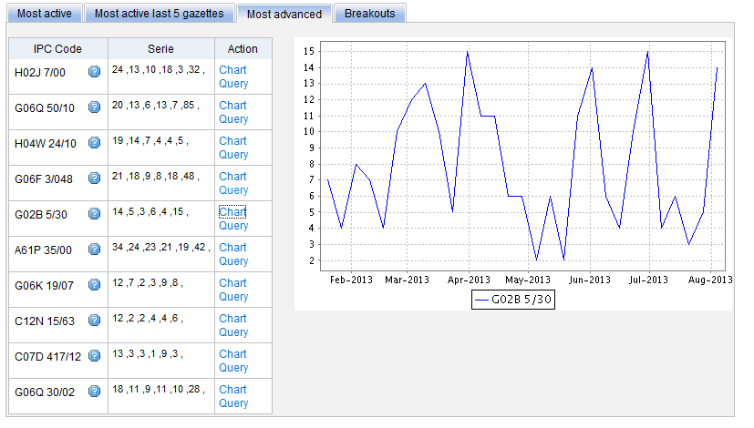
Most advanced

Slide 60
Breakouts

Slide 62
Q1: How can you increase the number of items shown in the analysis bar?
A
By clicking on the different columns
B
It is not possible
C
Options menu

Slide 63
Q1: How can you increase the number of items shown in the analysis bar?
A
By clicking on the different columns
B
It is not possible
C
Options menu

Slide 64
Q2: How can you translate into Chinese a patent abstract in English?
A
CLIR
B
WIPO Translate

Slide 65
Q2: How can you translate into Chinese a patent abstract in English?
A
CLIR
B
WIPO Translate

Slide 66
Q3: Where are the IPC statistics available?
A
In the result list
B
In the Analysis bar
C
In the Browse menu
D
In the Help menu

Slide 67
Q3: Where are the IPC statistics available?
A
In the result list
B
In the Analysis bar
C
In the Browse menu
D
In the Help menu

Slide 69
patentscope@wipo.int

Slide 70
June webinar: Translation tools in PATENTSCOPE
Tue, June 28
5:30 PM - 6:30 PM CEST
Thu, June 30
8:30 AM - 9:30 AM CEST
To sign up: http://www.wipo.int/patentscope/en/webinar/

Slide 71
mulțumesc
mulțumesc

