Slide 1
Introduction to IP, TK and TCEs
May 14, 2019
Daphne Zografos Johnsson
Legal Officer, Traditional Knowledge Division

Slide 2
Outline
Recap – key features of IP rights
Are TK and TCEs IP?
What are IP rights useful for?
Some examples
Some tools and resources

Slide 3
Key features of IP rights
Protect products of creative intellectual activity
Criteria of protection
Confer exclusive rights
Limitations and exceptions
Limited in time

Slide 4
IP
Copyright
Patents
Trade marks
Designs
GIs

Slide 5
Why do we have intellectual property rights?
What is the public domain?

Slide 6
Are TK and TCEs intellectual property?
TK/TCEs are creative expressions of indigenous peoples and local communities
They are products of creative intellectual activity so they are “intellectual property”

Slide 7
Traditional cultural expressions
Forms in which traditional knowledge and culture are expressed, communicated and manifested
May be tangible, intangible or mixed
Ex: songs, performances, crafts, names, symbols, art, narratives, designs, architecture and motifs

Slide 8
Traditional knowledge
Content or substance of knowledge which results from intellectual activity in a traditional context
Includes know-how, skills, innovations, practices, and learning
Not limited to a specific technical field and may include, traditional agricultural, environmental, medicinal knowledge, and any traditional knowledge associated with cultural expressions and genetic resources

Slide 9
Characteristics of TK and TCEs
Are handed down from generation to generation, either orally or by imitation
Reflect a community’s cultural and social identity
Are often made by “authors unknown” and are regarded as “belonging” to a community under customary laws
Are constantly evolving, developing and being recreated within a community

Slide 10
TK and TCEs are intellectual property
Traditional knowledge
Traditional cultural expressions
They cannot be fully protected by existing IP systems due to inadequacies of the system

Slide 11
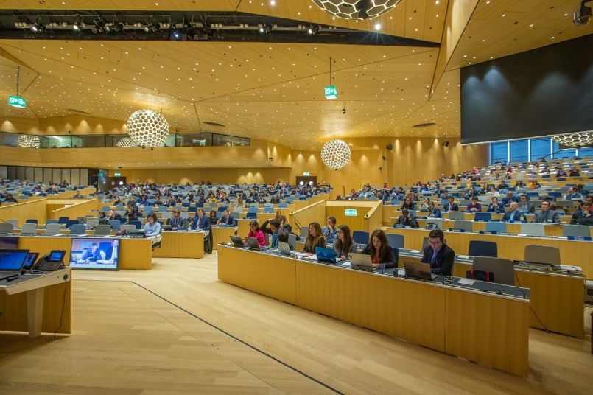
Options for protecting TK/TCEs with IP
Protection with conventional/existing IP systems
Adaptation of conventional/existing IP systems
Sui generis protection

Slide 12
What are IP rights useful for?
Defensive protection
Prevent third party uses
Prevent third party gaining IP rights over TK/TCEs
Positive protection
Proactive use of IP rights

Slide 13
Copyright
Key features
Idea/expression
No protection for style
Limitations
Originality
Authorship
Term of protection
Fixation
Protection of contemporary TCEs

Slide 14
Trade marks
Key features
First come first served
Preventing offensive and deceptive marks
Use as a distinctive tool – marketing tool
May be licensed

Slide 15
Collective and certification marks
Distinctive signs
Allow for collective use
Can certify some characteristics of the goods
Geographical origin
Authenticity
Possibility of joint marketing campaigns
Need for education/awareness-raising
Enable consumer recognition and customer loyalty

Slide 16
Geographical indications
Indication used on products
specific geographical origin
qualities, characteristics or a reputation
Collective use
Can help preserve traditional ways
TK as such not protected
Premium price
Heavier implementation

Slide 17
Designs
Key features
Protects aesthetic elements of a products
“The look and feel”
2D or 3D
Shape or designs

Slide 18
Patents
Key elements
Novelty, inventive step, industrial application
Defensive element – preventing the grant of erroneous patents
Positive element – encouraging TK-based innovation

Slide 19
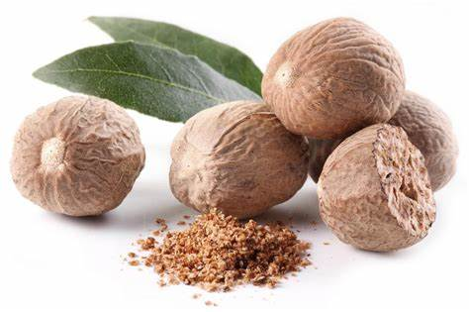
Nutmeg used since ancient times in India for oral diseases
Patent filed for “oral compositions containing extracts of nutmeg and related methods”
EPO prior art search found references in Indian TK digital library
Invention did not meet requirements of inventive step
Rejected

Slide 20
Collaborations
Confidentiality
What kind of output could result in IP rights?
Will those have sufficient commercial value to justify the expense of seeking IP protection?
Who will apply for the IP rights?
Who will own the IP rights?
How will the benefits be shared?

Slide 22
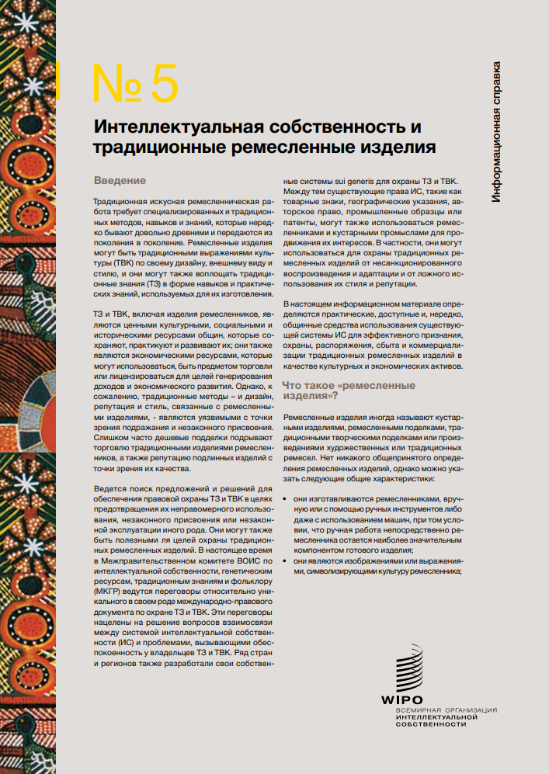

Slide 23
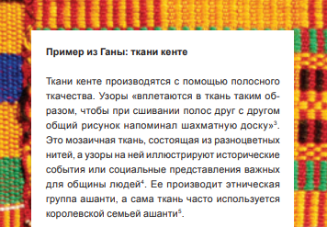
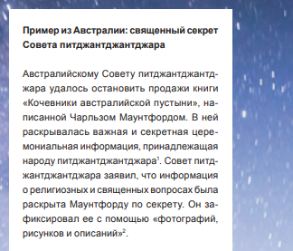
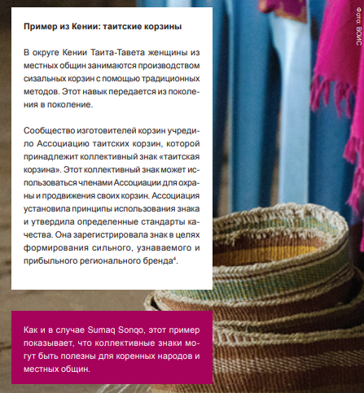
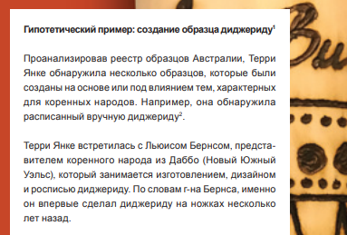
Geographical indications
Copyright
Trade secrets
Collective marks
Industrial designs

Slide 24
Thank you!
Daphne.Zografos@wipo.int
grtkf@wipo.int

