Slide 1
Putting in Place a Trade Secret Protection Program in an SME
WIPO-ARIPO Sub-Regional Training of Trainers Program on Effective IP Asset Management by SMEs
Harare
November 26 to 28, 2014
Mrs. Lien Verbauwhede Koglin
Senior Program Officer, Innovation Division, SMEs Section, WIPO

Slide 2
INTRODUCTION
Notes:
2

Slide 3
What are TS ?
Definition:
Any business information that
has an economic value
is not generally known or easily accessible
is kept confidential through proper measures (reasonable steps)

Slide 4
What are TS ?
Idea:
By keeping valuable info secret, prevent competitors from learning about and using it and thereby enjoy a competitive advantage in the marketplace.

Slide 5
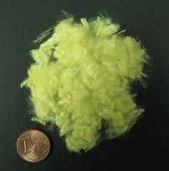
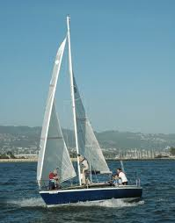
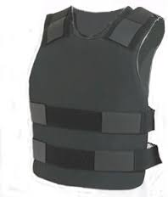
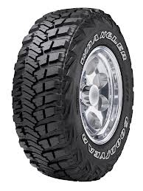
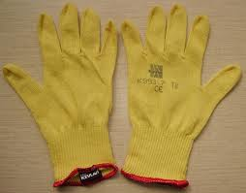
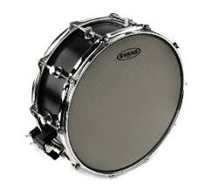
A Story… DuPont vs Kolon Industries
DuPont’s core patents on Kevlar (para-aramid fiber) expired.
DuPont developed trade secret (TS) estate over 40 years on application development and process improvement.
Kolon and several of its executives and employees have been indicted for allegedly engaging in a multi-year campaign to steal TS related to DuPont’s Kevlar para-aramid fiber.

Slide 6
DuPont vs Kolon Industries
The trade secrets at stake ?
details about DuPont’s manufacturing processes for Kevlar
experiment results
blueprints and designs
prices paid to suppliers
new fiber technology
breakdown of DuPont’s capabilities and costs for the full line of its Kevlar products
customer pricing information
analyses of market trends
strategies for specific Kevlar submarkets

Slide 7
DuPont vs Kolon Industries
The remedies?
The Court ordered Kolon to not produce, market or sell any para-aramid fiber products, worldwide, for 20 years.
Permanently enjoined Kolon from using any of the TS it stole from DuPont.
Pay US$ 920 million damages.

Slide 8
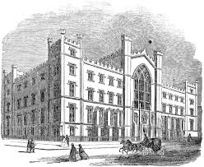
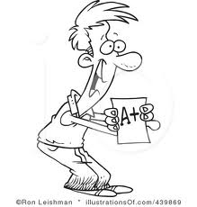
Another Story… University v Pharma company
Colombian University: cancer medicine, effectiveness verified in laboratory of 89 %.
R&D: 7 years and 4 million USD.
Project leader created virtual platform of investigation to which the investigators had unlimited access.
During investigation phase: conversations with PLUS LAB, a pharmaceutical multinational (LA), interested in the commercialization of the medicine. Invited to discuss.
Student Hugo received PLUS LAB. Hugo supported University, knew in detail the compounds, the dynamics and the scope of the medicine, but had no contractual tie.

Slide 9
3m later: “Medicine doesn’t fulfill quality test”
1y later: University attends medical congress: PLUS RESEARCH (daughter cy) presents new compound for eradication of cancer. Director is … Hugo!
Same development, but effectiveness 95%.
Already commercialized in 25 countries in Europe and North America. Sales over billion USD, 7 PCT filings, several publications.

Slide 10
TRADE SECRETS
FROM AN
ECONOMIC PERSPECTIVE

Slide 11
Trade Secrets - The facts
Information & know-how = primary business asset of this century.
For vast number of businesses: most valuable IP asset
USA, NSF Survey, 2012: TM and TS identified by the largest number of businesses as important forms of IP.
EU, Study on TS and confidential business information in the internal market, 2012: Secrecy appears to be much more heavily employed across most industries than previously.

Slide 12
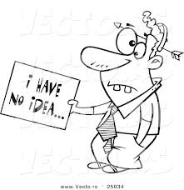
The Facts
Few recognize that vast majority of information assets are protected exclusively by trade secret law.
Lack of awareness
Traditional approach of IP (unrecognized)
No harmonization: no consensus on definition, protection, etc.

Slide 13
The Facts
While the information economy has made TS more important, it has also made them more likely to be lost or stolen.
WHY?

Slide 14
A Growing Problem – Why Does it Occur?
Way we do business today: global marketplace, increased use of contractors, temporary workers, out-sourcing
Declining employee loyalty: more job changes
Organized crime: discovered the money to be made in stealing high tech IP
Storage facilities: external memories, keys
Notes:
14

Slide 15
Why Do/Should SMEs Protect TS?
Competitive advantage
Future use of other, potentially more effective, IP rights
Extra income
Remain ready for commerial opportunities
Easy form of IP protection
Open innovation, networked innovation

Slide 16
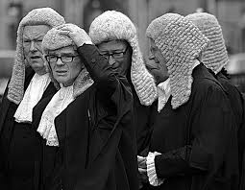
TRADE SECRETS
FROM A
LEGAL PERSPECTIVE

Slide 17
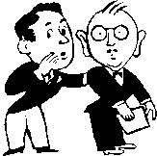
What Types of Information can Qualify as a TS ?

Slide 18
A gigantic amount !
Not limited to technical items
Need not to be particularly inventive or novel (mundane things can qualify)
You may have spent little or no money or effort to obtain the information

Slide 19
TRADE SECRET
Financial Information
Technical & Scientific Information
Commercial Information
Strategy Information

Slide 20
Examples
Technical and Scientific Information
Manufacture Information
production methods, processes, formulas, tolerances, technological know-how (e.g. weaving technique, process to treat metal)
raw materials, specialized machinery
Quality Control Methods
Product Information
technical composition of a product
technical data about product performance
service/maintenance manuals
status of products under development

Slide 21
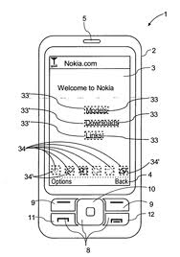
Drawings, designs, patterns, prototypes
Computer technology
hardware + software (esp. source code)
algorithms, formulas, data flow charts, circuitry
software design documents
Laboratory notebooks and invention disclosure reports
Pending patents or applications
Negative Know-How (e.g. dead-ends in research)

Slide 22
Examples
Strategy Information
Business, Marketing, Advertising and Investment Strategies
Business Methods that confer a particular advantage
Market Research & Competitive Intelligence Reports
Agreements

Slide 23
Examples
Financial information
Financial projections
Cost & pricing information
Sales data, price lists
Internal cost structure
Salary and compensation plans

Slide 24
Examples
Commercial information
Supplier information
Customer information
Personnel information
Contract terms
Databases
Sales methods

Slide 25
Three Essential Legal Requirements:
The information must be secret
It must have commercial value because it’s secret
Owner must have taken reasonable steps to keep it secret

Slide 26
BUSINESS
LAW
Automatic
Potentially forever
Only if treated as confidential
Remedies, but TS status can be lost
No monopoly
Do-it-yourself form of IP
Prevention is better than cure!
In-bound and out-bound protection

Slide 27
No monopoly:
Independent development
Reverse engineering

Slide 28
No Monopoly: Independent Development
Company Lien | Company Chander
Database. Compares different brands of chocolate advertising and resulting annual sales. | Independently creates similar database.
TS. Used to determine how to allocate advertising budget. | Publishes in business book.

Slide 29
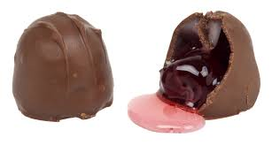
No Monopoly: Reverse Engineering
Company Lien | Company Chander
Creates new chocolate with a taste of cigarettes and gasoline. | Buys Lien’s chocolate. One of his chemists examines the product, learns its formula and constituents and produces similar chocolate under his own trademark.
The formula of the chocolate is a trade secret. | The formula is no longer a trade secret.

Slide 30
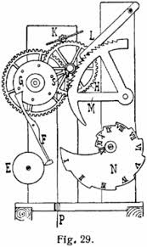
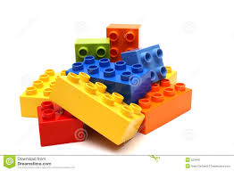
No monopoly:
Result: Often limited protection for features of innovative products after the product is put on the market (if the protected features are apparent from the marketed product)
Lego
Cuckoo clock

Slide 31
TS in a Nutshell
- Wide category
- No disclosure
- No fee
- Immediate protection
- Potentially forever
SMEs: non-incremental + cost
- Confidentiality measures
- No monopoly
- Danger of leakage
- No harmonization
- Enforcement difficult ?

Slide 32
Legal Protection in ARIPO
????
Paris Convention (art 10bis) + TRIPs (art 39)
Unfair competition

Slide 33
TRADE SECRETS
FROM A
PRACTICAL PERSPECTIVE

Slide 34
1. Identify and Document Trade Secrets
Accurate record keeping is important
May be of extreme use in case of litigation

Slide 35
2. Develop a Protection Policy
Advantages of a written policy:
Clarity (how to identify and protect)
How to reveal (in-house or to outsiders)
Demonstrates commitment to protection → important in litigation

Slide 36
Educate and train:
Clear communication and repetition
Copy of policy, intranet, periodic training & audit, etc.
Make known that disclosure of a TS may result in termination and/or legal action
Monitor compliance, prosecute violators

Slide 37
3. Restrict Access
to only those persons having a
need to know
the information
→ computer system should limit each
employee’s access to data actually
utilized or needed for a transaction

Slide 38
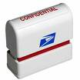
4. Mark Documents
Help employees recognize TS
→ prevents inadvertent disclosure
paper based
electronic (e.g. ‘confidential’ button on standard email screen)

Slide 39
5. Physically Protect
Separate locked depository
Authorization
Access control
log of access: person, document reviewed
biometric palm readers
Surveillance of depository/company premises
guards, surveillance cameras
Shredding

Slide 40
6. Restrict Public Access to Facilities
Log and visitor’s pass
Accompany visitor
Sometimes NDA/CA
Visible to anyone walking through a company’s premises
type of machinery, layout, designs, physical handling of work in progress, etc

Slide 41
7. Maintain Computer Secrecy
Secure online transactions, intranet, website
Password
Mark confidential or secret (legend pop, or before and after sensitive information)
Lock up: computer tapes, discs, other storage media
Firewalls; anti-virus software; encryption
TS protection in the cloud

Slide 42
8. Measures for Third Parties
Consultants, financial advisors, computer programmers, website host, designers, subcontractors, joint ventures, etc.
Confidentiality agreement, NDA
Limit access on need-to-know basis

Slide 43
9. Measures for Employees
1. New employees
Brief on protection expectations early
Obligations towards former employer!
Assign all rights to inventions developed in the course of employment
NDA/CA
Non-compete provision
Requirements
Limits

Slide 44
Non-Competition Clauses in Labor Contracts
After employee leaves prior employer:
May he work for competitor?
May he work in related job?
May he open a competing business?
Is a covenant not to compete enforceable?

Slide 45
Some jurisdictions: NC covenant binding if ‘reasonable’
limited in time
limited in area
limited in type of industry
special compensation to be paid to employee for his obligation not to compete
Some jurisdictions: in writing + payment

Slide 46
2. Current employees
Prevent inadvertent disclosure (ignorance)
Train and educate
NDA for particular task
3. Departing employees
exit interview
letter to new employer
treat fairly & compensate reasonably for patent work

Slide 47
TRADE SECRETS FOR BUSINESSES CONCLUSIONS

Slide 48
(1) TS Protection for Financial, Commercial and Technical Information :
develop effective internal TS program to maintain trade secret status
restrict access
impose obligation of confidentiality to anyone who has access

Slide 49
(2) Certain Aspects of Business/Products Cannot Be Maintained as a TS :
information or technology which is part of a product sold to the public and can be reverse-engineered
mass-marketed technology or products
where competition is so intense, that very likely to be independently developed by others within short time
if great deal of personnel movement between competitors

Slide 50
Putting in Place a Trade Secret Protection Program in an SME
Thank You!
lien.verbauwhede@wipo.int
www.wipo.int/sme

Slide 51
Trade Secret
No registration
- less costs (but measures)
- immediate
Can last longer
- but: uncertain (leak out)
- but: cannot be widely licensed
Patent
Registration
- fees (+ translation)
- takes time
Limited in time
- generally, 20y max
- geographic
No public disclosure
- but: practical need to disclose
- if leak: TS lost
Public disclosure
- publ. 18m after filing
- if P not allowed: no TS

Slide 52
Trade Secret
Large subject matter
Only protection against improper acquirement/use
- Independent discovery
- Reverse engineering
Patent
Limited subject matter
- Reqs: new, non obvious, useful
- Scope: patent claim
Exclusive rights
- but: inventing around
More difficult to enforce
- Patchwork of laws
- TS during litigation
- Good faith 3d party
- Proof misappropriation
“Power Tool”
- but: infringement sometimes difficult to determine
- but: cost of defending patent
- but: can be invalidated
Investors like to see patent portfolios

Slide 53
Trade Secret
Patent impossible or narrow
- Invention does not meet requirements for patent protection
- Incremental inventions
- Easy to invent around
To avoid disclosure
- Patent may provide competitors with ideas for further R&D
Patent
Likely reverse engineering
E.g. structural inventions related to an engine
Likely independent development
Secrecy difficult
- many persons need to know
- employee mobility
- costly security measures
Short market life
- Computer software
- Designer fashion
“”
-
Business lacks capital to take invention to market
- TS at risk if licensed out or disclosed to investors
- In some industries, patents are necessary to secure venture capital
Business lacks capital to pay patent costs and invention has only modest economic value

Slide 54
Trade Secret
If invention cannot be learnt from the product sold
E.g. methods of manufacturing
E.g. physical process to manufacture a certain chemical substance (temperature, pressure)
To avoid disclosure
- Patent may provide competitors with ideas for further R&D
Patent
Likely reverse engineering
Likely independent development
Secrecy difficult
- many persons need to know
- employee mobility
- costly security measures
Short market life
- Computer software
- Designer fashion
“blabla”
-
Business lacks capital to take invention to market
- TS at risk if licensed out or disclosed to investors
- In some industries, patents are necessary to secure venture capital
Business lacks capital to pay patent costs and invention has only modest economic value

Slide 55
Alternatives to TS and Patent
Documentation | Hidden Publication
Written Similar to patent specification Describe the character and essence of the invention, name of inventors, date, etc | Publication at remote place and manner (newspaper, magazine, etc) Must satisfy the requirements of creating printed state of the art in the sense of general P laws But not creating a too big risk that it is really read by the persons interested in the technology
Third party can patent, but TS owner may still keep certain rights | Third party cannot patent

