Slide 1
The INN Programme and the INN Global Hub

Slide 2
IT'S THE CORE OF WHO'S CORE BUSINESS
The Constitution requires WHO “to develop, establish and promote international standards with respect to biological and pharmaceutical products”.
This has been done for more than 60 years now
The norms and standards are established by Expert Committees

Slide 3

WHAT IS A WHO EXPERT COMMITTEE?
Official Advisory Body to Director-General of WHO
Established by World Health Assembly or Executive Board
  WHO Expert Group on International Nonproprietary Names (INN)
Secretary: Dr Raffaella Balocco
  WHO Expert Committee on Specifications for Pharmaceutical Preparations Secretary: Dr Sabine Kopp
  WHO Expert Committee on Biological Standardization
  Secretary: Dr David Wood

Slide 4
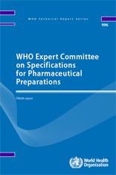
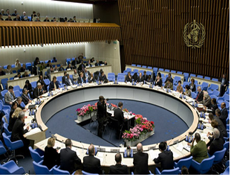
LINK WITH WHO GOVERNING BODIES
WHO Expert Committee reports are presented to the Executive Board

Slide 5
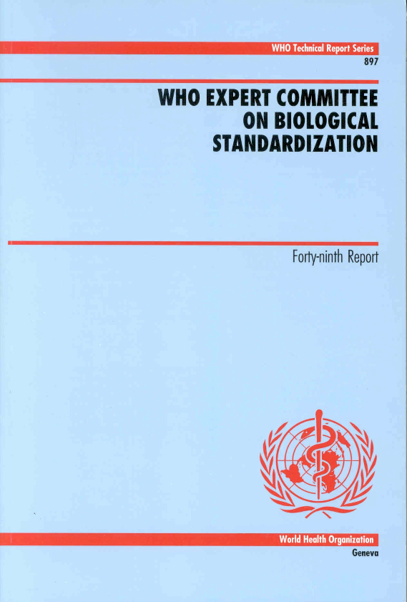

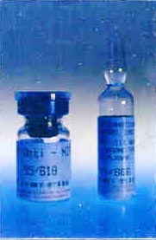
WHO GLOBAL STANDARDS AND NORMS
– ROBUST, DURABLE and RESPONSIVE TO PUBLIC HEALTH NEEDS
Global written standards
Global measurement standards
Tools for product development,
licensing and lot release
INNs
A single name for a substance for use globally
Tools for appropriate regulation
of quality, safety and efficacy
sofosbuvir
now in Essential Medicines List to treat

Slide 6

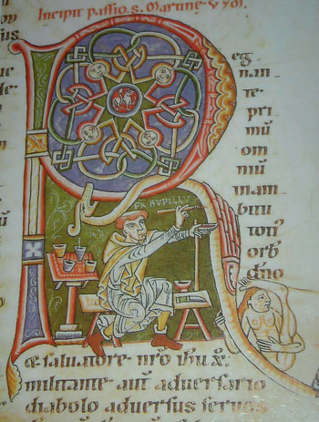
WHAT'S IN A NAME?
Safety
Letters?
Efficacy
Quality
Images?
Procurement
Information
Rational use
Regulation

Slide 7



INNs
galidesivir
Ebola
sofosbuvir
(now in EML)
Hepatitis C
Monoclonal Antibodies
        trastuzumab emtansine
        FDA ado-trastuzumab

Slide 8
INNs
Unique name
Distinctive in sound and spelling
Not liable to confusion with other names in common use
Formally placed by WHO in the public domain
Can be used without any restriction to identify pharmaceutical substances

Slide 9
Protection
WHA46.19 requests Member States:
1) to enact rules and regulations, as necessary to ensure that INNs used in the labelling and advertising of pharmaceutical products are always displayed prominently;
2) to encourage manufacturers to rely on their corporate name and the INNs, rather than on trade-marks, to promote and market multisource products introduced after patent expiration;
3) to develop policy guidelines on the use and protection of INNs, and discourage the use of names derived from INNs, and particularly names including established INN stems as trade-marks.

Slide 10
INN Protection
INNs have to be distinctive in sound and spelling, and should not be liable to confusion with other names in common use….they are formally placed by WHO in the public domain
INN Leaflet for TM departments.

Slide 11
Reaching the world
Circular letter
Publications (INN Lists, Cumulative List, Stem Book, etc)
Mednet
WHO Global Data Hub
Mobile application (under development)

Slide 12
Publications
Lists of proposed and recommended INN (WHO DI and Web)
Cumulative List of INN (Cd-Rom)
Stem book "The use of stems in the selection of INN for pharmaceutical substances"
Radical book "Names for radicals, groups & others, comprehensive list"
Other....

Slide 13
Publications – in practice
(-)-6(2amino-phenylacetamido)-3,3-demethyl-7-oxo-4-thia-1-azabicyclo
[3.2.0]heptane-2-carboxylic acid
ampicillin
[3^{B}-L-lysine,29^{B}-L-glutamic acid]insulin (human)
insulin glulisine

Slide 14
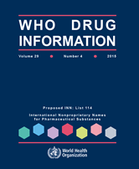
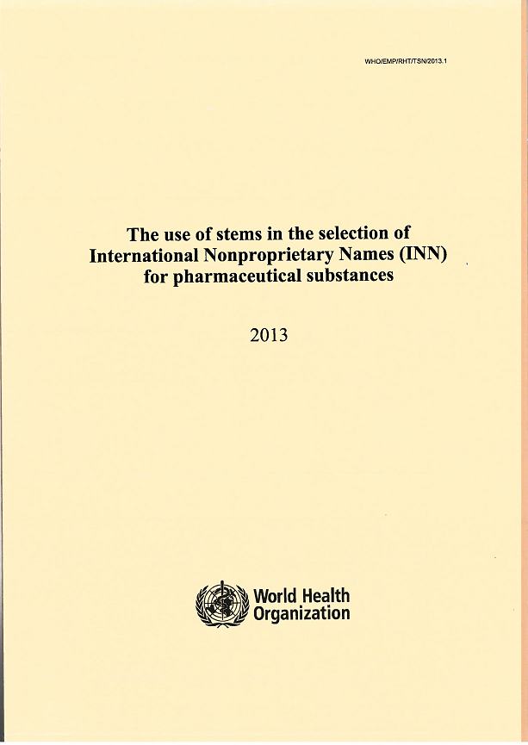
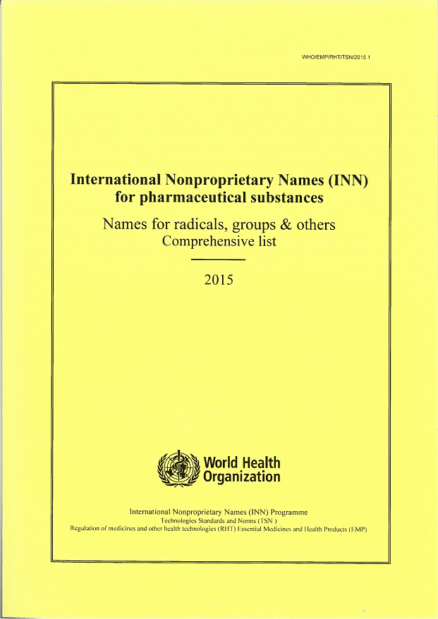
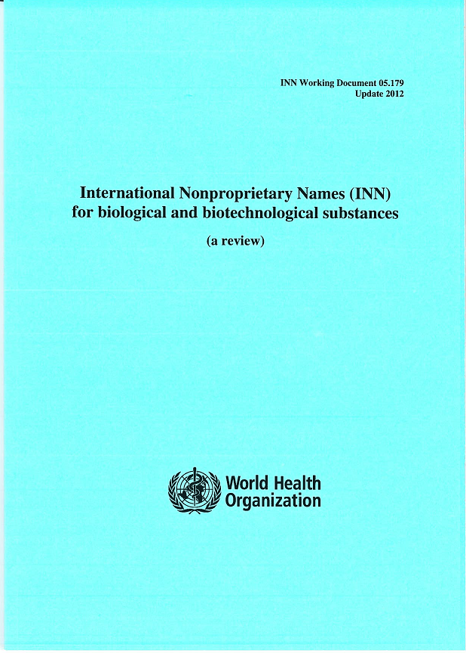
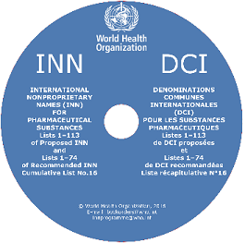
Publications - covers

Slide 15
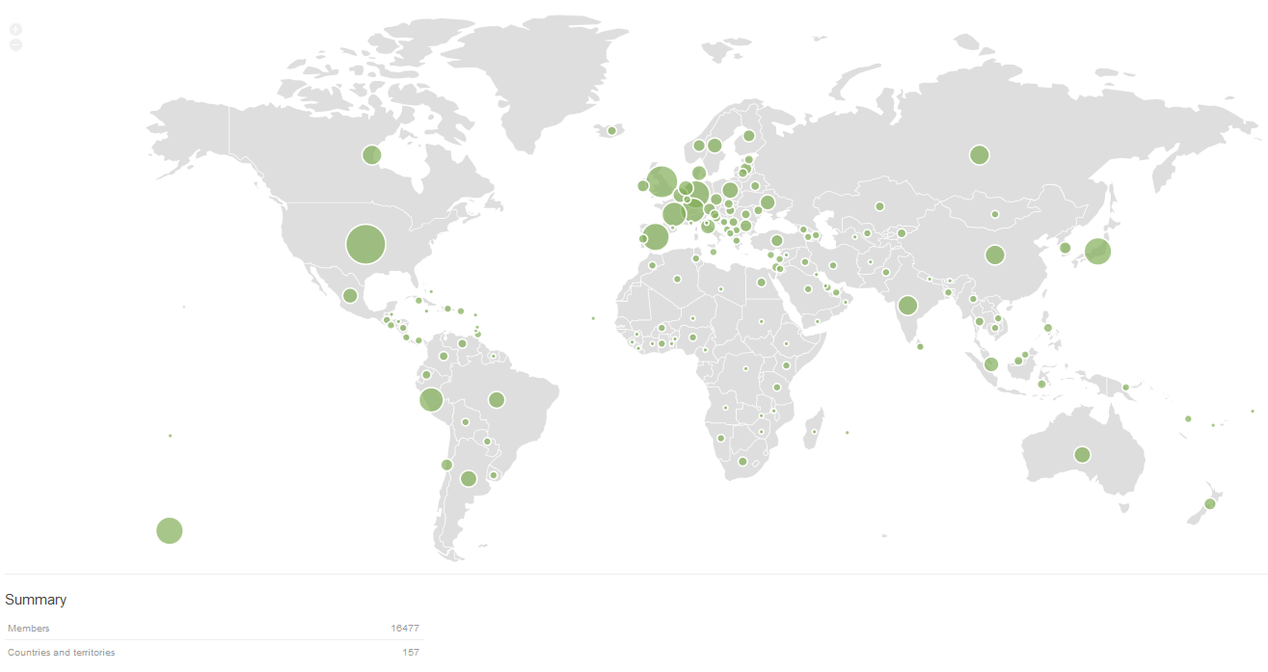
Mednet members

Slide 16
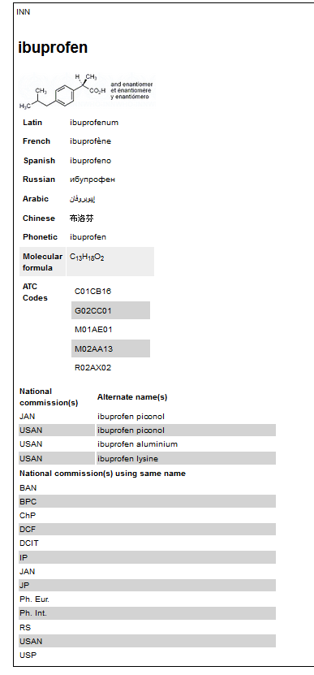
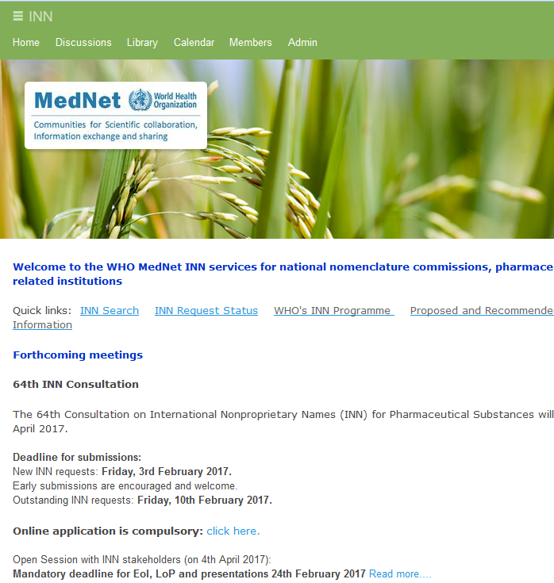
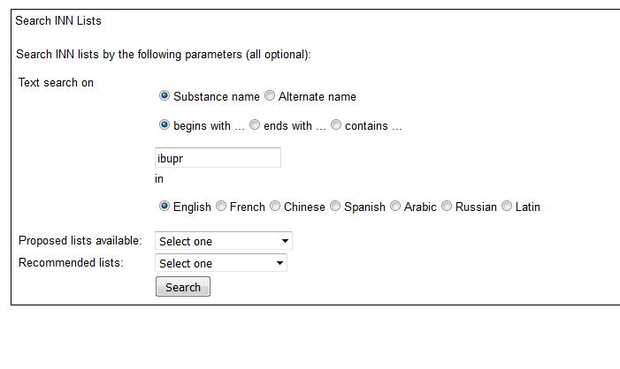
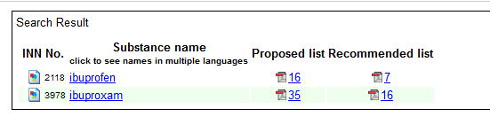
Mednet

Slide 17









INN Challenge: collaborative network… …for a global data hub
WIPO
FDA
USP
DRAs
IMGT
INN
SIB-University of Geneva
BPh
AFSAPS
VIDAL
Trademark Dep
Software Company
Pharmaceutical Industry

Slide 18


INN global data hub…interface
INN

Slide 19
IT technical specifications
Common Structure (XML Schema)
Web service interface (INN protocol)
Java script on the client/server side
Access control

Slide 20
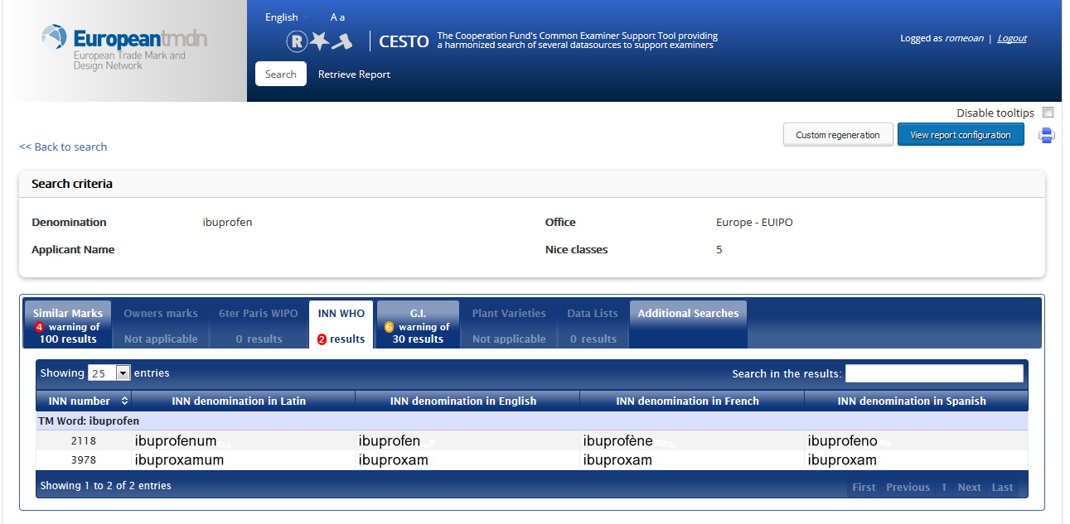
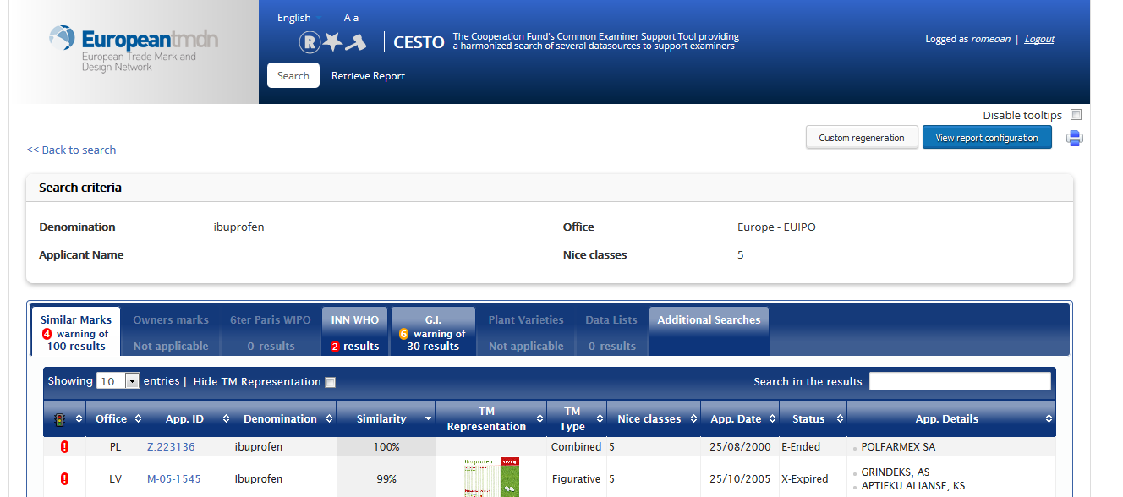
INN Global Data Hub: Examples

Slide 21

News: School of INN
School of INN

Slide 22
INN Links
http://www.who.int/medicines/services/inn/en/index.html
http://mednet.who.int/
https://extranet.who.int/tools/inn_global_data_hub/
innprogramme@who.int

