Slide 1

Incentives (other than Fee Reductions) to Encourage Patenting from
Universities – developing country experience
Prof. Dr. Fazilet Vardar Sukan
Director of SUNUM
Sabanci University Nanotechnology Research Center, Istanbul, Turkey
Vice-President of USIMP
Workshop on PCT Fee Reductions for Universities, World Intellectual Property Organization, Geneva, June 18, 2018

Slide 2
A short Introduction
An academician of 35 years with experience in R&D&I arena and University administration.
Currently,
Director of SUNUM Sabanci University Nanotechnology Research Center (2017 - )
Vice-President of USIMP –University Industry Collaborations Platform of Turkey (2008 - ), Representative of USIMP on International Platforms
Representative in international organisations (ASTP, ATTP, AUTM, EuKTS, EPO Academy)
RTTP-Registered Technology Transfer Professional -2016
EuKTS Grandfather certificate -2016
Previously,
Director of Ege University Technology Transfer Office EBILTEM-TTO (1998-2017)
Vice-President of Ege University Technopark Executive Board (2015-2018)
Founding Head of Department of Bioengineering (2000-2017)
National Coordinator for the EPO Project «The Dissemination of IP Knowledge in Universities» (2011-2012)

Slide 3
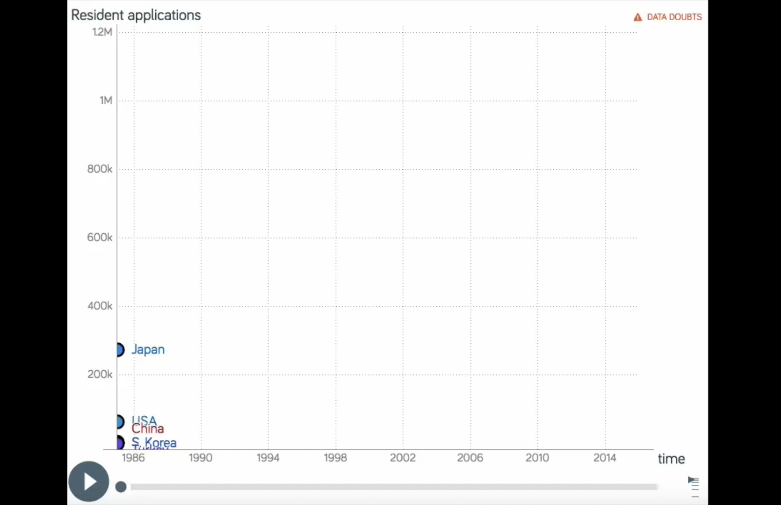
Resident patent applications between 1985-2016

Slide 4
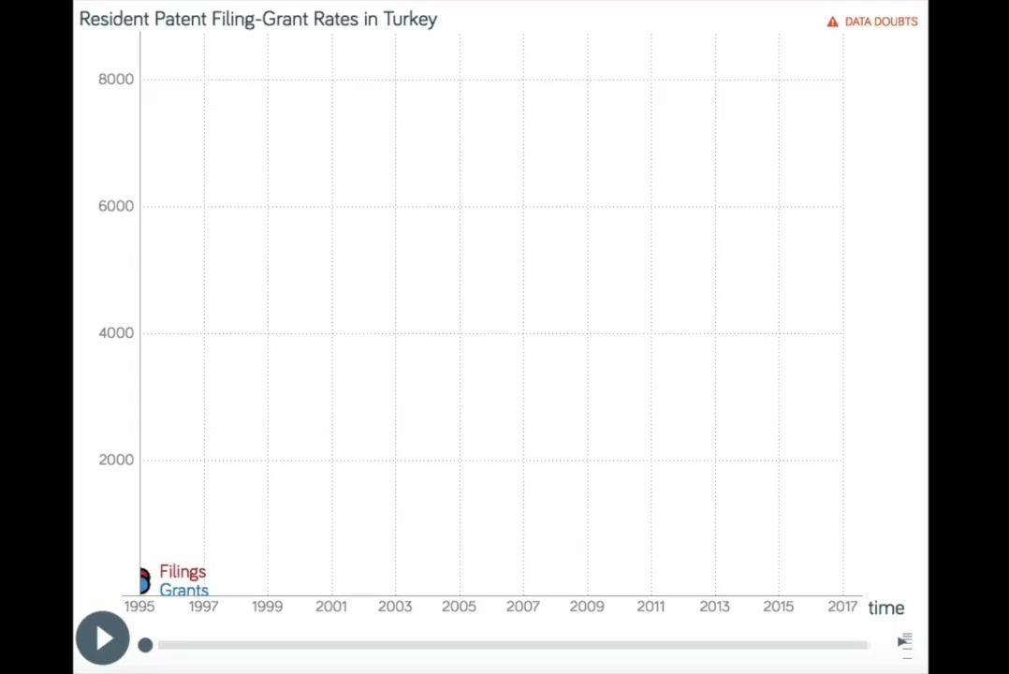
Resident patent applications and grants in Turkey between 1995-2017

Slide 5
PATENTS…
… are one of the Innovative Outputs of Knowledge-based societies;
together with trademarks, registered designs and scientific publications as well as material transfer agreements and business method patents.
…REQUIRE ECOSYSTEMS
FACILITATING, ENCOURAGING & AWARDING
FREE THINKING AND CREATIVITY…

Slide 6
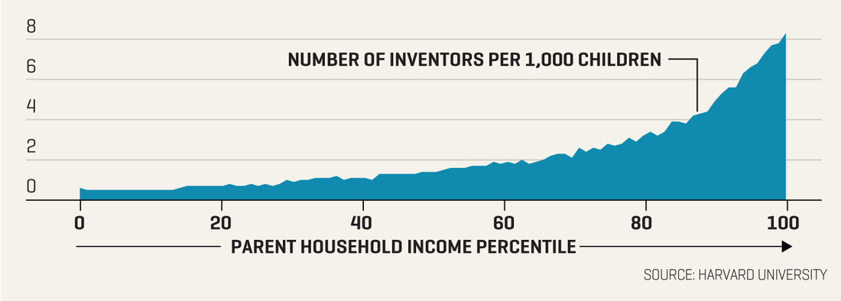
CREATIVITY vs ECONOMIC STATUS
A Study conducted by Harvard University (WORLD ECONOMIC FORUM -wef.ch/2Jz3SnG )
Children from the top 1% of household incomes were found to be 10 times as likely to become inventors when they grew up as their middle- and low-income peers.
White children were three times as likely as black children, and girls go on to hold just 18% of patents in the U.S.
Having a mentor or a role model that’s in some sense similar to you is important.”

Slide 7
CREATIVITY IN HIGHER EDUCATION
Creative Institutions: structures and leadership with future orientation, actively seek to influence future developments, rather than be grounded in the past or simply react to external pressures
Diversity
human potential
Creative Environments: Cities, regions, NGOs and governments
Creative partnerships: Diversity in HEIs and external stakeholders
Creative learners: Innovation in teaching and learning- human potential

Slide 8
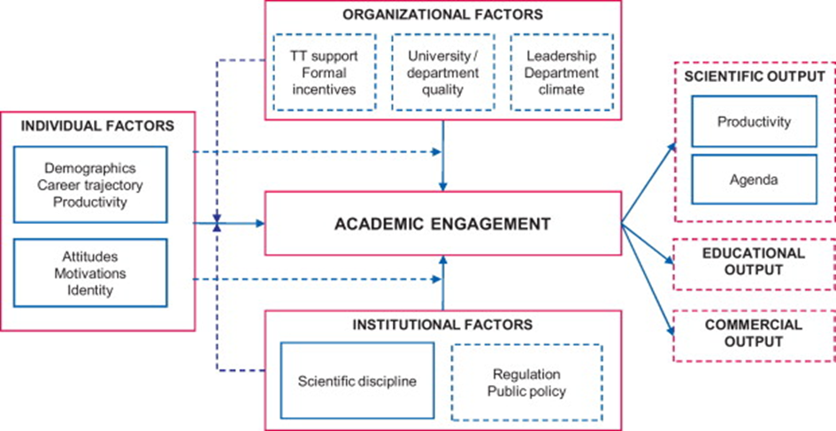
Factors for Academic Engagement
SOCIETAL IMPACT
Perkman et al. (2013) http://www.sciencedirect.com/science/article/pii/S0048733312002235

Slide 9
Creating a Societal Impact from Research Results-
Path from knowledge to market
RESEARCHER & RESEARCH
SMEs or Large Companies
Academic Engagement
SMEs or Large Companies
Contract Research
(Tailor made Licensing)
Disclosure & Assessment
Consultancy,
Collaborative projects
(to gain technology-market fit experience)
Protection or Open Source
Exploitation or Transfer
Licensing to Existing Companies
Creation of a Start-up
COMMERCIALISATION
SME Innovation Management Capacity
IPR,
Market Intelligence, Commercialisation potential,
Team

Slide 10
Turkish Universities
Total of 204 Universities spread out to 814.578 km2
Researchers – approximately 80,000
State Universities: 60,384 ( 21,205 Female – 39,179 Male)
18,920 Professors, 13,091 Associate Professors , 28,373 Assistant Professors
Private Universities :12,314 (4,905 Female – 8,354 Male )
3,487 Professors, 1,927 Associate Professors , 6900 Assistant Professors
128 Patent Information Centres of TURKPATENT active - 72 at universities

Slide 11
INHERENT WEAKNESSES
in Turkish HE System for a Culture of Creativity
One-size fits all concept
Questionable institutional autonomy
Rigid institutional structures restricting initiative taking
Limited interdisciplinarity and institutional cooperation
Lack of an innovation-friendly human resource policy
Permanent positions as civil servants and promotions not strictly based on performance
Over-extended teaching load
Limited cross-fertilisation for research and economic output
THUS LIMITED SOCIETAL IMPACT…

Slide 12
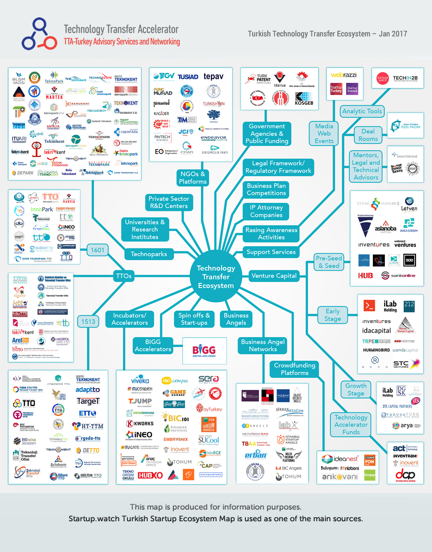
TECHNOLOGY TRANSFER ECOSYSTEM

Slide 13
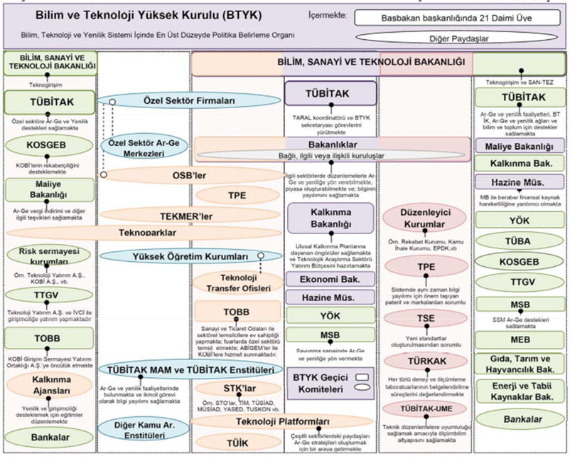
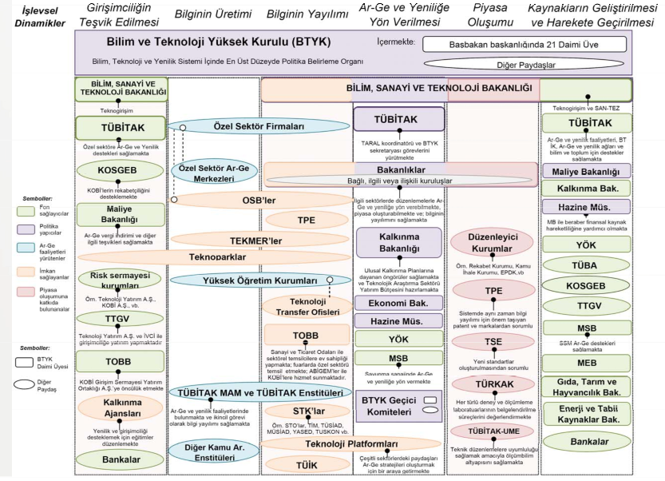
The Public R&D&I Ecosystem
Encouraging Enrepreneurship
Knowledge Generation
Knowledge Dissemination
Focusing R&D&I Efforts
Market Development
Resource Generation and Mobilisation
Funding Agencies
Policy Makers
Implemention of R&D
Facilitators
Market Regulators

Slide 14
Universities
Need collaborations and networks to improve the R&D&I capacity and competitiveness of their clients
Partially in an ivory tower - Need realistic projects for patents with commercial value
Technoparks
Academia
Awareness
Project Development
Industrial Collaboration
Contract Research
IPR
Licensing
Entrpreneurship
Technopark Companies
Coordination and Services for R&D
Acess to Universities’ Infrastructure
Acquisitions & Mergers, Licensing
TTO’s
INDEX for UNIVERSITIES
R&D Performance
Economic Impact
IPR
Entrpreneurship
Collaborations
Industry
INDEX for TECHNOPARKs
R&D Performance
Investments
Exports
IPR
Incubator Services
Collaborations
R&D Centres
Companies
INDEX for IND. RESEARCH CENTRES
R&D Performance
Number of Projects
IPR
Collaborations
Need new ideas and approaches and Access to basic science for development of new products and processes
R&D Projects
New Technologies
New Patents

Slide 15
Outputs of Research Results
Publications | TR | World
Top 25% Impact Journals | 21 % | 44%
Second 25% | 22% | 25%
Third 25% | 23% | 18%
Lowest Impact Journals 25% | 32% | 14%
Exports (added-value) | 2000 | 2017 | Difference
High | 7.8 % | 3.8% | -4.0%
High-Medium | 20.4% | 34.2% | +14.2%
Medium-Low | 20.5% | 28.7% | +8.2%
Low | 51.3 % | 33.3% | -18.0%

Slide 16
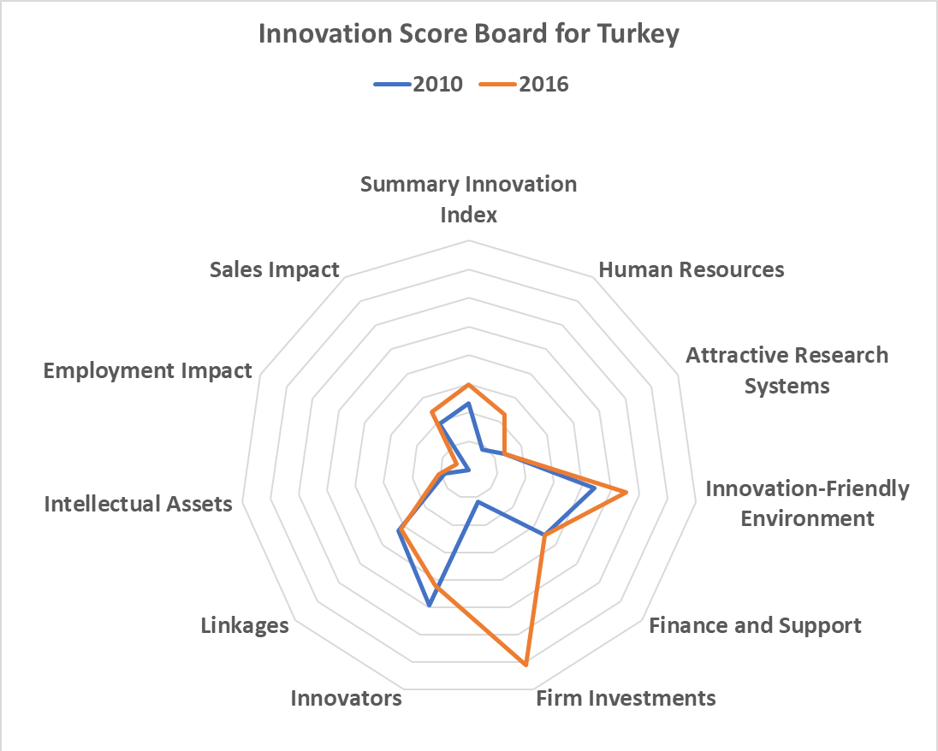
Turkey is a Moderate Innovator – performance increased by 13.2% relative that of the EU in 2010
European Innovation Scoreboard - 2016

Slide 17
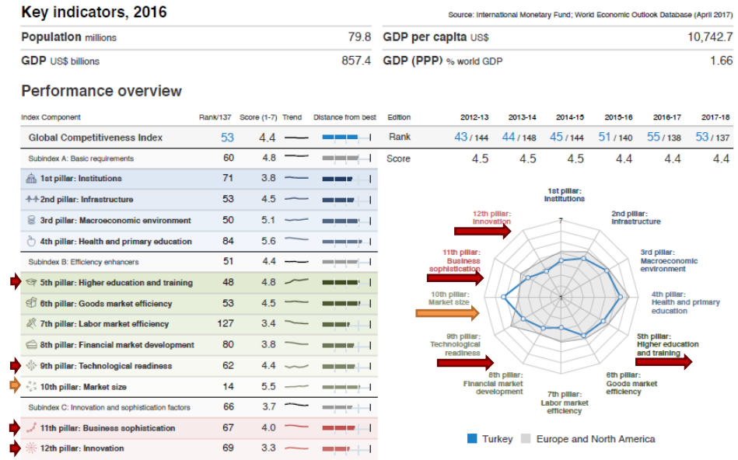
Global Competitiveness Index -2017-2018

Slide 18
Major Problems
R&D Supports lacking in thematic / sectoral / output focus
Input oriented R&D Support mechanisms not measuring outputs leading to low commercialization of R&D results,
Insufficient Supports for multi-disciplinary large projects involving cross-sectoral collaborations, thus insufficient validation for transforming prototypes into production
Lack of Multi-stage R&D supports with feedback loops facilitating the reiteration of intermediate outputs of projects
Insufficient funds available for mobilizing critical mass of qualified human resources in priority areas
Insufficient funds for early stage start-ups and lack of country and sector planning in international collaborations

Slide 19
Major Problems
Lack of a national R&D&I Strategy – no positive discrimination in R&D Supports for high technologies
A knowledge asymmetry existing between large companies and SMEs
Not enough demand from companies for science graduates or doctorates

Slide 20
Global Trends
Customer or end-user oriented R&D collaborations with special emphasis on commercialization of Research results
Distributed production and increasing specialization amongst companies highlighting local needs & expertise
High correlations between governance of companies and R&D&I inputs
Support programmes for pioneering research at frontiers of science
Specialised centres of excellence for clustering of high calibre researchers
Early-stage investments coordinated by Science parks or specialised TTOs
National sectoral focus in Strategy Documents leading to mega-projects
Pre-competitive research encouraged within collaborative networks

Slide 21
How Can University Patenting Be Encouraged?
WHAT HAS BEEN DONE SO FAR?

Slide 22
Major Laws
4691 – Techoparks, 26 June 2001.
5746 – Industrial R&D Centres, 12 March 2008
6550 – Research Infrastructures, 10 July 2014
6676 – R&D Incentives, 16 February 2016
6769 – New IPR Law, 10 January 2017
7033 – Production Package, 18 June 2017

Slide 23
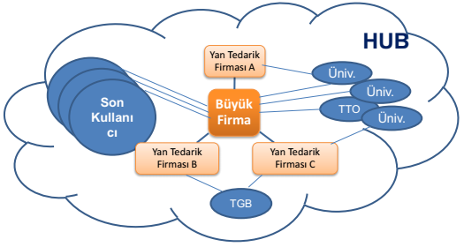
New Model for Turkey - proposed
Phase 1:
Collaborative Networks
Phase 2:
Strategic Products
Phase 3:
Industrial Innovation
Partnerships
Interface Supports
Mega R&D Supports
R&D Supports for
Networks in Priority Areas
OUTPUTS:
Product/Theme Roadmaps
Strategic Partnerships
OUTPUTS:
Strategic Products
Strategic Technologies
Sharing Knowledge/Experiences

Slide 24
The Approach
IDEA
MARKET DEMANDS
IDEA
Technology
Development
New
Product
Product
Development
Prototyping
Production
RESEARCH
SCIENCE
MARKET

Slide 25


Options for Universities
Research
Invention
Application
1
IP Commercialization
Development
and
Commercialization
IP
Process
2
Collaborative research
Industry brings funding and «real problems» to research. Research with industrial partners solves real problems and naturally leads to licensing.

Slide 26
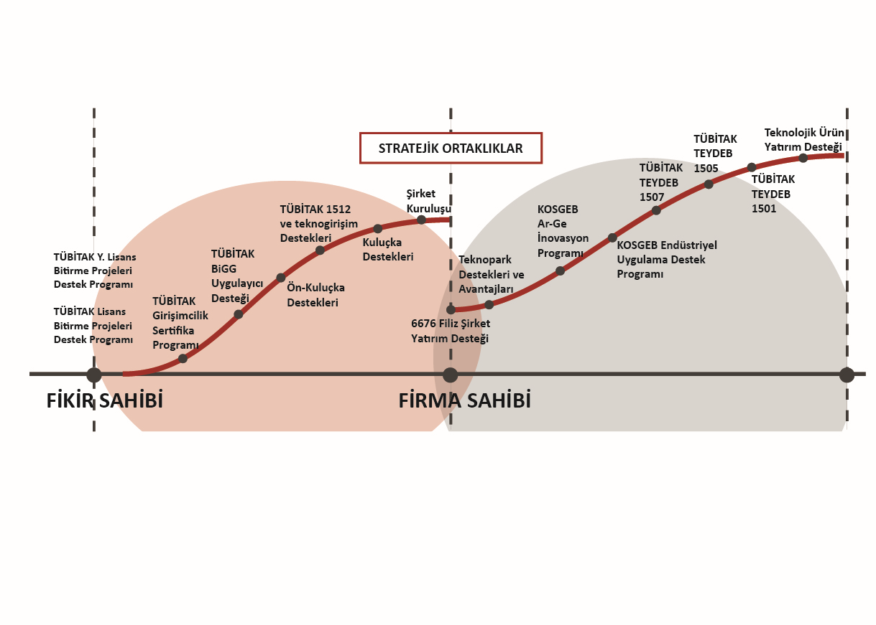
R&D SUPPORTS – Seamless Chain of Funding
Better alignment of the well-intentioned, but often separate, efforts of the many players may be necessary …

Slide 27
EPO for the Project “The Dissemination of IP Knowledge in Universities” - March 2011- December 2012
First initiation - 21 February 2008 EPO Roving workshop
Implemented in cooperation with EPO, OHIM, TURKPATENT
Goals
    Raising the current level of awareness and knowledge on IPR in Turkish Universities.
      Sharing of Best Practices, Coordination of Inter-University Communication For Building On Experiences And Supporting Excellence
      Establishment of IPR Policy and Increasing Awareness of IPR at Universities
    Integration of IP courses at different levels into university curricula
      Short Training Modules (Certificate Programmes)
      Multidisciplinary Advanced Programmes Leading to IP Specialists
    Integration of IP in knowledge transfer activities of the universities
    Establishment and improvement of IP Offices and TT Offices within the universities.
    Simplifying the Procedures for the Commercialization of Inventions Generated By Universities

Slide 28
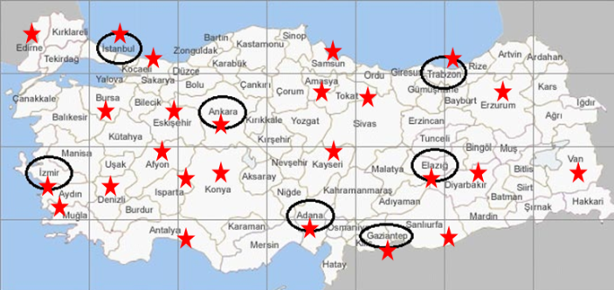
ACHIEVEMENTS
    ESTABLISHMENT OF NETWORK
    A Steering Committee chaired by the TURKPATENT President,
    40 members: 7 Regional Coordinators, 26 Representatives,
AWARENESS ACTIVITIES:
Events organized at 23 different Universities.
Presentations to University Senates, Engineering Deans’ Council
IPR awareness activities incorporated into activities organized by universities
Free seminars and certificate programs organised by different institutions,
    INSTITUTIONAL SYNERGIES CREATED:
    Liaisons with University – Industry Centers Platform (USIMP), Research based Intangible Assets Platform (ARTEV), Association of University Technology Managers (AUTM), etc

Slide 29
ACHIEVEMENTS-2
    DUE DILIGENCE SURVEY: An on-line for “Awareness of Industrial Property Rights (IPR) in the Turkish Universities”
    University Rectors mobilized, the Heads of Departments completed the survey and 2985 responses were collected (82% response rate)
    A comprehensive final report was prepared in June 2012.
TEACHING:
    Over 400 Volunteers from universities as trainers were identified in 4 regions.
    Translation of EPO teaching kit was completed
    Training programmes for trainers on IPR and Technology Transfer were organised.
PATENT APPOINTMENT SYSTEM: face-to-face appointments initiated by TURKPATENT
    ESTABLISHMENT OF TTOs: A TUBITAK initiated a special support program for the establishment of TTOs
UNIVERSITY IPR POLICIES: A sample document developed as a template

Slide 30
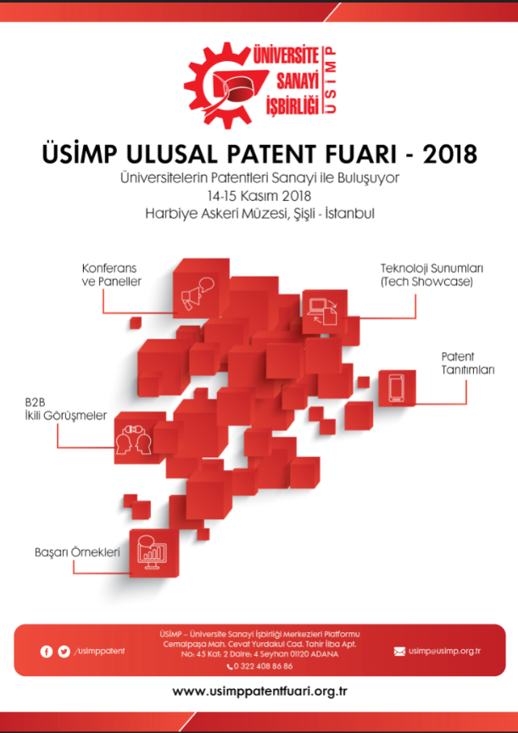
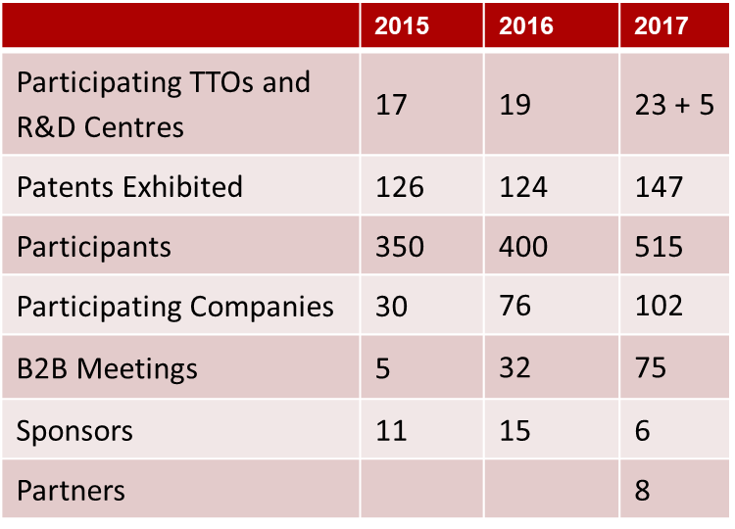
Improving the Ecosystem – USIMP National Patent Fair
In November each year since 2015…
Only University originated Patents…

Slide 31
Initiatives from TURKPATENT
In addition to numerous awareness activities and active contributions to various events…
ISIF Istanbul International Inventions Fair – Open to all
An on-line Technology Platform – announcing licensing opportunities http://www.teknolojitransferi.gov.tr/TeknolojiTransferPlatformu/
A patent Competition for University Students – “PATENTLE TÜRKİYE” – ideas with no protection ?
A Patent Valuation Platform - a possible conflict of interest ?

Slide 32
Financial Support Programmes of TUBITAK
International Patents
Support for International Patent Applications – JPO, USPTO, EPO, WIPO (PCT)
Search Reports - Invention Valuation
Support for International Examination Reports – provided the application is made to TPE
International Patent Award – individuals, universities & companies.
National Patents for:
Turkish Patent Attorneys / Turkish Patent Agents,
Search & Examination reports
Awards to patent agents & to those with patents granted

Slide 33
Patent Support Program - TUBITAK & TPI
signed a new protocol on February 08, 2018 to increase patenting activity in the country:
all the costs for international patent applications and international search reports under PCT will be funded by TUBITAK provided that Turkish applicants select TURKPATENT as International Search Authority (ISEA) and International Examination Authority (IPEA).
China and South Korea has been included among the group of countries (USA, EPO, JAPAN) where costs for patent applications filed by Turkish residents are supported.
Funds available to Turkish Patent Attorneys / Turkish Patent Agents for their professional development and supporting the inventors have been increased.

Slide 34
Outputs of Research Results
 | Rank in 2016 | Number in 2016 | Increase in the last 10 years
No of Publications | 18 | 32,000 | 2.1%
No of Publications per Million Population | 53 | 395 | -
No of Patents | 21 | 1012 | 4%
No of Patents per Million Population | 40 | 13 | -

Slide 35
Possible Reasons for Improvements
FIRST PHASE – EPO initiated Awareness project
Increase in IPR awareness within Universities / University administrations
Increasing effect of Patents on academic promotions New courses on IPR
New graduate programmes on IPR
Increase in the number of Technology Transfer Offices
SECOND PHASE – Impact of TTO’s
Improved quality of research outputs through the involvement of the end-users (companies)
Increasing trends for university-corporate collaborations leading to Joint projects and joint IP.
THIRD PHASE – New Patent Law – January 2017
At least 30% of royalties going inventors – royalty sharing incentives
Increased weight of patents in academic promotions
Commercialisation overheads- revenue creation for University administrations to be used for new inventions
Still some complications….

Slide 36
Thank you
Prof. Dr. Fazilet Vardar Sukan
Director of SUNUM
Sabanci University Nanotechnology Research Center, Istanbul, Turkey
Vice-President of USIMP
Mail: fazilet.vardar@gmail.com
Twitter: @faziletvardar
LinkedIn: /in/faziletvardarsukan/

