Slide 2
Impact of Fee Reductions on Ability of Universities to Access the Patent System – Developed Country Experience
Anne Lane
Executive Director
UCL Business PLC
18th June, 2018

Slide 3
Overview
Technology transfer in the UK
UCL Business (UCLB) - what we do, how and why
Patenting activity in UK universities

Slide 4
Technology Transfer Organisations in the UK
McMillan report (Sept 2016) definition of technology transfer (TT)
“The commercialisation of university-owned research outputs through the licensing of IPRs (patents, copyrights, know-how, databases and design rights) to existing companies and setting up new spin-out companies. These are ‘technology push’ rather than ‘market pull’ mechanisms”

Slide 5
Comparison of UK University Structures
All TT entities provide:
Identification & assessment of invention disclosures from university research
Protection of IP
Investigation of commercial landscape
Licensing
Set-up of spin-out companies and management of portfolio of investments

Slide 6
Models of Technology Transfer Support
Internal TTO
Internal TTO with external spin-out support
Wholly-owned subsidiary TTB
Part-owned subsidiary TTB
Contracted out
Shared TTO/TTB

Slide 7
Comparison of Key UK University Structures
HEI | Model
UCL* | Wholly-owned subsidiary UCL Business PLC
Cambridge* | Wholly-owned subsidiary Cambridge Enterprise LTD
Oxford* | Wholly-owned subsidiary Oxford University Innovations Ltd
Manchester* | Wholly-owned subsidiary with external spin-out support UMI Ltd
Imperial College* | Part-owned subsidiary (with separate spin-out support IP Group Ltd)
Nottingham | Internal TTO with external spin-out support
Leeds | Internal TTO with external spin-out support
King’s College* | Internal TTO with external spin-out support
* Top 6 by research grants & contracts

Slide 8
UCL – UCLB Commercialisation Environment
UCL owns employees’ intellectual property
UCL shares any revenue with employees
UCL assigns IP to UCLB if requested to by UCLB
UCLB commercialises IP
Revenue from commercialisation

Slide 9
Developing New IP from Basic Research
UCLB has 16 Business Managers and Directors covering the range of faculties and embedded into the Institutes and Departments.
The Business Managers work with academics and clinicians to identify new technologies developed at UCL.
These are evaluated for commercial potential and then patent protected or registered designs filed where appropriate.
Develop a technology to add value and make it more market ready.
UCLB invests strategically into new technologies to develop them to a stage where they can leverage larger external funding.

Slide 10
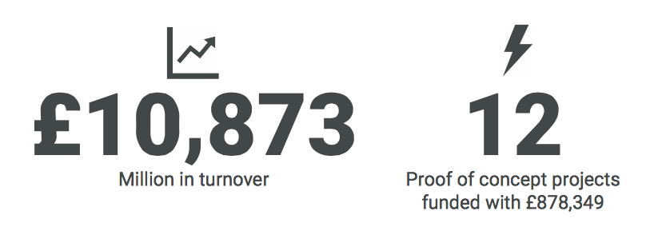
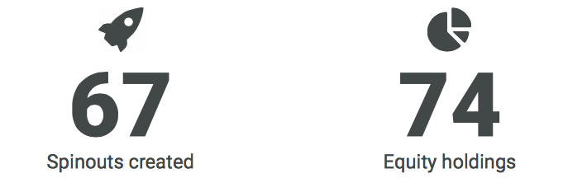
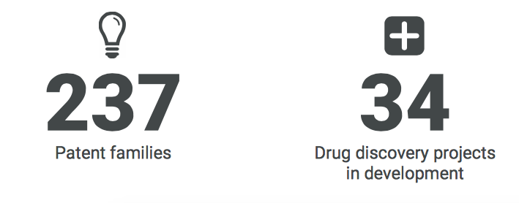

Slide 11
UCL & Top 6 HEIs
Annual patent spend (filing, prosecution & maintenance) ~ £1.5 m
5 year annual average 40 PCT applications
Annual PCT spend ~ £220k
25% reduction on filing fees for 5 applications ~ £6,875 saving*
3% overall saving on PCT spend, 0.4% overall patent spend saving
Average patent applications for top 6 HEIs 127
0.9% overall saving PCT spend (assuming all applications are PCT)
* assuming £5500/PCT

Slide 12
HE-BCI Data – Average HEI
2011-2012
Invention disclosures 27
Patent applications 14
Average PCT spend (assume 10 PCT) £55,000
Average saving 12.5%
Total patent spend saving 8%
2015-2016
Invention disclosures 34
Patent applications 16
Average PCT spend (assume 12 PCT)
Average saving 10%
Total patent spend saving 7%

Slide 13
Universities in the UK have increased their income from IP by 18.5% year on year, generating £155 million during 2014-15 (Higher Education Funding Council for England).
Universities in the UK are increasingly judged on income generated from IP rather than patent number
UK applicants filing abroad is negligible
Market size drives patenting strategy
UK government wants increased innovation from universities – R&D tax credits, Patent Box
Increasing number of other types of IPR being used by universities

Slide 14
2014 EC report almost 80% of UK universities viewed patent costs as a barrier to filing
Fee reductions at the EPO resulted in ~20% increase in patent applications in the mid-1990s (de Rassenfosse & van Pottelsberghe de la Potterie 2012)
Reducing patent fees increases number of patent applications but not levels of innovation (Nicholas 2011)
There is mixed evidence of a positive link between patenting and innovation (Hall & Harhoff, Baldrin & Levine)
PCT fee reductions would result in significant cost savings for the average UK HEI
However not clear if this would significantly increase ability to access to the patent system

Slide 15
Anne Lane
Executive Director
UCL Business PLC
The Network Building
97 Tottenham Court Road
London W1T 4TP
Tel: 020 7679 9000
Fax: 020 7679 9838
Web: www.uclb.com
Email: info@uclb.com

