Slide 1
Workshop on Erroneously-Filed Elements and Parts

Slide 2
Issues
scale of problem/experience with current divergent practices of ROs and DOs?
what would be the elements of a fair system from applicant and third party perspective?
could the underlying problem be solved by other means?

Slide 3
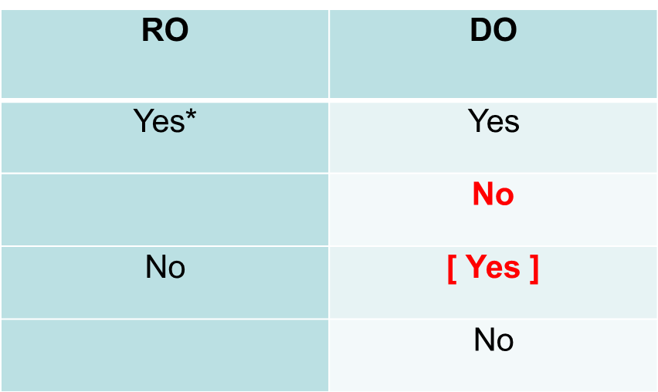
Divergent practices of ROs and DOs

Slide 4
A fair system
fairness for the applicant
rights of third parties
requirements for incorporation : Rule 20.6(b)
priority claimed on the date on which one or more elements … were first received (Rule 4.18)
“completely contained” (Rule 20.6(b))
any incorporation would be allowed prior to publication
clear indication in publication

Slide 5
A fair system
clearly exceptional and few cases: not a heavy burden for ROs and IAs
appropriate to clarify the practice of IAs during IS and IPE

Slide 6
Guidelines for Search and Examination at the EPO as PCT Authority
GL/PCT-EPO B‑III, 2.3.3 Incorporating missing parts or a missing element completely contained in the priority document
… The examiner checks whether the RO’s assessment of the "completely contained" criterion was correct (see GL/PCT-EPO H‑II, 2.2.2). If a RO has erroneously considered that the missing part(s) or the missing element were completely contained in the priority document, the search should be extended to include documents which would be relevant if the application were to be redated (such documents can be cited as "L" in the ISR).

Slide 7
Elements of the solution
include a Rule to allow correction of “erroneously filed part or parts” under clear conditions
any correction of the erroneously filed element or part should be allowed only in pre-publication phase
incorporate the “correct part” without removing the “erroneously filed part”.
the international publication should include both the incorporated part and the “erroneously filed part”
the incorporated part is to be considered for the international search

Slide 8
PCT/WG/11/21: Suggestion by EPO
amend the PCT Receiving Office Guidelines / Rule 20.5
not allow the “replacement” of the erroneous element or part but only the incorporation by reference of the correct element or part
the “incorporation by reference” only be allowed in the pre-publication phase
the International Searching Authority should be entitled to charge an additional fee if the search of the erroneous filing has already been started
clarify that the “correct” elements will be considered for the IS

Slide 9
PCT/WG/11/21: Suggestion by EPO
receiving Offices and designated Offices should be allowed to submit a notification of incompatibility where their national law does not allow the correction of erroneous filings
notification of incompatibility by a RO: Would it be possible to transmit the International Application to the IB following Rule 19.4(a)(iii)?

Slide 10
Institut der beim Europäischen Patentamt zugelassenen Vertreter Institute of Professional Representatives before the European Patent Office Institut des mandataires agréés près l'Office européen des brevets
Thank you
for your attention!

