Slide 1
PCT – Statistics
Patent Cooperation Treaty (PCT) Working Group
Seventh Session
Geneva, June 10 to 13, 2014

Slide 2
Outline
PCT International Filings
PCT National Phase Entries
Receiving Offices
International Authorities
PCT – Patent Prosecution Highway

Slide 3
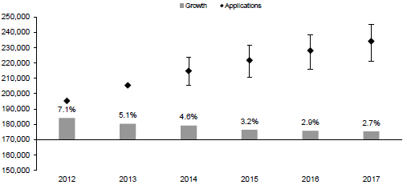
1) PCT – International Application Filings
234,200
228,100
221,700
214,800
205,373
195,320

Slide 4
Filing Trends for Top 5 Origins

Slide 5
Distribution of PCT Applicants in 2013
Top Applicants
Businesses: Panasonic Corporation – 2,839 applications published
Universities: University of California – 398 applications published
Government and Research Institutions – Commissariat à l’Energie
Atomique et aux Energies Alternatives – 419 applications published

Slide 6
Main Fields of Technology in 2013
Main Fields of Technology for PCT Applications by Percentage of Total:
  Electrical Machinery 14,897 applications (7.8%)
  Computer Technology 14,684 applications (7.7%)
  Digital Communications 14,059 applications (7.3%)
  Medical Technology 11,920 applications (6.2%)
Largest increases:
  IT methods for management: +27.2%
  Optics: +23.0%
  Computer technology: +18.0%
Decreases in 4 out of 35 fields:
  Micro-structural and nano-technology: -8.0%
  Organic fine chemistry: -3.3%
  Pharmaceuticals: -1.3%
  Basic communication process: -0.8%

Slide 7
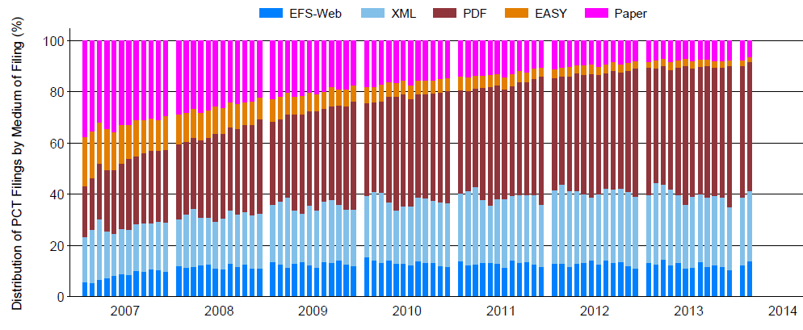
PCT Applications by Medium of Filing
Distribution in 2013: 7.6% paper, 2.8% PCT-EASY, 89.7% fully electronic
(49.9% PDF, 27.4% XML, 12.4% EFS-Web).

Slide 8
Distribution of Filing Languages in 2013
Top 10 filing languages make up 99.2% of total filings.

Slide 9
2) PCT – National Phase Entries
539,300 national phase entries estimated for 2012 (+ 6.2%)
458,800 (about 85%) of NPEs are from non-resident applications
representing 55% of all non-resident patent applications filed
worldwide in 2012.

Slide 10
Average Number of National Phase Entries (NPEs) per PCT Application for 15 Top High-Income Origins
United States of America has highest number of NPEs (146,988), followed by Japan (112,862) then Germany (59,966); all average between 3.1 and 3.3 NPEs per PCT application. Switzerland has the highest average number of NPEs per PCT application at 5.

Slide 11
Average Number of National Phase Entries (NPEs) per PCT Application for 15 Top Middle-Income Origins
Among middle-income countries, China has highest number of NPEs (16,978), followed by India (3,322), Brazil (1,167) and South Africa (934).
The top 15 middle-income countries had lower average numbers of NPEs per PCT application than their high income counterparts.

Slide 12
PCT National Phase Entries for Top 10 Offices 2012
USPTO most preferred office by National Phase Entries and had
highest growth among the top 10 Offices (+ 12.7%).

Slide 13
PCT National Phase Entries for Next 10 Offices 2012

Slide 14
3) PCT Applications by Receiving Office
Ten of the top 15 receiving Offices received more applications in 2013 than in 2012. Together, these 15 Offices received almost 96% of all applications filed in 2013.

Slide 15
PCT applications for selected receiving Offices of middle-income countries
Twelve of the above 15 receiving Offices received more PCT applications
in 2013 than in 2012.

Slide 16
Receiving Offices: Timeliness of Transmitting PCT Applications to the International Bureau
Average transmission time between the international filing date
and the date of receipt of the application from the receiving
Office was 3.3 weeks in 2013 (3.2 weeks in 2012).
86.9% of PCT applications transmitted to the IB within
4 weeks in 2012.

Slide 17
4) International Authorities
Search Reports by International Searching Authority

Slide 18
Average Timeliness in transmitting ISRs to the IB measured from Date of Receipt of Search Copy
Average timeliness in transmitting ISRs fee from 4.2 to 3.6 months between 2012 and 2013.
65% of ISRs transmitted to the IB within 3 months from date of receipt of search copy (57.8% in 2012).
77.3% of all ISRs issued within 16 months of priority date (69.9% in 2012).

Slide 19
Distribution of Supplementary International Search Reports by SISA
Supplementary International Searching Authority Year | 2010 | 2011 | 2012 | 2013
Total | 41 | 41 | 46 | 67
Austria |  | 1 | 2 | 2
European Patent Office | 3 | 7 | 21 | 30
Nordic Patent Institute | 1 |  | 3
Russian Federation | 35 | 31 | 19 | 32
Sweden | 2 | 2 |  | 3
Finland |  |  | 1

Slide 20
International Preliminary Examination Authorities
Reports produced by IPEAs fell by 6.3% from 2012 to 2013.
For 2013, 84.5% of IPRPs (Chapter II) were produced by the EPO, the JPO or the USPTO.

Slide 21
Average Timeliness in Transmitting IPRPs
Average time taken to transmit IPRPs increased from 27.6 months
in 2001 to 30.6 months in 2013. 72.8% of IPRPs transmitted within
28 months (68.4% in 2012).

Slide 22
5) PCT-Patent Prosecution Highway
6,336 PCT-PPH requests in 2013 (4,577 in 2012)
In 2013, 53 PCT-PPH pilots were active, with the participation of
24 Offices, including 14 International Authorities.

Slide 23
Further information:
2014 PCT Yearly Review
The International Patent System
(to be published soon)
2013 World Intellectual Property Indicators
WIPO Publication No:941E/2013
Statistics on the PCT System http://www.wipo.int/ipstats/en/statistics/pct/
Patent Prosecution Highway Portal Site http://www.jpo.go.jp/ppph-portal/index.htm

