Slide 1
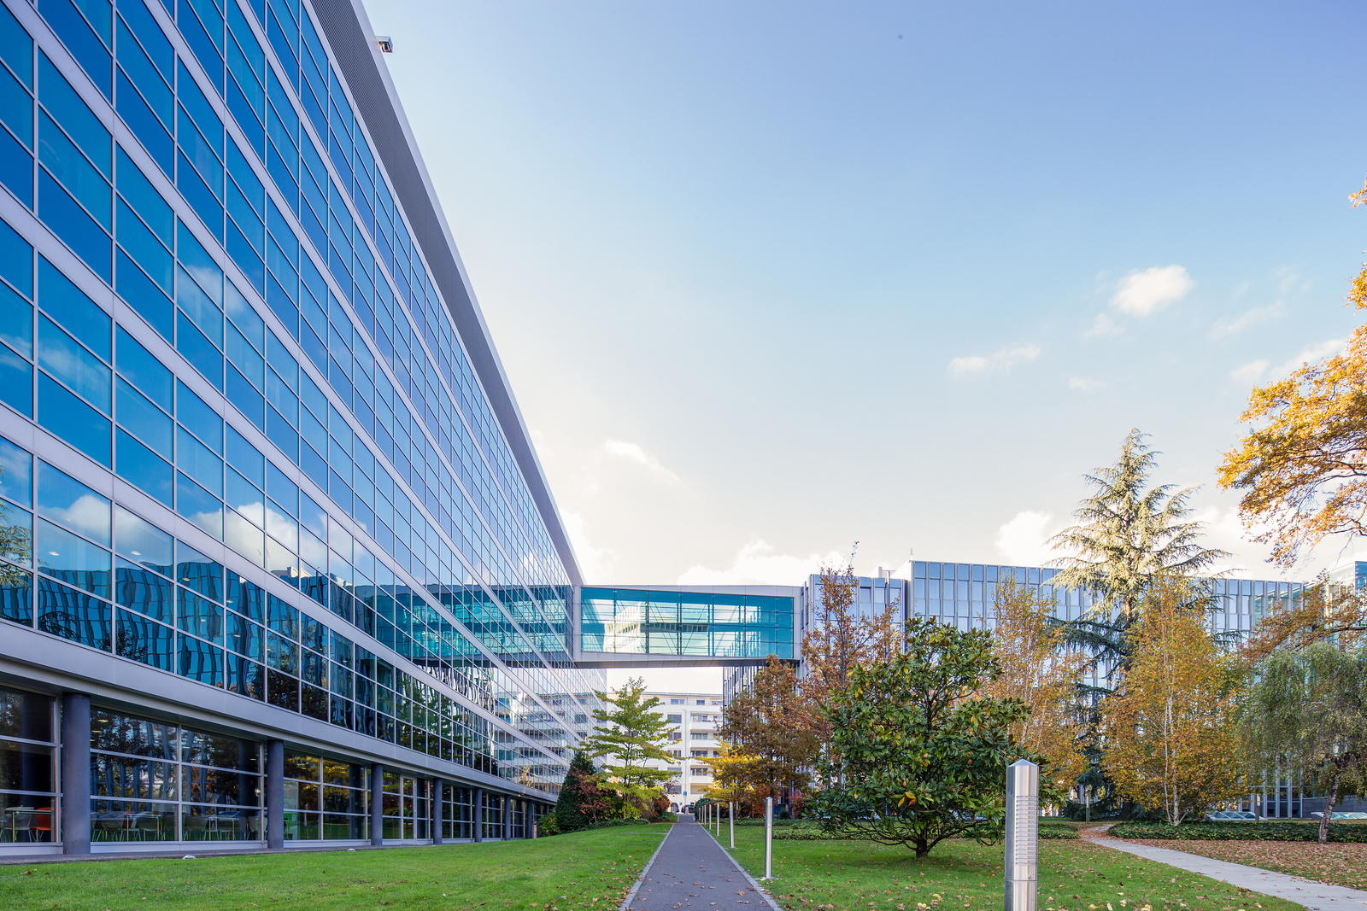
Patent Prosecution Highway (PPH) and the PCT
Thomas Marlow
Senior Policy Officer
PCT Business Policy Section PCT Business Development Division

Slide 2
Introduction
Outline of presentation
What is the Patent Prosecution Highway (PPH) and the PCT-PPH ?
Bilateral and Plurilateral Agreements
PPH and PCT-PPH Requests in 2022

Slide 3
What is the Patent Prosecution Highway (PPH)?
PPH is a framework under which an applicant can request accelerated examination at an Office of Later Examination (OLE) if a corresponding application is found allowable by an Office of Earlier Examination (OEE)
Agreement between OEE and OLE
Original PPH Agreement in June 2006 (Japan Patent Office and USPTO)
More than 50 participating Offices in PPH network

Slide 4
Patent Prosecution Highway (PPH)
OEE (Office of Earlier Examination)
Indication of Allowability
Application A
OEE Examination History
Examiner
OLE (Office of Later Examination)
Corresponding Application A’
PPH request
Accelerated Examination
OLE uses search and examination information from OEE
Requires claim correspondence between applications A and A’
OLE agrees to accelerate processing but not to accept OEE findings

Slide 5
What is PCT - PPH?
PCT-PPH allows a PPH request for accelerated examination to be based on a positive written opinion or international preliminary report on patentability (Chapter I or II)
Agreement between ISA/IPEA and designated/elected Office
Original PCT-PPH Agreement in 2010
21 Offices or organizations participate as ISA/IPEA in PCT-PPH Network

Slide 6
PCT – Patent Prosecution Highway (PPH)
International Phase
National / Regional Phase
Designated / Elected Office Application A
Positive Written Opinion or IPRP (Chapter I or II)
PCT Application
PPH request
Designated / Elected Office Application B
Accelerated Examination

Slide 7
PPH Agreements
Bilateral or Plurilateral Agreements between participating Offices
Agreements specify eligible applications and requirements
Form and timing of PPH request
Supporting documentation to show claim correspondence and allowability (Dossier Access Systems, PATENTSCOPE, machine translation etc.)

Slide 8
Plurilateral PPH Agreements
Plurilateral PPH Agreements between Offices standardize requirements and allow accelerated processing requests at any participating Office based on national or PCT work product from any other participating Office.
IP5 PPH - IP5 Offices publish IP5 PPH Metrics
Global PPH – 27 Offices including 15 ISA/IPEAs (July 6, 2020)
PROSUR-PPH
Allianza de Pacífico-PPH

Slide 9
PPH Requests in 2022
Office of Later Examination
Office of Earlier Examination
 | USPTO | JPO | EPO | CNIPA | KIPO | Others | Total
USPTO | 921 | 998 | 1,603 | 2,035 | 604 | 830 | 6,991
CNIPA | 2,451 | 1,323 | 857 | 0 | 275 | 261 | 5,167
JPO | 1,449 | 1,177 | 684 | 303 | 156 | 183 | 3,952
KIPO | 1,252 | 605 | 302 | 179 | 59 | 181 | 2,578
EPO | 660 | 293 | 0 | 230 | 134 | 119 | 1,436
Others | 5,683 | 1,431 | 1,254 | 245 | 207 | 716 | 9,536
Total | 12,416 | 5,827 | 4,700 | 2,992 | 1,435 | 2,290 | 29,660
Source: https://www.jpo.go.jp/e/toppage/pph-portal/statistics.html

Slide 10
PCT-PPH Requests in 2022
Office of Later Examination
International Searching and Preliminary Examining Authority
 | JPO | EPO | USPTO | CNIPA | KIPO | Others | Total
JPO | 1,177 | 473 | 83 | 149 | 45 | 53 | 1,980
CNIPA | 323 | 592 | 171 | 0 | 84 | 63 | 1,233
EPO | 151 | 0 | 162 | 123 | 48 | 60 | 544
KIPO | 100 | 138 | 92 | 65 | 59 | 41 | 495
CIPO | 17 | 158 | 101 | 22 | 19 | 100 | 417
Others | 187 | 359 | 388 | 52 | 43 | 137 | 1,166
Total | 1,955 | 1,720 | 997 | 411 | 298 | 454 | 5,835
PCT-PPH data unavailable from some Offices of Later Examination including United States Patent and Trademark Office and German Patent and Trademark Office
Source: https://www.jpo.go.jp/e/toppage/pph-portal/statistics.html

Slide 11
Thank you! Further information available at: PPH Portal and WIPO PCT-PPH and Global PPH page
2024
WIPO

