Slide 1
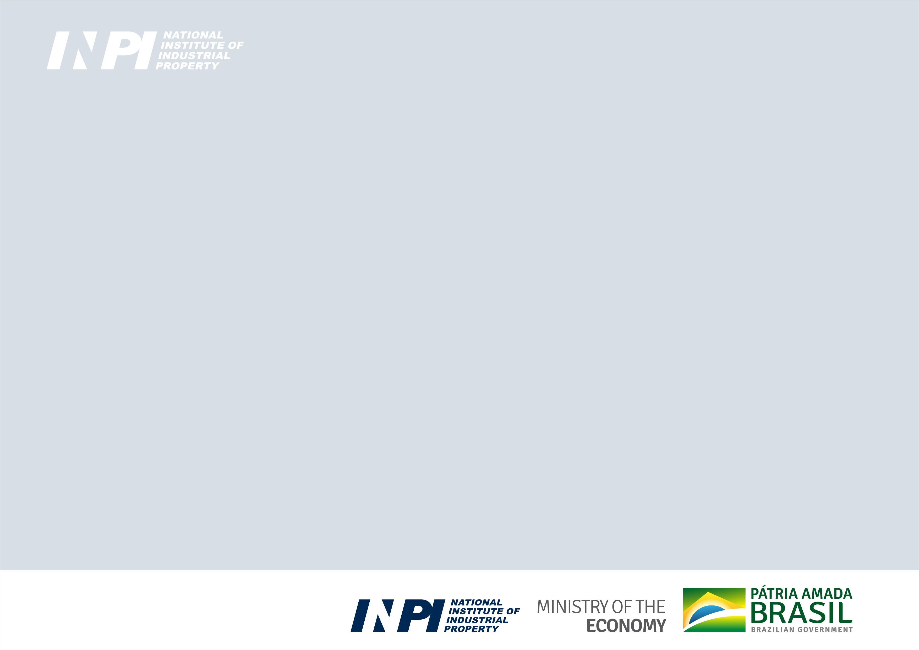

Patent Cooperation Treaty (PCT)
Working Group
Filing medium of the international application
and related documents
PCT/WG/15/13
Document submitted by Brazil
Geneva, October 3 to 7, 2022

Slide 2
Summary
The Regulations under PCT permit that international applications and subsequently documents be filed and processed in electronic form or by electronic means.
However, the option on paper must be available in the receiving Offices.
(Rule 89bis.1 and Rule 89bis.2)
This proposal is regarding an amendment of
Rule 89bis.1 and Rule 89 bis.2, allowing only electronic format and not on paper.

Slide 3
Background – electronic means
March 1998, the Assembly of Member States of WIPO approved the proposal for automation of PCT operations;
January 1999, PCT EASY software was launched, allowing creation of an electronic request form, submitted on physical media with paper application bodies.
February 2003, WIPO's electronic filing project PCT-SAFE entered service as a pilot, allowing fully-electronic filings to be made;
June 2011, the International Bureau reported that a new IT system was being developed to improve the services provided under the PCT - ePCT system;
In 2013, “ePCT-Filing” was initially offered for filings at the RO/IB;
In 2014, “ePCT-Filing” was extended for filings to any Office.

Slide 4
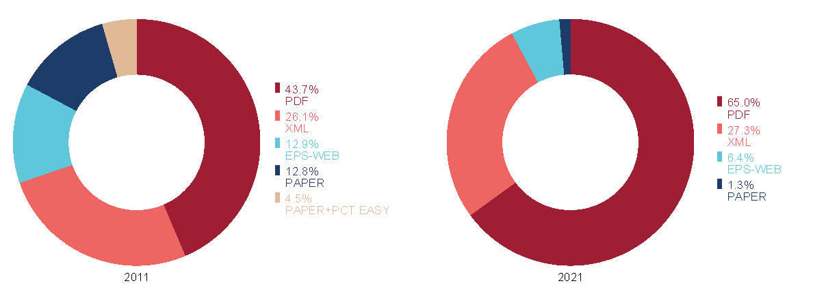
Background
Sharp decrease in the international filing on paper in the last 10 years:
from 12,8% in 2011 to 1,3% in 2021
Distribution of PCT Applications by Filing Medium, 2011 and 2021
Source: WIPO Statistics Database, March 2022

Slide 5
Decrease in paper filings
Some reasons:
Offices and their applicants have adopted the ePCT electronic filing system (reduction in cost and processing time);
Some Patent Offices that have their own electronic filing systems also use the ePCT system for the electronic filing of the PCT international application;
Offices have different fees according to the filing medium - special discount for international application filed by electronic means.

Slide 6
Current situation
Filings on paper Jun/2022– 1.06%
In 2021:
Less than 1% - JP, CN, KR, SE, IN and others
More than 40% - RU, PL, EG, MA, BG and others
100% - UA, GR, TH, KZ, VN and others
- the scenarios are quite different
proposals must be wide
contemplate all the Contracting States

Slide 7
Current situation
International Bureau has spared no effort to improve the ePCT system;
National and regional Offices also seek to improve the services provided, using the IT system to develop electronic services;
The electronic processing takes place not only in the transmission of documents but also within the Office itself, for example, upon receiving the application, formal analysis and issuance of forms;
Many Patent Offices have electronic processing in all sectors responsible for the activities involved in granting a patent;
The PCT international application filed on paper takes longer to process, considering the International Bureau and International Authorities only work with documents in electronic format;

Slide 8
Current situation
The work of the receiving Office is twofold with regard to the forms issued, as the applicant will receive all paper documentation, while the International Bureau and the Authorities responsible for International Searching will receive it in electronic format;
The transcription of information from paper to electronic form introduces risk of errors, whether in data entry or document scanning;
International Bureau's initiatives are aimed at encouraging and reinforcing electronic services in all phases of the PCT;
The receipt of all documentation of international applications in electronic format is an important point for the participation and contribution of the Offices in the priority initiatives of the PCT.

Slide 9
Considerations
Each Member State has specific regulations regarding the filing medium of the national application documentation;
The electronic procedures in each Office are different;
The means of communication available between the International Bureau and the other receiving Offices and International Authorities is permanently and exclusively electronic;
Benefits with the elimination of applications filed on paper:
- increased operational efficiency;
- reduced effects on the environment;
- reduction of costs;
- vacating of physical spaces.

Slide 10
Proposal (i)
It is proposed an amendment of Rule 89bis.1 and Rule 89bis.2, to allow receiving Offices to require the filing of the international application and the submission of subsequently-filed documents to be performed only in electronic format and not on paper.
In addition, it is proposed to include a provision in the Section 703(e) of the Administrative Instruction to clarify that an Office could accept a paper filing (or a subsequently‑filed document) if this is considered appropriate, even if it had made a notification indicating that paper filings were no longer allowed.

Slide 11
Proposal (i)
When adopting such procedures, the Office should notify the International Bureau to be published in the PCT Gazete and make it available in other places;
The proposal would not require receiving Offices to make any changes to the filing formats that they currently accept;
Alternatively, applicants from a country whose Office had made such a notification would remain free to file paper applications at the receiving Office of the International Bureau.

Slide 12
Proposal (ii)
It is also proposed to invite the International Bureau to study the issues concerning to make the national phase entry electronic only.
This amendment involves other issues to be analyzed in the context of Article 22 and Rule 49 of the PCT, and
It also has more significant effect on the interests of applicants from all PCT Contracting States

Slide 13

www.gov.br/INPI/en

