Slide 1

PCT Statistics PCT Working Group Twelfth Session
Geneva June 11 to 14, 2019

Slide 2
Outline
PCT Application Filings
Receiving Offices
International Authorities
PCT National Phase Entries

Slide 3
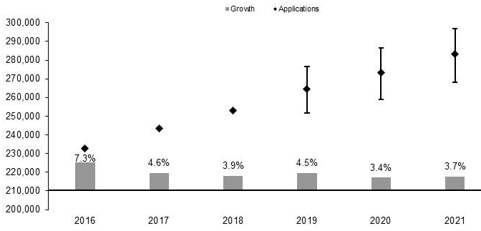
PCT Application Filings
283,300
273,300
264,400
252,900
243,519
232,907
Source: Economics and Statistics Division, WIPO

Slide 4
Filing Trends for the Top 5 Origins
Source: WIPO Statistics Database, March 2019

Slide 5
PCT Applications for the Top 20 Origins
Source: WIPO Statistics Database, March 2019

Slide 6
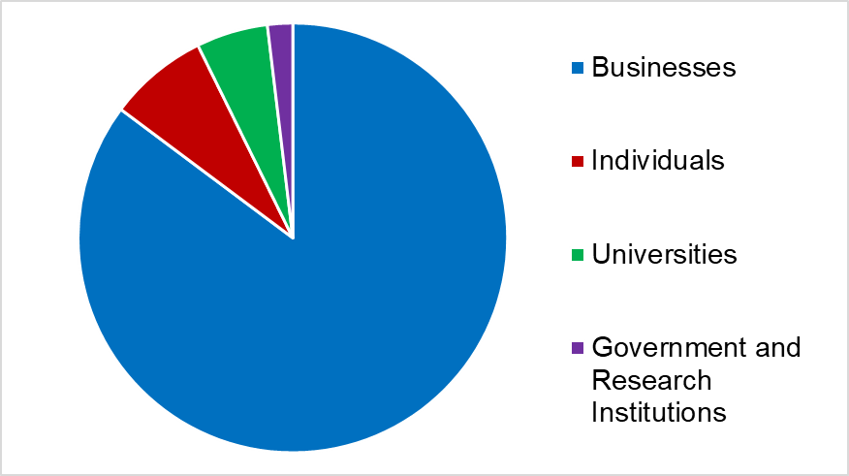
Distribution of PCT Applicants in 2018
Top Applicants
Businesses: Huawei Technologies – 5,405 published applications
Universities: University of California – 434 published aplications
Government and Research Institutions: Frauenhofer-Gesellschaft zur Förderung der angewandten Forschung – 345 published applications

Slide 7
PCT Applications by Gender
17.1% of all inventors in PCT applications were women (+0.8 percentage points)
32.6% of PCT applications in 2018 included at least one woman inventor (+2.1 percentage points)
Source: WIPO Statistics Database, March 2019

Slide 8
Main Fields of Technology in 2018
Main Fields of Technology by Percentage of Total
Digital Communication 20,271 applications (8.6%)
Computer Technology 19,152 applications (8.1%)
Electrical Machinery 16,577 applications (7.0%)
Medical Technology 15,826 applications (6.7%)
Largest increases:
Basic Communication Processes: +29.5%
Control: +21.2%
Machine Tools: +13.9%
Transport: +11.3%
Largest decreases:
Micro-structural and Nano-technology: -7.0%
Basic Materials Chemistry: -1.3%
Source: WIPO Statistics Database, March 2019

Slide 9
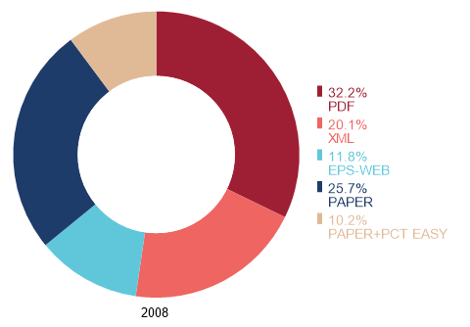
PCT Applications by Medium of Filing
Distribution in 2018 (2017 in brackets): 2.9% (3.8%) paper, PDF 60.2% (57.9%), EFS-Web 8.3% (9.1%), XML 28.6% (29.2%)
Source: WIPO Statistics Database, March 2019

Slide 10
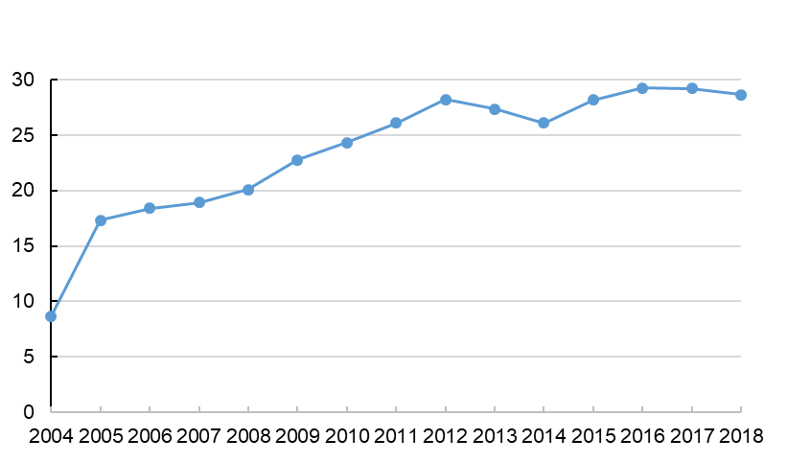
Percentage of PCT Filings in XML
XML filings rose by 6 percentage points from 2008 to 2011, then by 2.5 percentage points from 2011 to 2018

Slide 11
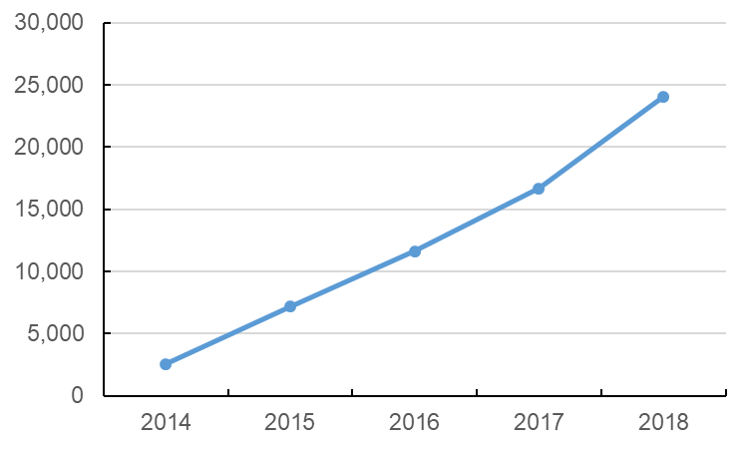
Number of Applications filed using ePCT
Filings through the ePCT-filing portal increased by 44.1% to 24,070 applications, 9.5% of the total of international applications filed in 2018

Slide 12
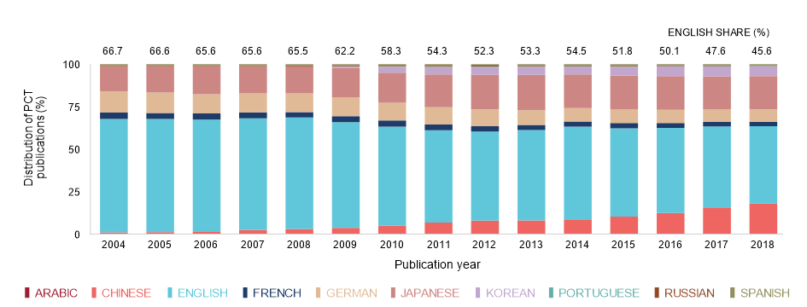
PCT Applications by Publication Language
Share of PCT publications in English declined (45.6% in 2018)
Other percentages: 19.6% Japanese, 17.9% Chinese, 7.3% German, 5.8% Korean, 2.5% French, 0.62% Spanish, 0.43% Russian, 0.22% Portuguese, 0.01% Arabic
Source: WIPO Statistics Database, March 2019

Slide 13
PCT Applications for Top 20 Receiving Offices in 2018
Source: WIPO Statistics Database, March 2019
United States of America and China received more than 55,000 applications.
Highest percentage rises for filings in Turkey (+44.5%), India (+21.4%) and at the International Bureau (+20.2%)

Slide 14
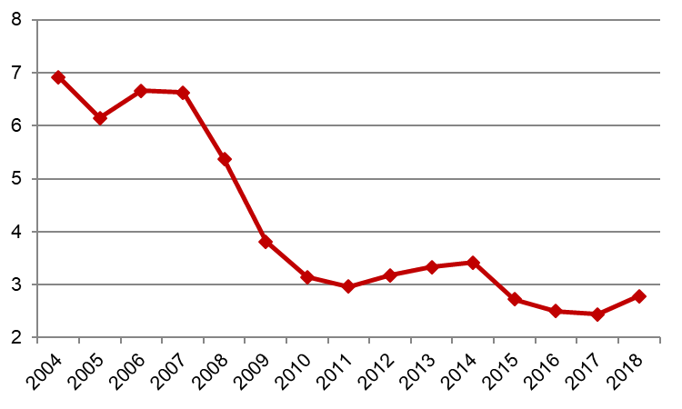
Receiving Offices: Timeliness of Transmitting PCT Applications to the IB
Weeks
Source: WIPO Statistics Database, March 2019
Average transmission time between international filing date and date the IB received the application increased slightly to 2.8 weeks in 2018 (from 2.5 weeks in 2017).
93.3% of PCT applications transmitted to IB within 4 weeks in 2018 (95.1% in 2017)

Slide 15
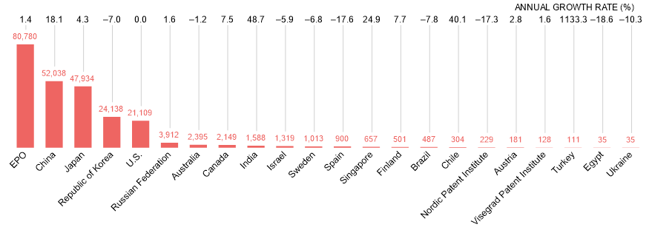
Search Reports established by International Searching Authority in 2018
Source: WIPO statistics database, March 2019
China became second most used International Searching Authority in 2018.
IP5 Offices established 93.4% of reports.
High percentage increases in search reports from Offices India (+48.7%), Chile (+40.1%), Singapore (+24.9%) and China (+18.1%).

Slide 16
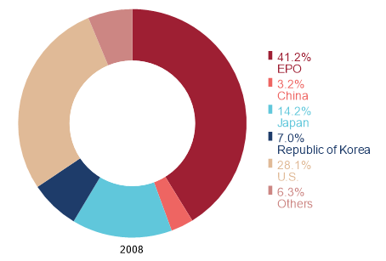
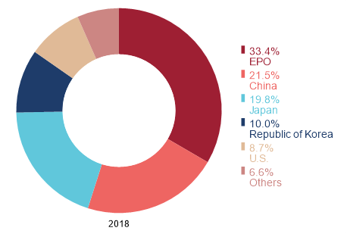
Distribution of International Search Reports by International Searching Authority
Source: WIPO statistics database, March 2019
IP5 Offices established 93.4% of reports in 2018 (93.7% in 2008).
Increases in percentage share for China, Japan and Republic of Korea; decreases for EPO and United States of America.

Slide 17
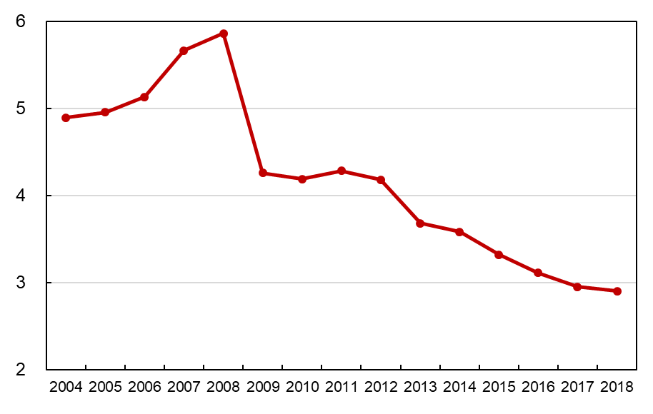
Average Timeliness in transmitting ISRs to the IB from Date of Receipt of Search Copy
Months
Source: WIPO statistics database, March 2019. Excludes cases where the time limit of 9 months from the priority date applies.
Average timeliness in transmitting ISRs to the IB was 2.90 months in 2018
85.0% of PCT applications transmitted to IB within 3 months from date of receipt of search copy (84.1% in 2017)
97.2% of international publications published with ISR (97.4% in 2017)

Slide 18
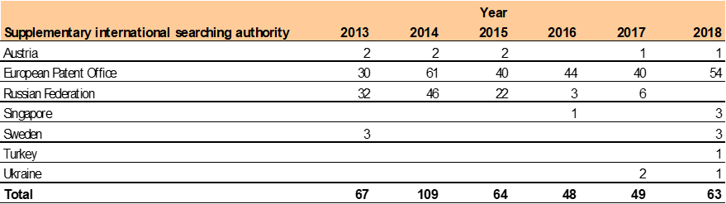
Supplementary International Search Requests
The EPO accounted for 85.7% of requests for supplementary international search in 2018.
Source: WIPO Statistics Database, March 2019

Slide 19
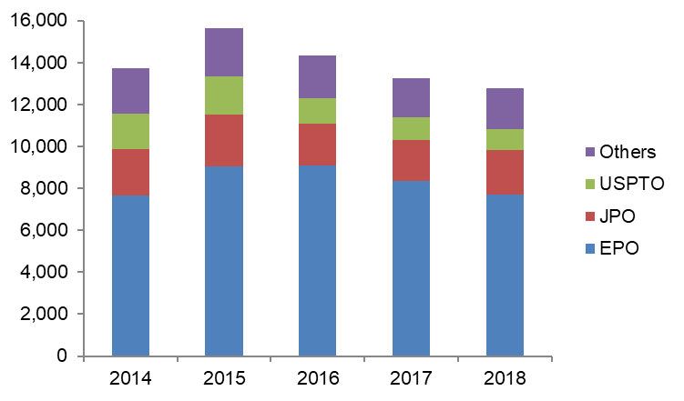
IPRPs (Chapter II) by International Preliminary Examination Authority
Source: WIPO Statistics Database, June 2019
Reports established by IPEA fell by 3.8% in 2018 to 12,767
84.8% of IPRPs (Chapter II) were produced by the EPO, the JPO or the USPTO

Slide 20
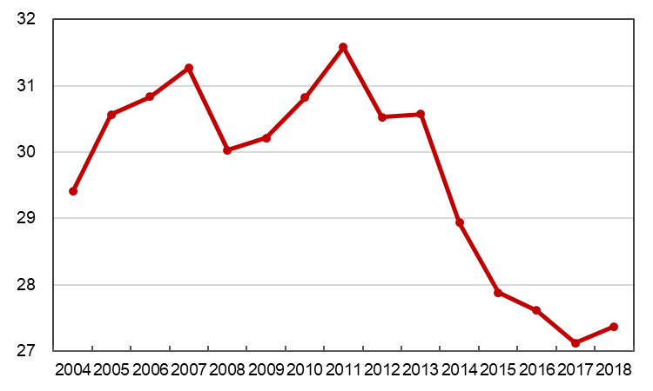
Average Timeliness in Transmitting IPRPs
Months
Source: WIPO Statistics Database, March 2019
Average time in transmitting IPRPs rose to 27.4 months from priority date in 2018
86.3% of all IPRPs were transmitted to the IB within 28 months of priority date (89.3% in 2017)

Slide 21
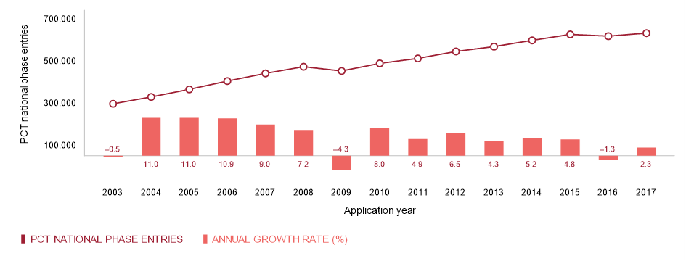
PCT- National Phase Entries
Source: WIPO Statistics Database, March 2019
630,000 national phase entries estimated for 2017 (+2.3%)
About 83% are non-resident national phase entries

Slide 22
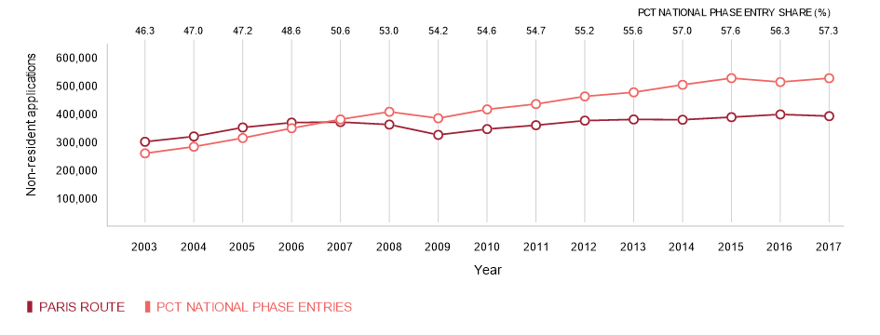
Non-Resident Applications by Filing Route
Source: WIPO Statistics Database, March 2019
526,000 non-resident national phase entries (+2.7%), 398,900 non-resident Paris-route filings (-1.9%) in 2017
57.3% of all non-resident applications filed through PCT in 2017 (56.3% in 2016)

Slide 23
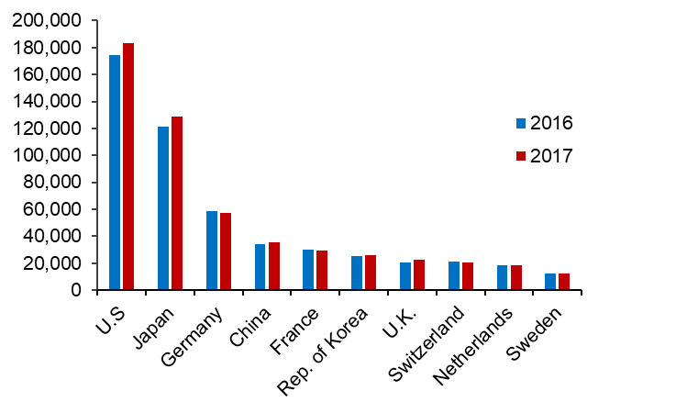
National Phase Entry for Top 10 Origins
183,532
129,108
57,556
35,289
29,538
25,990
22,268
20,573
18,394
12,241
Source: WIPO Statistics Database, March 2019
U.S. origin national phase entries rose by 5.2% from 174,417 to 183,532 in 2017 (192,933 in 2015)
2.7% growth for China (after 3 successive years of >20% growth)

Slide 24
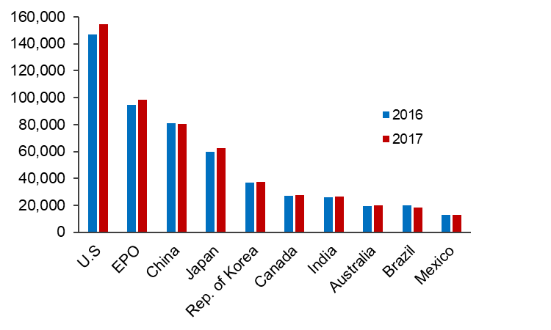
National Phase Entry for Top 10 Offices
154,403
98,431
80,301
62,327
37,248
27,350
26,373
19,898
18,268
12,664
Source: WIPO Statistics Database, March 2019
Growth in national phase entries for U.S. (+5.1%), EPO (+4.0%) and Japan (+4.1%) for 2017

Slide 25
Further information:
2019 PCT Yearly Review
The International Patent System
WIPO Publication No. 901E/2019
World Intellectual Property Indicators 2018
WIPO Publication No. 941E/2018
WIPO IP Statistics Data Center
http://www.wipo.int/ipstats/en/

