Slide 1
PCT Netting Pilot
PCT Working Group
Geneva
18 June
2018

Slide 2
Agenda
Netting Structure
  PCT fee transaction payment flow – Current system
  PCT fee transaction payment flow – Netting solution
  Netting implications – Receiving Offices & International Searching Authorities
  Benefits of netting
Implementation of netting pilot
Current status of netting pilot

Slide 3
1. Netting Structure Payment flow - Current system

Slide 4
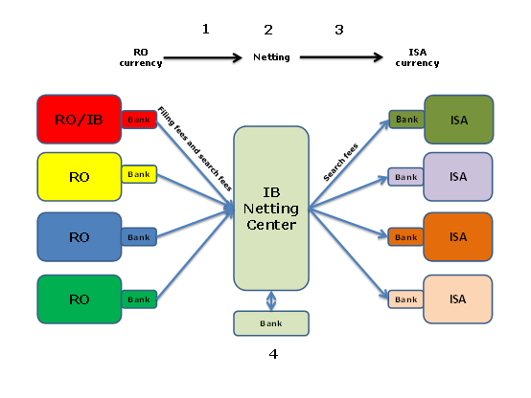
Netting Structure Payment flow – Proposed netting solution

Slide 5
Netting: Receiving Offices
Very low impact:
  Send search fees to IB instead of ISA
  Information to include the usual IA/search fee information
    IA number, date of receipt of IA, fee code (= search fee), amount of search fee in prescribed currency
  IB checks search fee information; in case of any missing information, payment or over/under payment, contacts RO
  RO can combine sending of international filing fees and search fees to IB in one bank transfer (optional, can be two different bank transfers)

Slide 6
Netting:
International Searching Authorities
PCT fees received by participating Office (as RO, ISA or IPEA) for the benefit of IB or other Offices
  international filing fees collected by Office as RO (for benefit of IB)
  search fees collected by Office as RO (for benefit of other ISA)
  handling fees collected by Office as IPEA (for benefit of IB)
PCT fees received by IB on behalf of participating Office (as ISA, SISA or IPEA)
  search fees collected by RO/IB (for benefit of ISA)
  supplementary search fees collected by IB (for benefit of SISA)
  handling fees collected by Office as IPEA (for benefit of IB)
Amounts owed by IB to ISA or by ISA to IB under Rule 16.1(e)
  gains or losses incurred by ISA in search fee income due to exchange rate fluctuations IB
Payments relating to other WIPO services, such as Madrid and Hague Systems
  at initial stage, for some Offices only

Slide 7
Benefits of Netting
Improved cash management
  Reduction in bank transfers processed to and from ISA
  Reduction in bank fees paid by ROs (if combining the transfer of filing fees and search fees) and by IB and ISA
  All fees received by IB on behalf of ISA transferred by IB to ISA in the currency in which ISA has fixed the search fee and in the amount fixed by the ISA
Reduced currency exchange risk
  All PCT search fees received by ISA in the fixed currency
  All PCT filing fees collected by participating Office (ISA) in capacity as RO settled in home currency of ISA (if convertible)
  All cash flow centralized at IB, which can buy or sell currency to minimize exchange risk
Reduced administration effort – verification process
  All PCT search copies sent by ROs verified by IB
  All PCT search fees sent by ROs verified by IB

Slide 8
2. Implementation of Netting Pilot
(ISA – IB – RO)
Memorandum of Understanding between IB and ISA
In close cooperation with ISA, IB invites ROs that have specified ISA as competent to participate in netting pilot
Netting pilot begins with IB/ISA transactions for two month period
ROs join netting pilot after two month period

Slide 9
3. Current Status of Netting Pilot
Netting pilot with ISA/EP operational since 1 January 2018
  10 ROs for which ISA/EP is competent currently participating
  Remaining ROs for which ISA/EP is competent to be invited to participate according to plan agreed between IB and ISA/EP, with pilot fully operational including all ROs for which ISA/EP is competent by February 2019
Netting pilot with ISA/JP began operation on 1 April 2018
  4 ROs for which ISA/JP is competent invited to participate as of 1 June 2018
Talks with other ISAs under way

