Slide 1
The Budapest Treaty
on the International Recognition of the Deposit of Microorganisms for the Purposes of Patent Procedure
E. Glantschnig, Patent Law Division
May 2017

Slide 2
Why a specific treaty ?
Requirement of sufficient disclosure of the invention
How to disclose a microorganism?
Requirement of the deposit of the microorganism
Usefulness of a single internationally recognized deposit

Slide 3
What is a microorganism?
Microorganisms are microscopic organisms (e.g., bacteria, fungi, viruses and yeasts) which are used in the production of food (e.g., yogurt, beer), pharmaceuticals (e.g. antibiotics) and other products (e.g., washing powder)
Definition in Concise Oxford Dictionary: « an organism not visible to the naked eye, e.g., bacterium or virus »

Slide 4
Disclosure requirement
Patent law protection requires the disclosure of inventions, usually by the publication of a description
The public may use the information for experimental purposes (depending on the national patent law) and, once the patent has lapsed, for commercial purposes

Slide 5
Disclosure of a microorganism
Where an invention involves the use of or concerns a new microorganism which is not yet publicly available and which cannot be fully disclosed in the description, it is necessary to deposit a sample of that microorganism with a culture collection

Slide 6
Multiplicity of deposits
Many national laws require the deposit of microorganisms
Complex and costly procedures for distinct deposits in various countries
Necessity of rationalization at international level

Slide 7
The Budapest Treaty
Proposal by the United Kingdom to the Executive Committee of the Paris Union that WIPO study the possibilities of international treaty on deposits of microorganisms
Decision to establish a Committee of Experts
The Committee held three sessions (in 1974, 1975 and 1976) and prepared a draft of a Treaty and Regulations to be submitted to a Diplomatic Conference

Slide 8
Adoption and signature
Diplomatic Conference, held in Budapest, April 14 to 28, 1977
Adoption of the Treaty on April 28, 1977
Signature by 18 States: AT, BG, CH, DE, DK, ES, FI, FR, HU, IT, LU, NL, NO, SE, SN, SU, UK, US

Slide 9
Entry into force
Ratification by Hungary, Bulgaria, the United States and France
Entry into force on August 19, 1980, after the accession of Japan
Today:
  80 Contracting States
  46 International Depositary Authorities (IDAs)

Slide 10
Contracting States (1)
Albania, Armenia, Australia, Austria, Azerbaijan, Bahrain, Belarus, Belgium, Bosnia and Herzegovina, Brunei Darussalam, Bulgaria, Canada, Chile, China, Colombia, Costa Rica, Croatia, Cuba, Czech Republic, Democratic People’s Republic of Korea, Denmark, Dominican Republic, El Salvador, Estonia, Finland, France, Georgia, Germany, Greece, Guatemala, Honduras, Hungary, Iceland, India, Ireland, Israel, Italy, Japan, Jordan, Kazakhstan, Kyrgyzstan, Latvia, Liechtenstein, Lithuania, Luxemburg, Mexico, Monaco, Montenegro,

Slide 11
Contracting States (2)
Morocco, Netherlands, Nicaragua, Norway, Oman, Panama, Peru, Philippines, Poland, Portugal, Qatar, Republic of Korea, Republic of Moldova, Romania, Russian Federation, Serbia, Singapore, Slovakia, Slovenia, South Africa, Spain, Sweden, Switzerland, Tajikistan, the former Yugoslav Republic of Macedonia, Trinidad and Tobago, Tunisia, Turkey, Ukraine, United Kingdom, United States of America, Uzbekistan.

Slide 12
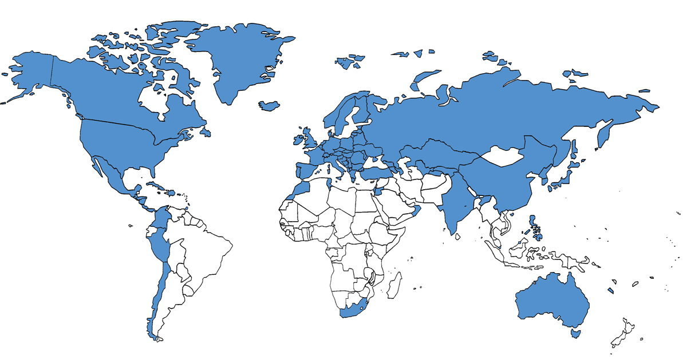
Budapest Treaty World Map

Slide 13
Declarations of acceptance
have been deposited by the following intergovernmental industrial property organizations:
- European Patent Organisation (EPO)
- Eurasian Patent Organization (EAPO)
- African Regional Intellectual Property
Organization (ARIPO)

Slide 14
Principal characteristics of the Treaty
All Contracting States recognize the deposit of a microorganism with any IDA
Any deposit of a microorganism with an IDA shall be accepted for the purposes of patent procedure by the patent offices of the Contracting States and by any regional office who filed a declaration of acceptance

Slide 15
International Depositary Authority (1)
A scientific institution
  located on the territory of a Contracting State
  accepting deposits of microorganisms
  storage of microorganisms
  furnishing samples of any deposited microorganism

Slide 16
International Depositary Authority (2)
Status acquired after acceptance of communication from the Contracting State to the Director General of WIPO
(Art. 7)

Slide 17
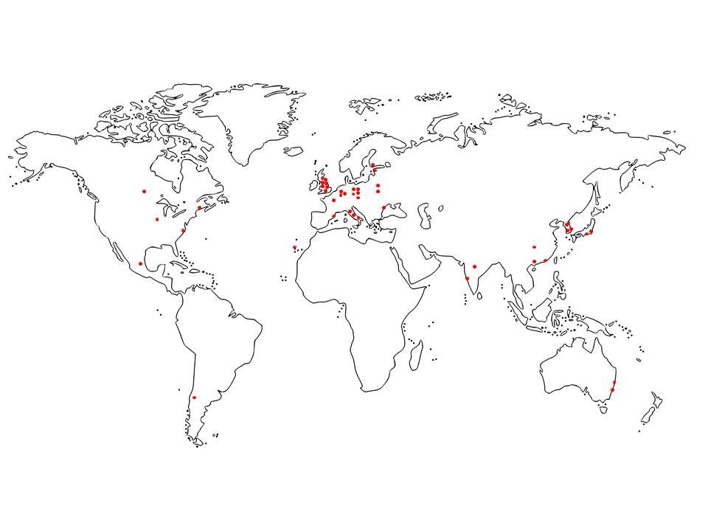
IDA World Map

Slide 18
The subject matter of the deposit
The Treaty does not define the term microorganism thus allowing a broad interpretation of the term
It includes unicellular and multicellular organisms, bacteria, fungi, plant, animal
and human cell cultures, murine embryos, plasmids, seeds, etc.
Today, the term « biological material » is more commonly used

Slide 19
Most widely accepted kinds of MO by IDAs
non-pathogenic yeasts 34
non-pathogenic bacteria 34
non-pathogenic fungi 32

Slide 20
Infrequent accepted kinds of MO by IDAs
Pathogenic Protozoa (1)
Murine embryos, Oncogenes (2)
Nematodes, RNA (4)

Slide 21
Deposit procedure
Mandatory acceptance of the microorganism by the IDA when requirements for deposit are met
Delivery of a receipt
Time limit for the deposit: depends on the national law, in general, the filing date of the patent application
Storage during at least 30 years

Slide 22
Rule 11: Access to deposited biological material
Any interested industrial property office
The depositor or third parties authorized by the depositor
Any parties legally entitled under the applicable legislation, with the prescribed form and certified by the industrial property office

Slide 23
Budapest Treaty Statistics 2015
Overall Deposits 4.893
(nearly doubled since 2005)
Samples Furnished 2.673

Slide 24
The Top 8 IDAs in Terms of Deposits in 2015
CGMCC (CN) 1.645, CCTCC (CN) 1.055,
ATCC (US) 653,
KCTC (KR) 231, DSMZ (DE) 217,
NCIMB (GB) 157,
NRRL (US) 155, KCCM (KR) 145

Slide 25
The Aggregate of Deposits since February 1981
Overall Deposits: 96.906
ATCC 31.114
CGMCC 11.977
IPOD (JP) 10.201
DSMZ 7.988
CCTCC 7.872

Slide 26
Advantages of the
Budapest Treaty (1)
Simplification and cost reduction of patent procedures
Prevention of certain risks in the field of biotechnology
Promotion of R&D through access to deposited biological material
Promotion of cooperation and exchange between IDAs

Slide 27
Advantages of the
Budapest Treaty (2)
The Contracting States
  must recognize the deposit with any IDA
  must give the assurances that the IDAs fulfill the requirements of the Treaty
  are not obliged to establish an IDA on their own territory
  do not have to pay any financial contribution to WIPO

Slide 28
Documentation on the Treaty
Budapest Treaty and its Regulations
Guide to the Deposit of Microorganisms under the Budapest Treaty
(www.wipo.int/budapest)

Slide 29
Some other useful texts
Patent Cooperation Treaty (PCT), Rule 13bis
European Patent Convention (EPC), Rules 31 - 34
European Directive on the legal protection of biotechnological inventions
(Directive 98/44/EC)
TRIPS Agreement, Art. 27.3

Slide 30
Where to get information?
Budapest Treaty Section
Patent Law Division
WIPO
Chemin des Colombettes, 34
1211 Geneva 20 (Switzerland)
Ewald Glantschnig
Tel.: 00 41 22 338 84 80
Fax: 00 41 22 338 88 30
E-mail: ewald.glantschnig@wipo.int

