Slide 1

PCT Statistics Meeting of International Authorities Thirty-second session
Geneva October 29 to 31, 2025

Slide 2
Outline
International Filings
Data for 2024
Medium of Filing
National Phase Entries
International Authorities
International Search
Supplementary International Search
International Preliminary Examination
PCT-PPH pilot
Applications with Sequence Listings
Timing of Third-party Observations

Slide 3
PCT Filings in 2024
273,900 international applications filed in 2024 (+0.5%)
Top 5 countries: China (70,160, +0.9%), United States of America (54,087, -2.8%), Japan (48,397, -1.2%), Republic of Korea (23,851,+7.1%) and Germany (16,721, -1.3%)
Top applicant: Huawei Technologies (6,600 published PCT applications in 2024)
Top educational institution filer: University of California (519 published PCT applications in 2024)
More information in PCT Yearly Review 2025
Source: PCT Yearly Review 2025

Slide 4
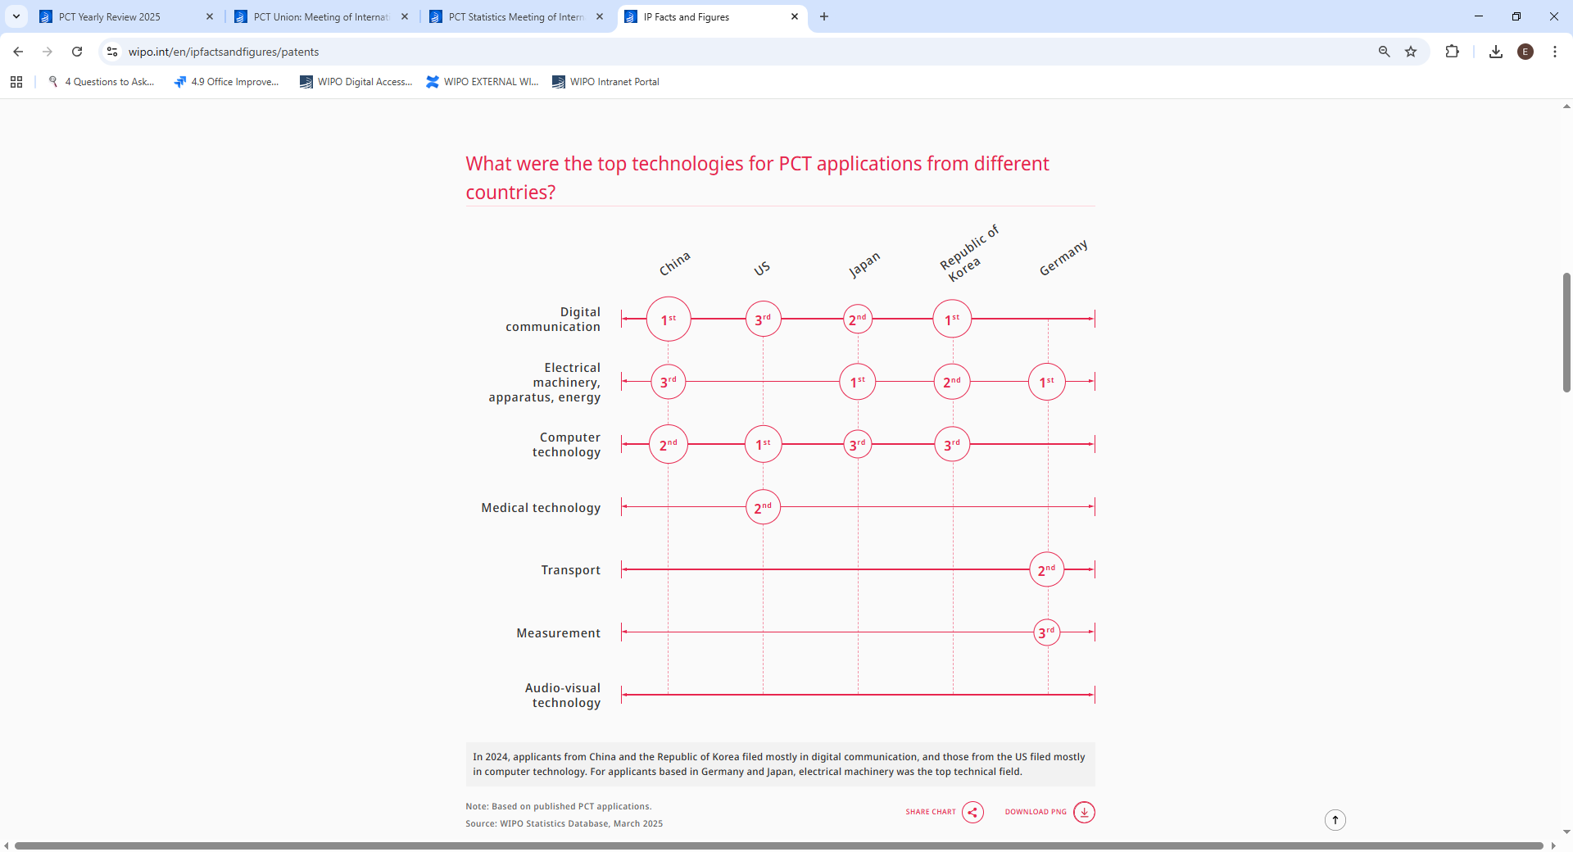
PCT Filings in 2024 – Top technologies by country
In 2024, applicants from China and the Republic of Korea filed mostly in digital communication, and those from the US filed mostly in computer technology. For applicants based in Germany and Japan, electrical machinery was the top technical field.
Source: WIPO Statistics Database, March 2025

Slide 5
PCT Filings from 2023, month-to-month
Source: WIPO Statistics Database, October 2025

Slide 6
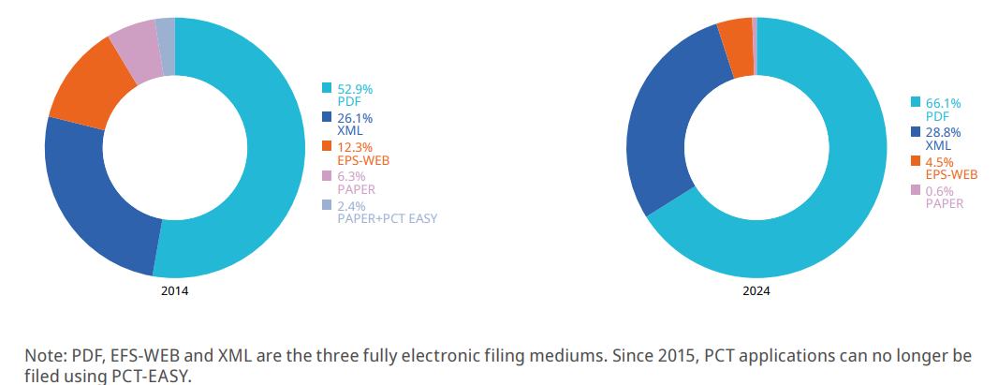
Medium of Filing
10 years
Source: WIPO statistics database, March 2025, PCT Yearly Review 2025

Slide 7
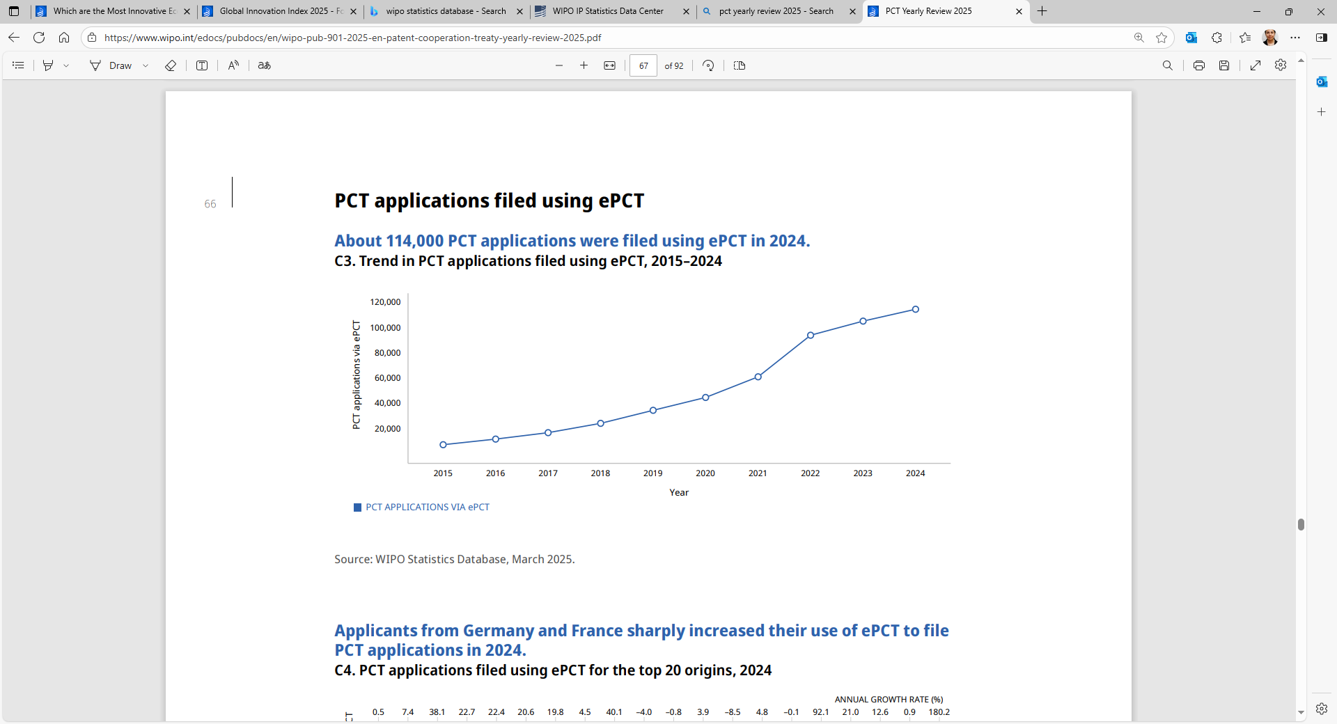
Medium of Filing : ePCT
Nearly 114,000 PCT applications were filed using ePCT in 2024 (+8.6 %). 41.8 % of all PCT applications filed globally in 2024 were filed using ePCT
Source: WIPO statistics database, March 2025, PCT Yearly Review 2025

Slide 8
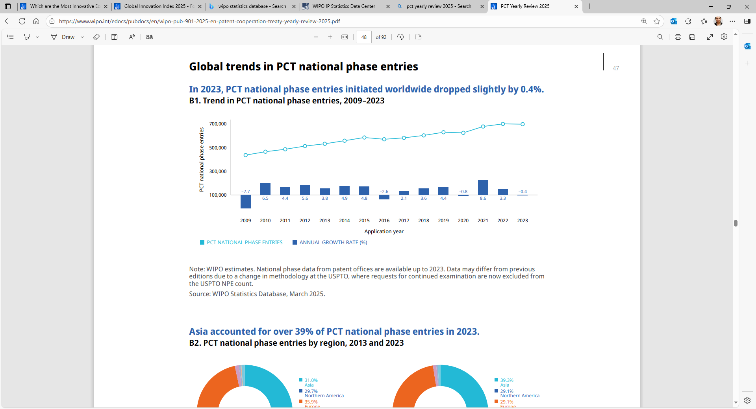
PCT National Phase Entries
698,500 total PCT national phase entries in 2023 (-0.4%) 591,100 non-resident national phase entries in 2023 PCT System accounted for 57.4 % of all non-resident filings in 2023
Source: WIPO statistics database, March 2025, PCT Yearly Review 2025

Slide 9
International Authorities
International Search Reports
Distribution by International Authority
Timeliness of Transmission to International Bureau
A1 Publication Percentage
Supplementary International Search Reports
International Preliminary Examination Reports
Number of IPRPs per IPEA
Timeliness of Transmission to International Bureau

Slide 10
Distribution of ISRs established by ISA
Data based on international filing year of application
Source: WIPO statistics database. October 2025

Slide 11
Distribution of ISRs established by ISA (excl. IP5 Offices)
Data based on international filing year of application
Source: WIPO statistics database. October 2025

Slide 12
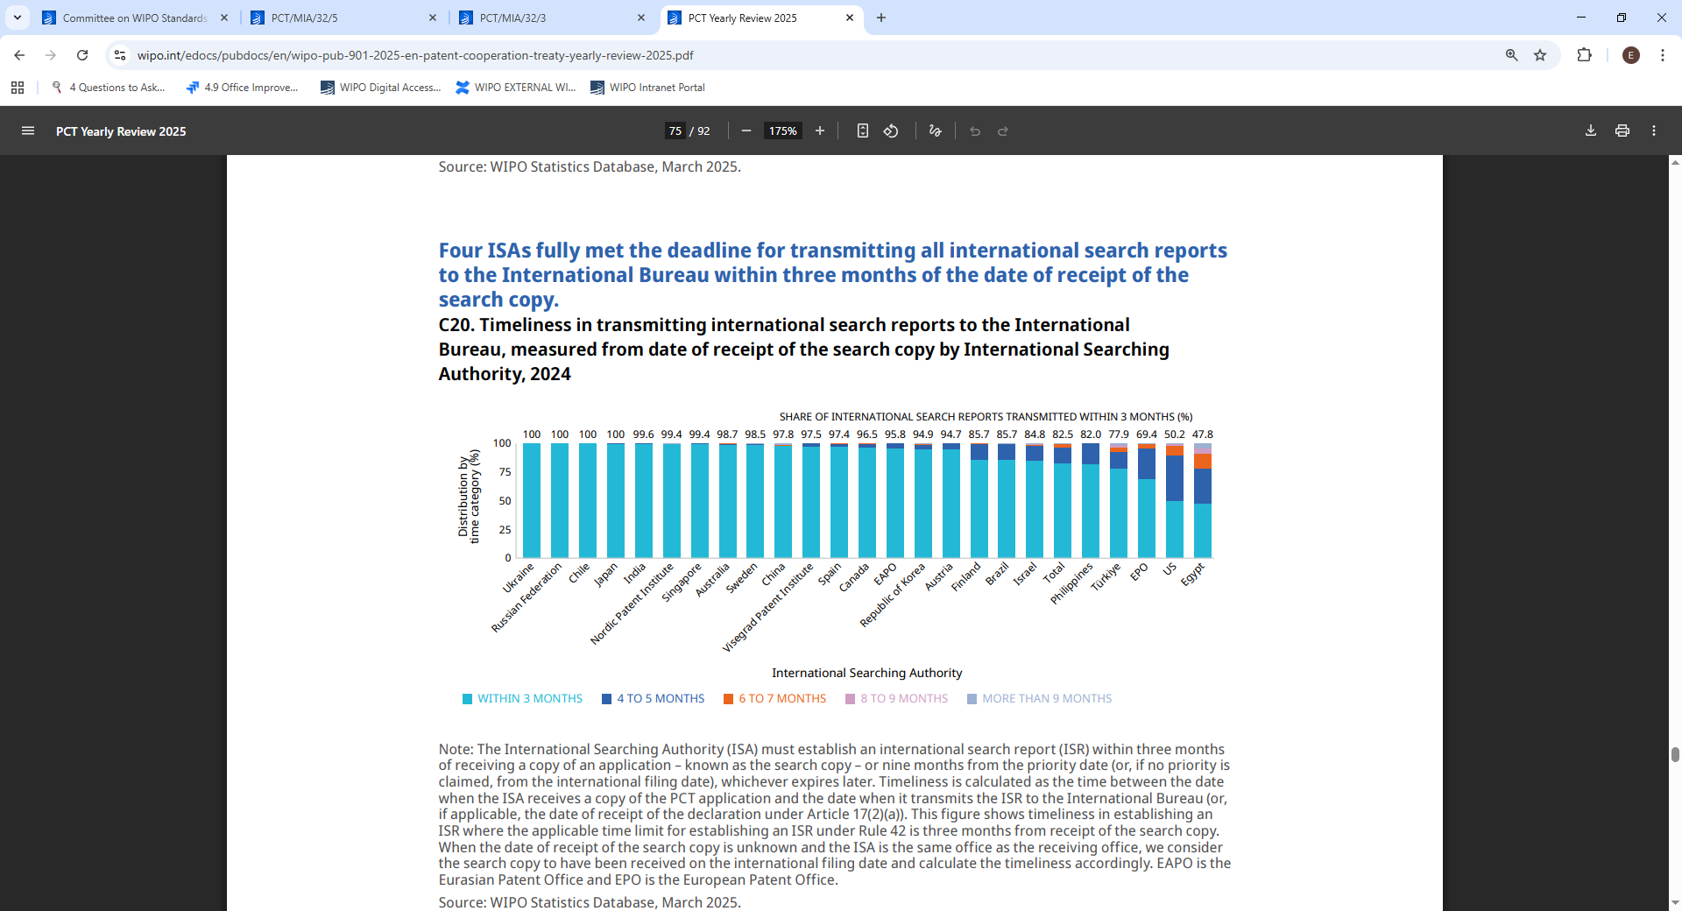
Timeliness in Transmitting ISRs to the IB measured from Date of Receipt of Search Copy by ISA for 2024
In 2024, 82.5% of all ISRs were transmitted within 3 months of date of receipt of search copy (down from 86.3% in 2023)
Source: WIPO statistics database. March 2025. Excludes cases where Rule 42 time limit of 9 months from priority date applies.

Slide 13
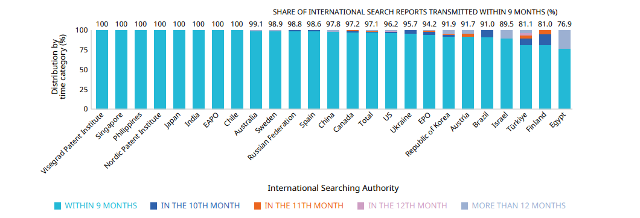
Timeliness in Transmitting ISRs to the IB measured from Priority Date by ISA for 2024
In 2024, 97.1% of all ISRs required to be transmitted to the International Bureau within 9 months of the priority date met this deadline (slightly up from 96.9% in 2023)
Source: WIPO statistics database, March 2025. Excludes cases where Rule 42 time limit of 3 months from date of receipt of search copy applies.

Slide 14
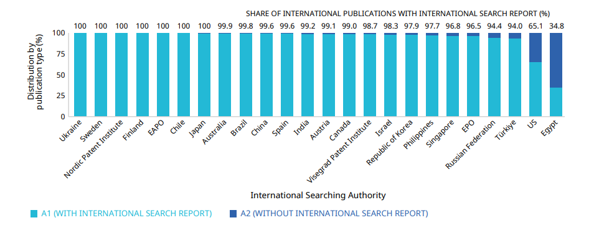
PCT A1 Publication Percentage by ISA in 2024
The International Bureau published more than 94.6% of PCT applications together with an ISR (slightly down from 96.3 % in 2023)
Source: WIPO statistics database. March 2025

Slide 15
Supplementary International Search Requests
 | 2017 | 2018 | 2019 | 2020 | 2021 | 2022 | 2023 | 2024 | 2025 (partial)
Austria | 1 | 1 | 2 | 2 | 1 |  | 3 | 2 | 1
European Patent Office | 40 | 54 | 94 | 50 | 48 | 48 | 28 | 22 | 11
Finland |  |  |  |  |  |  |  |  | 1
Nordic Patent Institute |  |  | 2 | 1 | 1 |  |  | 1 | 2
Russian Federation | 6 |  | 3 | 1 | 3 |  |  |  | 1
Singapore |  | 3 | 4 | 2 |  | 3
Sweden |  | 3 | 1 | 1 | 1 | 1 | 1 |  | 1
Türkiye |  | 1 | 2 | 1
Ukraine | 2 | 1 | 4 | 1 |  | 1 |  | 1 | 1
Visegrad Patent Institute |  |  | 2 | 1
Total | 49 | 63 | 114 | 60 | 54 | 53 | 32 | 26 | 18
Source: WIPO statistics database. Last update : October 2025

Slide 16
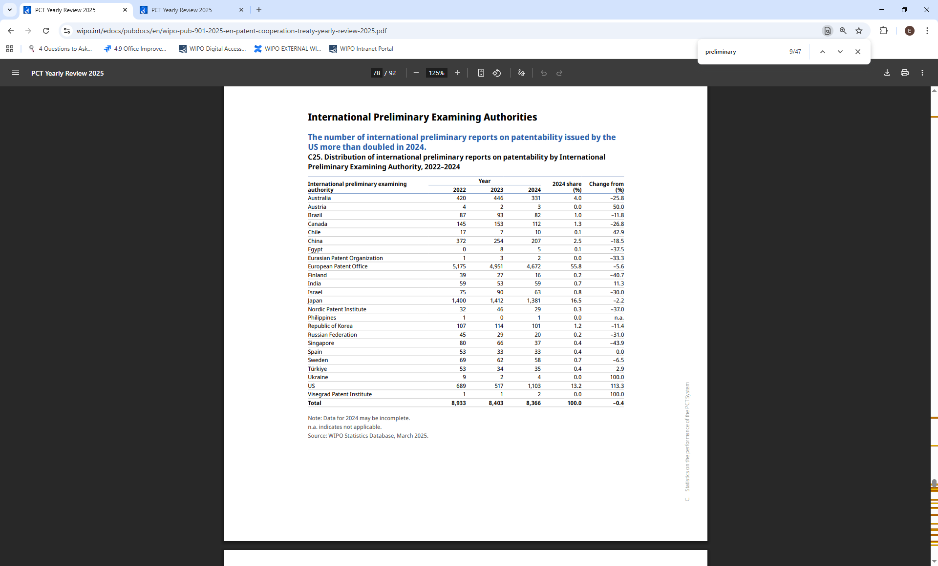
Number of IPRPs issued by IPEA
Overall steady decline continues over the last few years (dropped by further 0.4% in 2024)
EPO, Japan and US issued 85.5% of all Chapter II IPRPs
Reports issued by the US more than doubled in 2024
Note: Data for 2024 may be incomplete
Source: WIPO statistics database, March 2025, PCT Yearly Review 2025

Slide 17
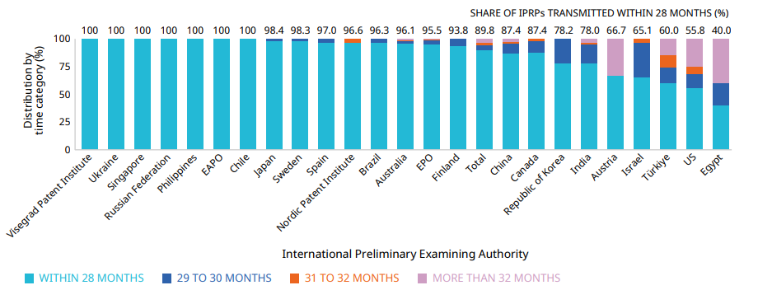
Timeliness in transmitting IPRPs by IPEA in 2024
In 2024, 89.8% of IPRPs were transmitted to the International Bureau within 28 months of the priority date (89.8% in 2023)
Timeliness calculated as time elapsed between priority date and date on which International Bureau received IPRP from IPEA
Source: WIPO statistics database. March 2025

Slide 18
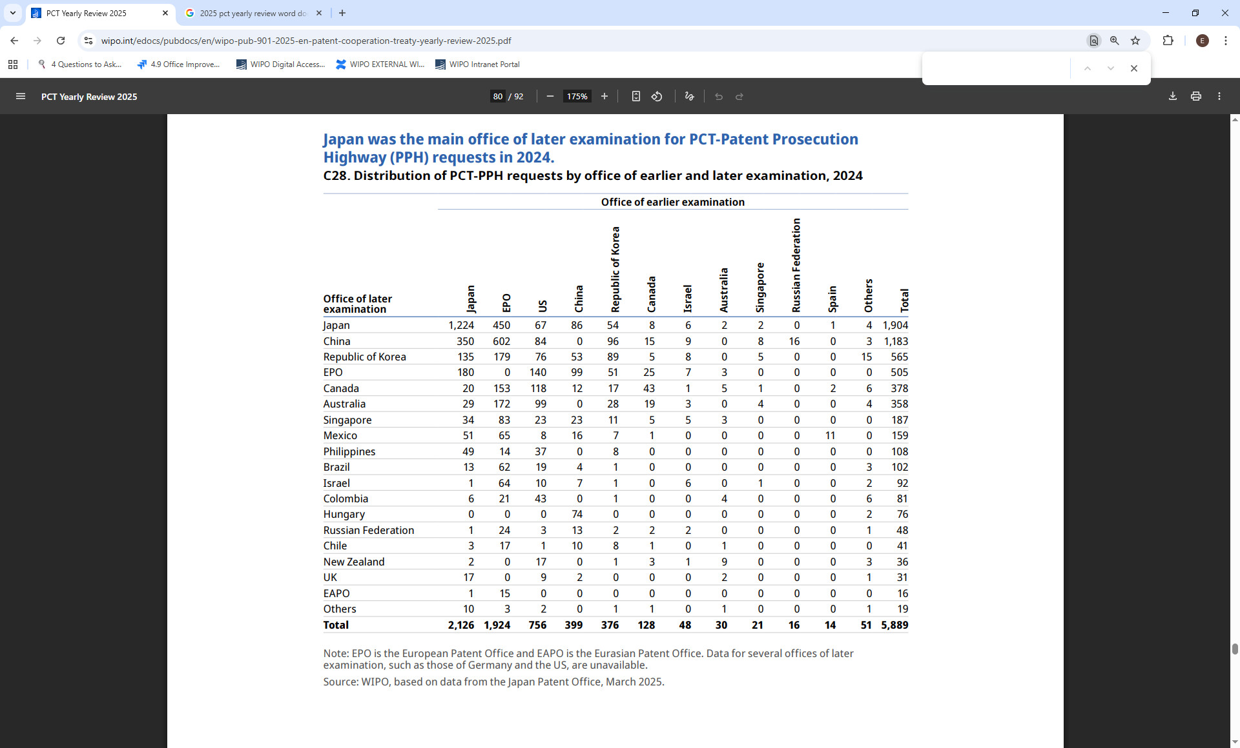
PCT-PPH pilot
Data for some offices of later examination, such as those of Germany and the US, are unavailable.

Slide 19
Applications with Sequence Listings (top 15 ROs)
Around 40,000 PCT applications filed with sequence listings since July 2022 (as of Sept 2025).
Around 13% of these applications have Rule 13ter submissions. 30% of applications with a Rule 13ter submission had a sequence listing in addition to listing as filed.

Slide 20
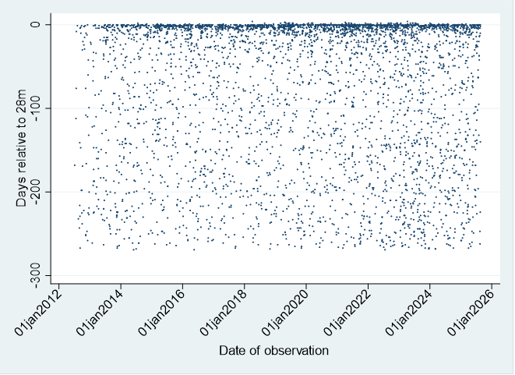
Timing of Third-Party Observations relative to 28 months from Priority Date

Slide 21
Timing of Third-Party Observations from Priority Date (since 2012)

Slide 22
Further information:
2025 PCT Yearly Review
The International Patent System
WIPO Publication No. 901EN/25
WIPO IP Statistics Data Center
http://www.wipo.int/ipstats/en/
IP Facts and Figures
https://www.wipo.int/en/ipfactsandfigures/patents

