Slide 1

PCT Statistics
Meeting of International Authorities
Twenty-Ninth Session
Geneva
June 20 to 22, 2022

Slide 2
Outline
International Filings
  Data for 2021
  Medium of Filing
National Phase Entries
PCT Applications with Sequence Listings
International Authorities
  International Search
  Supplementary International Search
  International Preliminary Examination

Slide 3
PCT Filings in 2021
277,500 international applications filed in 2021 (+0.9%)
Top 5 countries: China (69,540 +0.9%), United States of America (59,570 +1.9%), Japan (50,260 -0.6%), Republic of Korea (20,678 +3.2%) and Germany (17,322 -6.4%)
Top filer: Huawei Technologies (6,952 +27%)
Top educational institution filer: University of California (551)
More information in PCT Yearly Review 2022
Source: PCT Yearly Review 2022

Slide 4
PCT Filings from 2020, month-to-month
Predicted growth for 2022 : between 3% and 3.5%
Source: WIPO Statistics Database, June 2022

Slide 5
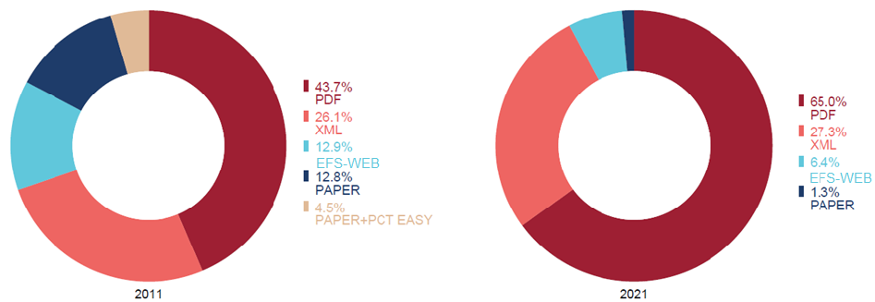
Medium of Filing
10 years
Filing medium distribution for 2021 (2020):
65.0% (70.3%) PDF, 27.3% (28.0%) XML, 1.3% (1.7%) Paper
In 2021, PDF filings rose by 5,468 in 2020, XML filings fell by 1,284, Paper filings fell by 946
Source: WIPO statistics database. June 2022, PCT Yearly Review 2022

Slide 6
Receiving Offices receiving the most Paper Filings in 2021
Percentages show proportion of applications
received on paper at that receiving Office
56%
1.7%
0.6%
0.3%
11.9%
4.3%
0.6%
0.7%
3.1%
100%
3,618 applications received on paper in 2021 (1.3% of total filings) – down from 4,564 in 2020
These 10 Offices account for 69.9% of paper filings
Source: WIPO statistics database. June 2022

Slide 7
PCT National Phase Entries
664,700 total national phase entries in 2020 (-1.7%)
552,900 non-resident national phase entries in 2020 (-2.0%)
PCT system accounted for 56.9% of all non-resident filings in 2020 (56.7% in 2019)
Source: WIPO statistics database. June 2022

Slide 8
Number of PCT applications with a Sequence Listing
4.1%
3.9%
3.7%
3.6%
3.4%
3.4%
3.3%
3.3%
3.1%
3.1%
Number of PCT applications containing a sequence listing as filed or as provided for the purposes of search/examination, and percentage of PCT applications containing a sequence listing
Source: WIPO PCTIS database, June 2022

Slide 9
International Authorities
International Search Reports
  Distribution by International Authority
  ISA Selection and languages for international search
  Timeliness of Transmission to International Bureau
  A1 Publication Percentage
Supplementary International Search Reports
International Preliminary Examination Reports
  Distribution by International Authority
  Timeliness of Transmission to International Bureau

Slide 10
Distribution of ISRs established by ISA
IP5 Offices produce 93.5% of International Search Reports
Data based on international filing year of application
Source: WIPO statistics database. June 2022

Slide 11
Distribution of ISRs established by ISA (excluding IP5 Offices)
Data based on international filing year of application
Source: WIPO statistics database. June 2022

Slide 12

Selection of ISA
77.5% of applications were searched in 2021 by the same Office as ISA that acted as RO
75.6% of ROs accept more than 1 competent ISA:
No ISA choice for 28 ROs
8 possible ISAs
for 5 ROs
Source: WIPO statistics database. June 2022

Slide 13
Languages for the international search
79% of ISAs offer more than one language for the international search, all accept EN
Number of ISAs accepting a given publication language for the search:
7 ISAs also accept at least one language for the search that is not a PCT publication language

Slide 14
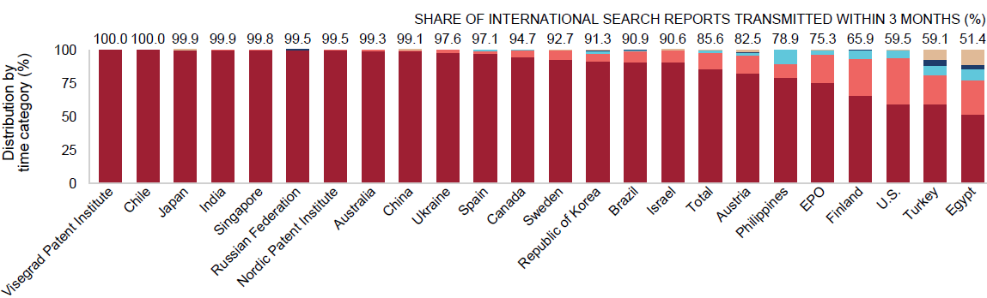
Timeliness in Transmitting ISRs to the IB measured from Date of Receipt of Search Copy by ISA for 2021
All ISRs that ought to be transmitted to the International Bureau within 3 months of the date of receipt of the search copy met this deadline at the Office of Chile and the Visegrad Patent Institute
Source: WIPO statistics database. March 2022. Excludes cases where Rule 42 time limit of 9 months from priority date applies.

Slide 15
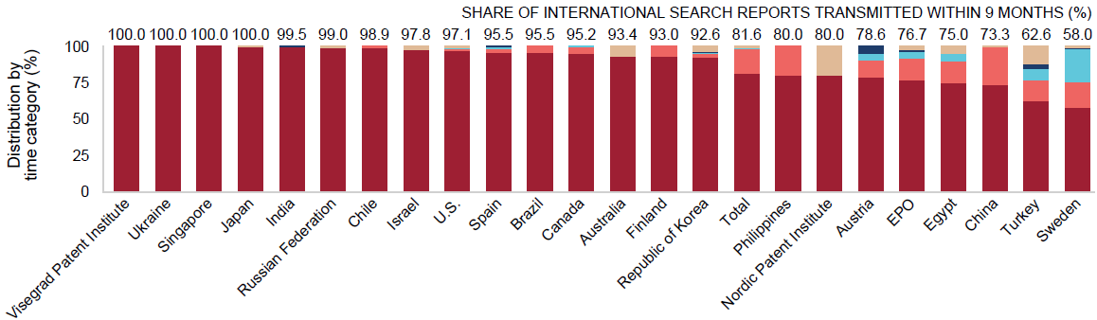
Timeliness in Transmitting ISRs to the IB measured from Priority Date by ISA for 2021
At 15 ISAs, more than 90% of international search reports required to be transmitted to the International Bureau within 9 months of the priority date met the deadline
Source: WIPO statistics database, March 2022. Excludes cases where Rule 42 time limit of 3 months from date of receipt of search copy applies.

Slide 16
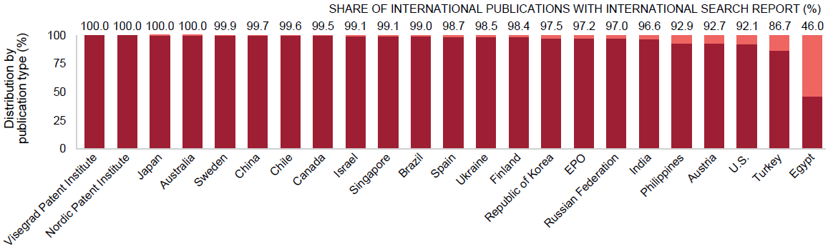
PCT A1 Publication Percentage by ISA in 2021
The International Bureau published more than 90% of PCT applications together with an ISR for 21 of the 23 ISAs
Source: WIPO statistics database. March 2022

Slide 17
Supplementary International Search Requests
 | 2015 | 2016 | 2017 | 2018 | 2019 | 2020 | 2021
Austria | 2 |  | 1 | 1 | 2 | 2 | 1
European Patent Office | 40 | 44 | 40 | 54 | 94 | 50 | 48
Nordic Patent Institute |  |  |  |  | 2 | 1 | 1
Russian Federation | 22 | 3 | 6 |  | 3 | 1 | 3
Singapore |  | 1 |  | 3 | 4 | 2
Sweden |  |  |  | 3 | 1 | 1 | 1
Turkey |  |  |  | 1 | 2 | 1
Ukraine |  |  | 2 | 1 | 4 | 1
Visegrad Patent Institute |  |  |  |  | 2 | 1
Total | 64 | 48 | 49 | 63 | 114 | 60 | 54
Source: WIPO statistics database. March 2022

Slide 18
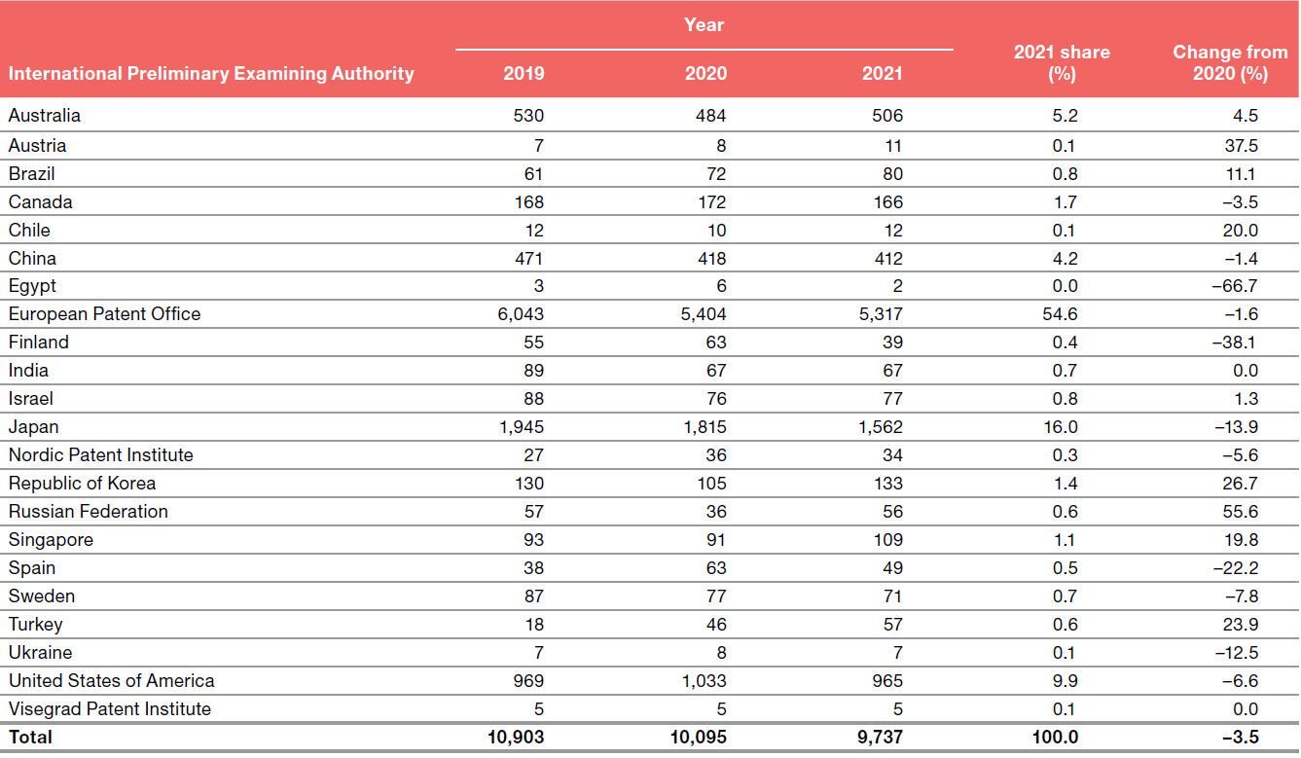
IPRPs Chapter II by IPEA
Number of IPRPs dropped by 3.5% in 2021
Source: WIPO statistics database. March 2022. Data for 2021 may be incomplete

Slide 19
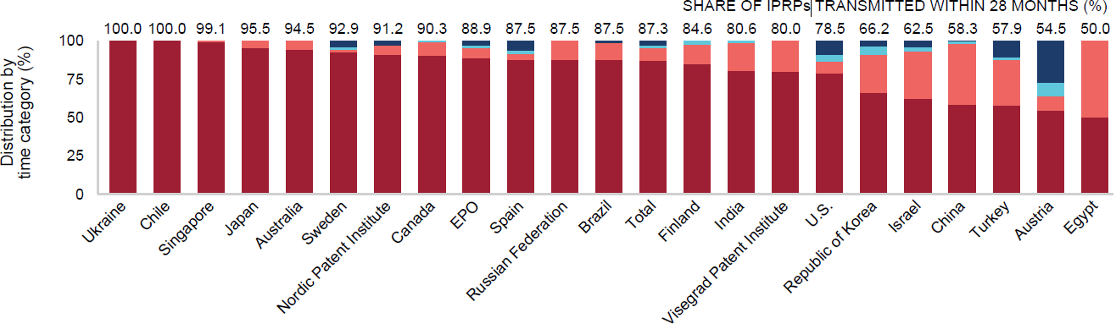
Timeliness in transmitting IPRPs by IPEA in 2021
15 Offices transmitted at least 80% of IPRPs to the International Bureau within 28 months of the priority date
Timeliness calculated as time elapsed between priority date and date on which
International Bureau received IPRP from IPEA
Source: WIPO statistics database. March 2022

Slide 20
Further information:
2022 PCT Yearly Review
The International Patent System
WIPO Publication No. 901E/2022
WIPO IP Statistics Data Center
http://www.wipo.int/ipstats/en/

