Slide 1
CIPO Patent Quality Summit
PCT/MIA Quality Subgroup
Marie Quinn
Program Manager – Quality, Patent Branch, CIPO
February 2020

Slide 2
Welcome to CIPO’s presentation on its Patent Quality Summit!
“
Quality is never an accident. It is always the results of intelligent effort
- John Ruskin
”

Slide 3
AGENDA FOR TODAY’S PRESENTATION
Purpose of the Summit
By the Numbers
Quality Summit
Panels
Workshop insights
Defining Patent Quality
Quality Factors
Publishable Metrics
Summit Feedback
Summary of Key Findings
Next Steps

Slide 4
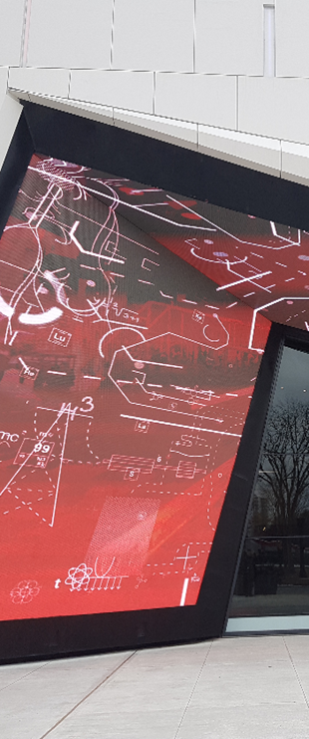
PURPOSE OF THE SUMMIT
The CIPO Patent Quality Summit fostered innovation through enhancing patent quality by:
Engaging participants on quality related topics through panel discussions
Collecting participant feedback on how they define patent quality and what they would like to see in terms of metrics and reporting
Encouraging networking and sharing of perspectives regarding patent quality

Slide 5
CIPO PATENT QUALITY SUMMIT
SUMMIT – BY THE NUMBERS
1-day event – on February 26, 2019 at the Canada Science and Technology Museum
Over 60 participants - including agents, industry, private inventors, Government of Canada agencies, USPTO representatives and CIPO employees
1 keynote speaker - Dr. Khaled El Emam discussed the role of IP in a successful business strategy
6 guest panelists – 3 panel discussions
1 presentation – CIPO QMS presentation
1 interactive workshop – 3 parts

Slide 7
CIPO PATENT QUALITY SUMMIT
SUMMIT - AGENDA
Morning
Keynote Address
Panel Discussions
Search and Patent Quality
AI, Databases, Search tools, client and examiner searching, comprehensive searching, etc.
Obstacles to Patent Quality
Quality vs timeliness vs cost, etc.
Afternoon
CIPO Patent Quality Presentation
Panel Discussion
Listening to our Clients
Workshop
Defining Patent Quality
Prioritization of Quality Factors
Monitoring and Reporting on Patent Quality

Slide 8
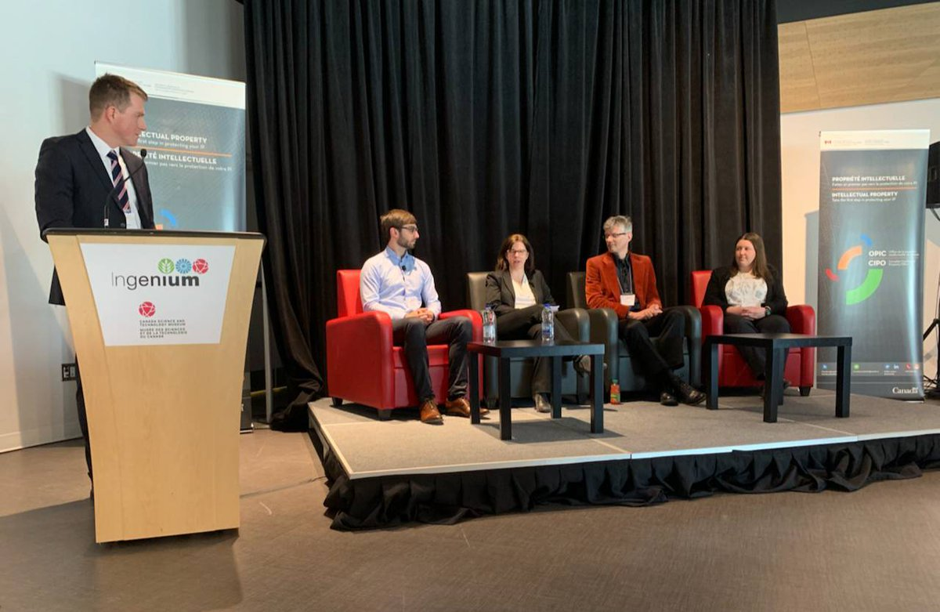
Panel 1: Searching and Patent Quality
Notes:
Panelists
Ian Wetherbee – Engineering Lead for Google Patents
Alexandra Daoud – Patent Agent and Partner at Norton Rose Fulbright
Berry de Bruijn – Researcher, National Research Council
Anne-Marie Garand-Sheridan – Patent Examiner and Search Expert

Slide 9
CIPO PATENT QUALITY SUMMIT
PANEL 1 – SEARCHING AND PATENT QUALITY
Highlights
Searcher must be able to clearly understand the invention
Work done at outset in drafting and communication with searcher lays the ground for a more meaningful search
Trade off between time and quality
Using the appropriate search engine is key to returning most relevant results
Advances will be able to capture meaning of paragraphs or full documents to find relevant hits
AI driven technologies may start to look at whole collections at once
Confidence in ability to know when the search is done

Slide 10
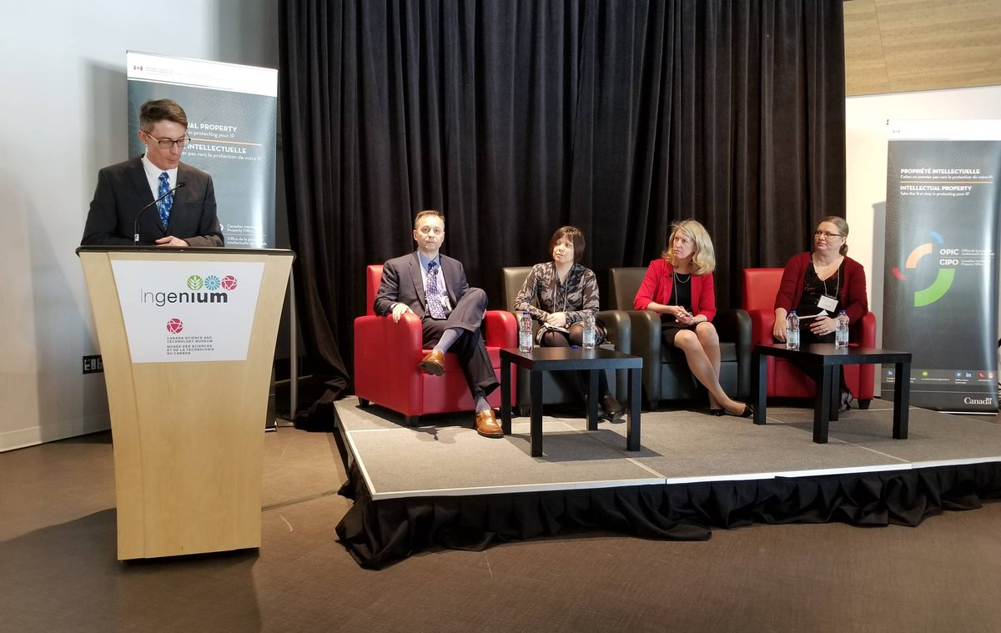
Panel 2: Obstacles to Patent Quality
Notes:
Panelists
Greg Vidovich – Associate Commissioner for Patent Quality, USPTO
Jenna Wilson – Patent Agent, Partner at Wilson Lue, and Chair of the Patent Practice Committee
Catherine Eckenswiller – Legal Counsel, VBI Vaccines Inc.
Kathleen Murphy – Director Biotechnology Division, CIPO

Slide 11
CIPO PATENT QUALITY SUMMIT
PANEL 2 – OBSTACLES TO PATENT QUALITY
Highlights
Patents must be compliant with Act and Rules, enforceable and valuable
Balance between quality, cost and time
both to prepare and examine applications
How to measure quality?
Quality is a shared responsibility between stakeholders and the office

Slide 12
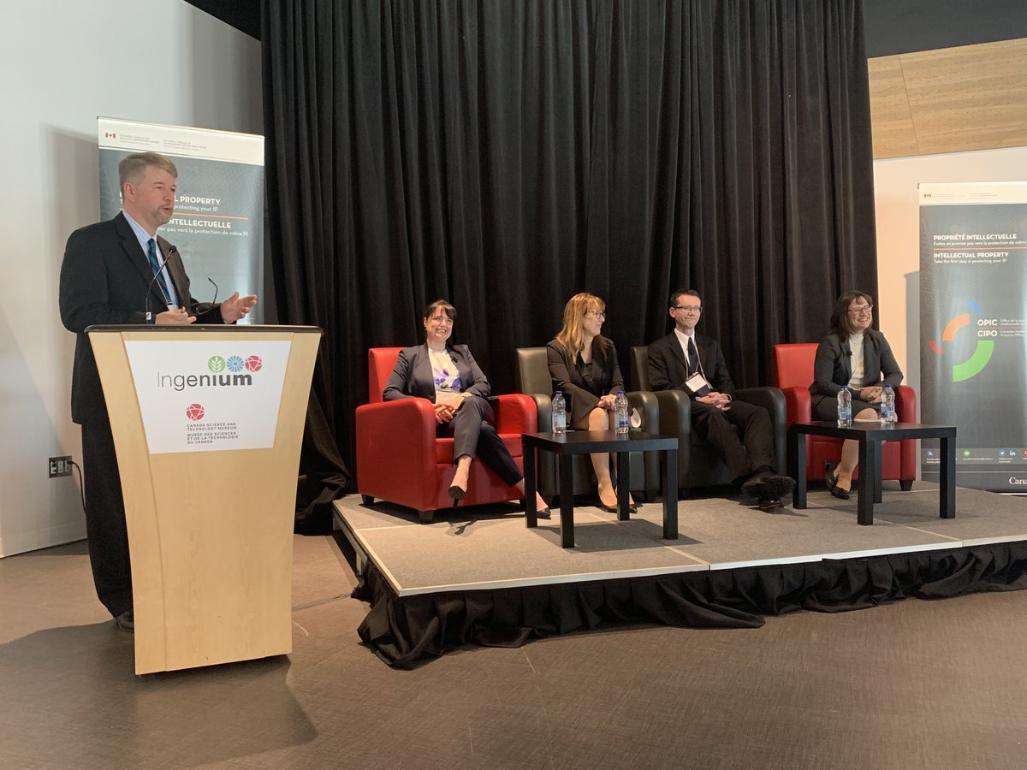
Panel 3: Listening to Our Clients
Notes:
Marie Quinn – Program Manager - Quality, Patent Branch
Stephen MacNeil – Member, Patent Appeal Board
Andrée Patry – Manager, Operations Sector
Christine Piché – Senior Director, Patent Services and Strategic Affairs

Slide 13
CIPO PATENT QUALITY SUMMIT
PANEL 3 – LISTENTING TO OUR CLIENTS
Highlights
CIPO was preparing for the Patent Law Treaty
Mapping updates, addition of QC steps, testing of software, awareness
Review of office correspondence and improvements put into place
Ensured client was well aware of what steps needed to be taken
Should examiner interview service be expanded?
Should CIPO standardize examiner’s reports?
Quality is a shared responsibility between stakeholders and the office

Slide 14
CIPO PATENT QUALITY SUMMIT
WORKSHOP INSIGHTS

Slide 15
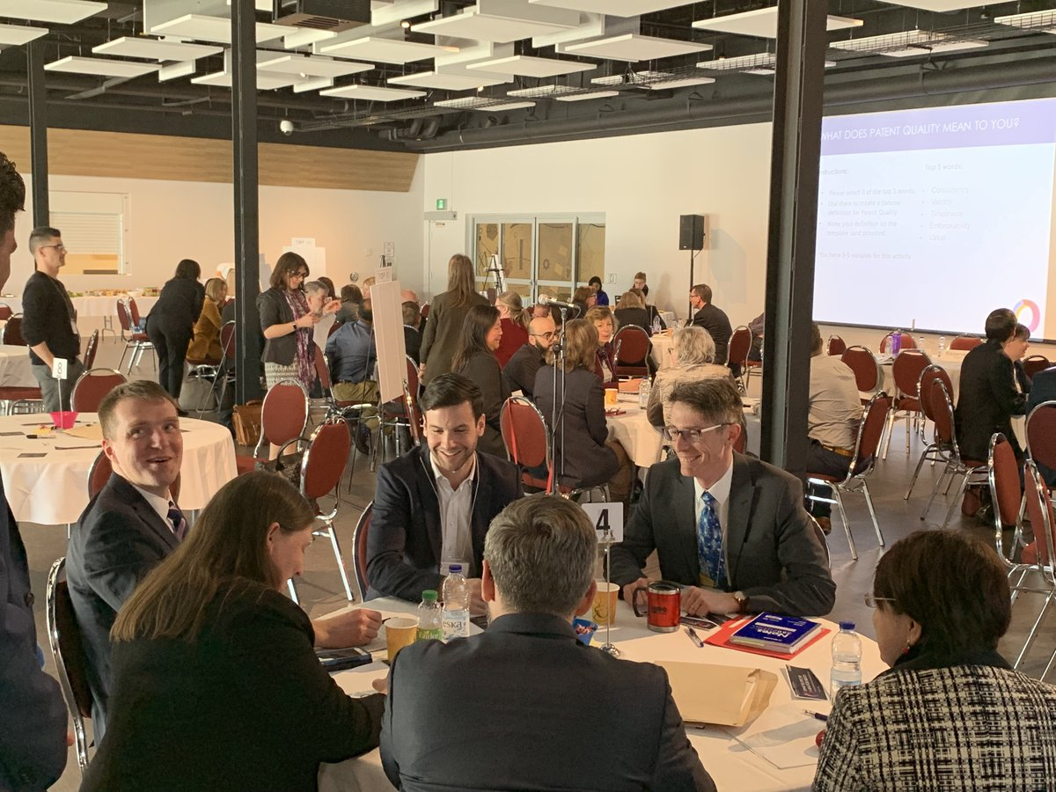

Slide 16
WORDS USED TO DEFINE PATENT QUALITY Workshop part 1 - Defining Patent Quality

Slide 17
DEFINING PATENT QUALITY
HOW DO STAKEHOLDERS DEFINE PATENT QUALITY?
VALUE
CONSISTENCY
VALIDITY
ENFORCEABLE
TIMELINESS

Slide 18
PATENT QUALITY DEFINITION
HOW DO STAKEHOLDERS DEFINE PATENT QUALITY?
An enforceable and valuable patent obtained in a timely manner
begets
drives
Validity
enforceability
value

Slide 19
PATENT QUALITY DEFINITION
HOW DO STAKEHOLDERS DEFINE PATENT QUALITY?
Provide a consistent and timely process in order to provide a valid and enforceable patent having value for the patent holder
Patent Quality refers to a high value property right stemming from an enforceable and valid patent
19

Slide 20
PATENT QUALITY DEFINITION
HOW DO STAKEHOLDERS DEFINE PATENT QUALITY?
Consistent delivery of enforceable patent rights in a timely fashion
A quality patent are high-value enforceable rights in a timely manner
QUALITY MEANS DIFFERENT THINGS TO DIFFERENT PEOPLE

Slide 21
PATENT QUALITY FACTORS
FACTORS AFFECTING QUALITY
Workshop part 2 - Quality Factors
Top 6/20 Quality Factors selected:
Claims granted commensurate in scope with what the applicant has invented and disclosed
Examination of applications and of responses from the applicant is thorough
Application of Canadian Patent Act and Rules and CIPO practices is consistent between all examiners
A comprehensive search of the prior art is conducted by a knowledgeable examiner
Confidence in the expertise and knowledge of the examiner
Correspondence received from the Office is easy to understand and free of errors
21

Slide 22
PATENT QUALITY INPUT
STAKEHOLDER INPUT
Consistency and accuracy are more important than timeliness
Confidence in examiner knowledge is key
Improvement of online services is needed
22

Slide 23
PATENT QUALITY METRICS
MEASURING AND REPORTING ON PATENT QUALITY
Workshop part 3 - Publishable Metrics
Ultimate goal:
To create patent quality dashboards
Determine measureable quality attributes
Stakeholder feedback
From the list of 20 quality factors, pick 3 and identify metrics

Slide 24
PATENT QUALITY METRICS
MEASURING AND REPORTING ON PATENT QUALITY
Ensuring consistency:
Training frequency
Customer survey/complaints review
Audit granted patents
Centralize review of QC
Standardize examiner reports

Slide 25
PATENT QUALITY METRICS
MEASURING AND REPORTING ON PATENT QUALITY
Ensuring error free grants:
Compiling number of grant corrections
Tracking number of errors originating from applicant/office
Quality audit of granted patents
Number of certificates of correction issued per quarter
Number of re-examinations and reissues

Slide 26
PATENT QUALITY METRICS
MEASURING AND REPORTING ON PATENT QUALITY
Ensuring excellence in client service:
Track number of applications filed through website vs. paper
Compile amount of times CIPO website malfunctions
Regular client surveys targeting work products

Slide 27
QUALITY SUMMIT FEEDBACK
SUMMIT – PARTICIPANT FEEDBACK
Clients are more confident knowing that CIPO has a robust QMS system in place where we continually strive to improve our products
Examiner interview service is a very positive initiative.
more frequent
include discussion of more substantive issues
Interview record content

Slide 28
CIPO PATENT QUALITY SUMMIT
SUMMARY OF KEY FINDINGS
2-way street:
Quality is a shared responsibility between stakeholders and the office
Patent quality is influenced by the quality of the application
Clients are more confident knowing that CIPO has a robust QMS system in place
Timeliness:
Quality, timeliness and cost are a balancing act
Consistency and accuracy are more important than timeliness
Examination:
Interview service is a positive initiative
Confidence in examiner knowledge is key
Take action:
Improvement of online services is needed
Sharing of information with stakeholders is appreciated

Slide 29
CIPO PATENT QUALITY SUMMIT
NEXT STEPS
Develop Proposed Quality Dashboards
Dashboard Working Group launched October 2019
Get Feedback on Proposed Quality Dashboards
Follow-up with stakeholders in 2020
Publish Quality Dashboards

Slide 30
Thank you!

Slide 31
Questions?

