Slide 1
EPO’s Quality Management System
EPO: global quality leader in patent products and services
Piotr Wierzejewski
Quality Management
February 2019

Slide 2
Our principles of quality and excellence
Commitment
Active involvement of the
EPO top management
Legal certainty
Granting patents with the highest
presumption of legal validity
Openness
Engaging with users
The EPO
quality
policy
y
Service
Reliable, efficient and effective
services for the benefit of users
and society
Informed decision making
Basing decisions on facts
Involvement
Empowering staff
and management
Continual improvement
Continually improving trainings,
tools, procedures and processes

Slide 3
Users' satisfaction with our core services increased
Source : EPO User satisfaction survey carried out every year.

Slide 4
EPO's position as global leader in quality confirmed by 2018 survey of IAM Magazine
EPO once more ranked n°1 for quality (consistent since 2010)
Quality of patents granted by the EPO assessed as
excellent/very good/good¹:
  91% of the corporate respondents
  93% of the private practitioners
¹ Source : Results of the 2018 benchmarking survey on IP matters carried out by the Intellectual Asset Management (IAM) Magazine.

Slide 5
Methodology of IAM survey 2018
Frequency: yearly
Sample size: 900 respondents among IAM readers
Targeted groups: IP professionals in senior positions:
  Corporate professionals working in IP-owning businesses
  Private practitioners
Geographic repartition of respondents: Europe (38%),
North America (31%), Asia (19%), Rest of the world (12%)
IP offices included in the survey: JPO, KIPO, USPTO, SIPO and EPO

Slide 6
Our strategy to deliver consistent high quality
Recruiting experts and investing in them
Divisions of three examiners and consistent work methods
Largest prior-art databases in the world
Timely delivery of services
A transparent review mechanism of our decisions
Certified Quality Management System
New agile structure mirroring latest technology trends
More service and lower costs for applicants

Slide 7
Continuous recruitment of examiners
6 848
6 850
Total EPO staff
Examiners
(+ 411)
185
157
193
127
Examiners
recruited yearly
182
64
46
103
Other staff
Source : EPO staff figures. Status: 31 Dec 2017.

Slide 8
No outsourcing of the core tasks of examiners
Applicants' files are not processed by third parties
Classification
Examination
Grant
✓
Search
Opposition
Core tasks of EPO examiners

Slide 9
Highly qualified and continually trained examiners
Minimum requirements
Master's degree in physics, chemistry, engineering or natural sciences
Excellent knowledge of one official language (DE, EN, FR) and the ability to understand the other two
In 2017 we received 15 000 job applications and hired only the best 1%
Continuous, career-long training on legal and procedural matters
45.5 days initial instructor-led, interactive, classroom training
First two years: on the job coaching by experienced examiners supervising all activities
In 2017, 94% of all DG1 staff received training
Over 800 technical missions per year to stay in touch with applicants
Low staff turnover of 3.4%

Slide 10
Our strategy to deliver consistent high quality
Recruiting experts and investing in them
Divisions of three examiners and consistent work methods
Largest prior-art databases in the world
Timely delivery of services
A transparent review mechanism of our decisions
Certified Quality Management System
New agile structure mirroring latest technology trends
More service and lower costs for applicants

Slide 11
Consistent methods involving three examiners
per file (1)
One legal framework
The European Patent Convention complemented by extensive, regularly updated guidelines for examinations
A division of three technically qualified examiners to search and examine a file
One examiner carries out search and examination
Agreement from other two examiners required before grant

Slide 12
Consistent methods involving three examiners
per file (2)
Another division of three technically qualified examiners to conduct oppositions
At least two of them must have not been involved in the grant proceedings for the patent
Mixed divisions for files related to several technical fields
Ad-hoc examination divisions composed of examiners across several technical fields
In 2017, about 10% of all decisions were taken by mixed divisions
An independent second instance for appeals
The Boards of Appeal unit

Slide 13
Our strategy to deliver consistent high quality
Recruiting experts and investing in them
Divisions of three examiners and consistent work methods
Largest prior-art databases in the world
Timely delivery of services
A transparent review mechanism of our decisions
Certified Quality Management System
New agile structure mirroring latest technology trends
More service and lower costs for applicants

Slide 14
Largest prior-art databases in the world
World's largest collection of documents
Over 1.3 billion technical records of patent and non-patent literature
Over 50 million patent documents of Asian origin
Over 3 million standards-related documents
CPC¹ becoming the world standard for refined classification
EPOQUE search tool: a benchmark used by examiners worldwide
In 48 patent offices, including Australia, Brazil and China
A
Machine translation from 31 languages into English
谢
¹ Cooperative Patent Classification: classification system for patent documents jointly developed by the EPO and the US Patent and Trademark Office.

Slide 15
Optimisation and enrichment of EPO databases
77
IP
Offices
Deliver patent data in full-text format
Experts
at the EPO
Cross-link related documents
Enrich data with classifications and citations
Build patent families
Standardise inventor and applicant names
EPOQUE
High performing prior-art
search tool
of the EPO
deliver patent data
add value to the data
00101
1011
10110
010110111
00101100101
10110111010

Slide 16
Our strategy to deliver consistent high quality
Recruiting experts and investing in them
Divisions of three examiners and consistent work methods
Largest prior-art databases in the world
Timely delivery of services
A transparent review mechanism of our decisions
Certified Quality Management System
New agile structure mirroring latest technology trends
More service and lower costs for applicants

Slide 17
High quality search and opinion as early as possible
Deliverables
Search reports and thorough written opinions assessing the patentability of the invention
Top-up searches at the start of substantive examination to source documents published after the initial search
Objectives
Identify as early as possible the documents most relevant for
subsequent prosecution
Enable the applicant to assess the merits of the invention early on
Get it right the first time!

Slide 18
Speeding up our work processes
Search reports
Delivering search reports within
6 months of receipt
Examination time
Reducing examination times to just 12 months on average by 2020
Opposition time
Completing oppositions in 15 months on average, while ensuring the parties are heard
Actual Search
timeliness: 4.8 months
Actual Examination timeliness: 22.1 months
Actual duration of oppositions: 22.4 months
6.0
12.0
15.0
4.8
22.1
22.4
Source: EPO data – Quarter 4 2017.

Slide 19
Our strategy to deliver consistent high quality
Recruiting experts and investing in them
Divisions of three examiners and consistent work methods
Largest prior-art databases in the world
Timely delivery of services
A transparent review mechanism of our decisions
Certified Quality Management System
New agile structure mirroring latest technology trends
More service and lower costs for applicants

Slide 20

A transparent review mechanism of our decisions
Applicants have the right to be heard in
oral proceedings (Article 116 EPC)
Any third-party has the possibility to make observations (Article 115 EPC)
Any person may file an opposition to an EPO's decision to grant or refuse a patent
Applicants have the right to appeal
an EPO decision (Article 106 EPC)
The Boards of Appeal unit carries out an independent review at second instance

Slide 21
Our strategy to deliver consistent high quality
Recruiting experts and investing in them
Divisions of three examiners and consistent work methods
Largest prior-art databases in the world
Timely delivery of services
A transparent review mechanism of our decisions
Certified Quality Management System
New agile structure mirroring latest technology trends
More service and lower costs for applicants

Slide 22
Quality Management System certification
No nonconformities
Patent process
ISO 9001:2008 certification
Scope expanded
to include
ISO 9001:2015
+
Patent granting process
Search
Examination
Limitation/revocation
Opposition
Classification
Supporting processes
Patent information and post-grant activities
EP Publication
EP Register and Bulletin
Post-grant fee handling
Audit on preparatory work for UPP to integrate into the patent process¹
Recertification of the patent process
The scope of the QMS is the end-to-end patent process
Surveillance audit of the patent process
Yearly audit to assess the continual improvement and maintenance of the QMS
2014
2015
2016
2017
2018
2014 2015 2016 2017
¹ Ratification pending. Integration in the QMS after a period of operative implementation.

Slide 23
Quality assurance throughout the patent process
Operational Quality Control
of products
and processes
procedure
in place for
non-conforming products
Conformity Assurance for
Search and Examination
in process control
it is applied for all grants
Operational Quality Control
Conformity Assurance for
Search and Examination
Opposition
Metrics
Filing
Search
Examination
Grant
Opposition
Appeal
Quality Audit
Quality Audit
Publication of the application and search report
Publication
of the patent specification

Slide 24
User feedback: a core element of our QMS
Metrics-based feedback
Customer services
Satisfaction surveys
Complaints
Applicant filing patterns
Market Research
Actionable, high value and timely insights
Other patent offices
Statutory bodies
(e.g. SACEPO)
Meetings with applicants /
user groups
Partnership
for quality
EPO staff
Non-metrics-based feedback

Slide 25
EPO user surveys: solid methodology
Ca. 5000 in-depth interviews annually to assess user satisfaction with our services
Search and examination: ca.3 000 interviews
Formalities: ca.1 500 interviews
Opposition: about 400 interviews
Interviews in six languages: EN, DE, FR, JP, CN, KR
Complementary specific satisfaction surveys
i.e. dedicated surveys targeting Asian users
Implementation by a market research specialist: BERENT¹
¹ BERENT is a member of ESOMAR (European Society for Opinion and Marketing Research) and BVM (Berufsverband Deutscher Marktforscher).

Slide 26
Our strategy to deliver consistent high quality
Recruiting experts and investing in them
Divisions of three examiners and consistent work methods
Largest prior-art databases in the world
Timely delivery of services
A transparent review mechanism of our decisions
Certified Quality Management System
New agile structure mirroring latest technology trends
More service and lower costs for applicants

Slide 27
Re-organisation of our patent process end-to-end (1)
Less fragmentation, leaner structure, higher agility
Three broad technical sectors to mirror latest technological trends:
Mobility and Mechatronics
Healthcare, Biotechnology and Chemistry
Information and Communications Technology
One end-to-end process handled by integrated teams
Formalities officers embedded in examiner teams, under one management

Slide 28
Re-organisation of our patent process end-to-end (2)
Higher efficiency in handling oppositions
Opposition work concentrated amongst fewer expert examiners and formalities officers under a dedicated director
Strengthened management oversight and involvement
Executive Operations Committee chaired by the President

Slide 29
Our strategy to deliver consistent high quality
Recruiting experts and investing in them
Divisions of three examiners and consistent work methods
Largest prior-art databases in the world
Timely delivery of services
A transparent review mechanism of our decisions
Certified Quality Management System
New agile structure mirroring latest technology trends
More service and lower costs for applicants

Slide 30
Additional services at lower costs for applicants
More service
Reduced fees
Patent protection in up to 44 countries
38 member states, 2 extension states,
4 validation states (Cambodia, R. of Moldova, Morocco, Tunisia)
Improved timeliness
Accelerated examination
  at EPO via PACE and PPH
  at 15 other offices via PPH agreements
Efficient processing: PCT-Direct
Machine translation of patent documents: Patent Translate
Free online access to over 100 million documents: Espacenet
EP fees stable since 2010
(only slight inflation adjustment)
PCT fees not increased since 2012
(not even for inflation)
From 1.4.2018: PCT fees reduced by 5%
Estimated saving for applicants
25 million Euro in 2018

Slide 31
Interacting with users, training and supporting them
Strengthening our user's understanding with internships
ca. 100 EPO examiners on internships with patent attorneys in 2018
in Europe, the US, Japan, China and R. Korea
Sharing our expertise with users on events and training
Patent drafting training to improve the quality of incoming applications
Informing on our patenting practices in key technology fields such as Artificial intelligence, Life sciences, Computer Implemented Inventions
Delivering direct support for our products and services
EPO Account Managers dedicated to supporting our top 600 users

Slide 32

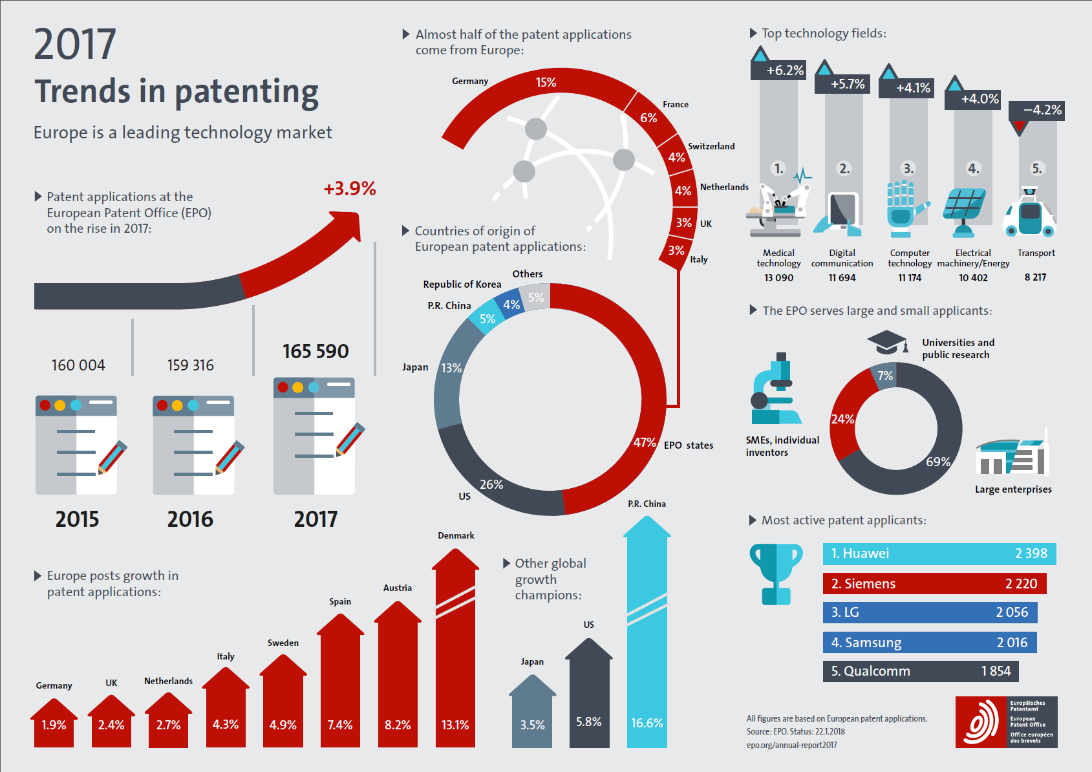
Read more on our quality deliverables
Quality Report 2017
Quality indicators are integrated in the Annual Report
epo.org/quality
epo.org/annual-report2017

Slide 33




Need more information?
Visit epo.org/quality
Follow us on
facebook.com/europeanpatentoffice
twitter.com/EPOorg
youtube.com/EPOfilms
linkedin.com/company/european-patent-office
Contact us via epo.org/contact

