Slide 1
Meeting of International Authorities under the Patent Cooperation Treaty (PCT) : QUALITY SUBGROUP
8th Informal Session

Slide 2
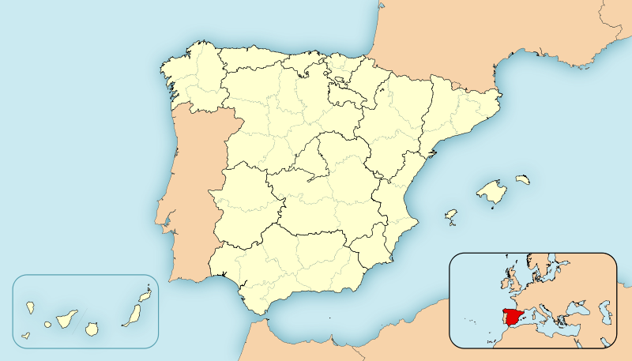
SPAIN
Kingdom of Spain: Parlamentary democracy and constitutional monarchy
Population: 46,77 millions
Member of the following IP related organizations:
World Intellectual Property Organization (WIPO)
European Patent Organization (EPO)
European Union Intellectual Property Office (EUIPO)
Programa Iberoamericano de Propiedad Industrial y Promoción del Desarrollo (IBEPI)

Slide 3
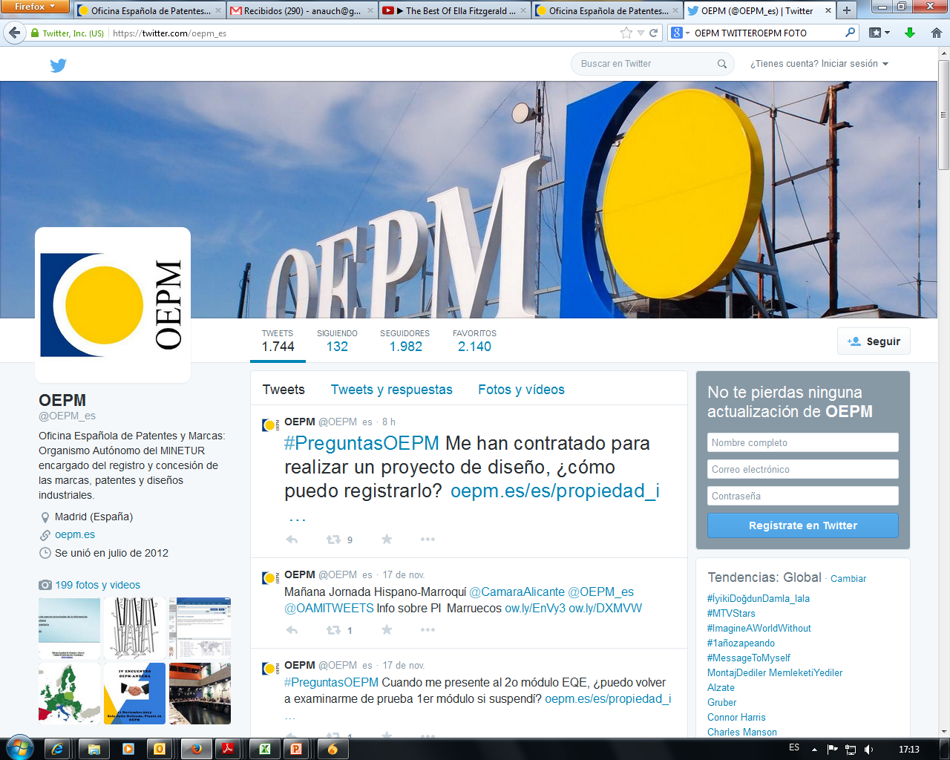
The Spanish Patent and Trademark Office (SPTO) is an autonomous body. It promotes and supports technological and economic development providing legal protection to Industrial Property by awarding:
      Patents
      Industrial Designs
      Trademarks
The SPTO also:
      Disseminates information on the various ways in which IP can be protected
      Represents Spain in international forums and organizations IP related

Slide 4
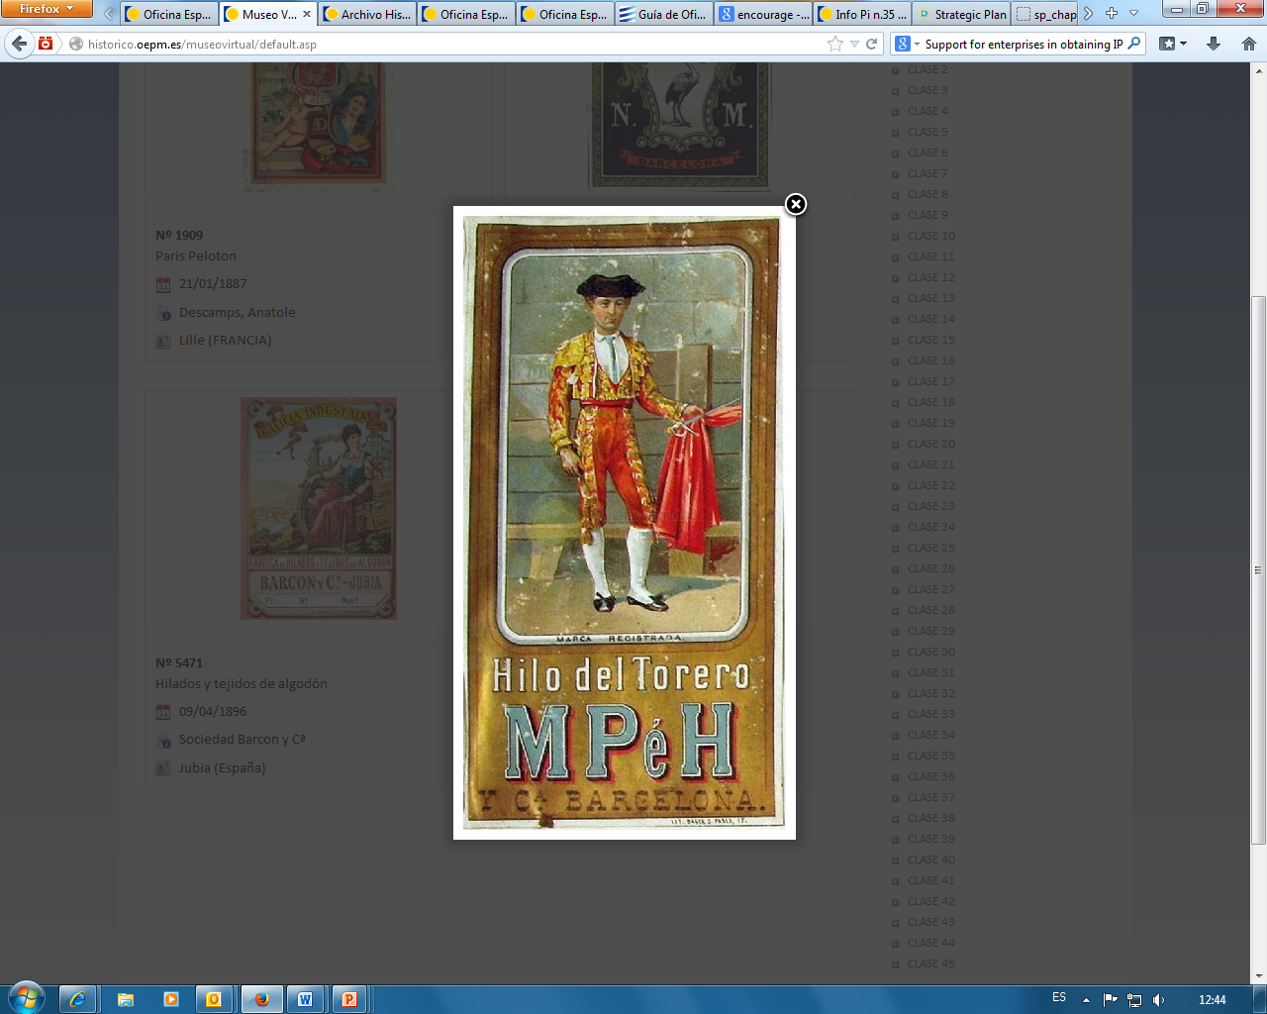
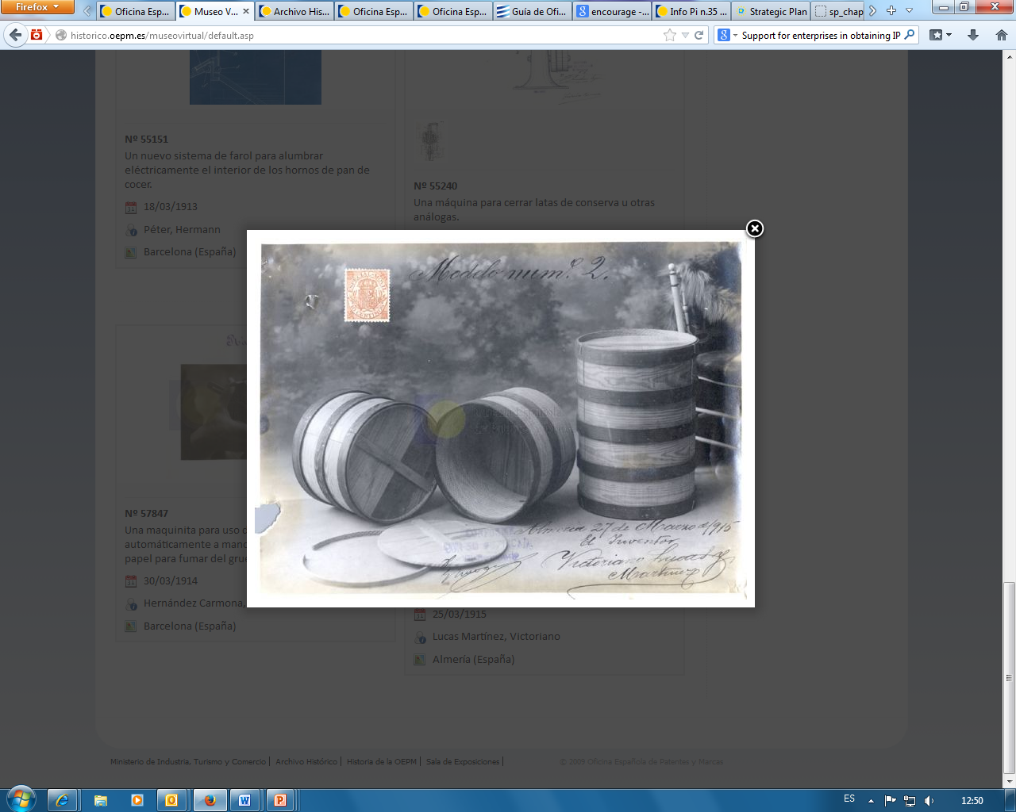
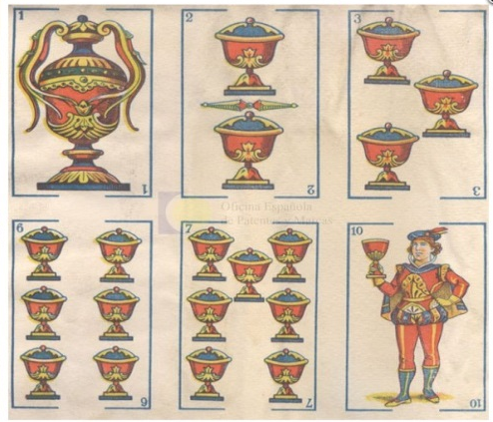
SPTO | Historical Reference
1820: Creation of the Royal Conservatory of Arts and Crafts.
1887: Special Department of Patents, Trademarks and Industry.
1903: Industrial Property Register
1975: Industrial Property Register became an autonomous body
1992: Spanish Patent and Trademark Office.

Slide 5
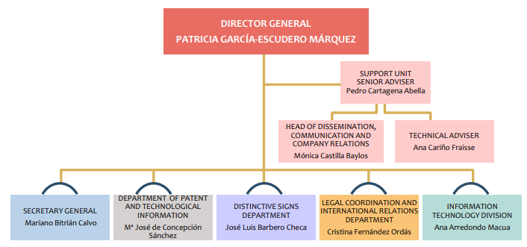
SPTO | STRUCTURE

Slide 6
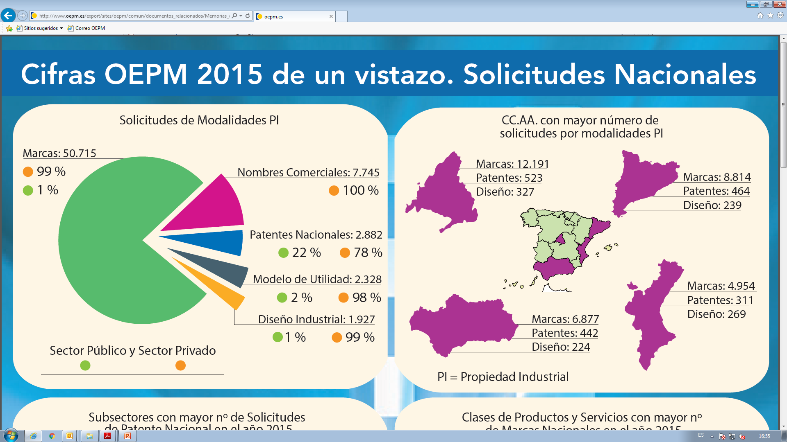
SPANISH PATENT AND TRADEMARK OFFICE (SPTO)
IP APPLICATIONS
TRADEMARKS
TRADENAMES
PATENTS
UTILITY MODELS
INDUSTRIAL DESIGNS
PUBLIC SECTOR
PRIVATE SECTOR

Slide 7
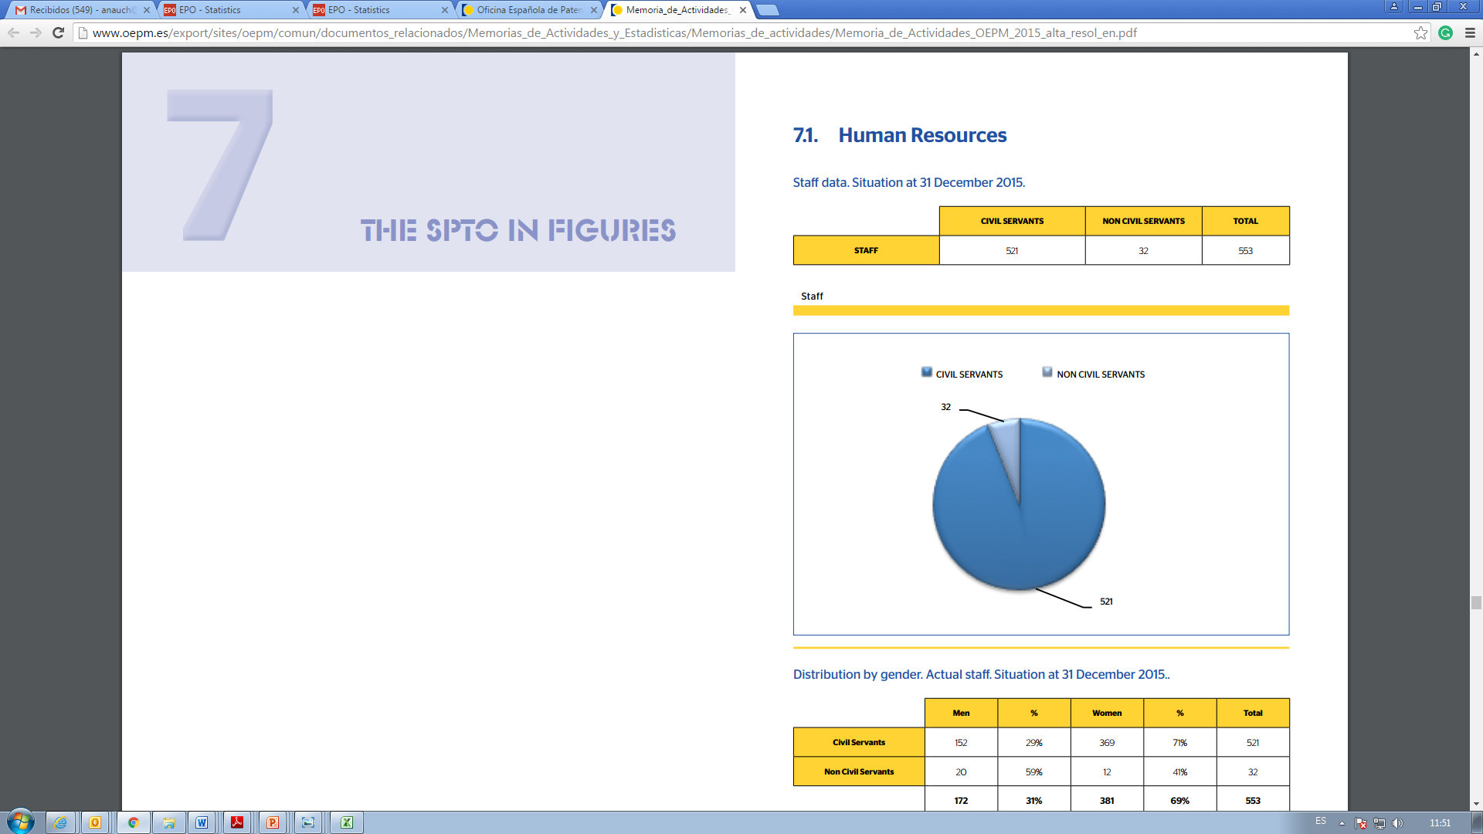
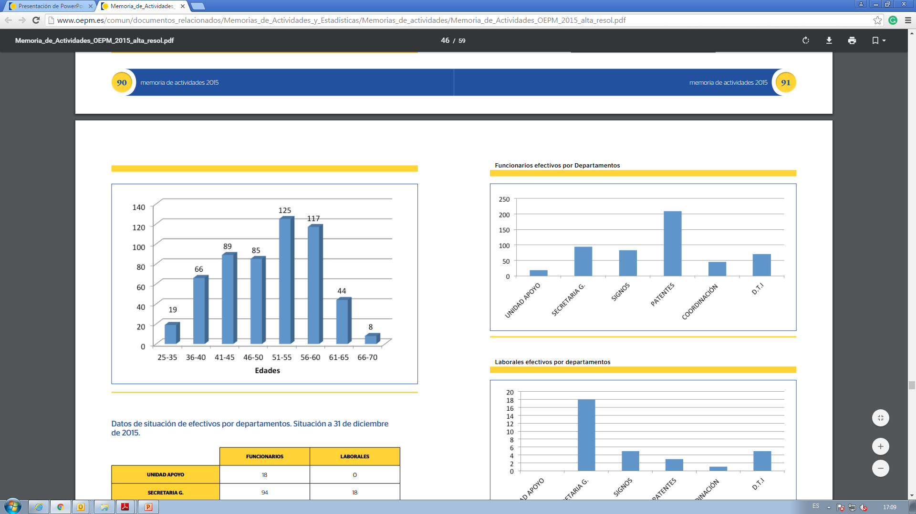
SPTO| HUMAN RESOURCES
553 EMPLOYEES

Slide 8
SPTO | INTERNATIONAL RELATIONS
World Intellectual Property Organization (WIPO)
European Patent Office (EPO)
European Union Intellectual Property Office (EUIPO)
EU IP Working Groups
Patent Prosecution Highway (PPH)
MoUs, Bilateral agreements

Slide 9




SPTO-WIPO COOPERATION
LATIPAT:
Memorandum of Understanding between WIPO-EPO-SPTO: Project for promoting the exchange of information on patents and improving the electronic publication of patent information by Latin American Industrial Property Offices. Patent database in Spanish.
FIT/ES:
Trust fund created in 2004 for financing projects and activities in Latin America
SPTO-WIPO MEMORANDUM FOR COUNTRIES IN TRANSITION:
Training activities in European and Eastern countries and ex Soviet republics.
Projects: LATIPAT, Regional Seminars, Ibero-American IP Programme and development promotion, Case law database, Trademark and Patent Manuals
Specific collaboration in other areas: itinerant WIPO seminars in Spain

Slide 10
SPTO CONTRIBUTION TO LATIN AMERICAN PATENT SYSTEM
CIBIT PROGRAM
DISTANCE LEARNING COURSES
Patent online course
CIBIT: Capacity-building program in patent search and technological information
6 months - 1 year stay at SPTO headquarters.
Guided training in patent databases and non-patent literature
Since 2002, more than 60 participants
2018, 5 participants foreseen
Cooperation Agreement between the SPTO and the CEDDET Foundation (e- learning Academy) for the development of Latin America, organising IP courses and seminars
IP experts network with more than 1,000 participants
Judges and prosecutors IP online course

Slide 11
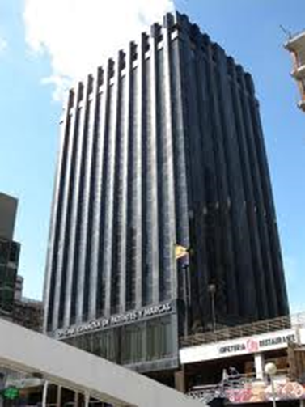
SPTO: INFORMATION SERVICES
SMEs Support Service
Patent examiner on duty
Trademark examiner on duty
Technological information Service
Frontdesk Information Service

Slide 12
SPTO|PATENTS
New Spanish Patent Law – Act 24/2015, of 24 July – entered into force on 1 April 2017. It equated the Spanish Patent legislation with the international law and strengthened the Spanish National Patent System.
Main changes
The granting procedure is changed to a single procedure with a prior examination of novelty and inventive step.
The new system reduces administrative charges and speeds up procedures.
The regulation on “compulsory licences” is simplified.
Supplementary Protection Certificates (SPC) are expressly included .
SPTO is now competent for the promotion and development of mediation and arbitration.
Fee reduction up to a 50% for application, patent search and examination for certain entrepreneurs, SMEs and universities.

Slide 13
SPTO|PCT
1993- SPTO APPOINTED AS ISA
2001- SPTO APPOINTED AS IPEA
2018- SPTO EXTENDED AS ISA/IPEA
1989- SPAIN JOINED THE PCT
1995- SPTO ACTING AS ISA
2003- SPTO ACTING AS IPEA
The SPTO was the first ISA/IPEA accepting PCT applications in Spanish
The SPTO, from the beginning, met all substantive requirements for being a PCT International Authority. This included, for example, a Quality Management System, which the PCT system has implemented in recent years.
The SPTO is competent for international applications filed at the following receiving Offices: Chile, Colombia, Costa Rica, Cuba, Dominican Republic, Ecuador, El Salvador, Guatemala, Honduras, Mexico, Nicaragua, Panama, Peru and Spain.

Slide 14
SPTO|PCT
LATEST PCT NEWS IN SPAIN
Appointment as ISA/IPEA extended for 10 years
Promotion of electronic exchanges of information between offices:
PCT Paperless Project with EPO
e-Search Copy with IB, MX, CL, PA, PE.. (and more to come)
English accepted for international search and for international preliminary examination (and, of course, Spanish)

Slide 15
SPTO|QUALITY
Certified by ISO 9001:2015
International patent applications (PCT)
Technological information services
National IP applications (trademarks, designs and patents)
Restoration and re-establishment of rights (patents)
Appeals
Licenses and transfers of righs (patents)
European patent validation
Certified by UNE 166006:2011
Technological surveillance system

Slide 16
www.oepm.es

