Slide 1
IPOS’ Quality Management System under ISO 9001 Standard
Seong Loong Lo
Principal Patent Examiner
Intellectual Property Office of Singapore

Slide 2
Quality Management System (QMS)
Fully comply with the requirements of ISO 9001 Standard
  Certified to ISO 9001:2008 in November 2014
  Certified to ISO 9001:2015 in October 2017
ISO-certified processes
  International (PCT) search and examination
  National search and examination
  Patent analytics services

Slide 3
Quality Objectives
“Our quality objectives are to provide high quality search and examination products and services that are valid, reliable, delivered in an efficient manner.”
 | Validity | Reliability
Search | Employing an appropriate search strategy, and using a comprehensive set of authoritative sources of information | Sufficiently documented to permit a reproducible and consistent search result
Examination | The law is correctly interpreted and logically applied to arrive at a sound decision, and where that decision and its basis are clearly communicated to the customer | Using a consistent approach based on an open and transparent set of Guidelines, and where considerations for arriving at a decision have been documented to show that Guidelines have indeed been followed during the examination

Slide 4
PDCA Cycle in the QMS
Formulating patent examination policy
Management, Senior Examiners and
Supporting Offices*
- Quality policy and objectives
- SOPs, resources and infrastructure
Implementation on the processes
Communications on quality policy
Setting up of workflow and procedures
Provision of training to staff
Competency Framework
Follow-up actions
Management
Operations
Relevant Supporting Offices*
Evaluation of the performance
Regular Management Reviews
Conformity levels (QC & QA, efficiency)
Internal & external audits
Customer feedback
* Supporting Offices
Quality Mgmt Office
PCT Task Force
Examination Standards Office
Search Standards Office
Training
Cadre
Learning & Development

Slide 5
The ISO Compliance Matrix
Clause in ISO 9001:2015 | Main Requirements | Ch.21 of ISPE GLs
Context of the organisation | Organisational structure & Scope of QMS | Leadership & policy
Leadership | Policy, roles, responsibilities & authorities
Planning | Risk assessment & Quality objectives | Resources Mgmt of workload Communication Documentation (incl. search process)
Support | Resources, competence, communication, documented info
Operation | Requirements for products & services, provision of products and services
Performance evaluation | Quality control and quality assurance Internal audit | Quality assurance Internal review
Improvement | Nonconformity and corrective action | Communication

Slide 6
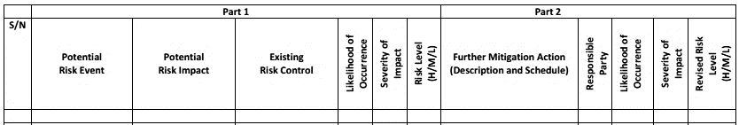
Unique Features in the QMS: Risk Management
Risk assessment & management
  Strategic level: SWOT analysis during the annual planning process
  Operational level: risk assessment during planning and execution of the product realization processes

Slide 7
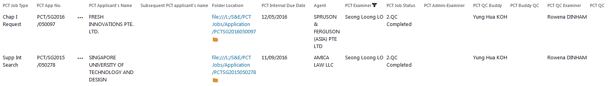
Unique Features in the QMS: Workflow Management
Workflow management system
  Microsoft SharePoint
  Create task and notify examiner by email
  Provide deadline and latest status of each task

Slide 8
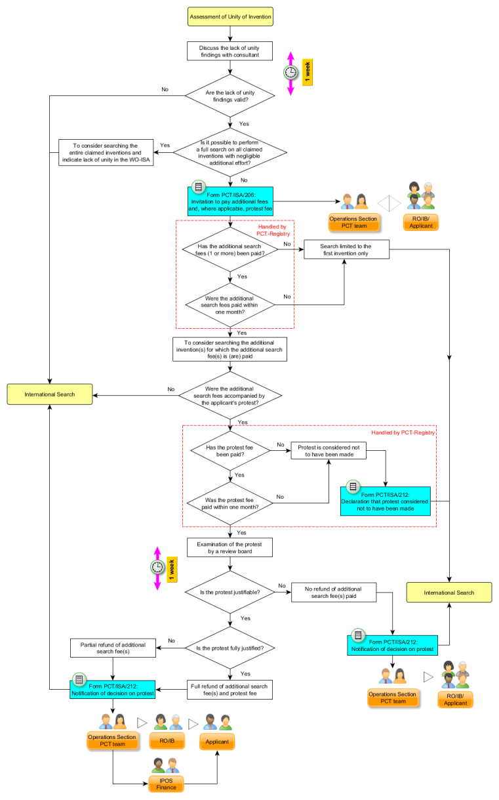
Unique Features in the QMS: Flowcharts
Use of flowcharts
  For training purpose – overview of the processes
  As part of the SOPs – for quick decision-making

Slide 9

Unique Features in the QMS: Example of Flowcharts

Slide 11
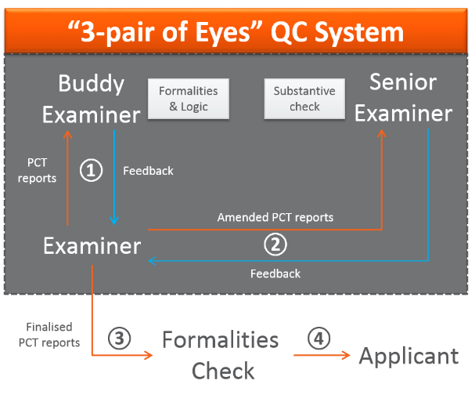
Unique Features in the QMS: Quality Control System
“3-pair of eyes” QC system
  Search team discussion
  100% QC with QC form for quantitative measure of levels of conformance

Slide 12
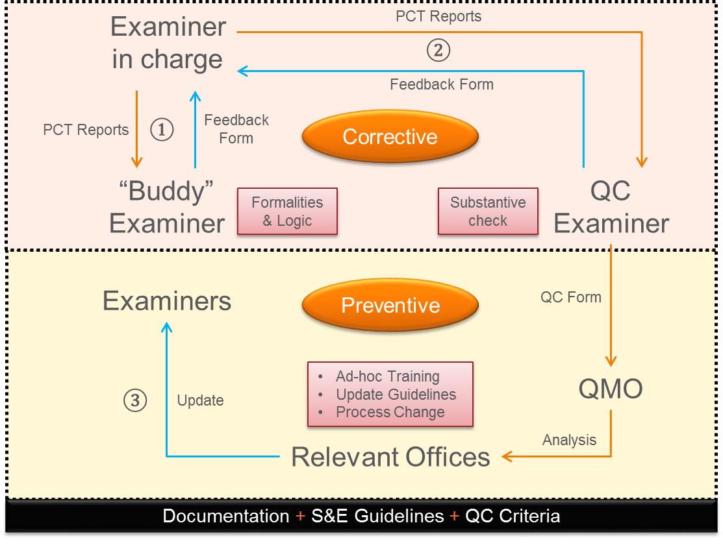
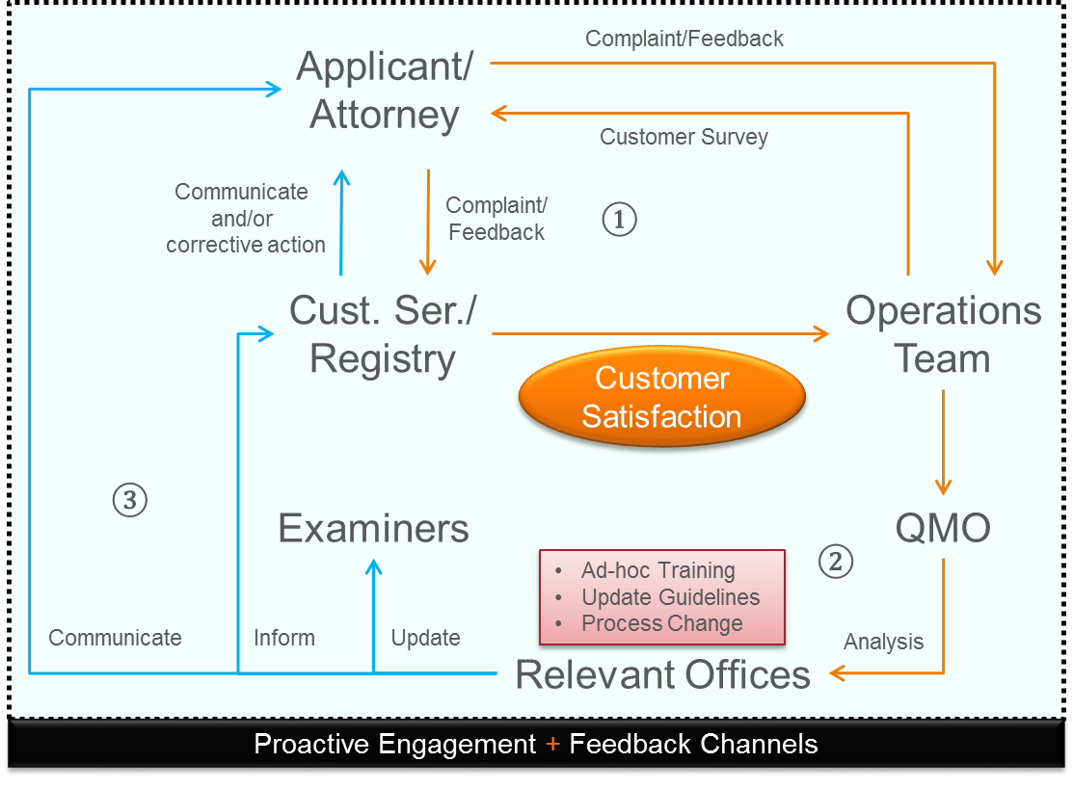
Unique Features in the QMS: Feedback Systems
Internal and external feedback systems
  Input based on QC forms and customer satisfaction survey forms
  Analysis by QMO and follow-up actions by relevant offices or management

Slide 13
Performance Indicators
PRODUCING QUALITY REPORTS
>980
~12
>130
International
Search Reports¹
Percent ISRs
from foreign
ROs
International
Preliminary Report
on Patentability
(Chapter II)²
^{1,2} WIPO Statistics Data Centre (accurate as of 13 Feb 2018)

Slide 14
Performance Indicators
ENSURING QUALITY AND TIMELINESS
99.5
94.5
100
Percent of
ISRs
issued within
3 months¹
Percent ISRs
with at least one
X/Y/E citation²
Percent of
IPRP-II
issued within
28 months³
^{1,3} WIPO Statistics Data Centre (accurate as of 13 Feb 2018)
² Annex to PCT Circular C. PCT 1524

Slide 15



IPOS’ Commitment to Quality
A
语
あ
Certified to ISO 9001:2008 in Nov 2014
Certified to ISO 9001:2015 in Oct 2017
ISO certification
*
94.5% of ISR with at least one X or Y citation
Multi-language citations (EN, CN, JP, KR)
Citations
Deliver high quality reports in a timely manner
SOPs with flowcharts
3-member search team
100% QC with additional formalities check
99.5% ISR issued within 3 months
100% IPRP-II issued within 28 months
^
Quality control
Timeliness
* Annex to PCT Circular C. PCT 1524
^ WIPO Statistics Data Centre (accurate as of 13 Feb 2018)

Slide 16
THANK YOU

