Slide 1

PCT Statistics
Meeting of International Authorities
Twenty-Third Session
Santiago
January 20 to 22, 2016

Slide 2
Outline
International Applications Filed
  Overall Trends and Forecasts
  Medium of Filing
  Languages
National Phase Entries
International Authorities
  International Search
  Supplementary International Search
  International Preliminary Examination

Slide 3
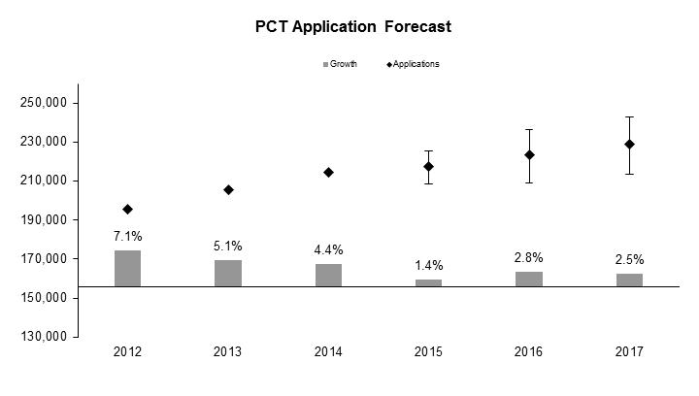
PCT Application Filings
229,000
223,400
217,300
214,316
205,290
195,335
Source: Economics and Statistics Division, WIPO

Slide 4
Monthly Filing Trends
Source: Economics and Statistics Division, WIPO

Slide 5
Medium of Filing
Distribution in 2015 – 2014 distribution in parenthesis:
5.4% paper (6.4%), 1.0% (2.4%) PCT-EASY,
93.6% (91.3%) fully electronic [PDF 64.9% (65.2%), XML 28.7% (26.1%)]

Slide 6
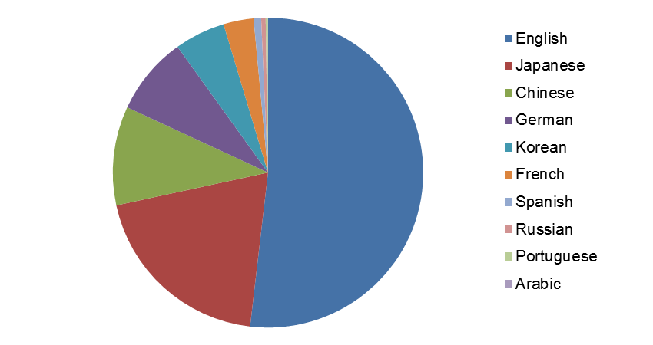
Publication Languages in 2015
Source: WIPO statistics database. January 2016

Slide 7
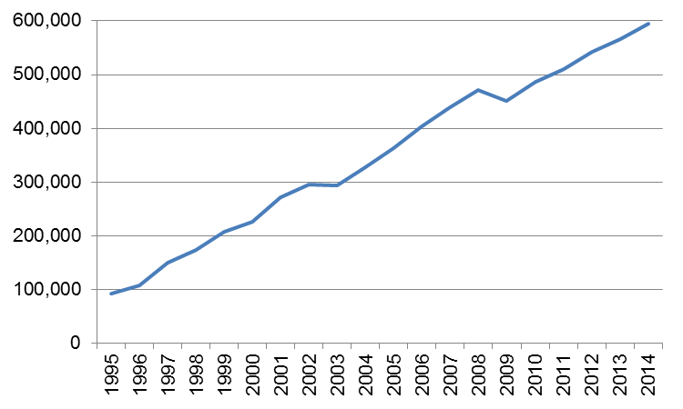
PCT National Phase Entries
595,400 total national phase entries in 2014 (+5.2%)
501,900 non-resident national phase entries in 2014 (+5.5%) –
57.0% of all non-resident patent applications (55.6% in 2013)
57.0% of non-resident applications in 2014 are PCT national phase entries
Source: WIPO statistics database. December 2015

Slide 8
International Authorities
International Search Reports
  Distribution by International Authority
  Timeliness of Transmission to International Bureau
Supplementary International Search Reports
International Preliminary Examination Reports
  Demand
  Distribution by International Authority
  Timelines of Transmission to International Bureau

Slide 9
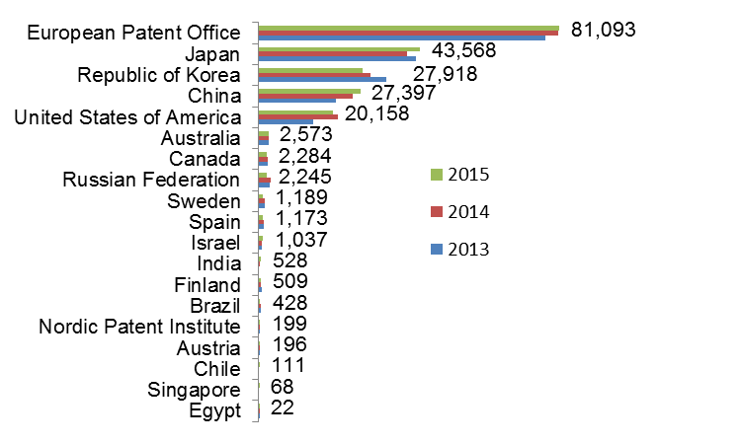
Distribution of ISRs established by ISA
Data based on international filing year of application
Data for 2015 are incomplete
Source: WIPO statistics database. January 2016

Slide 10
Average Timeliness in transmitting ISRs to the IB from Date of Receipt of Search Copy
Source: WIPO statistics database, March 2014. Excludes cases where the time limit of 9 months from the priority date applies.
Average timeliness in transmitting ISRs to the IB was 3.6 months in 2014 - shortest time since 2001
67% of PCT applications transmitted to IB within 3 months from date of receipt of search copy in 2014 – expected to rise to just under 76% for 2015

Slide 11
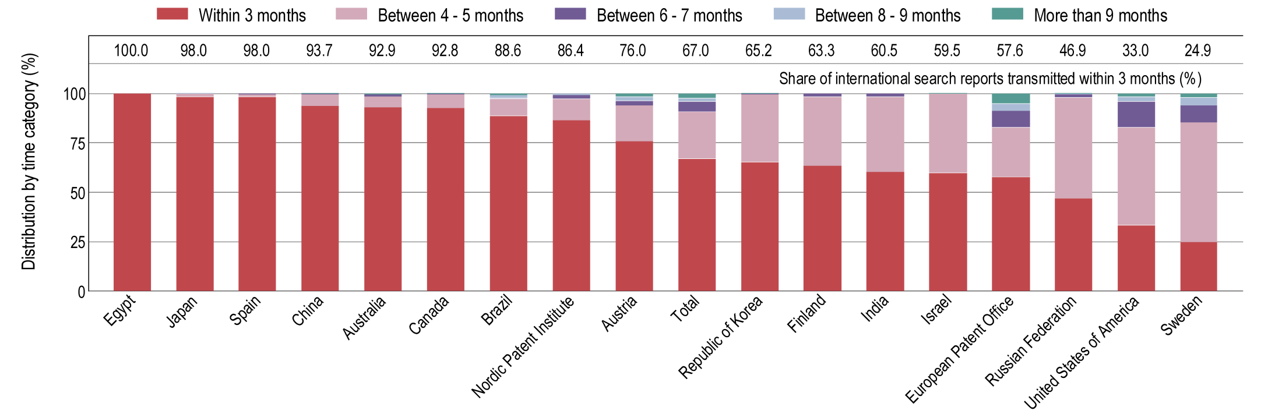
Timeliness in Transmitting ISRs to the IB measured from Date of Receipt of Search Copy by ISA for 2014
100
89.4
99.1
96.6
91.9
95.0
81.4
87.0
80.2
75.8
90.4
75.2
38.6
55.6
68.2
55.6
39.0
26.8
Provisional share transmitted within 3 months for 2015 (for comparison)
Source: WIPO statistics database, March 2015 and January 2016. Excludes cases where the time limit of 9 months from the priority date applies.

Slide 12
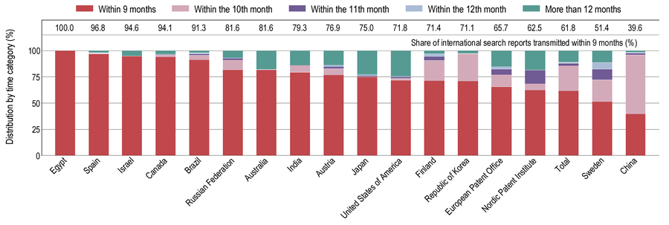
Timeliness in Transmitting ISRs to the IB measured from Priority Date by ISA for 2014
Source: WIPO statistics database, March 2015. Excludes cases where the time limit of 3 months from receipt of search copy applies.

Slide 13
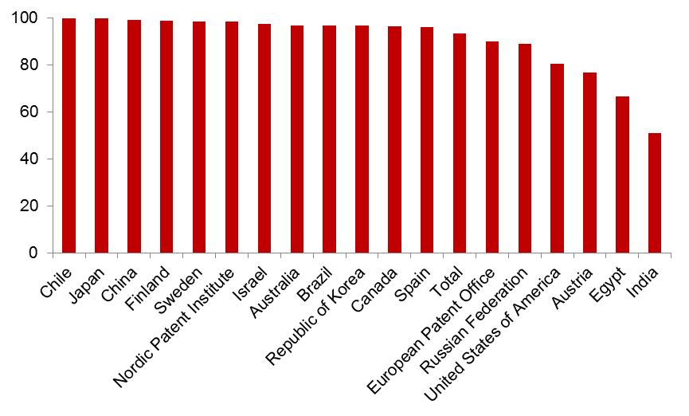
PCT A1 Publication Percentage by ISA in 2015
Overall Percentage of A1 International Publications = 93.4%
(90.0% in 2014)
Source: WIPO statistics database January 2016.

Slide 14
Supplementary International Search Requests
 | 2011 | 2012 | 2013 | 2014 | 2015
Total | 41 | 46 | 61 | 109 | 64
Austria | 1 | 2 | 2 | 2 | 2
European Patent Office | 7 | 21 | 30 | 61 | 40
Finland |  | 1
Nordic Patent Institute |  | 3
Russian Federation | 31 | 19 | 32 | 46 | 22
Sweden | 2 |  | 3

Slide 15
International Preliminary Examination Demands
2015 figures are incomplete
Source: WIPO statistics database. January 2016

Slide 16
International Preliminary Examination Reports
2015 figures are incomplete
Source: WIPO statistics database. January 2016

Slide 17
Average Timeliness in transmitting IPRPs
Average time in transmitting IPRPs fell to 28.9 months in 2014, similar to level observed in 2003
73.2% of all IPRPs were transmitted to the IB within 28 months of priority date in 2014 (expected to rise to about 80% for 2015)

Slide 18
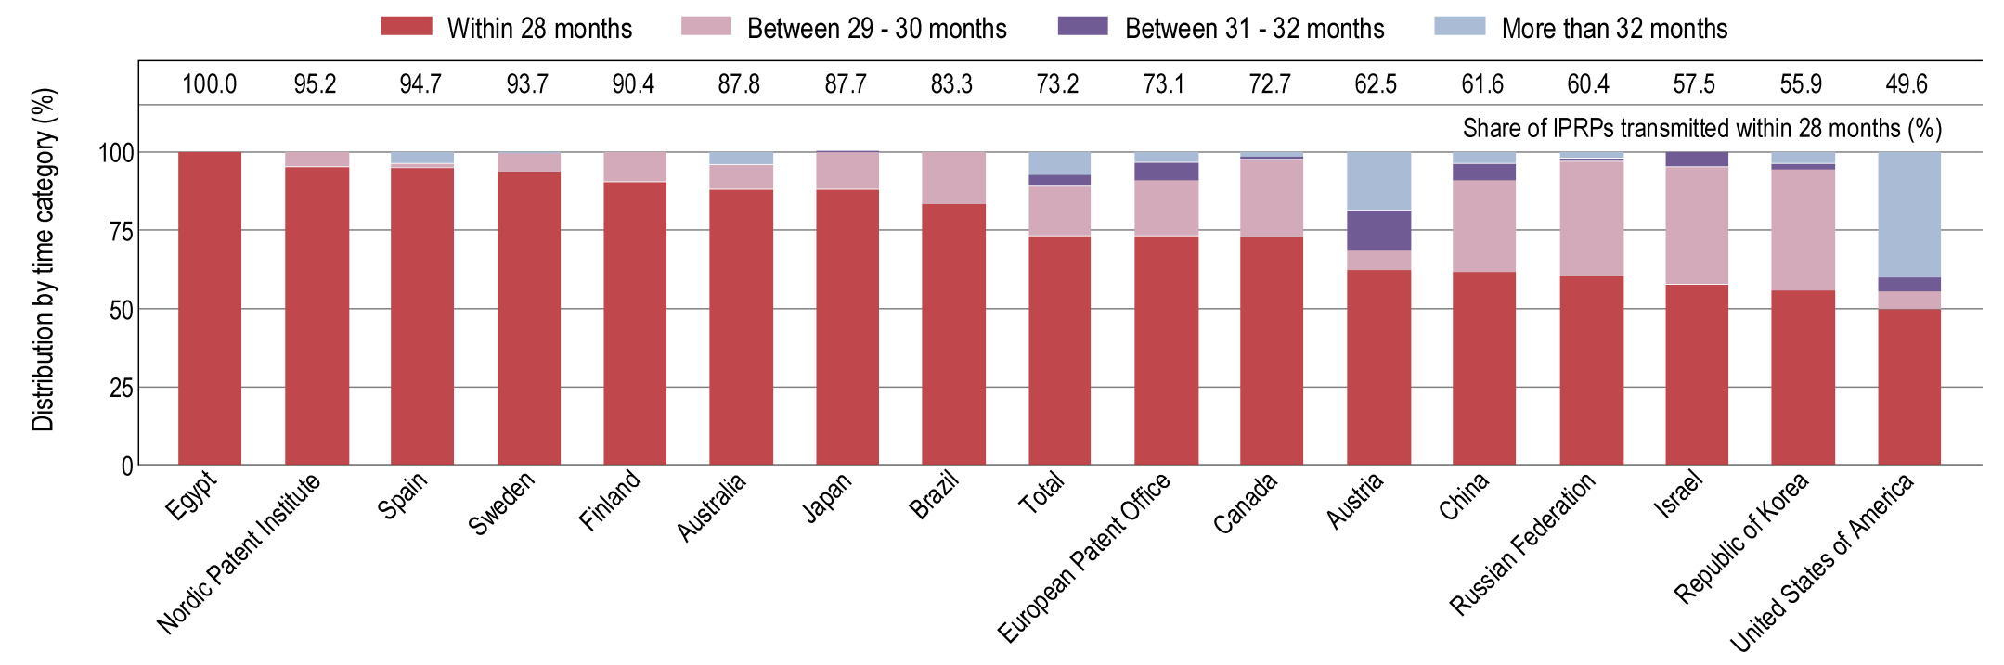
Timeliness in Transmitting IPRPs by IPEA in 2014
75.0
85.1
97.0
89.4
89.4
84.6
93.4
83.7
80.4
80.8
81.8
40.0
39.7
57.3
55.4
73.5
69.4
Provisional share transmitted within 28 months for 2015
Timeliness calculated as time elapsed between priority date and date on which International Bureau receives IPRP form the IPEA.
Source: WIPO statistics database, March 2015 and January 2016.

Slide 19
Further information:
2015 PCT Yearly Review
The International Patent System
WIPO Publication No. 901E/2015
2015 World Intellectual Property Indicators
WIPO Publication No. 941E/2015
WIPO IP Statistics Data Center
http://www.wipo.int/ipstats/en/

