Slide 1
PCT Statistics
Meeting of International Authorities
Twenty-Second Session
Tokyo, February 4 to 6, 2015

Slide 2
Outline
International Applications Filed
  Overall Trends and Forecasts
  Medium of Filing
  Languages
National Phase Entries
International Authorities
  International Search
  Supplementary International Search
  International Preliminary Examination
PCT – Patent Prosecution Highway

Slide 3
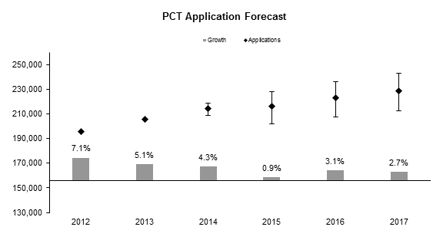
Application Filings and Forecast
228,800
222,800
216,100
214,100
205,268
195,334
Source: Economics and Statistics Division, WIPO

Slide 4
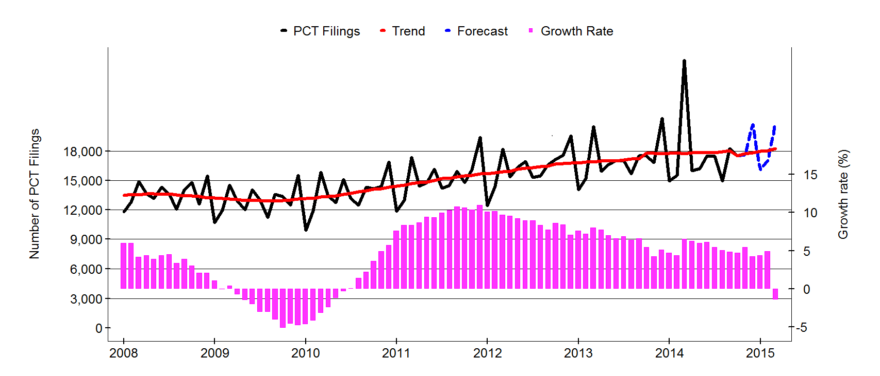
Monthly Trends in Applications Filed
Source: WIPO Statistics Database, January 2015

Slide 5
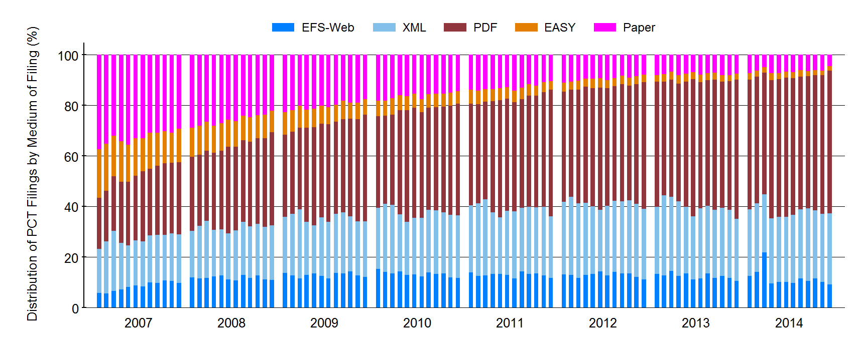
Medium of Filing
Source: WIPO Statistics Database, January 2015
For 2014, 6.3% paper, 2.1% PCT-EASY, 53.0% PDF, 26.4% XML, 12.2% EFS-web

Slide 6
Publication Languages
2009
Total 155,514
2014
Total 210,609
All publication languages showed an increase in absolute numbers between 2013 and 2014. Highest percentage increases were Chinese (+19.3%) and English (+11.9%).
Note: 2014 data are WIPO estimates
Source: WIPO Statistics Database, January 2015

Slide 7
National Phase Entries
475,500 non-resident national phase entries in 2013 (+4.3% growth)
565,500 total national phase entries for 2013
Note: Data refer to the international phase of the PCT system. Counts are based on the international application date.
Source: WIPO Statistics Database, January 2015

Slide 8
International Authorities
International Search Reports
  Distribution by International Authority
  Timeliness of Transmission to International Bureau
Supplementary International Search Reports
International Preliminary Examination Reports
  Demand
  Distribution by International Authority
  Timeliness of Transmission to International Bureau

Slide 9
Distribution of ISRs established by ISA
Note: 2014 data are WIPO estimates
Source: WIPO Statistics Database, January 2015
Data based on international filing year of application
Notes:
9

Slide 10
Average Timeliness in Transmitting ISRs to the IB
Source: WIPO Statistics Database, March 2014
Average time between the priority date and the receipt of the ISR
by the IB was 15.8 months in 2013.
77.3% of ISRs were received within 16 months in 2013
[69.9% in 2012].
For 2014, 77.7% of ISRs were received within 16 months.

Slide 11
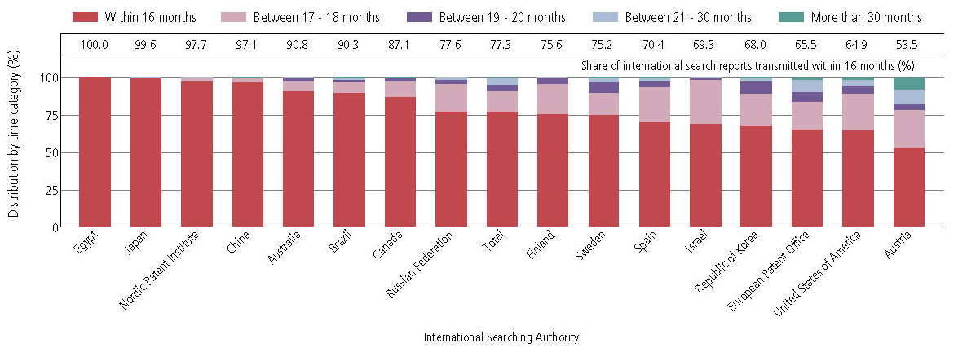
Timeliness in Transmitting ISRs by ISA in 2013
Provisional share transmitted within 16 months for 2014 (for comparison)
100
99.6
98.2
97.8
90.6
92.8
87.3
64.6
87.1
99.2
80.0
86.0
77.1
81.7
67.2
42.6
70.6
Source: WIPO Statistics Database, March 2013
Timeliness calculated as time elapsed between priority date and date ISA transmits ISR to the International Bureau

Slide 12
Average Timeliness in transmitting ISRs to the IB measured from Date of Receipt of Search Copy
Source: WIPO Statistics Database, March 2014 Excludes cases where the time limit of 9 months from the priority date applies
Average time to transmit ISRs improved from 4.2 months in 2012 to 3.6 months in 2013.
Excludes cases where time limit of 9 months from priority date applies.

Slide 13
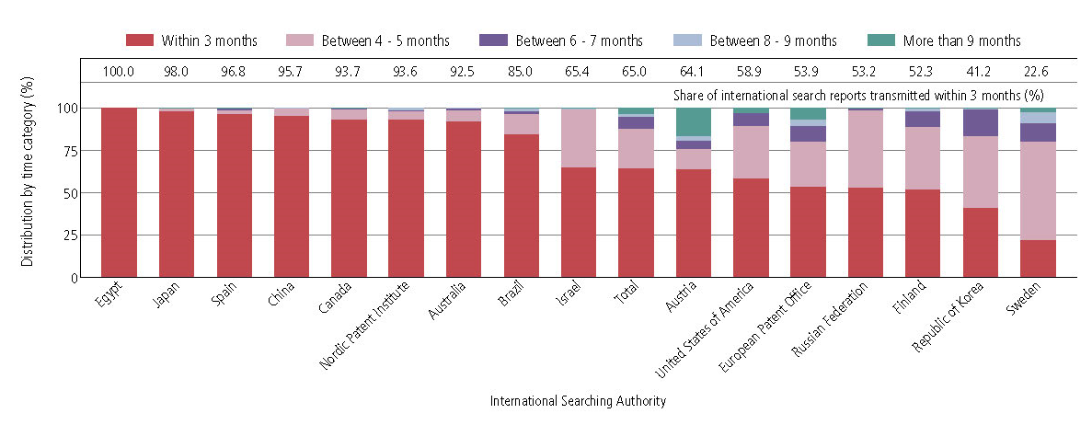
Timeliness in transmitting ISRs to the IB measured from Date of Receipt of Search Copy by Authority for 2013
Provisional share transmitted within 3 months for 2014 (for comparison)
100
98.0
98.3
93.7
92.6
86.2
98.9
88.5
59.4
67.0
75.8
32.6
57.5
46.4
63.6
64.8
24.8
Source: WIPO Statistics Database, March 2014 Excludes cases where time limit of 9 months form priority date applies.
13

Slide 14
Distribution of SIS Requests
Supplementary International Searching Authority Year | 2011 | 2012 | 2013 | 2014
Total | 41 | 46 | 61 | 109
Austria | 1 | 2 | 2 | 2
European Patent Office | 7 | 21 | 30 | 61
Finland |  | 1
Nordic Patent Institute |  | 3
Russian Federation | 31 | 19 | 32 | 46
Sweden | 2 |  | 3
Source: WIPO Statistics Database, January 2015

Slide 15
International Preliminary Examination Demands
2014 figures are incomplete
Source: WIPO Statistics Database, January 2015

Slide 16
International Preliminary Examination Reports
For 2014 (incomplete), 56.0% of IPRPs (Chapter II) were produced by the EPO, 12.4% by the USPTO, 16.0% by the JPO, and 15.6% by
other International Authorities.
Source: WIPO Statistics Database, January 2015 Data for 2014 are provisional

Slide 17
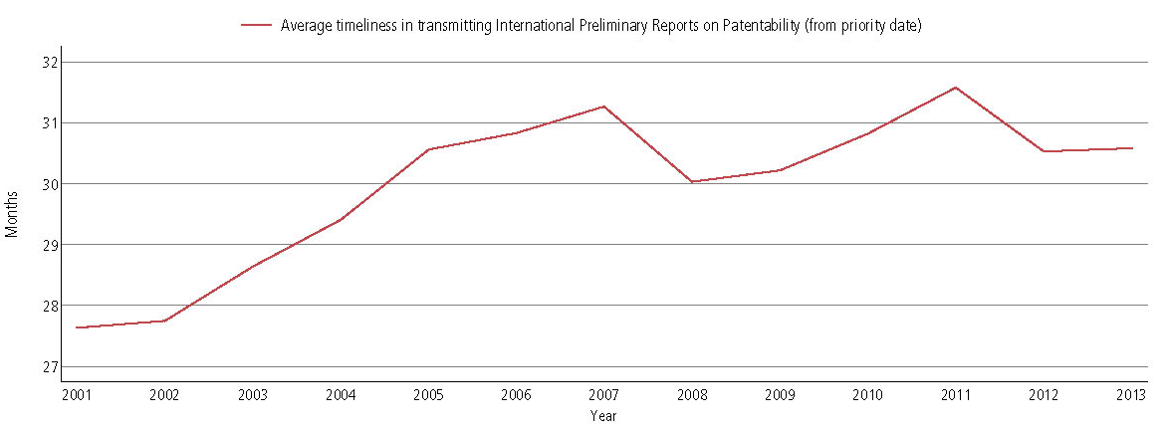
Average Timeliness in Transmitting IPRPs
Source: WIPO Statistics Database, March 2014
Average time taken to transmit IPRPs increased from 27.6 months in 2001 to 30.6 months in 2013. 72.8% of IPRPs transmitted within 28 months in 2013 (68.4% in 2012) (provisional 69.3% for 2014).

Slide 18
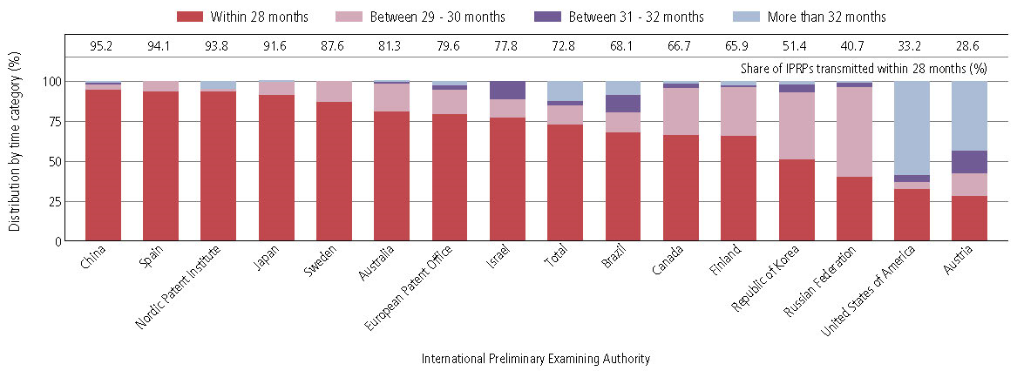
Timeliness in Transmitting IPRPs by IPEA in 2013
Provisional share transmitted within 28 months for 2014
61.7
94.6
95.1
87.6
93.7
87.8
73.1
60.5
66.3
83.0
73.2
90.4
55.9
57.5
49.2
62.5
Source: WIPO Statistics Database, March 2013
Timeliness calculated as time elapsed between priority date and date on which International Bureau receives IPRP form the IPEA.

Slide 19
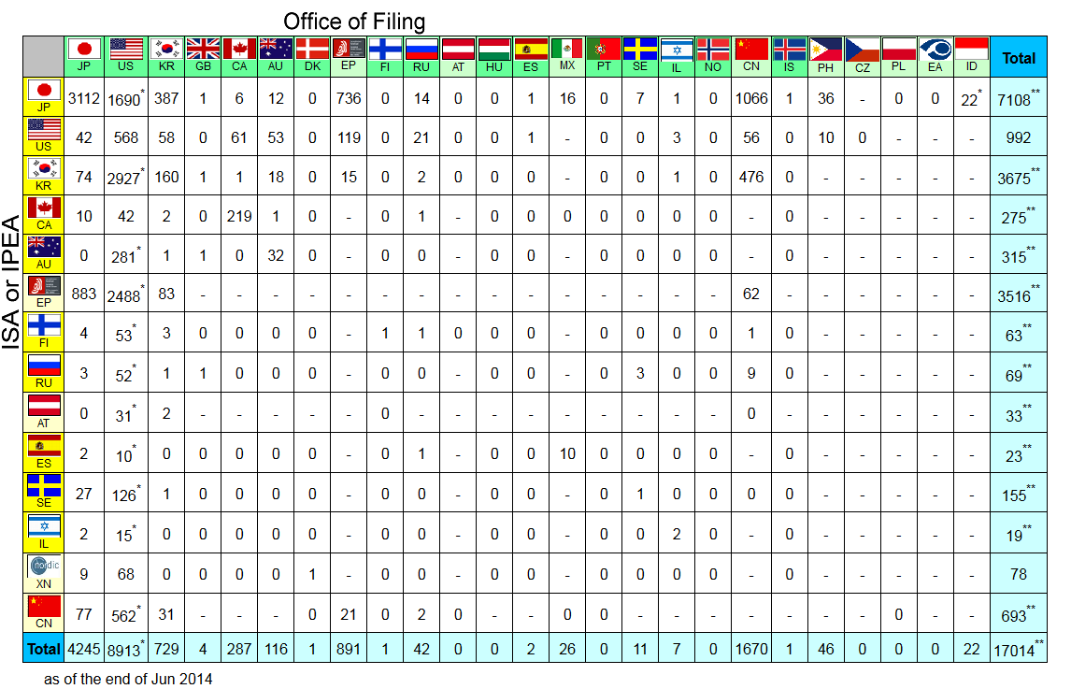
PCT-Patent Prosecution Highway
* as of end December 2013 Source: Patent Prosecution Highway Portal Site
17,014 PCT-PPH requests until end June 2014
6,333 PCT-PPH requests in 2013 (+38.3% on 2012)

Slide 20
Further information:
2014 PCT Yearly Review
The International Patent System
WIPO Publication No:901E/2014
2014 World Intellectual Property Indicators
WIPO Publication No:941E/14
Statistics on the PCT System http://www.wipo.int/ipstats/en/statistics/pct/
Patent Prosecution Highway Portal Site http://www.jpo.go.jp/ppph-portal/index.htm

