Slide 1
The digital divide is essentially a knowledge divide
Enhancing Access to Information and Knowledge Production for the Developing World.
Brian Wafawarowa, Geneva November 2009

Slide 2
Proposition
While the developing world needs greater access to information and knowledge to develop, this development can only be sustainable if the developing world is able to exploit its rich cultural and creative traditions to benefit its people and trade with the rest of the world. Our objective should be to become equal players in knowledge and information exchange with the rest of the world.
The Question: How do we use Digital Technology to improve access to information while enhancing the capacity of the developing world to meet its own information and knowledge needs and contributing to global dialogue?

Slide 3
Contribution of Literature and Press to GDP
Notes:
Source: Richard Owen (2009)

Slide 4
The Current Book Production and trade Situation
Africa contributes less than 3% of all books produced in the world
Access to remote regions of the same country is inhibited by infrastructure and distribution costs (up to 200% of the production costs)
Intra-African trade in books is constrained by physical and national policy barriers, discrepancies between currency values and security issues
Trade with the rest of the world is hindered by cost of shipping

Slide 5
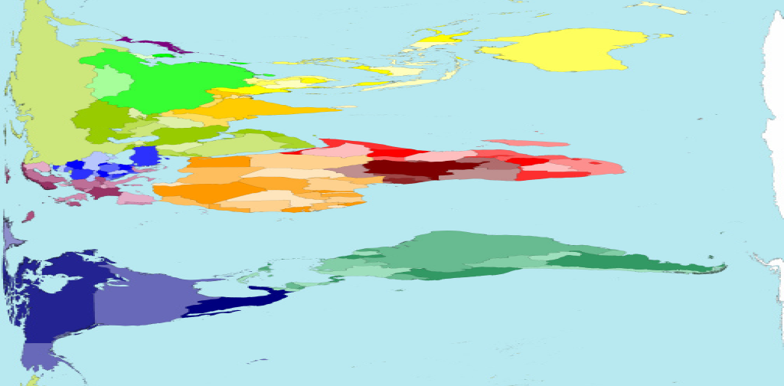
Comparison: Land Area

Slide 6
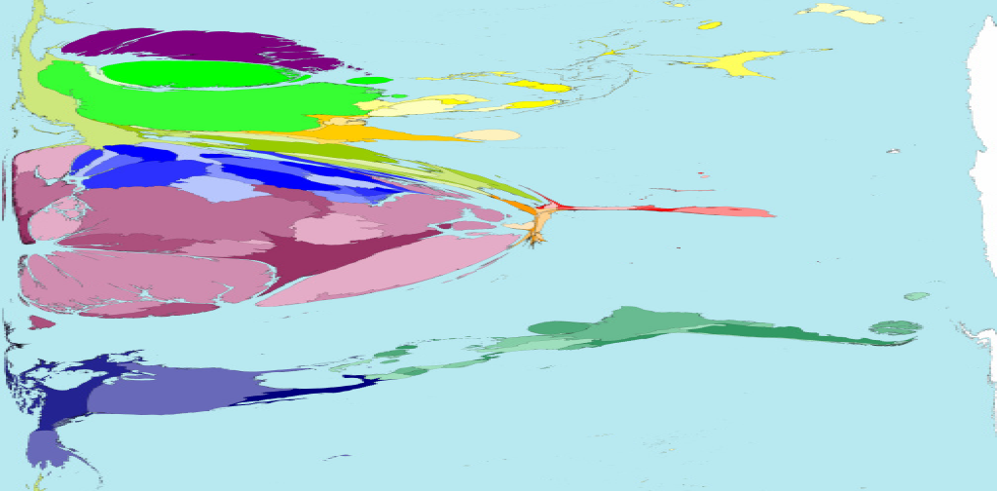
Comparison: Titles Published in 1999

Slide 7
The digital Solution:Possible Benefits
Overcomes barriers that are associated with the traditional methods of moving books
Reduces the cost of knowledge exchange significantly
Overcomes political , physical and tariff barriers
Improves economies of scale
Encourages co-production
Allows quick customisation and convenient archiving
Allows rapid exchange of information and access to opportunities
Improves access to markets and access to knowledge

Slide 8
Hindrances to the Solution
Only 3 in 100 people use the internet in Africa compared to 1 in 2 among the G8 countries
The number of internet users among the G8 is the same as the number of user in the rest of the world.
The top 20 internet user countries have 80% of all internet users in the world
There are 8 times as many users in the USA as in the whole of the African continent.
The whole of the African continent with more than 50 countries has fewer internet users than France alone
Denmark has two times more bandwidth than Latin America and the Caribbean
75% of Africa’s fixed 26 million fixed lines are in 6 of the 55 countries.
Africa has 3 fixed lines per 100 people, America has 34 while Europe has 40 .

Slide 9
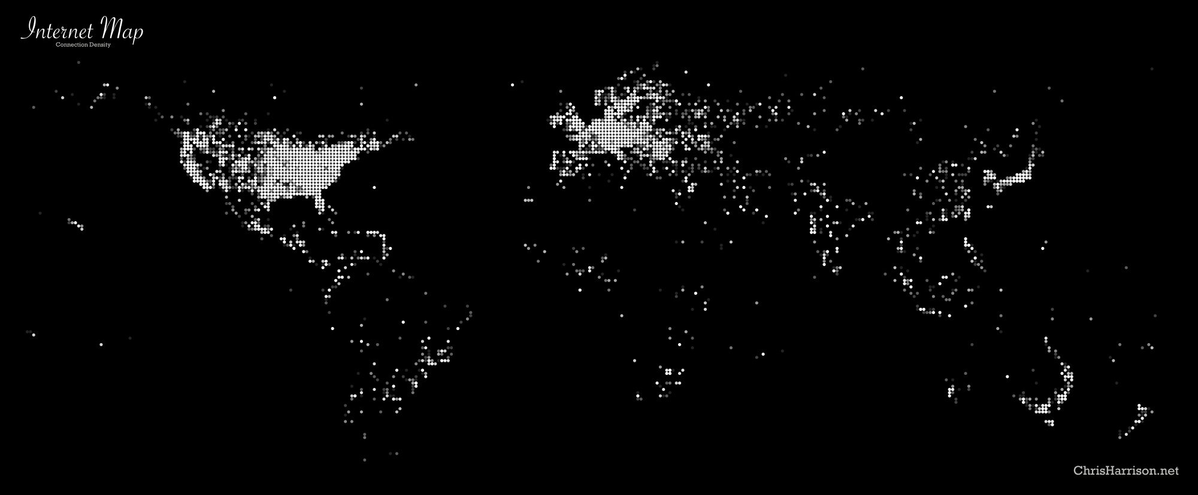
World Connection Density

Slide 10
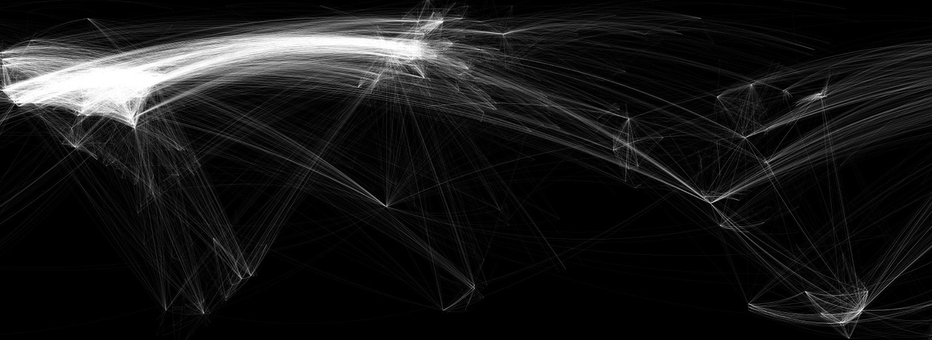
City to City Connectivity
Notes:
Source and copyright: ChrisHarrison.com

Slide 11
Implications of Poor Connectivity for Access to Information, Trade and Development
Inhibits intra-African Trade
Inhibits trade with the developed parts of the world
Increases the cost of doing business among the developing countries and the developing world
Confines developing countries to unsustainable methods of production and distribution
Erodes global competitiveness of developing countries
Inhibits exploitation of IP and indigenous knowledge
Undermines knowledge exchange and dialogue at a global
Perpetuates poverty and under-development

Slide 12
Possible Solutions
Sensitise our governments and policy makers on the role of IP for development and trade
Bridge the technological gap between creators and rights holders and users
Create communal IT hubs for communities for both users and rights holders
Improve knowledge and appreciation of role of IT in knowledge sector among users and rights holders
Increase collaboration between rights holders, users, policy makers and donor communities
Ensure that all IT initiatives and negotiations include rights holders and users

Slide 13
Solutions continued……
Reduce the level of mistrust between rights holders and users by developing appropriate Digital Rights Management systems and appropriate compensation for rights holders
Thank You

