Slide 1
Mexican Institute of
Industrial Property
Support System for Patent Applications Management: CADOPAT
Nahanny Canal
Director of the Patent Division

Slide 2
SCP context
Patent
Quality
Support System for Patent Applications Management
Division
of Work
Notes:
Recomendaría integrar una primera diapositiva que explique porqué estamos hablando de CADOPAT en el SCP, dentro del punto 6 del orden del día.
Uno de los principales temas dentro del Comité, que ha causado cierta polémica sobre todo en países en desarrollo y PMA, es la calidad de las patentes, dentro del cual se discute también la división del trabajo entre las ONAPIs. CADOPAT es un ejemplo claro, en el contexto de estos países, del beneficio que puede traer la utilización del trabajo previo de búsqueda y examen de otras oficinas.
Bajo el sistema de CADOPAT, las BO pueden utilizar el trabajo de la oficina mexicana para tomar la decisión, de acuerdo con su legislación, acerca de las solicitudes de patente ingresadas en el sistema. Esto les ayuda a reducir su backlog y a hacer más eficiente el trabajo de sus examinadores.
Con este sistema, a través de la información brindada por los examinadores mexicanos, se incrementa la calidad de sus decisiones, logrando que la patente otorgada sea más fuerte y, por ende, más difícil de impugnar.

Slide 3

Layout
Created in 2007
To foster innovation protection movement in the Latin American region.
CADOPAT
To strengthen cooperation between Central America and the Caribbean offices.
Offered by IMPI to IP offices that require support with the examination of patent application.
International search of the prior art
Substantive examination
Patentability opinions
Free of
charge

Slide 4
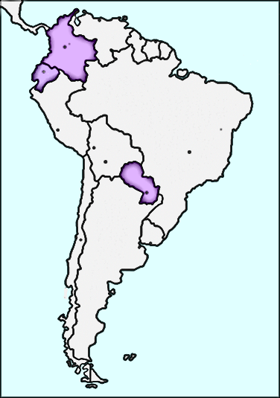
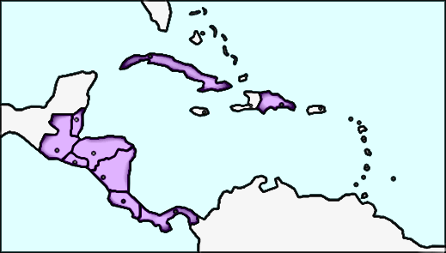
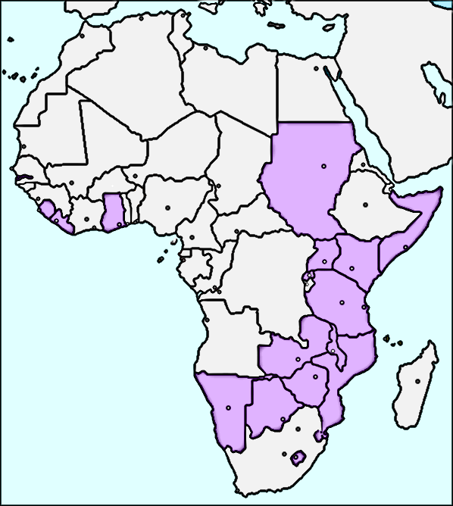
Beneficiary Offices (BO)
In the beginning, the beneficiary offices were only Costa Rica, El Salvador, Guatemala, Honduras, Nicaragua, Panama and Dominican Republic.
Since then, it has grown to Cuba, Belize, Colombia, Paraguay, Ecuador and the African Regional Intellectual Property Organization (ARIPO).
A total of 31 countries

Slide 5
Objectives
Contribute in the search of prior art and substantive examination processes of patent applications from BO.
Respond to support requests related to patent applications from the BO that have an equivalent patent application in Mexico.
Respond to support requests related to patent applications from the BO that do not have an equivalent patent application in Mexico.

Slide 6
Advantages
Facilitates information exchange related to prior art searches, substantive examination and patentability opinions made by Mexican examiners.
Issues electronic notifications via email to all parties involved in each change of status of the request.
CADOPAT
Constitutes a database of all the published answers which are available to all BO.

Slide 7
Benefits for BOs
Increase in the number of patent applications processed
Free service
Strengthening of granted IP rights
More qualified and trained staff at IP Offices.
Increased quality of the substantive examination

Slide 8
Requirements
To participate in CADOPAT, the BO needs to:
Be a small IP Office
Have access to Internet
Have an updated browser
Access the service with the password IMPI provides to the assigned contact at the BO

Slide 9
Modalities
This service distinguishes two types of requests from BO:
1
With an equivalent patent application in Mexico
Substantive Examination Report, including the result of the prior art search.
Support documents (PDF files)
Response
*Sometimes it may include the Mexican Search Report and the Mexican granted claims
2
Without an equivalent patent application in Mexico
Patentability Opinion
Support documents (PDF files)
Response
*Sometimes it may include the Mexican Search Report

Slide 10
Process
START
REGISTERED
ADMITTED
ASSIGNED
0
Enter request
1
To admit
2
To assign responsible
3
To study
IN STUDY
1a
1b
1c
IN REVISION-MODIFIED
4
CANCELED
REJECTED
IN CLARIFICATION-
MODIFIED
5a
Reply request
6
Authorize publication
5
Status
Final status
PUBLISHED
ANSWER
ANSWERED

Slide 11
Deadlines for attention / response
Initial status | Final status | Maximum term | Type of Request | Comments
Registered | Admitted | 10 days | 1 y 2 | If the information submitted by OB is incomplete or incorrect: clarification will be asked.
Admitted | Published Answer | 1 month | 1 | If the Mexican patent application has already been studied.
 |  | 2 months | 1 | If the Mexican patent application has not been studied yet.
 |  | 3 months | 2

Slide 12
Requests entered
(January 2007 – May 2016)
BO | TYPE 1 | TYPE 2 | TOTAL
NI | 1 | 2 | 3
HN | 76 | 28 | 104
SV | 512 | 110 | 622
GT | 14 | 1 | 15
DO | 109 | 43 | 152
PA | 25 | 19 | 44
CR | 265 | 87 | 352
CU | 24 | 10 | 34
BZ | 82 | 72 | 154
AP | 25 | 3 | 28
CO | 171 | 0 | 171
PY | 70 | 30 | 100
EC | 15 | 2 | 17
TOTAL | 1389 | 407 | 1796

Slide 13
Requests status
(January 2007 – May 2016)
REQUESTS | TYPE 1 | TYPE 2 | TOTAL
REGISTERED | 1389 | 407 | 1796
PUBLISHED ANSWERS | 1179 | 199 | 1378
REJECTED/CANCELED | 189 | 195 | 384
IN CLARIFICATION | 6 | 0 | 6
TOTAL PROCESSED REQUESTS | 1374 | 394 | 1768
IN STUDY | 15 | 13 | 28
98.44 % PROCESSED REQUESTS

Slide 14
CADOPAT
https://cadopat.impi.gob.mx

Slide 15
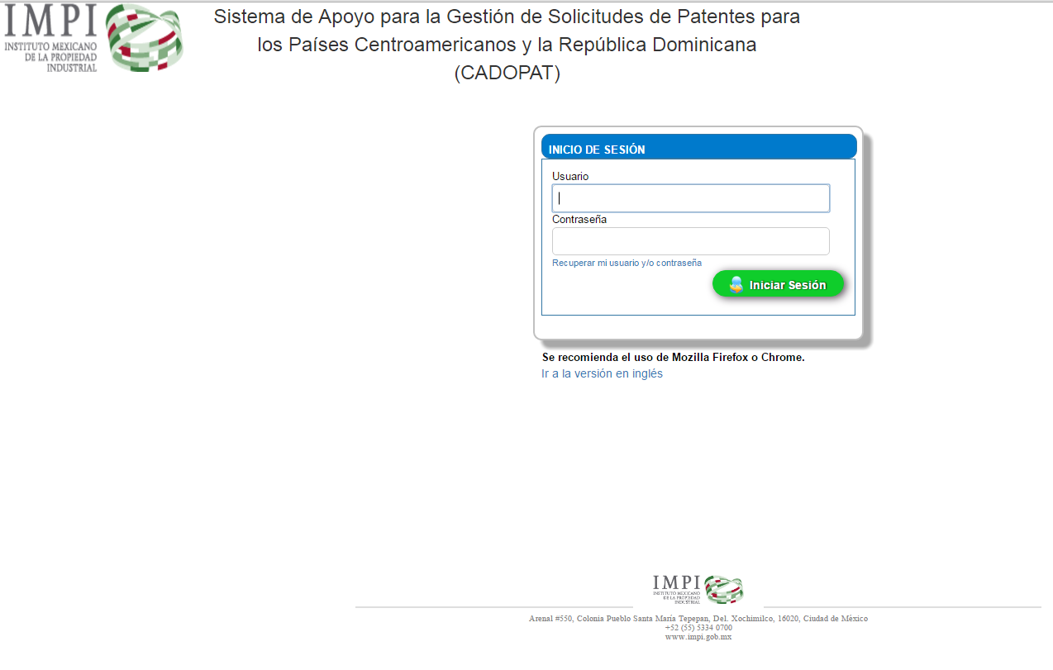
User name
and
password

Slide 16
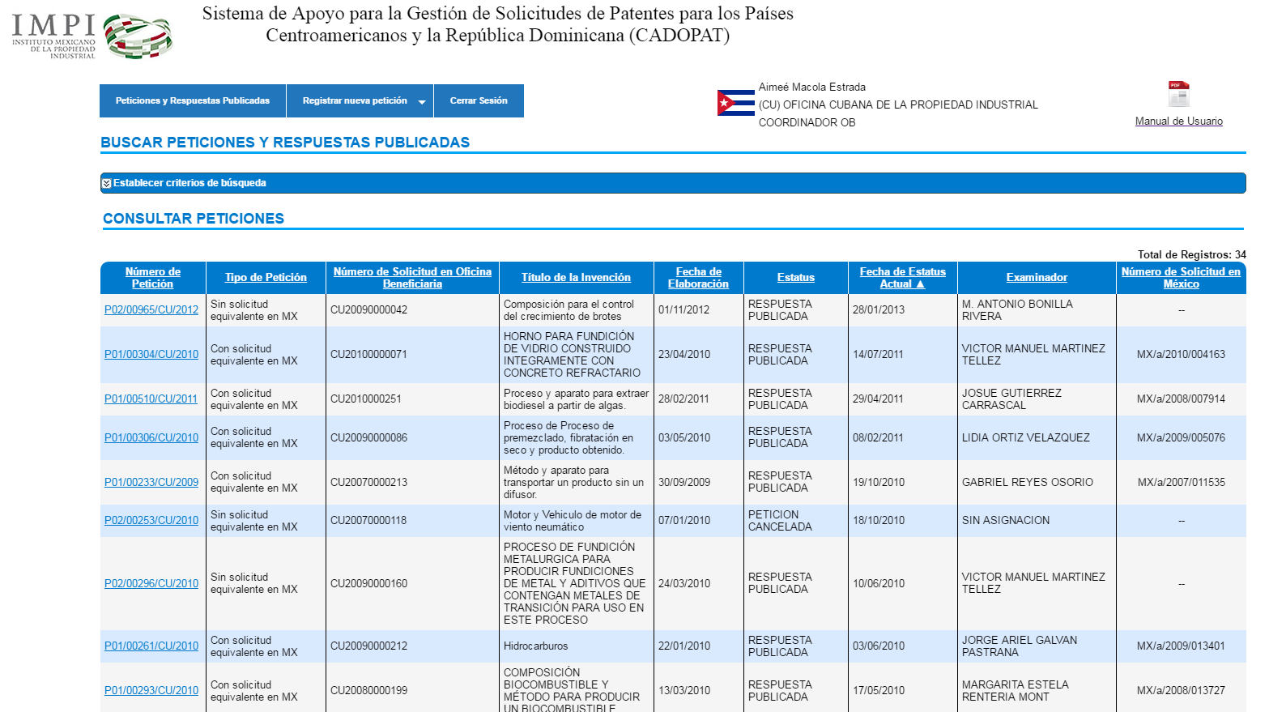
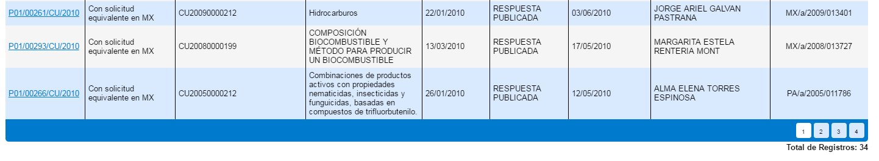
Requests and Published Responses
Requests and published responses
User data
User’s Manual

Slide 17
Requests and Published Responses
Search requests and published responses
Consult requests

Slide 18
Consult Requests
Type 2
Type 1
Total number of results

Slide 19
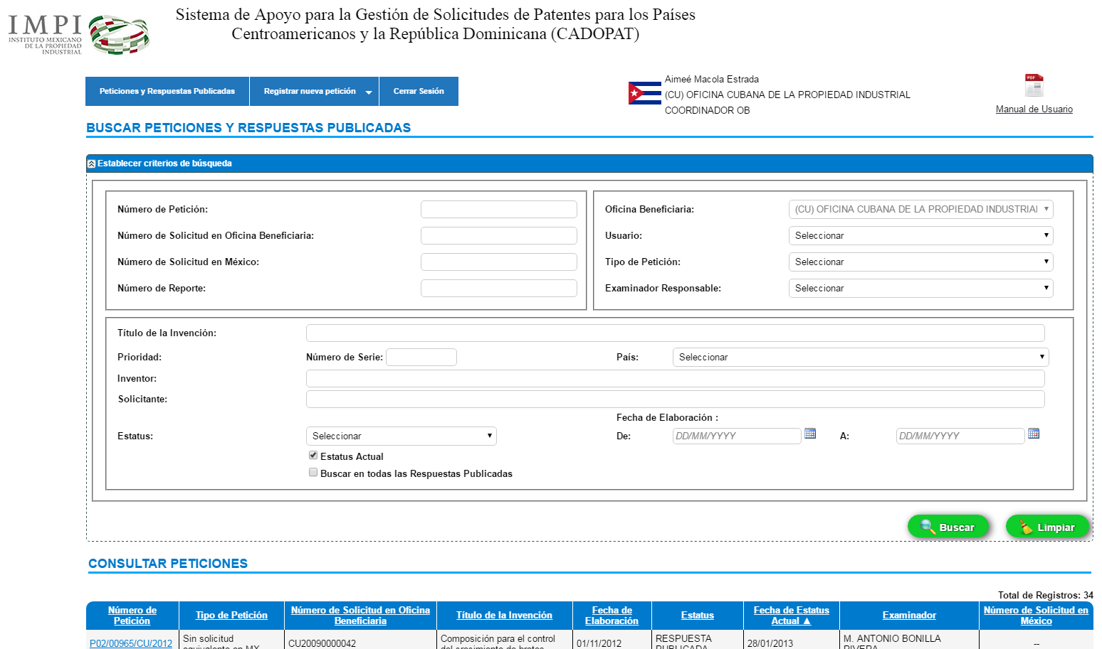
Search Requests and
Published Responses

Slide 20
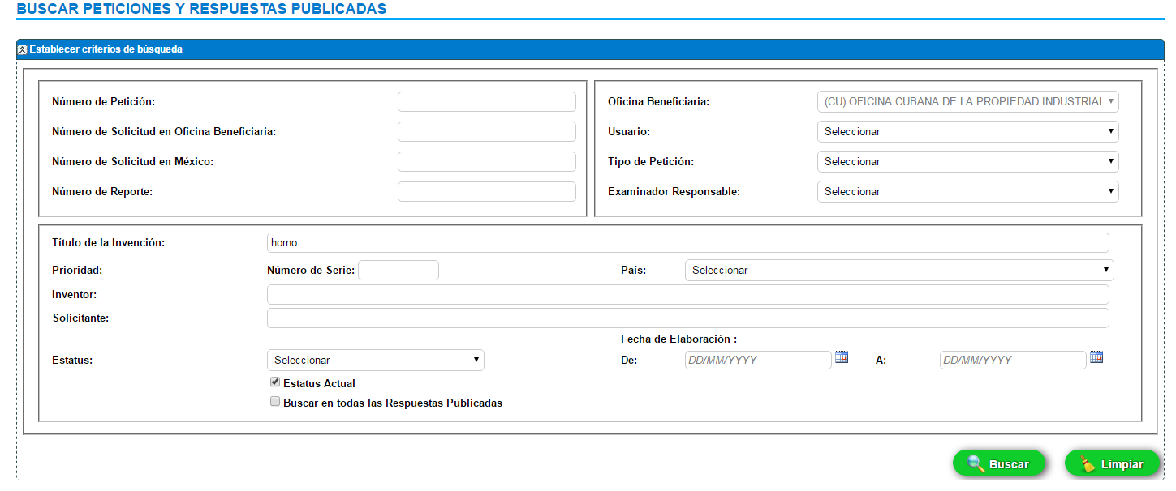
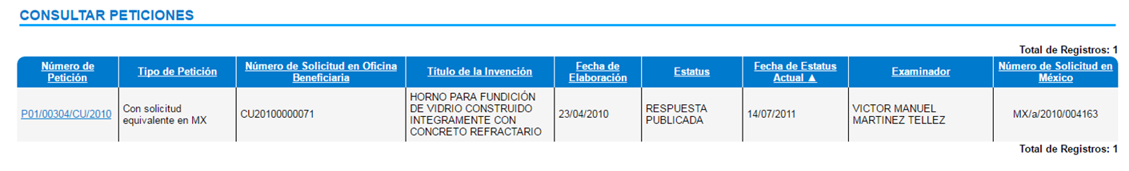
Search Requests and
Published Responses
List of Results:

Slide 21
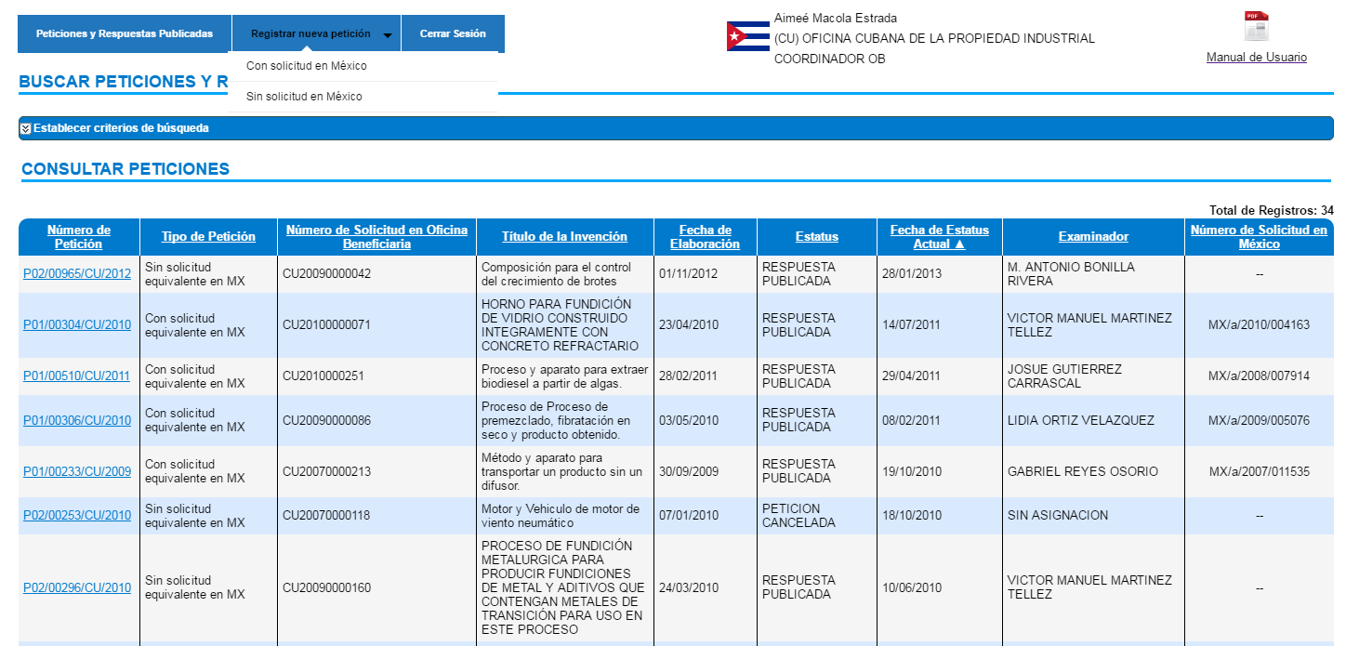
New Requests
Register new request
With an equivalent patent application in Mexico
Without an equivalent patent application in Mexico

Slide 22
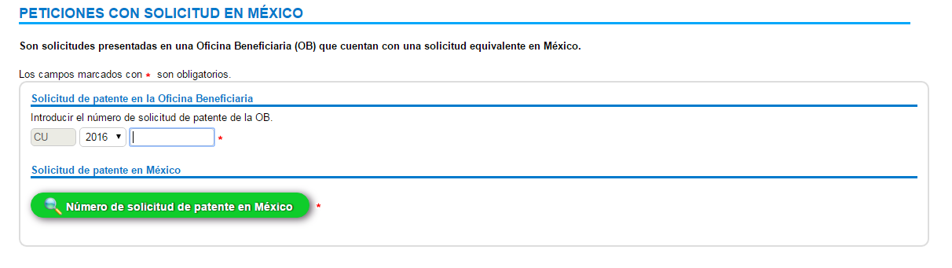
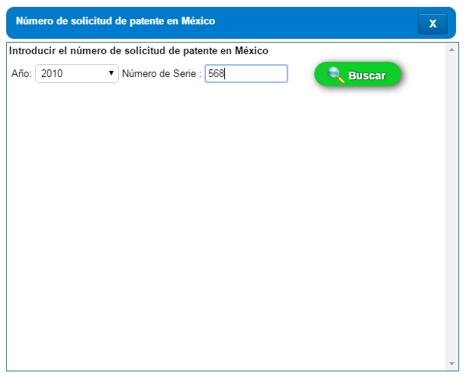
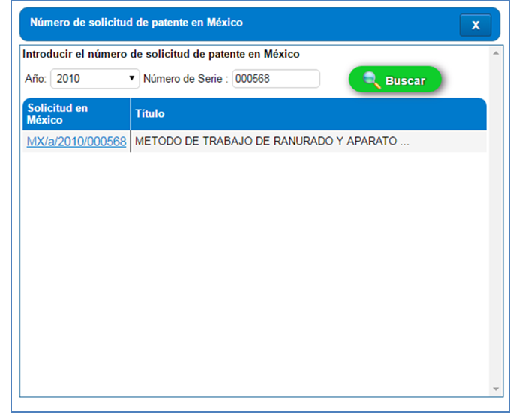
New Requests
OB patent application
MX patent application
2010
568
MX/a/2010/000568

Slide 23
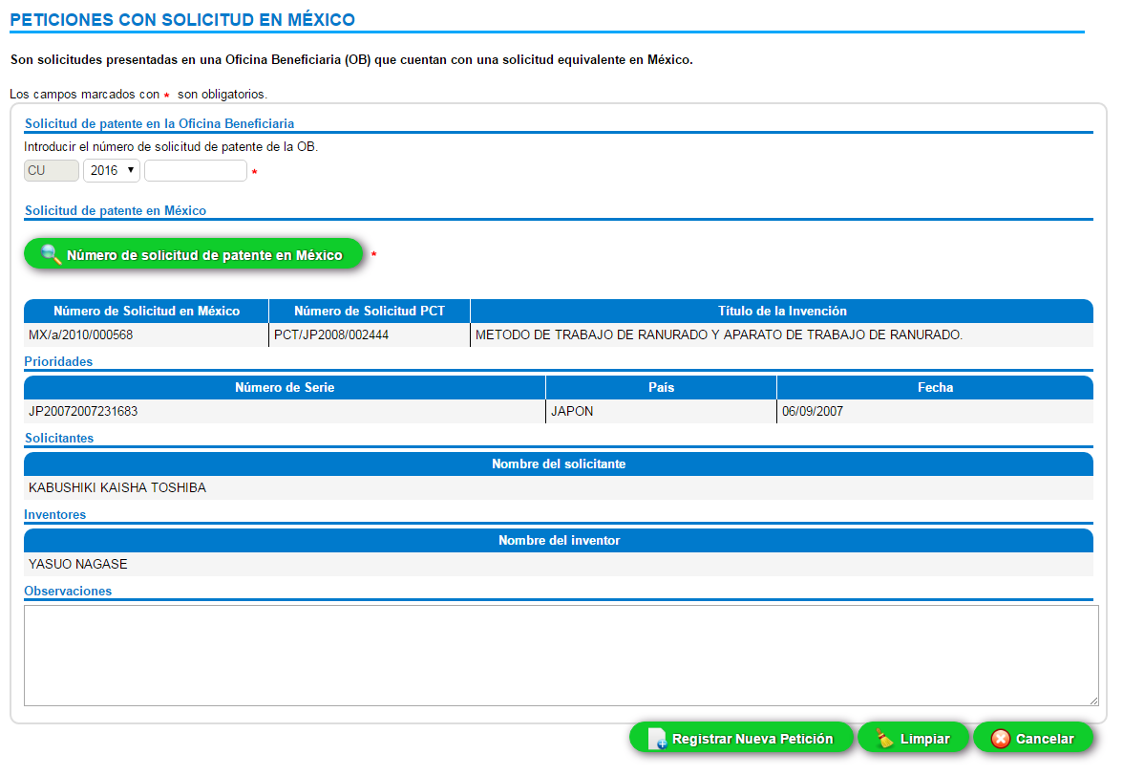
OB
patent application
MX
patent application
Register new request

Slide 24
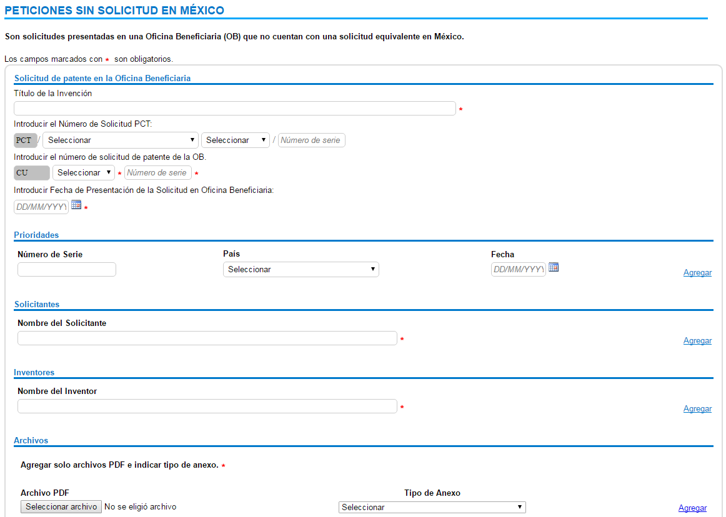
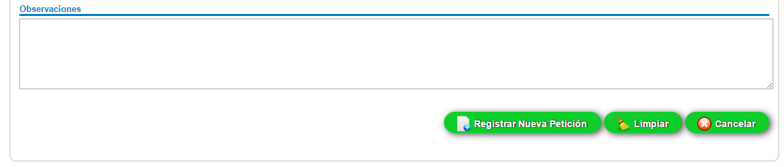

Requests without an equivalent patent application in Mexico
Register new request

Slide 25
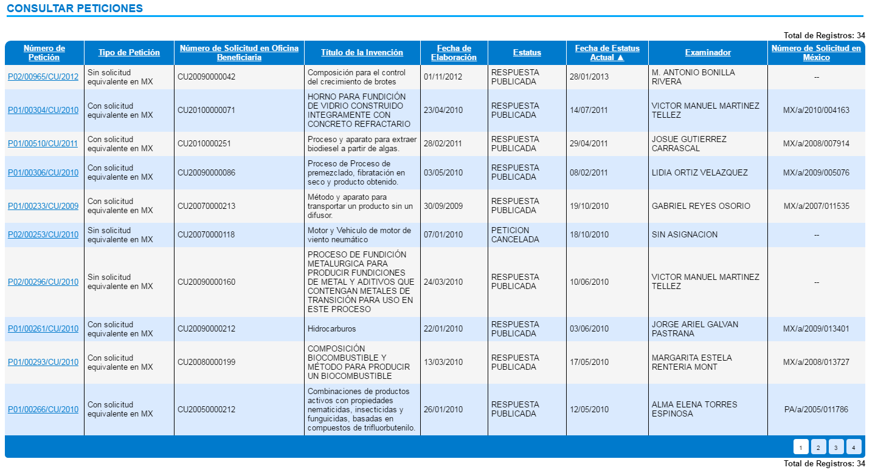
Consult Requests
List of Results:
P01/00266/CU/2010

Slide 26
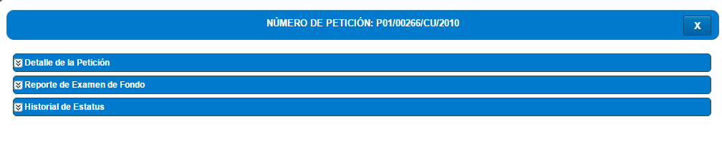
Consult Requests
Type 1 request
Request detail
Substantive examination report
Status history

Slide 27
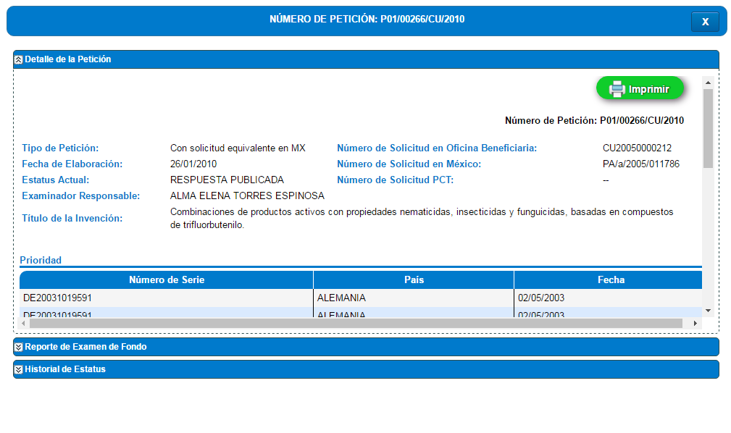
Request Detail

Slide 28
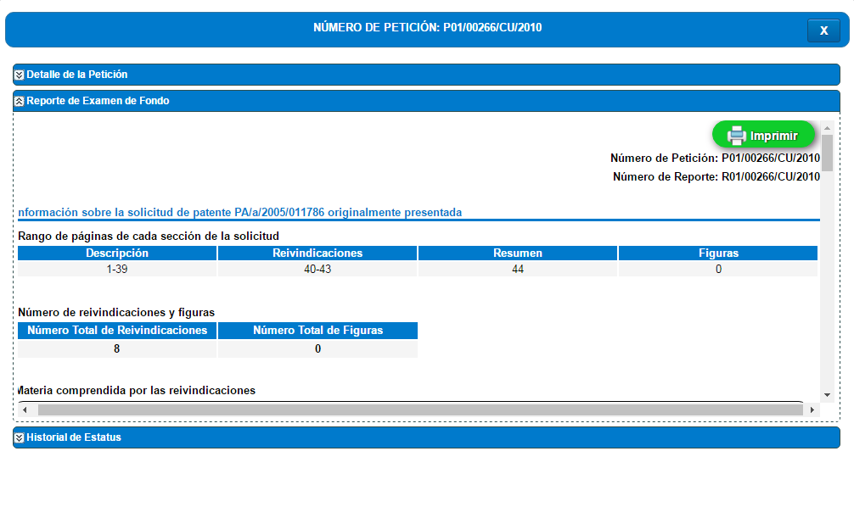
Substantive Examination Report

Slide 29
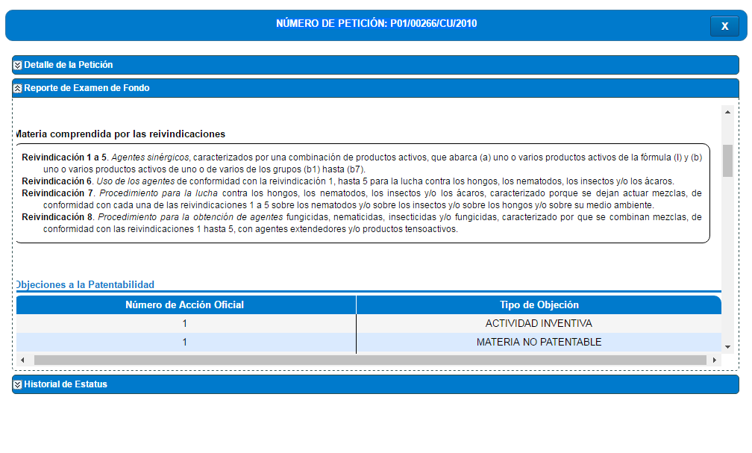
Substantive Examination Report (cont.)

Slide 30
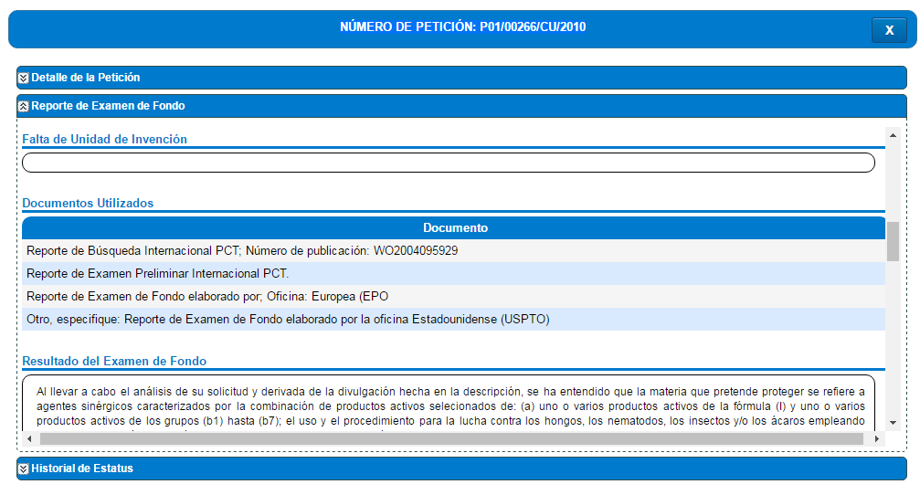
Substantive Examination Report (cont.)

Slide 31
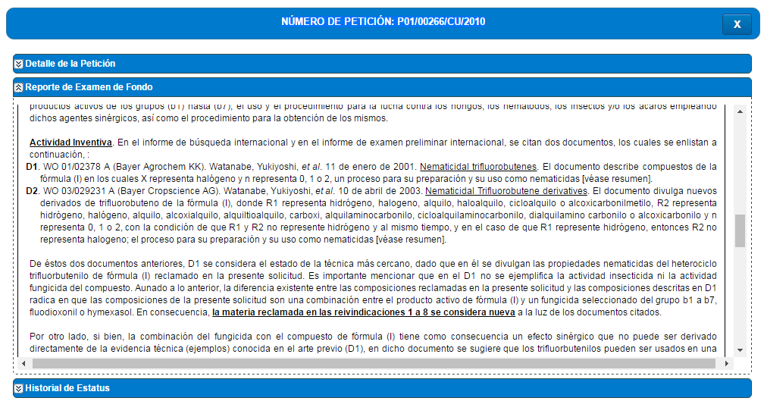
Substantive Examination Report (cont.)

Slide 32
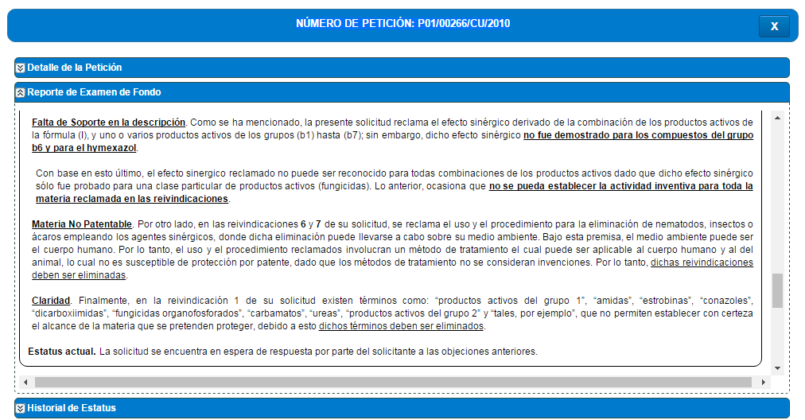
Substantive Examination Report (cont.)

Slide 33
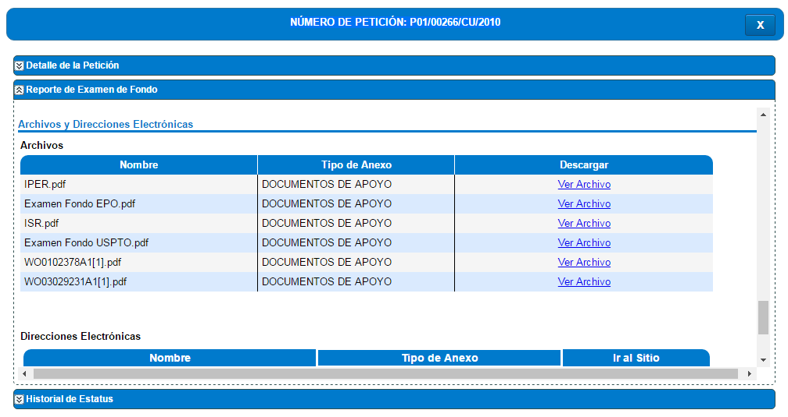
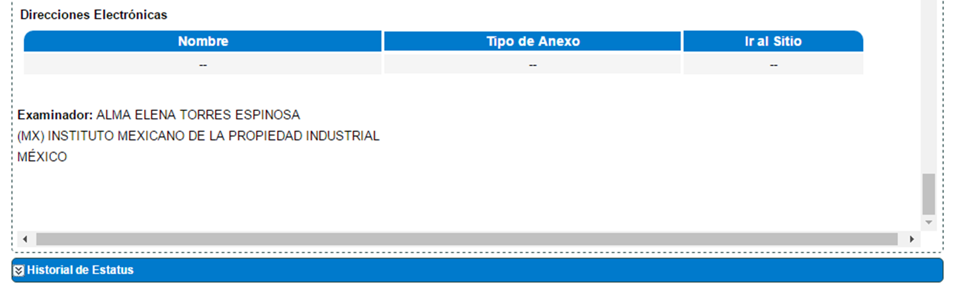
Substantive Examination Report (cont.)
Documents supporting the response:

Slide 34
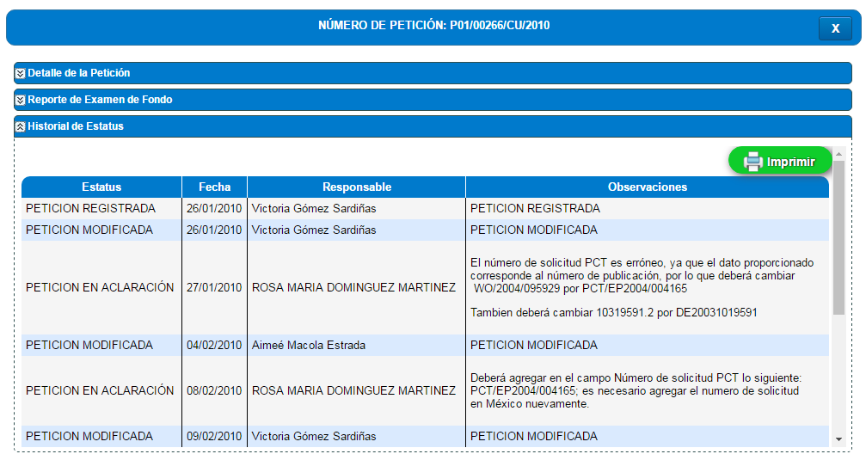
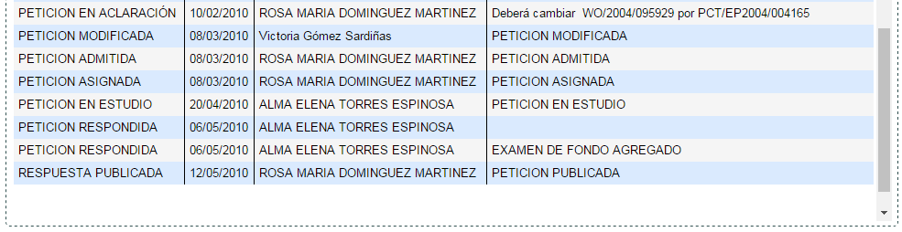
Status History

Slide 35
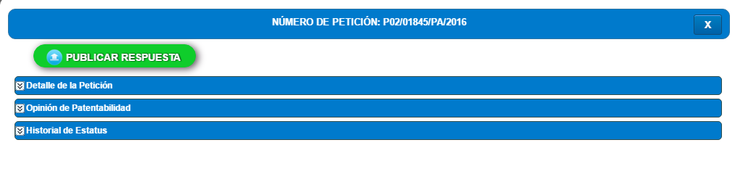
Consult Requests
Type 2 request
Request detail
Patentability opinion
Status history

Slide 36
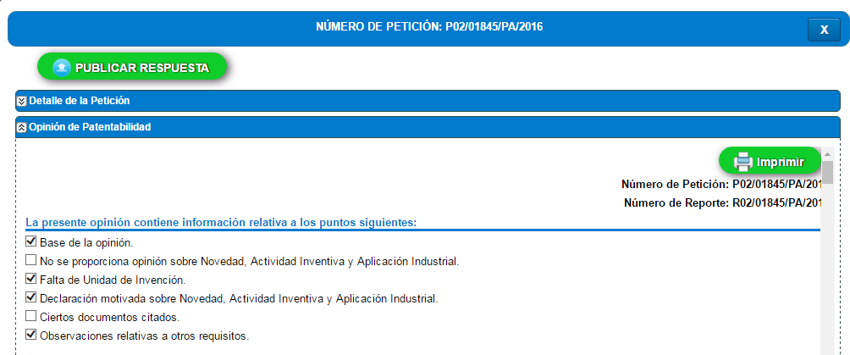
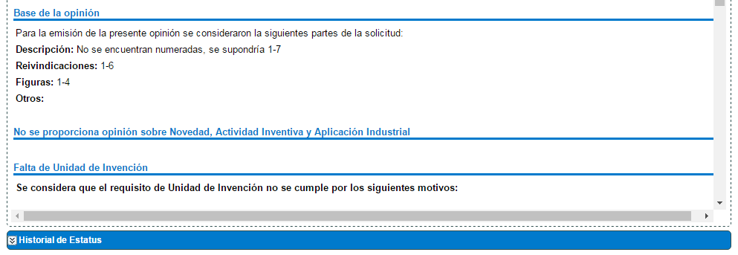
Patentability Opinion

Slide 37
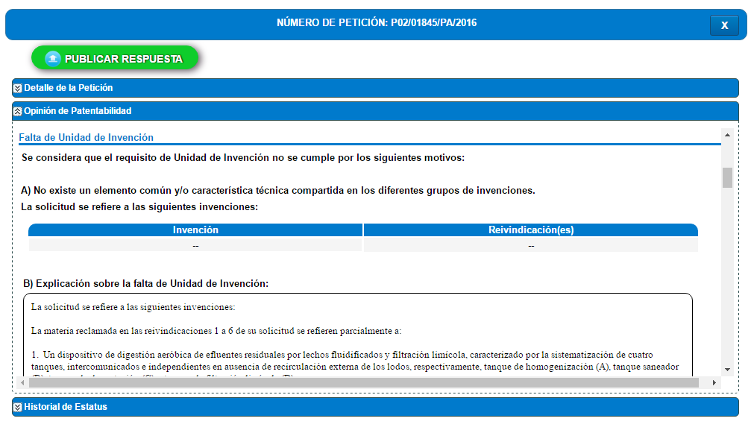
Patentability Opinion (cont.)

Slide 38
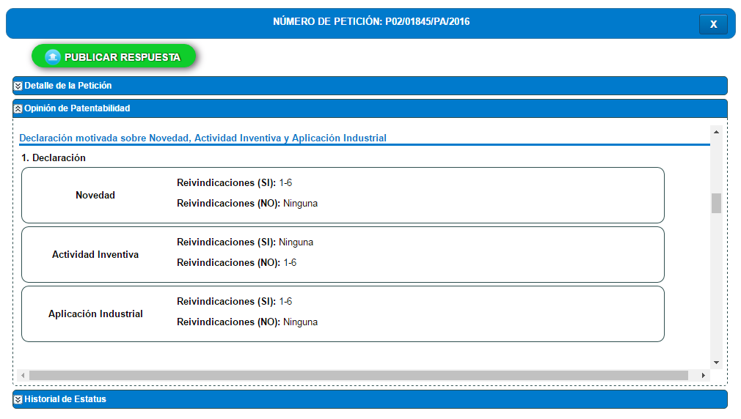
Patentability Opinion (cont.)

Slide 39
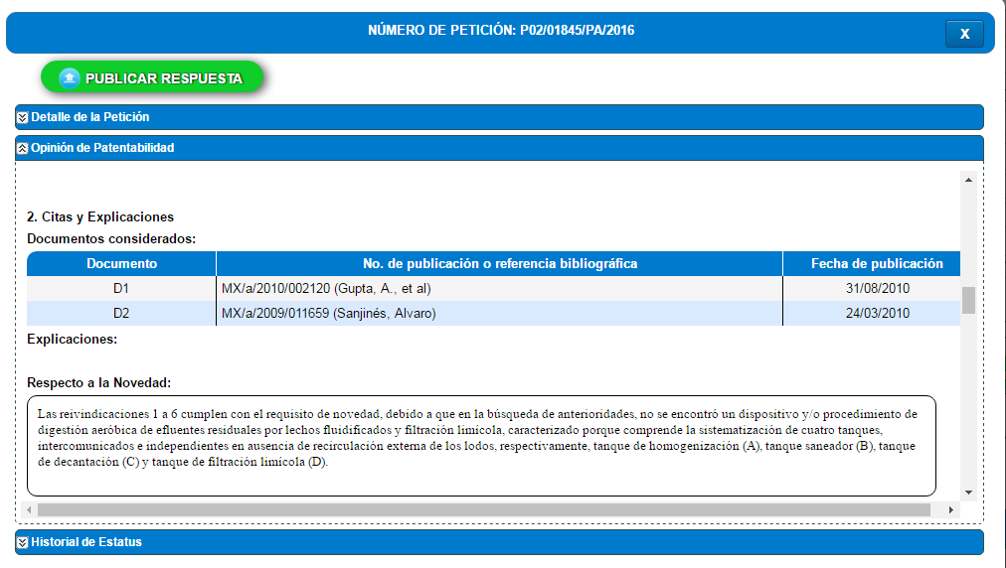
Patentability Opinion (cont.)

Slide 40
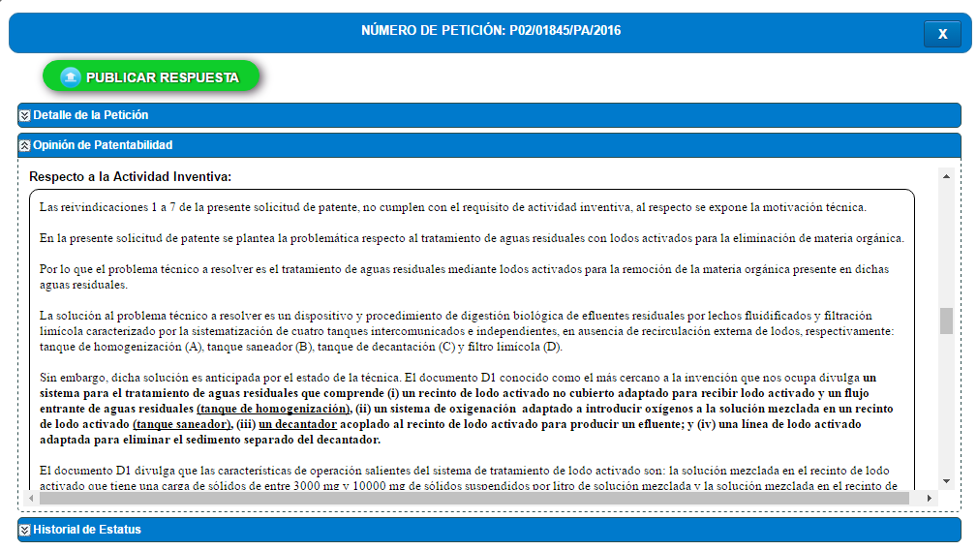
Patentability Opinion (cont.)

Slide 41
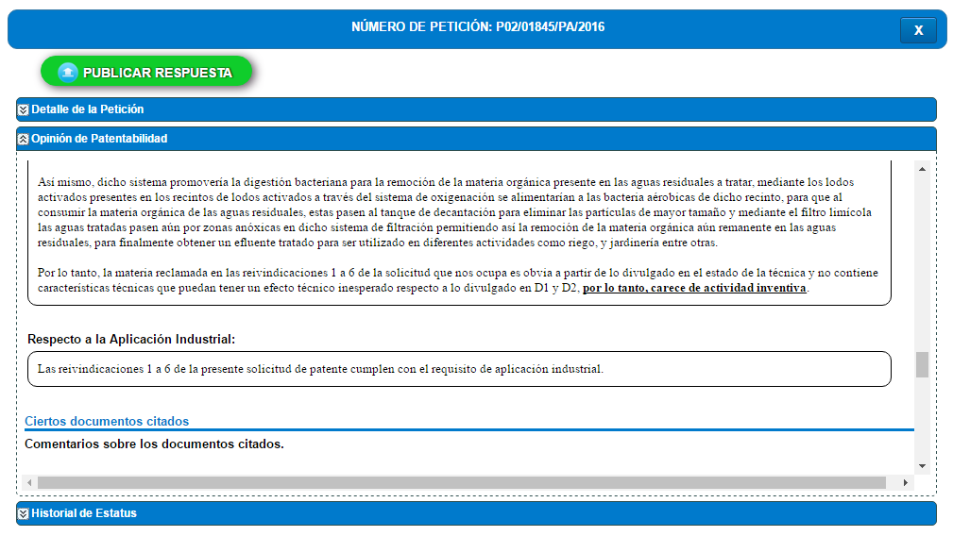
Patentability Opinion (cont.)

Slide 42
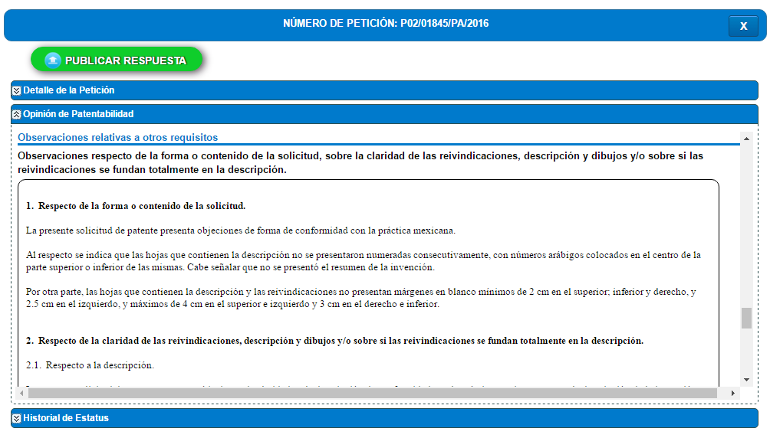
Patentability Opinion (cont.)

Slide 43
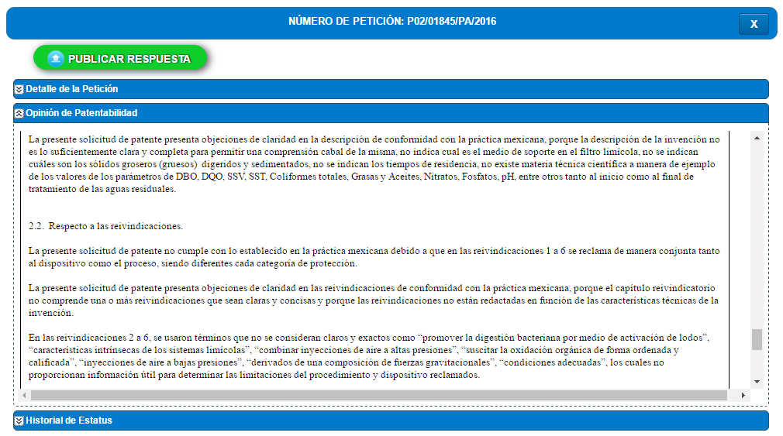
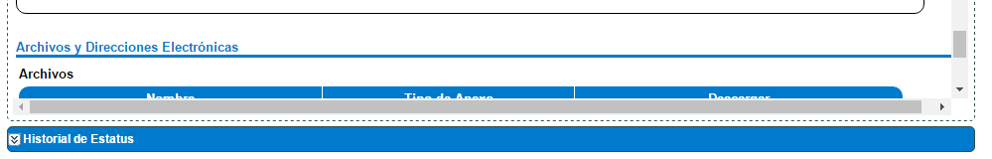
Patentability Opinion (cont.)

Slide 44
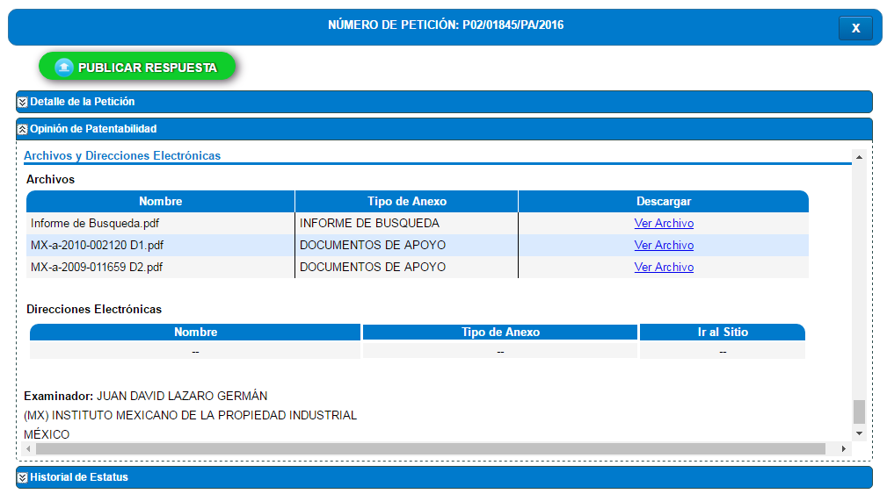
Patentability Opinion (cont.)
Documents supporting the response:

Slide 45
Thank you!
www.impi.gob.mx

