Slide 1
The result list in PATENTSCOPE
Online
June
2020
Sandrine Ammann
Marketing & Communications Officer

Slide 2
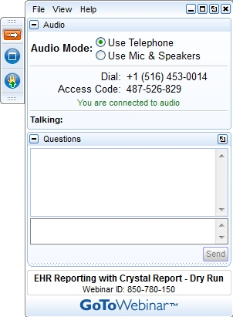
Raise your hand only if you can hear me otherwise please send me a message using the Questions box

Slide 3


Slide 4
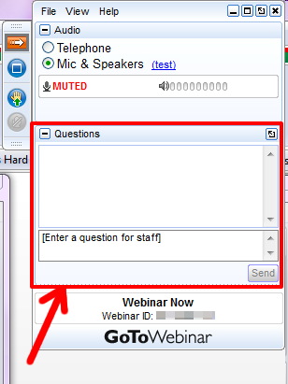

Slide 5
Questions/concerns
patentscope@wipo.int

Slide 6


Proof of existence for any intellectual asset
100% digital, effective and affordable
Highest technical encryption standards
Backed by WIPO: Trusted authority
Complementing IP registration services
https://wipoproof.wipo.int/wdts/
Notes:
We are pleased to introduce you to the newest service from WIPO:
WIPO PROOF is an easy way to safeguard any digital asset.
Consider files like Trade Secrets, software algorithms, sets of data resulting from R&D work, or design drafts of textiles, ceramics, flooring, wood manufacturing, apparel and accessories.
In our increasingly digitized world, inventions and creative outputs are often produced collaboratively, with the work spread out among contributors in many locations, or it must be shared with third parties because it needs a peer review, or needs feedback from the client.
In all these cases, your work is at risk from misuse or misappropriation. WIPO PROOF is an easy to use tool for safeguarding your creations. In a few seconds, the service creates a tamper-proof digital fingerprint of the file containing your work that is date and time stamped. This is called a WIPO PROOF token. WIPO PROOF tokens provide evidence that your work existed at a given point in time, and was in your possession before anyone else.
WIPO PROOF accepts any file format… (give examples from the FAQ) and in any size (to confirm).
The service is fast (a few seconds) and has a very affordable fee structure, which means you can use it routinely to document your work at every stage, from concept to commercialization. If you are a high-volume creator, you can purchase token bundles of 10, 100 or more, that are valid for 2 years, so you can document your work more frequently.
You can also request a WIPO PROOF premium certificate, signed by a WIPO Official, for each WIPO PROOF token. These certificates can be downloaded as a PDF and used as evidence in a legal dispute.
WIPO’s long history as the global forum for the international IP system means the service benefits from WIPO’s reputation for secure, reliable and trustworthy services, which are recognized worldwide among business, institutes, and legal jurisdictions.
WIPO PROOF is built on industry leading technology and robust encryption protocols that meet the highest technical standards. The service interacts with your file directly via your local browser, so that WIPO never, copies or stores your original asset.
WIPO PROOF complements, without replacing, existing intellectual property registration systems. It is designed to address the growing digital economy where innovation and creativity are enabled by technology, big data and global collaboration; where a strong foundation of evidence of the existence your creations at various points in time is useful whether or not your outputs become formal IP rights.
WIPO PROOF is available at wipoproof.wipo.int, for further information please visit the website where you can watch videos. Some webinars will also be organized soon.
Mention 3 complimentary tokens till June 15th.
Note to presenter: start with examples meaningful to your audience. This order works for PCT.

Slide 7

Search results list

Slide 8
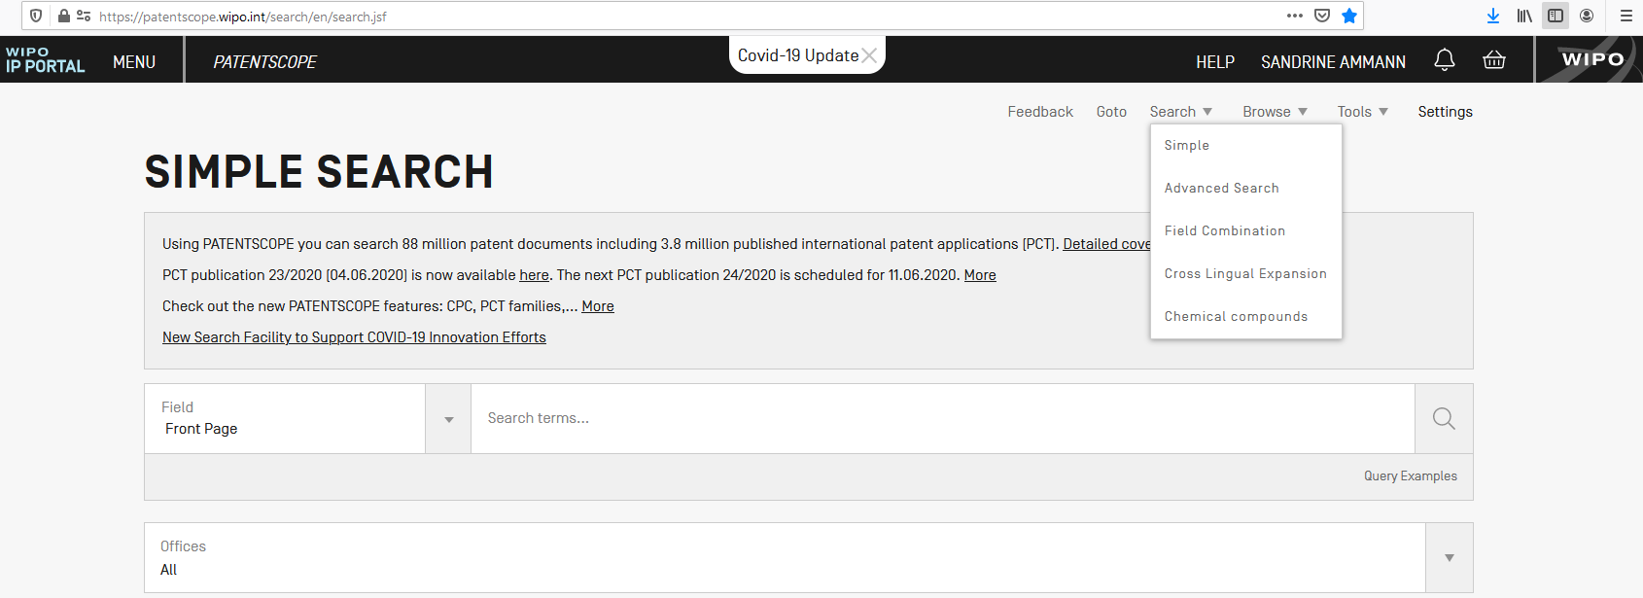

Slide 9
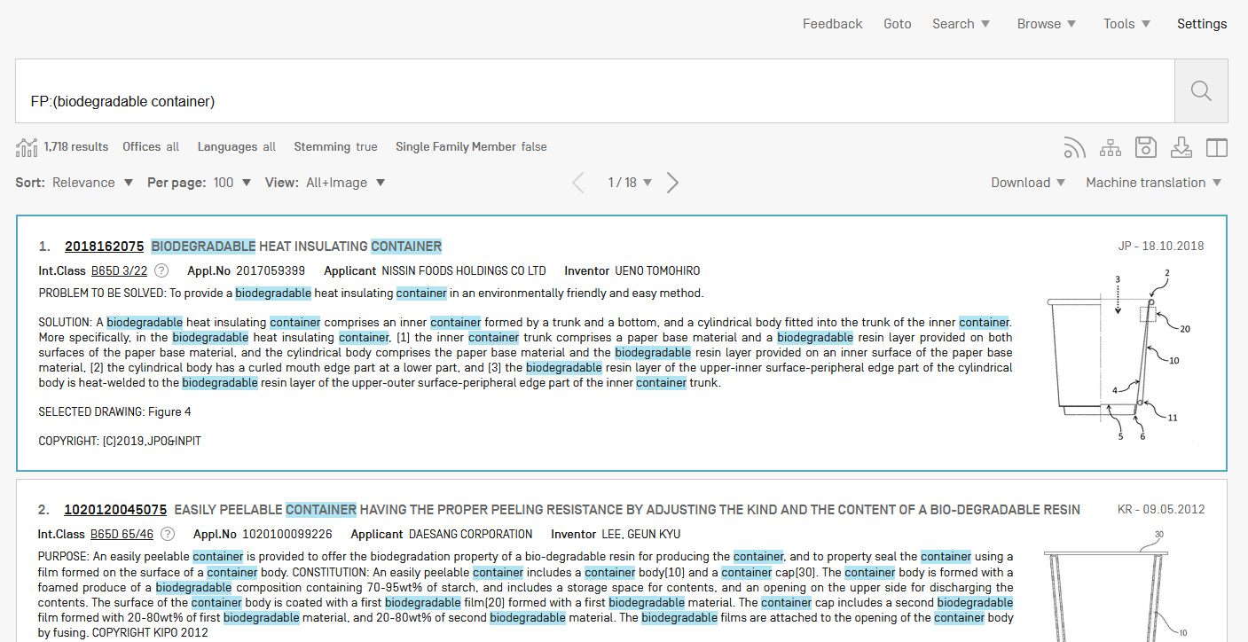

Slide 10
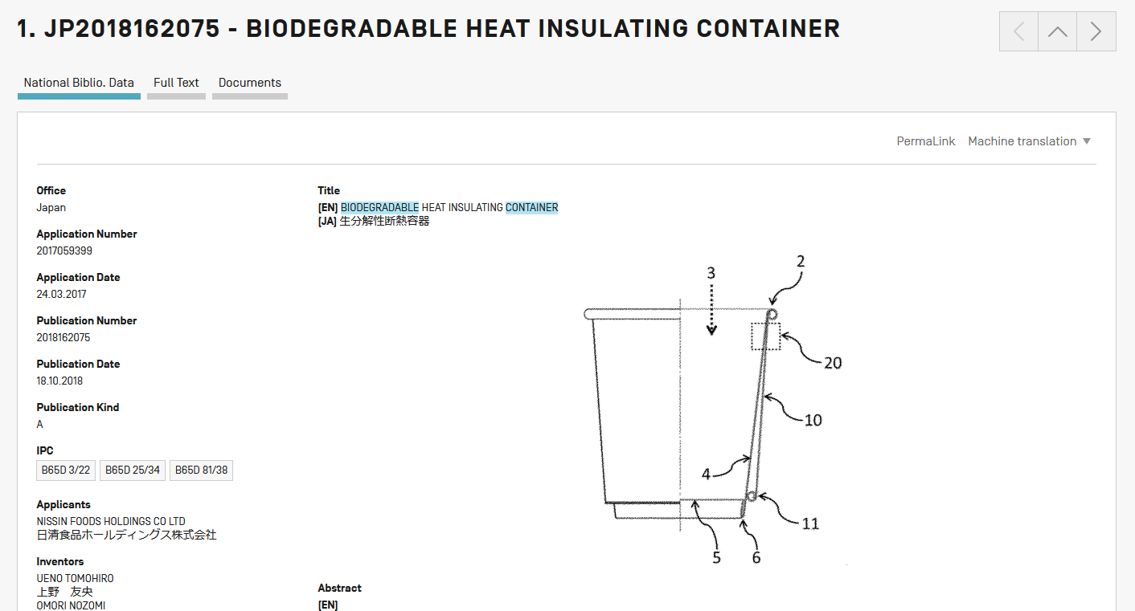
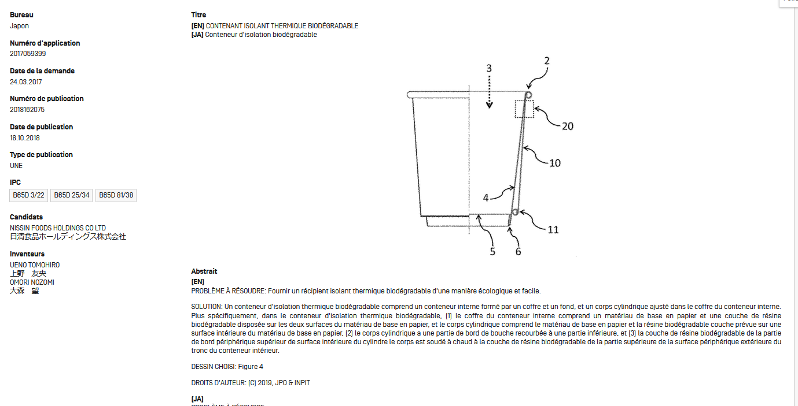

Slide 11
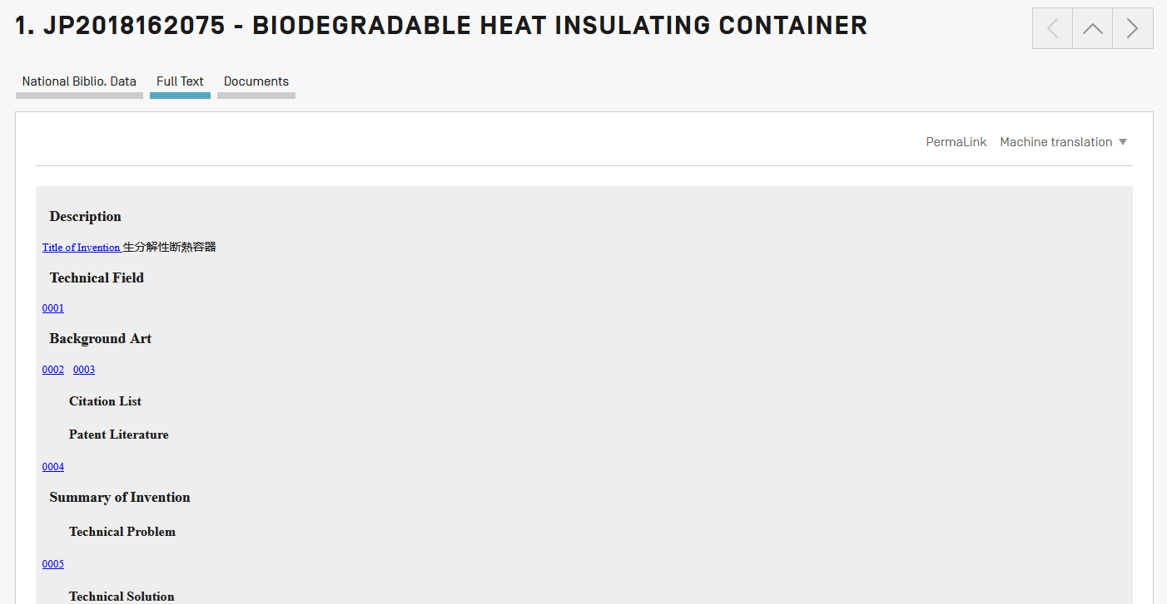
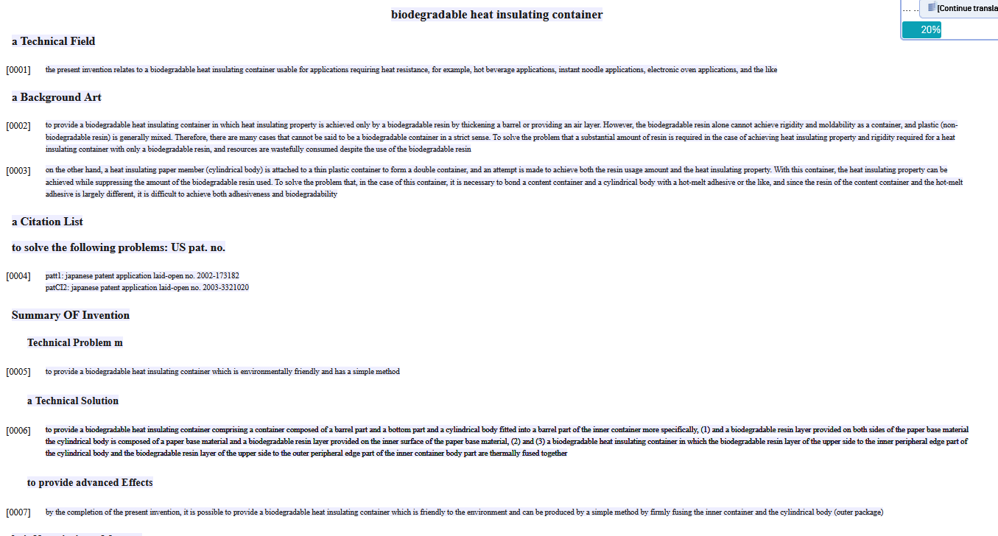
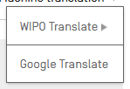
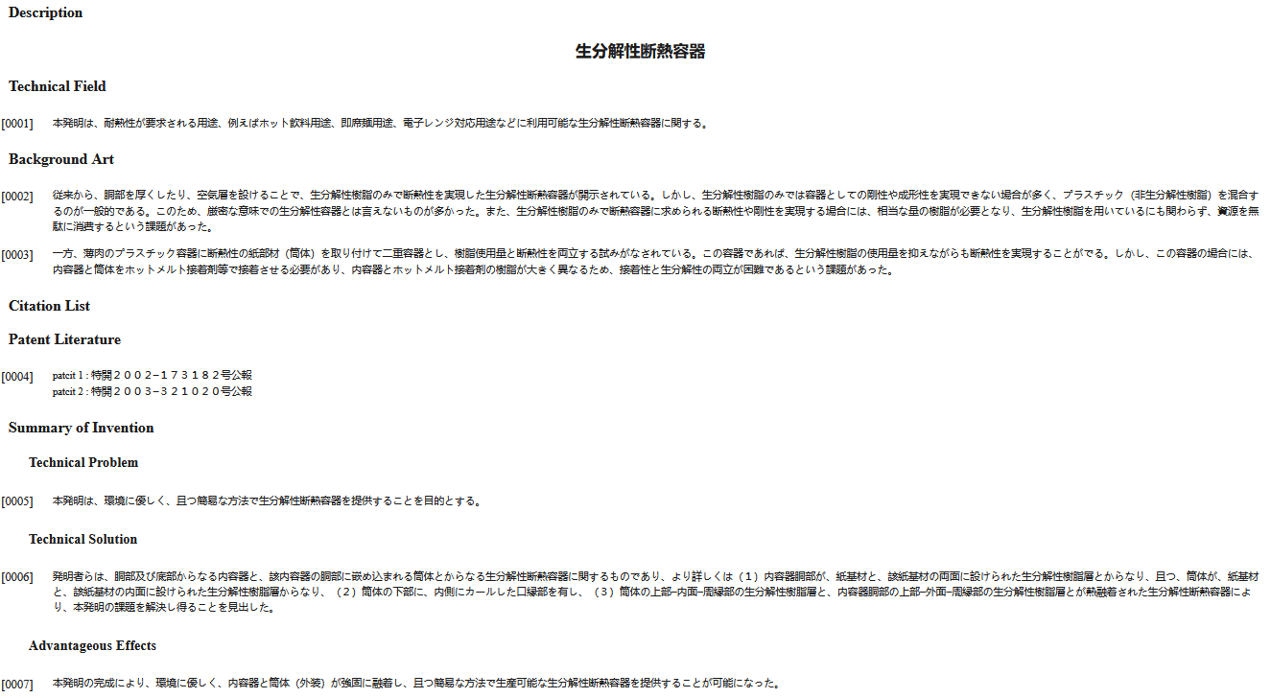

Slide 12
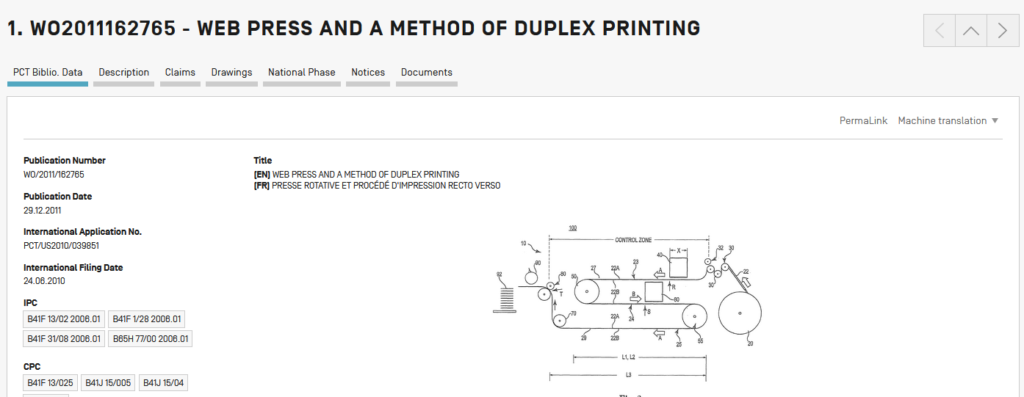

Slide 13
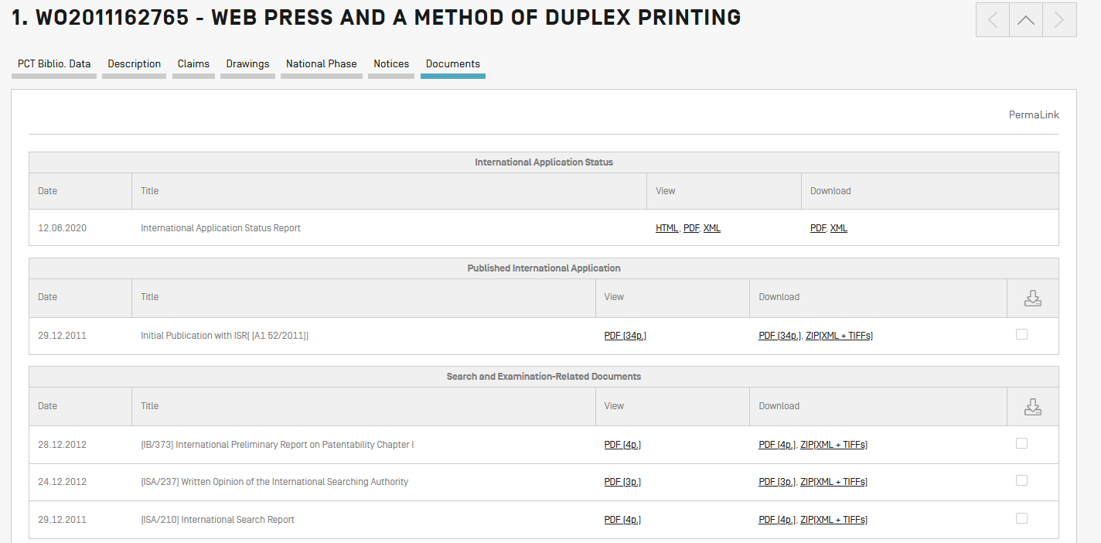

Slide 14
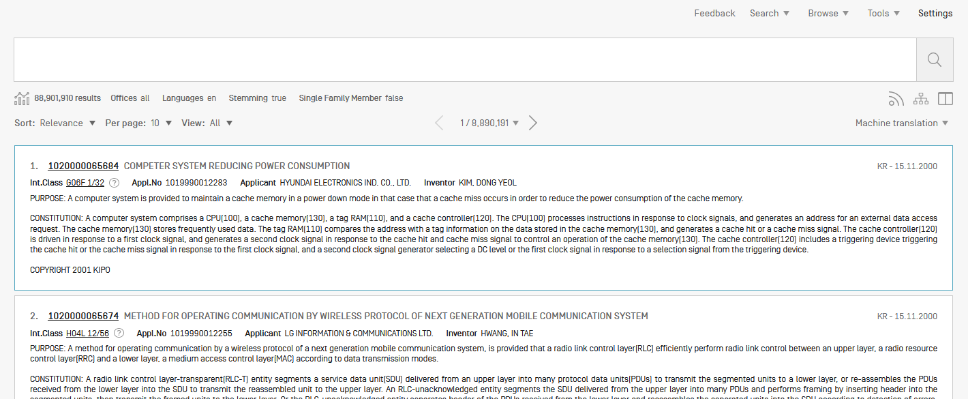
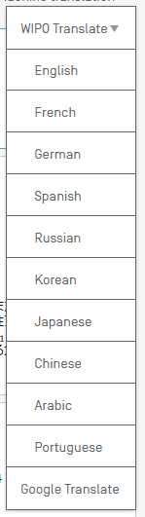

Slide 15
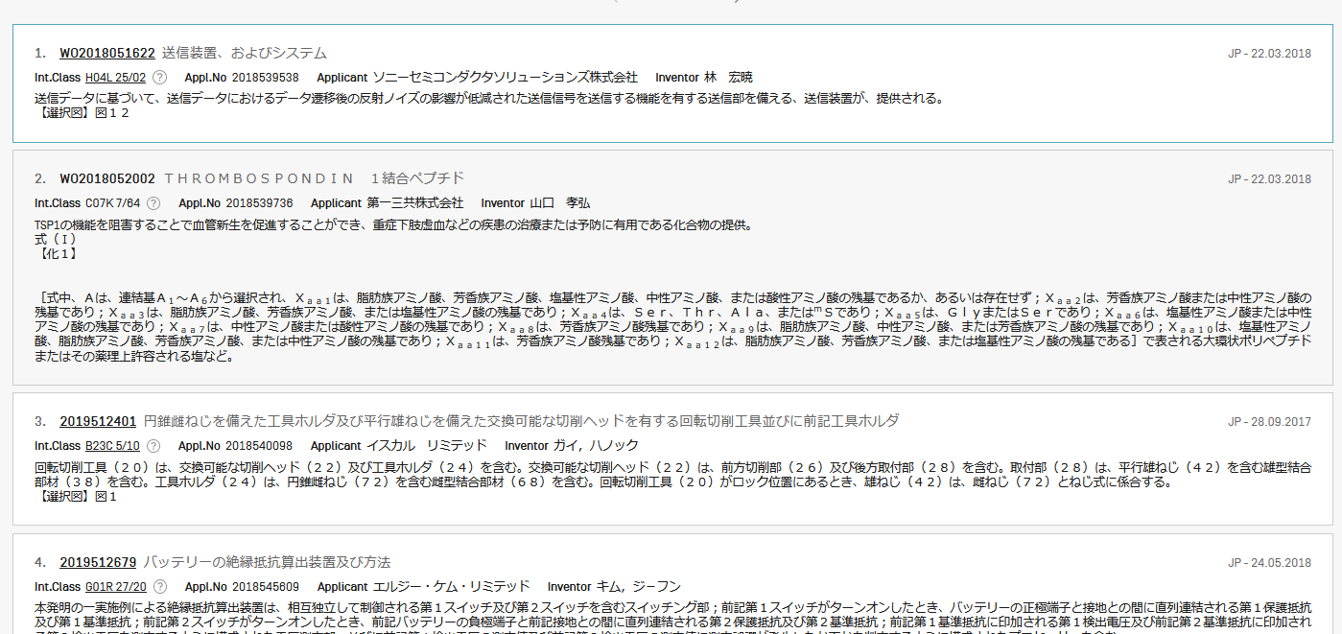
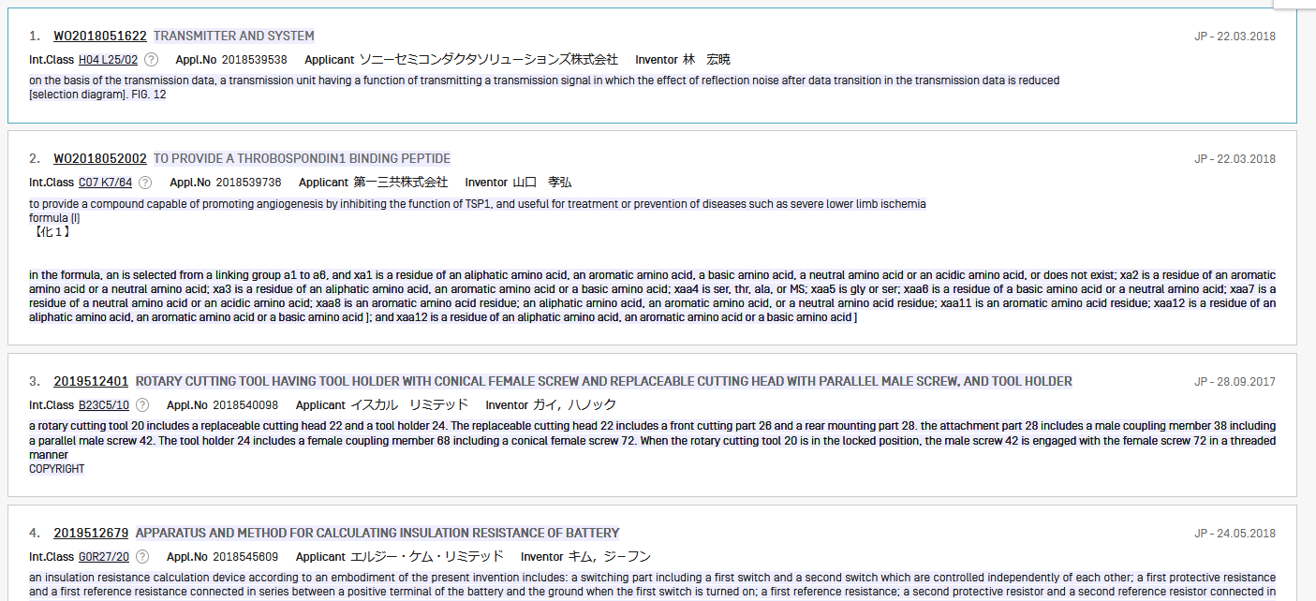

Slide 21
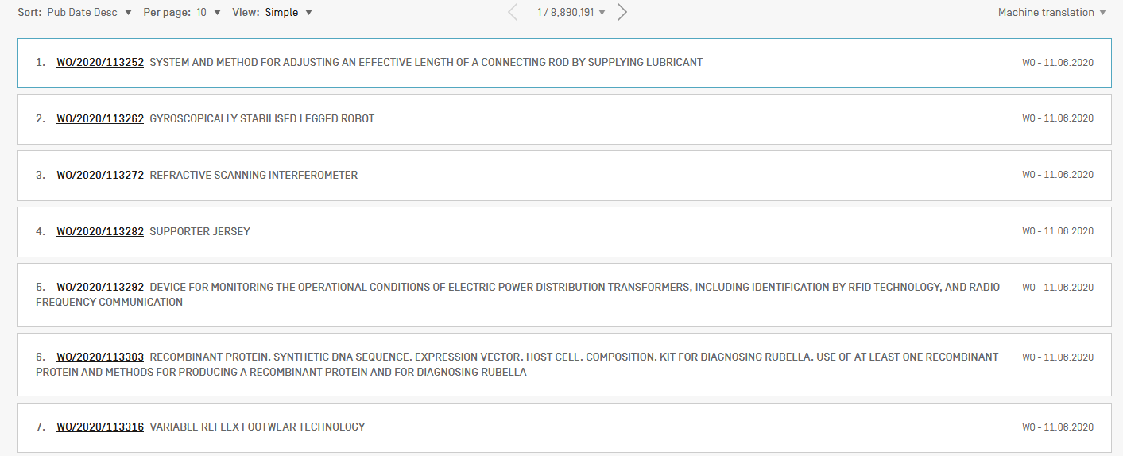

Slide 22
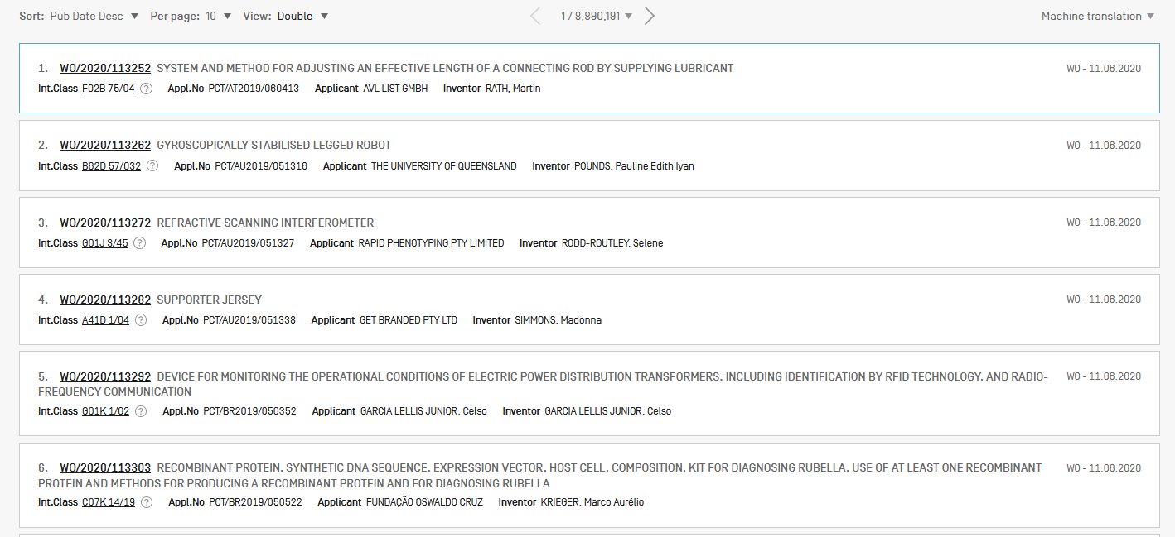

Slide 23
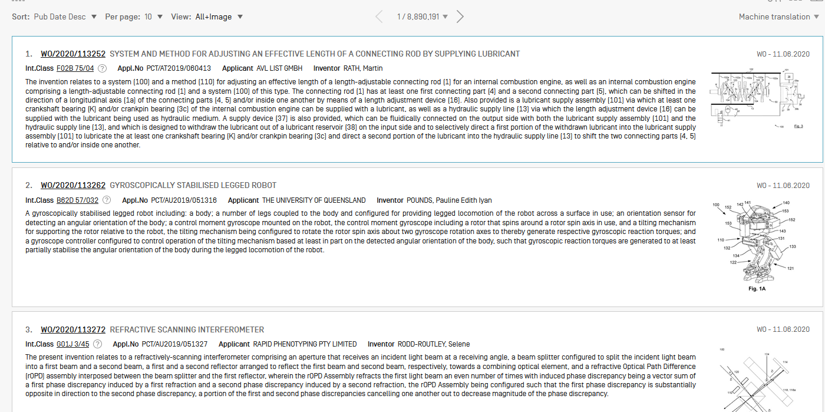

Slide 24
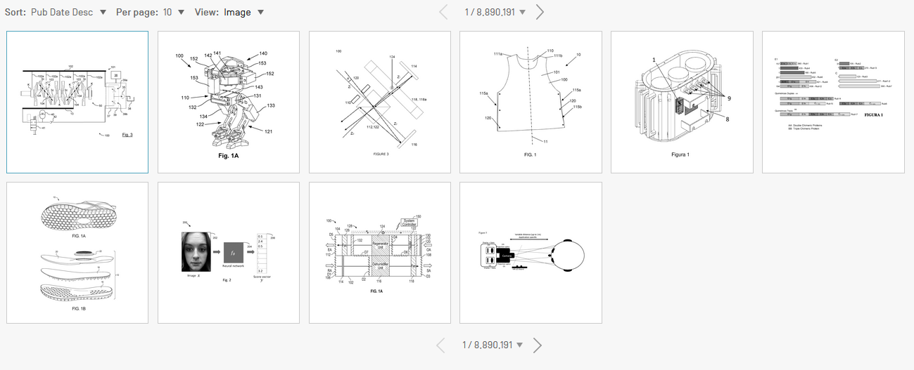

Slide 25
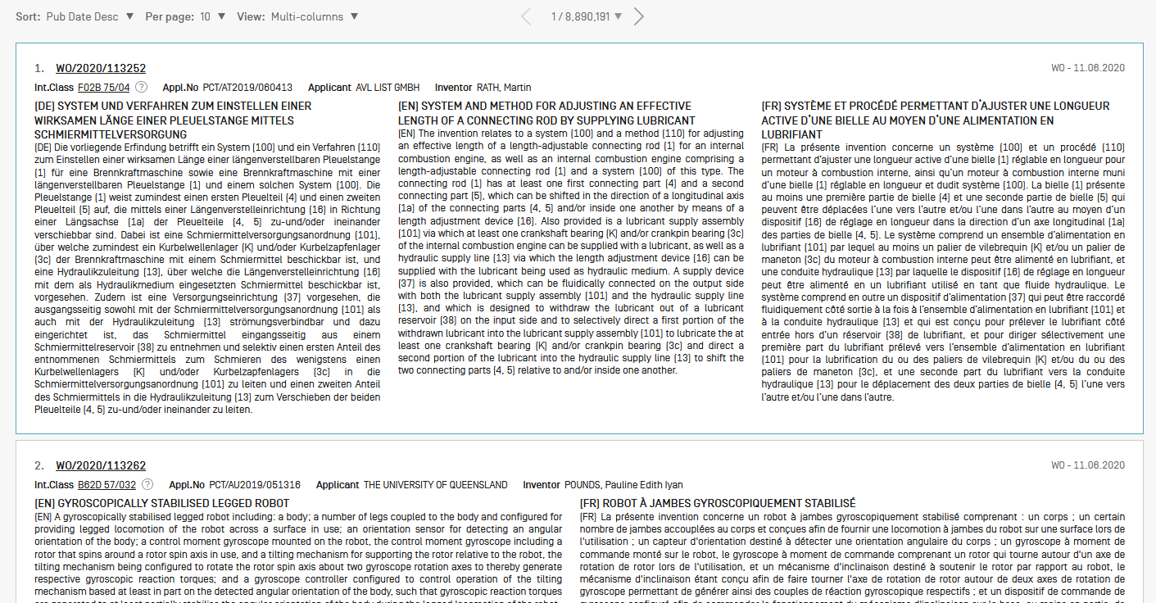

Slide 26
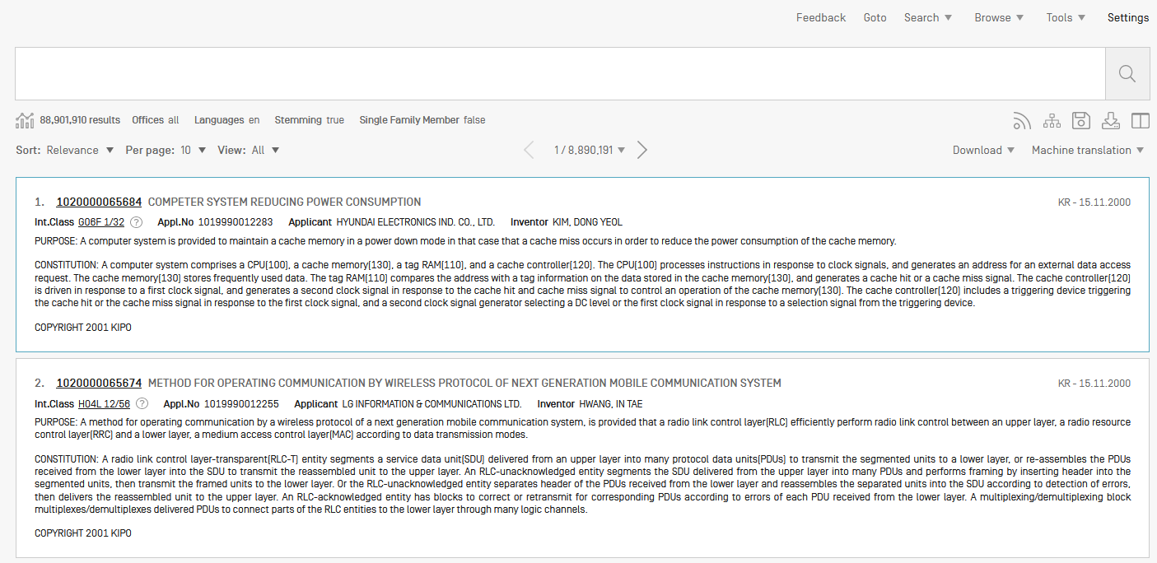

Slide 27
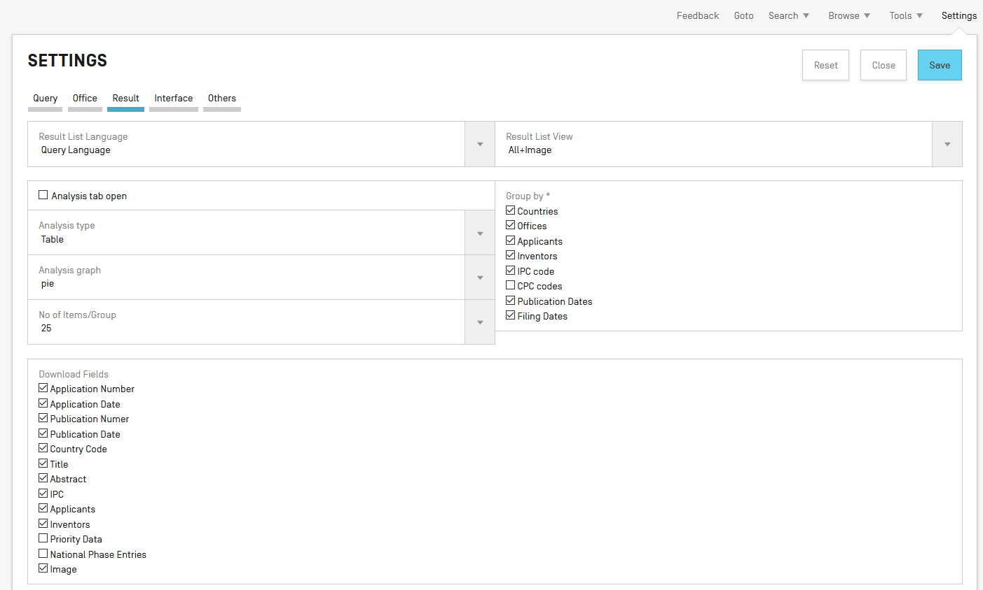

Slide 29


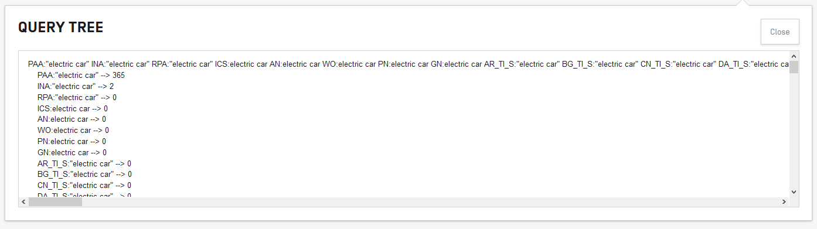
RSS & Query tree
RSS feed

Slide 30


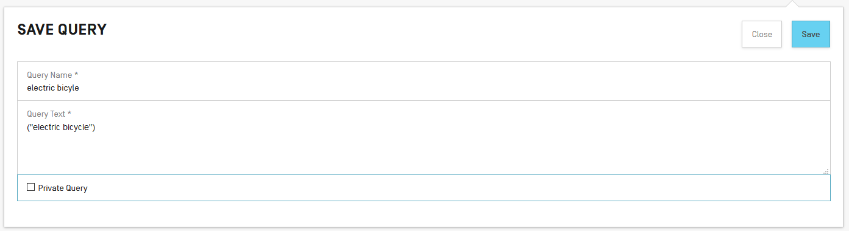
Save & Download
Download button

Slide 31
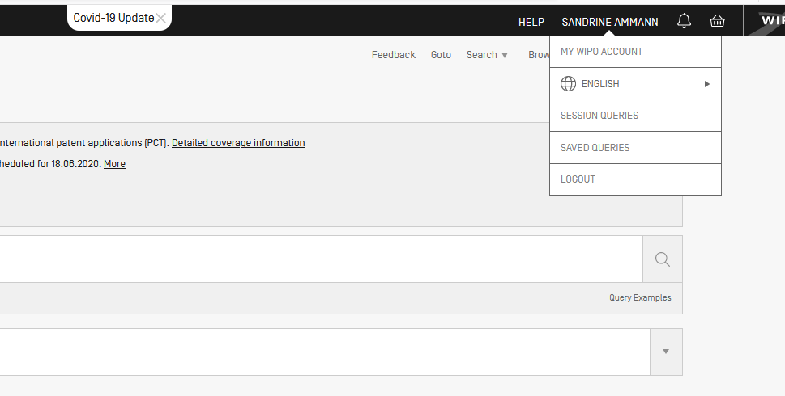

Slide 32
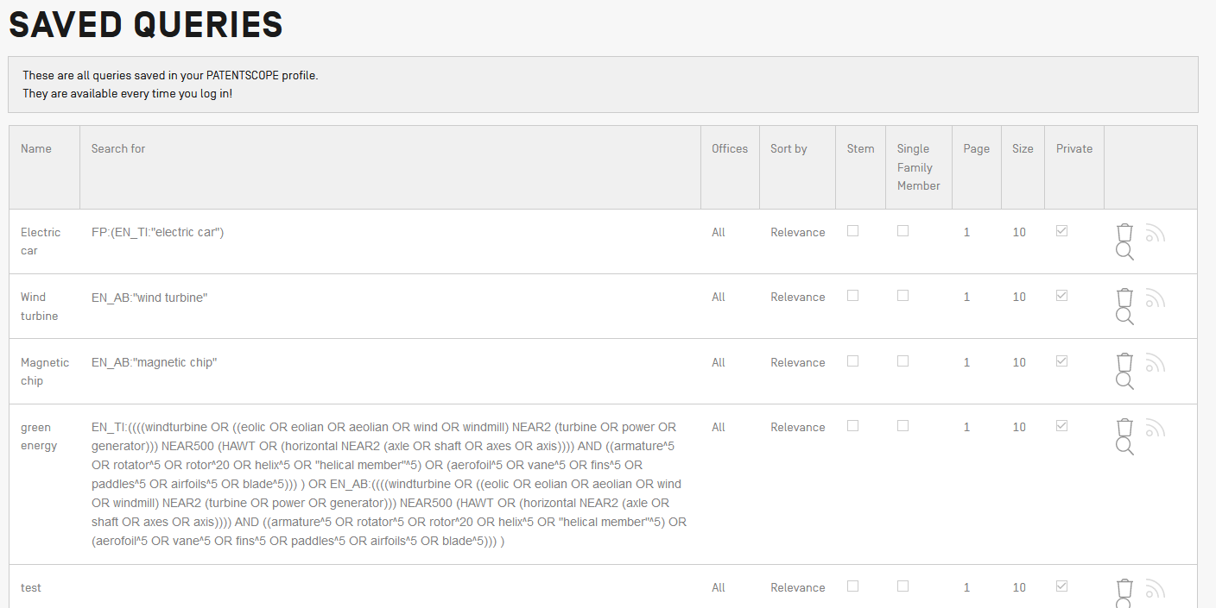
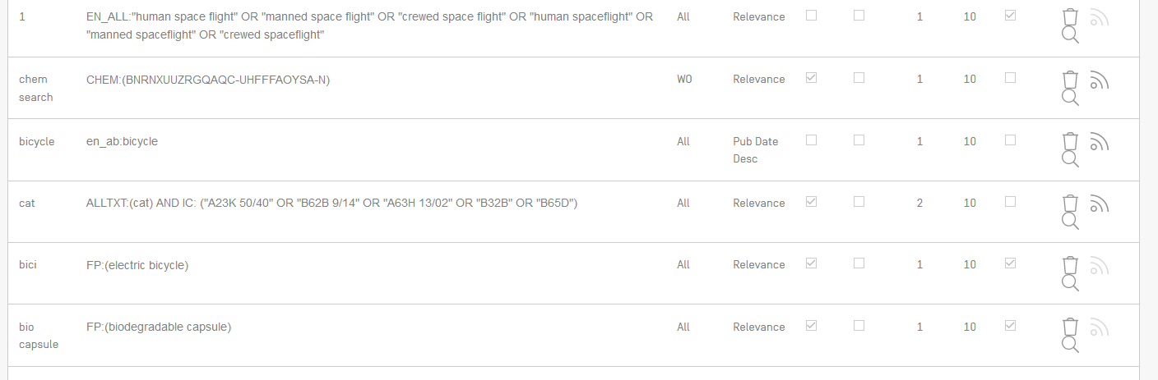

Slide 33
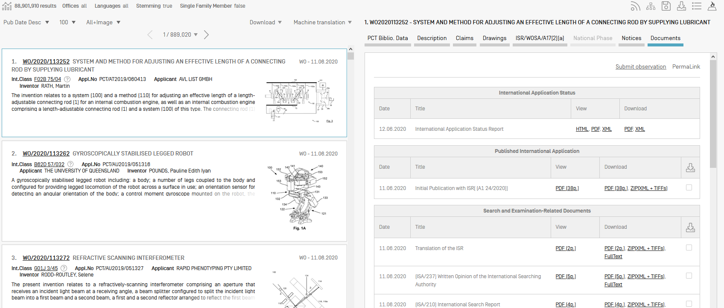
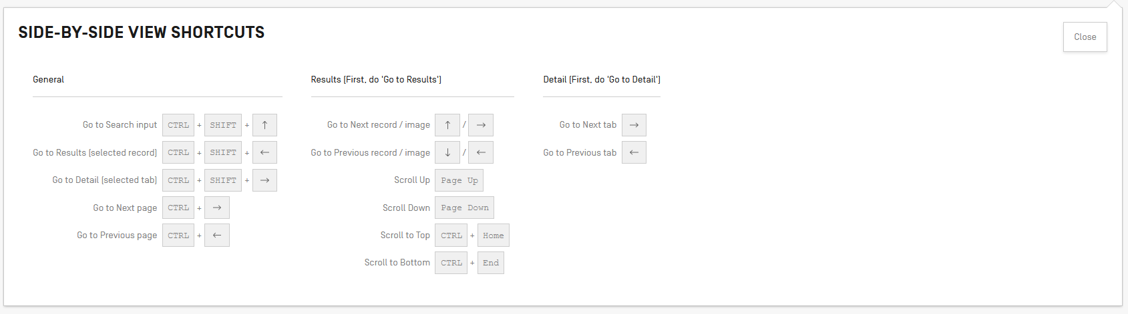
Display

Slide 34
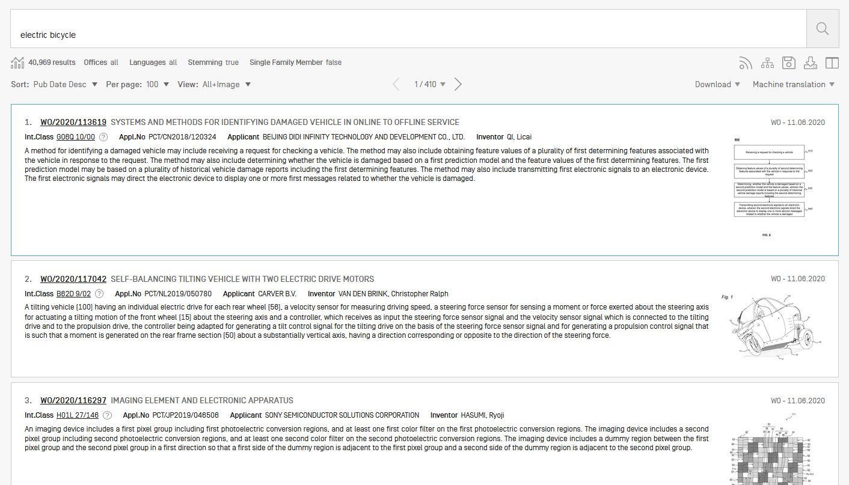

Slide 35
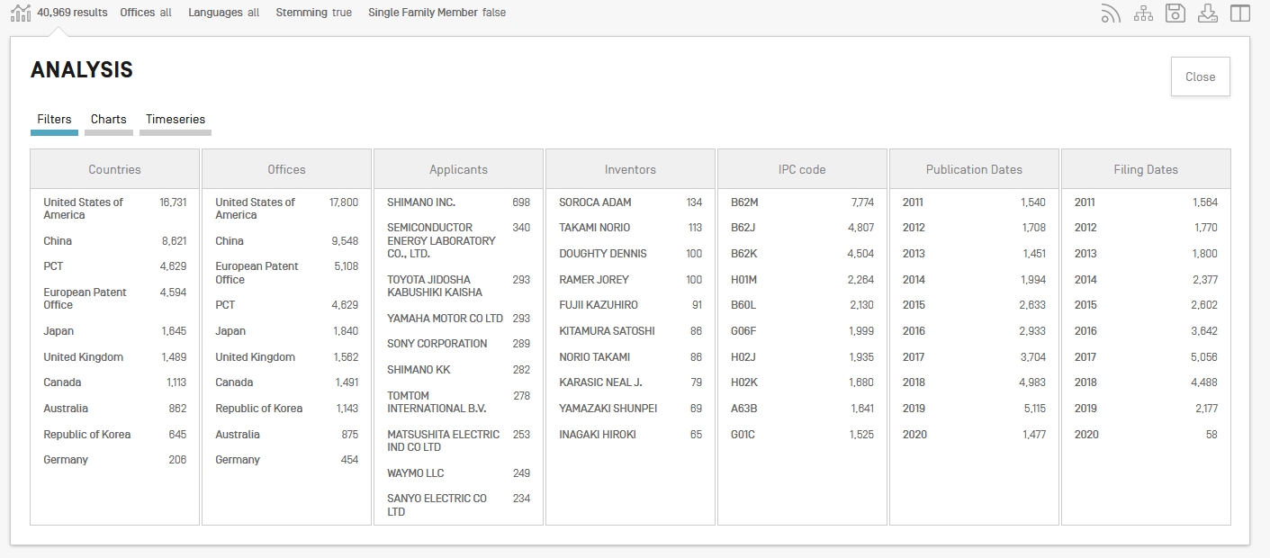

Slide 36
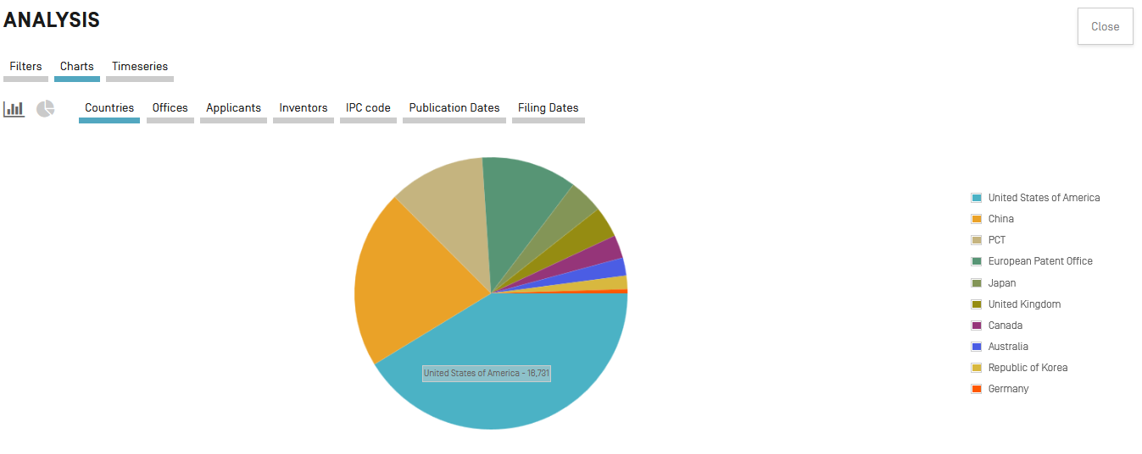

Slide 37
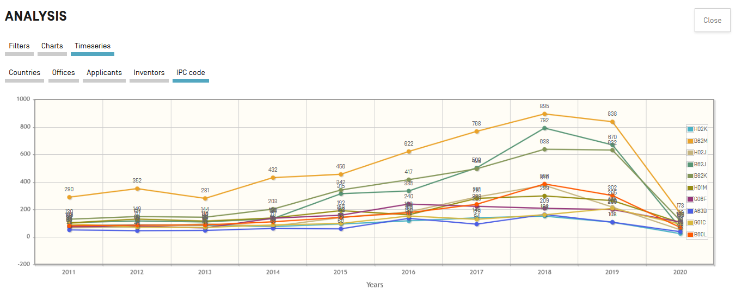

Slide 38
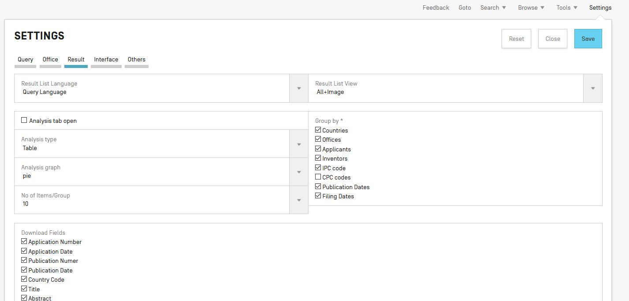

Slide 40
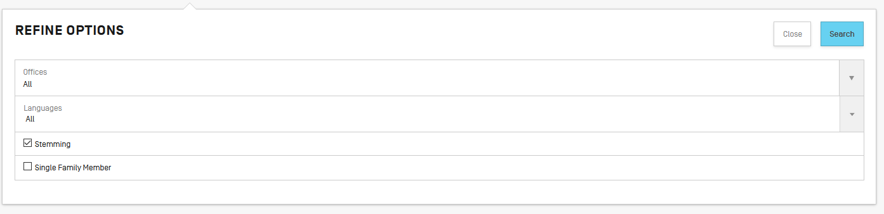

Slide 41
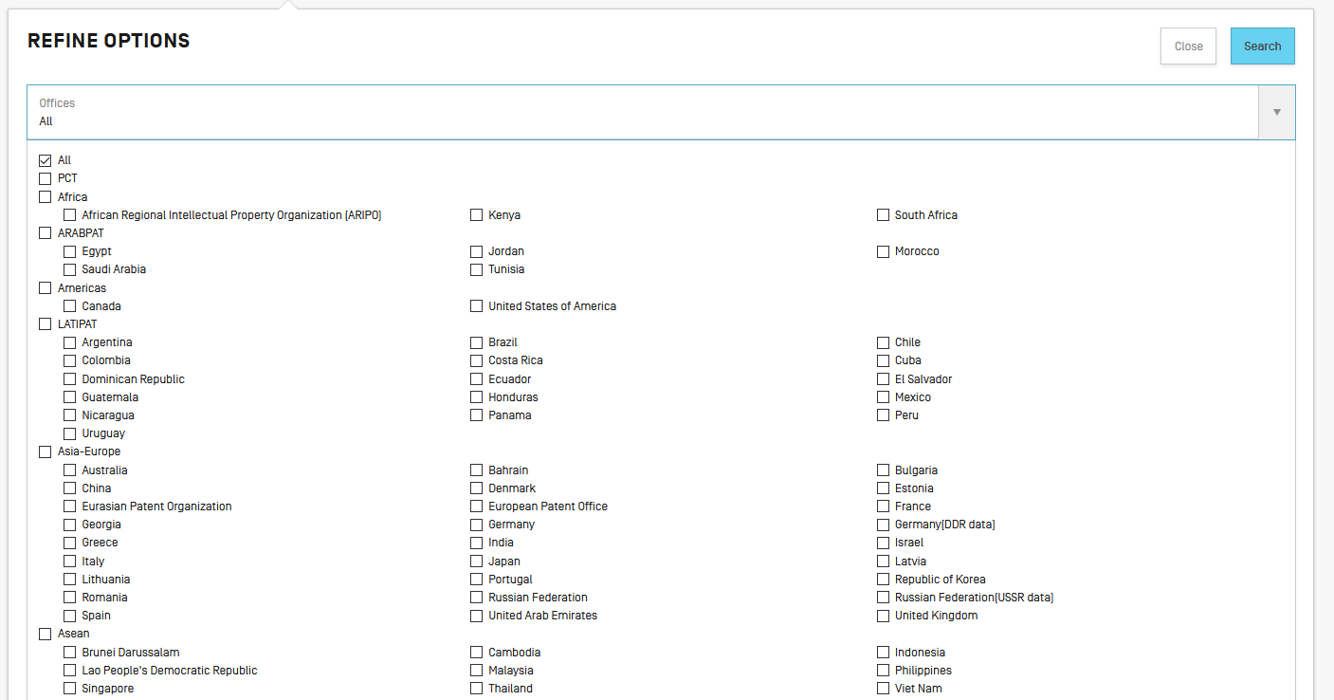
Offices

Slide 42
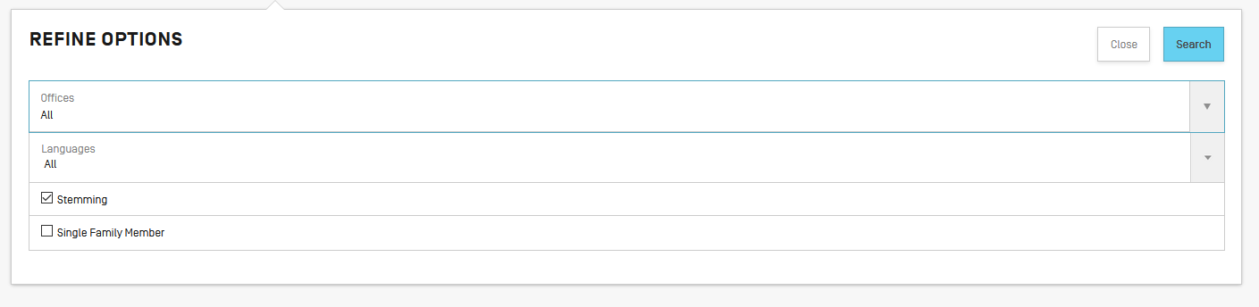
Stemming

Slide 43
Stemming
Stem = stemming
Process that removes common endings from words.
critical
critically
criticism each word is reduced to ‘critic’
criticisms
critics

Slide 44
Stemming
no dictionary includes the necessary technical terms to express patent concepts
Porter Stemming Algorithm finds words that contain common roots
Save time and effort

Slide 45
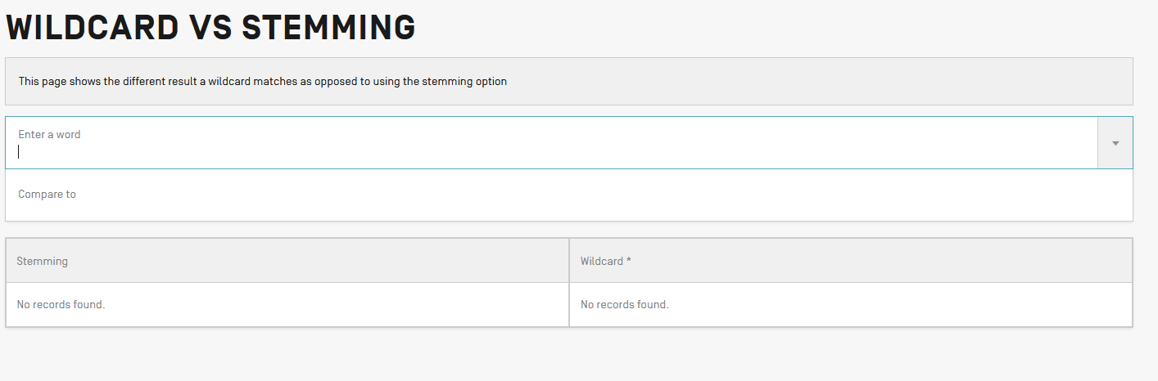

Slide 46
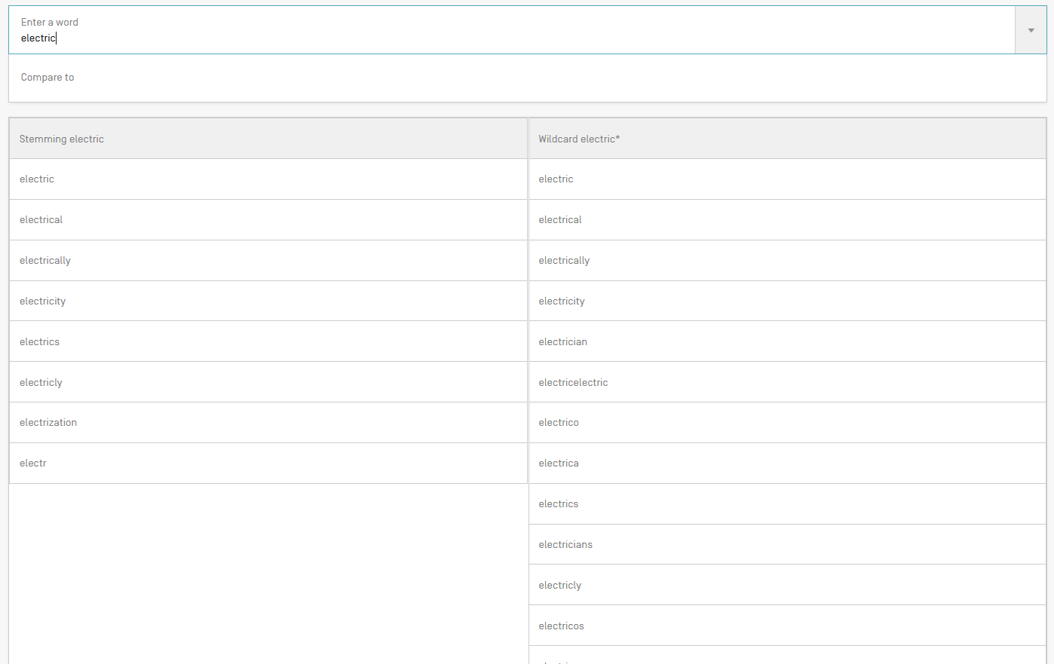
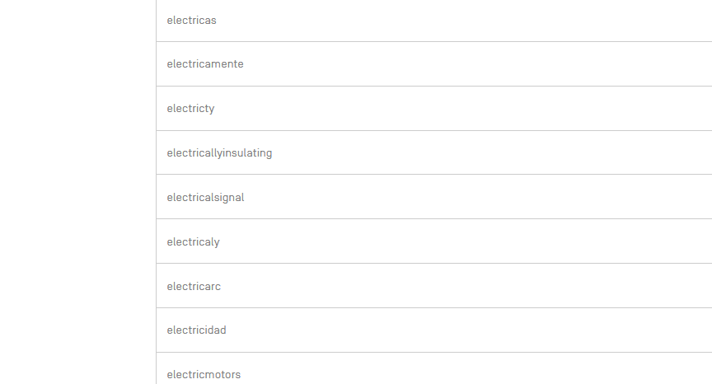

Slide 47
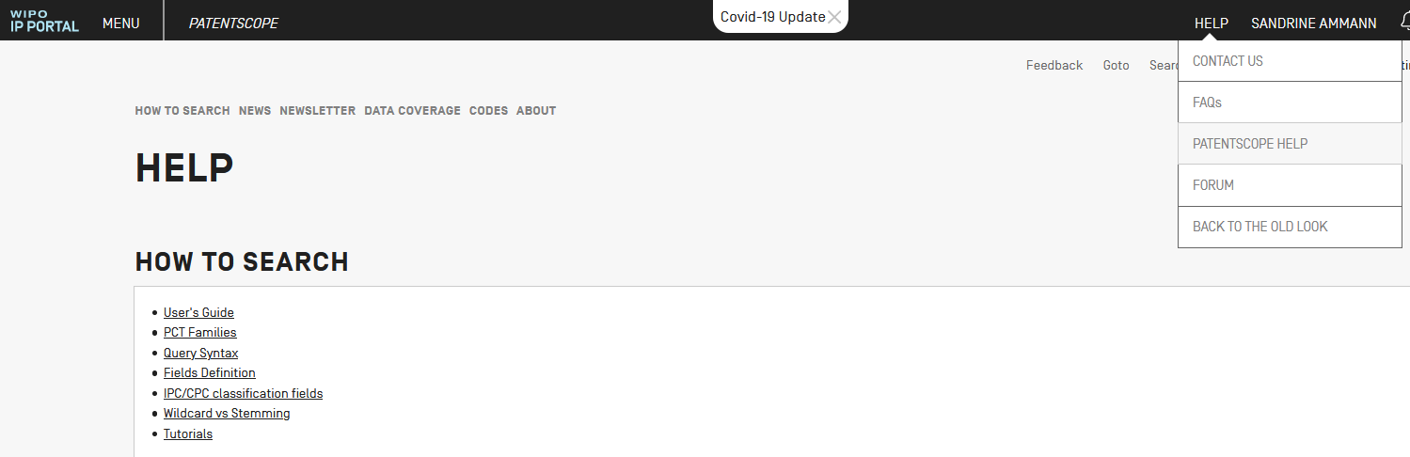

Slide 48
Families

Slide 49
Families in PATENTSCOPE a
PCT applications + national phase entries a
1st filing – PCT – national phase entries a
US Provisional – PCT a

Slide 50
Families in PATENTSCOPE x
2 first filings – PCT – national phase entry x
US provisional – nonprovisional – PCT x
Chain of provisional/nonprovisional – PCT x
Republications = one single record

Slide 51
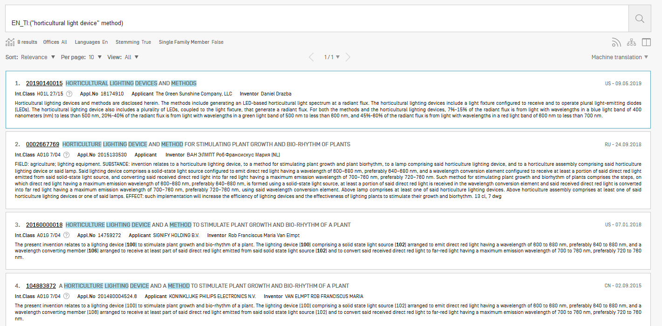
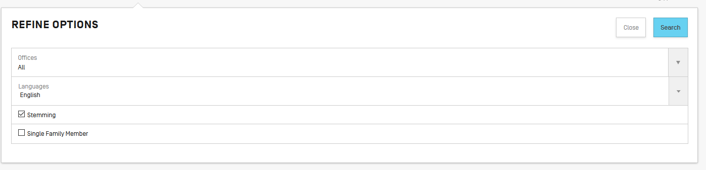

Slide 52
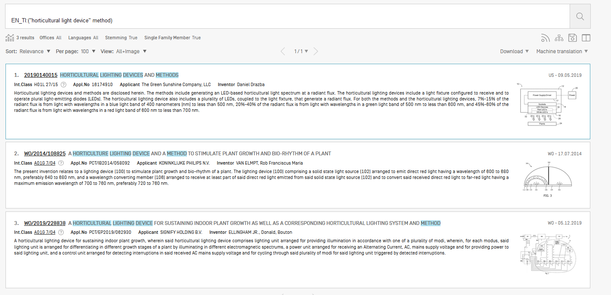

Slide 53
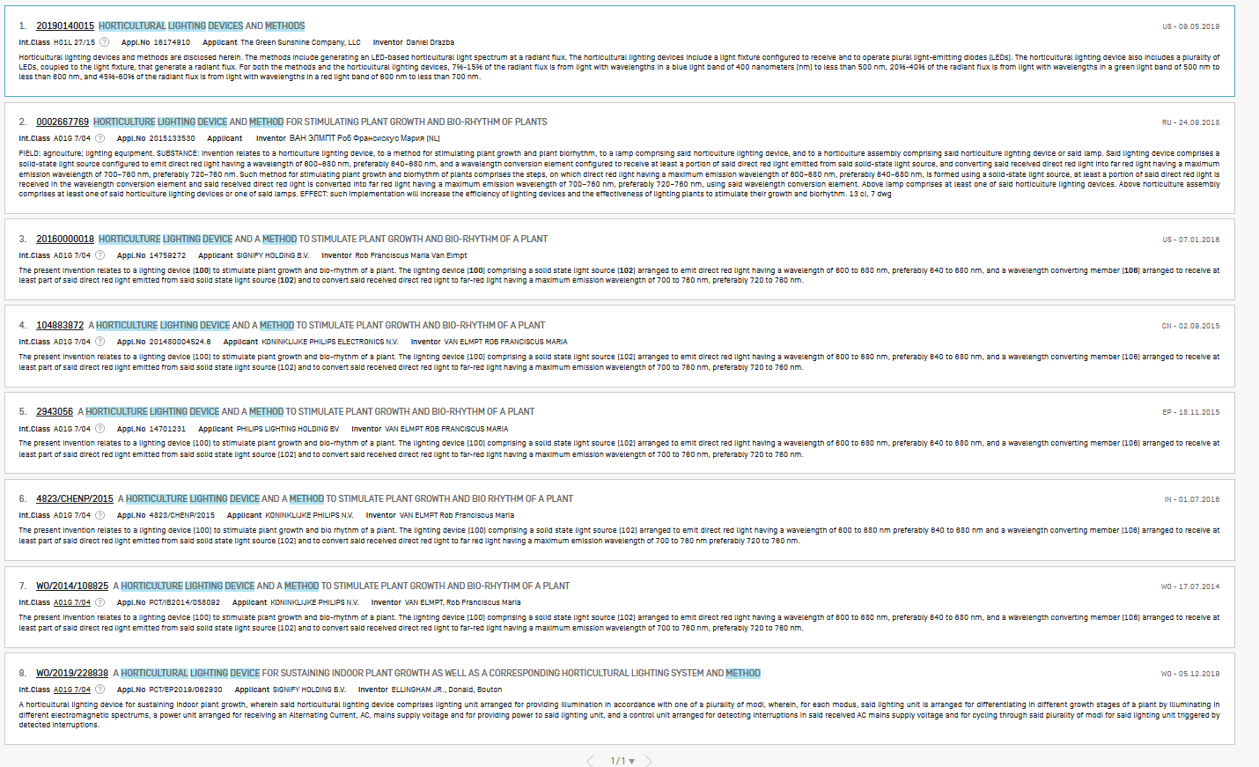
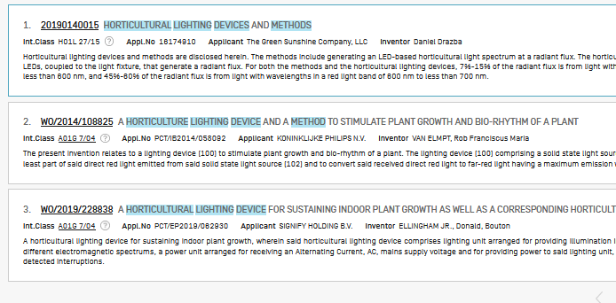

Slide 54
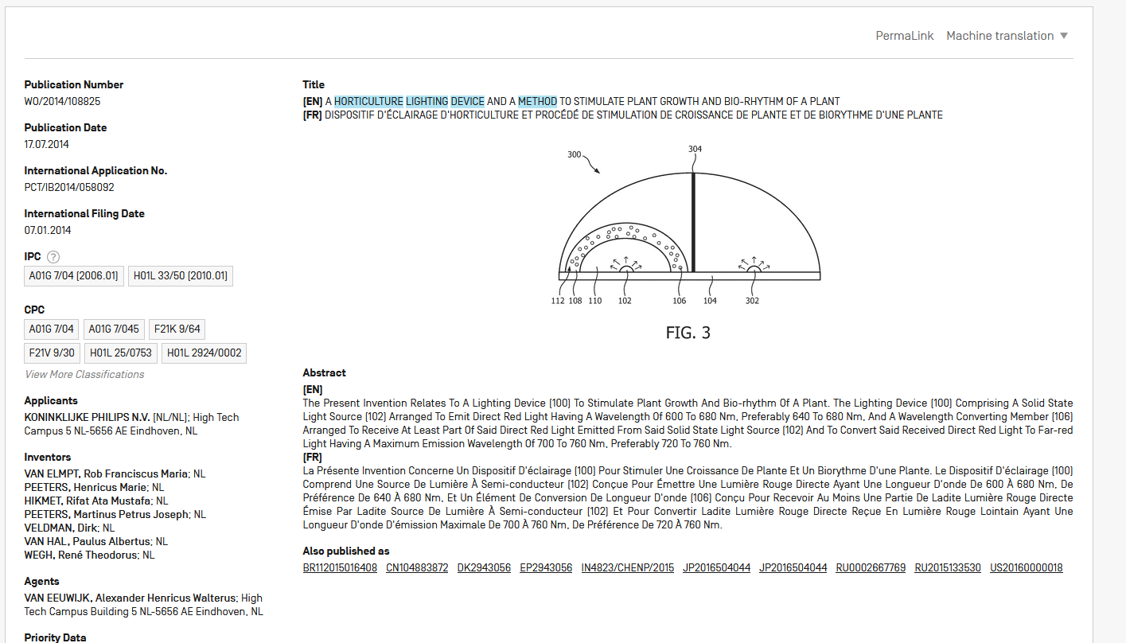

Slide 55
Next webinar
CPC & IPC in PATENTSCOPE
July 7 or 9
To register: https://www.wipo.int/patentscope/en/webinar/

Slide 56
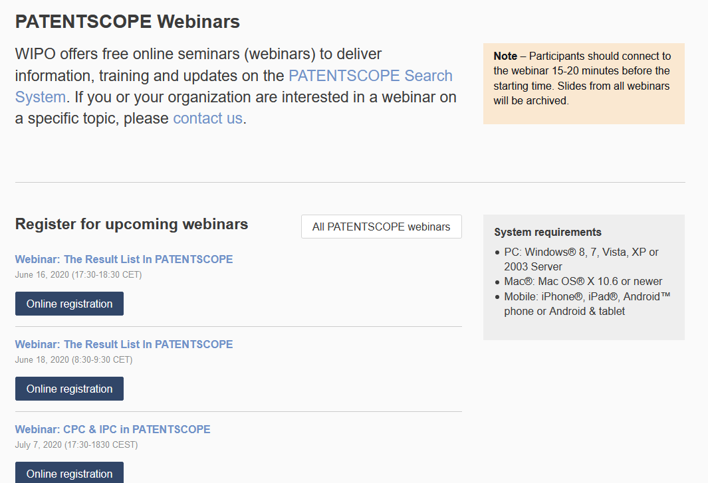
wipo.int/patentscope/en/webinar

Slide 57
Global Brand Database, Global Design Database
Webinars:
https://www.wipo.int/reference/en/branddb/webinar/index.html
https://www.wipo.int/reference/en/designdb/webinar/index.html

Slide 58
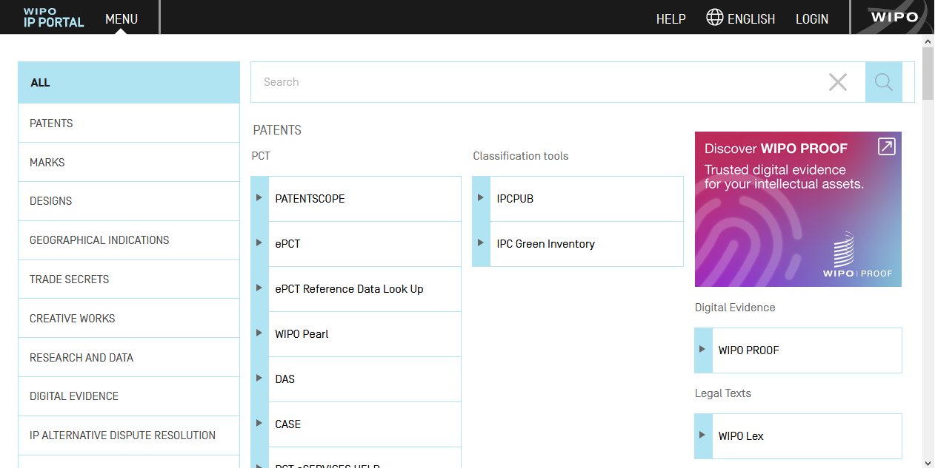
WIPO IP Portal
Notes:
We have recently created a portal to make your experience working with WIPO as seamless as possible.
The IP Portal is here to help protecting your ideas and provides many services to our customers in the 6 UN official languages.
Here is what we’ve done so far…
Through the IP Portal you will find more than 40 WIPO online services and more will be added soon.
The black bar that you see on top gives you easy access to our portfolio of IP services. Just by click on the MENU and you will see, grouped by category and searchable, all the available IP services.
Through the IP Portal you can easily access the services you need for Filing your application, Managing your registrations or for searching what may be available about your competition.
You only need to sign-in once, by clicking on LOGIN in the black navigation bar and you can navigate around all the IP services.
When you login you will notice that the LOGIN has been replaced in the black navigation bar by your username and that some additional icons appear in the black navigation bar. These are special services provided only to logged in users.

Slide 59





Single sign-on
Notes:
All the services that require authentication are protected by a state of the art secure system, including strong authentication similar to banks for those highly confidential services, such as filing for a patent.

Slide 60


Streamlined payment processing
Notes:
We are putting in place a streamlined payment processing to be implemented by all our services: filing, renewal, purchase data services.
We have made your payment process easier. You can easily buy services or products through our online payment functionality that you can access if you click on the PAYMENT BASKET icon you will see at the black navigation bar at the top of the page.
This streamlined payment system is already used for industrial design payments and soon will be integrated for patents, then all the other services will follow.

Slide 61

Customizable dashboard of widgets
Notes:
Then, there is the IP Portal dashboard.
The dashboard makes your WIPO experience even more personal.
Just click on WIPO IP Portal link at the top left of the screen and you are directed to your dashboard. You can add the widgets that you need and create your own dashboard of widgets.
The benefit of these widgets is that they provide quick access to your information, such as payment transactions or allow you to perform some basic tasks, like searches. Additionally, there are some generic widgets, such as the world clock in which you can add multiple clocks in different time zones, or the latest news, where you may find all the news shared through the available communication sources.
You can move the widgets around the screen, add more widgets and remove them if you don’t find them relevant any more.
Please note that the widgets do not replace the IP services. They present summary information from the existing IP services and provide you with a quick entry point into the services.

Slide 62

Customizable dashboard of widgets
Notes:
If you click on “Manage Widgets” you have access to over 15 widgets from different IP property services and we are constantly adding more.
You can make your dashboard as useful as you wish.
Here, you can also find a Feedback box where you can provide your feedback about the IP Portal!

Slide 63

Personal messaging system
Notes:
Our most recent service, still in its infancy but growing fast, is the IP Portal Alerts & Messages page.
This is your personal messages inbox where you’ll receive messages from the IP services you work with. These messages are the same as the e-mails that you receive from WIPO in your e-mail addresses but we have gathered them under one page in the IP Portal for easier access.
You can access it if you click on the MESSAGES BELL icon that you will see at the black navigation bar at the top of the page.
Currently, it is under development and linked to the messages received from only some of the IP services but very soon all the messages that IP services share with you will be also shared through this messaging system.
Finally, if you click on HELP in the black navigation bar you can find FAQs & Contact details which are application specific (For example Help in Madrid Fee calculator takes you to Contact Madrid).

Slide 64

IP Portal Suggestion Box
https://ipportal.wipo.int
Notes:
If you were to remember one thing about the WIPO IP Portal it is this:
It is the one-stop shop for WIPO IP online services
We are here to listen to you and make your experience with WIPO as easy and pleasant as possible
If you have your smartphone handy, here is a QR to the feedback form.
Otherwise, you can login into the IP Portal dashboard and click on the « Feedback» button to access the feedback form.
We would love to hear from you!

Slide 65


Slide 66
DOWNLOAD
  Is it possible to download my search queries? No, you can save your search queries in your WIPO account.
  Is it possible to download result list greater than 10,000? No, the maximum number of results is 10,000.
  Can you export patent search list to Excel? Yes using your WIPO account.
  Can we download the machine translated full text? You can copy it.
  Can I choose some patents in result list for downloading? Yes in the excel downloaded file.

Slide 67
ANALYSIS
  In the analysis, data shows only from 2011, can we increase number of publication years for analysis? Yes, in the Settings menu, select the Result tab and then the No of Items/Group.
  In the “ANALISIS” tool, what is the difference between “Countries” and “Offices”? Countries indicates the number of documents in the national/regional collection while Offices indicates as well the number of documents of the national/regional office but also the PCT applications that entered into national phase in that country

Slide 68
FAMILIES
  How can one specify which country will appear as representative of a family - i.e, if the family contains US, EP, WO, GB etc., When there are multiple patents from different countries in a family; how can one be presented only with the US publication? This is currently not available.
  Can you please explain what does families exactly apply to? There is no universally recognized definition of what a patent family is, and patent families often vary from database to database, in simple terms, a patent family is a group or collection of patent applications covering either similar or the same technical content.

Slide 69
FAMILIES
  what role does it have with regard to searching a patent?
1. less result to check
2. no language barrier
3. classification available across family members
4. find related invention
5. identify technological trends
STEMMING
  Is the stemming button automatic? Yes, unless you are using wildcards

Slide 70
  MISCELLANEOUS
  Can we find the global dossier in PATENTSCOPE?
  Yes in the Documents tab.
  Is any way to retrieve large data information on patent citations? Not currently.
OTHER TOPICS:
  IPC green inventory
  Patent landscaping tool/research by idea
  Wipo account
  WIPO Proof
  International Patent Classification and Cooperative Patent Classification

Slide 71

patentscope@wipo.int

