Slide 1

The Role of Technical Assistance in Intellectual Property (IP) and Innovation for Business Competitiveness in Africa Dr. McLean Sibanda Managing Director: Bigen Global Limited
Under the auspices of, Development Agenda Coordination Division (DACD), Development Sector, World Intellectual Property Organisation (WIPO), Geneva, Switzerland Webinar, 12h00 CAT, 10th December 2019

Slide 2

S. No.
Contents
Page No.
1
Continental Perspective
4
2
WIPO Development Agenda
9
3
State of Intellectual Property and Innovation in Africa
14
4
Role of Technical Assistance in Africa’s Development
20
5
The Case of South Africa – IP and Innovation for Development and Competitiveness
25
6
Concluding Remarks
36

Slide 3
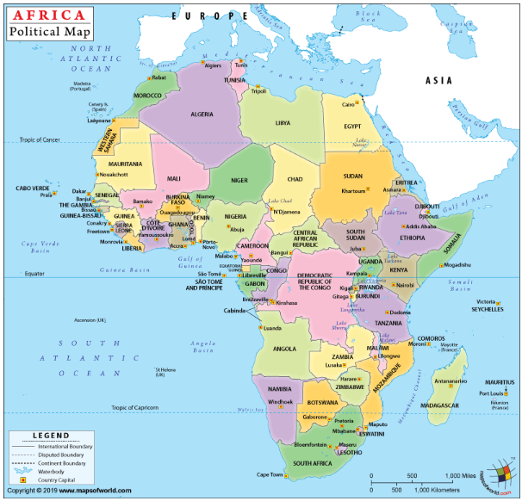
S. No.
Contents
Page No.
1
Continental Perspective
3
2
3
4
5

Slide 4
Continental Perspective - Overview
“We shall accumulate machinery and establish steel works, iron foundries and factories;
We shall link the various states of our continent with communications;
We shall astound the world with our hydroelectric power;
We shall drain marshes and swamps, clear infested areas, feed the undernourished, and rid our people of parasites and disease.
It is within the possibility of science and technology to make even the Sahara bloom into a vast field with verdant vegetation for agricultural and industrial developments”.
– President Kwame Nkrumah - at the foundation summit of the Organization of African Unity, Addis Ababa, 24 May 1963
Notes:
It is not that Africa has ever lacked a vision, roadmaps or recognised the important role of science and technology for her development. Africa has had a well articulated vision of economic development through science and technology as far back as 1963 when the Ghana President stated thus, at the founding summit of the Organisation for Africa Unity in Ethiopia. The founding fathers of the OAU (now Africa Union) foresaw the important role of science and technology for development, industrialisation, energy, telecommunications, health and food security. Perhaps the challenge has been one of its history, her being left out of critical conversations regarding economic development strategies, lack of capacity (both technical and financial), or balancing between addressing today’s challenges versus investing in long term development.
In this regard, it is important when dealing with the issue of the Role of Technical Assistance in Intellectual Property and Innovation for Business Competitiveness in Africa, to have a clear shared vision between African countries and High Income Countries on “What Success Looks Like”. This presentation will attempt to paint a picture of what success could look like – an Africa that invests significantly in R&D for its own development and contributing to addressing the multitude of global challenges - an Africa that has vibrant private sector businesses that are sustainable and competitive in the global arena – an Africa whose higher education institutions and Small Medium Enterprises (SMEs) have great appreciation of the importance of intellectual property and innovation, protect and commercialise their own IP and have well established capabilities to conduct advanced IP searched and mappings – an Africa with growing industries that continuously increase value of her exports (goods, services, knowledge and human capital) to the rest of the world – an Africa that is an equal in the discussions on trade and knowledge economy in global platforms; and an Africa that is industrialised and is a major contributor in the 4th industrial revolution.
The developmental journeys of Japan, Korea, China and Singapore provide hope and inspiration that this vision of Africa can be realised in perhaps an even shorter period of time than it took these Asian Tigers to achieve their development status, because of the lessons learnt about the role and importance of IP and Innovation, advantages that the 4th industrial revolution provides, Africa’s demographic dividend and renewed commitment by African governments.

Slide 5
Continental Perspective - Overview
Countries: | 55 countries recognized by the African Union
Demographics: | 1.32billion (2019); Projected > 2.2billion (2050) Second-largest continent 16% of world population – second most populous continent 43.4 % of the population lives in urban areas (567,387,619 people in 2019) Most youthful continent - median age of 19.4 years
Economic Development: | Significantly high growth rates since 2008 global crisis Typically > 5% per annum (see next slide) Key drivers for growth: infrastructure investments and string domestic demand
Other: | 32 or 55 countries (58%) fall under the United Nations definition of Lease Developed Countries, with the remainder being middle income

Slide 6
Continental Perspective – GDP Growth Rates
6 of World's 15 Fastest Growing Economies are in Africa (Ethiopia, Rwanda, Cote d’Ivoire, Tanzania, Senegal, Ghana)
Of the eight (8) countries in Africa with the fastest growing economies, 62.5% are LDCs
For most, economic growth driven by significant infrastructure investments
Rising entrepreneurship levels amid high youth population and unemployment
Low industrialisation
Rising services industries
Source: Data from IMF World Economic Outlook
Notes:
Of the top 15 fastest growing economies in the world, six of them are in Africa, with GDP growth rates of between 6.1 and 7.9% per annum. What is worth noting is that other than Cote d’Ivoire and Ghana, the rest are so called LDC. [World's Fastest Growing Economies: https://www.focus-economics.com/blog/fastest-growing-economies-in-the-world]
The top eight (8) fastest growing economies in Africa have growth rates in the range 6.1 – 7.9%. For most of these countries, the growth has been on the back of significant investments in infrastructure, oil and gas discoveries and development of necessary infrastructure to extract these. What is evident is that other than Mozambique, most of the fastest growing economies are in East and West Africa. Although it could be argued that these countries are starting off a lower base than the Southern African countries, the reality is that there are definite signs of recovery and deliberate support of innovation which has seen innovations in the financial services for most of the unbanked in East Africa, for example. Entrepreneurial levels are on the rise, much supported by donor funding targeted at LDCs. Notwithstanding the good progress being made in many cases, industrialisation and in particular, manufacturing levels remain very low, and there is a need to boost industrialisation so the countries’ economies can effectively support the growing urban population and rising youth. Government in most of these countries, remains the largest employer, a situation that is not sustainable, if government services to citizens is to increase, as there would be a need for more taxes to be collected.

Slide 7
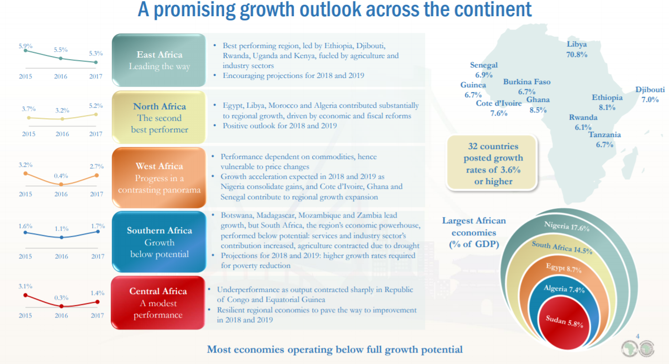
Continental Perspective – Economic Growth Outlook
https://www.afdb.org/fileadmin/uploads/afdb/Documents/Financial-Information/2018_Financial_Presentation-EN.pdf

Slide 8
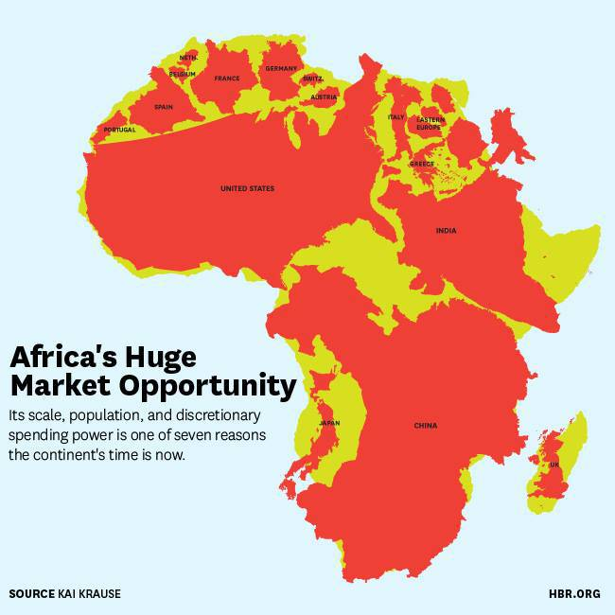
Continental Perspective – Business Environment
Innovation critical for Africa’s economies to address many challenges and realise opportunities
Poverty, Inequality, Unemployment Infrastructure and service delivery Inclusive health Water and food security
Accelerate Africa’s Development and position her for 4IR and to be a key contributor to global knowledge pool
Industrialisation on the back of value addition to Africa’s abundant mineral resources
Africa continues to show improvement in respect of ease of doing business. Notwithstanding, there is still slow progress in improving governance and addressing corruption Of the ten (10) African countries in the Top 100 Ease of Doing Business, eight (8) are in Sub-Saharan Africa

Slide 9
Questions
Summary and Concluding Remarks
Do you believe intellectual property and innovation could contribute to Africa’s economic development?
  YES
  NO
All forms of intellectual property are important but arguably have different contributions to economic development. Select only ONE that you believe would make the biggest contribution to Africa’s economic development:
Patents, designs and utility models
Trade marks
Copyright
Geographical Indications
Indigenous Knowledge Systems and Trade Secrets

Slide 10



S. No.
Contents
Page No.
2
WIPO Development Agenda
10
3
4
5

Slide 11
WIPO Development Agenda
Cluster A: Technical Assistance and Capacity Building
Cluster B: Norm-setting, flexibilities, public policy and public domain
Cluster C: Technology Transfer, Information and Communication Technologies (ICT) and Access to Knowledge
Cluster D: Assessment, Evaluation and Impact Studies
Cluster E: Institutional Matters including Mandate and Governance
Cluster F: Other Issues
Development Agenda (DA) is a pro-development reform of the international intellectual property (IP) system
Adopted in 2007
45 recommendations
6 Clusters
Notes:
The WIPO Development Agenda, adopted in 2007 by members states comprises 45 recommendations in 6 clusters. This Webinar will focus on Cluster A-Technical Assistance and Capacity Development.
In respect of TA and Capacity Development, there is a realisation that the world will remain unequal, if those who have more advanced economies are not in any way involved in capacitating those countries with developing economies. By and large, most developing countries are endowed with natural resources (minerals, oil and gas, human resources) that could and in many cases, have benefitted the developed countries. There is also a recognition that as the world is becoming more globalised, it is important to ensure harmonisation of rules relating to trade, intellectual property, etc. to facilitate trade and development.
It is also worth noting the overlap between Cluster A and Cluster C, particularly when it comes to issues of economic development, as TA in the area of technology transfer is critical to the discussion about innovation in Africa, as we will see in the case study of South Africa towards the end of this presentation.

Slide 12
Development Agenda – Technical Assistance and Capacity Building
Cluster A –Overview of 14 Recommendations
  Development-oriented, demand-driven and transparent,
  Consider priorities and the special needs of developing countries, especially LDCs, incl. different levels of development of Member States;
  Legal, commercial, cultural, and economic exploitation of intellectual property
  Human and financial allocation for technical assistance programs
  Needs of small and medium-sized enterprises (SMEs) and institutions dealing with scientific research and cultural industries
  Greater public awareness on IP and appropriate IP Strategies
  Development of national scientific and technological infrastructure for protection of domestic creations and innovations
  Access to specialized databases for purposes of patent searches by national offices of developing countries (esp. LDCs) as well as their regional and sub-regional IP organizations
  Bridge digital divide through databases to match specific IP-related development needs with available resources

Slide 13
Development Agenda – Technical Assistance and Capacity Building
Cluster A – Some Completed TA Projects in Africa
Project | Beneficiary Countries | Brief Description
Intellectual Property, Tourism and Culture: Supporting Development Objectives and Promoting Cultural Heritage in Egypt and other Developing Countries (CDIP15/7 Rev.) | Egypt Namibia | Analysis, support and promotion of awareness on role of IP system in tourism-related economic activity, including promotion of national and/or local knowledge, traditions, and culture.
Project on the Use of Information in the Public Domain for Economic Development (CDIP/16/4 Rev.) | Kenya South Africa Morocco | New services and tools to supplement existing TISC services, to identify inventions in the public domain and support inventors, researchers and entrepreneurs in using this information to generate new research outputs.
Strengthening and Development of the Audiovisual Sector in Burkina Faso and Certain African Countries | Burkina Faso Kenya Senegal | Accelerate development of African audiovisual sector through use of the copyright system. Rights management, training program and distance learning program (development of skills, practices, infrastructure and tools.

Slide 14
Development Agenda – Technical Assistance and Capacity Building
Cluster A – Some Ongoing TA Projects in Africa
Project | Countries | Brief Descriptions and Expected Outputs
Intellectual Property Management and Transfer of Technology: Promoting the Effective Use of IP in Developing Countries, Least Developed Countries and Countries with Economies in Transition (CDIP/19/11 Rev.) | Chile South Africa Rwanda | Enhance the innovation capabilities of DCs, LDCs and countries with economies in transition by deploying training/capacity building opportunities, cooperation opportunities, and learning materials such as guides and best practices documents (both academic and practical in nature) for a range of players along the innovation value in a more targeted manner Mapping of technology value chains in the pilot countries, funders, developers, managers, and users of IP and associated support institutions such as TISCs
Increasing the Role of Women in Innovation and Entrepreneurship, Encouraging Women in Developing Countries to use the Intellectual Property System (CDIP/21/12 Rev.) | Mexico Oman Pakistan Uganda | Increase participation of women inventors and innovators in the national innovation system by supporting them make better use of the IP system. Collection of a set of individual stories of women inventors and innovators; a guide on the IP issues in bringing a patent-based product to market and/or in creating a start-up; a presentation material for use in workshops and, a compilation of existing relevant material in WIPO.
Project on Enhancing the Use of Intellectual Property in the Software Sector (CDIP/22/8) | Trinidad Tobago Kenya Philippines | Enhancing the use of IP in the software sector to support economic growth in the beneficiary countries by providing tools that could also be used in other countries. Typology of various IP rights relevant to protect mobile applications, including where applicable copyright, patent, utility model, trademark, design and trade secrets. Mentoring program connecting experienced business leaders and specialized lawyers volunteering to assist software start-ups in the beneficiary countries.

Slide 15
S. No.
Contents
Page No.
2
3
State of Intellectual Property and Innovation in Africa
14
4
5

Slide 16
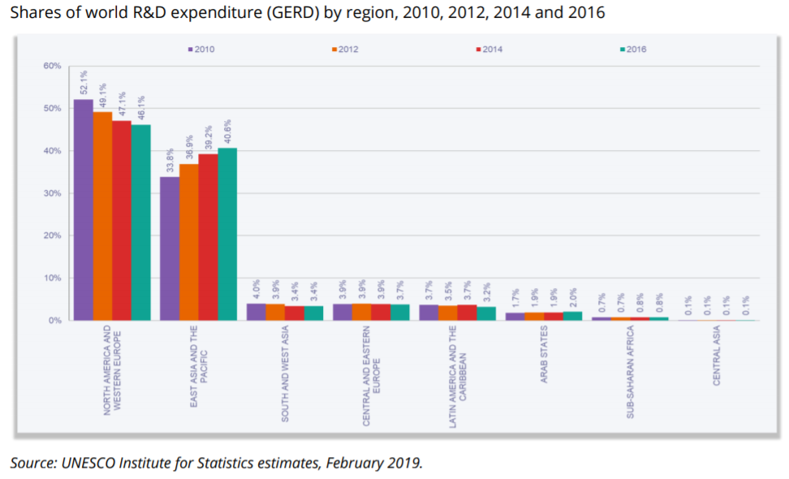
R&D Investment in Africa – much more to be done
Sub-Saharan Africa contribution to global R&D investment very low <1%
http://uis.unesco.org/sites/default/files/documents/fs54-global-investments-rd-2019-en.pdf

Slide 17
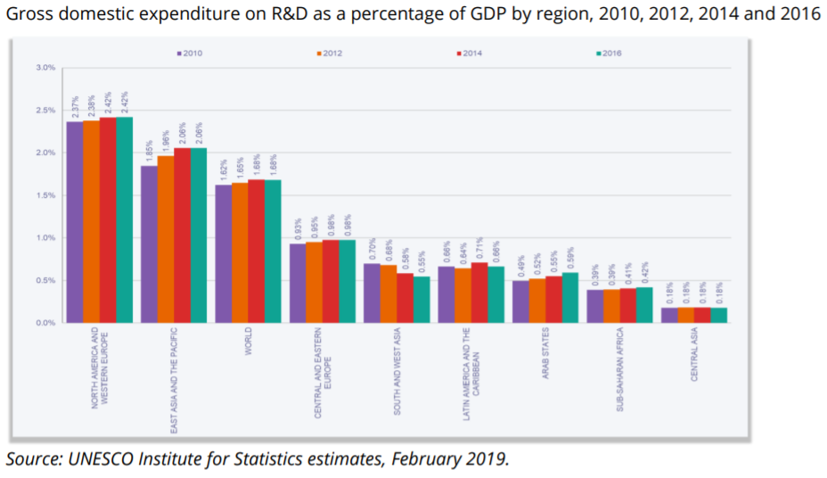
R&D Investment in Africa – much more to be done
R&D expenditure in Sub-Saharan Africa is lowest globally at ~0.4% GDP
Highest GERD is South Africa ~ 0.78%
Low intensity of technology / knowledge intensive industries
Little appreciation of link between R&D investment and GDP growth
Despite good intentions and commitments (e.g. Africa Union), there are more pressing challenges which impact on governments prioritisation of limited resources
http://uis.unesco.org/sites/default/files/documents/fs54-global-investments-rd-2019-en.pdf

Slide 18
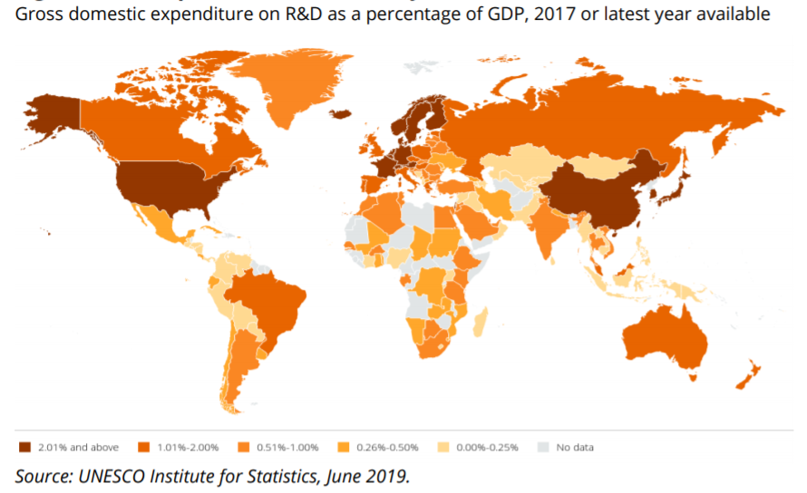
R&D Investment in Africa – much more to be done
Most of Africa spending on R&D as a percentage of GDP is below 0.5%
Paucity of data on R&D investment in certain parts of Africa – this would make it difficult to determine and tailor the type of technical assistance that could be provided to foster innovation and business competitiveness
http://uis.unesco.org/sites/default/files/documents/fs54-global-investments-rd-2019-en.pdf

Slide 19
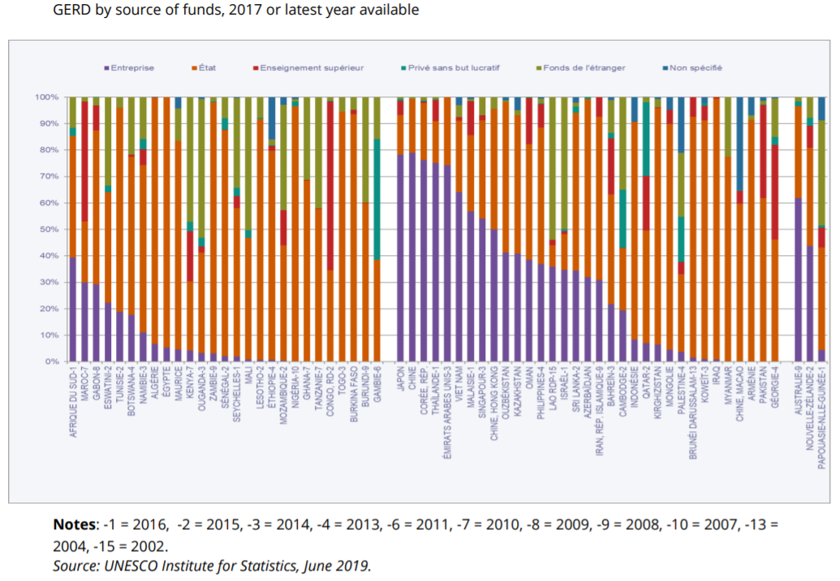
R&D Investment in Africa – much more to be done
Asia and Pacific – business biggest investor in R&D
Africa - Government is the largest investor in R&D
Small size of the business sector – government is the largest employer
Another notable funder of R&D is Non-Profit Sector (NGOs) which one assumes receive funding from abroad
http://uis.unesco.org/sites/default/files/documents/fs54-global-investments-rd-2019-en.pdf

Slide 20
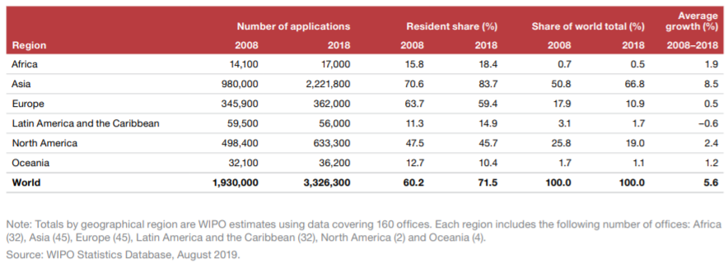
Patent Applications Per Region
Although Africa has shown growth (~2%) in actual numbers from 14,100 to 17,000 PCT patent applications per year – actual share of global applications has fallen

Slide 21
Questions
Summary and Concluding Remarks
What approach to technology transfer do you think will yield biggest results?
Acquisition of IP in specific sectors [Government led]
Acquisition of IP in specific sectors [Private sector led]
Acquisition of IP + exchange of personnel for know how transfer sectors [Government led]
Acquisition of IP + exchange of personnel for know how transfer sectors [Private Sector led]
Acquisition of IP + exchange of personnel Patents, designs and utility models [Public Private Partnership between Government and Private Sector]

Slide 22
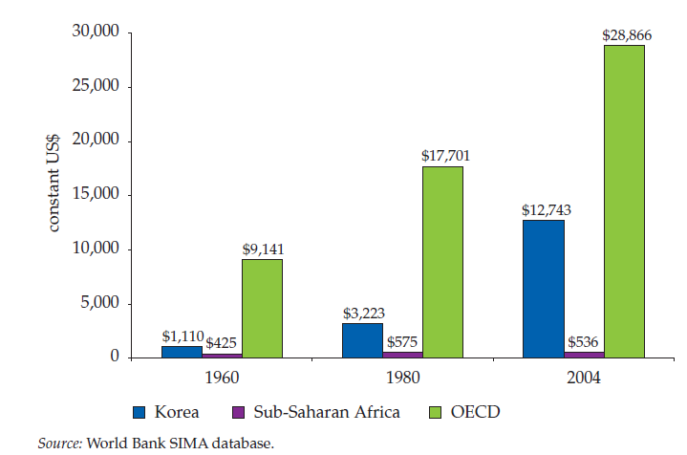
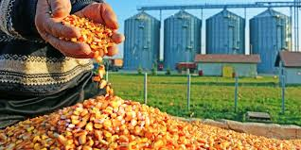
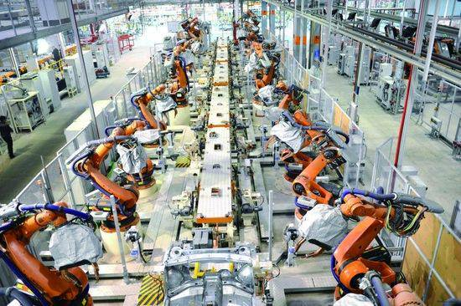
S. No.
Contents
Page No.
2
3
4
Role of Technical Assistance in Africa’s Development
22
5

Slide 23
Key Development Lessons from Developed and Emerging Economies
Technology an enabler and important for country to develop its technological capacity (e.g. Korea, Japan, Germany, USA, China, Singapore, India, etc.)
Investment in R&D - to generate new technological capabilities ( most as we have seen >2%GDP)
Linkages between economic and education planning – education system to be appropriate for today’s development – employment vs entrepreneurship
  In the former, the role of intellectual property was not that significant
  intellectual property and innovation are differentiators for SMEs / Entrepreneurship - TA to empower users of IP System
  Build higher education on sound foundation of high quality schooling
Role of higher education in economic development:
  Human capital for growth and development and enhancement of technology absorptive capacity
  Research and innovation (IP generation, protection and commercialisation / technology transfer)
Developing one’s technological capability takes time – IP system enables one to use IP in the public domain, licence & acquire 3rd party IP, strategic technology transfer, to supplement local innovations
Specific development orientation and priorities

Slide 24
Development Lessons from Developed and Emerging Economies
Africa comprises 55 discrete economies - no uniform approach to IP technical assistance
  In some cases, TA focused on IP protection is of very little use (low R&D and IP generation)
  Developing country needs critical - needs (address specific challenge or opportunity)
  WIPO assist developing countries in assessing needs based on a broad and medium-term perspective
  Not only challenges but opportunities (e.g. Specific local industries where better understanding and utilisation of IP may make them competitive, such as (i) music industry in West Africa, or (ii) certain high international commercial value products from developing countries – e.g. Platinum)
Tailor TA explicitly around countries’ strategic plans and should generally be delivered through multi-year, broad-based programmes and not just one-off events
Integrate TA and capacity-building into new international trade negotiations and agreements covering IP issues at the bilateral, regional and multilateral levels
TA and Capacity Building to be approached not as an obligation but striving for a win-win outcomes to reduce donor dependency and contribute to sustainability
** WIPO supported TA projects: https://www.wipo.int/ip-development/en/agenda/projects.html
Notes:
Sharing of lessons from own development journeys

Slide 25
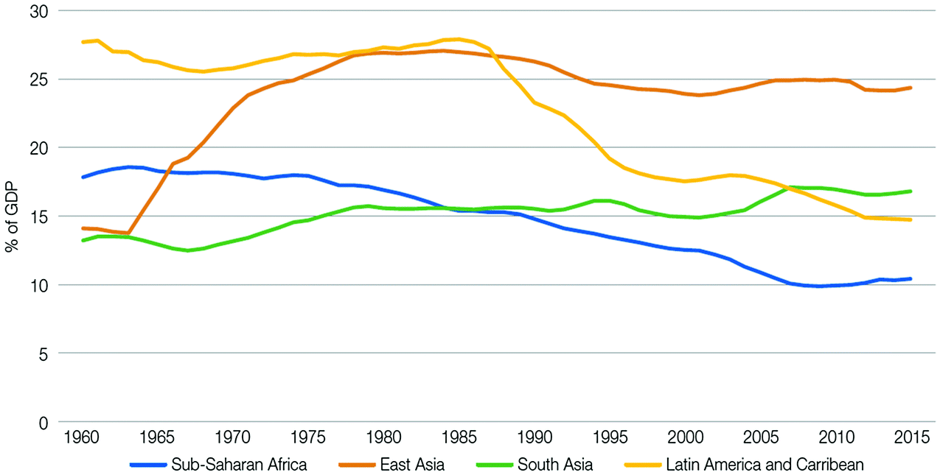
Some Thoughts on TA and Capacity Building Initiatives - Manufacturing
“…Manufactured goods make up almost 60% of imports, while energy (mostly oil) constitutes the dominant export”
- Jong-Dae Park Re-Inventing Africa's Development-
https://link.springer.com/chapter/10.1007/978-3-030-03946-2_9
What could TA look like?
On basis of manufacturing moving closer to markets, TA could involve specific IP searches for public domain and proprietary technologies that could enhance local manufacturing
Support with negotiating and concluding technology acquisition, transfer and assimilation
Capacity Building of appropriate human resources for technology absorption, entrepreneurial talent to support growth of local SMEs and other manufacturing businesses
IP Strategies for SMEs including Patent Landscape analysis and identifying opportunities

Slide 26
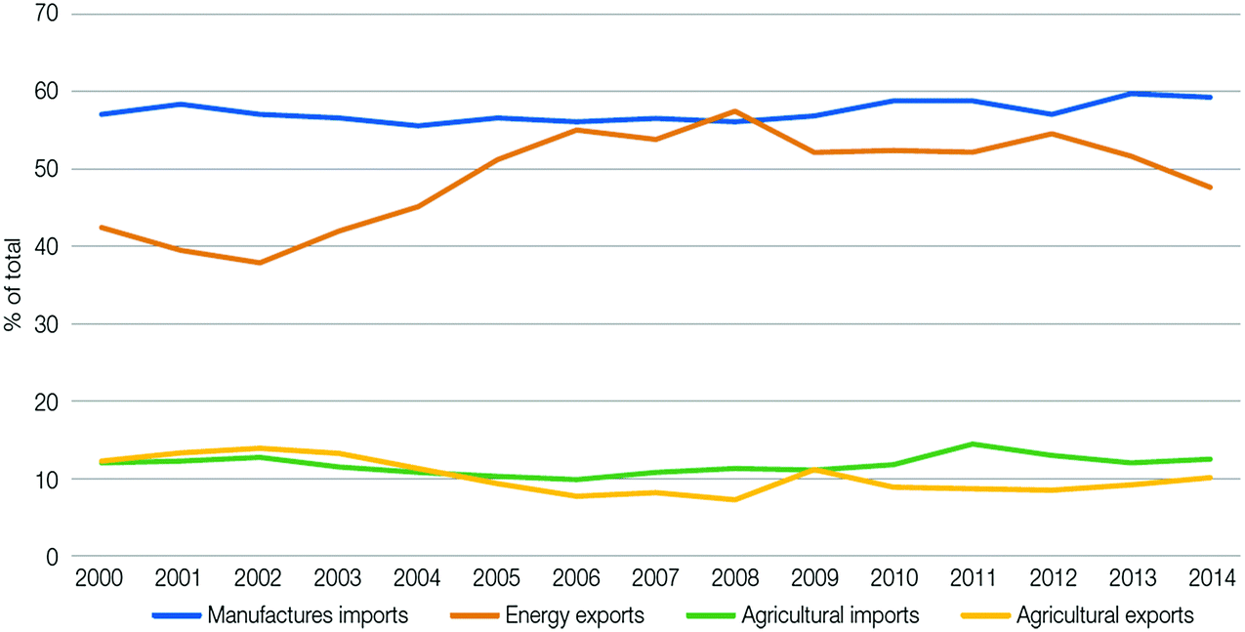
Some Thoughts on TA and Capacity Building Initiatives - Agriculture
“…..evidence shows that in sub-Saharan Africa (SSA), investing in agriculture is 11 times more rewarding in reducing poverty than investment in other sectors …80% of marketed agricultural production in SSA comes from smallholders, 60% being women. The issue … therefore, is how Africa should invest boldly in its agrifood systems so as to leapfrog the structural transformation of the overall African economies”
- Jong-Dae Park Re-Inventing Africa's Development- https://link.springer.com/chapter/10.1007/978-3-030-03946-2_9
What could TA look like?
IP searches for specific technologies for agro processing so that higher value products exported
Assistance with development & protection of better varieties (disease and drought resistance, higher yields)
Sustainable communities and High Growth SMEs

Slide 27
Questions
Summary and Concluding Remarks
Do you think that African countries are ready for the Fourth Industrial Revolution (4IR)
Yes
No

Slide 28
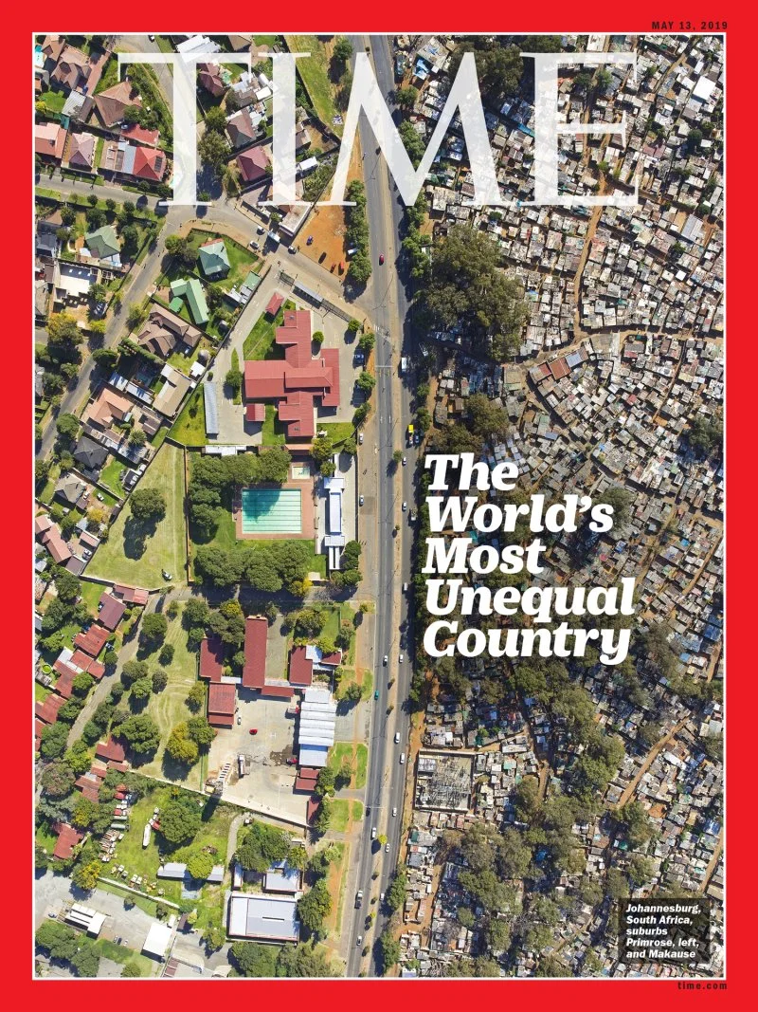
S. No.
Contents
Page No.
2
3
4
5
The Case of South Africa – IP and Innovation for Development and Competitiveness
28

Slide 29
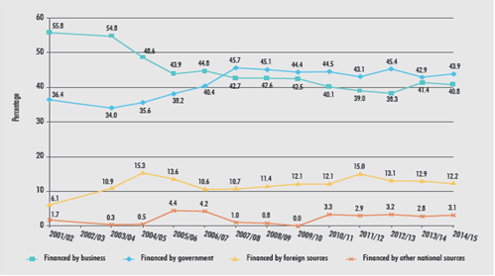
The Case of South Africa
Stimulating Economic Development through Strategic Use of IP
The Elusive 1% GERD: GDP also a moving target
Private sector investment on decline
Increased public investment in R&D
Manufacturing has potential for job creation provided overcome structural constraints:
  skills deficit
  policy uncertainty
  wage increases that have outpaced inflation and exceeded productivity
  rising electricity supply uncertainty
  low technology use as a result of underinvestment in R&D by business
Strategic use of natural resources, e.g. potential use of platinum metals in fuel cells, which is supported by the Hydrogen South Africa (HySA)
Appropriate technologies acquisitions coupled with promoting R&D investment in specific sectors
Decline in BERD since 2001 to date
Slight increase since 2013/14 (tax incentives?)
[Source: CeSTII (2017)]

Slide 30
Stimulating Economic Development through Strategic Use of IP
Trade Balance for High Technology Manufacturing Industries (USDmillion)
Increase in imports
  Pharmaceuticals
  Computer, electronic and opticals
Increase in exports
  Computer, electronic and opticals
Decline in imports
  Aerospace
Decline in exports
  Pharmaceuticals
[Source: NACI (2015:46]
Notes:
An analysis of South Africa’s trade balance for high industries shows three key areas – increase in pharmaceuticals, computer, electronic and opticals. At the same time, exports have been on the increase also in computers, electronics and opticals. There is notable decline in exports in pharmaceuticals. Thus, over the period of 2005 – 2013, there has been increasing negative trade balance in pharmaceuticals, computes, electronics and opticals. Given the high value of these goods, it would be in South Africa’s long terms competitiveness to put in place interventions to boost competitiveness of these sectors, through acquisitions of appropriate IP and technologies (inbound technology transfer), increase capacity building in respect of appropriate human capital to make these industries more competitive. If South Africa was to request TA – perhaps such TA should be focused on these sectors resources which would also contribute to enhancing manufacturing in South Africa.

Slide 31
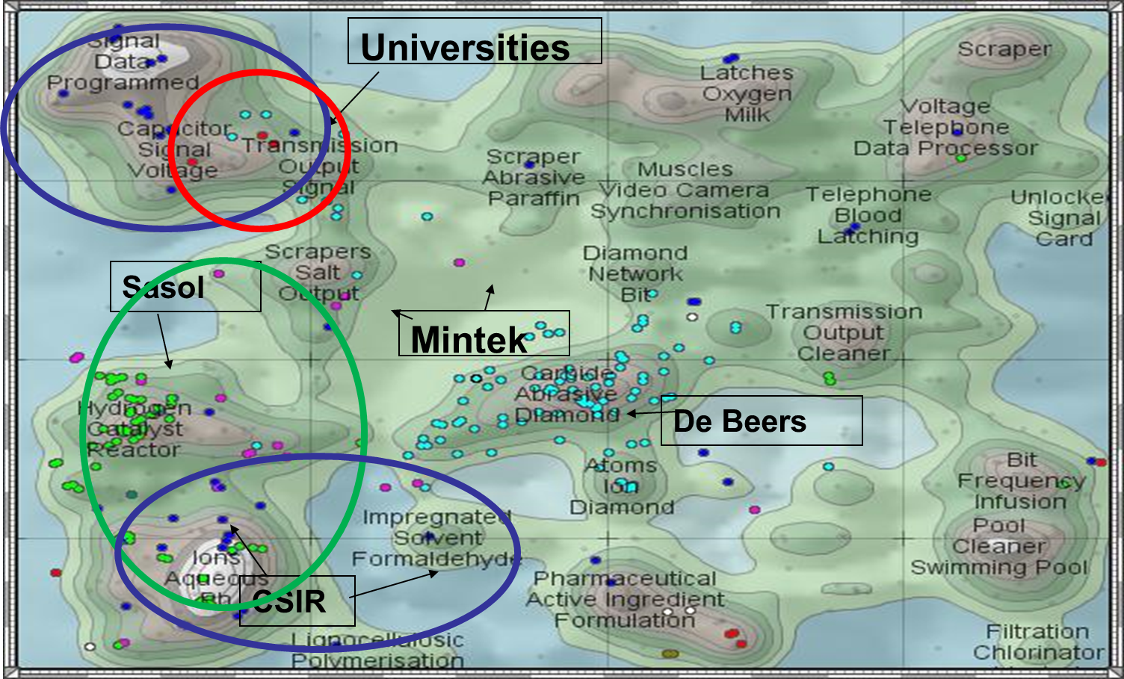
Stimulating Economic Development through Strategic Use of IP
South Africa PCT Applications, USPTO, EPO Patents ThemeScape Map (1991-2005)
Abrasives / Diamonds
Chemistry / Petrochemical
Electronics/ ICT (RFID)
[Source: State of Patenting in South Africa – Special Report 2007 (The Innovation Fund)

Slide 32
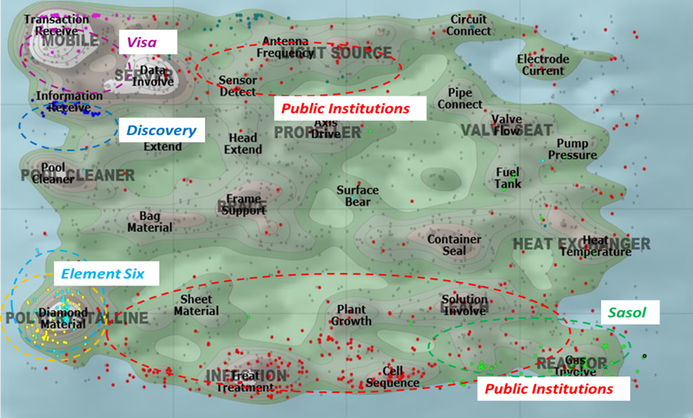
Stimulating Economic Development through Strategic Use of IP
ThemeScape Map of PCT Applications with South African Inventors (2006-2015)
Significant number of PCT applications, EPO and USPTO patents with a South African resident inventor but assigned to a non-South African domiciled corporate
Abrasives / Diamonds
Chemistry / Petrochemical
Financial Services
Biopharmaceutical/ Biotech
Electronics/ ICT
[Source: Sibanda (2017)]

Slide 33
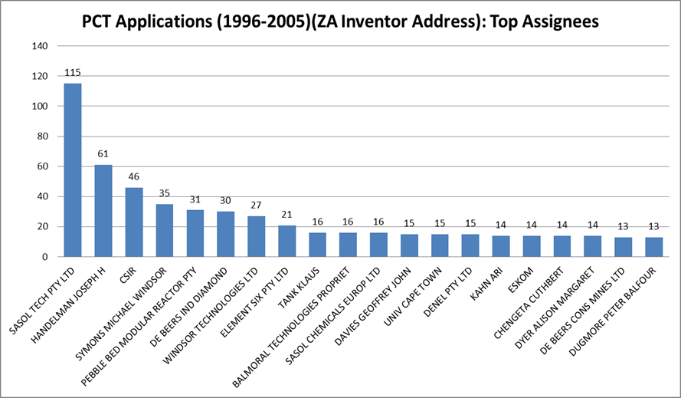
Stimulating Economic Development through Strategic Use of IP
Top Assignees of South African Inventors PCT Applications (1996-2005)
3 publicly financed institutions in the top 20
CSIR, PBMR, University of Cape Town
Mostly private sector dominated by Sasol and De Beers
[Source: Sibanda (2017)]

Slide 34
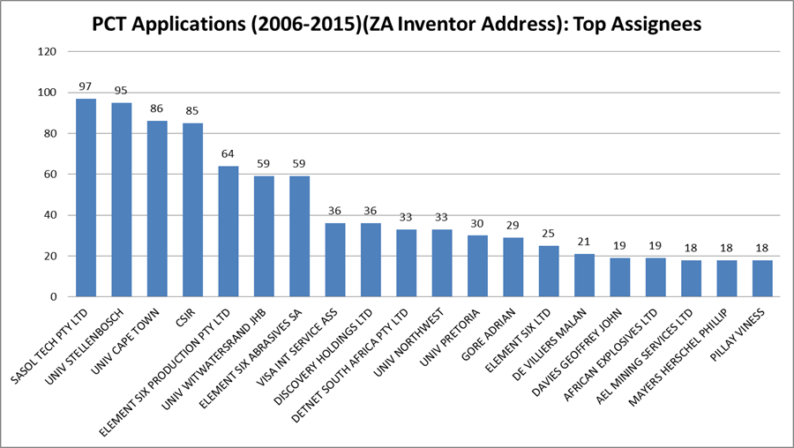
Stimulating Economic Development through Strategic Use of IP
Top Assignees of PCT Applications with South African Inventors (2006-2015)
6 publicly financed institutions in top 20
SUN, UCT, CSIR, WITS, NWU, UP
Private sector dominated by Sasol, Element Six, Discovery
VISA, African Explosives, Detnet
[Source: Sibanda (2017)]

Slide 35
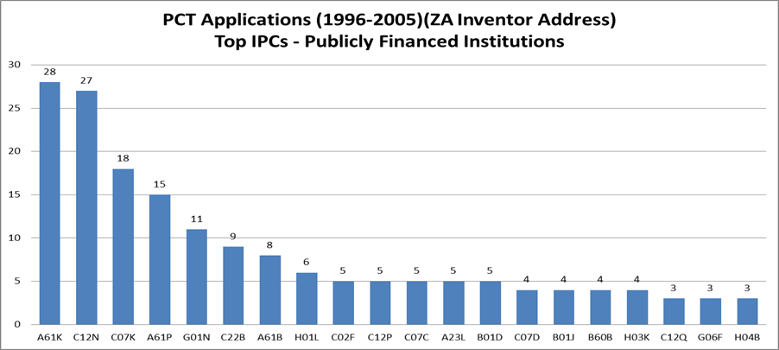
Stimulating Economic Development through Strategic Use of IP
Top IPC of PCT Applications by Public Institutions
Emerging cluster:
  Life sciences / Biotechnology
[Source: Sibanda (2017)]

Slide 36
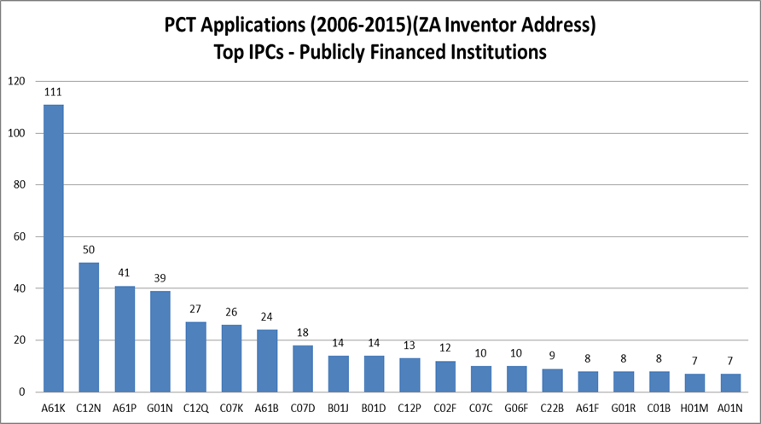
Stimulating Economic Development through Strategic Use of IP
Top IPC of PCT Applications by Public Institutions
Increased patenting by universities in
specific sectors where government R&D
funding was prioritised (specific funding
instruments
Mostly:
  Life sciences / biotechnology
  ICT / Electronics
[Source: Sibanda (2017)]
Notes:
TA could involve support in analysing patent data by International Patent Classification. In this case, an IPC analysis of PCT patent applications by South African publicly financed institutions reveals two broad technology strengths (i) life sciences / biotechnology and (ii) ICT /electronics.

Slide 37
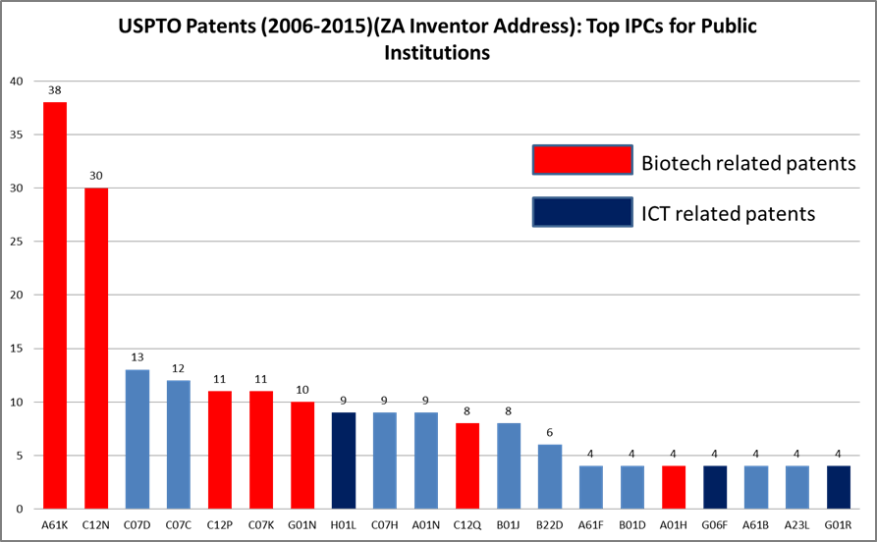
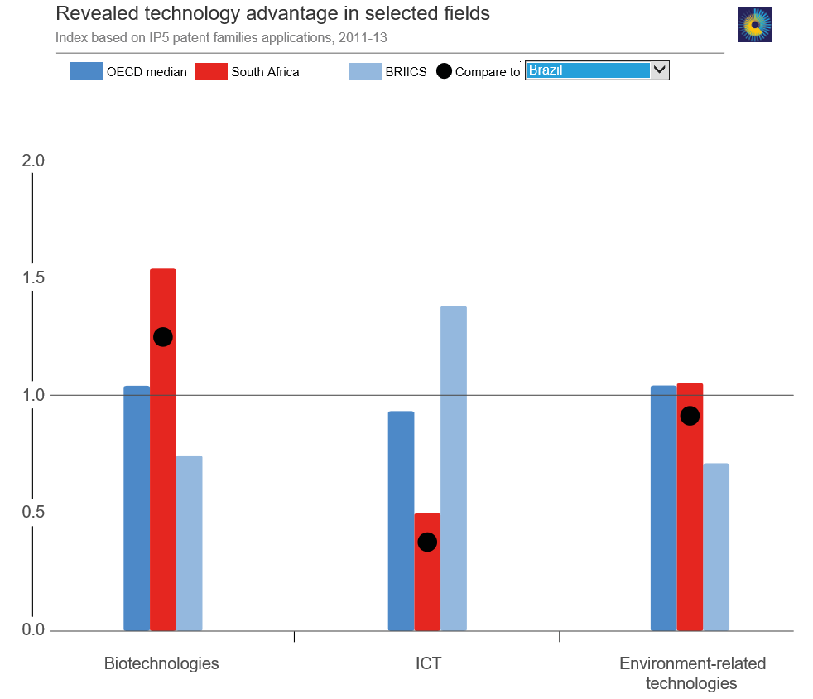
Stimulating Economic Development through Strategic Use of IP
USPTO Patents by Public Institutions (2006-2015)
[Source: Sibanda (2017)]
Source: http://innovationpolicyplatform.org/STICharting/BERD.htm?iso=ZA
Notes:
What is notable about these patent filings is that these three revealed technology advantage fields and most prolific patenting areas by South African universities in USPTO mirror the top Scientific Publications in Various Research Fields by South Africans.
Accordingly, any TA to South African universities should be directed to enhanced IP search and publication tools in these top fields, including identifying third party IP that could be acquired / licensed; and also promoting joint R&D programmes between institutions in high income countries and middle income / low income countries such as South Africa and research fellowships.

Slide 38
S. No.
Contents
Page No.
6
Concluding Remarks
38

Slide 39
Concluding Remarks
Summary and Concluding Remarks
Technical Assistance is to African countries what incubators are to startups / SMEs
Intervention to be specifically tailored to country context / development priorities
Need to shift from typical support with policies, laws and strategies to development of local businesses and value chains
Manufacturing and value addition offer huge prospects to achieve win-win outcomes
Important to have common understanding of “how do we measure success” in Technical Assistance and Capacity Building
Ultimately with advent of Fourth Industrial Revolution, TA should support growth of the industrial sector and African countries’ efforts to ‘compress’ their development / industrialization (by focusing on fundamentals and more)

Slide 40




Thank you
Dr. McLean Sibanda
+27 83 378 0230
mclean.sibanda@bigenglobal.com
mclean.sibanda@gmail.com
”It is not the strongest of the species that survive, nor the most intelligent, but the ones most responsive to change.” Charles Darwin

