Slide 1

Design and its Place in the Promotion of Women’s
Entrepreneurship and Economic Empowerment
Violeta Ghetu
Legal Officer
Brands and Designs Sector
April 12, 2023

Slide 2
Women’s under-representation in the industrial designs registration activity:
Design
Trademark
Patent
Copyright
Lower labor market participation
Under-representation on science, technology, engineering and math degrees
Family and household burdens
Other factors
Lack of understanding of the importance of Intellectual Property protection

Slide 3
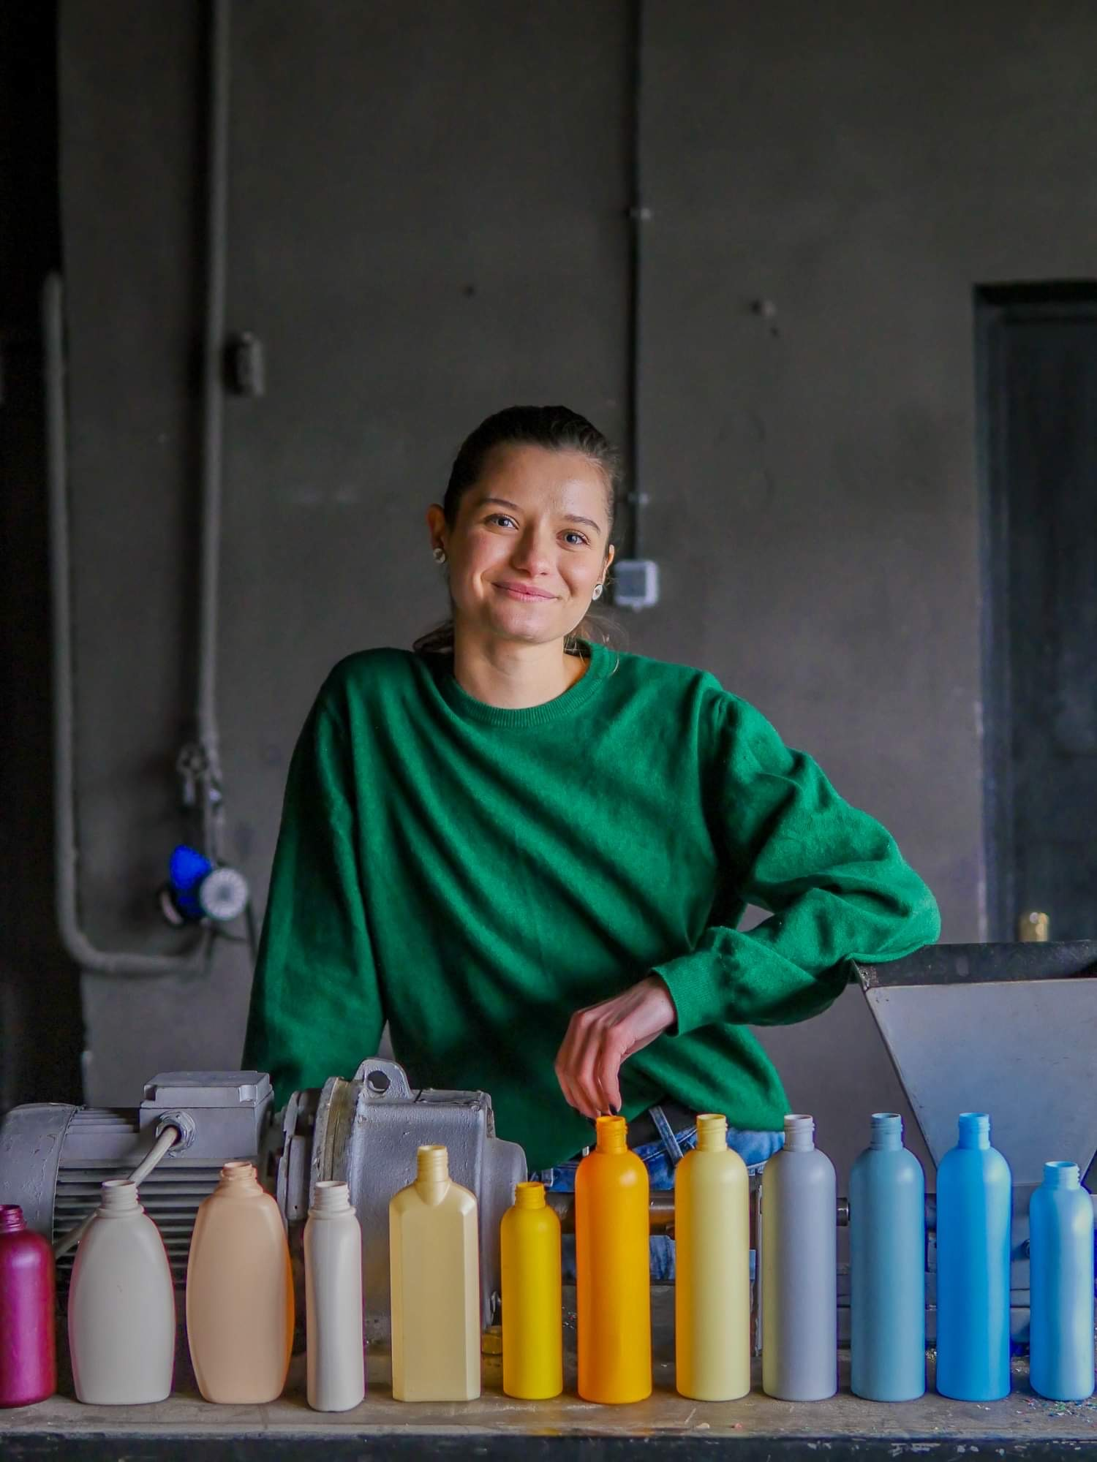
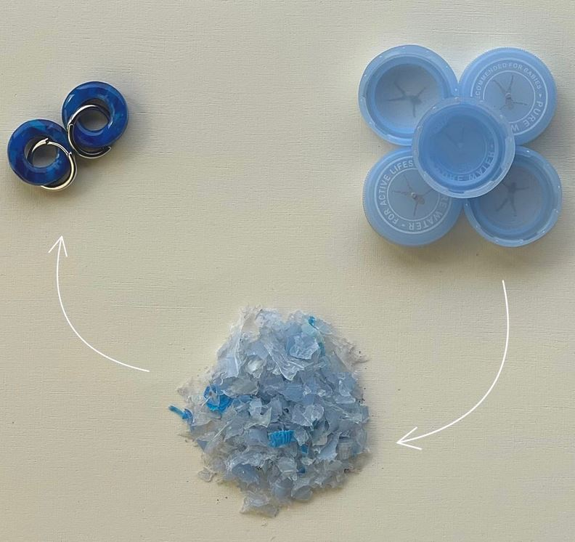
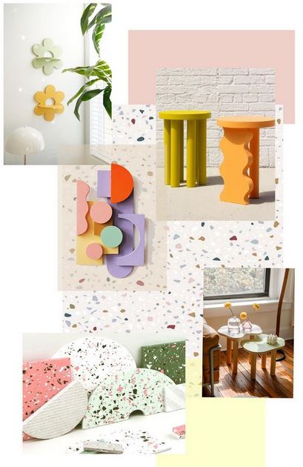
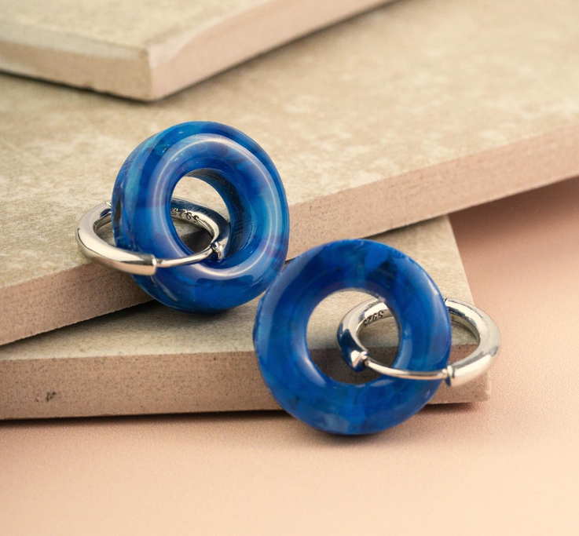
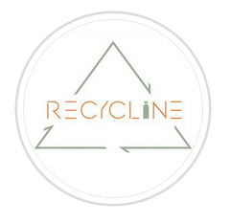
Importance of Design and its place in the Promotion of Women’s Entrepreneurship and Economic Empowerment
© Cristina Tocari
RECYCLINE Moldova
https://www.instagram.com/recycline_/?hl=en

Slide 4
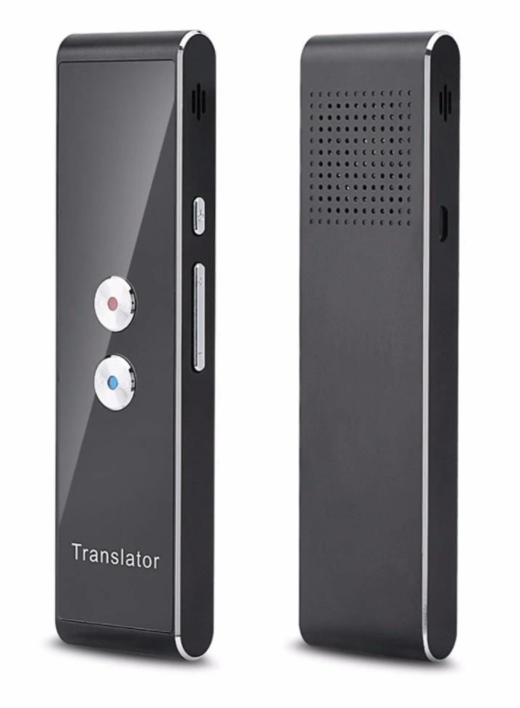

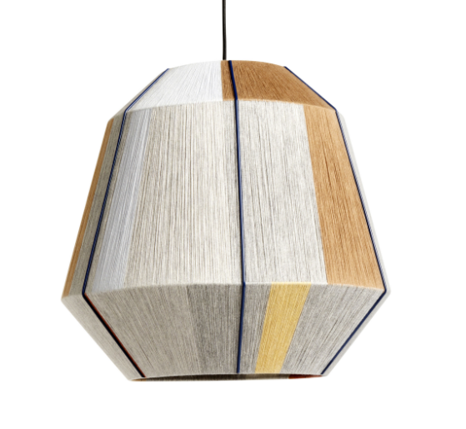

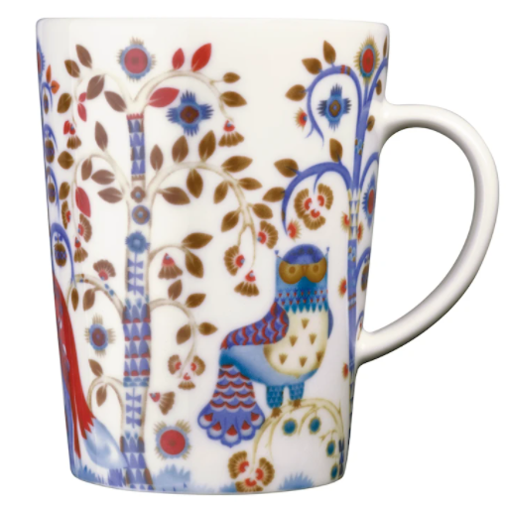
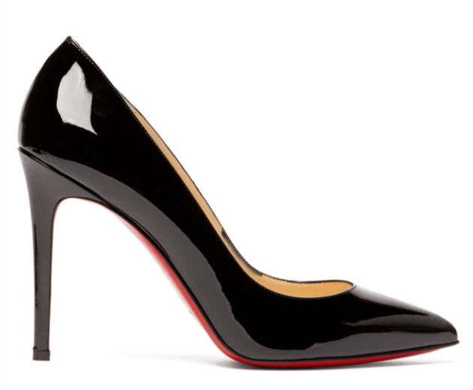
Importance of design and of its protection

Slide 5

What is an industrial design?
« Look » of a product or its packaging
Ornamental or aesthetic aspect/appearance of an article
A design only covers “the appearance of a product”
      - no technical aspect (Patents)
      - nor its name (Trademarks)

Slide 6
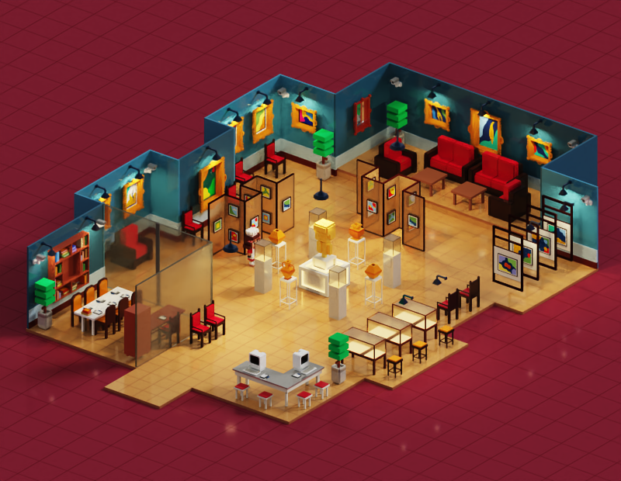
What is an industrial design?
Any kind of article: vehicle, home appliance, furniture, clothes, jewelry, food, etc.
Three-dimensional features (shape, etc.) or two-dimensional features (lines, colours, etc.)

Slide 7
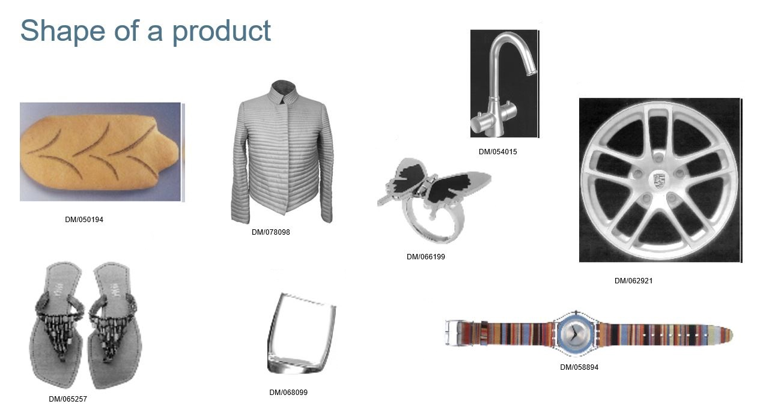

Slide 8
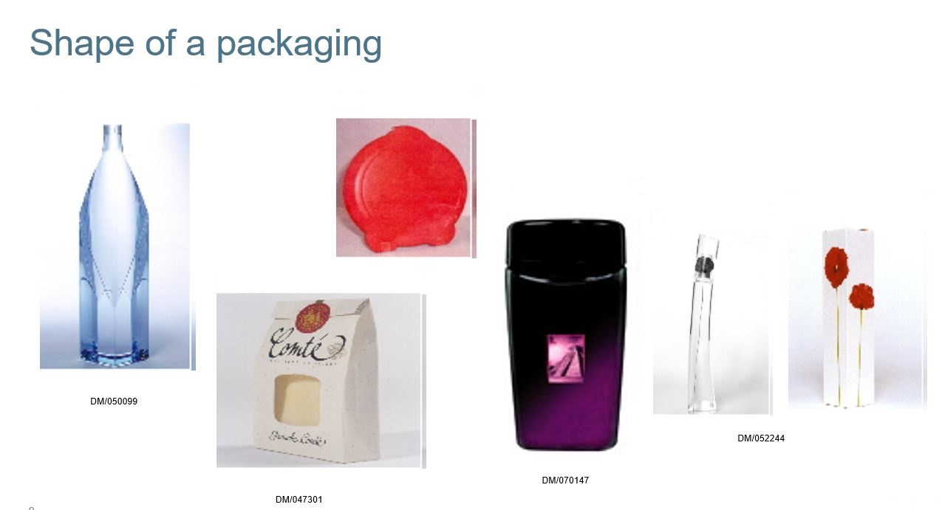

Slide 9
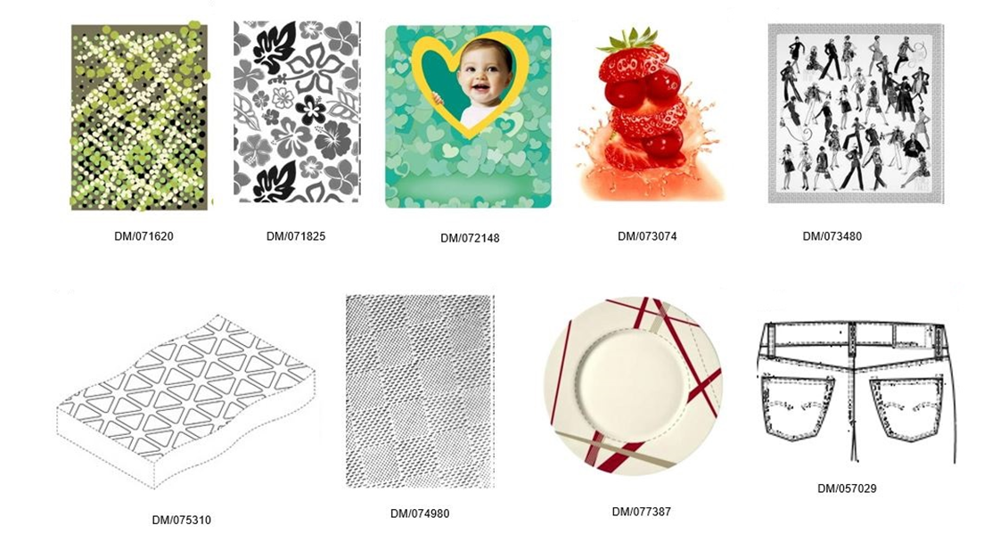
Ornamentation or pattern

Slide 10
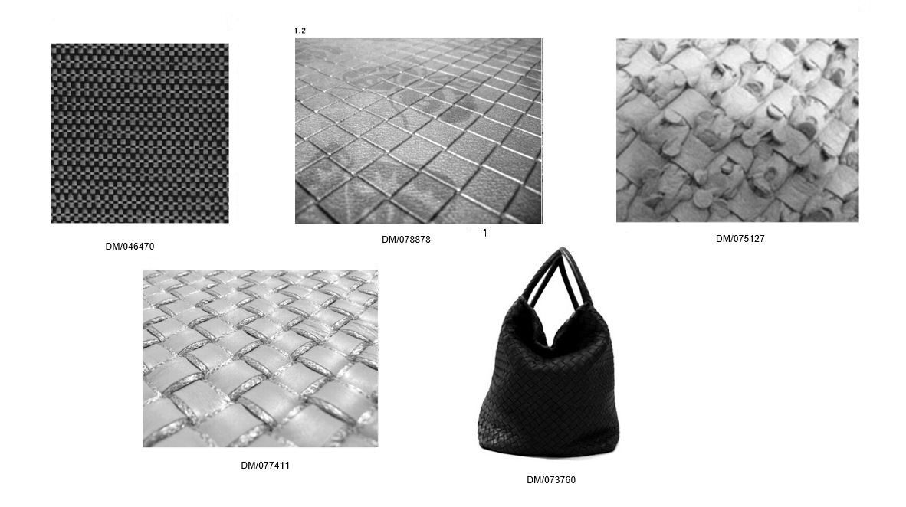
Texture

Slide 11
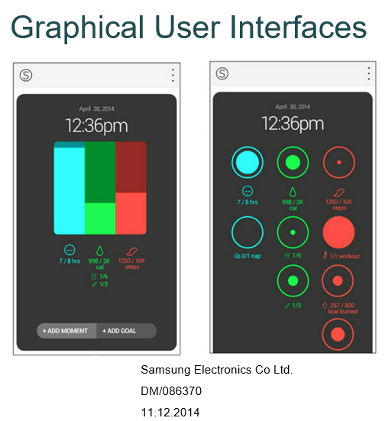
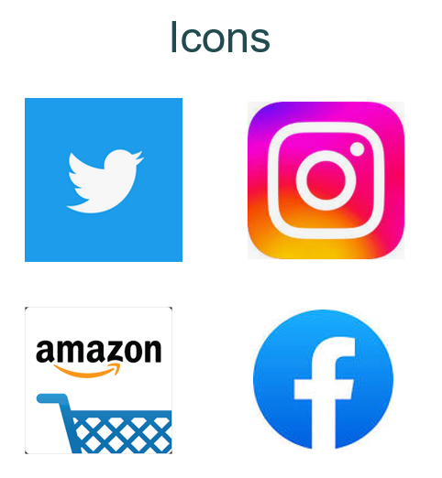
New technological designs

Slide 12

Criteria for registration
Independently created
Novelty
Originality

Slide 13
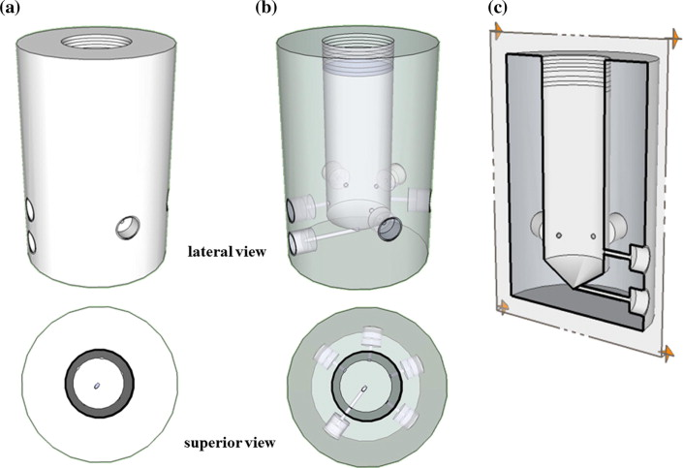
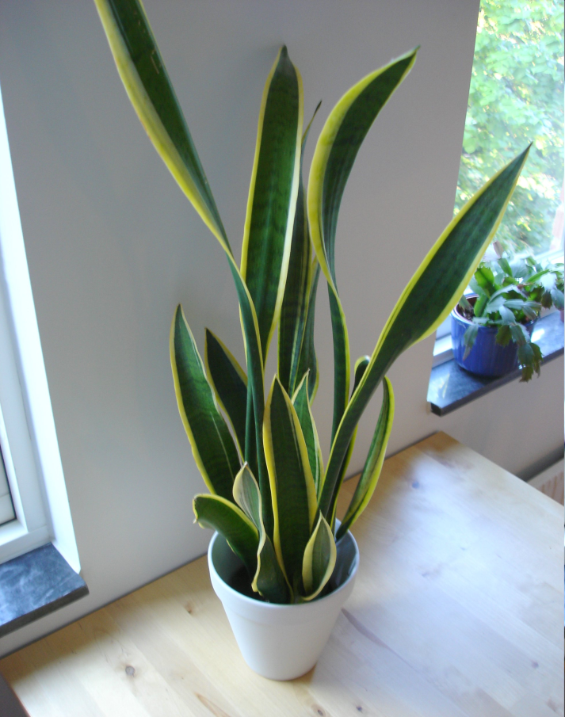

What cannot be protected?
any object belonging to the natural world
Any item which does not consist of the outward appearance of a product or a part of it

Slide 14
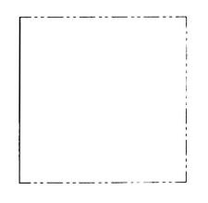
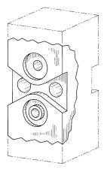
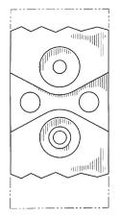
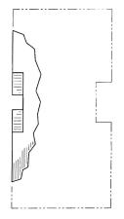

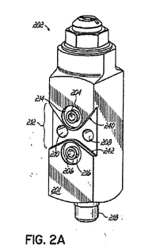
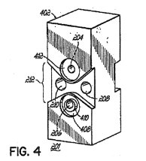
What cannot be protected?
Any item whose appearance is exclusively dictated by its technical function
Any item which is deemed to be against morality or public order
Design number : 000232996-0008
Case R 211/2008-3
http://oami.europa.eu/
Judgment of 20/11/2011, T-23210
Soviet coat of arms
www.curia.europa.eu

Slide 15

How are industrial designs protected?
Registration system
Design patent system
Unregistered design
Copyright

Slide 16
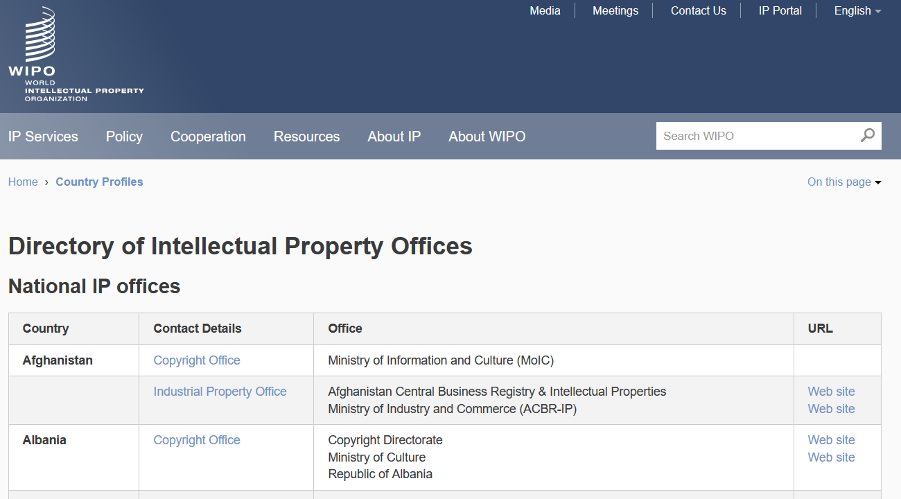





Who grants industrial design registrations?
IP office of the country (or region) where an application is filed

Slide 17
When should an application be filed?
Grace period
6 (or 12) months
January 2023
February
March
April
May
June
July
Disclosure of a design
Filing

Slide 18
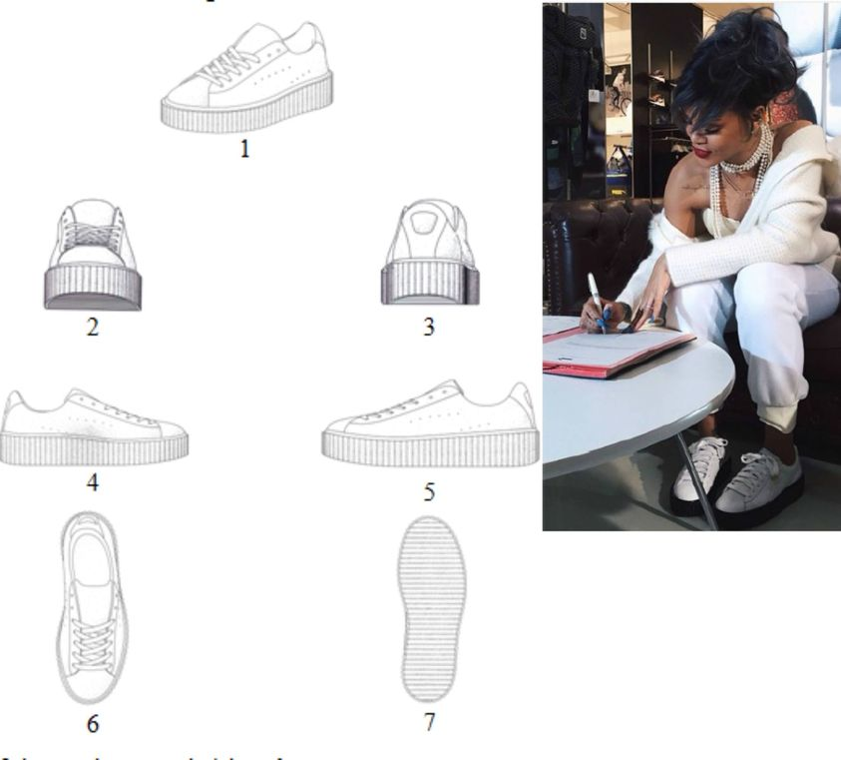
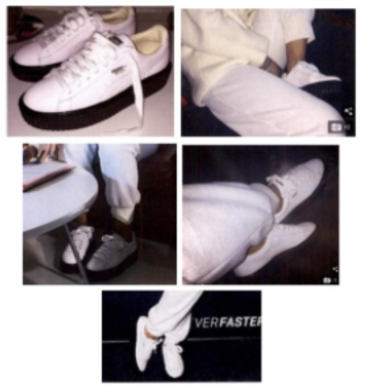
PUMA, Rihanna and Instagram
Posted on Instagram in 2014
application filed on
July 25, 2016

Slide 19
Rights conferred
to prevent third parties not having the owner's consent from
  making,
  selling or
  importing
  articles bearing or embodying a design which is a copy, or substantially a copy, of the protected design,
  when such acts are undertaken for commercial purposes.

Slide 20
Community Design against Copycat Slippers - Court of Milan, Decision of 12 March 2009
A.C. Distribution's
"Linea Confort" slippers
De Fonseca slippers

Slide 21
Duration of protection
Protection shall amount to at least 10 years
Renewal
Renewal
5 years
5 years
5 years
5 years
5 years
Initial protection
Renewal
Renewal

Slide 22
International protection: Hague System
International Registration of Industrial Designs
System administered by WIPO
Efficient means to protect designs in multiple jurisdictions: 96 countries (79 Contracting Parties)

Slide 23
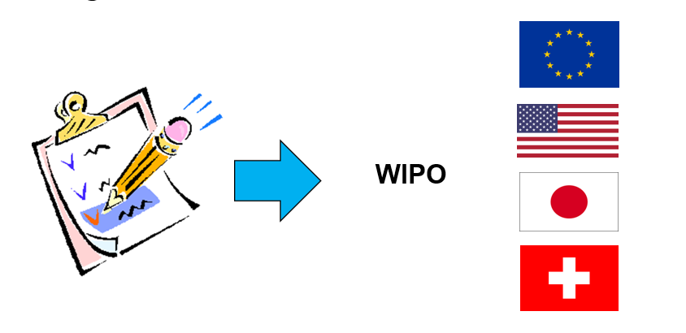
Registration in several countries

Slide 24
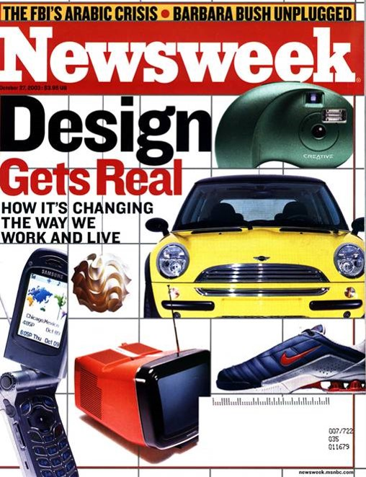
Why protecting industrial designs is important?
Exclusive rights
Return on investments
Opportunity to license or sell
Strengthen brands
Positive image
Encourage Creativity

Slide 25

Not protecting an industrial design means:
No exclusive right
No legal means to fight
No recoup of the investments
Harm to firm’s reputation/products

Slide 26
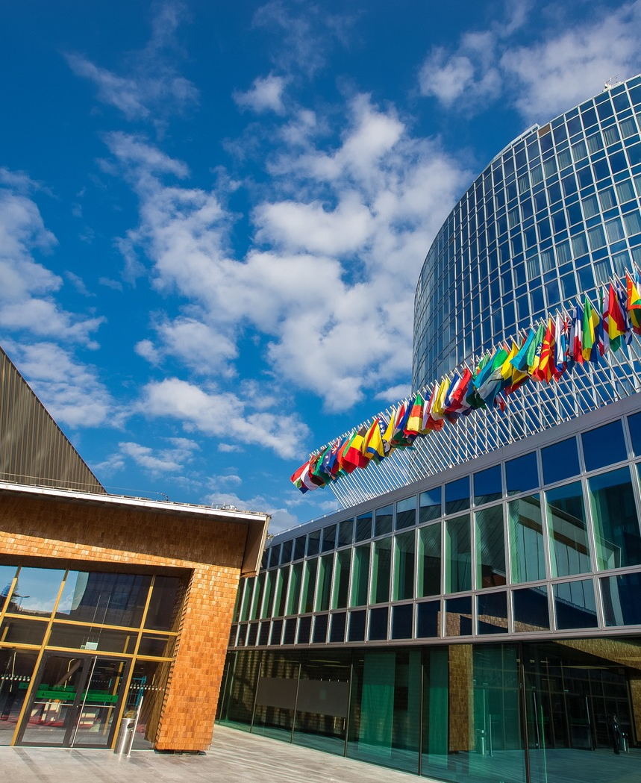
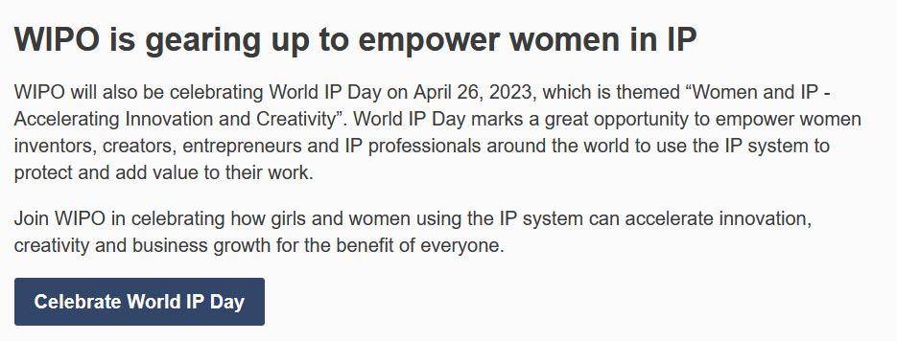
2023

