Slide 1
PATENTSCOPE for experts
Online
March
2020
Sandrine Ammann
Marketing & Communications Officer

Slide 2
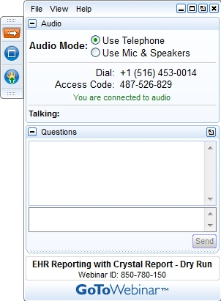
Click this button if you can hear my voice and see my screen

Slide 3


Slide 4
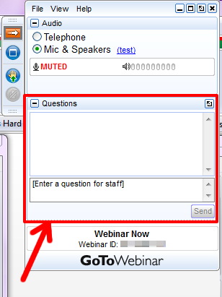

Slide 5
Questions/concerns
patentscope@wipo.int

Slide 6
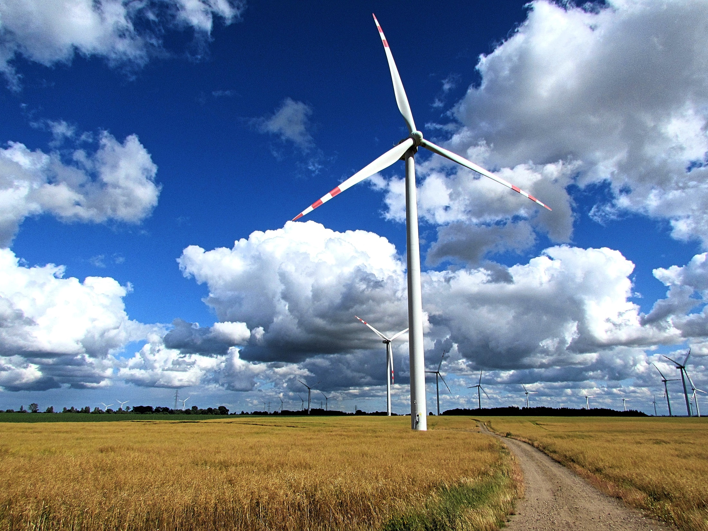

Slide 7
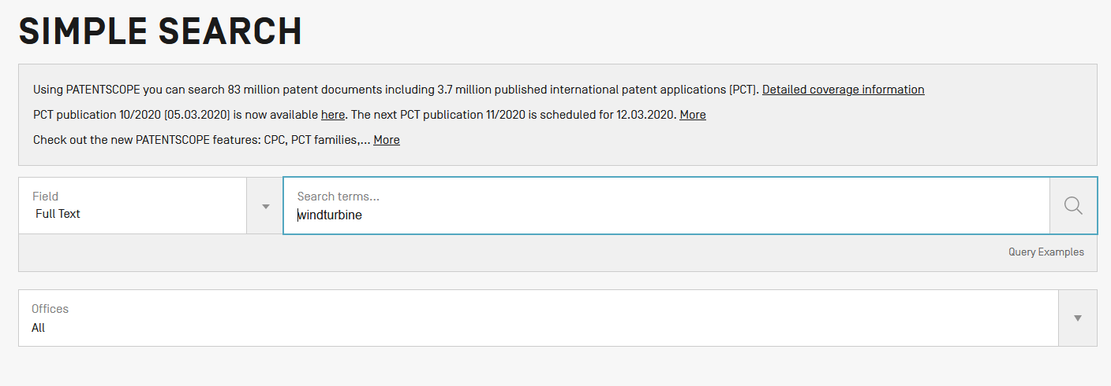

Slide 8
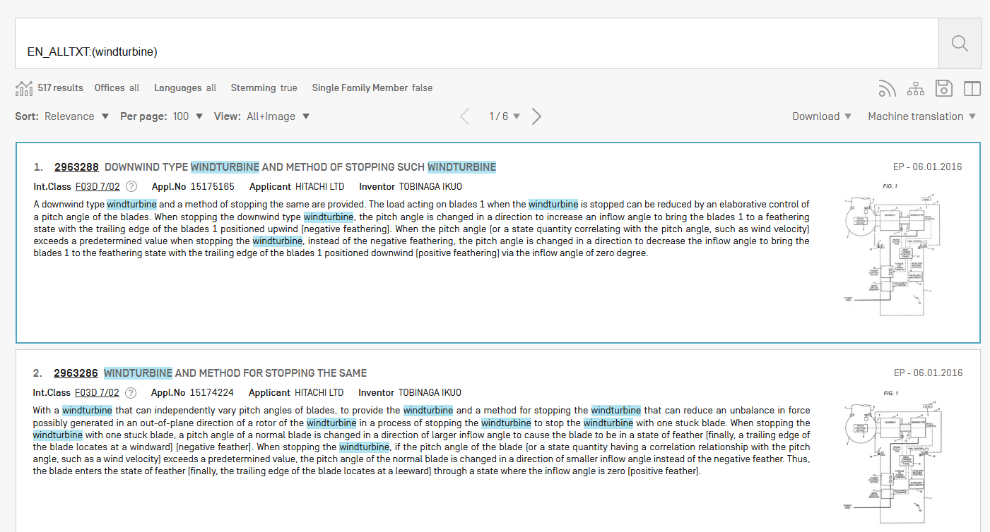

Slide 9
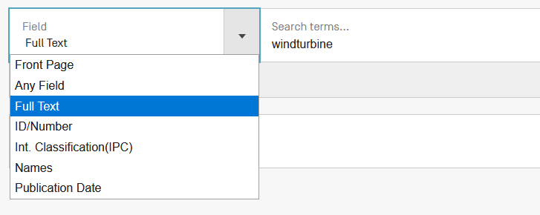

Slide 10
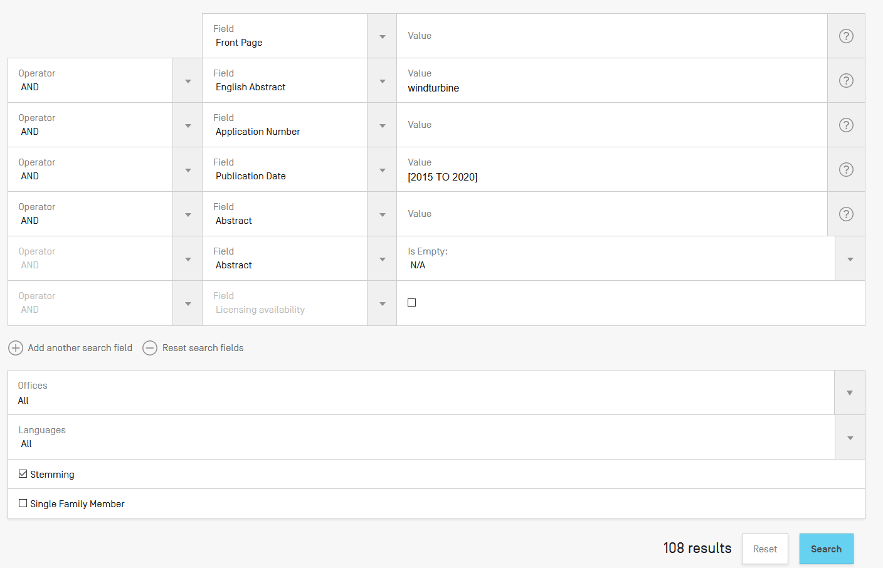
?

Slide 11
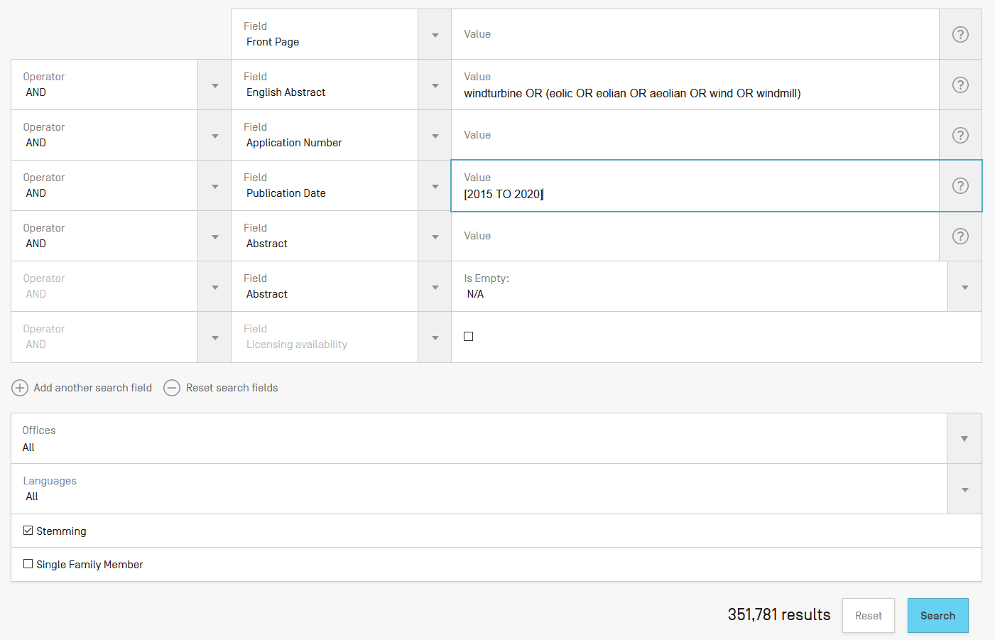

Slide 12
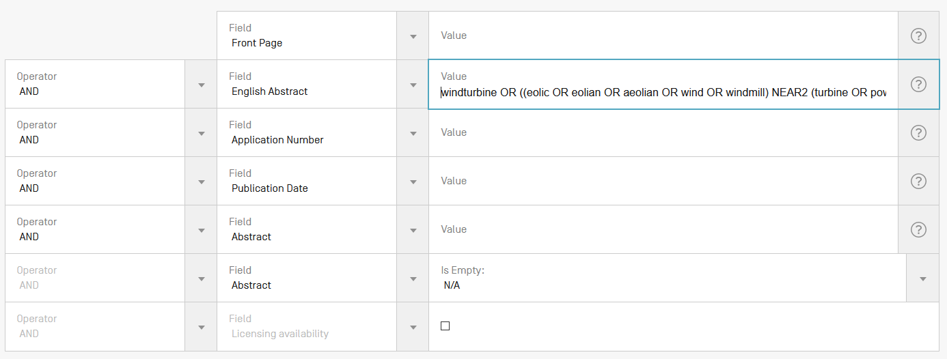

Slide 13
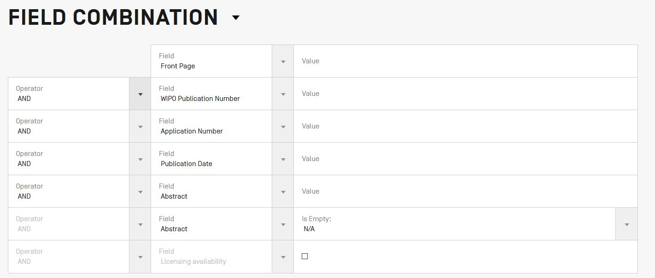
Field combination - cons

Slide 14
Field Combination - pros
Predefined fields
Immediate results on the same page

Slide 15
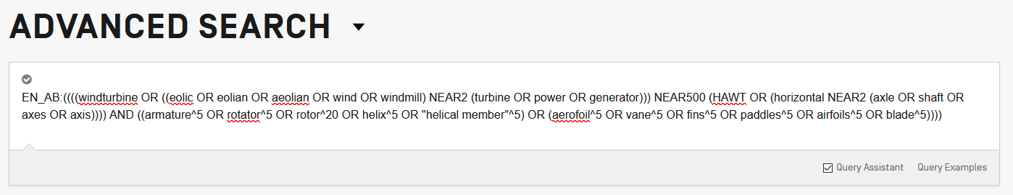

EN_AB = field

Slide 16

Fields: where to search
Source: http://spicewallpaper.blogspot.ch/2012/08/green-fields-with-blue-sky.html

Slide 17
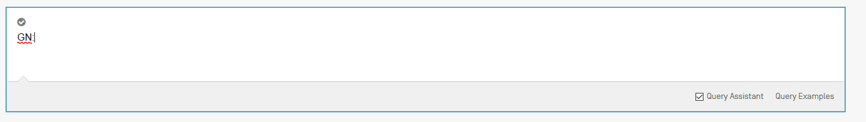
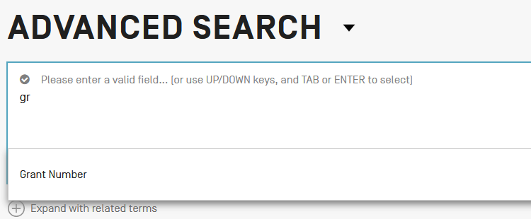
Auto-suggested fields

Slide 18
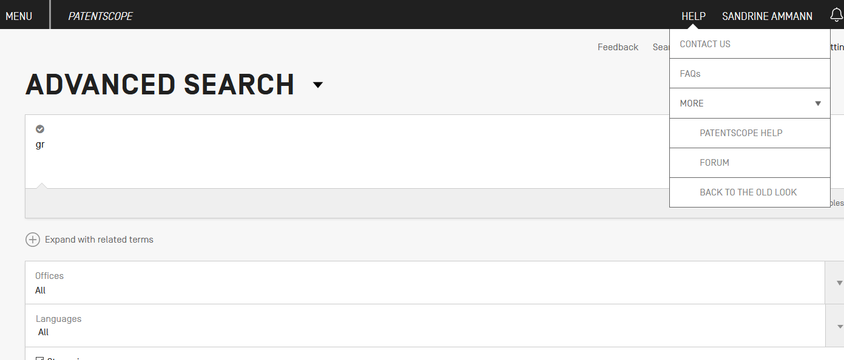

Slide 19
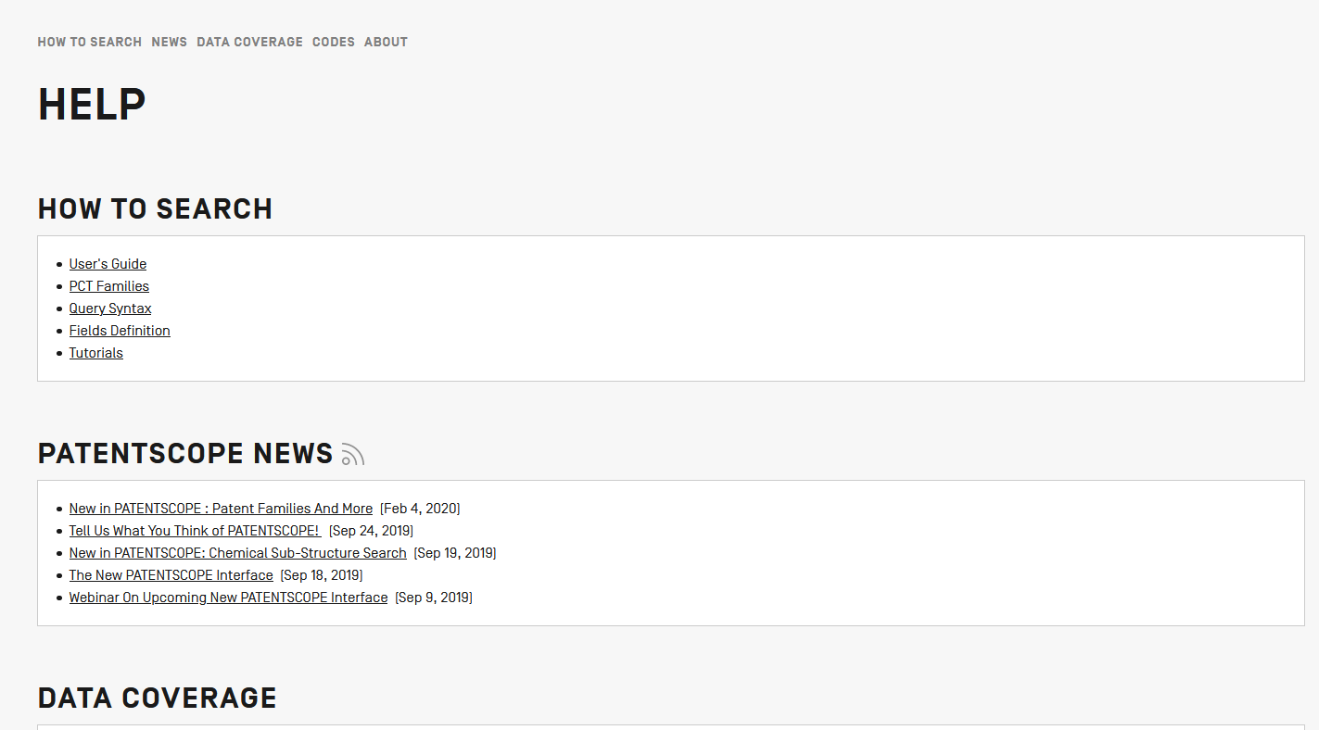

Slide 20
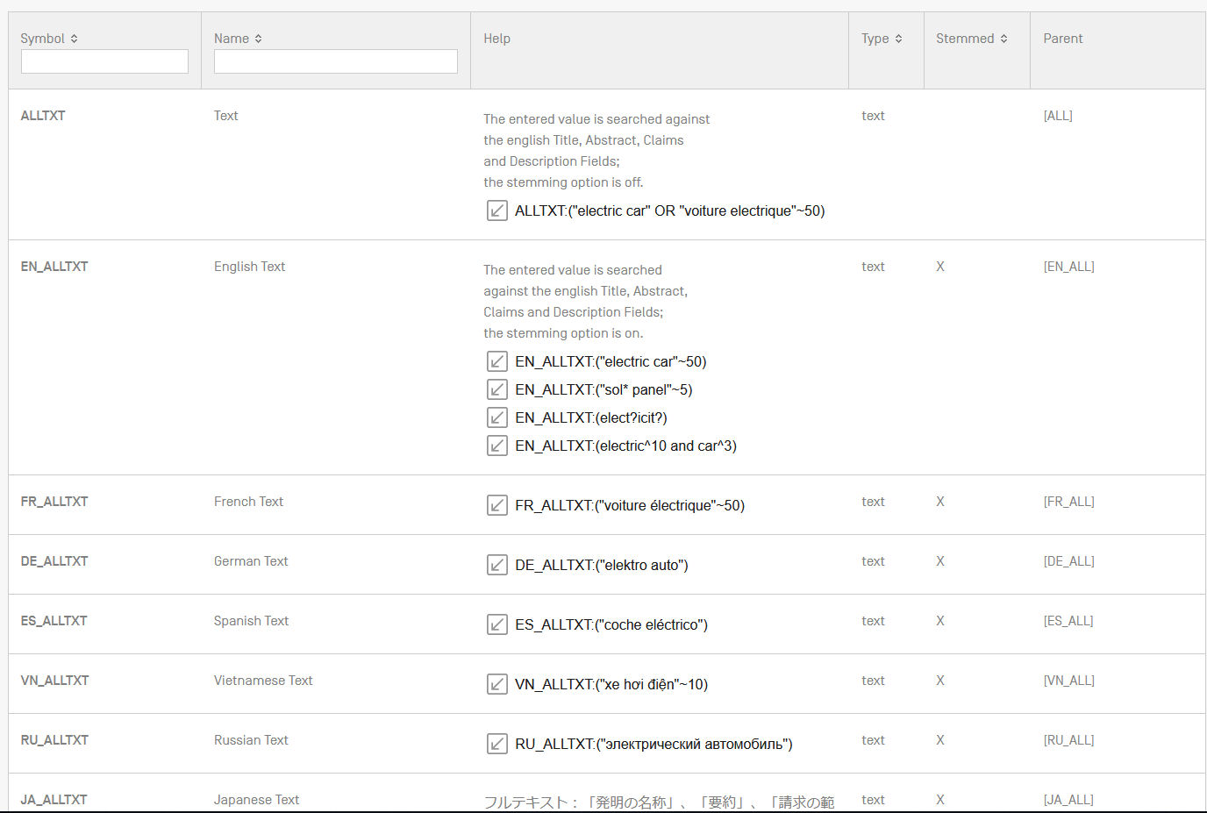

Slide 21
Examples
FP = front page
ALL = all fields
ALL_NAMES = all names
IC = IPC
DP = publication date
CTR = country either WO or country from nat collection
NPCC= national phase entry
AN = origin of PCT

Slide 22
Date search
Simple:
  DP:01.02.2000
  DP:20000201
  DP:02.2000
  DP:200002
  DP:2000

Slide 23
Example: IPC
IC = International Classification
  IC :A
  IC :A47
  IC :A47L
  IC :A47L1
  IC:A47L11
  IC:A47L11/03

Slide 24
D06F 1/06 will include by default
D06F 1/08
1/10
1/16
To exclude subgroup: IC_EX
ICI = International Classification Inventive
ICN = International Classification Non-inventive
ICI_EX ICN_EX = no subgroup

Slide 25
Fields rules
Basic fields: elements of a patent document
Derived fields
2 letter code = individual field
EN_TI FR_AB ES_DE_S
Convention: language specified by 2 letters
if not specified all languages
S = stemmed
: to separate term without any space

Slide 26
Fields: golden rules
EN_ALL = default field field indicator not required
Field name followed by : ":"
The field is only valid for the term that it directly precedes, so the query:
EN_TI:("wind turbine" AND electric) solar
"wind turbine" AND electric in the title field "solar" in the default field (EN_ALL ).

Slide 27
AND/NEAR/OR = operators

Slide 28
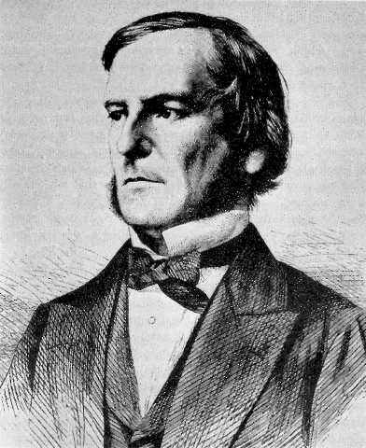
Boolean operators
AND
OR
NOT
ANDNOT

Slide 29
ANDNOT - NOT
Use ANDNOT when searching A excluding B
  Ex: bicycle ANDNOT boat
  Use NOT when searching all documents except A
    Ex:NOT(car AND bicycle AND boat)

Slide 30
Proximity operator NEAR
Finds words that are next to each other
NEAR3 3 = the max nb of word gaps between 2 search terms

Slide 31
Proximity search: BEFORE
the order of terms is significant.
trunk BEFORE cutting

Slide 32
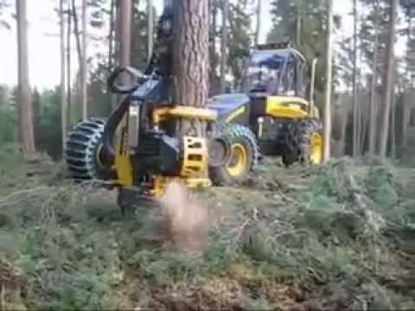
An example

Slide 33
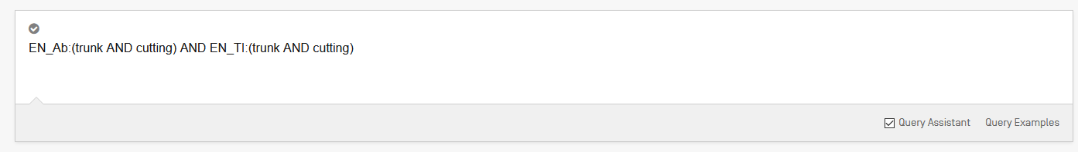
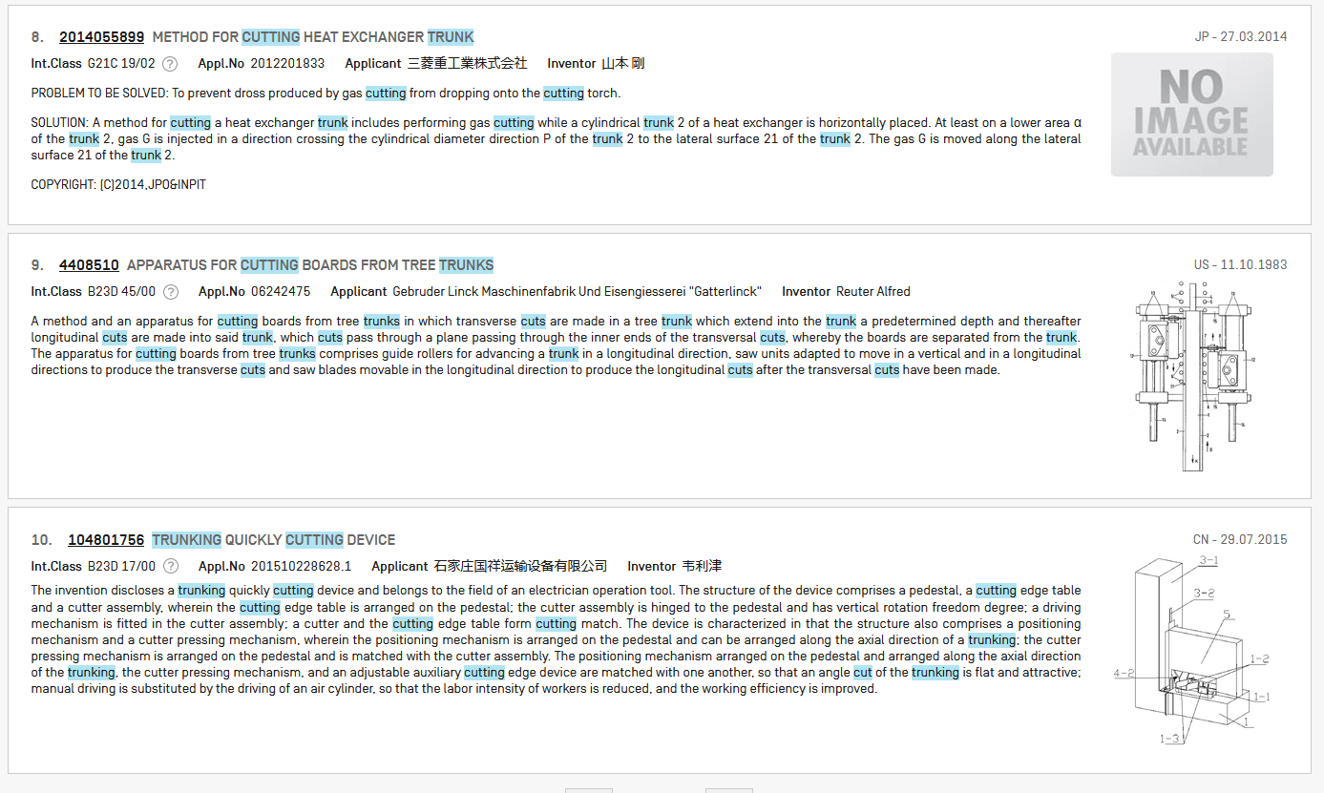

Slide 34

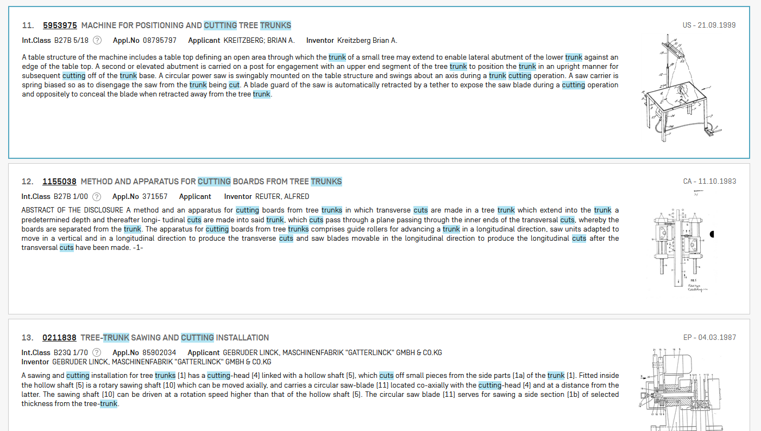

Slide 35


Slide 37
Grouping/nesting
Solar OR (wind AND turbine)
(solar OR wind) AND turbine
EN_TI: electric car
electric will be searched in English title but car in all fields
EN_TI: (electric car)
Both electric and car will be searched in the English title

Slide 38
Range search
Range:
  DP:[01.01.2000 TO 01.01.2001]
  Can also be used to search non-date fields
    IN: {Smith to Terence}

Slide 39
^ = weighting factor

Slide 40
^ caret = weighting factor
Same result but ranking will be different
touch^3 AND polarize

Slide 41
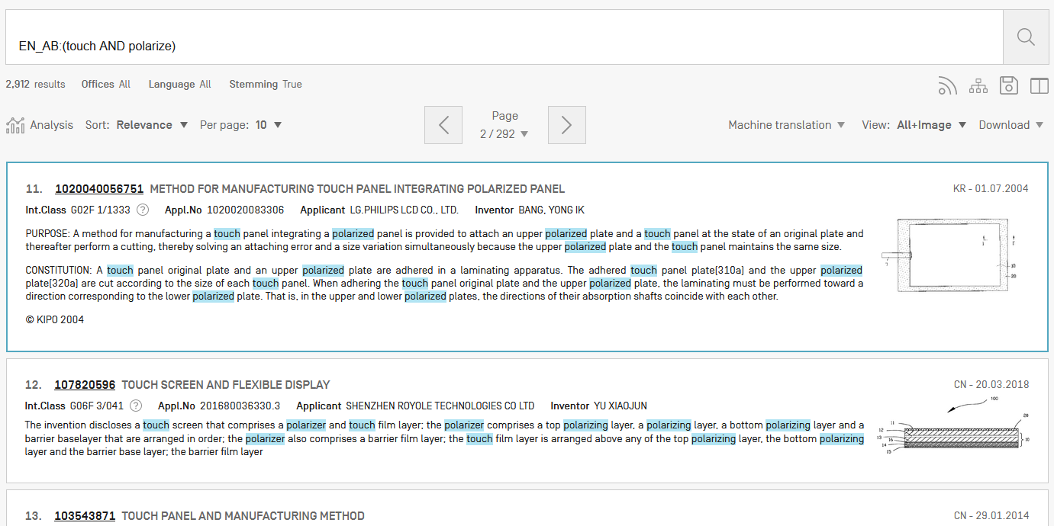
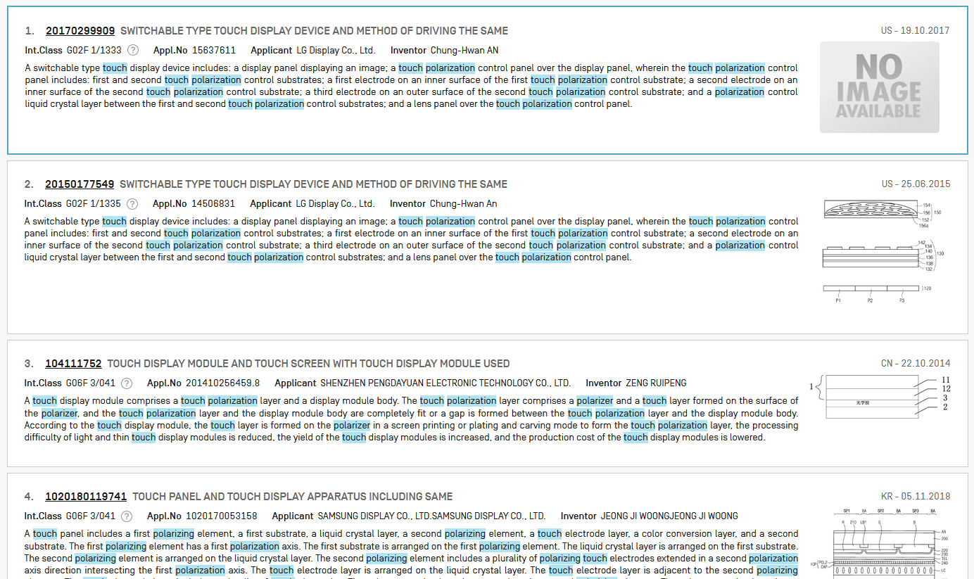

Slide 42
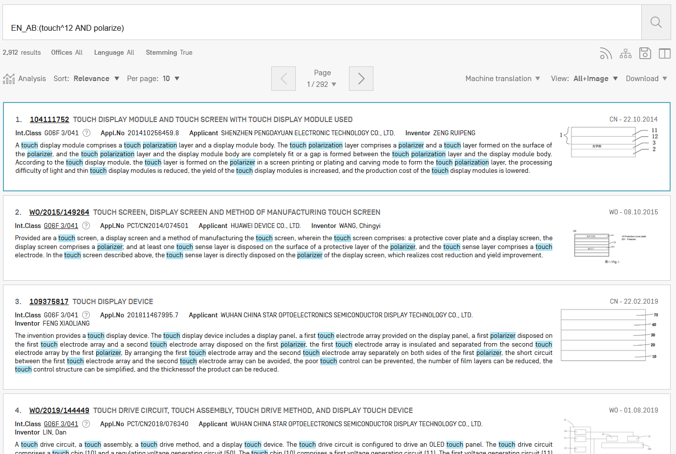

Slide 43
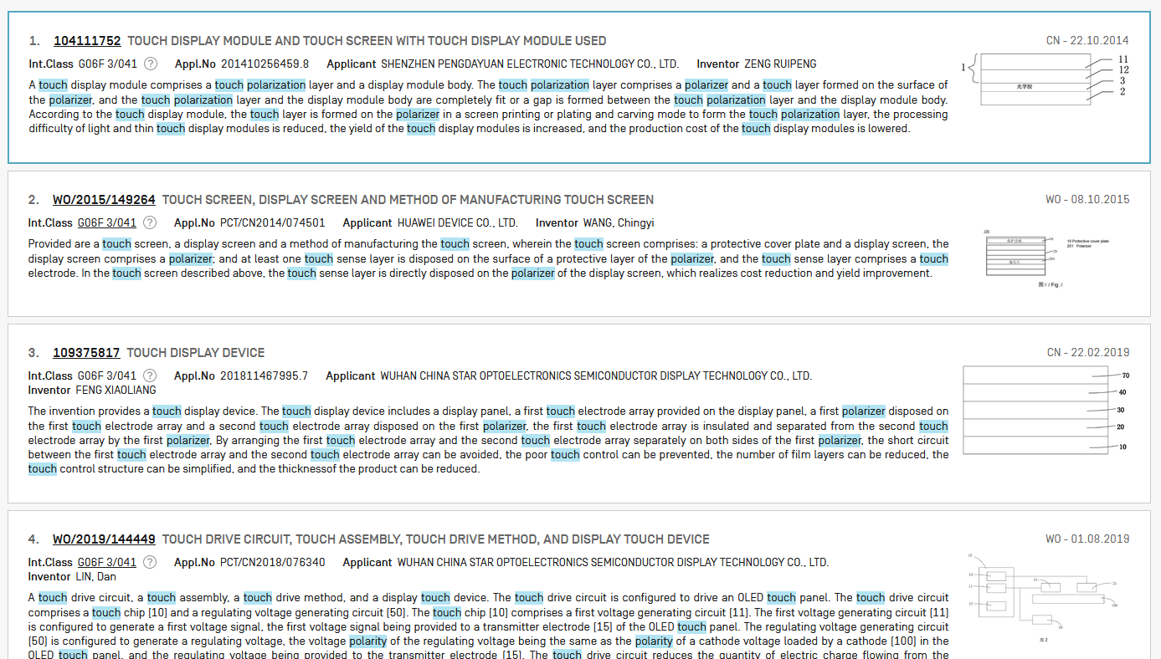

Slide 44
Keywords
Stemming
Wildcard
Truncation
Fuzzy

Slide 45
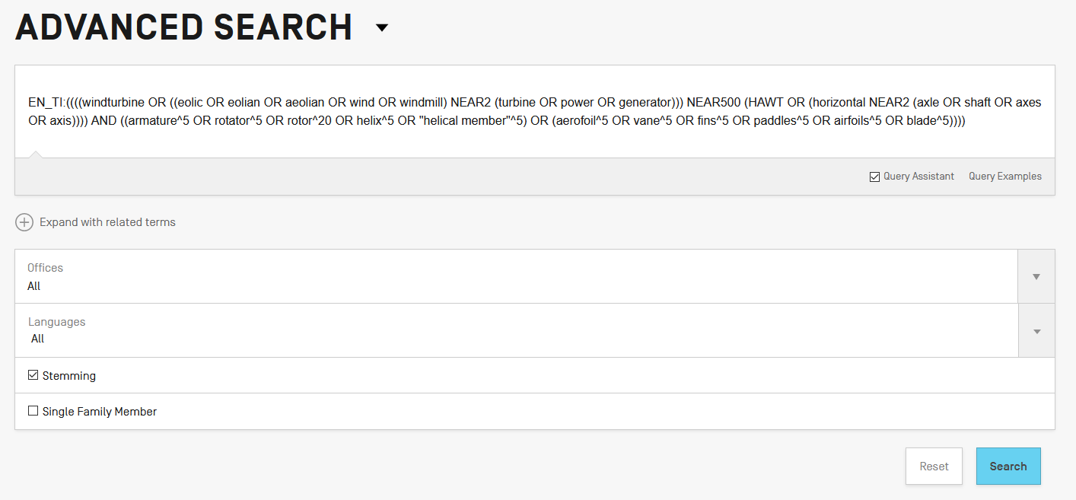
Stemming

Slide 46
Stemming
Stem = stemming
Process that removes common endings from words.
critical
critically
criticism each word is reduced to ‘critic’
criticisms
critics

Slide 47
Stemming
no dictionary includes the necessary technical terms to express patent concepts
Porter Stemming Algorithm finds words that contain common roots
Save time and effort

Slide 48
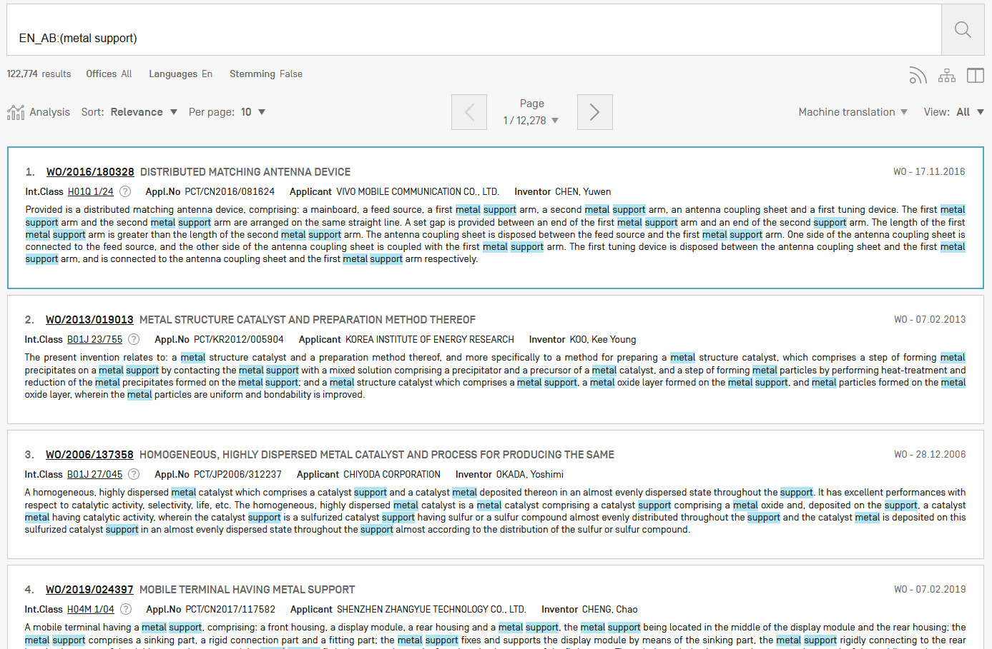
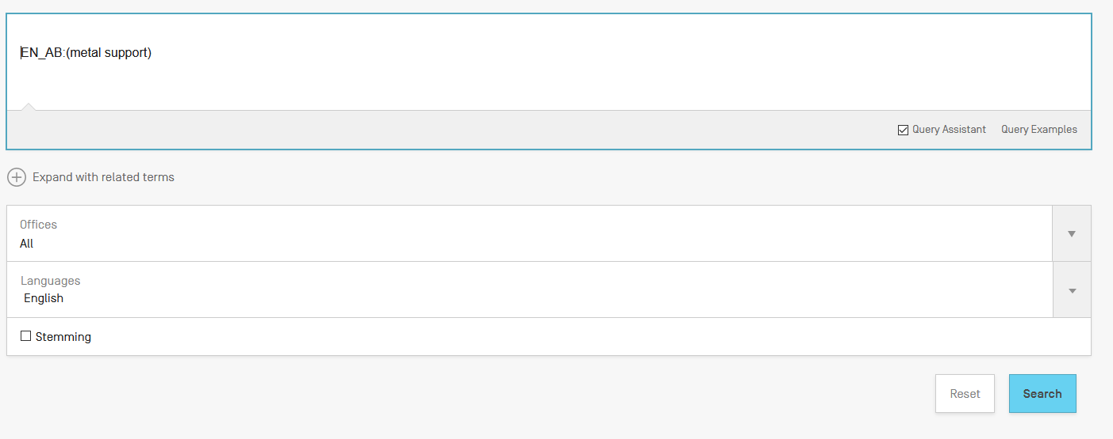
Search without stemming

Slide 49
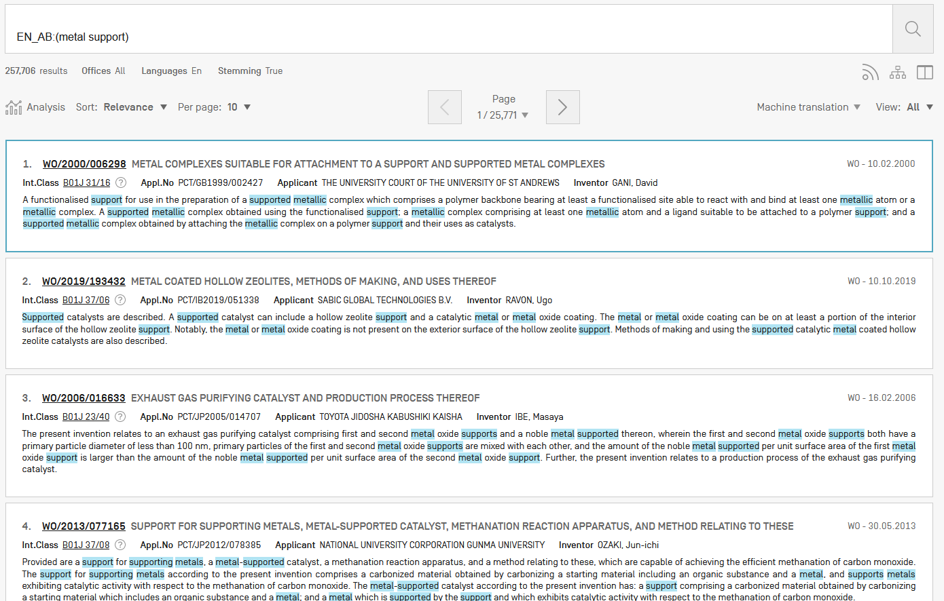
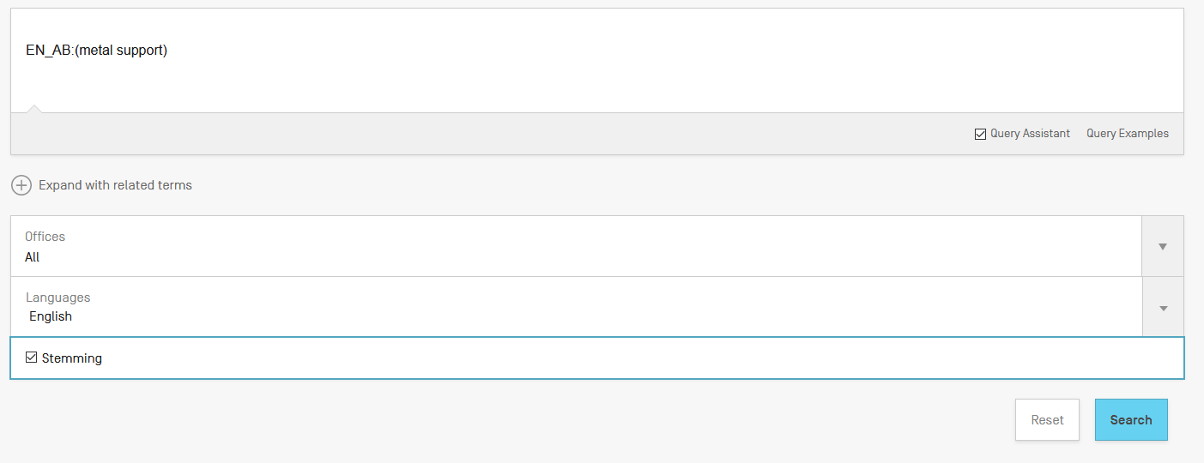
Same search with stemming

Slide 50
Wildcards/truncation : ? *
* stands for 0 or more characters
? stands single character
te?t = test or text
electric* = electrical; electricity
behavi*r = behaviour or behavior
micro?p* = microspeaker, microsporidial

Slide 51
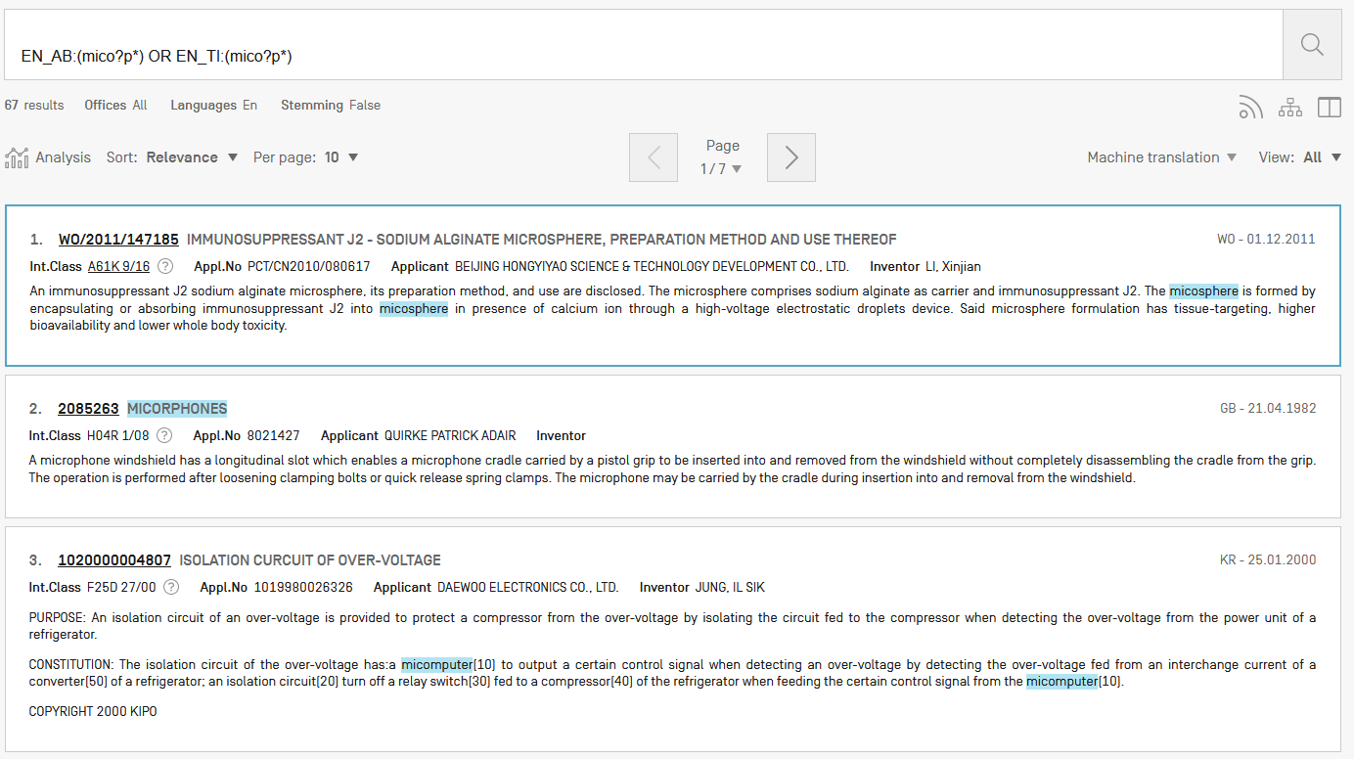

Slide 52
Use of wildcards
Spelling uncertainty (plural, tenses, foreign words):
  tyre vs. tire t*re
  University vs Universität Universit* Stuttgart
Multiple spelling variants are known:
  color vs. colour col*
Preferred option over stemming:
electric vs. electricity electri*

Slide 53
Wildcard vs stemming
Logic results:
  navy, navies or naval if nav* = navigating, navigation,
  electricity or electric if elect* = electoral

Slide 54

Fuzzy searches
Use of the tilde: ~
Examples:
roam~ foam / roams
Roam~0.8
Useful to find misstpyed, misspelt or mis-OCRed words
Notes:
Smilar in spelling

Slide 55


Slide 56
Result combination
Combine search with CLIR
Combine search with chemical structure search

Slide 57
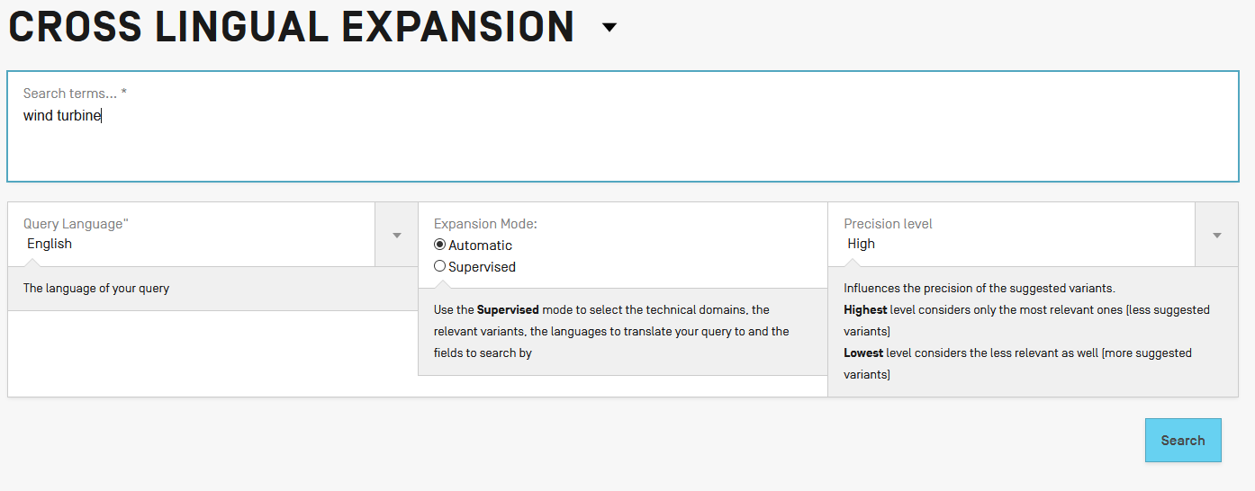
Combining with CLIR

Slide 58
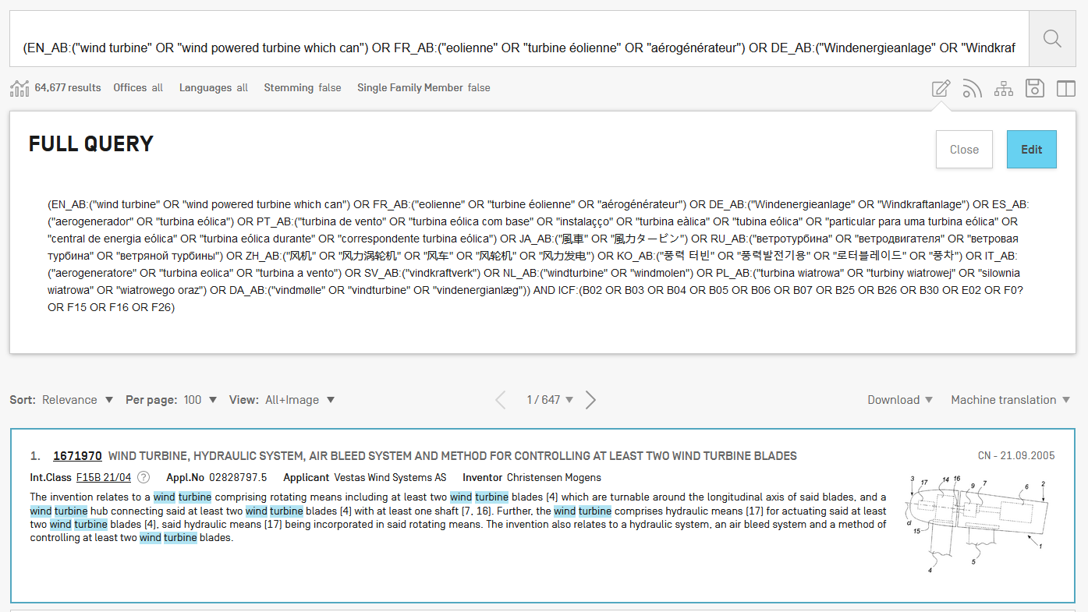

Slide 59
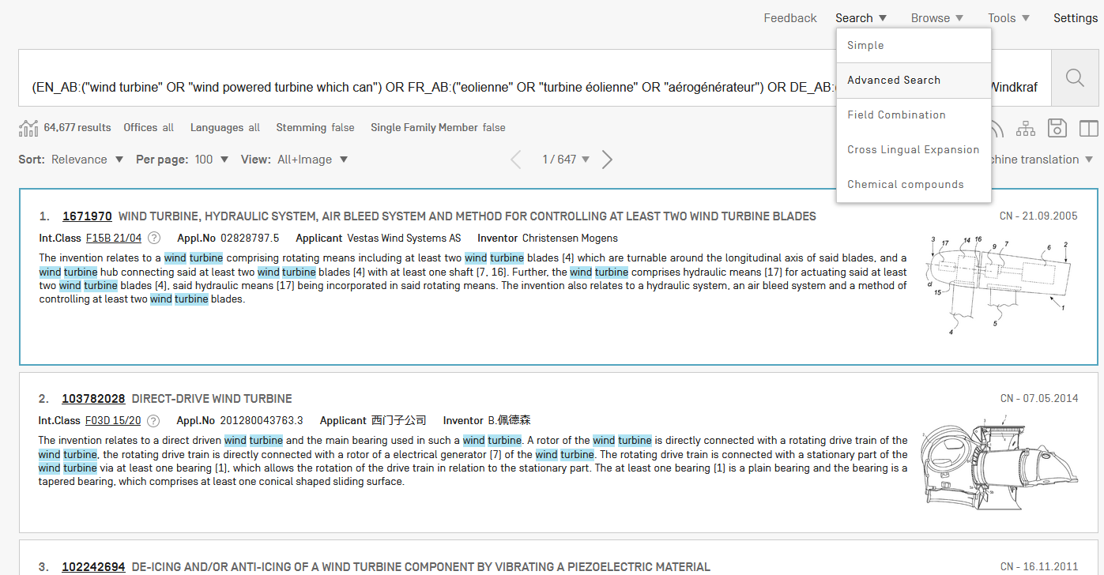

Slide 60
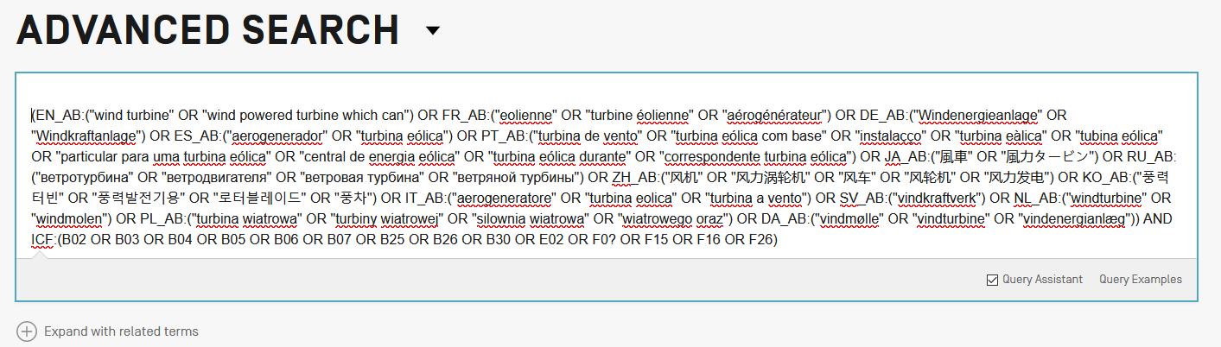
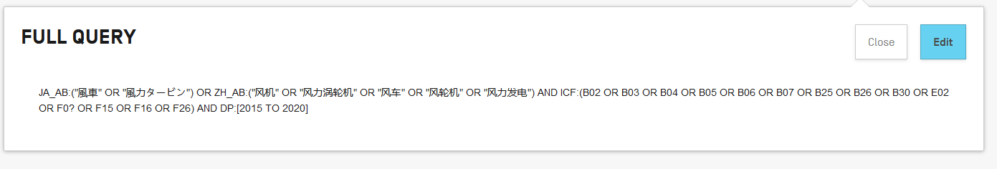

Slide 61
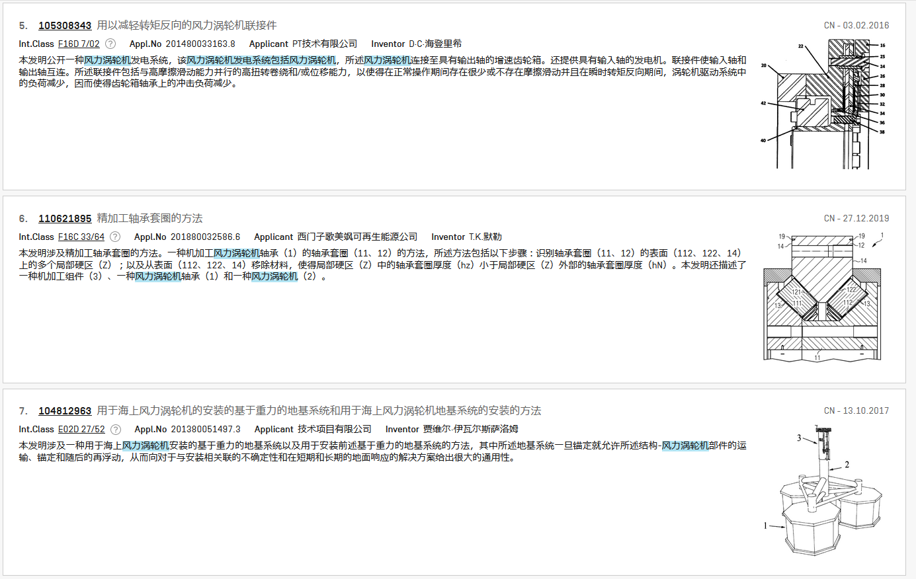

Slide 62
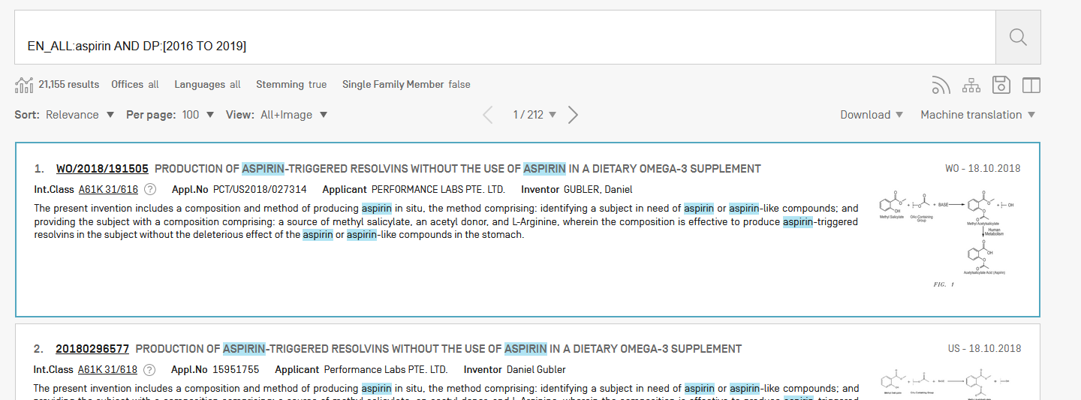
For queries with compounds

Slide 63
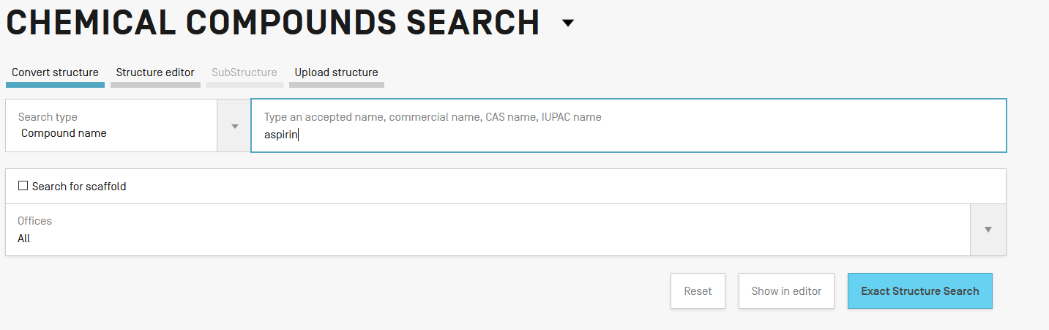

Slide 64
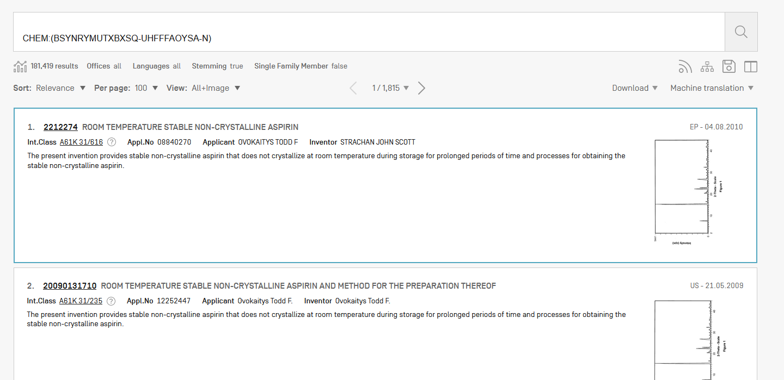

Slide 65
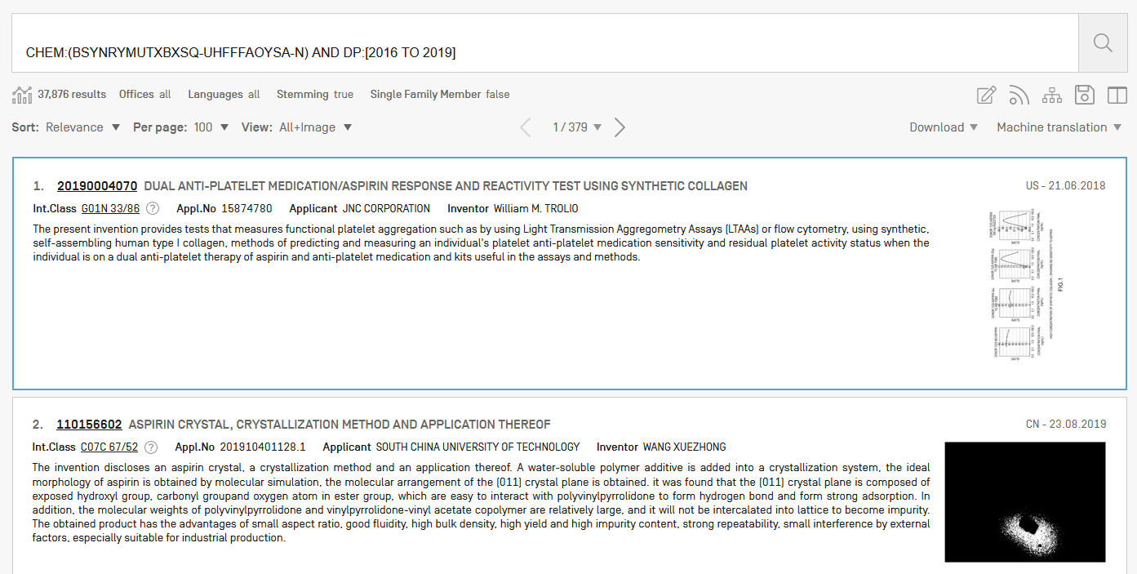

Slide 66
Most common errors
(….)
Field name
No space
Wildcard at the beginning of a word

Slide 67
Next webinar: April 21 or 23
Chemical structure search in PATENTSCOPE
To register: https://www.wipo.int/patentscope/en/webinar/

Slide 68
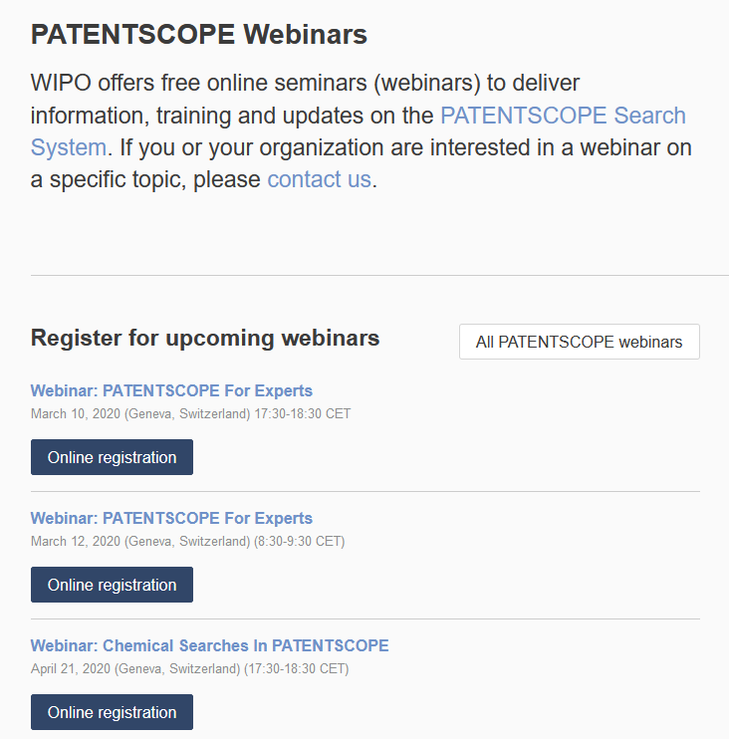
wipo.int/patentscope/en/webinar

Slide 69
Global Brand Database: webinar
Image search in the Global Brand Database
  April 7 at 5:30pm CET
  https://attendee.gotowebinar.com/register/6209538493436706818

Slide 70
Global Design Database: webinar
Overview of the Global Design Database
  April 16 at 5:30pm CET
  https://attendee.gotowebinar.com/register/790258985384599810

Slide 71

patentscope@wipo.int

Slide 72
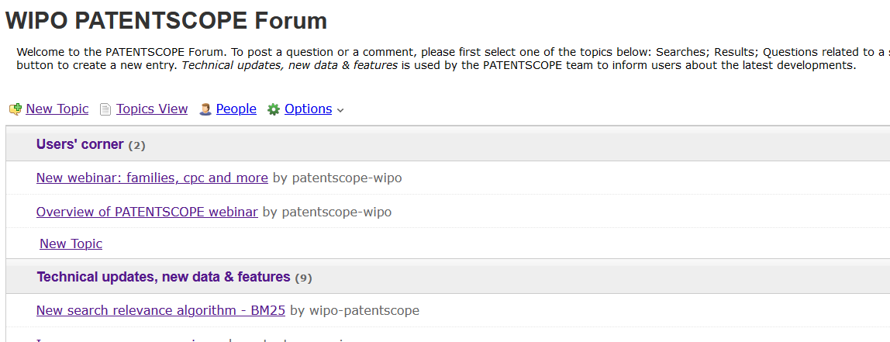
New in 2020!

Slide 74


Slide 75

patentscope@wipo.int

